Slide 1

Immunohistochemistry Fixation 2 & Autolysis
Dr. Ahmad H. Ibrahim
Semester 2
Week 8 & 9
Date 7/4/2025

Slide 2
University of TISHK
Immunohistochemistry
Fixation 2 & Autolysis
Dr. Ahmad H. Ibrahim
Lecture 8 & 9
Email: ahmad.ibrahim@Tiu.edu.iq

Slide 3
MICROTECHNIQUES
Tissue
Cell
Cytology
Histopathology
Specimen
Biopsy / Autopsy
Body fluids/ Smears from
aspiration or exfoliation
Method
Paraffin / Frozen
Smears / Imprint

Slide 4
Biopsy
Paraffin method

Slide 5
Reception of specimen
Fixation
Gross pathology
Processing
Embedding
Cutting with Microtome
Mounting
Staining
Cover slip
Steps of
Paraffin method

Slide 6
(1) Transfer and reception of biopsy specimens
Proper handling and transfer of biopsy specimens to the laboratory
Identification and reception of specimens
Initial laboratory work

Slide 7
2
Fixation

Slide 8
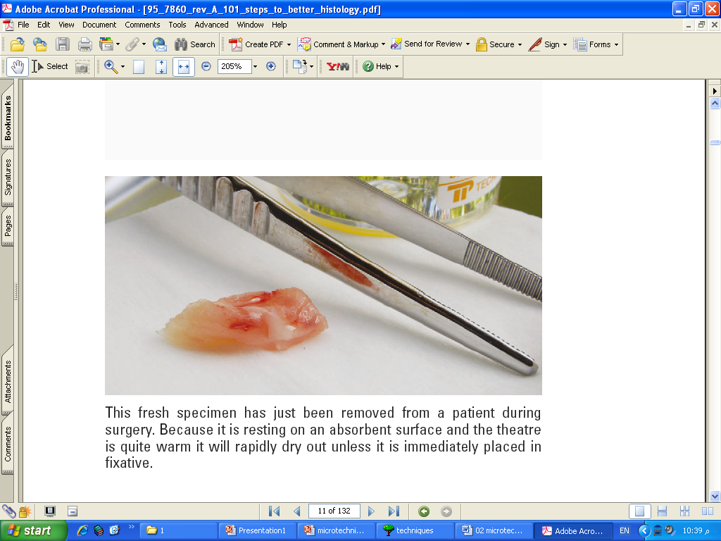
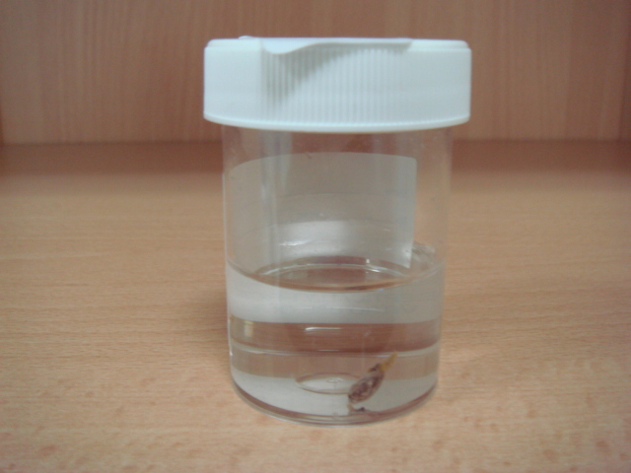
Definition
in order to preserve cells & tissue constituents
in a condition identical to that existing during life.
It is a process of treating pieces of tissue with certain fluids

Slide 9
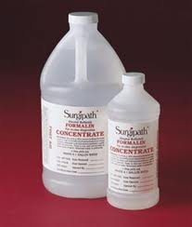
Fixatives
They are substances used in the process of fixation

Slide 10
Aims and effects of fixation
1. Preserve tissue by preventing autolysis by cellular enzymes,
to get similar appearance to the origin as much as possible

Slide 11
Aims and effects of fixation
2. Preventing decomposition by the actions of bacteria and molds

Slide 12
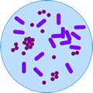
Aims and effects of fixation
3. Devitalize or deactivate infectious agents

Slide 13
Aims and effects of fixation
4. Harden tissue to allow thin sectioning.

Slide 14
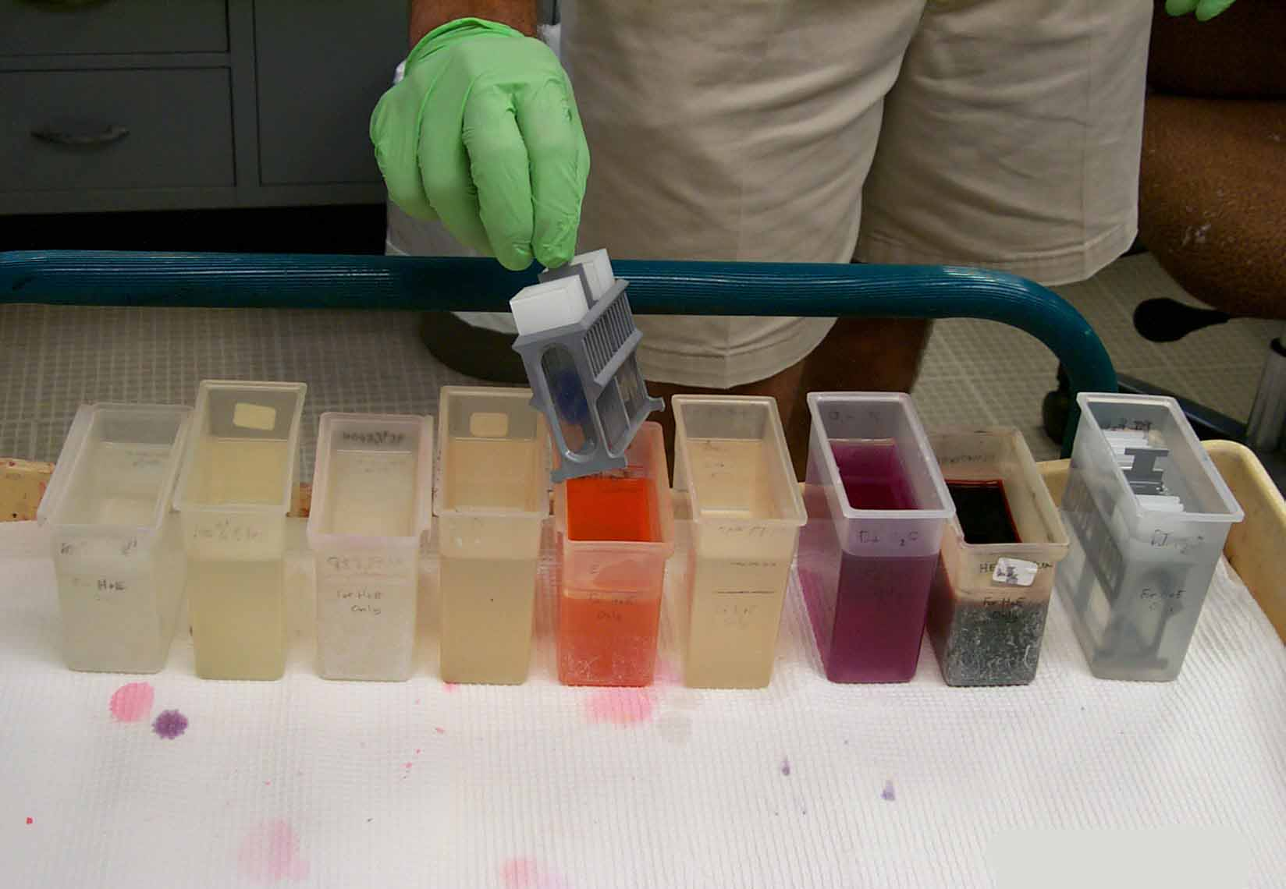
Aims and effects of fixation
5. Enhance avidity for dyes.

Slide 15
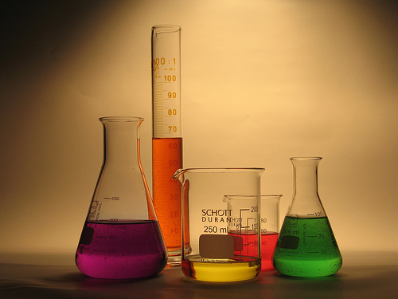
Aims and effects of fixation
6. Fortify tissue against harmful effects of tissue processing (e.g. dehydration, Clearing, infiltration…etc.).

Slide 16
Fixation
Autolysis
Bacterial decomposition
Infection
Enhance
avidity for
Staining
Harden
the tissue
fortify tissue

Slide 17
Autolysis

Slide 18
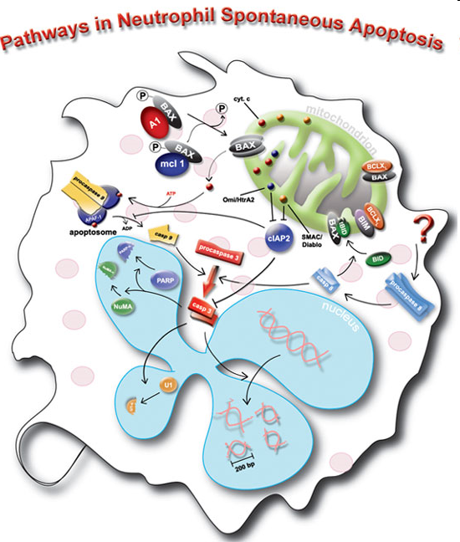
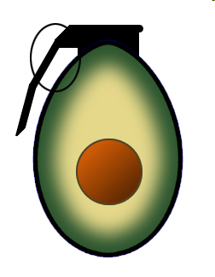
Autolysis (self digestion):
It is the process of destruction of cells or tissue of the body by autologous enzymes, as occur after death or some pathological conditions.

Slide 19
Autolysis is affected by many factors:
Inhibited by fixation and heating to 50 ⁰C
Retarded by → cold 4° C
Accelerated by → keeping at 37 ⁰C
Autolysis is more severe in tissue rich in enzymes like: liver, brain.

Slide 20
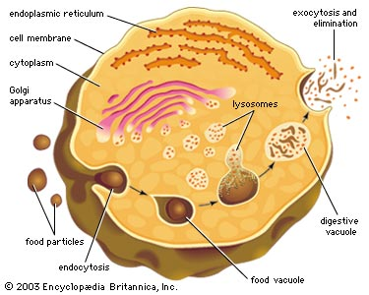
How it occurs
Autolysis is initiated by the cells lysosomes releasing the digestive enzymes out into the cytoplasm. The cell then starts to digest itself.

Slide 21
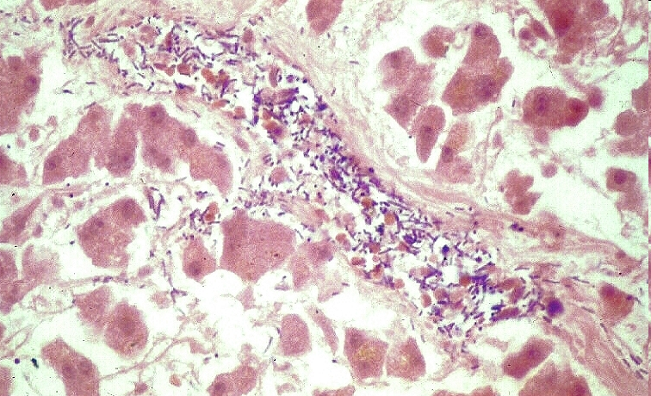
Features
The cytoplasm becomes swollen & granular

Slide 22
Bacterial
decomposition

Slide 23
Bacterial decomposition
It is the digestion and destruction of the cellular composition by bacterial enzymes to get nutrients to maintain their growth.
it is similar to the process of autolysis and is best inhibited by fixation and in keeping specimen in cold place (4 ° C)

Slide 24
Methods of fixation
Physical method
Chemical method
Heat fixation
Coagulant fixatives
Microwave fixation
Cross linking fixatives
Freeze drying
Compound fixatives

Slide 25
Physical method
Heat fixation:
Boiling of tissue in normal saline
Heating of fixatives solution
Microwave fixation
It reduce the time needed for fixation
Glyoxal-based fixatives heated at 55 ⁰C.
Freeze drying: liquid nitrogen or acetone at - 40 ⁰C

Slide 26
Chemical method
Coagulant fixatives
Coagulate protein making proteins inactive
Types:
Dehydrant:
Common
like: ethanol or acetone
Acidic:
Acetic acid: Coagulate nucleic acid. Not precipitate protein.
picric acid: precipitate proteins.

Slide 27
Chemical method
Cross linking fixatives
Forming cross linking of protein to nucleic acid
E.g. Formaldehyde, mercuric chloride, glutaraldehyde
Compound fixatives.

Slide 28
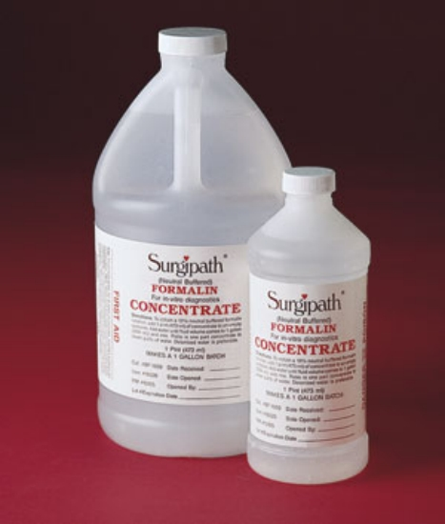

10% Buffered formalin

Slide 29
Factors affect tissue fixation

Slide 30

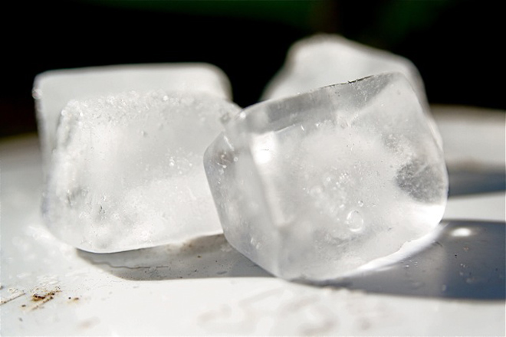
Temperature
Usually fixation is performed routinely at room temperature.
Sometime large specimens can be fixed better at 4° C
Avoid freezing because ice crystal distortion will result.
Hot formalin will fix tissue faster

Slide 31
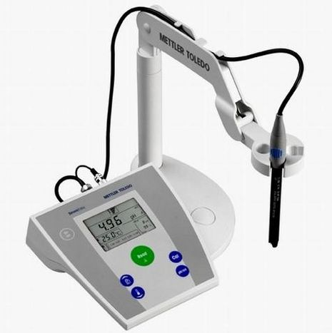
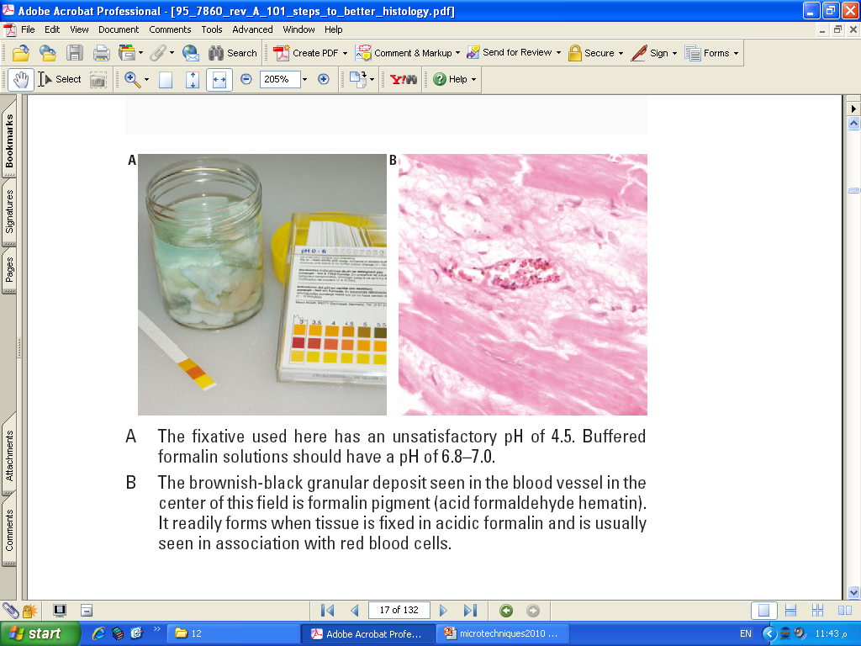
PH
Should be neutral between (PH=6-8).
Acidic formalin will cause formalin pigments.

Slide 32
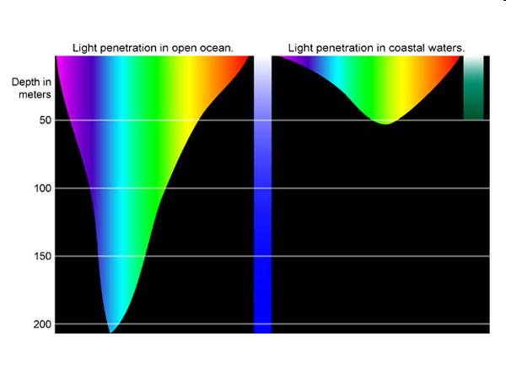
Penetration
10% buffered formalin penetrate the tissue at 1 mm/hr.
The time needed for fixation of specimens depend on the size of tissue or organ.

Slide 33

Concentration
10% formalin concentration is the best
Concentration in a range between 8% and 12% is accepted and no noticeable differences will be noted.

Slide 34
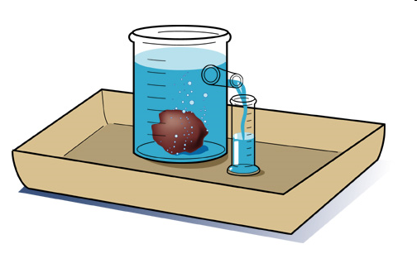
Volume
it should be at least 10 times the size of biopsy

Slide 35

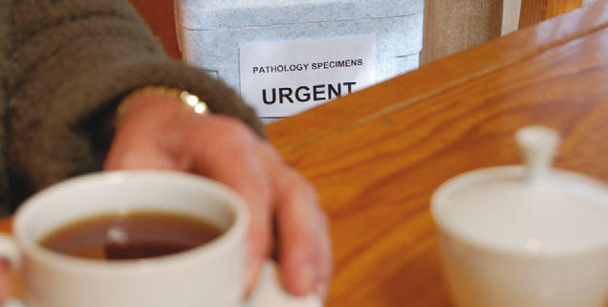
Time interval
rapid fixation is better than delay fixation

Slide 36
Osmolarity and ionic composition
Osmolarity best with slight hypertonic
Ionic composition should be isotonic

Slide 37
Additive:
Addition of electrolyte and nonelectrolyte improve morphology
Like: Calcium chloride, ammonium sulfate

Slide 38
The END

Slide 39
References
Dabbs DJ. Diagnostic Immunohistochemistry: Theranostic and Genomic Applications. 5th edition. Elsevier; 2019. ISBN-13: 978-0323567448.
Bancroft JD, Gamble M. Theory and Practice of Histological Techniques. 7th edition. Churchill Livingstone; 2013. ISBN-13: 978-0702042263.
Gown AM. Diagnostic Immunohistochemistry: What Can Go Wrong and How to Prevent It. 1st edition. Springer; 2009. ISBN-13: 978-0387894099.
Ramos-Vara JA, Kiupel M. Veterinary Comparative Hematopathology. 1st edition. Wiley-Blackwell; 2007. ISBN-13: 978-0813803890.
Shi SR, Gu J, Cote RJ, Taylor CR. Antigen Retrieval Techniques: Immunohistochemistry and Molecular Morphology. 1st edition. Eaton Publishing; 2000. ISBN-13: 978-

Slide 40
References
Taylor CR, Levenson RM. Quantification of immunohistochemistry--issues concerning methods, utility and semiquantitative assessment II. Histopathology. 2006 Sep;49(3):411-24. doi: 10.1111/j.1365-2559.2006.02513.x. PMID: 16922739.
Shi SR, Cote RJ, Taylor CR. Antigen retrieval techniques: current perspectives. J Histochem Cytochem. 2001 Sep;49(9):931-7. doi: 10.1177/002215540104900801. PMID: 11511661.
Ramos-Vara JA. Technical aspects of immunohistochemistry. Vet Pathol. 2005 Sep;42(5):405-26. doi: 10.1354/vp.42-5-405. PMID: 16145243.
Brown DC, Gatter KC. Monoclonal antibody Ki-67: its use in histopathology. Histopathology. 1990 Jul;17(2):489-503. doi: 10.1111/j.1365-2559.1990.tb01129.x. PMID: 1706161.
Rizzardi AE, Johnson AT, Vogel RI, Pambuccian SE, Henriksen J, Skubitz AP, Metzger GJ, Schmechel SC. Quantitative comparison of immunohistochemical staining measured by digital image analysis versus pathologist visual scoring. Diagn Pathol. 2012 Mar 19;7:42. doi: 10.1186/1746-1596-7-42. PMID: 22433176; PMCID: PMC3340902.

