Slide 1


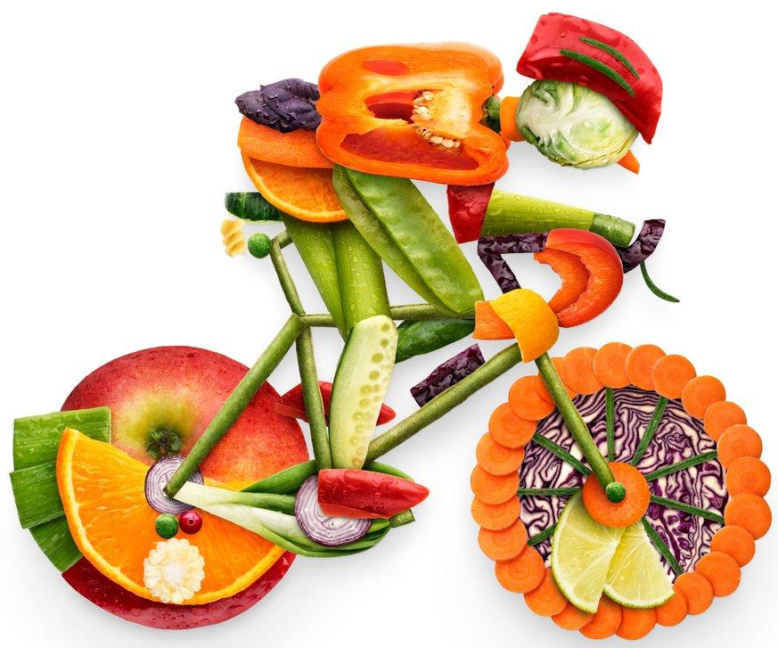

Sport and exercise nutrition
Yaseen Galali
Nutrition Department
Notes:
.

Slide 2
COURSE OUTLINE!
Part 1: The science of nutrition and sport
1- Introduction to sport and exercise nutrition
2-Energy for sport and exercise
3- Digestion and absorption of macro nutrient for sport exercise
4-Dietary assessment
5-diet planning

Slide 3
LEARNING OUTCOMES
Upon completion of this part you will be able to:
compare and contrast physical activity, exercise and sport
Describe different types of sport and exercise, and relate these to differing physiological processes and adaptations
Measure exercise performance and intensity
Describe the principles of exercise prescription
Describe muscle types and actions
Explain the body’s physiological response and chronic adaptations to exercise

Slide 4
PART 2: NUTRITION FOR EXERCISE
9-Macronutrient periodisation
10-Exercise nutrition
11-Hydration
12-sports supplement
13-changing body composition

Slide 5
LEARNING OUTCOME
Upon completion of this chapter you will be able to:
Understand that an athlete’s training/competition schedule involves changes in the type, quantity and goals of exercise sessions, which should be supported by changes in energy and macronutrient intake
appreciate that different dietary strategies can enhance the muscle’s capacity to use different fuels (such as fat vs carbohydrate), which may play a role in enhancing competition performance
understand the true meaning of ‘metabolic flexibility’ and some of the ways in which this concept is currently being used or misused
be aware of an emerging theme in sports nutrition whereby nutrient support around training can be provided to promote performance/recovery or withdrawn to increase the training stimulus/adaptation.

Slide 6
PART 3: APPLIED SPORT NUTRITION
15-strength and power athletes
16-Team sport athletes
17-Weight category and aethetic
18-Young athletes
19-master athletes
20-Paralympic athletes
21Travelling athletes
22-Environmental and climate considaration for athletes.
23-Gastrointrstinal disturbance in athletes.
24-nutrition support for injury management

Slide 7
LEARNING OUTCOME!
Upon completion of this chapter you will be able to:
understand the nutrition challenges faced by endurance athletes in daily training
Describe daily carbohydrate requirements for endurance athletes and identify important considerations when managing individual athlete
Assess an athlete’s daily food and fluid intake and identify key areas to modify to optimise daily training performance, recovery and the favoured metabolic adaptations to training
Identify important considerations for racing and the need to customise nutrition support across the wide variety of endurance events
manipulate fluid intake advice according to an athlete’s likely requirements.

Slide 8
PHYSICAL ACTIVITY, EXERCISE AND SPORT
Physical activity
is any movement that we perform that expends energy.
The simplest categorisation of physical activity is based on proportioning activities in daily life—namely, sleep, work and leisure

Slide 9
The energy expenditure during sleep is obviously very small, whereas the energy expenditure during work would depend on the type of employment.
A nurse who spends a lot of time walking around a hospital ward would expend much more energy than an office worker who spends the majority of the work day sitting down

Slide 10
Physical activity
Any bodily movement produced by skeletal muscles that results in energy expenditure
Exercise
Physical activity that is planned, structured, repetitive and purposeful with the aim to improve or maintain one or more components of physical fitness.

Slide 11
CRITERIA MUST BE MET IN ORDER FOR A SPORT TO BECOME A MEMBER OF THE ASSOCIATION OF SPORTS ASSOCIATION
The sport proposed should include an element of competition.
The sport should not rely on any element of ‘luck’ specifically integrated into the sport.
The sport should not be judged to pose an undue risk to the health and safety of its athletes or participants.
The sport proposed should in no way be harmful to any living creature.
The sport should not rely on equipment that is provided by a single supplier.

Slide 12
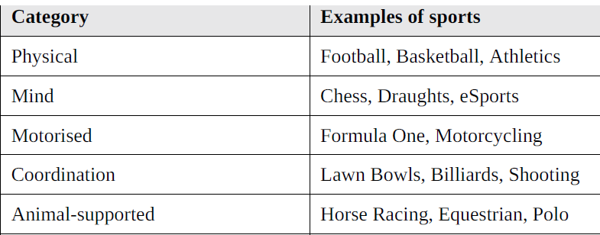
TYPES OF SPORT
Due to the large variety of sports in existence, the Global Association of International Sports Federations has also developed categories of sports.

Slide 13
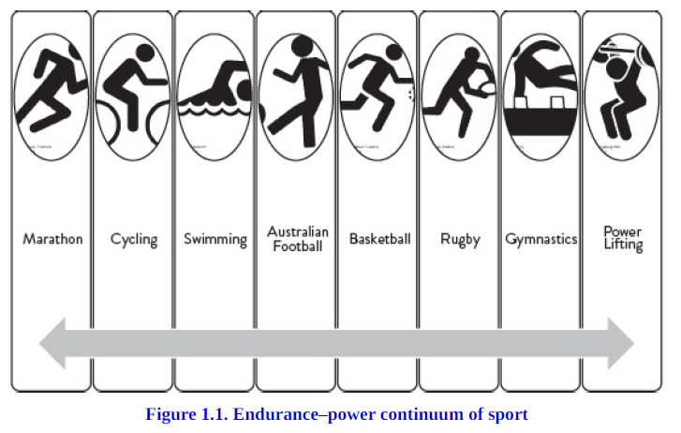
ENDURANCE-POWER CONTINUUM

Slide 14
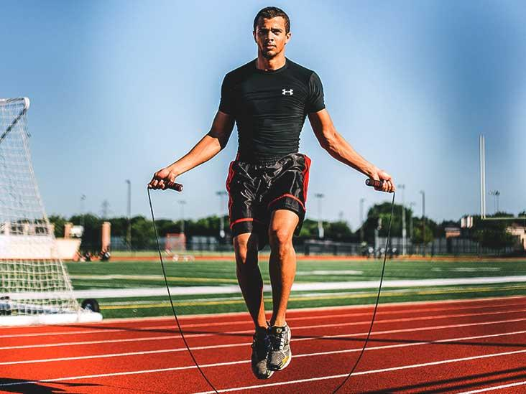
AEROBIC
Exercise at an intensity that is low enough to allow the body’s need for oxygen (to break down macronutrients) to be matched to the oxygen supply available.

Slide 15
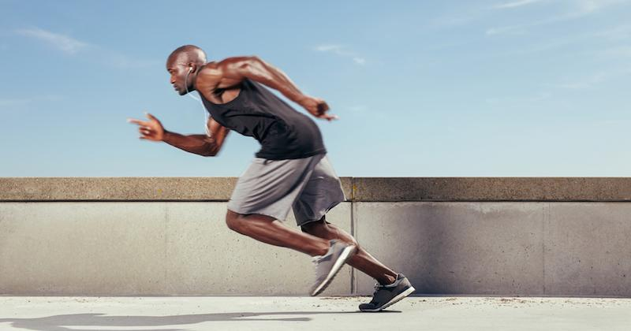
ANAEROBIC
Exercise at an intensity where the body’s demand for oxygen is greater than the oxygen supply available, therefore relying on anaerobic metabolism and the production of lactate.

Slide 16
EXERCISE CAN BE CATEGORISED INTO TWO MAIN TYPES
1-cardiorespiratory exercise
Whole-body, dynamic exercise that taxes predominantly the cardiovascular and respiratory systems, such as running, cycling and swimming.

Slide 17
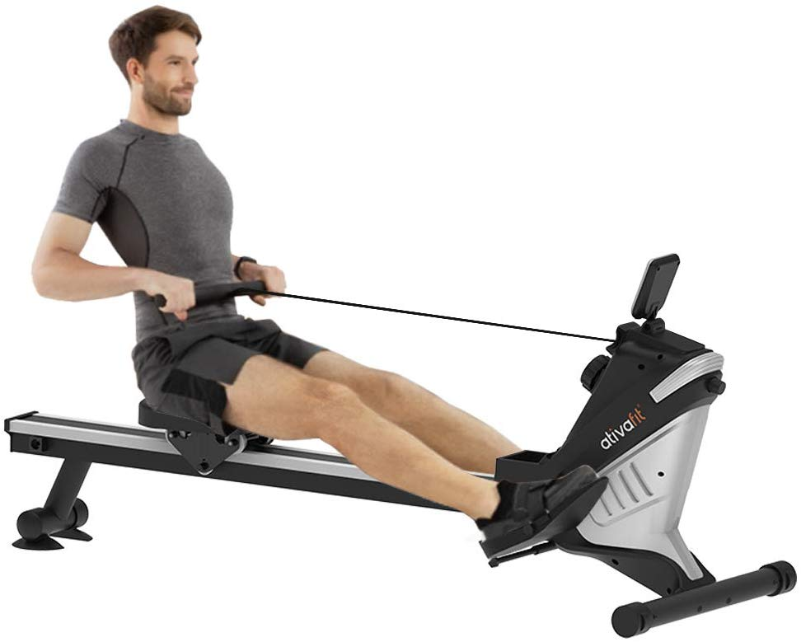
Resistance exercise
Exercise that predominantly involves the musculoskeletal system.

Slide 18
The intensity of cardiorespiratory and resistance exercise can be expressed in either absolute or relative terms.
Absolute exercise intensity refers to the
total amount of energy expended (expressed in kilojoules or kilocalories.
Absolute exercise intensity can be expressed in metabolic equivalents (METs), which describe exercise intensity as a multiple of the amount of energy required by the body at rest

Slide 19
One MET is approximately equivalent to an oxygen uptake of 3.5 mL.kg–1 · min–1.
For example:
the oxygen consumption for a 70 kilogram male exercising at an absolute exercise intensity of five METs for 30 minutes would be calculated as:
Oxygen consumption ( O2) =
5 × 3.5 mL ∙ kg–1 ∙ min–1 = 17.5 mL ∙ kg–1 ∙ min–1 O2
Oxygen consumption ( O2) = 17.5 mL ∙ kg–1 ∙ min–1 × 70 kg = 1225 mL ∙ min–1 O2

Slide 20
Oxygen consumption ( O2) =
1225 mL ∙ min–1 × 30 min = 36750 mL O2
Oxygen consumption= 36750/1000=36.750 (L of O2).
From the estimated oxygen consumption we can calculate the energy expenditure during exercise, since each litre of oxygen yields ~5 kcal
Therefore, the estimated energy expenditure for the example above is:
Energy expenditure (kcal) = 36.75 L O2 × 5 kcal = 183.75 kcal

Slide 21
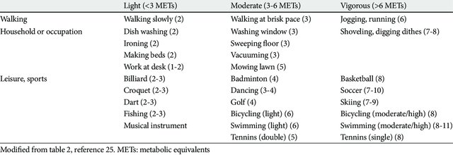

Slide 22
In comparison, resistance exercise may be expressed relative to the maximum amount of mass that a particular muscle group can lift successfully for one repetition, which is known as the one repetition maximum (1 RM), or
by using perceptual methods such as the RPE. Exercise intensity for resistance training can then be expressed as a percentage of an individual’s 1 RM.

Slide 23
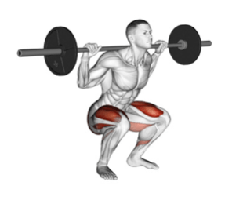
For example, an athlete with a 1 RM for the back-squat exercise of 120 kilograms wishes to develop their muscular strength, and so should lift ~85 per cent of their 1 RM in training. The mass they should lift in training can be calculated as follows:
85% 1 RM = 0.85 × 120 kg = 102 kg

Slide 24
PRESCRIBING PHYSICAL ACTIVITY AND EXERCISE
Due to the strong association between physical activity and health outcomes such as chronic disease and obesity.
the Australian Department of Health has developed age-specific guidelines for physical activity. These guidelines are intended to help facilitate positive health outcomes for all
Australians

Slide 25
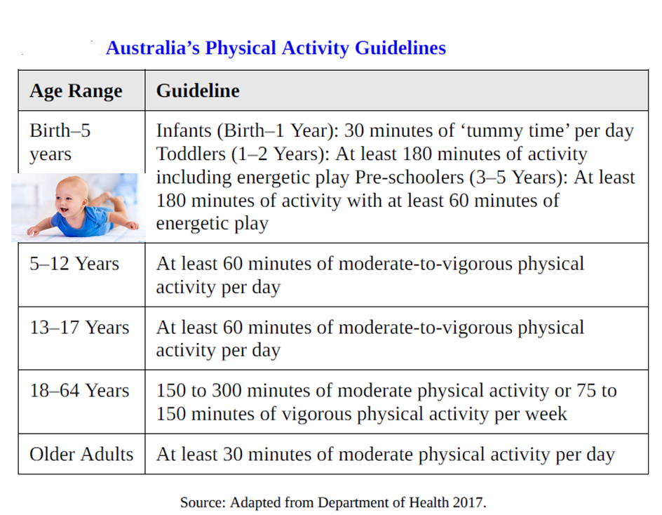
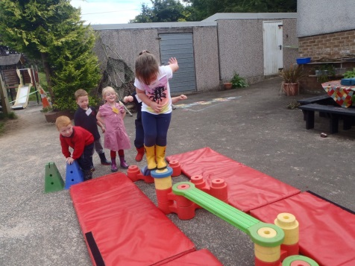

Slide 26
CHRONIC ADAPTATION OF TO EXCERICSE
Whether you are undertaking exercise for general health, or to improve your competitive performance, when exercise sessions are repeated over multiple weeks and months chronic adaptations to exercise begin to occur.
These chronic adaptations occur as a result of the specific loading and progression of exercise sessions and can be specific aerobic, anaerobic or strength adaptations, depending on the goals of the individual

Slide 27
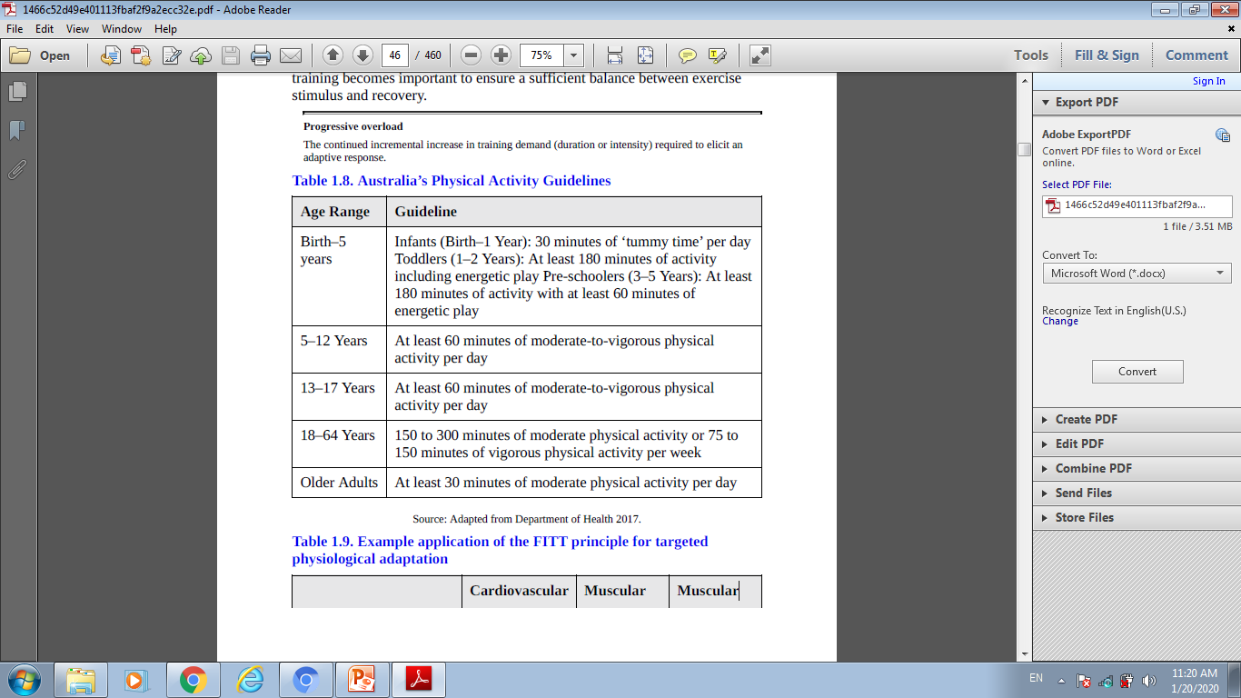
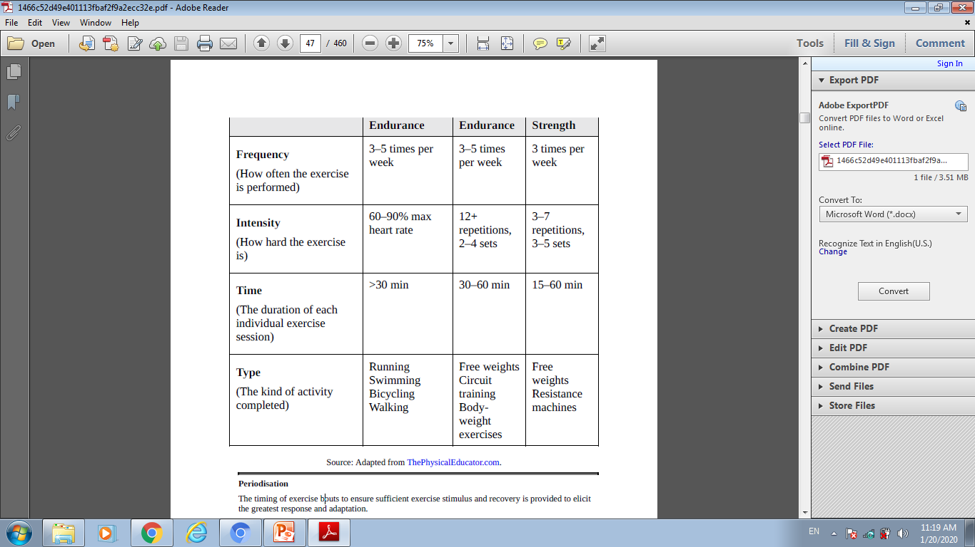
On of the example application of the frequency intensity, time and type (FITT)

Slide 28
CHRONIC ADAPTATIONS TO EXERCISE
Adaptations that occur as a response to exercise are specific to the training stimulus applied include changes to the cardiovascular, metabolic,respiratory and muscular systems.
Regular aerobic exercise, for example, enhances the ability of the body to use fat as fuel during exercise through increased transport of free fatty acids, fat oxidation
Oxidation
Part of a chemical reaction that results in the loss of electrons. During fat oxidation, triglycerides are
broken down into three fatty acid chains and glycerol.

Slide 29
All of these adaptations lead to an improved capacity to complete longer duration or higher intensity exercise while remaining within an aerobic state.
Exercise and prolonged training also stimulate the release of a number of hormones, including testosterone and growth hormone, which promote an anabolic (building up’ and repair of tissues) effect on the body

Slide 30
These hormones increase protein synthesis and cell growth, leading to an increase in lean muscle mass and decreased fat mass.
This chronic adaptation of an individual’s body composition, which increases the amount of active tissue in the body, also leads to an increased metabolic rate for the individual.
Growth hormone also stimulates cartilage formation and skeletal growth, which encourages bone formation

Slide 31
The mechanical loading of exercise, such as during foot strike while running, also elicits the remodelling of bone to adapt to the load under which it is placed, when the exercise stimulus is removed these adaptations revert back
Along with the more commonly discussed changes to our cardiovascular, metabolic and muscular systems, exercise also affects our immune system

Slide 32
exercise also affects our immune system, Following acute exercise, there is a reduction in white blood cell numbers and activity due to circulating hormones (catecholamines (adrenaline and dopamin), growth hormone, cortisol, testosterone) and as a result of local inflammation.
This acute-phase response can last from two to 72 hours post-exercise depending on intensity and duration.

Slide 33

The immune system can also be affected by travel and when in a team sport environment. Specific hygiene practices should be in place to reduce the duration and severity of illness, as well as to limit the spread of infection during periods of exercise

Slide 34

Nutrition is also thought to play a role in maintaining immune function, through the adequate intake of specific micronutrients (for example, iron, zinc, vitamins A, E and B12) and sufficient carbohydrate availability during exercise bouts to help limit the rise in the stress hormone cortisol.

Slide 35
RECOVERING FROM EXERCISE
In order for the body to adapt to the exercise stimulus, sufficient recovery is required.
It is during this recovery period that the body is able to replenish energy stores and repair damaged tissue to allow the body to
develop and adapt in response to the stimulus

Slide 36
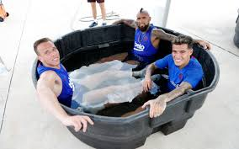
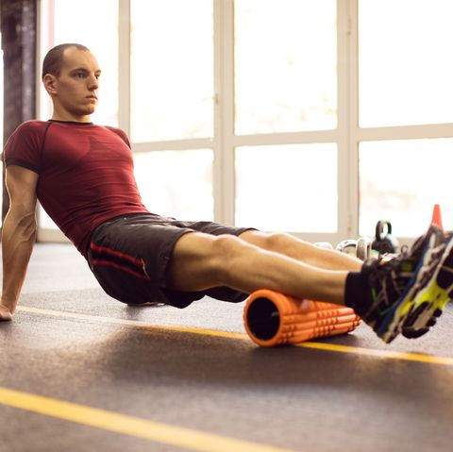
The simplest ways to recover from exercise are to have a rest day from training and to get good-quality sleep.
Other common recovery methods include cold or contrast , compression garments, foam rolling and massage
Compression clothing works to boost recovery by narrowing your veins, forcing blood to flow faster and more effectively up to your heart, which pumps oxygen-rich blood back to your aching muscles.

