Slide 1






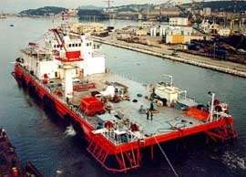
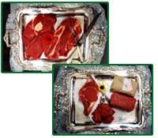

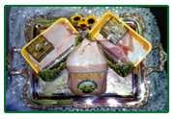
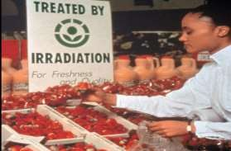
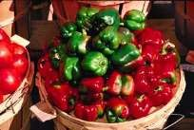
Irradiation in Food Processing
Yaseen Galali
Nutrition and dietetics Dept.

Slide 2

INTRODUCTION
Food irradiation is the process by which foods (
such as fruits ,
vegetables, spices and meats) is exposed to ionizing radiation to destroy
microorganisms ,bacteria, viruses, or insects that the food.
might be present in
It is the physical treatment that consists of exposing foods either prepackaged or in bulk to the direct action of electronic, electromagnetic rays.
Food Irradiation is a form of food preservation that prolong shelf life, improve microbiologic safety, and reduce the use of chemical fumigants and additives.

Slide 3

















History of Irradiation in Food Preservation
Oldest Methods
Newer Methods
1905 Begins the era of food
irradiation.
1980 Foods irradiated up to 10 kGy considered to be safe and wholesome.
Drying
freezing
Fermenting
Canning
2001 Irradiation is used to eliminate possible traces of Anthrax.
1984-2009 FDA approves the use of irradiation in a variety of foods.
Salting
Refrigeration
Smoking
Preservatives
Pesticides
applied to fresh, frozen
or cooked products.
environmenta
lly clean
efficient
technology
physical
safe

Slide 4

Why we irradiate foods?
Irradiation prevents food poisoning by killing pathogenic bacteria such as E.coli:0157(beef), Campylobacter, Salmonella,(poultry)Clostridium perfringens.
It control insects and parasite infestation.
It reduce spoilage by destroying molds, bacteria and yeast.
Increases shelf life by slowing ripening of fruits and vegetables and inhibit sprouting.
Irradiation causes microbial death by inhibiting DNA synthesis .
Other mechanisms involved in irradiation of microbial inactivation are cell membrane alteration, de-naturation of enzymes, alterations in ribo-nucleic acid(RNA)synthesis, effects on phospho-rylation, and DNA compositional changes.

Slide 5

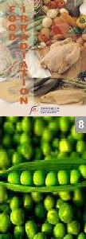
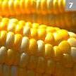
Food Irradiation Uses…
Reduce insect infestation -grain, spices, fruits and vegetables.
Inhibit sprouting -tubers and bulbs.
Retard ripening –fruits.
Inactivate parasites -meats and fish.
Eliminate spoilage microbes -fruits, vegitables
Extend shelf life -poultry, meat, fish, shellfish.
Decontaminate -poultry and meat.
Sterilize foods and feeds.
“Irradiation increases the number of free radicals in the food and decreases the antioxidant vitamins that neutralize them.”

Slide 6







What foods are currently irradiated?
Wheat
potatoes
flour
spices
tea
fruits and vegetables

Slide 7

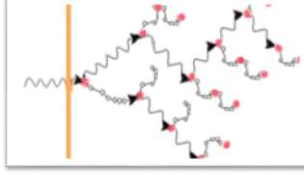










IONIZING RADIATION
Exists in form of waves.
Shorter wavelength = greater energy.
Causes disruption of internal metabolism of cells by destruction of chemical
bond.
The associated energy levels of these rays are too low to be practical value in preservation, they need to be accelerated (in cyclotrons, linear accelerators etc.) to make them acquire the required energy.
Since electrons cannot penetrate very far into food, compared with gamma radiation or X-rays, they can be used only for treatment of thin packages of food and free flowing or falling grains.
chemical events as a
Direct
result of energy
deposition on target
molecule.
Action of Ionization Irradiation
indirect
radicals formed from the radiolysis of water .

Slide 8

UNITS FOR MEASURING RADIATION
There are two types of units for measuring radiation:
1.Intensity:
The intensity refers to the source.
The intensity of a radioactive source is measured in number of dis- integrations per second.
The unit of intensity is the curie(which represents 3.7*1010 disintegrations per second).
1Ci=3.7×1010Bq=37GBq
2.Dose:
The dose refers to the product
The treatment received by the food product is characterized by the radiation dose, the quantity of energy absorbed by the food while it is exposed to the radiation field.
The unit of Dose is the gray(Gy).
One gray is equivalent to 100rad.

Slide 9



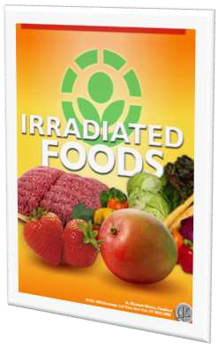
Dosimetry:-
Measuring the irradiation dose is known as Dosimetry
In Irradiation processing of foods, the doses are generally measured in kilograys(kGy,1,000Gy).
Low dose applications(up to 1kGy)
Control insects
Inhibit maturation
Inhibit sprouting
Medium dose applications(1kGy to 10kGy)
Extend shelf life
Reduce microorganism level
High dose applications(above 10kGy)
Sterilize - analogous to canning
Decontaminate certain food additives, e.g., spices

Slide 10

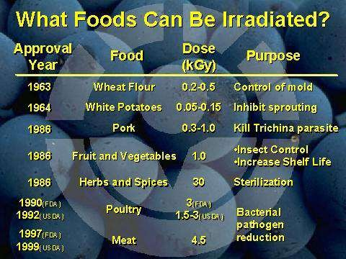
Types of irradiation
Accelerated electrons
Gamma rays (cobalt 60 or Cesium 137)
X-rays
When Food Exposed to Controlled Energy (Ionizing Radiation)
1-Gamma Rays (bulk foods on shipping pallets)
2-X Rays (deep penetration,
requires shield)
3-Electron Beam Radiation (shallow penetration)
Radiation Kills Microorganisms w/o Raising Food Temperature Contamination CAN Occur Post- Treatment

Slide 11
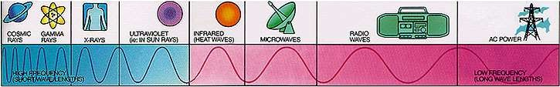
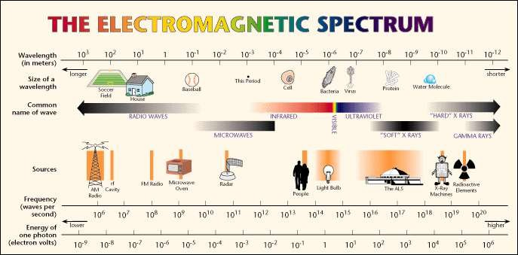
Electromagnetic Spectrum

Slide 12

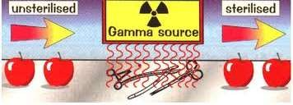
Gamma Radiation ()
Most widely used type of ionizing radiation.
All radiation penetrating are emitted in all directions continuously.
Cobalt-60 specifically manufactured, for radiotherapy, medical device sterilization and food irradiation, not a waste product of nuclear reactors.
The radiation is obtained through the use of radio isotopes.
cobalt-60, caesium-137.

Slide 13
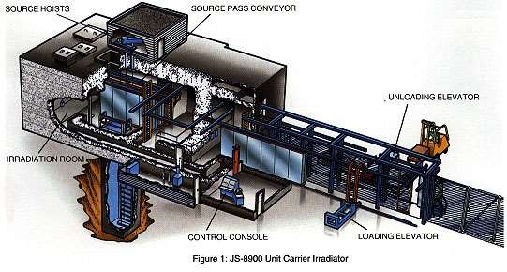
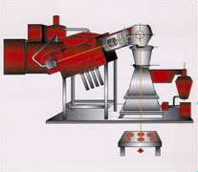


Food Irradiation Facilities
Gamma
Electron beam
Dose for food irradiation: 0.05-10 kGy

Slide 14












Affects microorganisms, such as bacteria, yeasts, and molds.
Causing lesions in the genetic material of the cell, effectively preventing it from carrying out the biological processes necessary for its continued existence.
The principal targets of irradiation are nucleic acids and membrane lipids.
Effects of Irradiation on Food Components
Proteins
Enzymes
Carbohy
drates
Effects of Irradiatio n
Vitamins
Lipids

Slide 15


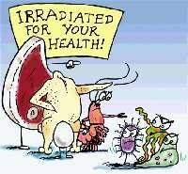
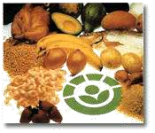
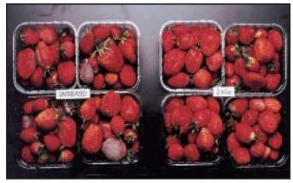
Food Irradiation - Safety
1.Radiologic and toxicologic safety:
Neither the food nor the packaging become radioactive.
No concern for unique radiolytic products (FDA).
Animal feeding studies since 1950 with metabolic, reproductive, teratogenic, mutageic endpoints. FAO, WHO, FDA food irradiation is safe under specified conditions .
2.Nutritional Adequacy
Changes similar to those of cooking, canning, pausteurizing, heat processing.
Vitamin loss: Thiamine>Vit C, B6>B2>niacin. Synergism with heat.
CHO and proteins relatively irradiation-resistant.
Fats can be oxidized rancidity, odour changes.

Slide 16
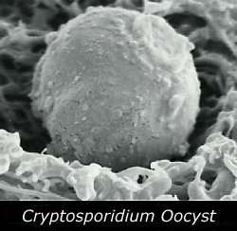
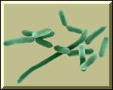
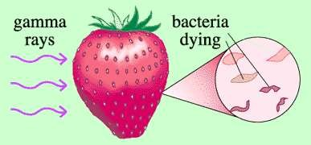
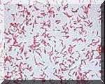
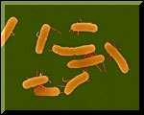
3.Microbiologic safety
Viruses, spores, prions radiation.
are resistant to
Gram(-)spoilage bacteria more suceptible than pathogenic bacteria.
Clostridium botulinun type E is resistant. Increase in mycotoxin after irradiation.
Radiation resistance and mutational changes.

Slide 17
U.S. Food & Drug Administration Approvals for Irradiated Foods
Food | Approved Use | Maximum Dose
Spices and dry vegetable seasoning | decontaminates and controls insects and microorganisms | 30 kGy
Dry or dehydrated enzyme preparations | controls insects and microorganisms | 10 kGy
All foods | controls insects | 1 kGy
Fresh foods | delays maturation | 1 kGy
Poultry | controls disease-causing microorganisms | 3 kGy
Red meat (such as beef, lamb and pork) | controls spoilage and disease-causing microorganisms | 4.5 kGy (fresh), 7 kGy (frozen)
Publication No. (FDA) 98-2320. Gy=1 Gray, or 100 rad (radiation absorbed dose)/kilogram. kGy=1000 Grays.

Slide 18
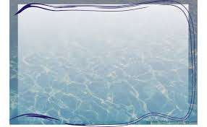

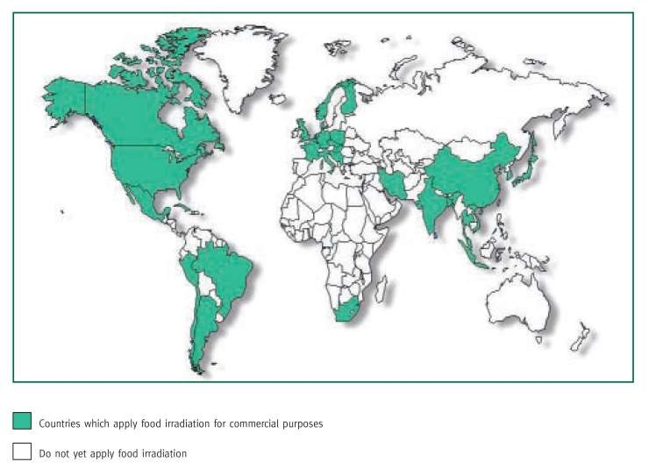

Slide 19













Application
The maximum recommended dose for foods is 15kGy, with the average dose not exceeding 10kGy .
Dis-infestation
Control of ripening
Inhibition of sprouting
Shelf Life Extension
Sterilisation (or radappertisation)
Reduction of pathogens (or radicidation)
Decontamination
Product Quality Improvement

Slide 20

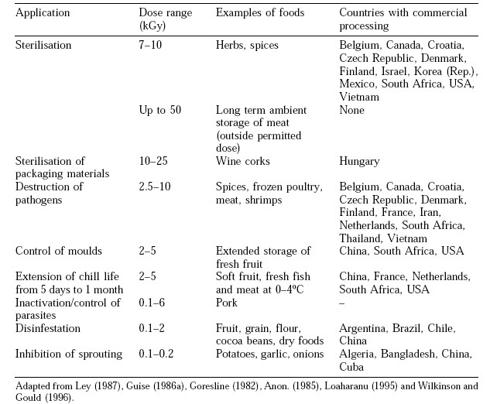

Slide 21










ADVANTAGES OF
IRRADIATION
There is little or no heating of the food
Minimize Food Losses and food spoilage
and therefore negligible change to sensory characteristics.
Packaged and frozen foods may be
treated.
Improve Public Health
Fresh foods may be preserved in a single operation, and without the use of chemical preservation.
Increase International Trade
Extended shelf life of some products.
An Alternative to
Fumigation of Food
Reduced risk of food-borne diseases
caused by micro-organisms.
Less need for some additives, such as preservatives and antioxidants.
Increase Energy Saving

Slide 22


LIMITATIONS
Irradiation cannot be used for all foods :
Dairy Products
Peaches
Nectarines

Slide 23

Continued…
Some foods, such as dairy foods and eggs, cannot be irradiated because it causes changes in Flavour or texture.
The process alters the nutrient content of some foods because
it reduces the level of some of the B-group vitamins.
Chemical compounds with nutritional or flavor functions can also be affected by ionizing irradiation.
radiation may cause some changes in the sensory characteristics of food and the functional properties of food components.
Irradiation initiates the autoxidation of fats, which gives rise to
rancid off flavors.
Proper handling food
Food irradiation does not replace the need for correct food handling practices in industry and in the home.

Slide 24



