Slide 1



Intracellular Accumulations
Lecture: 6
Dr. Suhayla H. Shareef 4/5/2026
Faculty of Applied Science Medical Analysis Department Spring Semester
General Pathology Grade 4

Slide 2


Lecture Outline
Mechanism of intracellular accumulations
Fatty changes of liver.
Hemosiderosis.
Pathological calcification.

Slide 3
Objectives:
1. To study the types and mechanism of intracellular accumulation.
2. To explain causes and morphology of fatty changes of liver.
3. To define hemosiderosis and pathological calcification.

Slide 4
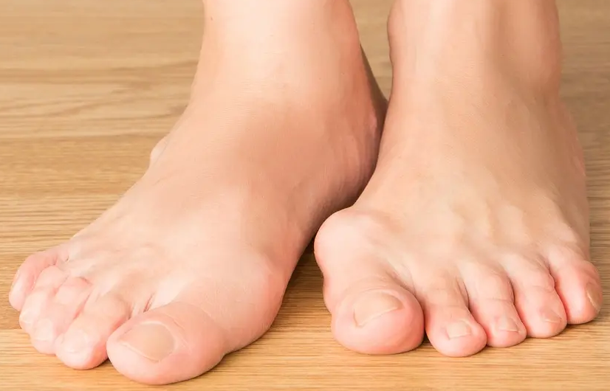
ACCUMULATION
Deposition of abnormal amount of various substances (like-protein, fat, carbohydrate, pigment etc.).
It may be intracellular or extracellular space.
INTRACELLULAR ACCUMULATION
Protein
Fatty changes Glycogen Infiltration Pigmentation
EXTRACELLULAR ACCUMULATION
Protein
Fibrinoid Degeneration Amyloid Degeneration Gout
Calcification

Slide 5
Intracellular Accumulation
1)Protein
- Cloudy swelling
- Hydropic Degeneration
- Hyaline Degeneration
- Mucinous Degeneration
- Mucoid or Myxomatous Degeneration
Fatty Change - Fatty Degeneration
- Fatty Infiltration
- Obesity
Glycogen Infiltration
Pigmentation - Endogenous Pigmentation
- Exogenous Pigmentation

Slide 6
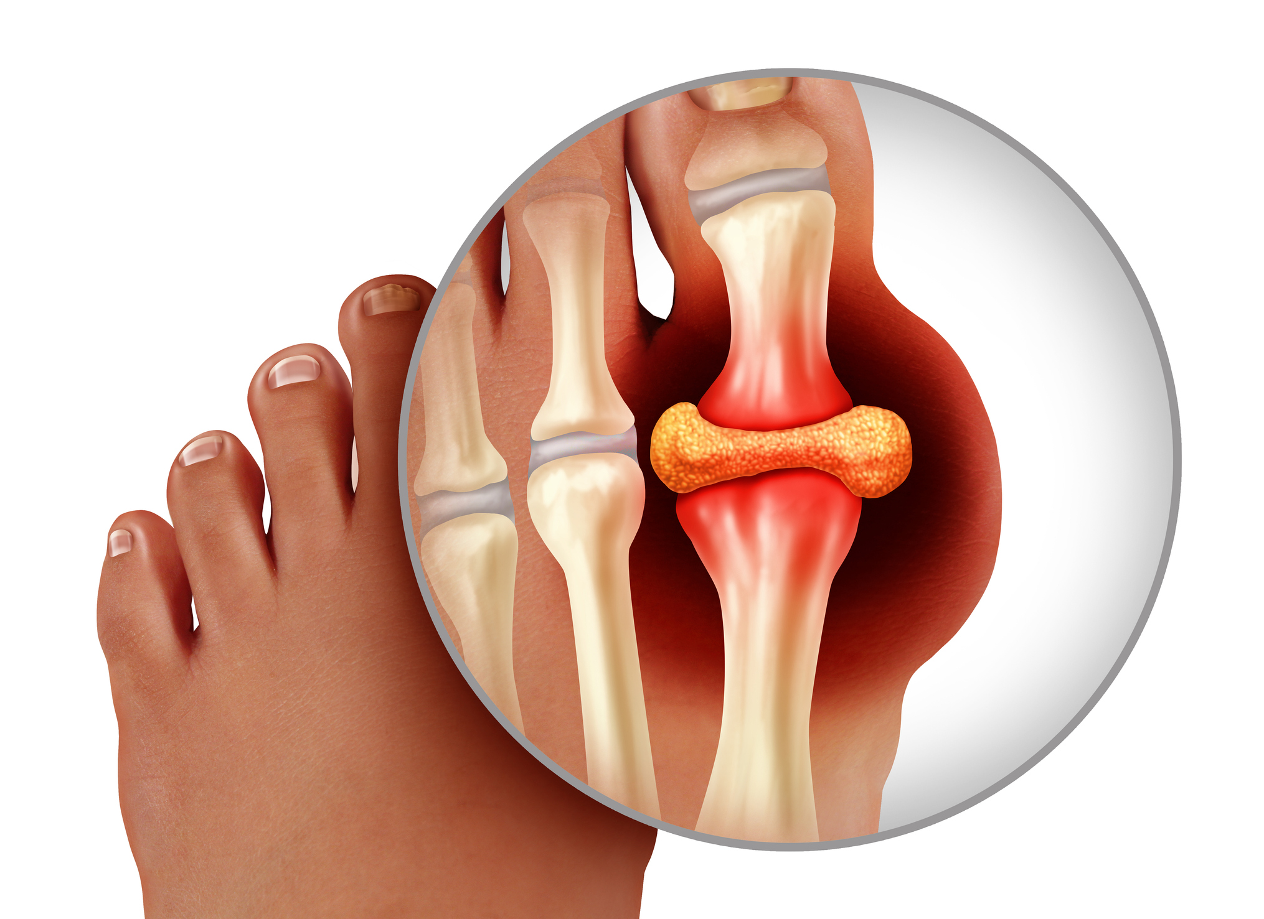
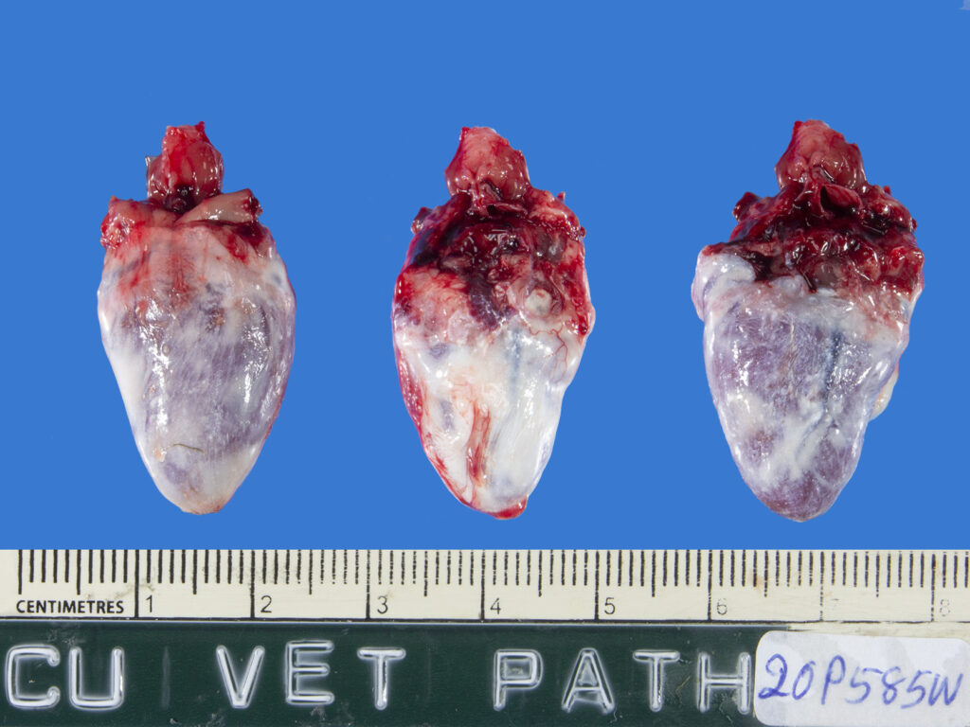
Extracellular Accumulation
1)Protrein
Hyaline Degeneration Fibrosis (collagen)
Fibrinoid Degeneration
Amyloid Degeneration
Articular gout
Gout
Visceral gout
Dystrophic calcification
Calcification
Metastatic calcification

Slide 7
Intracellular Accumulation:-
Under some circumstances cells may accumulate abnormal amounts of various substances, which may be harmless or associated with varying degrees of injury.
The location of accumulated substances may either in the cytoplasm, within organelles (lysosomes) or in the nucleus, and it may be synthesized by the affected cells or may be produced elsewhere.

Slide 8
There are three pathways by which cells can accumulate abnormal substances-
1- A normal substances may be produced at a normal or an increased rate, but the metabolic rate is inadequate to remove it. Ex:- fatty change in liver.
2- Endogenous substances accumulates because of genetic or acquired defect in its metabolism, transport or secretion. Ex:- ‟lysosomal storage disease‟
3- A abnormal outside substance may accumulate because the cell has neither the enzyme to degrade it nor the ability to transport it to other site. Ex:- Carbon (anthracosis),silica particles (silicosis) in the lungs.

Slide 9
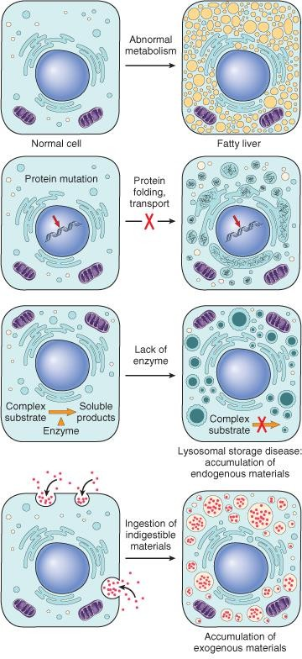

Slide 10
1)Fatty Change:-
Fatty Degeneration
Fatty Infiltration
Obesity
Refers to any abnormal accumulation of natural fat within parenchymal cells.
. Fatty Degeneration:- Found in parenchymatous cell of liver, kidney, heart.
Cause- hypoxia
Poison-hepatotoxics (chloroform)
Pathogenesis-When mitochondria are damaged due to irritant Enzymes concerned in metabolism of fat are disrupted So fat should be colloidal in protoplasm, accumulate and become visible
may be caused by Alcohol, protein malnutrition, diabetes mellitus and obesity,

Slide 11
The significance of fatty change depends on the cause and severity of the accumulation.
When mild it may have no effect on cellular function.
More severe fatty change may transiently impair cellular function.

Slide 12
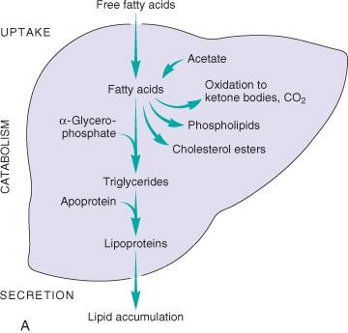
Diagram of the possible mechanisms leading to accumulation of triglycerides in fatty liver.
Any defects in any of the steps of uptake, catabolism or secretion can result in lipid accumulation.

Slide 13
Morphology
In any site, fatty accumulation appears as clear vacuoles within parenchymal cells.
Special staining techniques are required to distinguish fat from intracellular water or glycogen, which can also produce clear vacuoles.
To identify fat microscopically, tissues must be processed for sectioning without the organic solvents typically used in sample preparation.

Slide 14
Gross appearance: the organ enlarges and becomes progressively yellow until, in extreme cases, it may weigh 3 to 6 kg (1.5-3 times the normal weight) and appear bright yellow, soft, and greasy.
Light microscopy: Early fatty change is seen as small fat vacuoles in the cytoplasm around the nucleus. In later stages, the vacuoles coalesce to create cleared spaces that displace the nucleus to the cell periphery.

Slide 15
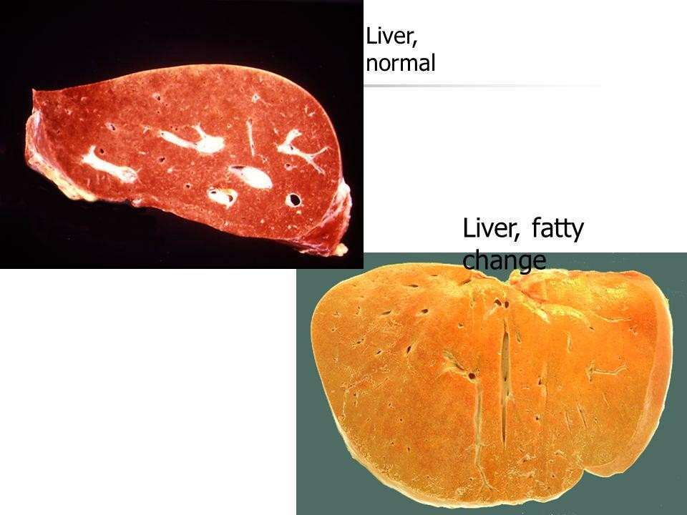

Slide 16
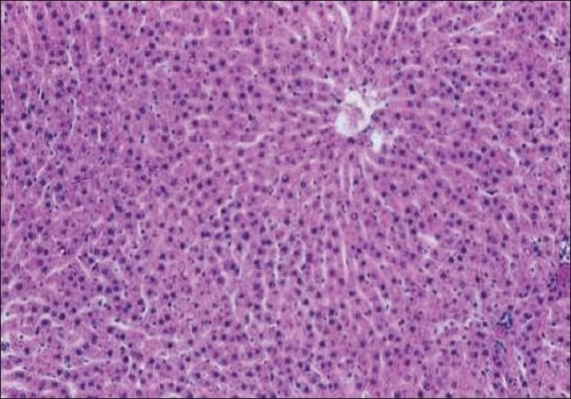
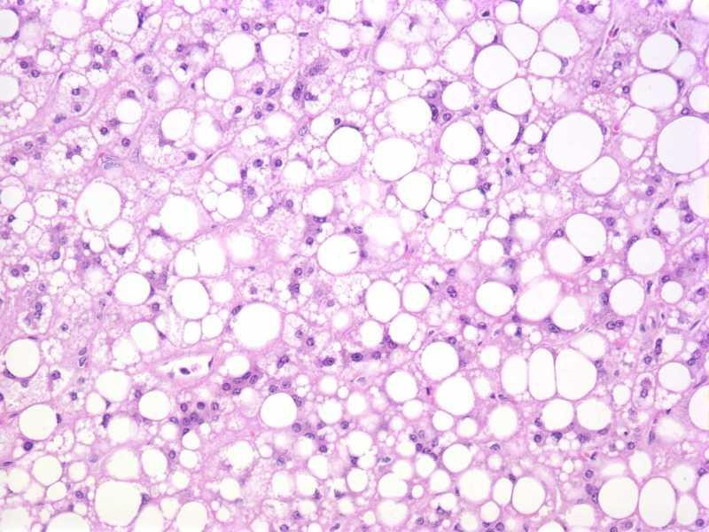
Normal liver histology
Microscopical appearance of fatty change of liver

Slide 17
Proteins:
Intracellular protein accumulation may be due to excessive synthesis, absorption, or defects in cellular transport.
Morphologically visible accumulation appear as rounded, eosinophilic, cytoplasmic droplets.
E.g. : protein in proximal convoluted tubular epithelium due to chronic reabsorption in the setting of proteinuria.

Slide 18
Glycogen:
Is a readily available cytoplasmic energy store.
Excessive intracellular deposits which seen as clear vacuoles, are seen with abnormalities of glycogen storage so called glycogenosis, and glucose metabolism as in diabetes mellitus.

Slide 19
Pigments:
Pigments are colored substances that are either exogenous, coming from outside the body, or endogenous, synthesized within the body itself.
The most common exogenous pigment is carbon (an example is coal dust), a common air pollutant of urban life.
When inhaled, it is phagocytosed by alveolar macrophages and transported through lymphatic channels to the regional tracheobronchial lymph nodes.

Slide 20
Aggregates of the pigment blacken the draining lymph nodes and pulmonary parenchyma (anthracosis).
Heavy accumulations may induce emphysema or a fibroblastic reaction that can result in a serious lung disease called coal workers' pneumoconiosis.

Slide 21
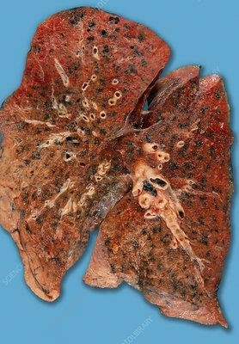
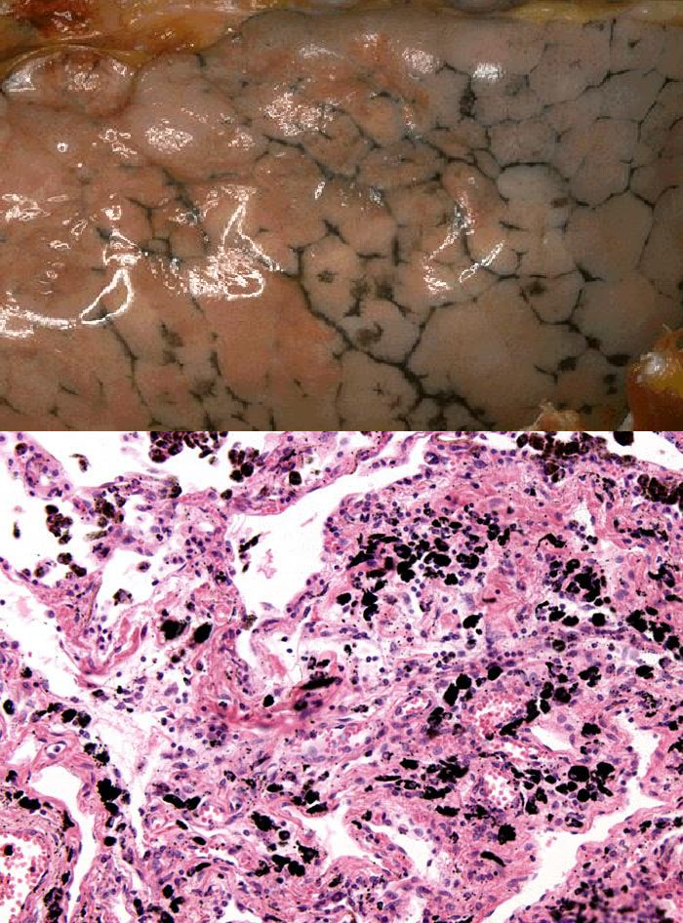
Anthracosis of Lung

Slide 22
4)Pigmentation:- Endogenous
-Melanin
Exogenous
-Pneumoconiosis
-Anthracosis
-Siderosis
-Silicosis
-Plumbism
-Argyria
-Tatooing
- lipofusin
-Hb derivatives (Hemosiderin, Porphyrin, Bilirubin)

Slide 23
Endogenous pigments Include:
Lipofuscin
Melanin
Hemosiderin.

Slide 24
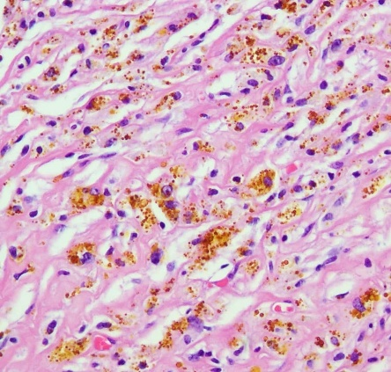
Melanin- Increase melanin production (melanomas,addision disease,Acanthosis nigricans in dogs)
-Little production of melanin (Albinism,Leucoderma)
-Microscopically appears as very minute ,
uniformaly regular dirty brown, spherical granules .
Heamoglobin derivative-
Heamosiderin- Golden yellow crystal within macrophages in spleen (increase- Heamosiderosis)
porphyrin- iron containing blood pigment.
Bilirubin- excessive bilirubin in blood (Jaundic).

Slide 25
Lipofusin- „wear-and-tear‟ or Aging pigment.
- prominent in liver and heart (Brown Atrophy) of aging patient.
Lipofuscin represents complexes of lipid and protein that derive from the free radical- injury.
The brown pigment when present in large amounts, imparts an appearance to the tissue that is called brown atrophy.
By electron microscopy, the pigment appears as perinuclear electron-dense granules.

Slide 26
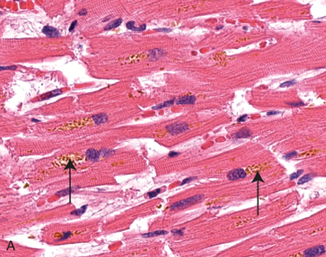
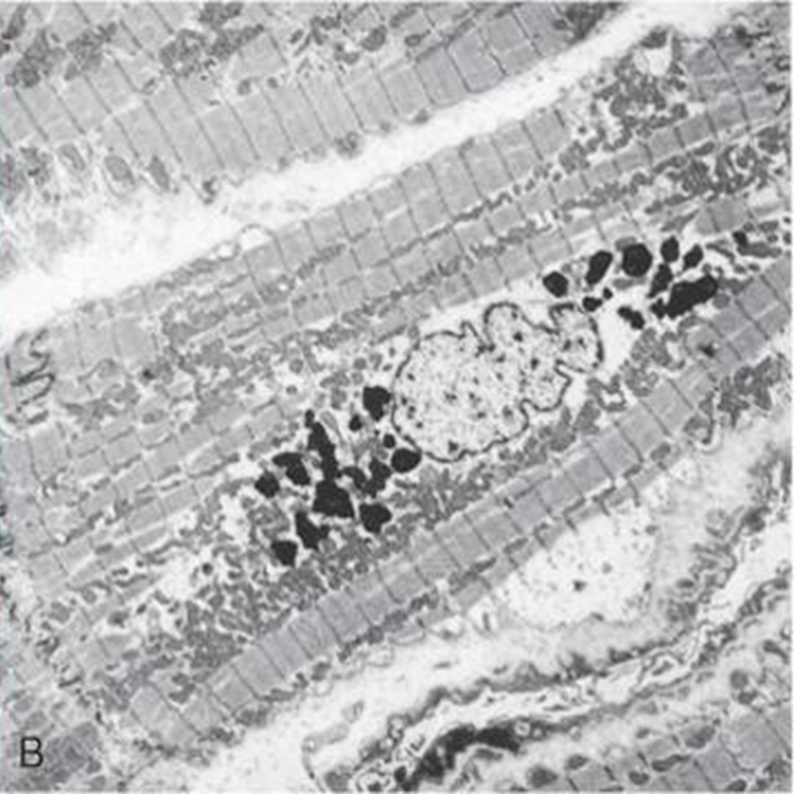
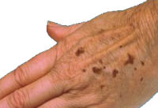
Lipofuscin
Lipofuscin gives a brown color to age spots (or called lentigo)
Lipofuscin is the wear-and-tear pigment that arises from damaged subcellular membranes with aging, resulting from free radical injury.
Electron microscopy
note perinuclear intralysosomal location

Slide 27
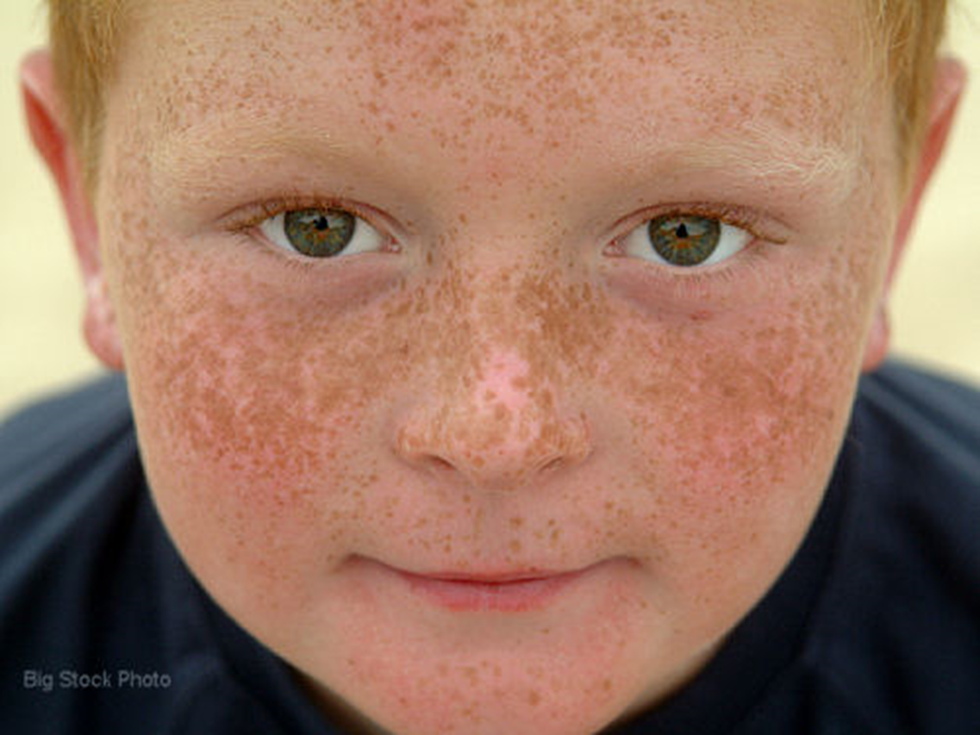
Melanin :
is an endogenous, brown-black pigment. It is synthesized exclusively by melanocytes located in the epidermis and acts as a screen against harmful ultraviolet radiation.
Accumulation of melanin in keratinocytes and dermal macrophages gives rise to freckles.

Slide 28
Hemosiderin:
is a hemoglobin-derived granular pigment that is golden yellow to brown and accumulates in tissues when there is a local or systemic excess of iron.
Iron is normally stored within cells in association with the protein apoferritin,
forming ferritin.
Hemosiderin pigment represents large aggregates of ferritin, readily visualized by light and electron microscopy; the iron can be identified by the Prussian blue histochemical reaction.

Slide 29
Although hemosiderin accumulation is usually pathologic, small amounts of this pigment are normal in the mononuclear phagocytes of the bone marrow, spleen, and liver, where there is extensive red cell breakdown.
With progressive accumulation, parenchymal cells throughout the body (but principally the liver, pancreas, heart, and endocrine organs) become "bronzed" with accumulating pigment.
Local excesses of iron, and consequently of hemosiderin, result from hemorrhage. The best example is the common bruise.

Slide 30
Hemosiderosis occur in the setting of:
increased absorption of dietary iron,
impaired utilization of iron,
hemolytic anemias.
transfusions (the transfused red cells constitute an exogenous load of iron).
  In most instances of systemic hemosiderosis, the iron pigment does not damage the parenchymal cells or impair organ function despite an impressive accumulation.

Slide 31
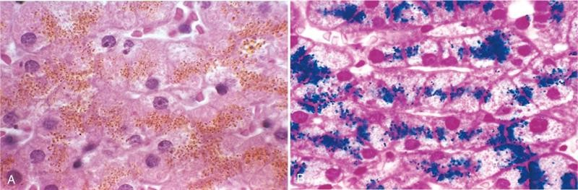
Hemosiderin granules in hepatocytes
Prussian blue histochemical reaction

Slide 32
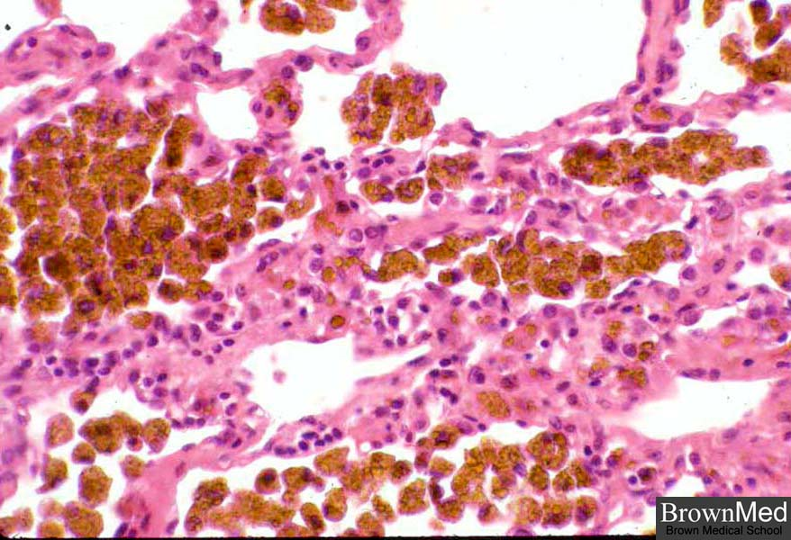
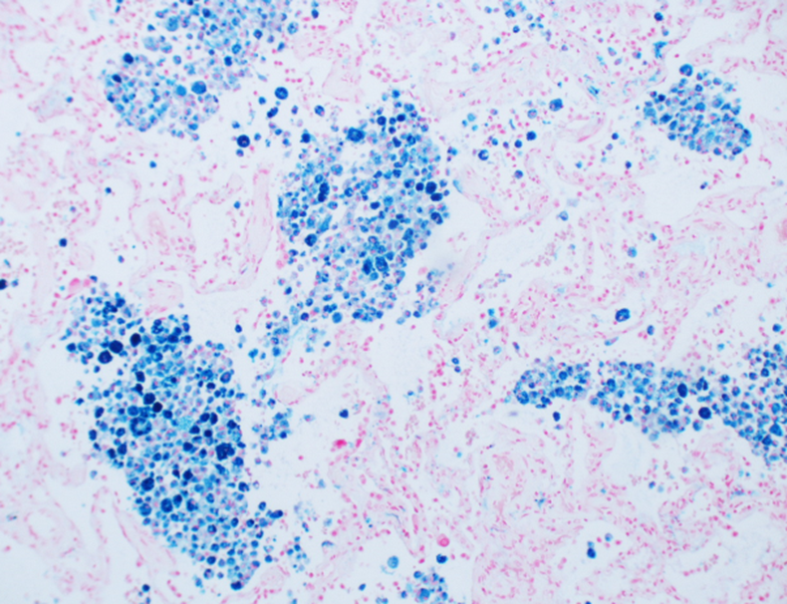
Hemosiderin
Hemosiderin is an aggregation of iron and apoferritin. It appears yellow-brown.
Since hemosiderin contains iron, you can stain it blue with Prussian blue.

Slide 33
PATHOLOGIC CALCIFICATION
Pathologic calcification is a common process in a wide variety of disease states;
it implies the abnormal deposition of calcium salts, together with smaller amounts of iron, magnesium, and other minerals.

Slide 34
CALCIFICATION
It is a process in which abnormal calcium level increase in body tissue except bone and teeth ,causing the tissue to harden. TWO TYPE:-
1)Dystrophic Calcification (local calcification) Necrotic areas
2)Metastatic Calcification (General calcification)
Affected organs-kidney, lungs, stomach
Ex:-Caseous tuberculosis, Degenerating tumors etc.
Ex:-Myeloid tumors,demineralization of Bone.

Slide 35
When the deposition occurs in dead or dying tissues, it is called dystrophic calcification; it occurs in the absence of calcium metabolic derangements (i.e., with normal serum levels of calcium).
In contrast, the deposition of calcium salts in normal tissues is known as metastatic calcification and almost always reflects some derangement in calcium metabolism (hypercalcemia).

Slide 36
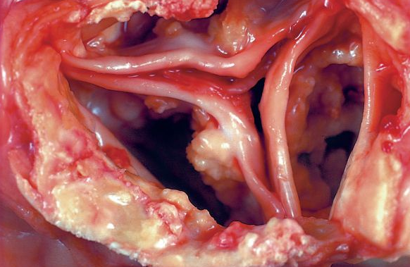
Dystrophic calcification:
Dystrophic calcification is encountered in areas of necrosis of any type.
It is virtually inevitable in the atheromas of advanced atherosclerosis, associated with intimal injury in the aorta and large arteries and characterized by accumulation of lipids.
Dystrophic calcification of the aortic valves is an important cause of aortic stenosis in the elderly.
areas of calcification on the aortic valve cusps
One of the most common causes of aortic stenosis is dystrophic calcification. Notice how calcium appears white grossly.
One of the most common causes of aortic stenosis is dystrophic calcification. Notice how calcium appears white grossly.

Slide 37
Metastatic Calcification:
Metastatic calcification can occur in normal tissues whenever there is hypercalcemia.
The four major causes of hypercalcemia are
increased secretion of parathyroid hormone,
destruction of bone due to the effects of accelerated turnover
vitamin D-related disorders including vitamin D intoxication
renal failure, in which phosphate retention leads to secondary hyperparathyroidism.

Slide 38
Thank You

