Slide 1
Inflammation
Lecture: 7
Faculty of Applied Science Medical Analysis Department Summer Semester
General Pathology
Grade 4
Dr. Suhayla Hamad Shareef 11/5/2026

Slide 2


Outline:
Inflammation, types and causes
Nomenclature of inflammation.
Mechanism of inflammation
Chemical mediators in Inflammation

Slide 3
Objectives:
To define inflammation and explain types and causes of inflammation
To explain nomenclature of inflammation
To study mechanism of inflammation
To identify chemical mediators in Inflammation

Slide 4
Inflammation:
Is the response of vascularized living tissue to injury.
Functions to:
▶Dilute toxins
▶Destroy and Isolate offending agent.
▶Initiate repair of tissue

Slide 5
Inflammation is divided into two patterns:
1. Acute inflammation
( is an immediate response to injury )
Short duration minutes, hours to 2 days characterized by
exudation of fluid & plasma protein, edema and emigration of leukocytes predominantly neutrophils.

Slide 6
2. Chronic inflammation
Longer duration with presence of lymphocytes, macrophages,
proliferation of blood vessels and connective tissue.

Slide 7
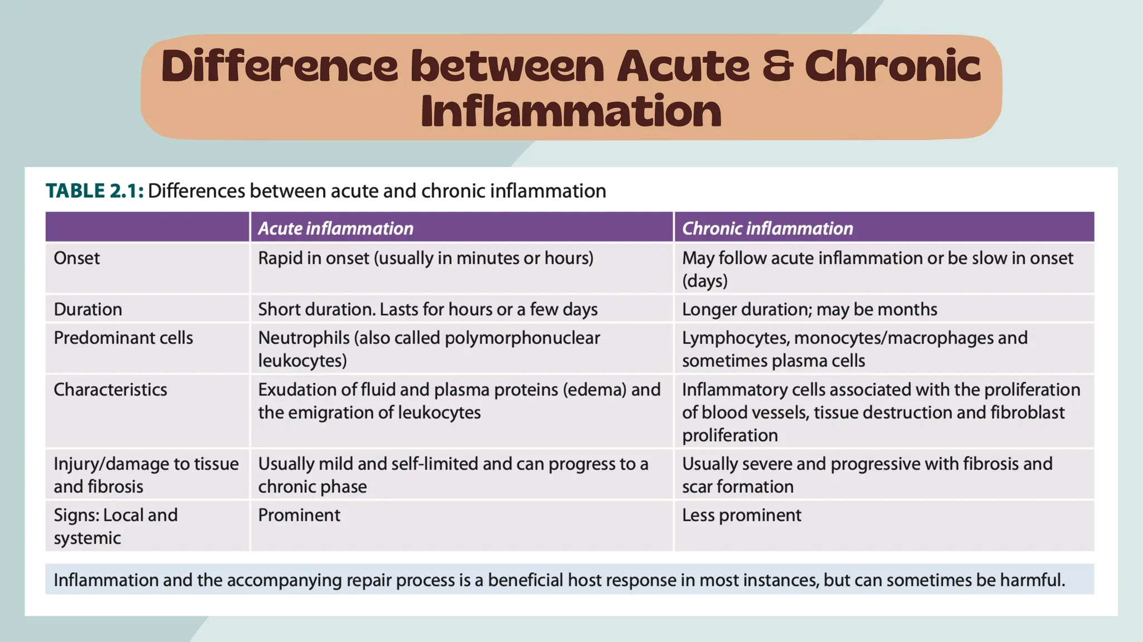

Slide 8
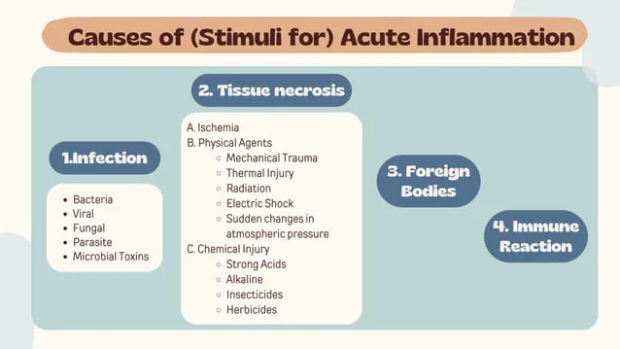
(splinter, dirt, sutures)
(also called hypersensitivity reactions)

Slide 9
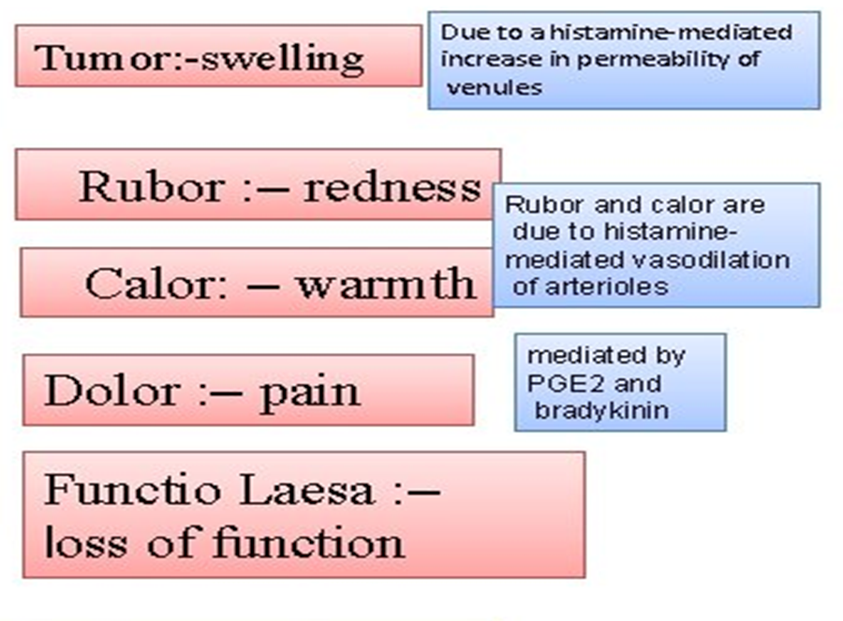
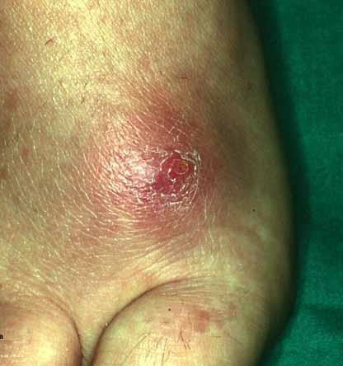

Cardinal signs of acute inflammation
Rubor= redness
Tumor = swelling
Calor
Dolor
= heat
= pain
Functio laesa = loss of function

Slide 10
Nomenclature
The nomenclature used to describe inflammation in different tissues employs
the tissue name and the suffix “-itis”
e.g.
pancreatitis
meningitis pericarditis arthritis

Slide 11
Acute inflammation involves:
Alteration of vascular caliber
(vasodilation leads to increased blood flow)
Changes of microvasculature
(increased permeability for plasma proteins and cells)
Emigration of leukocytes from microcirculation
(leukocyte activation leads to elimination of offending agent)

Slide 12
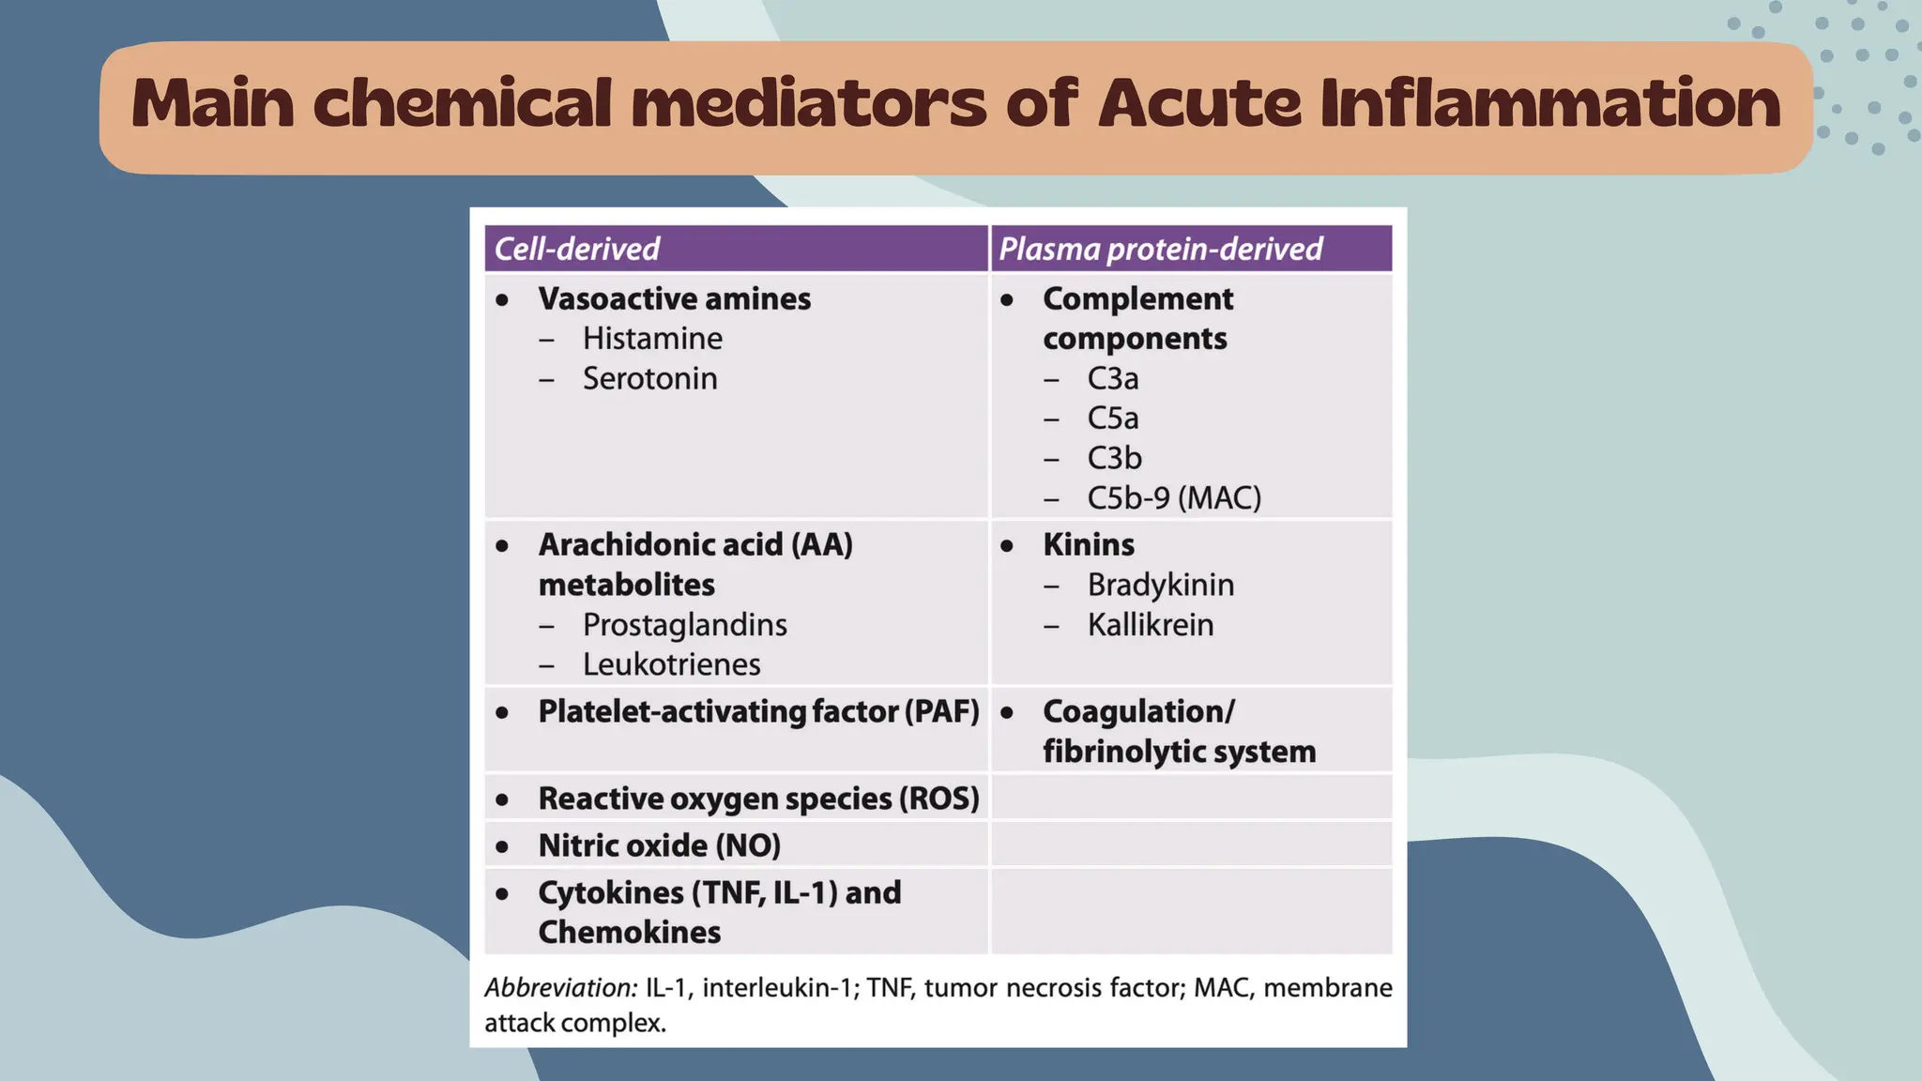

Slide 13
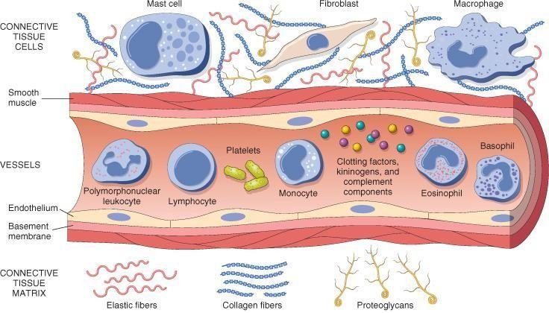
The components of acute and chronic inflammatory responses: circulating cells and proteins, cells of blood vessels, and cells and proteins of the extracellular matrix.

Slide 14
Vascular changes and fluid leakage during acute inflammation lead to Edema in a process called Exudation
Edema : excess fluid in interstitial tissue or body cavities, either:
1. Exudate:
result of inflammation
high protein and cell debris
specific gravity >1.018
Transudate:
  result of hydrostatic or osmoticimbalance
  ultrafiltrate of plasma,
  no increased vascular permeability
  low protein content
  specific gravity < 1.018

Slide 15
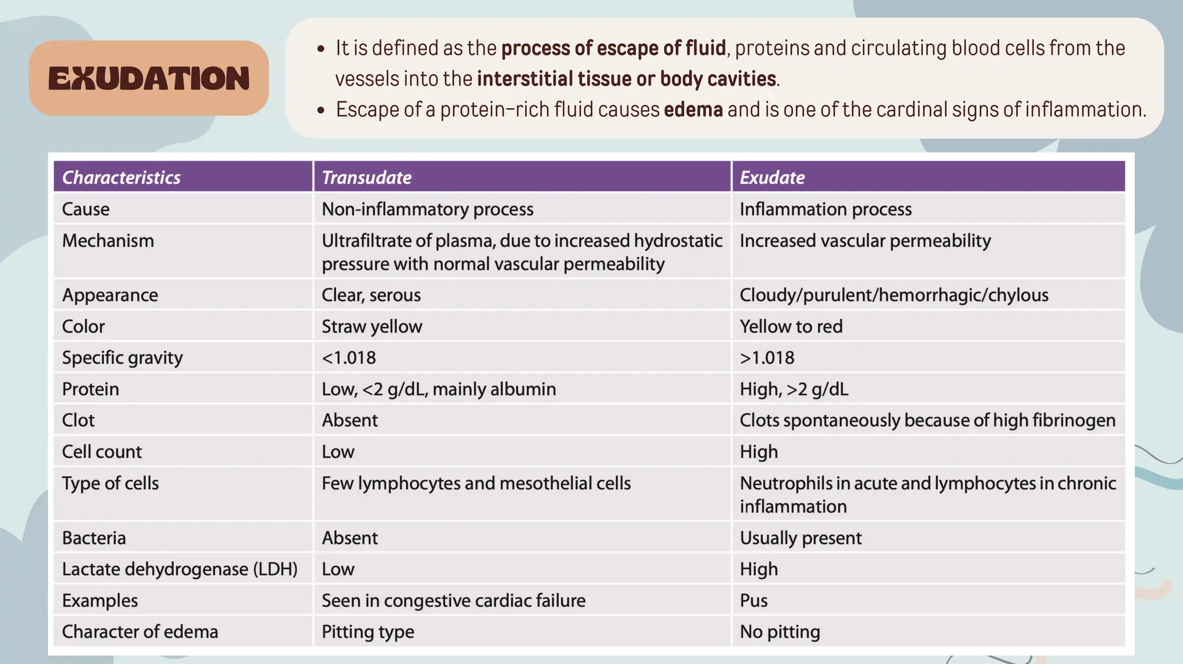

Slide 16
Pus: inflammatory exudate rich in neutrophils, debris of dead cells and microbes.

Slide 17
Two Major Changes in Acute Inflammation:
Vascular changes.
Cellular changes.
These two changes result in three of five classic local sign (heat, redness & swelling)
The other two cardinal features of acute inflammation (pain & loss of function) occur as a consequence of mediator elaboration.
.

Slide 18
Vascular Changes:
Transient momentary vasoconstriction (5 sec.)
Followed by vasodilatation result in increase blood flow & engorgement of blood vessels.
Increase Vessel permeability & movement of protein rich fluid to extravascular system.
Increased vessel permeability manifest clinically as edema which occur in microcirculation (small arterioles, capillary & venules)

Slide 19
Cellular Changes
Leukocytes leave the vasculature routinely through the following sequence of events:
  Margination and rolling
  Adhesion and transmigration
  Chemotaxis and activation
They are then free to participate in:
  Phagocytosis and degranulation
  Leukocyte-induced tissue injury

Slide 20

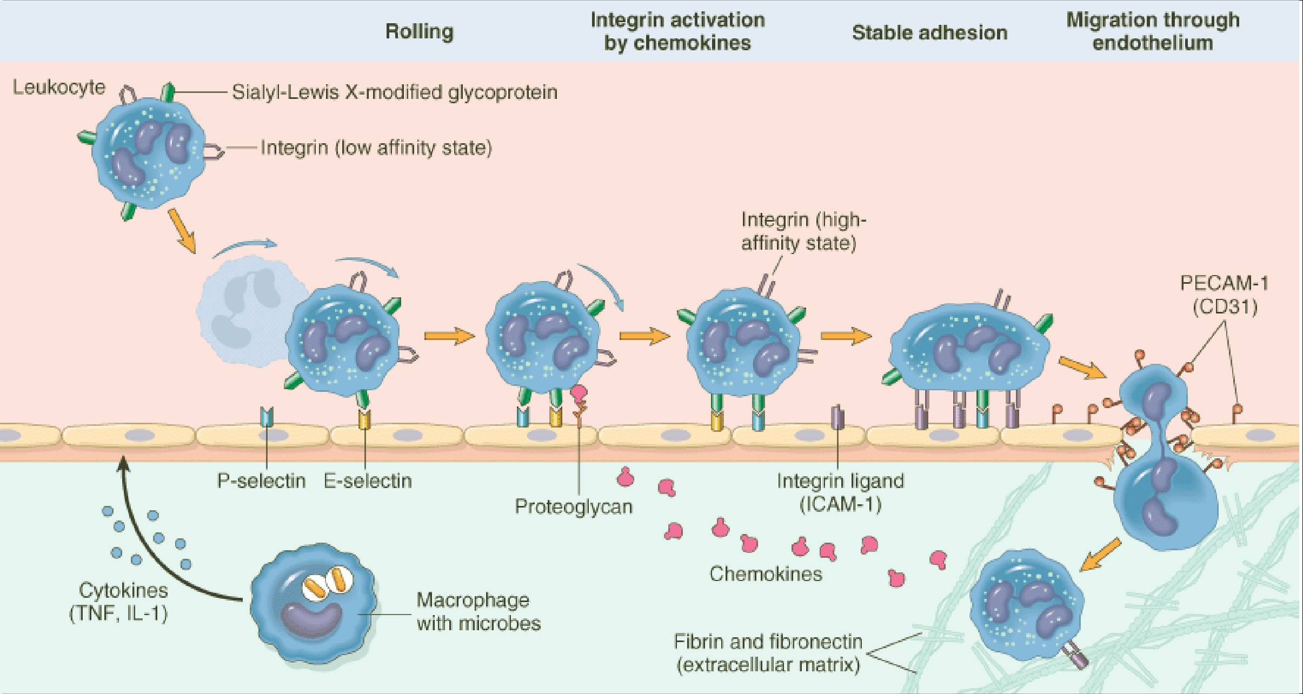

Slide 21
Chemotaxis
Leukocytes follow chemical gradient to site of injury (chemotaxis)
Chemotactic agents:
  Soluble bacterial products
  Complement components (C5a)
  Cytokines (e.g., IL-8)
  Leukotriene B4 (LTB₄)(AAmetabolite)

Slide 22
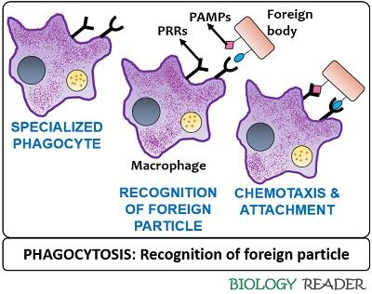
Phagocytosis and Degranulation
Once at site of injury, leukocytes:
  Recognize and attach to the particle.
  Engulfment (form phagocytic vacuole)
  Killing (degradation) of ingested material.

Slide 23
Chemical mediators in Inflammation
▶ Plasma-derived:
▶ Complement, kinins, coagulation factors
▶ Many in “pro-form” requiring activation (enzymatic cleavage)
▶ Cell-derived:
▶ Preformed, sequestered and released (mast cell histamine)
▶ Synthesized as needed (prostaglandin)

Slide 24
Cell derived mediators
▶ 1. Vasoactive amines
▶ Histamine:
vasodilation and venular endothelial cell contraction, junctional widening; released by mast cells, basophils and platelets

Slide 25
▶ 2. Leukotrienes (LT) & lipoxins (LX): via lipoxygenase pathway.
LT are chemotaxins (LTB4), vasoconstrictors, cause increased vascular permeability, and bronchospasm
LX act mainly as inhibitors of inflammation (endogenous antagonists of LT).

Slide 26
▶ 3. PAF (platelet activating factor)
▶ Derived also from cell membrane phospholipids, causes vasodilation, increased vascular permeability, increases
leukocyte adhesion

Slide 27
4. Cytokines
Protein cell products that act as mediators of inflammation &
immune responses.
IL-1, TNF are especially important in inflammation.
Increase endothelial cell adhesion molecule expression, activation and aggregation of PMNs.

Slide 28
▶ 5. ROS (Nitric Oxide):
▶ short-acting soluble free-radical gas with many functions.
▶ Produced by endothelial cells and macrophages, causes:
▶Vascular smooth muscle relaxation and vasodilation
▶Kills microbes in activated macrophages

Slide 29
Plasma derived mediators
▶ 1. Complement system
▶ 2. Clotting system
▶ 3. Kinin system

Slide 30
THANK YOU

