Slide 1
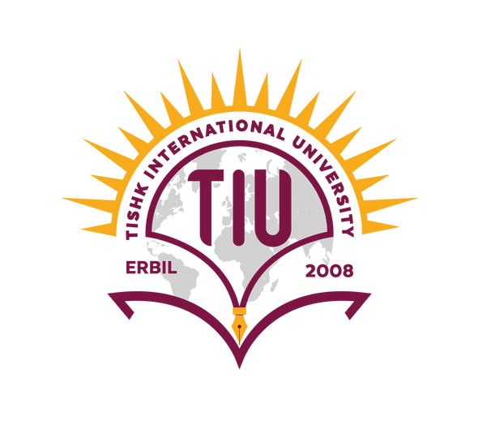


Tishk International University
Faculty of Applied Science
Nutrition and Dietetics Department
Circulatory system
Human Anatomy / 2nd Lecture
1st Grade / Spring Semester
Instructor: Adam Jalal Mohammed
Email: adam.jalal@tiu.edu.iq
Human Anatomy
2025 - 2026

Slide 2
Outlies
Components of the circulatory system
Heart Anatomy
Artery
Veins
Capillary

Slide 3
Learning outcomes
Identify the main components of the circulatory system.
Explain the function of the circulatory system.
Apply knowledge of blood flow to physiological processes.
Analyze differences between systemic and pulmonary circulation.
Evaluate the impact of cardiovascular disorders.

Slide 4
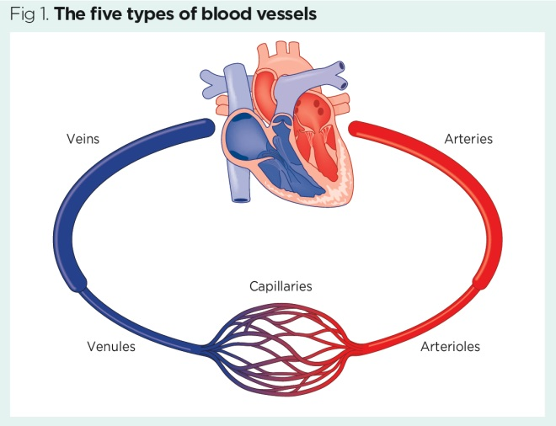
Components of the Circulatory System
The cardiovascular system, also known as the circulatory system, includes the heart, arteries, veins, capillaries, and blood.

Slide 5
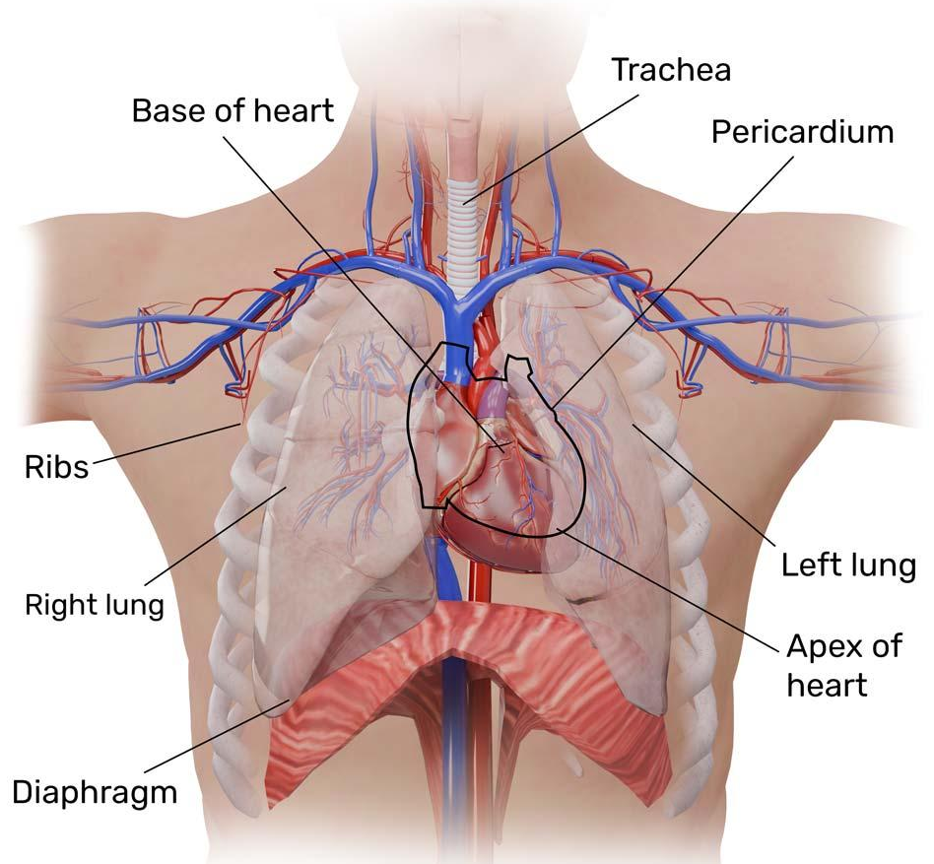
Heart
Heart is a four chambered, hollow muscular organ approximately the size of your fist.
• Location:
– Superior surface of diaphragm
– Left of the midline
– Anterior to the vertebral column, posterior to the sternum

Slide 6
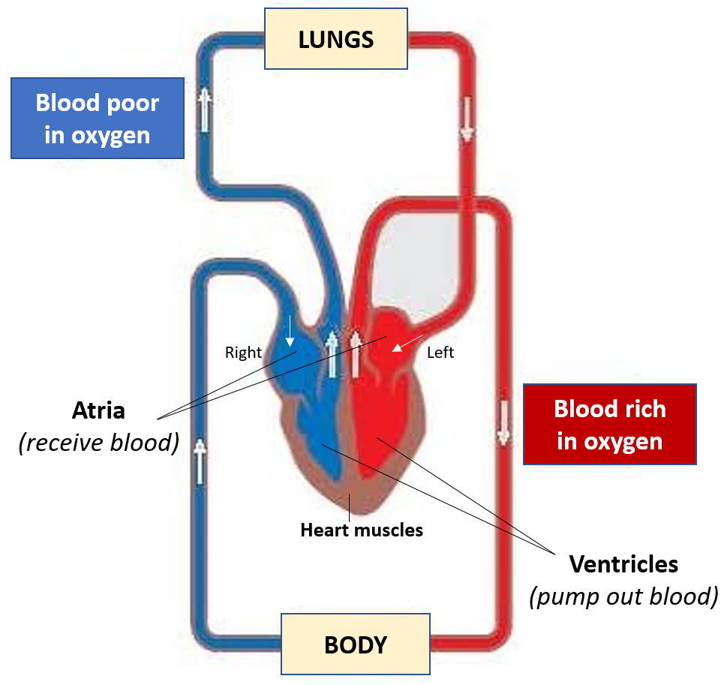
Functions of the Heart
1. Pumping oxygenated blood to the other body parts.
2. Pumping hormones and other vital substances to different parts of the body.
3. Receiving deoxygenated blood and carrying metabolic waste products from the body and pumping them to the lungs for oxygenation.
4. Maintaining blood pressure.

Slide 7
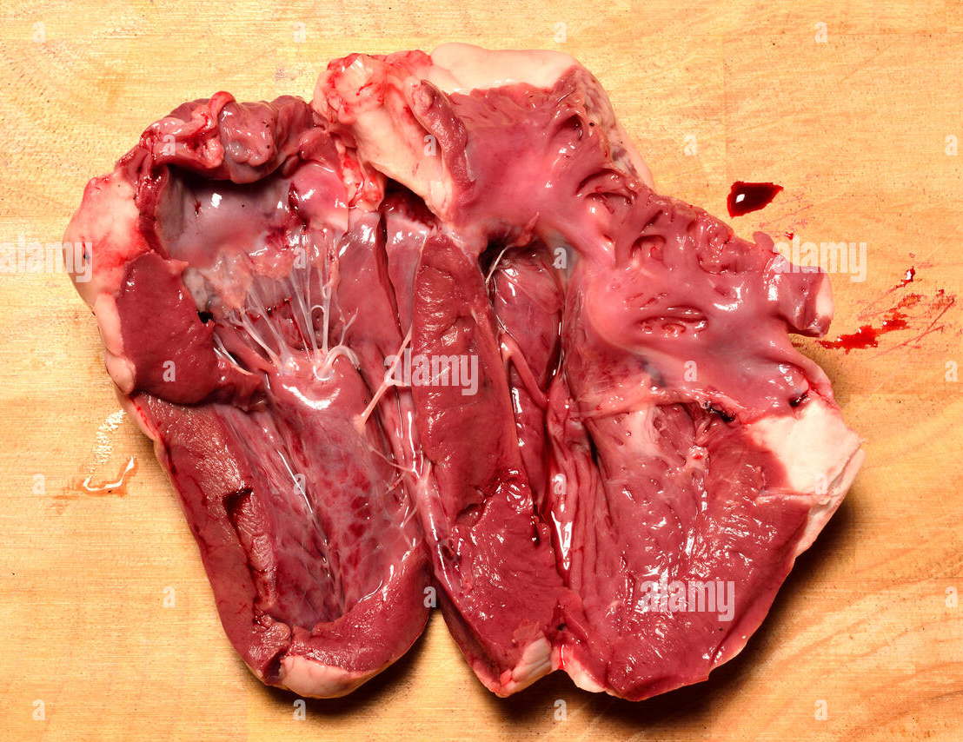

Slide 8
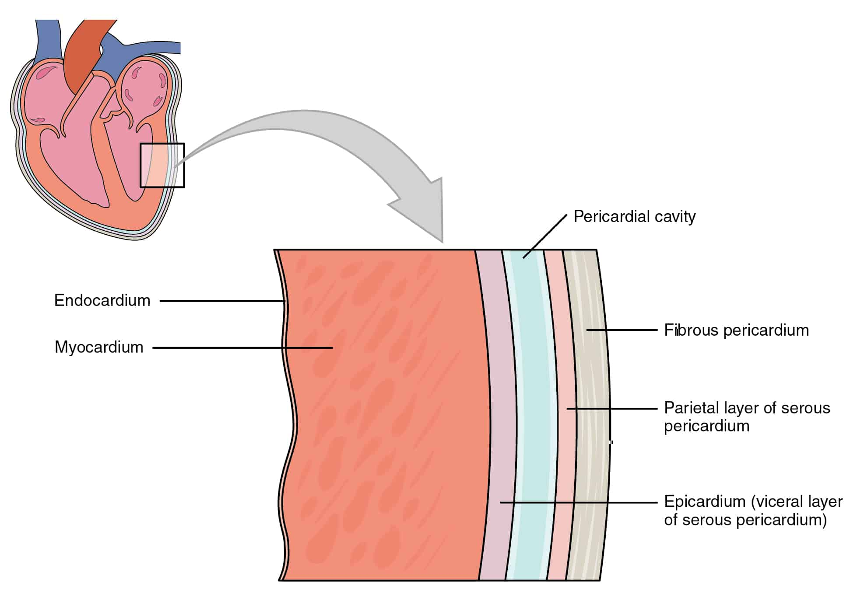
The Heart: Heart Wall
1. Epicardium
• Outside layer
• This layer is the parietal pericardium
• Connective tissue layer
2. Myocardium
• Middle layer
• Mostly cardiac muscle
3. Endocardium
• Inner layer
• Endothelium

Slide 9
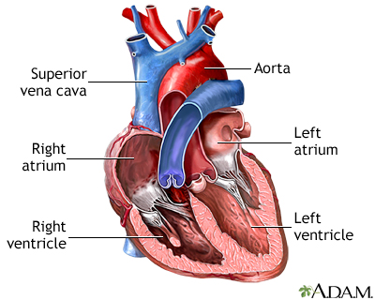
Heart chambers
There are four chambers: The left atrium and right atrium (upper chambers), and the left ventricle and right ventricle (lower chambers).

Slide 10
Heart chambers
The right and left sides act as separate pumps. Four chambers
➢ Atria
➢ Receiving chambers: Right atrium and Left atrium
➢ Ventricles
➢ Discharging chambers
➢ Right ventricle
➢ Left ventricle

Slide 11
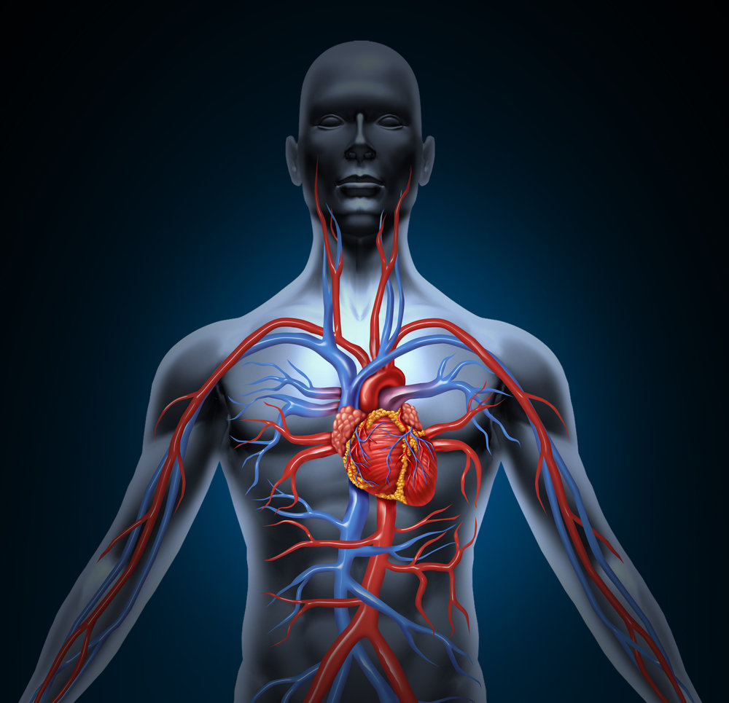
.
The heart functions as two separate pumps
•Right side→ pumps blood from the heart to the lungs (pulmonary circulation)
• In lungs CO2 leaves blood and O2 is absorbed
•Left side→ pumps blood from the heart to the rest of the body (systemic circulation)

Slide 12
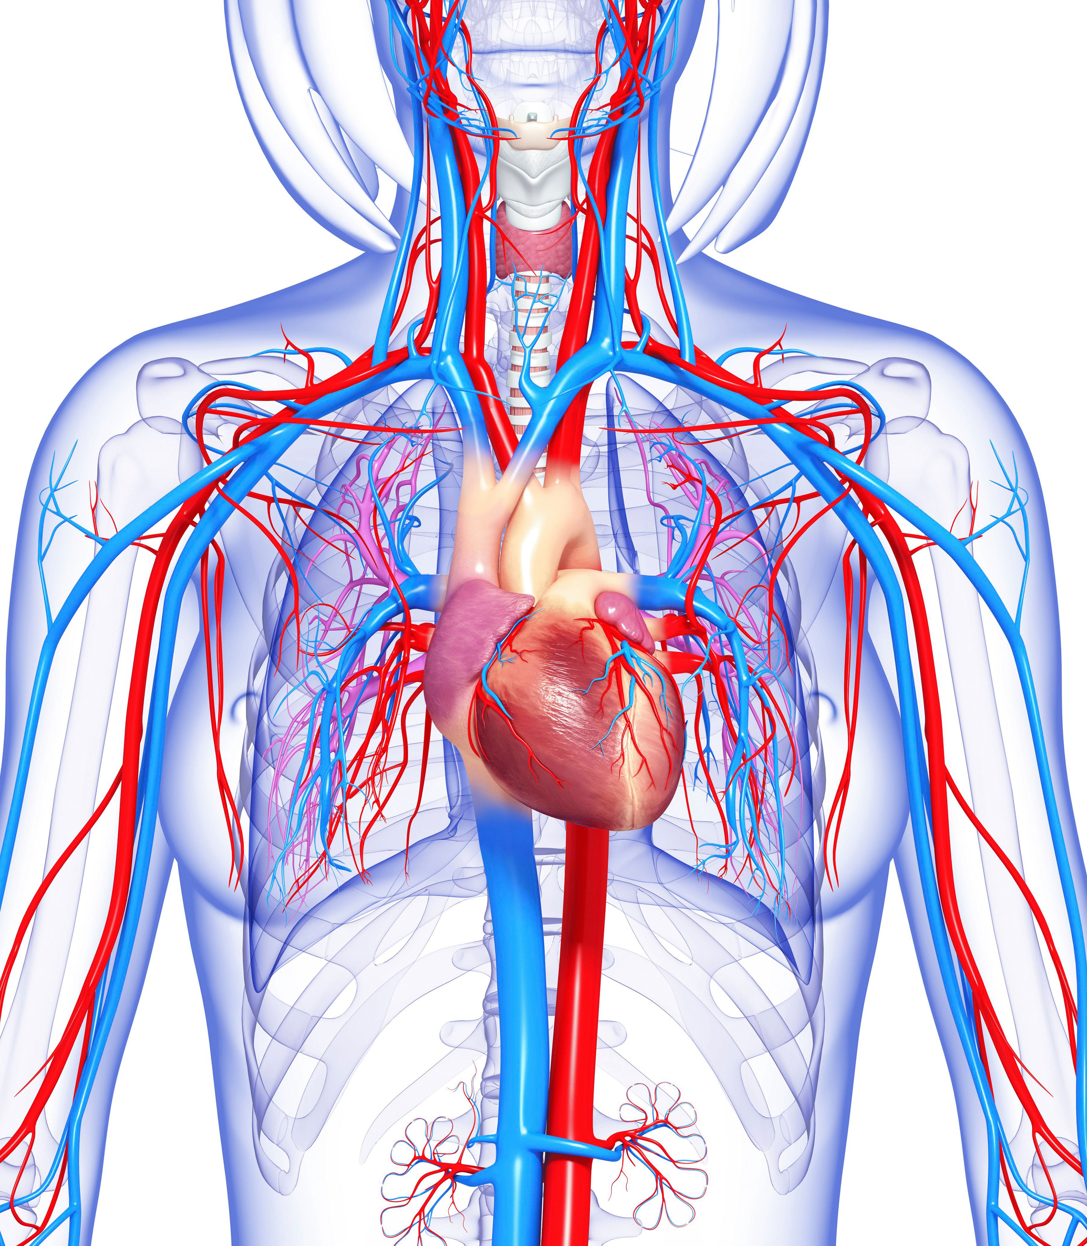
Circulatory System
The circulatory system is made up of blood vessels that carry blood away from and towards the heart. Arteries carry blood away from the heart, and veins carry blood back to the heart. The circulatory system carries oxygen, nutrients, and hormones to cells, and removes waste products, like carbon dioxide.

Slide 13
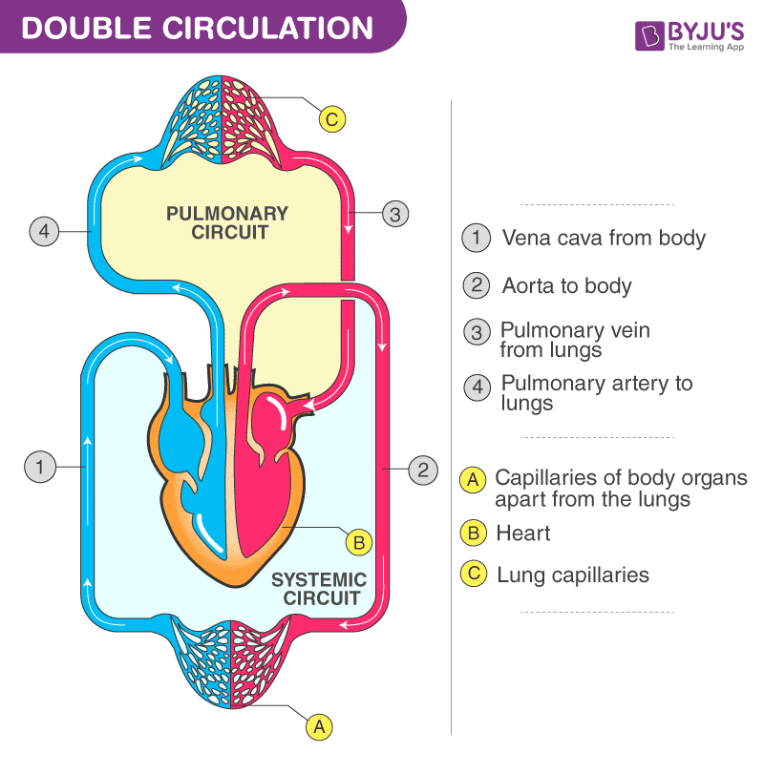
Types of Circulation
There are three different types of circulation that occur regularly in the body:
1. Pulmonary circulation. This part of the cycle carries oxygen- depleted blood away from the heart, to the lungs, and back to the heart.

Slide 14
Types of Circulation
There are three different types of circulation that occur regularly in the body:
2. Systemic circulation.
This is the part that carries oxygenated blood away from the heart and to other parts of the body.

Slide 15
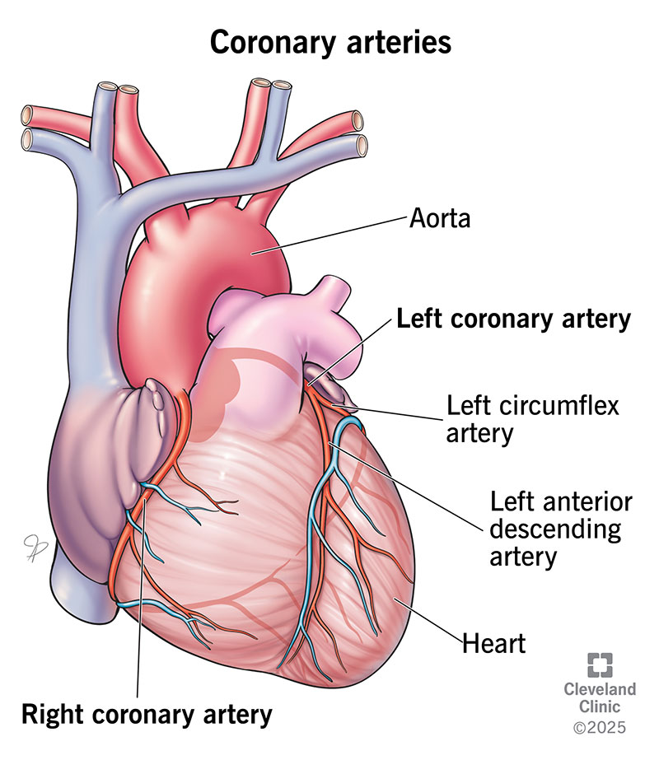
Types of Circulation
There are three different types of circulation that occur regularly in the body:
3. Coronary circulation: This type of circulation provides the heart with oxygenated blood so it can function properly.

Slide 16
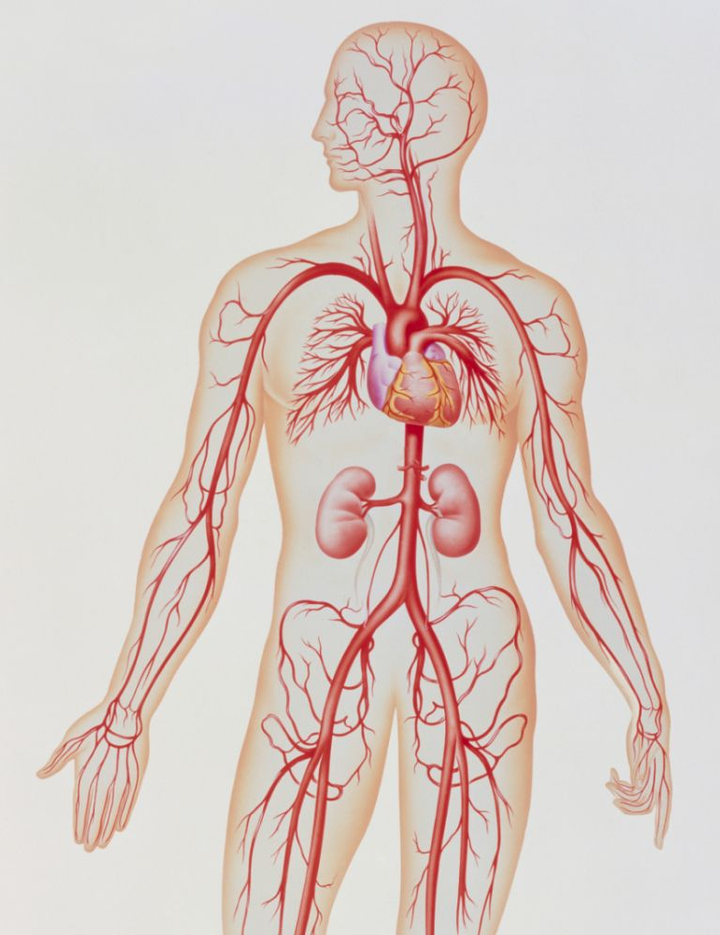
Types of blood vessels:
1. Arteries: Arteries are thin, muscular tubes that carry oxygenated blood away from the heart and to every part of the body.

Slide 17
Types of blood vessels

Slide 18
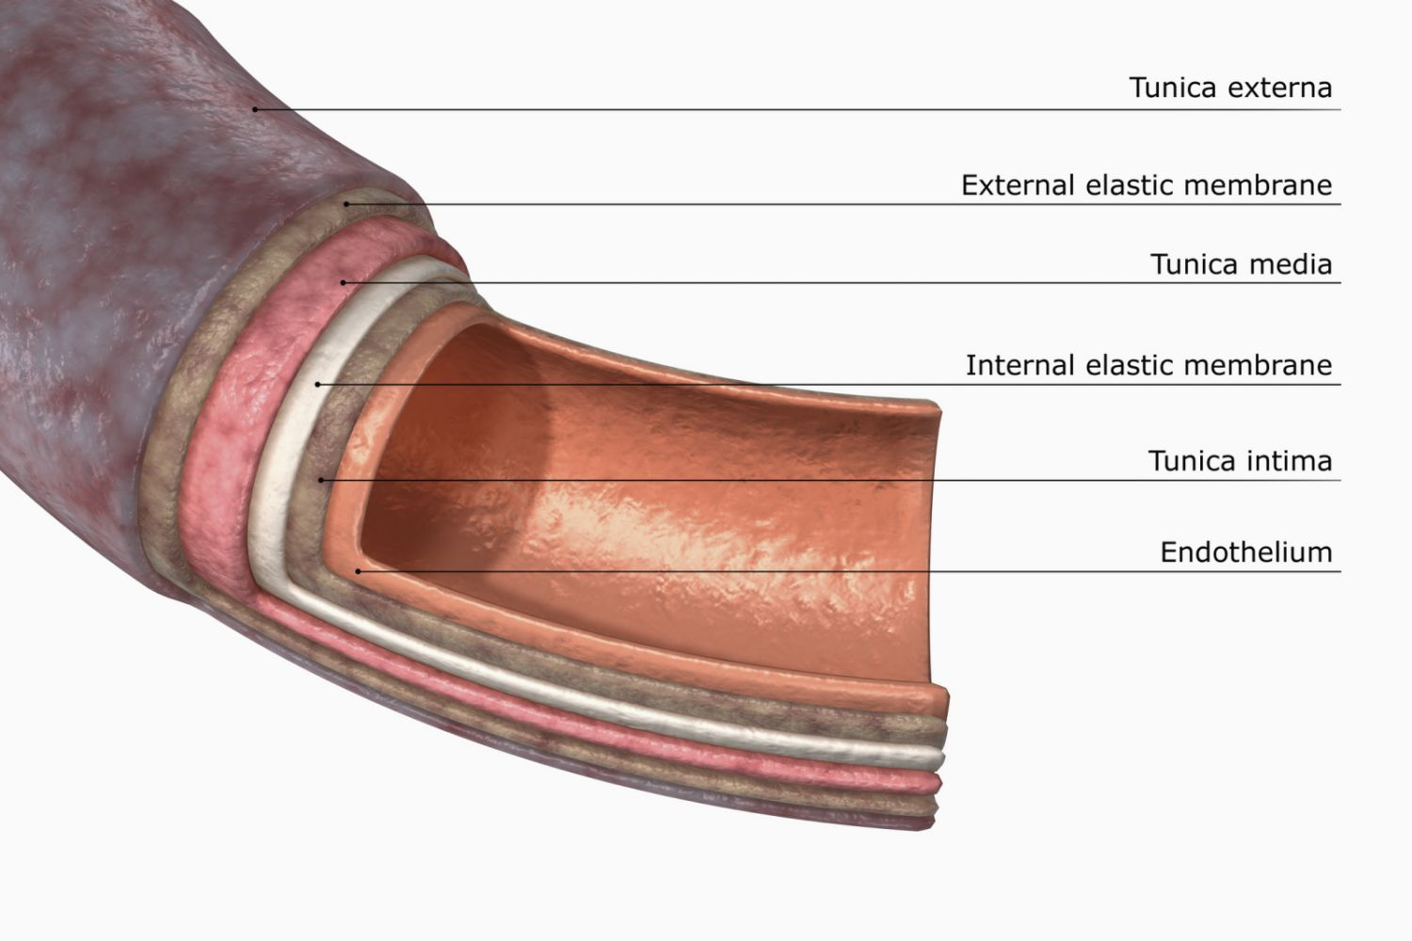
Artery
The arteries are the blood vessels that deliver oxygen-rich blood from the heart to the tissues of the body. Each artery is a muscular tube lined by smooth tissue and has three layers: The intima, the inner layer lined by a smooth tissue called endothelium.

Slide 19
Artery
Arteries carry blood away from the heart. Pulmonary arteries transport blood that has a low oxygen content from the right ventricle to the lungs. Systemic arteries transport oxygenated blood from the left ventricle to the body tissues.

Slide 20
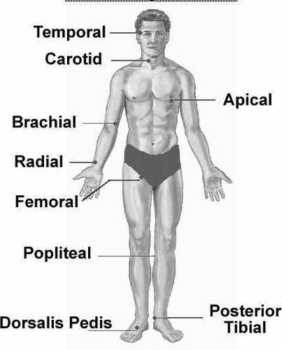
Pulse sites

Slide 21
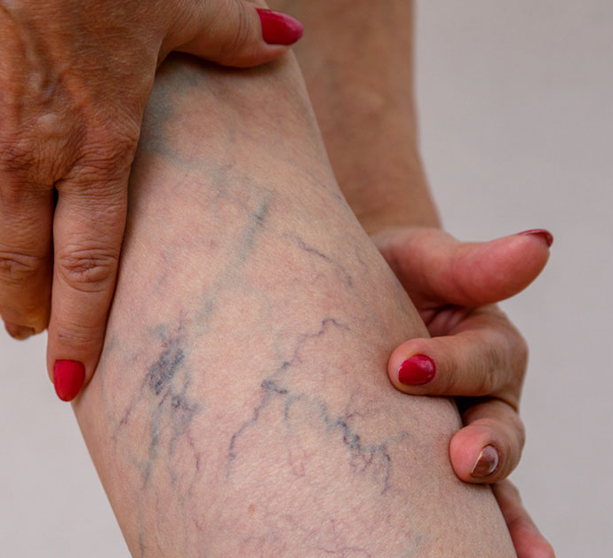
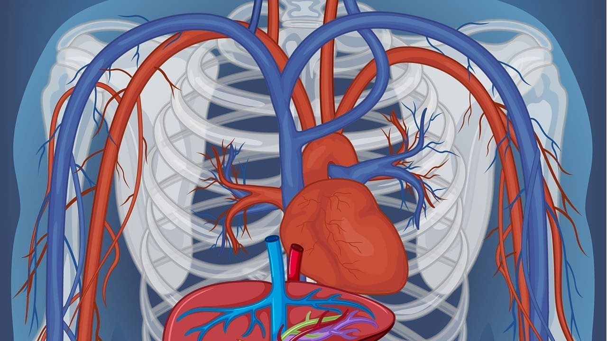
Types of blood vessels
2. Veins: Veins (in blue) are the blood vessels that return blood to the heart.
These blood vessels return oxygen-depleted blood to the heart. Veins start small (venules) and get larger as they approach your heart.

Slide 22
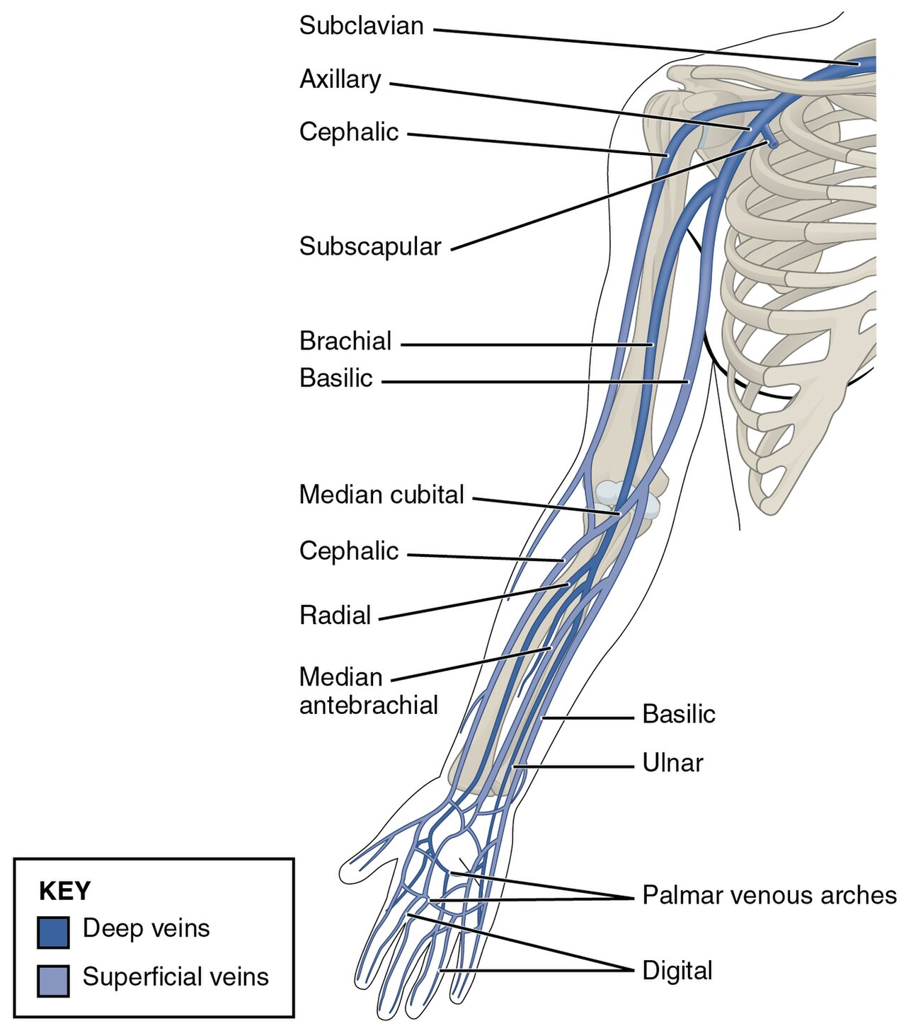
Types of Veins
1. A deep vein is a vein that is deep in the body. Deep veins are almost always beside an artery with the same name (e.g., the femoral vein is beside the femoral artery).
2. Superficial veins are often visible under the skin and are typically thin and wispy. They carry blood from surrounding tissues to the deep veins.

Slide 23
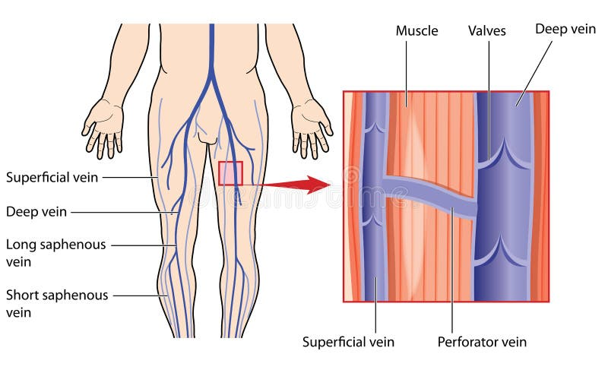
Types of Veins
3. Perforator veins are so called because they perforate the deep fascia of muscles to connect the superficial veins to the deep veins where they drain.

Slide 24
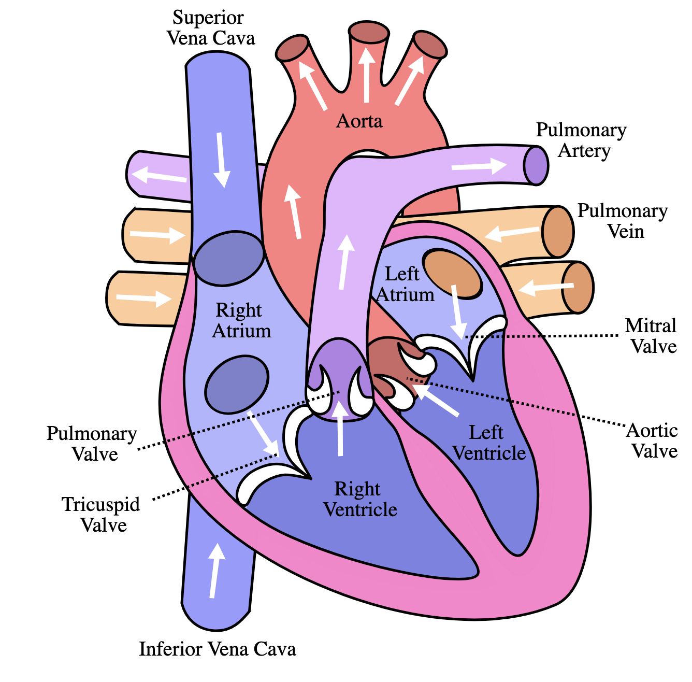
Two central veins deliver blood to the heart:
The superior vena cava carries blood from the upper body (head and arms) to the heart.
The inferior vena cava brings blood up from the lower body (stomach, pelvis, and legs) to the heart. Veins in the legs have valves to keep blood from flowing backward.

Slide 25
Types of Veins

Slide 26
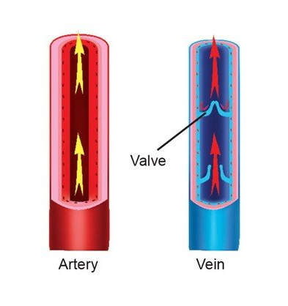
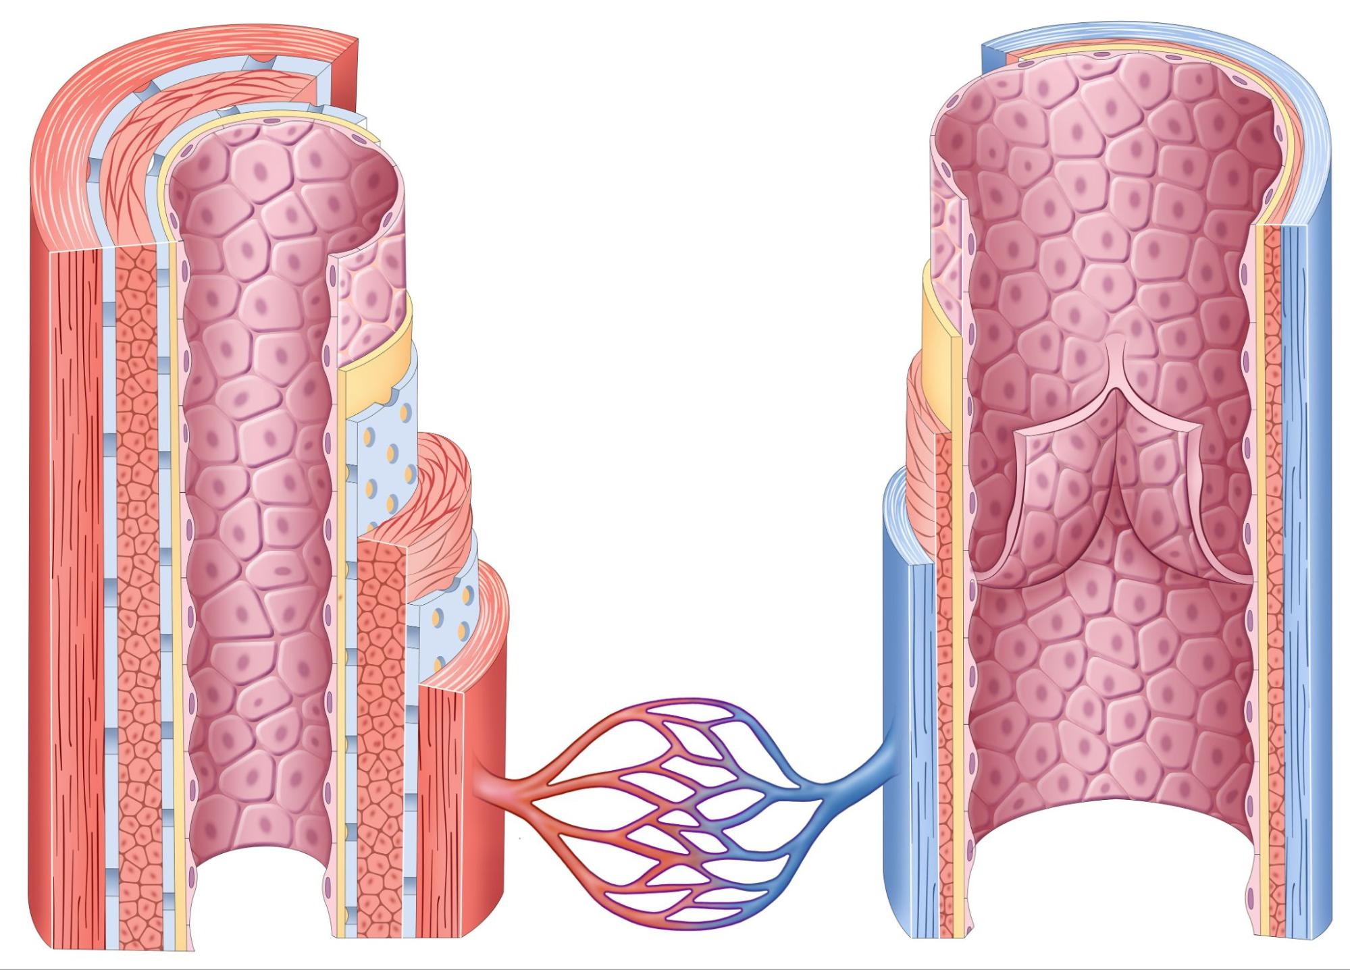
Artery vs Vein
Artery
Vein

Slide 27
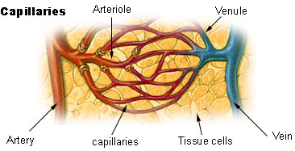
Types of blood vessels
3. Capillaries: These blood vessels connect very small arteries (arterioles) and veins (venules). Capillaries have thin walls that allow oxygen, carbon dioxide, nutrients, and waste products to pass into and out of cells.

Slide 28
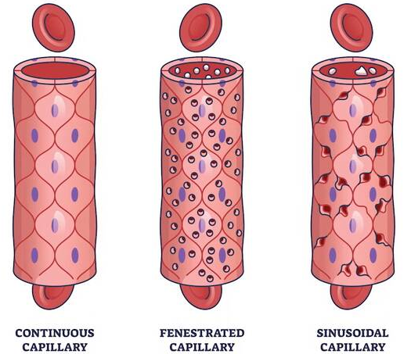
Types of Capillaries
1. Continuous capillaries. These are the most common types of capillaries. ...
2. Fenestrated capillaries. Fenestrated capillaries are “leakier” than continuous capillaries. ...
3. Sinusoid capillaries.

Slide 29
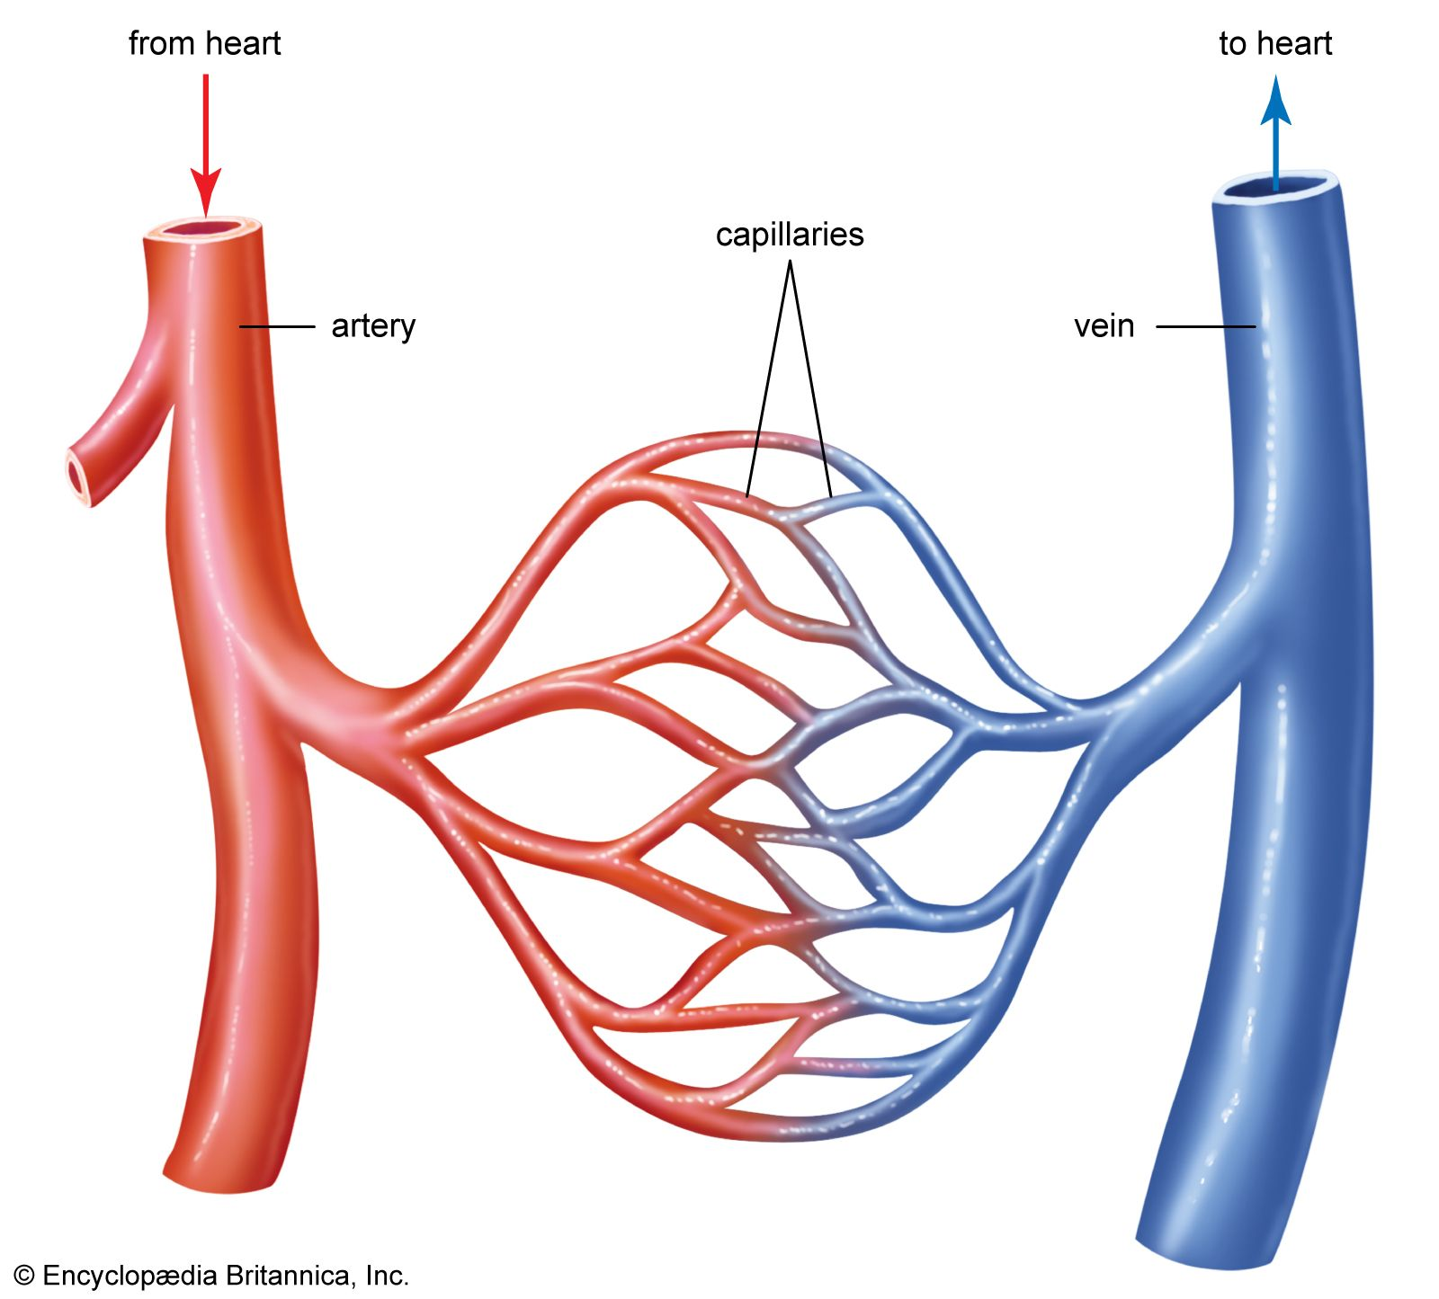
Capillaries
Connect arteries and veins
Smallest of blood vessels
Walls only one cell thick
Very narrow blood cells must
pass through a single file
Where gases are passed to/from
tissues

Slide 30
Capillaries
Capillaries, the smallest and most numerous of the blood vessels, form the connection between the vessels that carry blood away from the heart (arteries) and the vessels that return blood to the heart (veins).
The primary function of capillaries is the exchange of materials between the blood and tissue cells.

Slide 31
References
◦ Hall, J. E., & Hall, M. E. (2020). Guyton and Hall Textbook of Medical Physiology. Elsevier.
◦ Saladin, K. (2020). Anatomy & Physiology: The Unity of Form and Function. McGraw-Hill Education.

