Slide 1

Fundamental Programming II
Lecture_1
Dr. Hazha Saeed Yahia
hazha.yahia@tiu.edu.iq

Slide 2
Outline
Introduction to Array
Array Declaration
Array Initialization
Accessing Array Elements
Processing Array Contents
Array Size
Copying and Searching Arrays
Two-dimensional arrays
Three-dimensional arrays

Slide 3
Objective
Define the concept of an array and distinguish it from individual variables.
Illustrate the correct syntax for declaring and defining arrays in C++.
Explain various techniques for initializing arrays in C++, including both static and dynamic approaches.
Demonstrate how to output array elements to the console using different looping structures.
Describe the declaration, initialization, and access of elements in two-dimensional arrays in C++.
Develop the ability to create and manipulate multidimensional arrays beyond two dimensions.

Slide 4
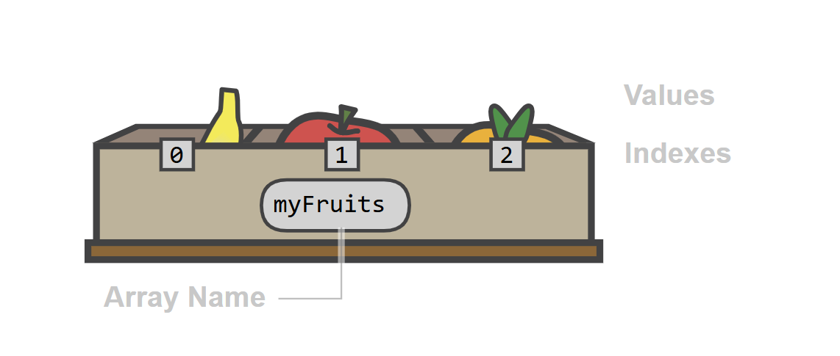
Definition of Array
Arrays are made for storing many values together.

Slide 5
Definition of Array
In C++, an array is a variable that can store multiple values of the same type.
An array used in programming to store a collection of elements, typically of the same data type, under a single variable name. These elements are stored in contiguous (adjacent) memory locations, which allows for efficient, direct access to any element using its numerical index.

Slide 6
Definition of Array
Why using array?
Arrays make it easier to work with groups of values compared to using a separate variable for each value.
For example:
    x=3; y=7; z=9;
Instead, we will use array:
  myNumbers = [3, 7, 9]

Slide 7
Types of Array
In programming, arrays have many types, such as:
One-dimensional Array: Stores elements in a single line and accessed using one index (arr[i]).
Two-dimensional Array: Stores data in rows and columns (table form) and accessed using two indices (arr[i][j]). Used for tables, grids, matrices
Multi-Dimensional Array: Array with more than two dimensions (3D, 4D…). Used in advanced applications (graphics, simulations)

Slide 8
Declaration of one-dimensional array
In programming, arrays have many types, such as:
To declare an array in C++, we must specify the type of the elements and the number of elements required by an array as follows:
type arrayName [ arraySize ];
The arraySize must be an integer constant greater than zero and type can be any valid C++ data type.

Slide 9
Declaration of one-dimensional array
In programming, arrays have many types, such as:
To declare an array in C++, we must specify the type of the elements and the number of elements required by an array as follows:
    type arrayName [ arraySize ];
The arraySize must be an integer constant greater than zero and type can be any valid C++ data type.

Slide 10
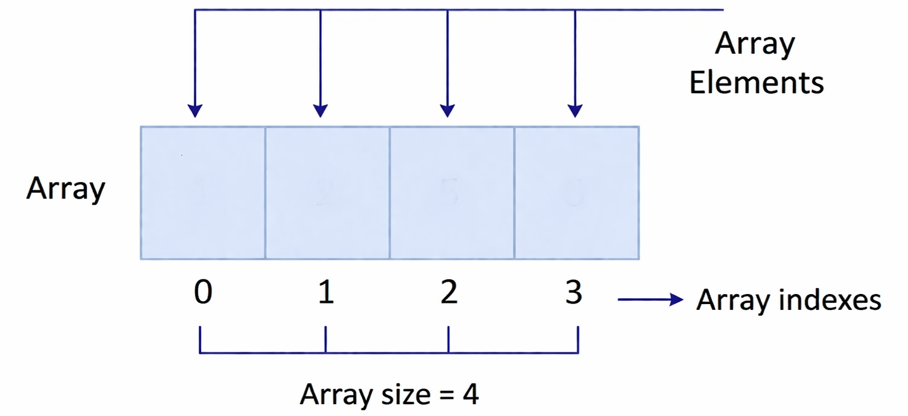
Declaration of one-dimensional array
For example:
Int myArray[4];
Note: the first index in array always starts with 0.

Slide 11
Initializing one-dimensional array
In C++ there are different ways for array initialization, as the following:
Initialization with Assignment Statements: Individual array elements can be initialized during program execution using assignment statements. For example:
      myArray[0] = 8
      myAarray[1] = 12;

Slide 12
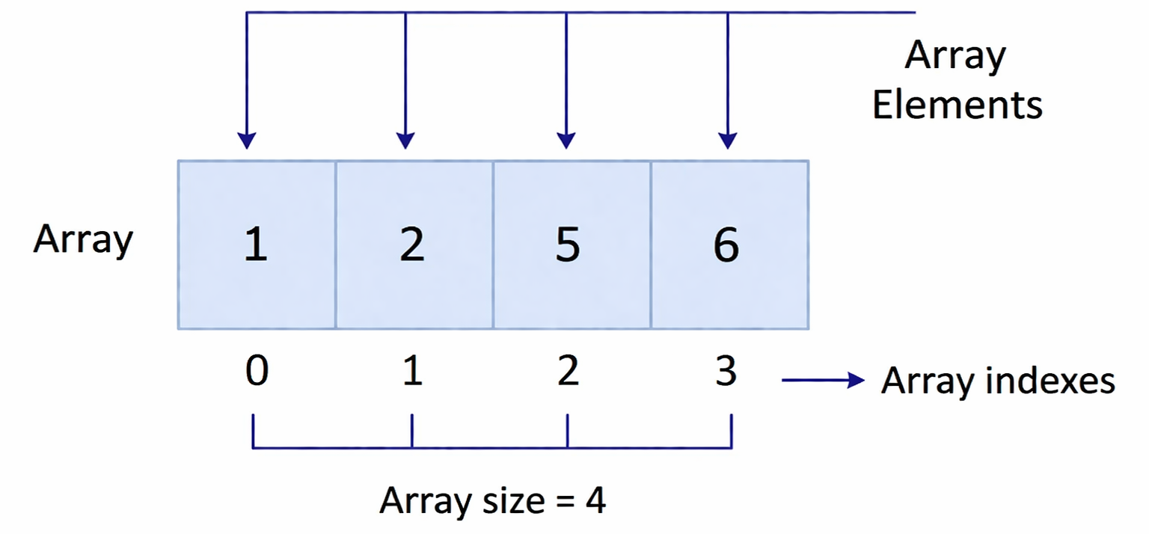
Initializing one-dimensional array
In C++ there are different ways for array initialization, as the following:
2. Initialization at Declaration: in this method assign values when declaring the array. For example:
int myArray[4] = {1, 2, 5, 6};

Slide 13
Initializing one-dimensional array
In C++ there are different ways for array initialization, as the following:
3. Size Omitted Initialization: initializing the array without determining the size, then the compiler automatically determines size.
    int myArray[] = {1, 2, 5, 6};
4. Special Cases for Initialization Lists:
    int A[5] = {0}; //all have zero

Slide 14
Initializing one-dimensional array
In C++ there are different ways for array initialization, as the following:
3. Size Omitted Initialization: initializing the array without determining the size, then the compiler automatically determines size.
    int myArray[] = {1, 2, 5, 6};
4. Special Cases for Initialization Lists:
    int A[5] = {0}; //all have zero

Slide 15
Accessing array elements
Array provides random access to its elements, which means that we can access any element of the array by providing the position of the element, means the index.
For example:
In this array int myArray[] = {1, 2, 5, 6}; if we out to print the value of index 3, then it will be:
int myArray[] = {1, 2, 5, 6};
cout myArray[3];
Output: 6

Slide 16
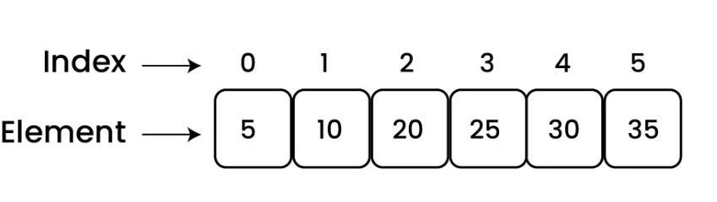
Examples
Example_1: Write C++ program to create an array with 6 elements as: 5, 10, 20, 25, 30, 35.
      #include <iostream>
      using namespace std;
      Int main(){
      Int arr[6] = {5, 10, 20, 25, 30, 35};
      return 0;
      }

Slide 17
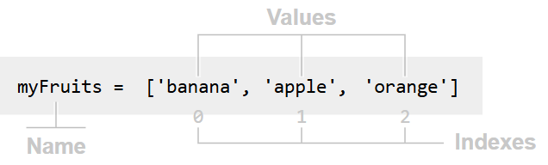
Examples
Example_1: Write C++ program to create an array for the following: banana, apple, orange.
      #include <iostream>
      using namespace std;
      Int main(){
      String myFruits[3] = {"banana","apple","orange"};
      return 0;
      }

Slide 18
Process array contents
Process array contents means performing operations on the elements of an array. This includes reading, printing, modifying, or calculating values (like sum or average).
Processing includes:
Display all elements
Find sum or average
Search for a value
Update elements

Slide 19
Process array contents
Example: Display all elements
  # include <iostream>
  using namespace std;
  int main() {
  int myNumbers[] = {10, 20, 30, 40, 50};
  // Print all the elements of the array
  int length = sizeof(myNumbers) / sizeof(myNumbers[0]);
  cout << "Array elements: ";
  for (int i = 0; i < length; i++) {
  cout << myNumbers[i] << " ";
  }
  return 0;
  }

Slide 20
Process array contents
Example: Find sum or average
  # include <iostream>
  using namespace std;
  int main() {
int arr[3] = {1, 2, 3};
int sum = 0;
for(int i = 0; i < 3; i++)
sum += arr[i];
cout << sum;
return 0;
}

Slide 21
Process array contents
Example: Find sum or average
  # include <iostream>
  using namespace std;
  int main() {
int arr[3] = {1, 2, 3};
int sum = arr[0] + arr[1] + arr[2];
cout << sum / 3.0;
return 0;
}

Slide 22
Process array contents
Example: Search for a value
  # include <iostream>
  using namespace std;
  int main() {
int arr[3] = {1, 2, 3};
if (arr[1] == 2)
cout << “Correct";
return 0;
}

Slide 23
Process array contents
Example: Update elements
  # include <iostream>
  using namespace std;
  int main() {
int arr[3] = {1, 2, 3};
arr[0] = 10;
cout << arr[0];
return 0;
}

Slide 24
Size of arrays
The size of an array refers to the number of elements it can store. Array size is fixed, meaning their size is determined at creation time and cannot be changed during program execution. For knowing the size of array, we can use: sizeof(array)
For example:
    int arr[] = {1,2,3,4,5};
    int size = sizeof(arr) / sizeof(arr[0]);
    cout << size;

Slide 25
Input Array elements
To input elements into an array, loop can be used to iterate through each index of the array and assign values, which can be done at declaration time or dynamically from user input.

Slide 26
Input Array elements
#include <iostream>
using namespace std;
int main() {
int arr[4];
// Input elements
cout << "Enter 4 elements:\n";
for (int i = 0; i < 4; i++) {
cin >> arr[i];
}
// Display elements
cout << "You entered:\n";
for(int i = 0; i < 4; i++) {
cout << arr[i] << " ";
}
return 0;
}

Slide 27
String arrays
Arrays can be any data types, the following exampls are arrays with string data type:
#include <iostream>
using namespace std;
int main() {
string names[3] = {"Ari", "Sara", "John"};
for(int i = 0; i < 3; i++) {
cout << names[i] << endl;
}
return 0;
}

Slide 28
String arrays
#include <iostream>
using namespace std;
int main() {
string names[3];
cout << "Enter 3 names:\n";
for (int i = 0; i < 3; i++) {
cin >> names[i];
}
cout << "Names are:\n";
for (int i = 0; i < 3; i++) {
cout << names[i] << endl;
} return 0;
}

Slide 29
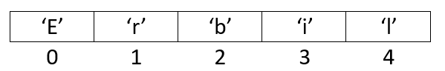
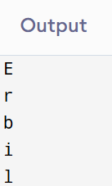
String arrays
What is you want to print the string element by element, for example:
#include <iostream>
using namespace std;
int main() {
string name="Erbil";
for (int i = 0; i<name.length(); i++) {
cout << name[i] << endl;
}
return 0;
}

Slide 30
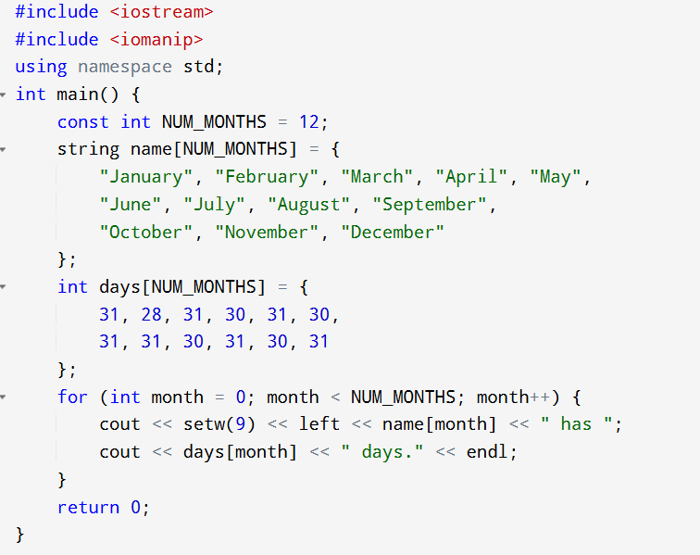
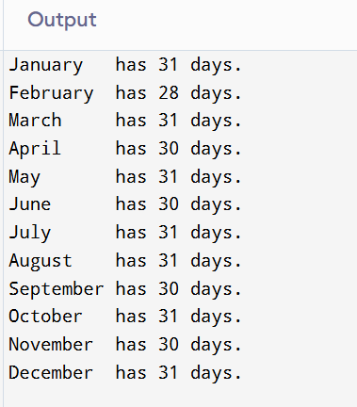
String arrays
Question: Write a C++ program that uses two arrays to store month names and their corresponding number of days, then prints only the months that have 31 days.

Slide 31
Copying arrays
Arrays are fixed-size collection, and the size cannot be changed, but we can copy an array to another array. For example:
  Input:
  arr1 = {10, 20, 30, 40, 50, 60}
  Output:
  arr2: {10, 20, 30, 40, 50, 60}
Example:
  int array-1[]= {4, 7, 8};
  Int array_2[3];
  array-1=array-2; NOT ALLOWED

Slide 32
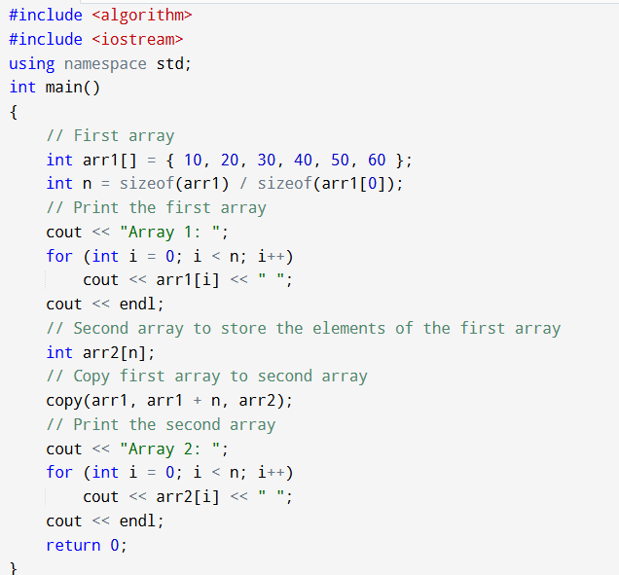
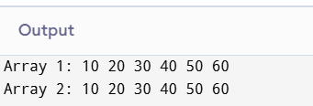
Copying arrays

Slide 33
Searching in arrays
Searching means finding a specific value inside an array.
How it works:
Compare the target value with each element
Stop when the value is found
If not found, report “not found”

Slide 34
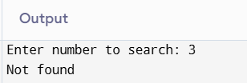
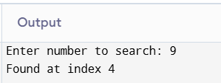
Searching in arrays
#include <iostream>
using namespace std;
int main() {
int arr[5] = {1, 2, 5, 6, 9};
int key;
bool found = false;
cout << "Enter number to search:";
cin >> key;
for (int i = 0; i < 5; i++) {
if (arr[i] == key) {
cout << "Found at index " << i << endl;
found = true;
break;
}
}
if (!found) {
cout << "Not found";
}
return 0;
}

Slide 35
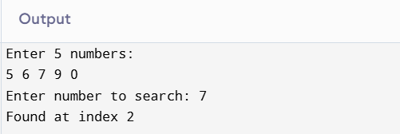
Searching in arrays
Example: search for an input inserted by user
#include <iostream>
using namespace std;
int main() {
int arr[5];
int key;
bool found = false;
// Input array elements
cout << "Enter 5 numbers:\n";
for(int i = 0; i < 5; i++) {
cin >> arr[i];
}
// Input value to search
cout << "Enter number to search: ";
cin >> key;
// Search
for(int i = 0; i < 5; i++) {
if (arr[i] == key) {
cout << "Found at index " << i;
found = true;
break;
}
}
if(!found) {
cout << "Not found";
}
return 0;
}

Slide 36
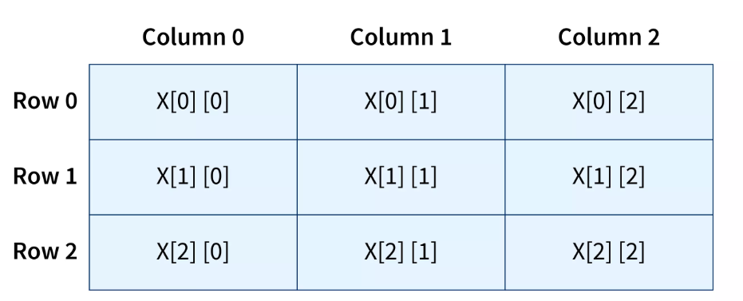
Two-dimensional arrays
The simplest form of the multidimensional array is the two-dimensional array.
The two-dimensional array in C++ is an array of arrays.
Visualizing the two-dimensional array in C++ is as a matrix. The data inside the two-dimensional array in C++ can be visualized as a table (row-column manner).
To declare a two-dimensional integer array of size x,y, you would write something as follows:
    type arrayName [ x ][ y ];

Slide 37
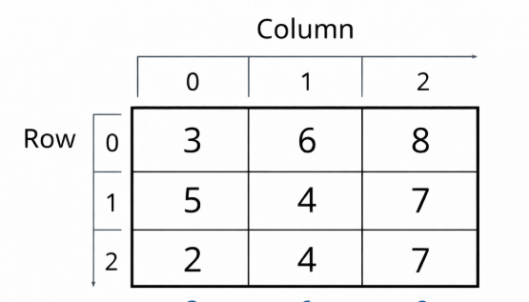
Declaration and Initiation of Two-dimensional arrays
We can visualize the two-dimensional array in C++ as a matrix. The data inside the two-dimensional array in C++ can be visualized as a table (row-column manner).
      int two_d_array[10][5]
Initialize an array at the time of declaration:
      int myArray[3][3] = {
      {3, 6, 8},
      {5, 4, 7},
      {2, 4, 7}};

Slide 38
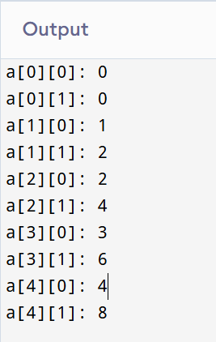
Accessing Two-Dimensional Array Elements
An element in 2-dimensional array is accessed by using the subscripts, means, row index and column index of the array. For example:
  #include <iostream>
  using namespace std;
  int main () {
  // an array with 5 rows and 2 columns.
  int a[5][2] = { {0,0}, {1,2}, {2,4}, {3,6},{4,8}};
  // output each array element's value
  for ( int i = 0; i < 5; i++ )
  for ( int j = 0; j < 2; j++ ) {
  cout << "a[" << i << "][" << j << "]: ";
  cout << a[i][j]<< endl;
  }
  return 0;
  }

Slide 39
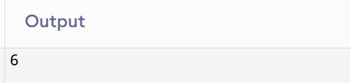
Accessing Two-Dimensional Array Elements
Example:
  #include <iostream>
  using namespace std;
  int main () {
  int arr[2][3] = {
  {1, 2, 3},
  {4, 5, 6}
  };
  cout << arr[1][2]; // Output: 6
  return 0;
  }

Slide 40
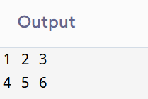
Accessing Two-Dimensional Array Elements
Question: Write a C++ program that declares a 2D array of size 2×3 and prints all its elements using nested loops. The output should be displayed in matrix form (rows and columns).
  #include <iostream>
  using namespace std;
  int main() {
  int arr[2][3] = {
  {1, 2, 3},
  {4, 5, 6}
  };
  // Print 2D array
  for(int i = 0; i < 2; i++) {
  for(int j = 0; j < 3; j++) {
  cout << arr[i][j] << " ";
  }
  cout << endl;
  }
  return 0;
  }

Slide 41
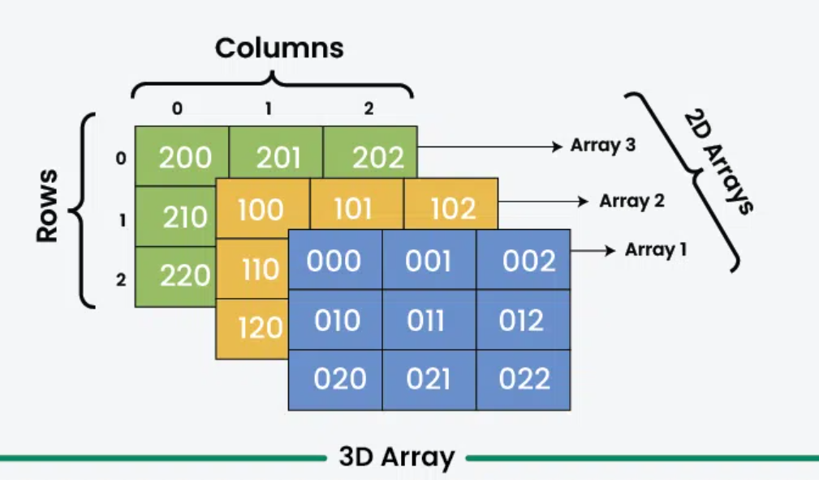
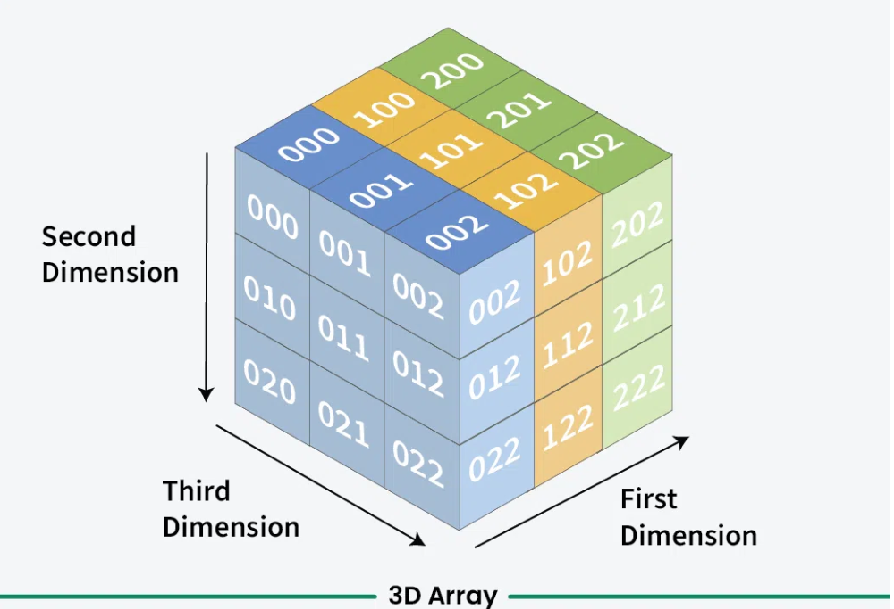
Three-Dimensional Arrays
In C++, a three-dimensional (3D) array is a multidimensional array that can be visualized as a collection of two-dimensional (2D) arrays stacked together, forming a cuboid structure.

Slide 42
Declaration and Initialization of Three-Dimensional Arrays
Declaration:
To declare a 3D array, you specify the data type, the name of the array, and three dimensions (size1, size2, and size3):
  data_type arrayName[x][y][z];
x: Number of 2D arrays (layers or blocks).
y: Number of rows in each 2D array.
z: Number of columns in each row.

Slide 43
Declaration and Initialization of Three-Dimensional Arrays
Initialization:
You can initialize a 3D array using nested braces for better readability or a flat list of values.
Nested Braces (Recommended): Groups values by layer and row.
  int arr[2][2][3] = {
  { {1, 2, 3}, {4, 5, 6} }, // First 2D layer
  { {7, 8, 9}, {10, 11, 12} } // Second 2D layer
  };

Slide 44
Declaration and Initialization of Three-Dimensional Arrays
2. Flat Initialization: Values are assigned sequentially across dimensions.
  int arr[2][2][3] = {1, 2, 3, 4, 5, 6, 7, 8, 9, 10, 11, 12};
3. Zero Initialization: Setting all elements to zero.
    int arr[2][2][3] = {0};

Slide 45
Declaration and Initialization of Three-Dimensional Arrays
2. Flat Initialization: Values are assigned sequentially across dimensions.
  int arr[2][2][3] = {1, 2, 3, 4, 5, 6, 7, 8, 9, 10, 11, 12};
3. Zero Initialization: Setting all elements to zero.
    int arr[2][2][3] = {0};

Slide 46
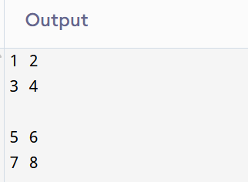
Declaration and Initialization of Three-Dimensional Arrays
Example:
#include <iostream>
using namespace std;
int main() {
int arr[2][2][2] = {
{
{1, 2},
{3, 4}
},
{
{5, 6},
{7, 8}
}
};
// Print all elements
for(int i = 0; i < 2; i++) {
for(int j = 0; j < 2; j++) {
for(int k = 0; k < 2; k++) {
cout << arr[i][j][k] << " ";
}
cout << endl;
}
cout << endl;
}
return 0;
}

Slide 47
Thank you

