Slide 1

Fundamental Programming II
Lecture_3
Dr. Hazha Saeed Yahia
hazha.yahia@tiu.edu.iq

Slide 2
Outline
Local and Global variables

Slide 3
Default Arguments in Functions
A default argument is a value provided for a parameter in a function declaration that is automatically assigned by the compiler if no value is provided for those parameters in the function call.
Default arguments must be present on the right side only. Once a default argument is provided, all the arguments to its right must also be defaults.
It is recommended to specify them in function declaration (usually in the header).

Slide 4
Default Arguments in Functions
#include <iostream>
using namespace std;
void myFunction(int a = 10){
cout << a << endl;
}
int main(){
f();
f(221);
return 0;
} Output:
10
221
Explanation: In this program, the function f has a default argument a = 10, so when no argument is provided, a defaults to 10, which is printed. When 221 is passed, a becomes 221 which is then printed.

Slide 5
Default Arguments in Functions
// This program demonstrates the use of default function arguments.
#include <iostream>
using namespace std;
void myFunction(int a = 10, int b = 1) {
cout << "a= " << a << endl;
cout << "b= " << b << endl;
}
int main() {
myFunction(); // a & b use defaults (10 & 1)
cout << endl;
myFunction(5); // a = 5, b uses default value 1
cout << endl;
myFunction(7, 3); // a = 7, b = 3. No defaults used.
return 0;
}

Slide 6
Default Arguments in Functions
Multiple Parameters
Inside the function, you can add as many parameters as you want:
#include <iostream>
using namespace std;
void myFunction(string fname, int age) {
cout << fname << " LastName. " << age << " years old. \n";
}
int main() {
myFunction("Liam", 3);
myFunction("Jenny", 14);
myFunction("Anja", 30);
return 0;
}
Output:
// Liam LastName. 3 years old.
// Jenny LastName. 14 years old.
// Anja LastName. 30 years old.

Slide 7
Function Overloading
Function overloading in C++ is a concept that allows two or more functions to have different logic but a common function name. To overload functions, they must have a different set of parameters, either parameters of different data types or a different number of parameters in the function definition.
Functions with different return types and identical parameters can not be overloaded. The determination to call a particular function is decided at compile time. Function overloading not only improves code readability and reusability but also speeds up code and reduces memory space.
For example:
int myFunction(int x)
float myFunction(float x)
double myFunction(double x, double y)

Slide 8
Function Overloading
How Does Function Overloading Work?
Function overloading must have:
The same function name is used for more than one function definition.
Overloaded functions must have different parameters. This difference can be created using a different number of function parameters or parameters of different data types in function definitions.
Rules Of Function Overloading in C++:
For the overloading function to work correctly, each function's parameters must be unique. The approaches mentioned above can create this uniqueness in function arguments.

Slide 9
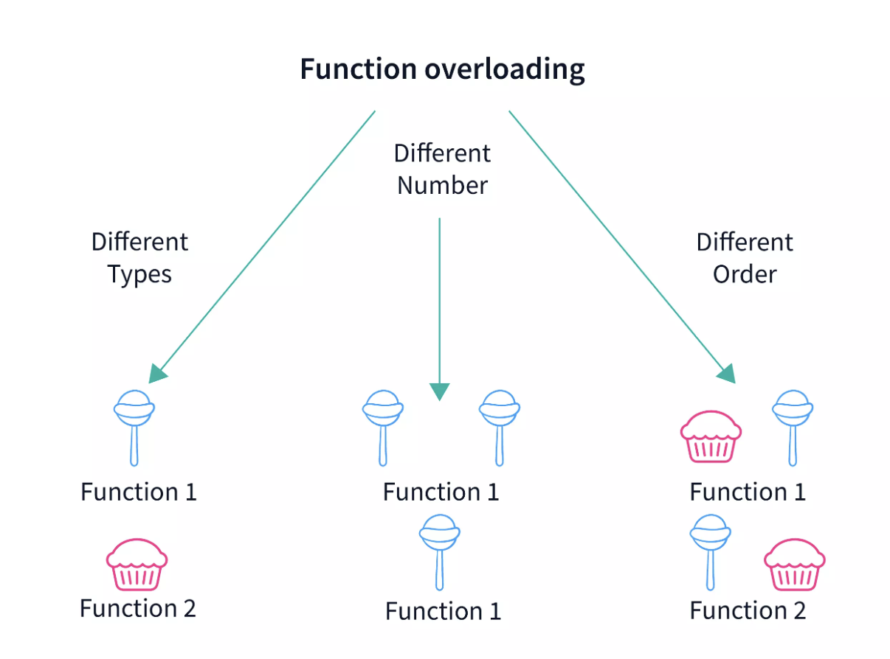
Function Overloading
How Does Function Overloading Work?

Slide 10
Function Overloading
1. Functions have Different Parameter Types: Every function can have arguments of different data types. For example :
    // Function is overloaded with different types of parameters.
    int multiple(int a) {} int multiply(double a) {}
2. Different Number of Parameters: Functions can have different numbers of parameters for the compiler to differentiate between them, like
    // Function overloaded with a different number of parameters.
    int sum(int a, int b) {} int sum(int a, int b, int c) {}
3. Functions Have Different Combinations of Arguments: Two or more functions can be overloaded if they have the same arguments but in different combinations, for example :
    // Function is overloaded with different combinations of parameters.
    int divide(int a, float b) {} int divide(float a, int b) {}

Slide 11
Function Overloading
// Function with the same name and different arguments.
int area(int a) {
// Function with one integer parameter.
}
int area(int a, int b) {
// Function with two integer parameters.
}
double area(double a) {
// Function with one parameter of type double.
}
double area(float a, float b) {
// Function with two parameters of type double.
}

Slide 12
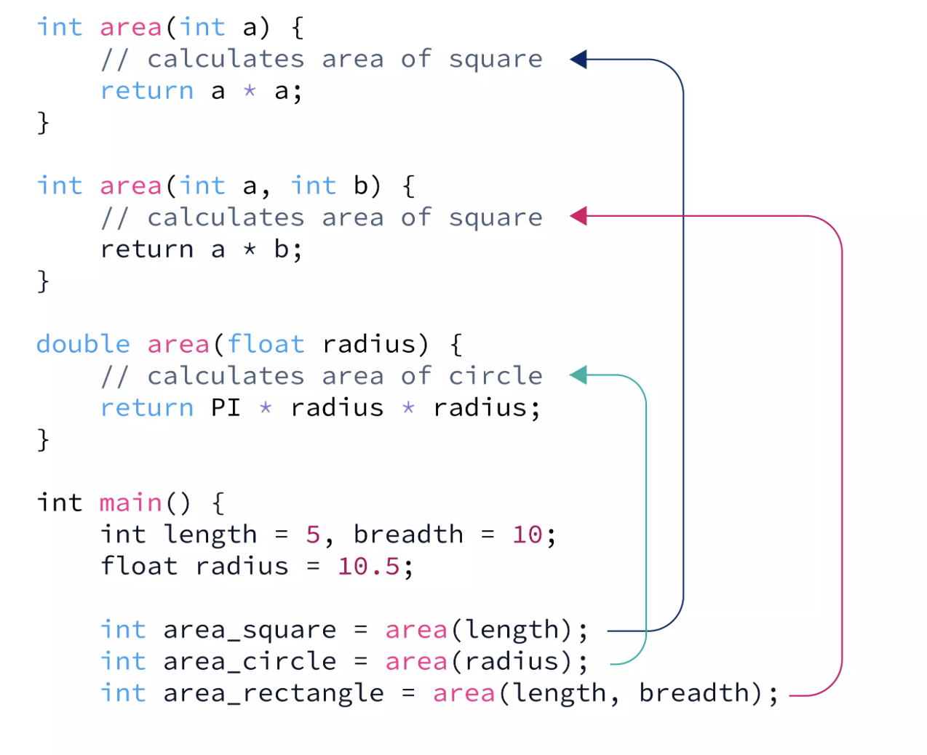
Function Overloading
Example_1: Function to calculate different area:
Suppose we want to create a function to calculate the area of different geometric figures. It makes more sense to have a

Slide 13
Function Overloading
#include <iostream>
#define PI 3.14
int area(int a) {
// Calculates the area of a square.
// Function takes one integer parameter.
return a * a;
}
int area(int a, int b) {
// Calculates the area of a rectangle.
// Function takes two integer parameters.
return a * b;
}
double area(float radius) {
// Calculates the area of a circle.
// Function takes one floating-point parameter.
return PI * radius * radius;
}
int main() {
int length = 5, breadth = 10;
float radius = 10.5;
// Calling function area with different arguments.
int area_square = area(length);
double area_circle = area(radius);
int area_rectangle = area(length, breadth);
printf("Area of square (length = %d) = %d\n", length, area_square);
printf("Area of rectangle (length = %d, breadth = %d) = %d\n", length, breadth, area_rectangle);
printf("Area of circle (length = %.2f) = %lf\n", radius, area_circle);
return 0;
}

Slide 14
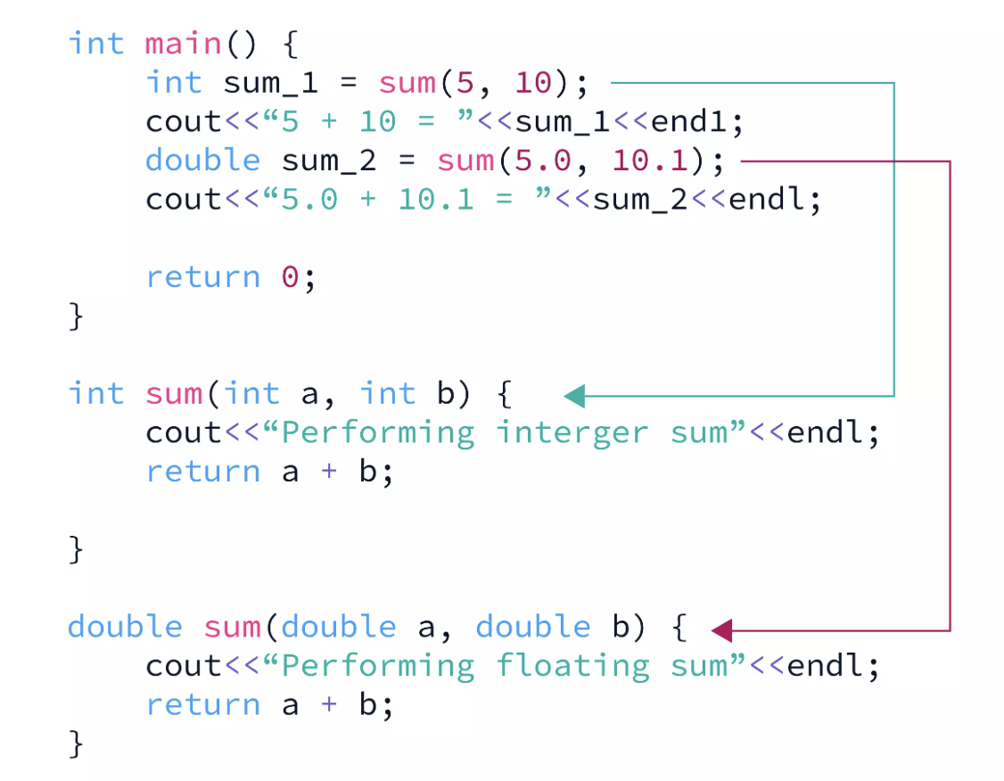
Function Overloading
Example_2: Overloading Using Different Types of Parameters:
Functions can be overloaded when overloaded functions have parameters with different data types. Parameters with different data types help the compiler differentiate between several functions having a common name, and hence, they are one of the correct ways to overload functions in C++. Let us understand this with an example :

Slide 15
Function Overloading
#include<iostream>
using namespace std;
int sum(int a, int b) {
// Function 'sum' takes two integer numbers as parameters.
cout<<"Performing integer sum"<<endl;
return a + b;
}
double sum(double a, double b) {
// This function sum takes two numbers of type double as parameters.
cout<<"Performing floating sum"<<endl;
return a + b;
}
int main() {
// Creating function call to perform integer summation.
int sum_1 = sum(5, 10);
cout<<"5 + 10 = "<<sum_1<<endl;
// Creating function call to perform floating-point summation.
double sum_2 = sum(5.0, 10.1);
cout<<"5.0 + 10.1 = "<<sum_2<<endl;
return 0;
}

Slide 16
Function Overloading
Example_3:
#include <iostream>
using namespace std;
int plusFuncInt(int x, int y) {
return x + y;
}
double plusFuncDouble(double x, double y) {
return x + y;
}
int main() {
int myNum1 = plusFuncInt(8, 5);
double myNum2 = plusFuncDouble(4.3, 6.26);
cout << "Int: " << myNum1 << "\n";
cout << "Double: " << myNum2;
return 0;
}

Slide 17
Local and Global Variables
We Learned that in a program, the basic unit of storage is a variable. It is a name given to a location in memory that stores some data. While program execution, we can change the value stored in a variable.
Now, What is variable Scope?
The scope of a variable in programming is the range of visibility, out of which the variable cannot be accessed.
Variables declared inside main() in C++ cannot be accessed from outside it. A variable’s scope is confined to the curly braces that contain it; attempting to access it from outside will result in a compilation error.
Variables in C++ can be one of two types, depending on their scope:
    Local variables
    Global variables

Slide 18
Local and Global Variables
First: Local variables
Local variables are variables that are declared within a function or code block. They can only be used by statements that are included within that function or block. They do not exist outside that function or block.
Initializing Local Variables: When we define a local variable, we need to initialize it. The system does not auto initialize it.

Slide 19
Local and Global Variables
First: Local variables
#include <iostream>
using namespace std;
void fun() {
int total = 100; //Local to fun()
cout<<total;
}
int main() {
cout<<"Total = "<<total;
return 0;
}
Output: Compilation error

Slide 20
Local and Global Variables
First: Local variables
#include <iostream>
using namespace std;
void fun() {
int total = 100; //Local to fun()
cout<<total;
}
int main() {
cout<<"Total = ";
fun();
return 0;
}

Slide 21
Local and Global Variables
Second: Global variables
Global variables are accessible from anywhere in the program. These are available until the lifetime of the program ends. These variables are normally defined at the top, outside all functions and blocks.
Initializing Global Variables: While defining a global variable if we do not assign any value to it, it is initialized by the system automatically. The values assigned are:

Slide 22
Local and Global Variables
Second: Global variables
#include <iostream>
using namespace std;
int g = 15; //global variable
int main() {
cout<<"Value of global variable = "<<g<<endl;
g*=2;
cout<<"Modified value of global variable = "<<g;
return 0;
}

Slide 23
Naming Variables
If you operate with the same variable name inside and outside of a function, C++ will treat them as two separate variables; One available in the global scope (outside the function) and one available in the local scope (inside the function):
However, you should avoid using the same variable name for both globally and locally variables as it can lead to confusion.
Example_1:
The function will print the local x, and then the code will print the global x:

Slide 24
Naming Variables
// Global variable x
int x = 5;
void myFunction() {
// Local variable with the same name as the global variable (x)
int x = 22;
cout << x << "\n"; // Refers to the local variable x
}
int main() {
myFunction();
cout << x; // Refers to the global variable x
return 0;
}

Slide 25
Naming Variables
Example_2:
// Global variable x
int x = 5;
void myFunction() {
cout << ++x << "\n"; // Increment the value of x by 1 and print it
}
int main() {
myFunction();
cout << x; // Print the global variable x
return 0;
}
// The value of x is now 6 (no longer 5)

Slide 26
Naming Variables
Local Variables | Global Variables
Limited to the block of code | Accessible throughout the program
Typically within functions or specific blocks | Outside of any function or block
Accessible only within the block where they are declared | Accessible from any part of the program
Created when the block is entered and destroyed when it exits | Retain their value throughout the lifetime of the program
Can have the same name as variables in other blocks | Should be used carefully to avoid unintended side effects
Temporary storage, specific to a block of code | Values that need to be accessed and modified by multiple parts of the program

Slide 27
Other Variables in C++
1. Static variables:
Static variables are defined using the static keyword. These retain their value even when they are no longer in use.
They are only initialized once and exist till the program is terminated.
They are local to the function in which they are defined.
Default initial value of a static variable is 0.

Slide 28
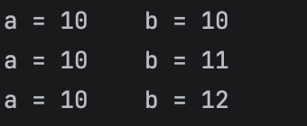
Other Variables in C++
#include <iostream>
using namespace std;
void sfun() {
int a = 10;
static int b = 10;
cout<<"a = "<<a++<<" ";
cout<<"b = "<<b++<<endl;
}
int main() {
for(int i=0; i<3; i++) {
sfun();
}
return 0;
}

Slide 29
Other Variables in C++
Explanation:
Variable a
int a = 10;
This is a normal local variable.
It is created every time the function runs
It is destroyed when the function ends
So every time: a starts again from 10
Variable b
static int b = 10;
This is a static local variable.
It is created ONLY ONCE
It keeps its value between function calls
So:
  first call: b = 10
  second call: b = 11
  third call: b = 12

Slide 30
Other Variables in C++
2. Automatic variables:
Using the auto keyword, the data type of a variable is automatically deducted by the compiler from the value assigned to it.
Scope of auto variables is local to the function in which they are defined. Their default initial value is garbage value.
For example:
    auto n = 10;
    auto word = “TechVidvan”;

Slide 31

Other Variables in C++
2. Automatic variables:
#include <iostream>
using namespace std;
void test() {
auto int x = 10; // auto variable
cout << "x = " << x << endl;
}
int main() {
test();
test();
return 0;
}

Slide 32
Other Variables in C++
3. External variables:
The extern keyword simply indicates that the variable is defined outside of the block in which it is being used.
It is a global variable that is declared and initialized to be used somewhere else.
The key purpose of extern variables is that they can be accessible from two separate files inside a larger program.
Their default initial value is 0.

Slide 33
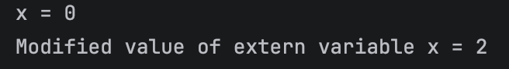
Other Variables in C++
3. External variables:
#include <iostream>
using namespace std;
int x;
void efun() {
extern int x; //Indicating that x is defined elsewhere
x = 2; //Modifying the value of x
cout<<"Modified value of extern variable x = "<<x;
}
int main() {
cout<<"x = "<<x<<endl;
efun();
return 0;
}

Slide 34
Thank you

