Slide 1
Depressive disorders
M.Sc. Hilal Farouq Hussein
7th 05 2026

Slide 2
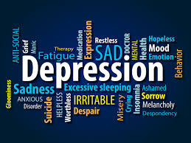

Slide 4
Objectives
What is Depression?
How can we recognize it?
How can we apply nursing care as nurse for depressive cases

Slide 5
Mood disorders
Mood disorders, also called affective disorders, are pervasive alterations in emotions that are manifested by depression, mania, or both.

Slide 6
What is Depression?
Nearly everyone has felt depressed, sad, or down in the dumps at one time or another.
Feeling depressed can be a normal reaction to a stressful event, such as when one suffers a loss or endures another of life’s various struggles or stresses. Typically after time our mood begins to lift and we can move on.
Depression is a serious medical condition that affects your behaviour, your thinking, your emotions and physical health over time.
While feeling down only lasts for a short while, depression affects you for at least 2 weeks and affects your everyday life and ability to function.
It can vary from mild to severe and can have a profound impact, affecting every aspect of the individual, their relationships, family and work life.

Slide 7
Classification of Mood disorders
Mood disorders
Bipolar I
Unipolar Bipolar
MDD Dysthymia Bipolar II

Slide 8
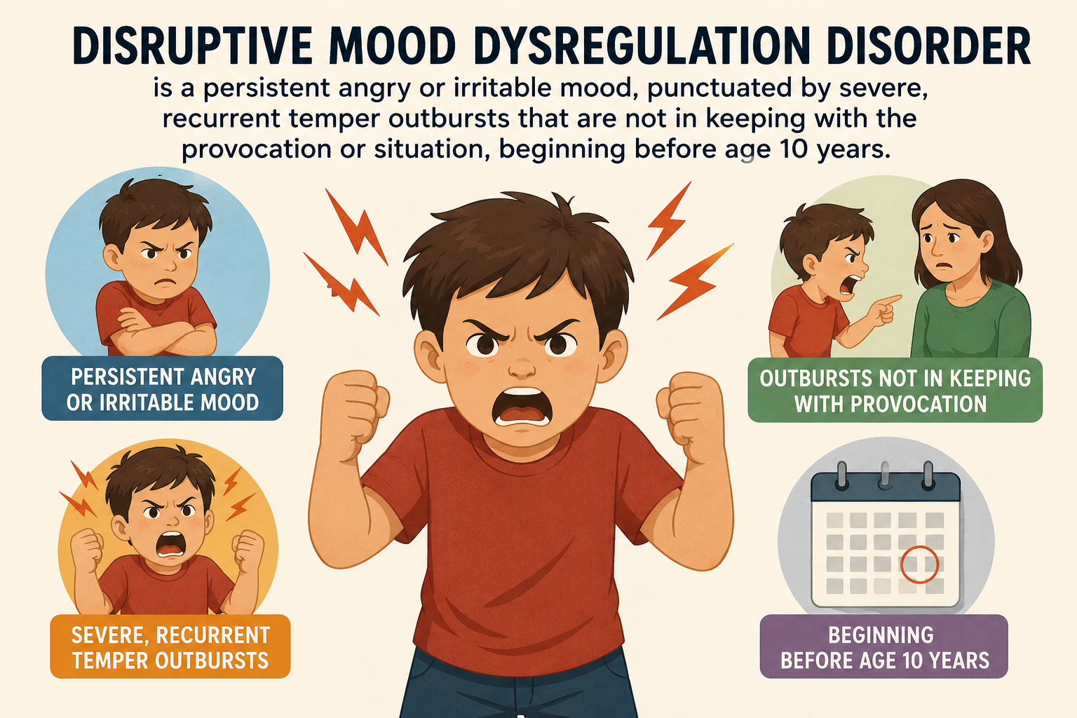
Other disorders classified with similarities to mood disorders include the following:
Disruptive mood dysregulation disorder is a persistent angry or irritable mood, punctuated by severe, recurrent temper outbursts that are much bigger than the situation deserves, beginning before age 10 years.

Slide 9
Other disorders classified with similarities to mood disorders include the following:
Cyclothymic disorder is characterized by mild mood swings between hypomania and depression without loss of social or occupational functioning.
Substance-induced depressive or bipolar disorder
Seasonal affective disorder

Slide 11
Major Depressive Disorder Diagnostic Criteria
A. Five (or more) of the following symptoms have been present during the same 2-week period and represent a change from previous functioning; at least one of the symptoms is either (1) depressed mood or (2) loss of interest or pleasure.
1. Depressed mood most of the day, nearly every day, as indicated by either subjective report (e.g., feels sad, empty, hopeless) or observation made by others (e.g., ‘appears tearful). (Note: In children and adolescents, can be irritable mood.)

Slide 12
Major Depressive Disorder Diagnostic Criteria
2. Markedly diminished interest or pleasure (anhedonia )in all, or almost all, activities most of the day, nearly every day (as indicated by either subjective account or observation).
3. Significant weight loss when not dieting or weight gain (e.g., a change of more than 5% of body weight in a month), or decrease or increase in appetite nearly every day. (Note: In children, consider failure to make expected weight gain.)
4. Insomnia or hypersomnia nearly every day.
5. Psychomotor agitation or retardation nearly every day.

Slide 13
Major Depressive Disorder Diagnostic Criteria
6. Fatigue or loss of energy nearly every day.
7. Feelings of worthlessness or excessive or inappropriate guilt (which may be delusional) nearly every day.
8. Diminished ability to think or concentrate, or indecisiveness, nearly every day (either by subjective account or as observed by others).
9. Recurrent thoughts of death (not just fear of dying), recurrent suicidal ideation without a specific plan, or a suicide attempt or a specific plan for committing suicide.

Slide 14
Major Depressive Disorder Diagnostic Criteria
B. The symptoms cause clinically significant distress or impairment in social, occupational, or other important areas of functioning.
C. The episode is not attributable to the physiological effects of a substance or to another medical condition.

Slide 15
Major Depressive Disorder Diagnostic Criteria
D. The occurrence of the major depressive episode is not better explained by schizoaffective disorder, schizophrenia, schizophreniform disorder, delusional disorder, or other specified and unspecified schizophrenia spectrum and other psychotic disorders.
E. There has never been a manic episode or a hypomanic episode.

Slide 16
Severity of MDD
1. Mild
2. moderate
3. Severe

Slide 17
Prevalence of MDD
in the United States is approximately 7%, with marked differences by age group such that the prevalence in 18- to 29-year-old individuals is threefold higher than the prevalence in individuals age 60 years or older.
Females experience 1.5- to 3 -fold higher rates than males beginning in early adolescence.

Slide 18
Comorbidity
Other disorders with which major depressive disorder frequently co-occurs are substance-related disorders, panic disorder, obsessive-compulsive disorder, anorexia nervosa, bulimia nervosa, and borderline personality disorder.

Slide 19
Persistent Depressive Disorder (Dysthymia) (chronic)
Diagnostic Criteria
A. Depressed mood for most of the day, for more days than not, as indicated by either subjective account or observation by others, for at least 2 years.
Note: In children and adolescents, mood can be irritable and duration must be at least 1 year.

Slide 20
Dysthymia = Diagnostic Criteria
B. Presence of two (or more) of the following:
1. Poor appetite or overeating.
2. Insomnia or hypersomnia.
3. Low energy or fatigue.
4. Low self-esteem.
5. Poor concentration or difficulty making decisions.
6. Feelings of hopelessness.

Slide 21
Dysthymia = Diagnostic Criteria
C. There has never been a manic episode or a hypomanic episode, and criteria have never been met for cyclothymic disorder.
D. The disturbance is not better explained by a persistent schizoaffective disorder, schizophrenia, delusional disorder, and other psychotic disorders.
E. The symptoms are not attributable to the physiological effects of a substance (e.g., a drug of abuse, a medication) or another medical condition (e.g. hypothyroidism).
F. The symptoms cause clinically significant distress or impairment in social, occupational, or other important areas of functioning.

Slide 22
Prevalence of Dysthymia
in the United States is approximately 0.5% for persistent depressive disorder.

Slide 23
Treatment of depression
1. PSYCHOTHERAPY
2. Antidepressant medication
3. ECT

Slide 24
Nursing care for depression
Provide for the safety of the client and others.
Institute suicide precautions if indicated.
Begin a therapeutic relationship by spending nondemanding time with the client.
Promote completion of activities of daily living by assisting the client only as necessary.
Establish adequate nutrition and hydration.
Promote sleep and rest.
Engage the client in activities.
Encourage the client to verbalize and describe emotions.
Work with the client to manage medications and side effects.

Slide 25
Nursing care for depression
Reorient the client to person, place, and time as indicated (call the client by name, tell the client your name, tell the client where he or she is, and so forth).
Spend time with the client.
If the client is ruminating, tell him or her that you will talk about reality or about the client’s feelings.
When approaching the client, use a moderate level tone of voice. Avoid being overly cheerful.
Use silence and active listening when interacting with the client. Let the client know that you are concerned and that you consider the client a worthwhile person.
When first communicating with the client, use simple, direct sentences; avoid complex sentences or directions.

Slide 26
Nursing care for depression
Allow (and encourage) the client to cry.
Teach the client about positive coping strategies and stress management skills, such as increasing physical exercise, expressing feelings verbally or in a journal, or méditation techniques. Encourage the client to practice this type of technique while in the hospital.
Teach the client about the problem-solving process: explore possible options, examine the consequences of each alternative, select and implement an alternative, and evaluate the results.

Slide 27
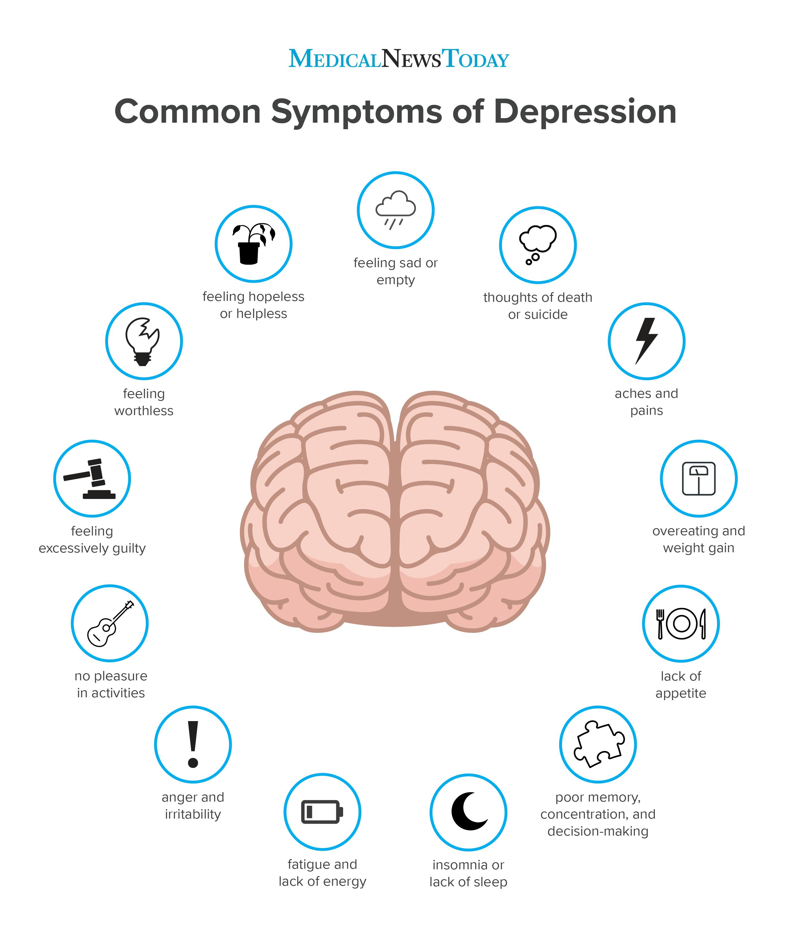

Slide 28
References
1. APA (2013) DSM-D. PP.155-171.
2. Sheila L. Videbeck (2017). PSYCHIATRIC –MENTAL HEALTH NURSING. 7 EDITION. P. 474- 505.

