Slide 1
Proteins
Notes:
با

Slide 2
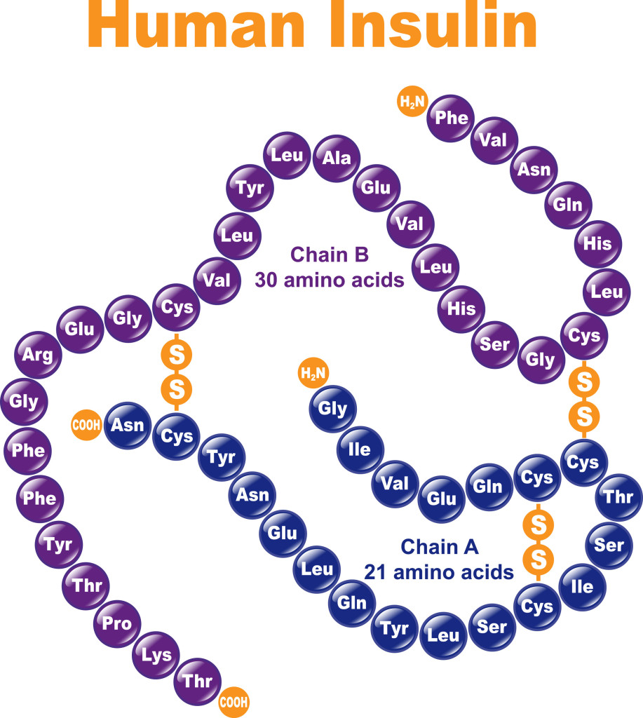
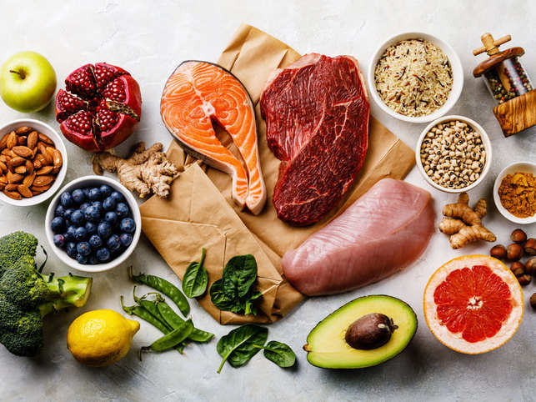
Protein
A protein molecule is very large compared with molecules of sugar or salt and consists of many amino acids joined together to form long chains.

Slide 3
AMINO ACIDS
Amino acids are known as the building blocks of protein. They perform many important functions such as: building cells, protecting the body from viruses or bacteria, repairing damaged tissue and carrying oxygen throughout the body

Slide 4
Types of amino acids
There are 20 different amino acids. Amino acids are linked together to form peptides, which are small chains of amino acids. The peptides are then linked together to form larger proteins

Slide 5
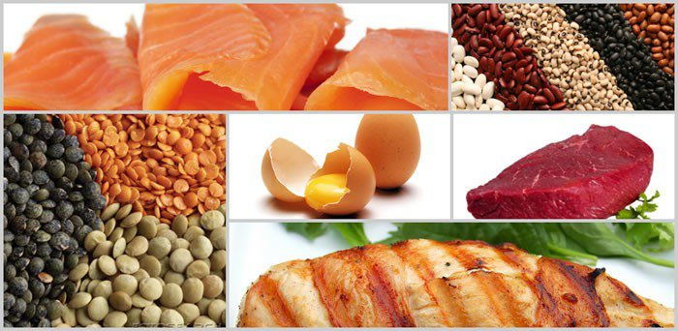
Types of amino acids
1) Essential Amino Acids –are those that are necessary for good health but cannot be produced by the body and so must be supplied in the diet.
Ex. Leucine, Isoleucine, Lysine, Valine Typtophan, Phenylalanine, Methionine threonin, Histidine

Slide 6
Types of amino acids
2) Non-Essential Amino Acids –are those that are produced by the body so not as necessary in the diet Ex. Aspartic Acid Tyrosine Glycine Cysteine, cyctine Arginine Glutamic Acid Glutamine Alanine Asparagine Proline

Slide 7
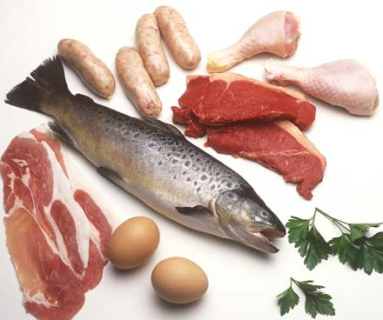
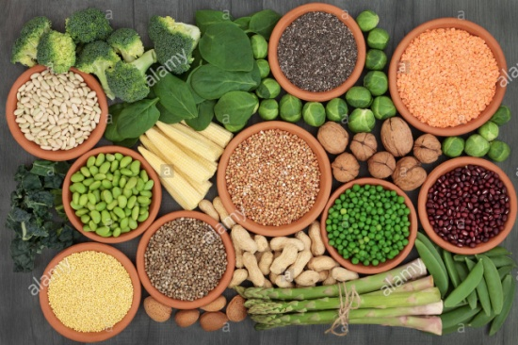
Complete and Incomplete Protein
Complete – contain all essential amino acid in sufficient quantities to supply the body’s need Sources: proteins from animals.
Incomplete – those deficient in one or more essential amino acids. Sources : Plant ( grains, legumes, seeds and nuts)

Slide 8
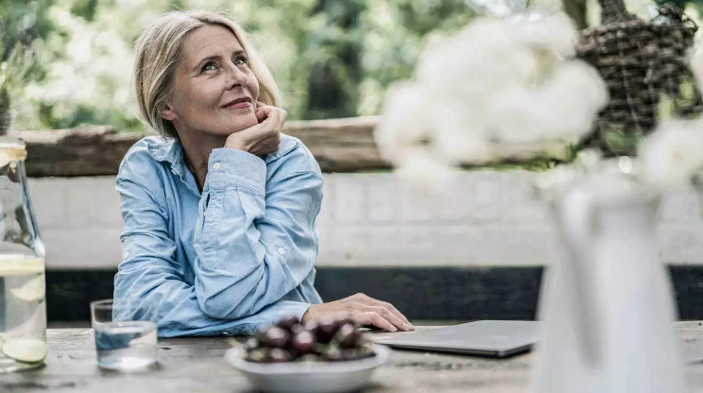
Functions of Proteins
1. Growth and Maintenance Your body needs protein for growth and maintenance of tissues.
Under normal circumstances, your body breaks down the same amount of protein that it uses to build and repair tissues. Other times, it breaks down more protein than it can create, thus increasing your body’s needs. This typically happens in periods of illness (injury and surgery) during pregnancy and while breastfeeding.

Slide 9
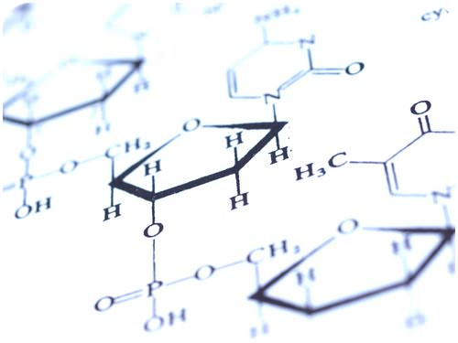
Functions of Proteins
2. Causes Biochemical Reactions
Enzymes are proteins that aid the thousands of biochemical reactions that take place within and outside of your cells
Bodily functions that depend on enzymes include
Digestion
Energy production
Blood clotting
Muscle contraction
Lack or improper function of these enzymes can result in disease

Slide 10
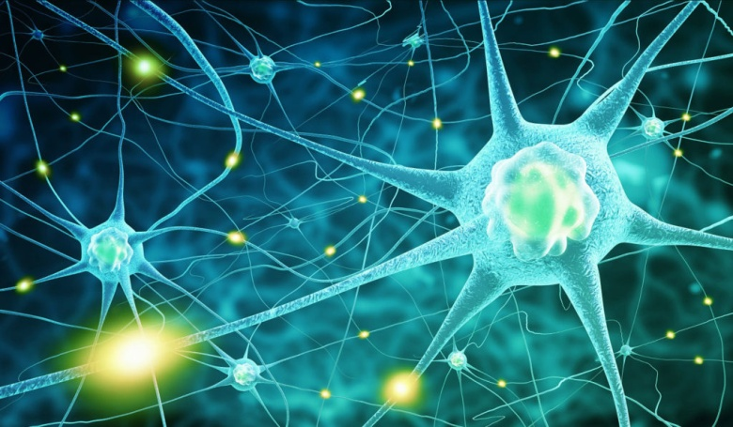
Functions of Proteins
3. Acts as a Messenger
Some proteins are hormones, which are chemical messengers that aid communication between your cells, tissues and organs. They’re made and secreted by endocrine tissues or glands and then transported in your blood to their target tissues.
Some examples include:
Insulin: Signals the uptake of glucose or sugar into the cell.
Glucagon: Signals the breakdown of stored glucose in the liver.
hGH (human growth hormone): Stimulates the growth of various tissues, including bone.
ADH (antidiuretic hormone): Signals the kidneys to reabsorb water.

Slide 11
Functions of Proteins
4. Provides Structure
Some proteins are fibrous and provide cells and tissues with stiffness and rigidity.
These proteins include keratin ( skin, hair and nails) , collagen (bones, tendons, ligaments and skin) and elastin ( uterus, lungs and arteries) which help form the connective framework of certain structures in your body

Slide 12
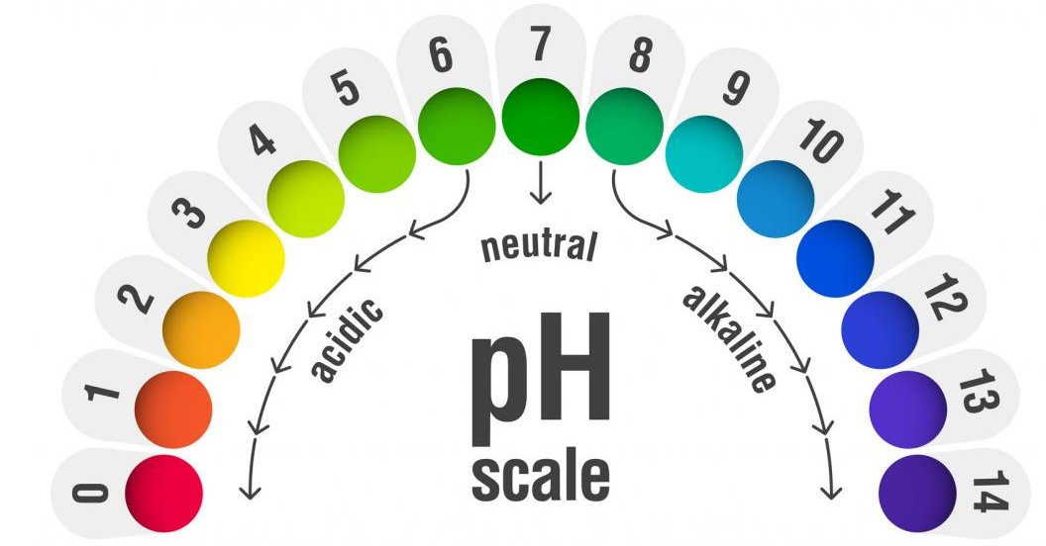
Functions of Proteins
5. Maintains Proper pH
One way your body regulates pH is with proteins. An example is hemoglobin, a protein that makes up red blood cells.
Hemoglobin binds small amounts of acid, helping to maintain the normal pH value of your blood.

Slide 13
Functions of Proteins
6. Balances Fluids
Albumin and globulin are proteins in your blood that help maintain your body’s fluid balance by attracting and retaining water.
If you don’t eat enough protein, your levels of albumin and globulin eventually decrease.
Consequently, these proteins can no longer keep blood in your blood vessels, and the fluid is forced into the spaces between your cells.
As the fluid continues to build up in the spaces between your cells, swelling or edema

Slide 14
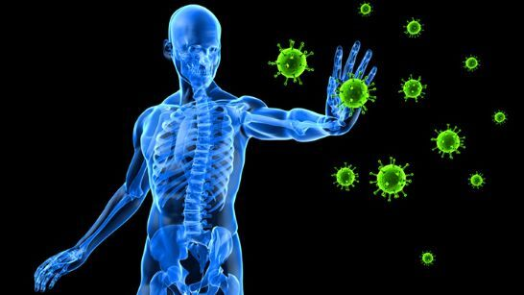
Functions of Proteins
7. Supports Immune Health
Proteins help form immunoglobulins, or antibodies, to fight infection.
Antibodies are proteins in your blood that help protect your body from harmful invaders like bacteria and viruses.
When these foreign invaders enter your cells, your body produces antibodies that tag them for elimination

Slide 15
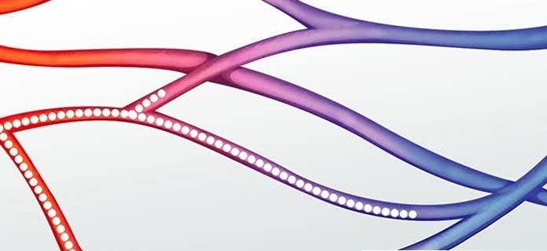
Functions of Proteins
8. Transports and Stores Nutrients
For example, hemoglobin is a protein that carries oxygen from your lungs to body tissues. Glucose transporters move glucose to your cells, while lipoproteins transport cholesterol and other fats in your blood

Slide 16
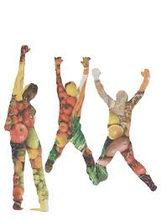
Functions of Proteins
Provides Energy
Proteins can supply your body with energy.
Protein contains four calories per gram, the same amount of energy that carbs provide. Fats supply the most energy, at nine calories per gram.
However, the last thing your body wants to use for energy is protein since this valuable nutrient is widely used throughout your body.

Slide 17
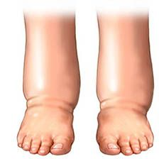
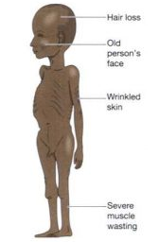
Health Complication Caused by Protein Deficiency
Oedema: Not getting enough protein can prompt oedema (liquid maintenance). This can cause swelling in various zones of the body, for example, the feet, hands and stomach.
Marasmus is a kind of protein inadequacy that can prompt weakness, muscle squandering, and lessened muscle versus fat levels and weight reduction and makes sufferers more helpless to infections

Slide 18
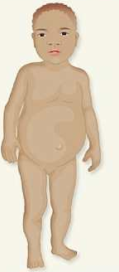
Health Complication Caused by Protein Deficiency
Kwashiorkor is a sort of protein inadequacy that influences youngsters.
Because of edema, children with kwashiorkor may look healthy so that their parents view them as well fed.

Slide 19

Health Complication Caused by Protein Deficiency
Weak immune system
Protein is basic for the creation of antibodies which are a key piece of the safe framework. On the off chance that you wind up plainly inadequate in protein your body will be not able produce these antibodies. This makes you more defenseless to disease.

