Slide 1
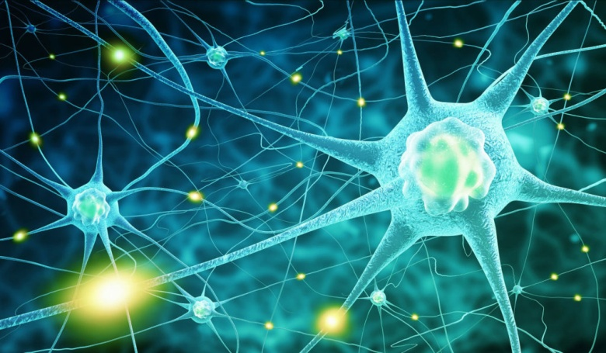
Functions of Proteins
3. Acts as a Messenger
Some proteins are hormones, which are chemical messengers that aid communication between your cells, tissues and organs. They’re made and secreted by endocrine tissues or glands and then transported in your blood to their target tissues.
Some examples include:
Insulin: Signals the uptake of glucose or sugar into the cell.
Glucagon: Signals the breakdown of stored glucose in the liver.
hGH (human growth hormone): Stimulates the growth of various tissues, including bone.
ADH (antidiuretic hormone): Signals the kidneys to reabsorb water.

Slide 2
Functions of Proteins
4. Provides Structure
Some proteins are fibrous and provide cells and tissues with stiffness and rigidity.
These proteins include keratin ( skin, hair and nails) , collagen (bones, tendons, ligaments and skin) and elastin ( uterus, lungs and arteries) which help form the connective framework of certain structures in your body

Slide 3
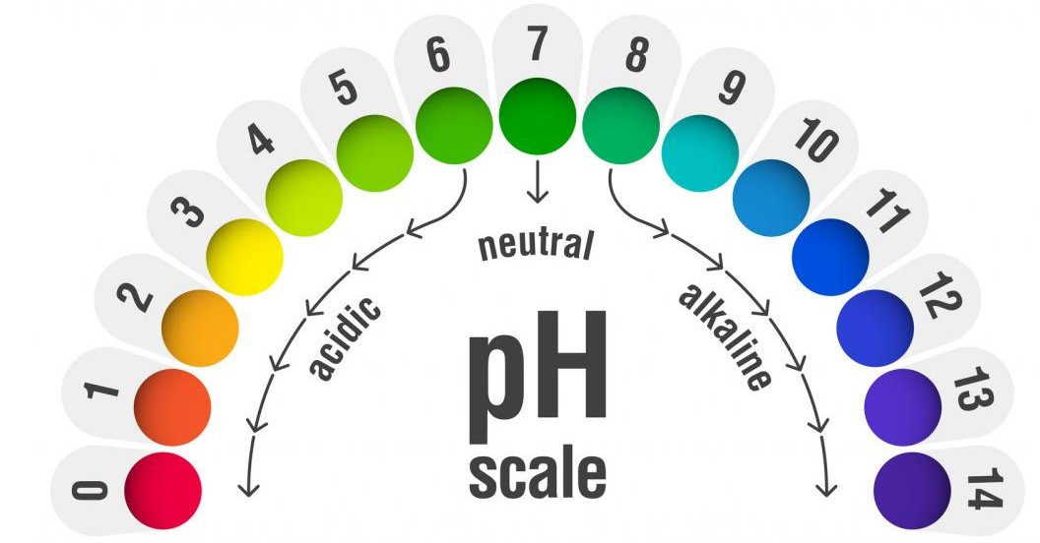
Functions of Proteins
5. Maintains Proper pH
One way your body regulates pH is with proteins. An example is hemoglobin, a protein that makes up red blood cells.
Hemoglobin binds small amounts of acid, helping to maintain the normal pH value of your blood.

Slide 4
Functions of Proteins
6. Balances Fluids
Albumin and globulin are proteins in your blood that help maintain your body’s fluid balance by attracting and retaining water.
If you don’t eat enough protein, your levels of albumin and globulin eventually decrease.
Consequently, these proteins can no longer keep blood in your blood vessels, and the fluid is forced into the spaces between your cells.
As the fluid continues to build up in the spaces between your cells, swelling or edema

Slide 5
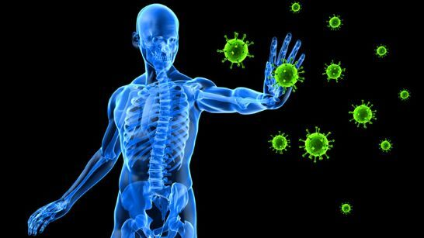
Functions of Proteins
7. Supports Immune Health
Proteins help form immunoglobulins, or antibodies, to fight infection.
Antibodies are proteins in your blood that help protect your body from harmful invaders like bacteria and viruses.
When these foreign invaders enter your cells, your body produces antibodies that tag them for elimination

Slide 6
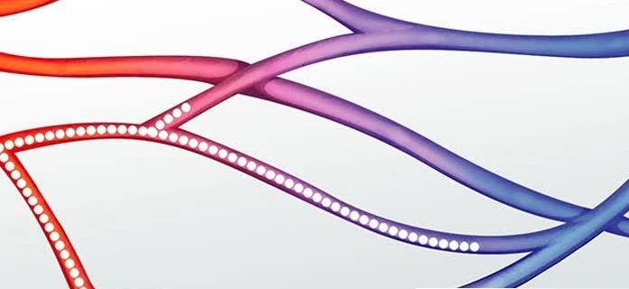
Functions of Proteins
8. Transports and Stores Nutrients
For example, hemoglobin is a protein that carries oxygen from your lungs to body tissues. Glucose transporters move glucose to your cells, while lipoproteins transport cholesterol and other fats in your blood

Slide 7
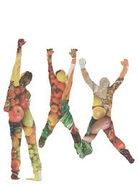
Functions of Proteins
Provides Energy
Proteins can supply your body with energy.
Protein contains four calories per gram, the same amount of energy that carbs provide. Fats supply the most energy, at nine calories per gram.
However, the last thing your body wants to use for energy is protein since this valuable nutrient is widely used throughout your body.

Slide 8
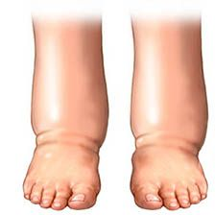
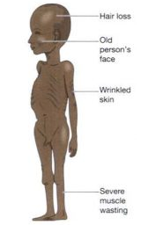
Health Complication Caused by Protein Deficiency
Oedema: Not getting enough protein can prompt oedema (liquid maintenance). This can cause swelling in various zones of the body, for example, the feet, hands and stomach.
Marasmus is a kind of protein inadequacy that can prompt weakness, muscle squandering, and lessened muscle versus fat levels and weight reduction and makes sufferers more helpless to infections

Slide 9
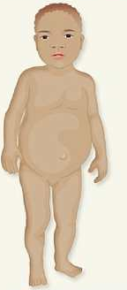
Health Complication Caused by Protein Deficiency
Kwashiorkor is a sort of protein inadequacy that influences youngsters.
Because of edema, children with kwashiorkor may look healthy so that their parents view them as well fed.

Slide 10

Health Complication Caused by Protein Deficiency
Weak immune system
Protein is basic for the creation of antibodies which are a key piece of the safe framework. On the off chance that you wind up plainly inadequate in protein your body will be not able produce these antibodies. This makes you more defenseless to disease.

