Slide 1

Schizophrenia Spectrum Disorders
MSc. Psychiatric: Hilal Farouq Hussein

Slide 2

Outline
Introduction
Psychosis Symptoms
Phases of Schizophrenia
DSM-5 CRITERIA FOR SCHIZOPHRENIA
EPIDEMIOLOGY
COMORBIDITY
Related Disorders
Nursing Intervention

Slide 3
Schizophrenia
Schizophrenia is a severe mental disorder are characterized by psychosis symptoms, which refers to altered cognition, altered perception, and/or an impaired ability to determine what is or is not real, emotional, and behavioral symptoms.
These symptoms often interfere with a person's ability to think clearly, manage emotions, make decisions, and relate to others.

Slide 4
Psychosis Symptoms
Positive symptoms
Negative symptoms
Cognitive symptoms

Slide 5
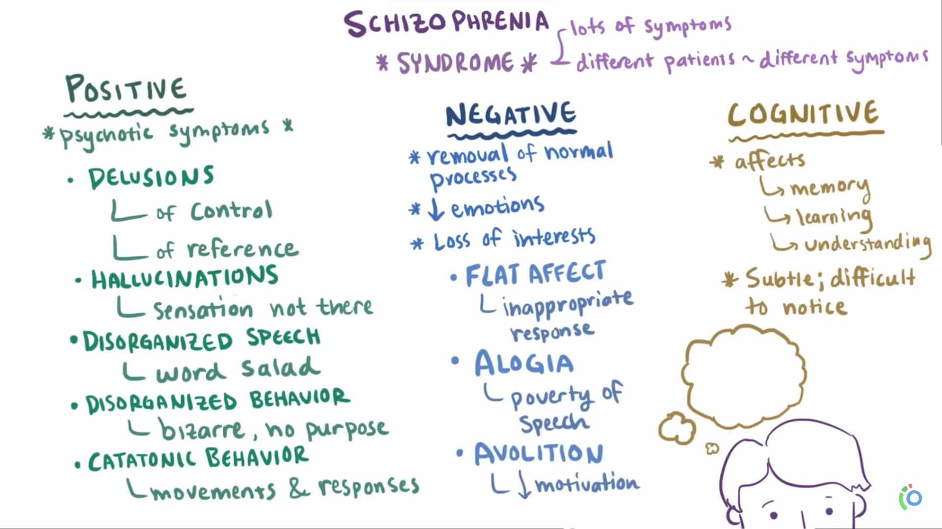

Slide 6
Types of schizophrenia:
1-Paranoid Schizophrenia
2-Disorganized Schizophrenia(Hebephrenic)
3-Residual Schizophrenia
4-Catatonic Schizophrenia
5-Undifferentiated Schizophrenia

Slide 7

Paranoid Schizophrenia
Is characterized mainly by:
Delusions (Persecution or grandeur).
Hallucinations(auditory Hallucination ).
Argumentative, guarded, suspicious, hostile and aggressive.

Slide 8
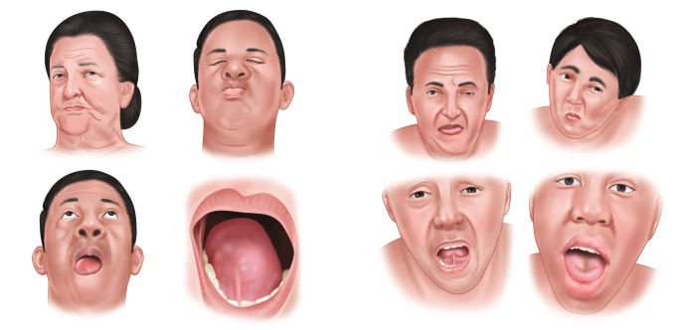
Hebephrenic (disorganized) Schizophrenia
is characterized by disorganized thinking with blunted and inappropriate emotions.
It begins mostly in adolescent age; the behavior is often bizarre. There could appear mannerisms, grimacing, inappropriate laugh and joking, personal neglected and social isolation.
Usually the prognosis is poor because of the rapid development of "negative" symptoms.

Slide 9


Catatonic Schizophrenia
Catatonic schizophrenia is characterized mainly by motoric activity, which might be strongly increased (catatonic excitement)or decreased (catatonic stupor).
We recognize two forms:
  Productive form (catatonic excitement) extreme and often aggressive activity.
    Treatment by neuroleptics or by electroconvulsive therapy.
  Stupor form (catatonic stupor) characterized by general inhibition of patient’s behavior or at least by retardation and slowness, followed often by mutism, negativism(motiveless) and waxy flexibility.

Slide 10
Undifferentiated (atypical) Schizophrenia
Psychotic conditions meeting the general diagnostic criteria for schizophrenia but not conforming to any of the subtypes, or exhibiting the features of more than one of them without a clear predominance of a particular set of diagnostic characteristics.
This subgroup represents also the former diagnosis of atypical schizophrenia.

Slide 11
Residual Schizophrenia
A chronic stage in the development of schizophrenia with clear succession from the initial stage with one or more episodes characterized by general criteria of schizophrenia to the late stage with long-lasting negative symptoms and deterioration).

Slide 12


Slide 13


Slide 14
Typical stages of schizophrenia:
  Phase I: The schizoid personality
  Phase II: The Prodromal phase
  Phase III: The Active or schizophrenia
  Phase IV: The Residual phase

Slide 15
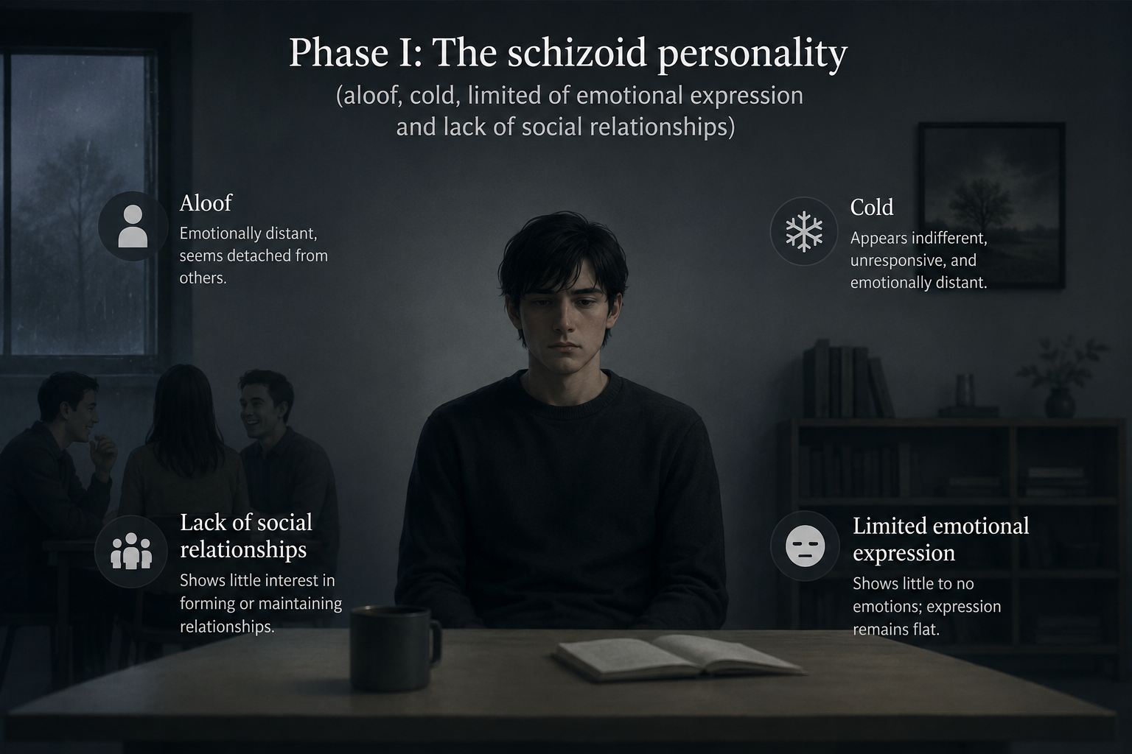
  Phase I: The schizoid personality
  (aloof, cold, limited of emotional expression and lack of social relationships)

Slide 16
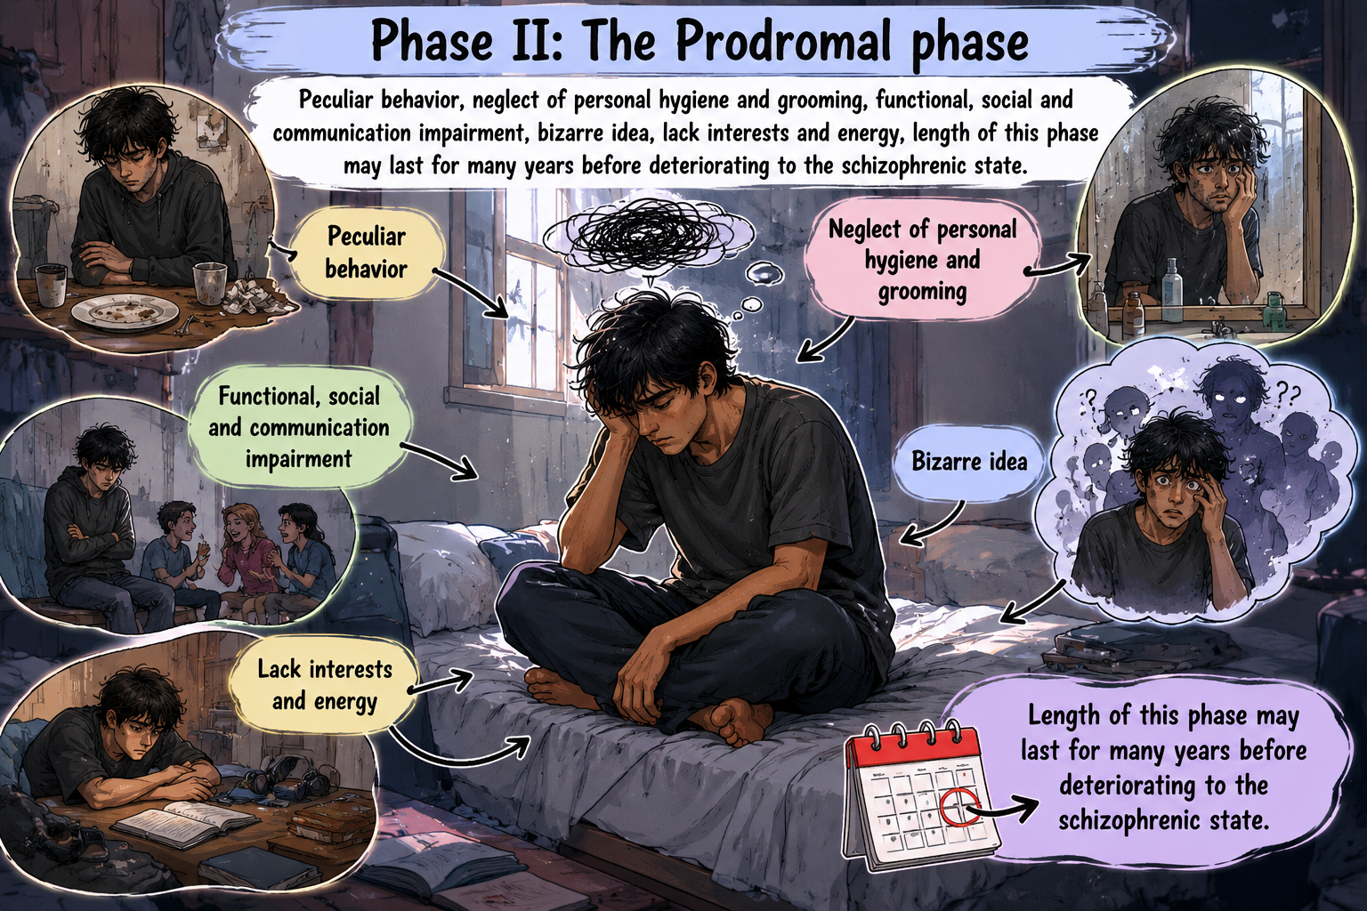
  Phase II: The Prodromal phase
  (peculiar behavior(action that stand out from what is considered normal), neglect of personal hygiene and grooming, functional, social and communication impairment, bizarre idea, lack interests and energy, length of this phase may last for many years before deteriorating to the schizophrenic state ).

Slide 17
  Phase III: The Active or schizophrenia
  (two or more of the following symptoms for 6 months period must be included at least 1 month of symptoms : Positive symptoms {Delusion, hallucination, disorganized speech and behavior} and,
  negative symptoms {affective flat or loss of emotional expression, alogia or poverty of speech and avolition or lack of motivation} ).

Slide 18
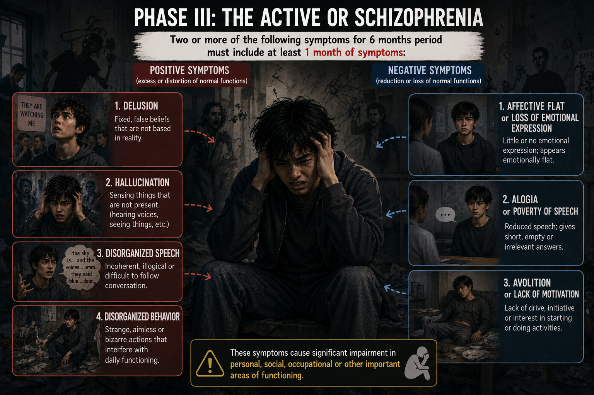

Slide 19
  Phase IV: The Residual phase:
  Condition has stabilized. Positive symptoms are usually absent or significantly diminished, but negative and cognitive symptoms continue to be a concern.

Slide 20
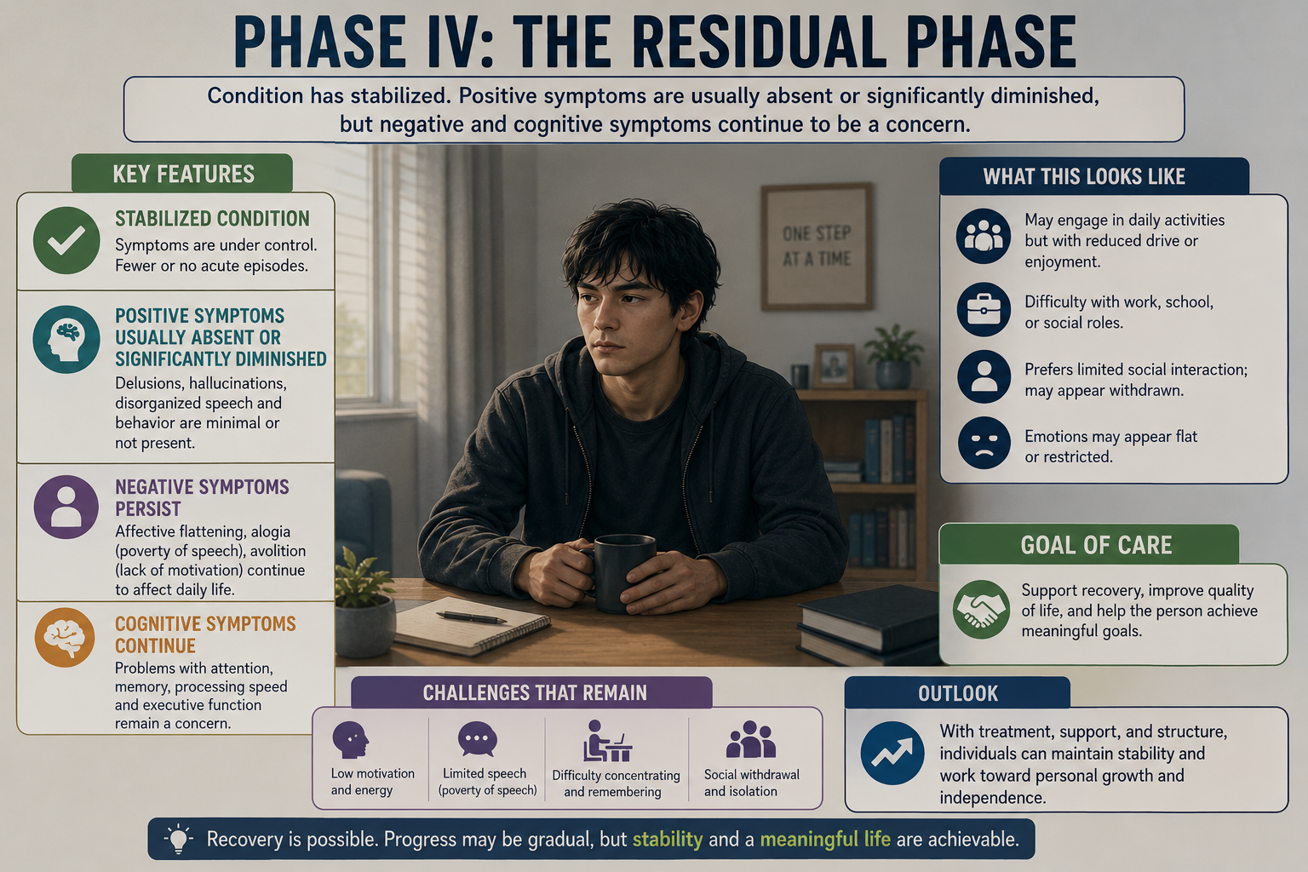

Slide 21
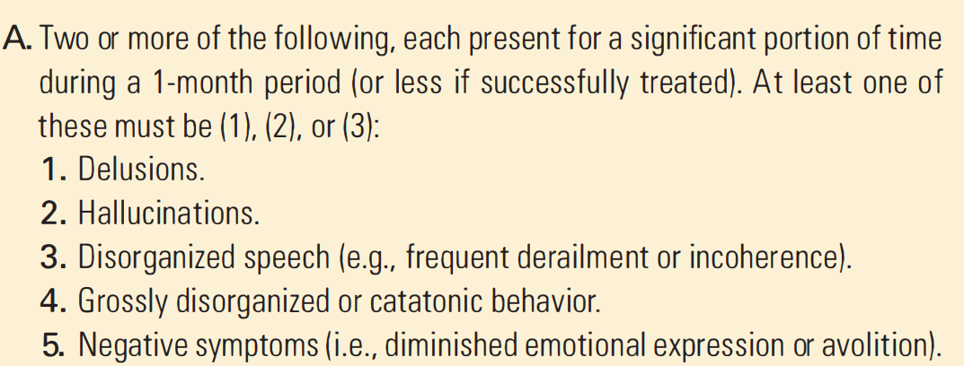
DSM-5 CRITERIA FOR SCHIZOPHRENIA

Slide 22
DSM-5 CRITERIA FOR SCHIZOPHRENIA
B
Disturbance level of functioning in one or more major areas, such as work, interpersonal relations, or self-care, is markedly below the level achieved before the onset.
when the onset is in childhood or adolescence, there is failure to achieve expected level of interpersonal, academic, or occupational functioning.

Slide 23
DSM-5 CRITERIA FOR SCHIZOPHRENIA
C
Continuous signs of the disturbance persist for at least 6 months.
This 6-month period must include at least 1 month of symptoms that meet Criterion A.

Slide 24
EPIDEMIOLOGY
The prevalence of childhood-onset schizophrenia is about 1 in 40,000 children.
It is diagnosed more frequently in males (1.4:1) .
Onset in males is usually between the ages of 15 and 25 years.
The onset tends to be somewhat later in women (ages 25 to 35 years)

Slide 25
COMORBIDITY
Substance use disorders, particularly alcohol and marijuana, occur in nearly half of affected individuals.
Substance use is associated with higher rates of treatment nonadherence, relapse, incarceration, homelessness, violence, suicide, and a poorer prognosis.

Slide 26
COMORBIDITY
Anxiety, depression, and suicide co-occur frequently in schizophrenia.
At least 20% of people with schizophrenia attempt suicide while 5% to 10% die by suicide.

Slide 27
Prognosis
Good prognosis | Poor prognosis
Later onset | Younger onset
Acute onset | Insidious onset
Good social, sexual and work history | Poor social, sexual and work history
Depression | Withdrawn behavior
Catatonic or paranoid features | Disorganized
Married | Single, divorced, widowed
Good support systems | Poor support systems
Positive symptoms | Negative symptoms

Slide 28
Related Disorders
DELUSIONAL DISORDER :
Delusional disorder is characterized by delusions that have lasted 1 month or longer.
These delusions are usually not severe enough to impair occupational or daily functioning.
Individuals with this personality disorder do not tend to behave strangely or bizarrely

Slide 29
Related Disorders
Brief psychotic disorder:
Is characterized by the sudden onset of at least one of the following: delusions, hallucinations, disorganized speech, and disorganized or catatonic (severely decreased motor activity) behavior.
The symptoms must last longer than 1 day, but no longer than 1 month with the expectation of a return to normal functioning

Slide 30
Related Disorders
SCHIZOPHRENIFORM DISORDER:
The essential features of this disorder are exactly like those of schizophrenia, except that symptoms last a much shorter period of time (less than 6 months).

Slide 31
Related Disorders
SCHIZOAFFECTIVE DISORDER:
This disorder is characterized by an uninterrupted period of illness during which there is a major depressive, manic, or mixed episode, concurrent with symptoms that meet the criteria for schizophrenia (Psychosis).

Slide 32
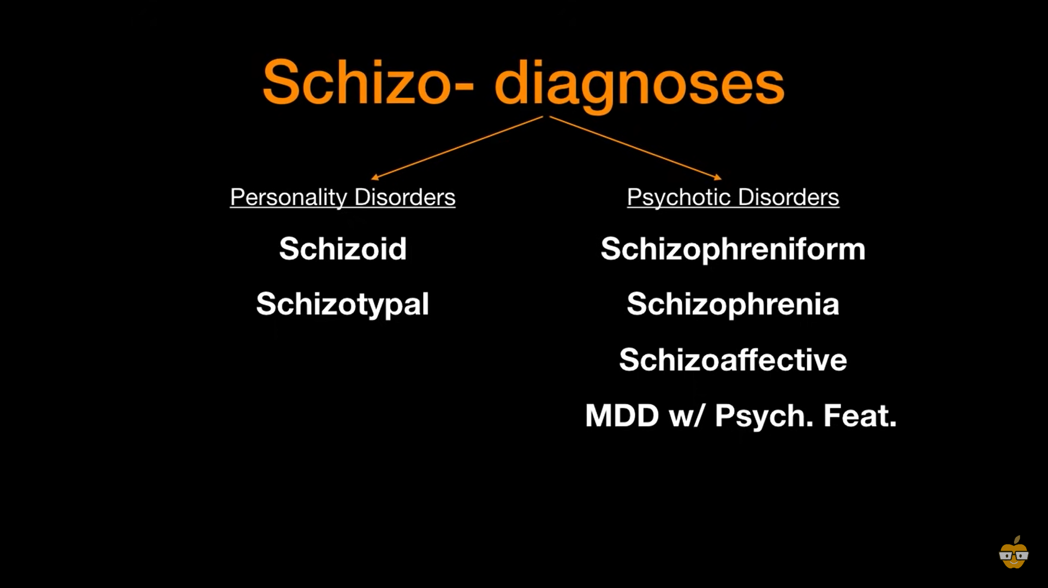

Slide 33
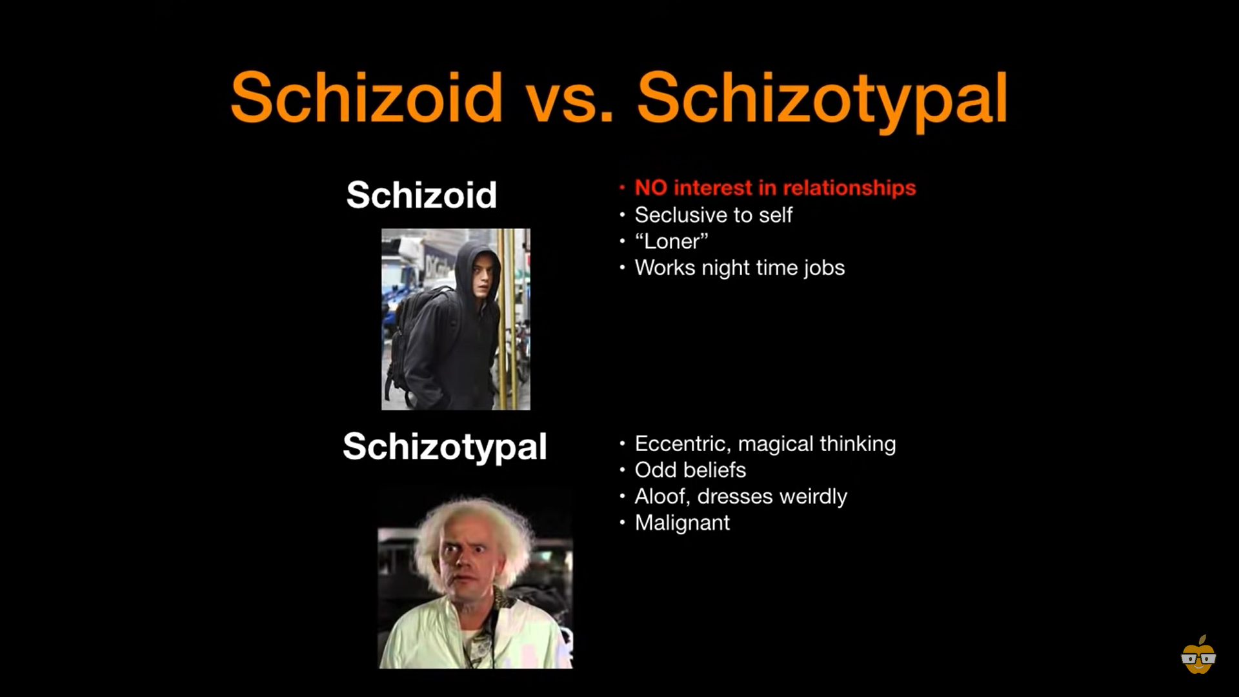

Slide 34
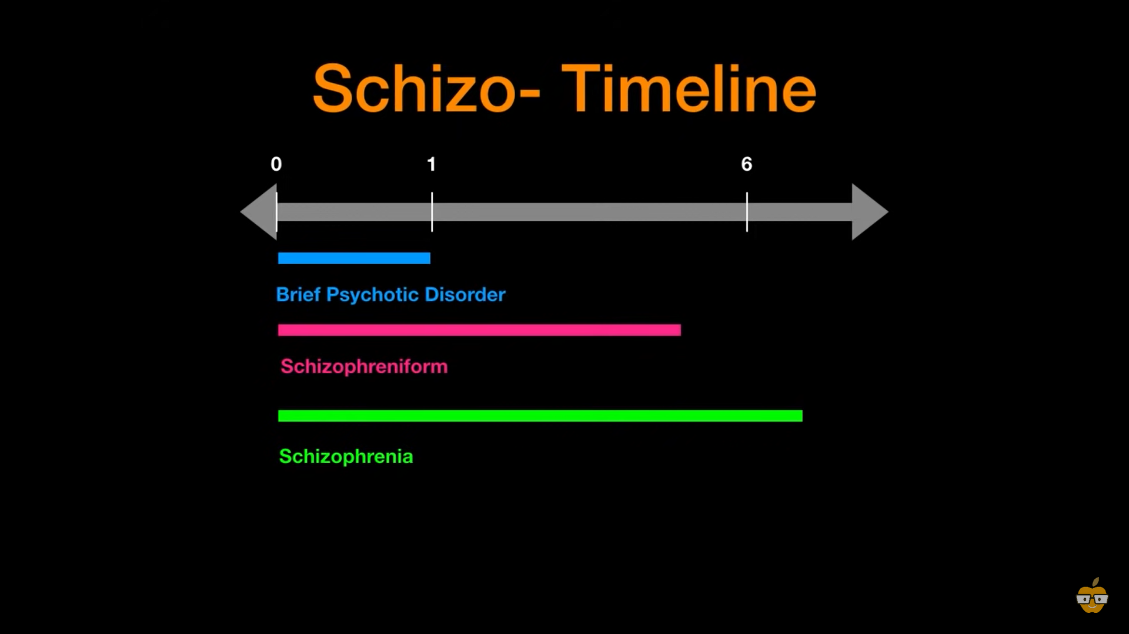

Slide 35
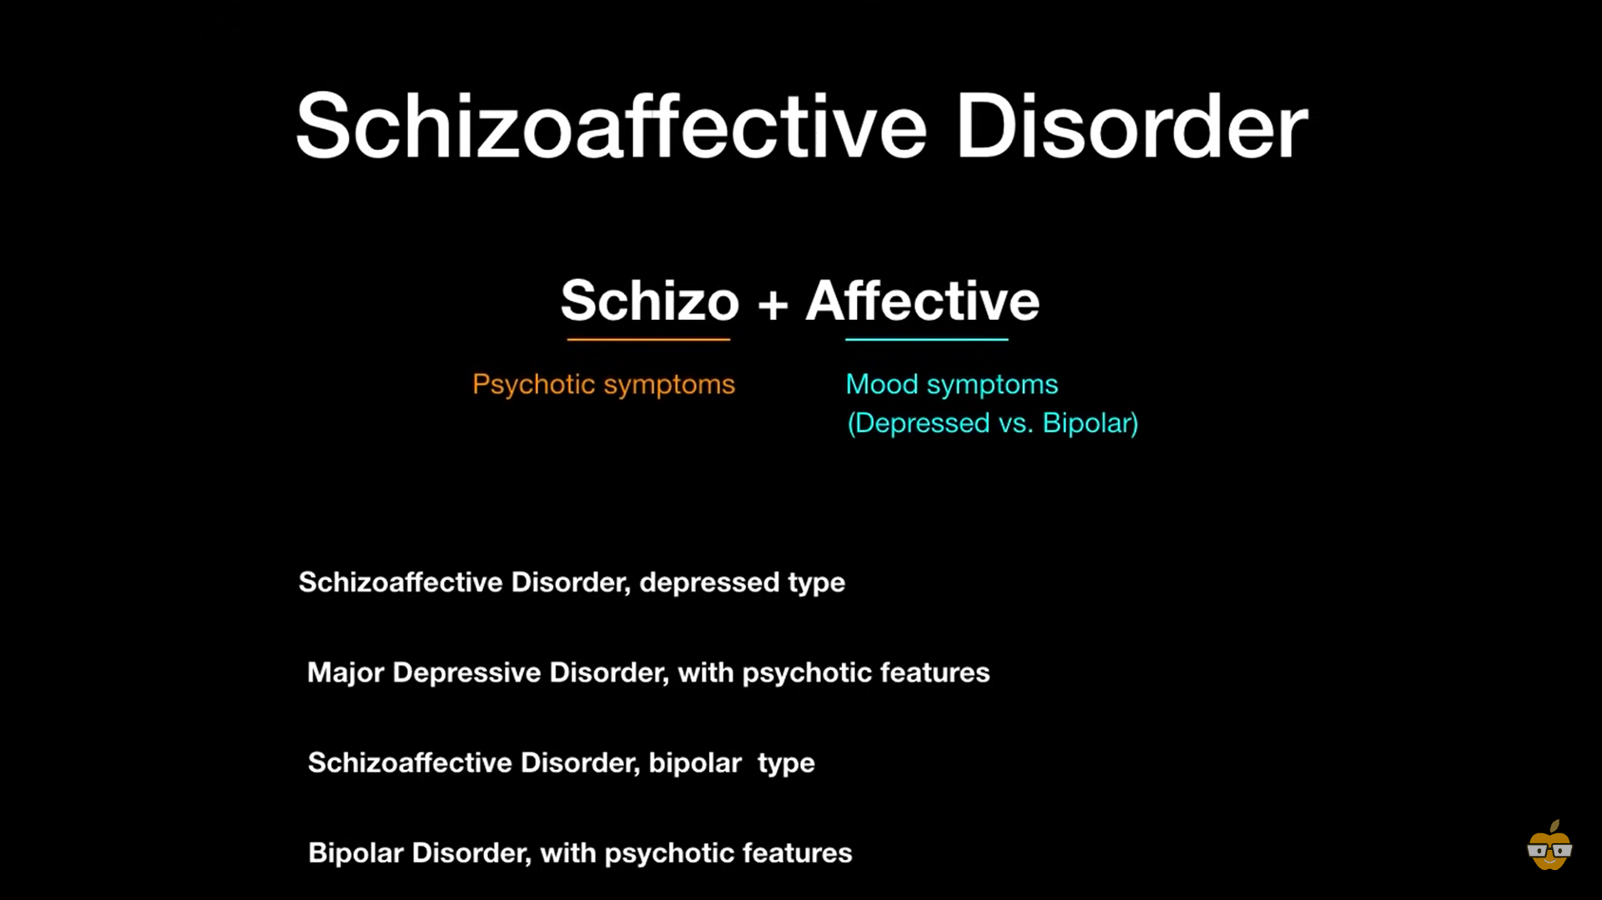

Slide 36


Slide 37
Nursing Intervention
Activities and Groups: Participation in activities and groups appropriate to the patient's needs and abilities may decrease withdrawal, enhance motivation, modify unacceptable behaviors, improve understanding of the illness.
Counseling and Communication Techniques: Therapeutic communication techniques and CBT for patients with schizophrenia aim to build trust and reduce anxiety.

Slide 38
Nursing Intervention
• Using second-generation antipsychotics for individuals with
first -episode psychosis or prominent negative symptoms.
• Monitoring and treatment for risk of suicide.
• Monitoring and treatment for concurrent substance use disorders.
• Preventing metabolic side effects.
• Monitoring for and promptly managing dangerous medication side effects.
• Monitoring for and promptly managing other medication side effects

Slide 39
Nursing Intervention
• Monitoring for and promptly managing fall and choking risk.
• Involving the patient in active case management services to ensure coordination of care and prevent "falling through the cracks“.
• Involving the patient in cognitive remediation programs and other activities that build cognitive skills.
• Promoting involvement in self-help and support groups (e.g., NAMI.org) and in other activities and resources consistent with the Recovery Model

Slide 40

References
Halter, M. J. (2018). Varcarolis’ foundations of Psychiatric-Mental Health Nursing: A clinical approach. Elsevier. 191-221p

Slide 41


