Slide 1

PRINCIPLE OF CRYPTOGRAPHY
NAME: Assistant Prof. Dr. Saman Mirza Abdualalh
saman.mirza@tiu.edu.iq
This Photo by Unknown Author is licensed under CC BY-SA

Slide 2
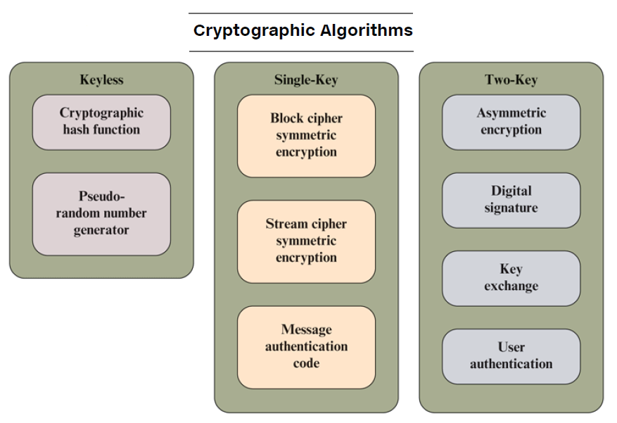
Cryptography
Is technique of securing information and communications using codes so that only those person for whom the information is intended can understand and process it.
Cryptography can be classified based on:
  Reversible and irreversible.
  Transposition and Substitution.
  Single-key, two-key, and less key.
  Block ciphering and stream ciphering.
  Symmetric and Asymmetric.

Slide 3
Class Objective
The main objective of this class is to:
  To distinguish between two Cryptosystems:
    Symmetric-Key and Asymmetric-Key
  To introduce trapdoor one-way functions and their use in asymmetric-key cryptosystems.
  To discuss the RSA cryptosystem.

Slide 4
Introduction
The acronym of RSA stands for Rivest, Shamir, and Adelman, the inventors of the technique.
The RSA algorithm is based on the fact that there is no efficient way to factor very large numbers.
It is an asymmetric cryptographic algorithm.
Asymmetric means that there are two different keys.
This is also called public key cryptography, because one of them can be given to everyone. The other key must be kept private. (This is the concept)

Slide 5
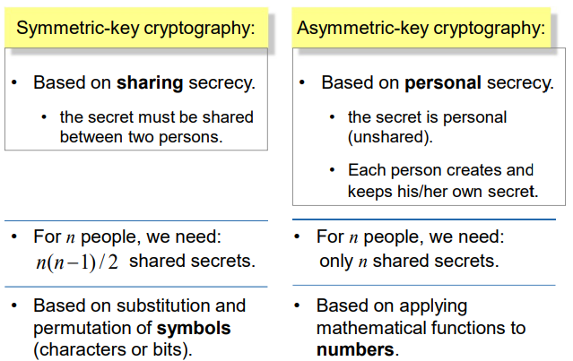
Introduction
Symmetric VS Asymmetric Keys

Slide 6
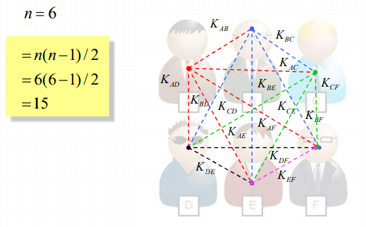
Introduction
Example on Symmetric-Key
Each one has a secret key and shared with all.

Slide 7
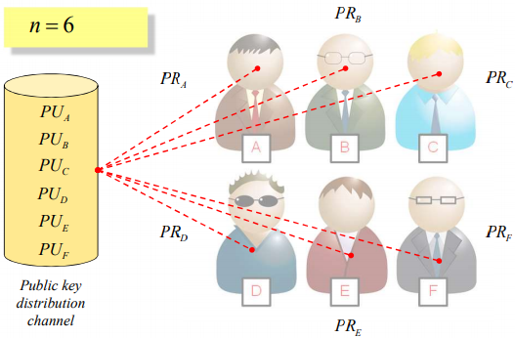
Introduction
Example on Asymmetric-Key
Asymmetric-key cryptography; Each one has a public key (PU) and a private key (PR); All PUs are shared.

Slide 8
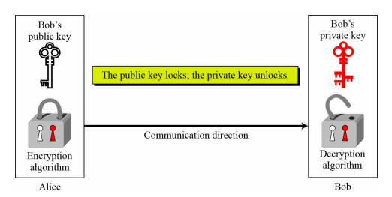
Introduction
Working With Two Keys
Asymmetric-key works with public and private keys.
  Passcode mobile locking and unlocking, as an example.

Slide 9
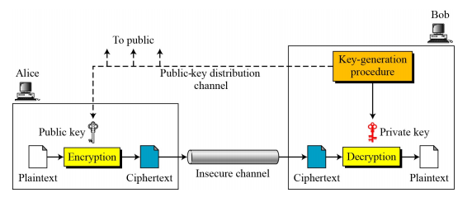
Introduction
General Ideas and Facts
There are two distinction keys:
  Private key
  Public key.
Secrete key is not private.
Secret is bits but private is number.

Slide 10
Introduction
General Ideas and Facts
Facts: ONE
  Encryption depends on receiver’s key.
  Receiver needs to generate two keys.
  Receiver needs to share public key to all.
  Public key distributed through channel.
  Channel should provide Authentication and Integrity.
  Intruder should not be able to use receiver’s public key.

Slide 11
Introduction
General Ideas and Facts
Facts: TWO
  Sender and receiver can’t use same private and public keys.

Slide 12
Introduction
General Ideas and Facts
Facts: THREE
  Receiver only need one private key to receive correspondences from (N) senders.
  Sender need to know (N) public keys to send information to N receivers.

Slide 13
Introduction
Asymmetric-Key
Plaintext / Ciphertext
  Before encryption, message converted to integer numbers.
  Plaintext is an integer or set of integer numbers.
  Asymmetric key uses for encrypting small size of information, such as key of encryption systems.
  It uses for secondary goal instead of message encryption.

Slide 14
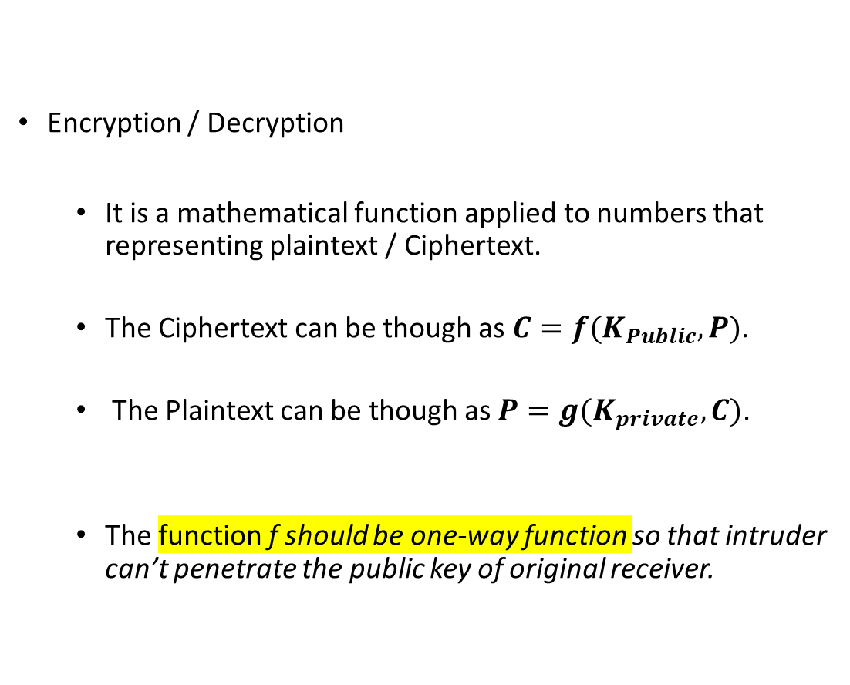
Introduction
Asymmetric-Key
Encryption / Decryption
  It is a mathematical function applied to numbers that representing plaintext / Ciphertext.
  The Ciphertext can be though as $C=f(K_{Public}, P)$.
  The Plaintext can be though as $P=g(K_{private}, C)$.
  The function f should be one-way function so that intruder can’t penetrate the public key of original receiver.

Slide 15
Introduction
Need of Both
Asymmetric-key is very slow for decrypting large size of messages.
  It means, Symmetric-key still needed for encrypting large size of message.
Symmetric-key can’t prove the authenticity and integrity of sent messages.
  It means, asymmetric-key is needed for key encrypting and keeping the authentication, integrity, and sending secrete keys.
Both needed. Both complementary to each other.

Slide 16
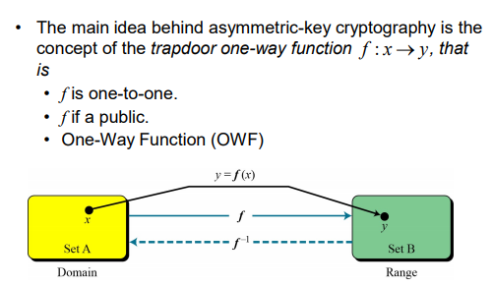
One Way Function
(OWF)

Slide 17
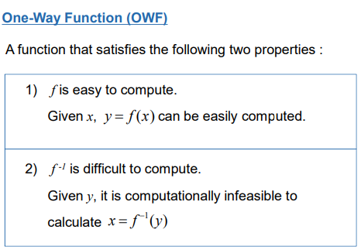
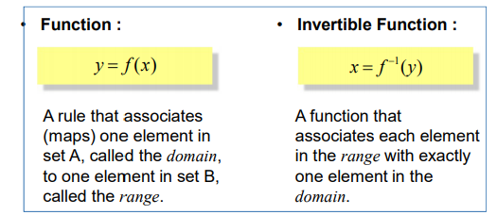
One Way Function
(OWF)

Slide 18
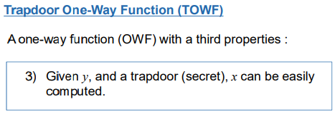
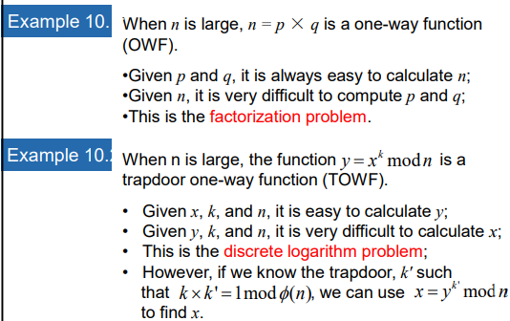
One Way Function
(OWF)

Slide 19
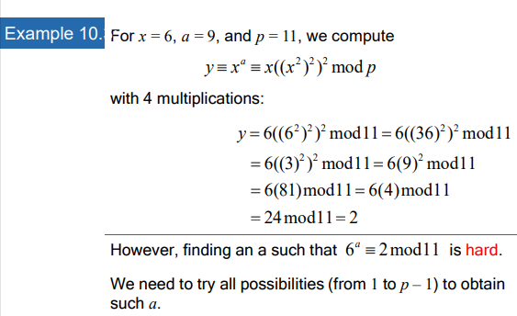
One Way Function (OWF)

Slide 20
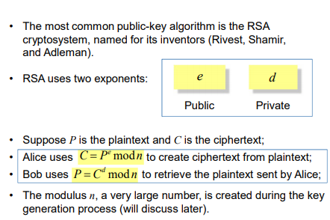
RSA
Introduction

Slide 21
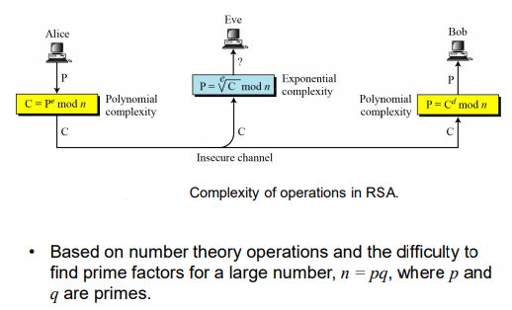
RSA
Introduction

Slide 22
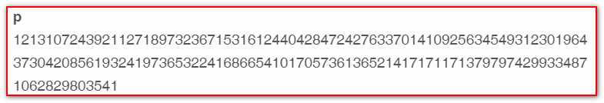
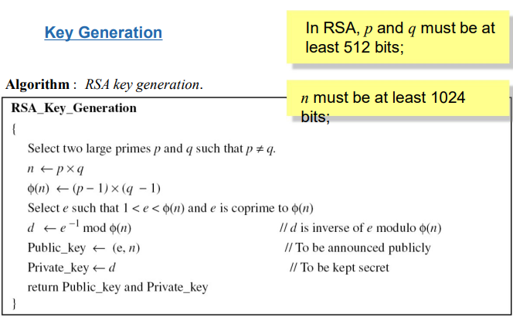
RSA
Introduction

Slide 23
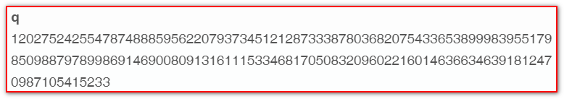
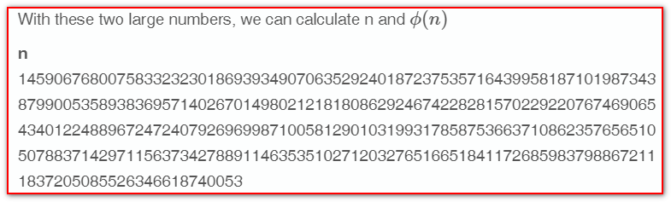
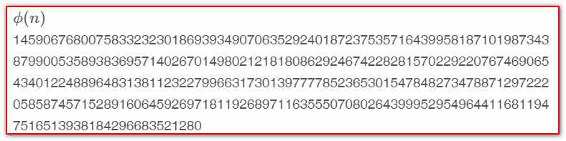
Real Example of RSA

Slide 24
RSA
Simple Example
Creating public and private keys:
  Choose two prime numbers (p = 2, q = 7)
  Find N = p x q = 2 x 7 = 14.
  Find Φ(N) = (p-1)x(q-1) = (2-1)x(7-1) = 6.
  Find e: 1<e< Φ(N) and not co-prime of (e, Φ(N) ).
    e=5.
    Public key is (e, N) = (5,14)
  Chose d: de x (mod Φ(N) )=1 ……
  d=5, private key is (5, 14)
Apply both keys on Message M, where M = letter B.

Slide 25

CLASS
END

