Slide 1

PRINCIPLE OF CRYPTOGRAPHY
NAME: Assistant Prof. Dr. Saman Mirza Abdualalh
saman.mirza@tiu.edu.iq
This Photo by Unknown Author is licensed under CC BY-SA

Slide 2
Class Objective
The main objective of this class is to explain three different applications of the public-key cryptography systems:
Key exchange in network protocols (Diffie-Hellman).
Encryption – Decryption (ElGamal Cryptographic System).
Digital Signature.

Slide 3
Diffie-Hellman

Slide 4

Introduction
To understand the Diffie-Hellman key exchanging algorithm, we have to know :
  Primitive root of a number.
  Discrete logarithm.

Slide 5
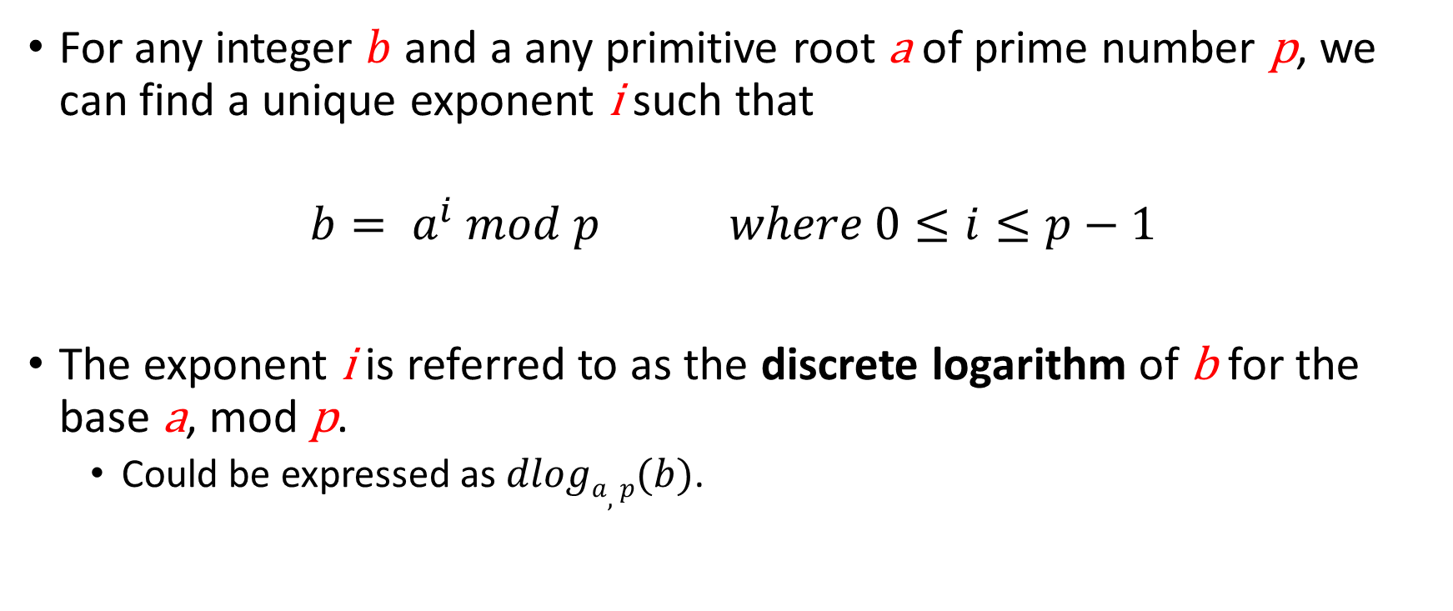
Introduction
Discrete Logarithm
For any integer $b$ and a any primitive root a of prime number p, we can find a unique exponent i such that
$$b= a^{i} mod p where 0≤i≤p−1$$
The exponent i is referred to as the discrete logarithm of b for the base a, mod p.
  Could be expressed as $dloga,p(b)$.

Slide 6
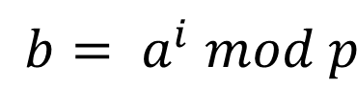
Introduction
Finding Primitive Root
Find the primitive root for the prime number (11).

Slide 7
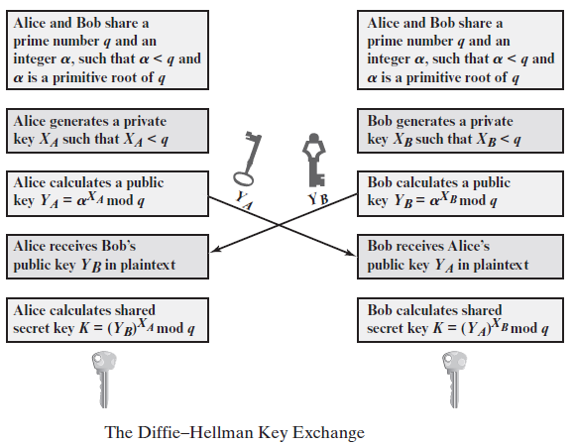
Diffie-Hellman Key Exchange
Key exchange is based on the use of the prime number
q = 353 and a primitive root of 353, in this case α = 3.
A and B select private keys
  (X_{A} = 97 and XB = 233)
A computes Y_{A} = 3⁹⁷ mod 353 = 40.
B computes Y_{B} = 3²³³ mod 353 = 248.
After they exchange public keys, each can compute the common secret key:
A computes K = (Y_{B})^{XA} mod 353
K = 248⁹⁷ mod 353 = 160.
B computes K = (Y_{A})XB mod 353
K = 40²³³ mod 353 = 160.

Slide 8
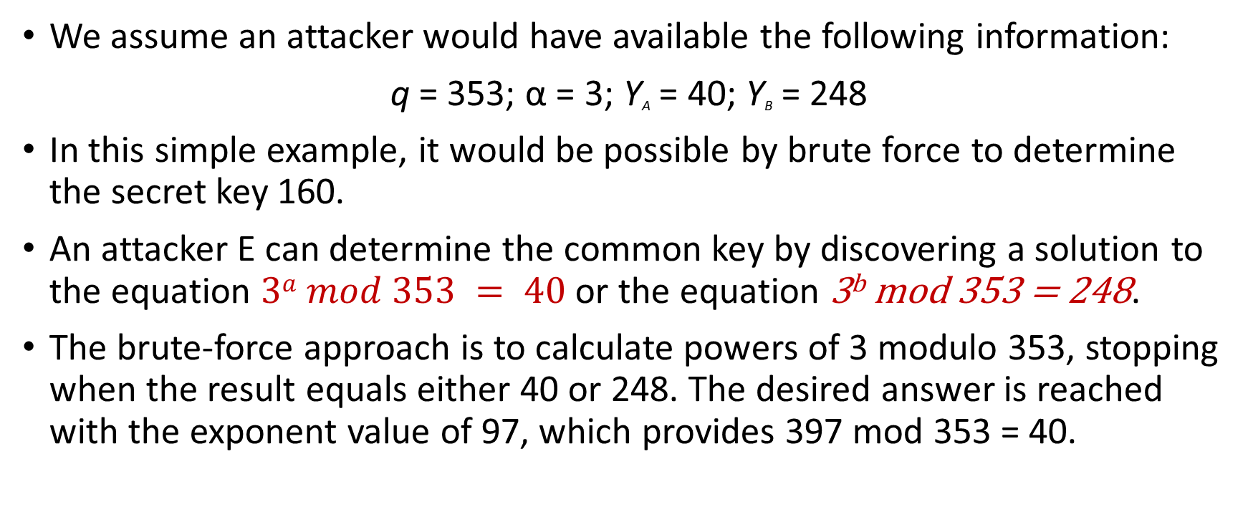
Diffie-Hellman
Attacks on Diffie-Hellman
We assume an attacker would have available the following information:
q = 353; α = 3; Y_{A} = 40; Y_{B} = 248
In this simple example, it would be possible by brute force to determine the secret key 160.
An attacker E can determine the common key by discovering a solution to the equation $3a mod 353 = 40$ or the equation 3^{b} mod 353 = 248.
The brute-force approach is to calculate powers of 3 modulo 353, stopping when the result equals either 40 or 248. The desired answer is reached with the exponent value of 97, which provides 397 mod 353 = 40.

Slide 9
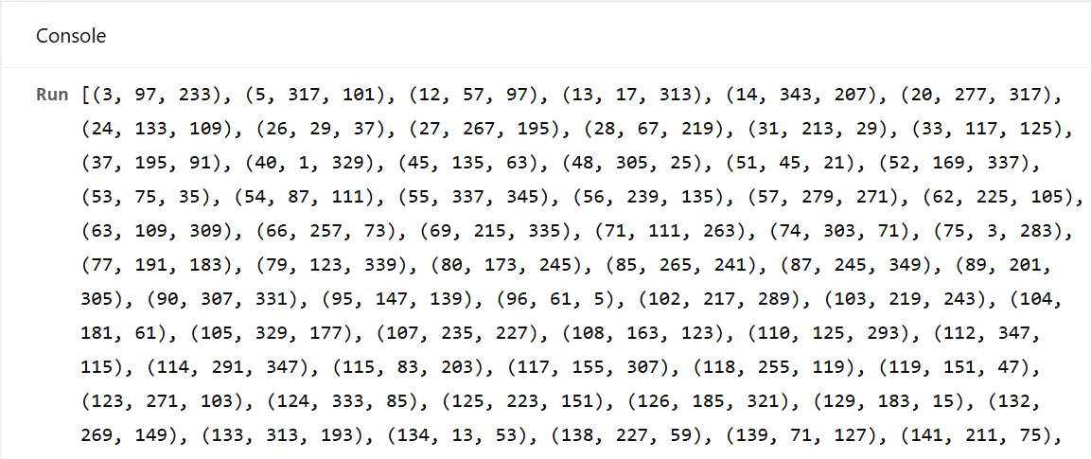
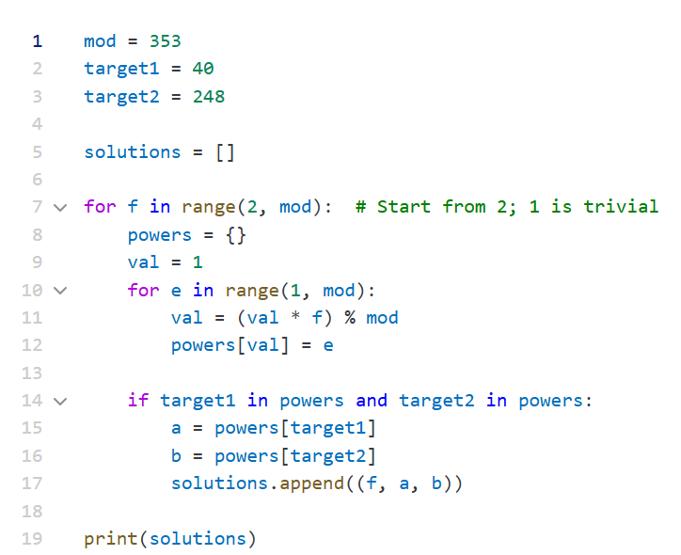

Slide 10
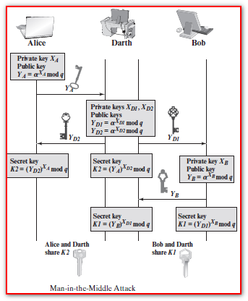
Diffie-Hellman key exchange
Attacks (MIMA)
One of the attack that defeat Diffie-Hellman algorithm is called Man-in-the-middle attack.
  It generates two private keys X_{D1}, X_{D2}.
  Computes two public keys Y_{D1}, Y_{D2}
The key exchange protocol is vulnerable to such an attack because it does not authenticate the participants

Slide 11
El-Gamal Encryption

Slide 12
Introduction
El-Gamal Encryption
It is a public key encryption system.
  Has public key and private key (Pair of keys).
It depends on
  Diffie-Hellman algorithm.
  Discrete Logarithm math.
It can be used for
  Establishing a secrete channel for key sharing.
  Encrypting messages.

Slide 13
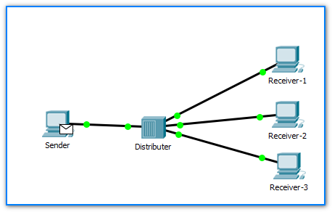
Introduction
El-Gamal Encryption
With El-Gamal Encryption, like the Diffie-Hellman, there is global elements, which are:
  q, any prime number.
  α, is the primitive root of q.
The intended receiver should generate :
  Public key (sends to all )
  Private key (keeps by the receiver)
Sender uses public key of the receiver, (Encrypt)
The intended receiver uses private key. (Decrypt)

Slide 14
El-Gamal Algorithm
Encryption
  Knowing both q and α,
  The Receiver (User A) generates the following:
    A random integer X_{A}, such that ${1<X}_{A} <q−1$
    Compute $Y_{A}= {\text{α}}^{X_{A}} mod q$.
    A’s private key is $X_{A}$ and public key is $\{q , ∝ , Y_{A}\}$

Slide 15
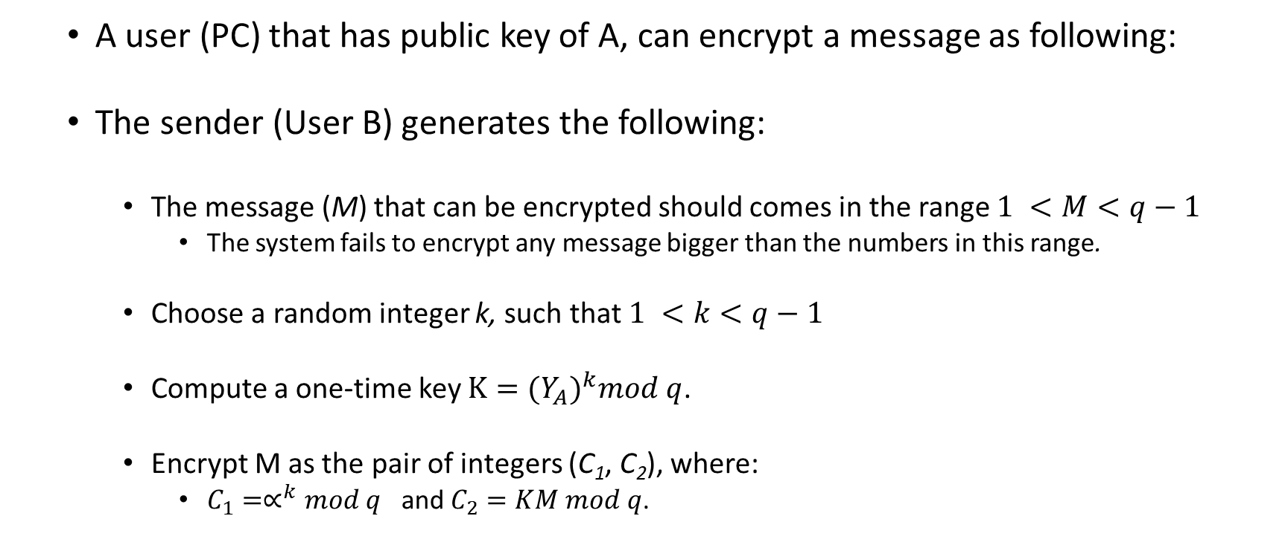
El-Gamal Algorithm
Encryption
  A user (PC) that has public key of A, can encrypt a message as following:
  The sender (User B) generates the following:
    The message (M) that can be encrypted should comes in the range $1 <M<q−1$
      The system fails to encrypt any message bigger than the numbers in this range.
    Choose a random integer k, such that $1 <k<q−1$
    Compute a one-time key $K={(Y_{A})}^{k}mod q$.
    Encrypt M as the pair of integers (C₁, C₂), where:
      $C_{1}=∝^{k}mod q$ and $C_{2}=KM mod q$.

Slide 16
El-Gamal Algorithm
Encryption Example
  Example of Key generation and Encryption .

Slide 17
El-Gamal Algorithm
Decryption
The receiver can recover the plaintext using the following steps
  Recovering the Key by computing the $K ={(C_{1})}^{X_{A}} mod q$.
  Recovering the plaintext by computing $M=\left(C_{2}K^{−1}\right) mod q.$

Slide 18
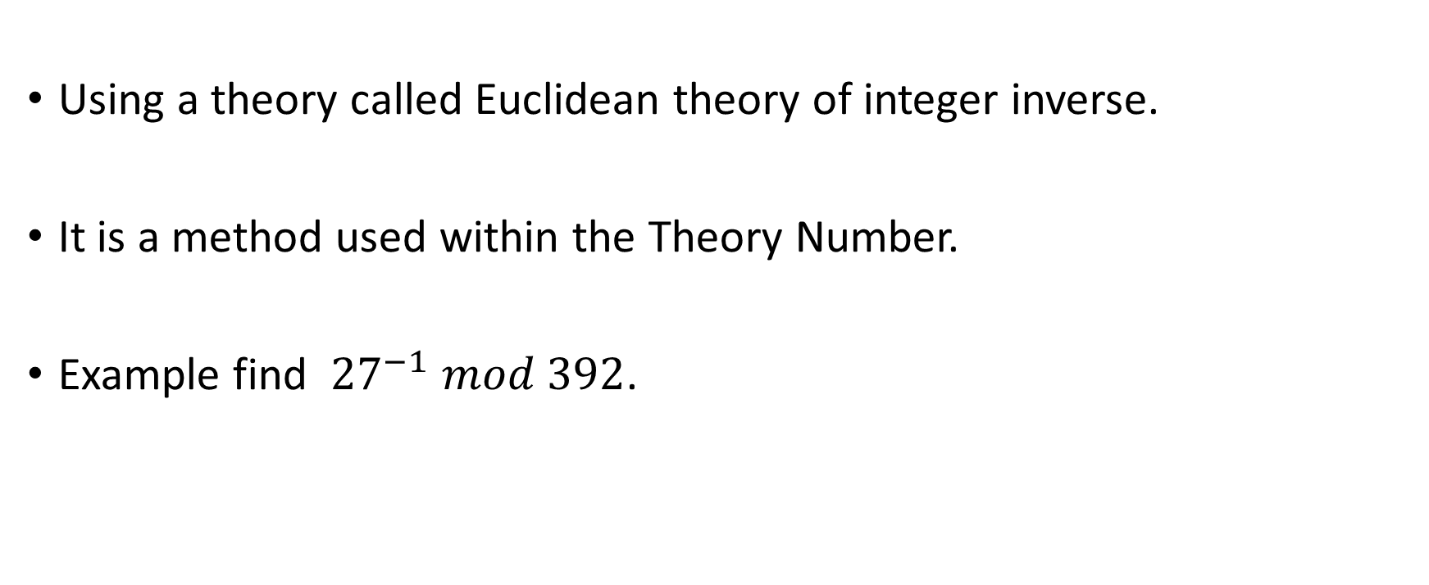
We need to learn how to find $K^{−1}$ of K.
Using a theory called Euclidean theory of integer inverse.
It is a method used within the Theory Number.
Example find ${27}^{−1} mod 392$.

Slide 19
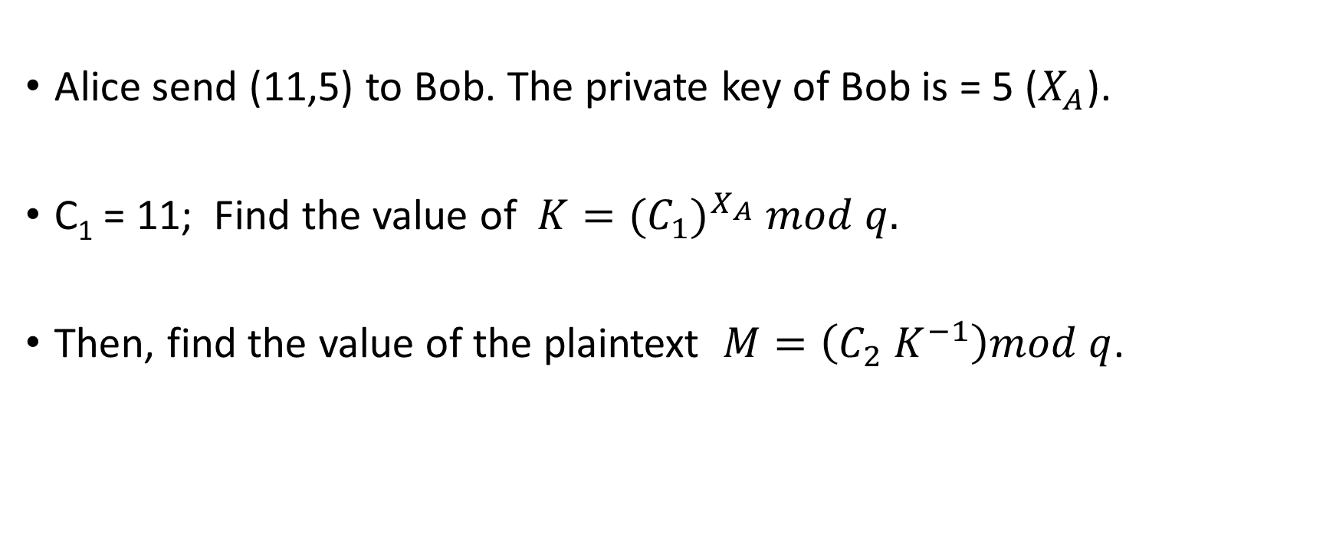
El-Gamal Algorithm
Decryption / Example
Alice send (11,5) to Bob. The private key of Bob is = 5 ($X_{A}$).
C₁ = 11; Find the value of $K={(C_{1})}^{X_{A}} mod q.$
Then, find the value of the plaintext $M=\left(C_{2} K^{−1}\right)mod q$.

Slide 20
El-Gamal Algorithm
Long M; More than q
When the size of M is greater than q, the M should be broken to set of smaller block such as M = {m₁, m₂, …..m_{n}}, considering the following condition:
  Size of each m should be less than the size of q, and
  For each m, different k should be assumed.

Slide 21
El-Gamal Algorithm
Security strength
This algorithm will be considered as strong if
  The prime number is considered as 300 decimal, and
  The assumed q has at least one large primitive root.
Since the random k is changed each time, the same plaintext will be resulting different ciphertext.

Slide 22
Digital Signature

Slide 23
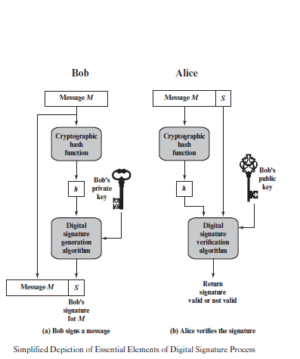
Digital Signature (Overview)
Digital Signature (DS) is the most important development of public-key cryptographic.
The DS can provide some sets of security capabilities that no easy to be done without DS.
Most of the DS schemes follow the same structure that shown in the figure.

Slide 24
Scenarios for DS
An encrypted message has been decrypted by a receiver, and same shared key has been used for alter the message. Can the sender verify that altered message is not the one that sent by him/her?
A hash function is used for message authentication. Same hash function is used by sender and receiver. The receiver will alter the message and hash it again. Can the sender prove that the authenticated altered message is not the one that sent by him/her?
Only be proved if DS be apart of the security system.

Slide 25
Properties of DS
When there is no trust between sender and receiver, DS is the best solution.
The DS must have the following properties
  It must verify the author and the time with the date of the signature.
  It must authenticate the contents at the time of the signature.
  It must be verifiable by the third parties to resolve arguments.

Slide 26
Digital Signature (Requirements)
The following requirements for a digital signature could be defined:
  The signature must be a bit pattern that depends on the message being signed.
  The signature must use some information only known to the sender to prevent both forgery and denial.
  It must be relatively easy to produce the digital signature.
  It must be relatively easy to recognize and verify the digital signature.
  It must be computationally infeasible to forge a digital signature, either by constructing a new message for an existing digital signature or by constructing a fraudulent digital signature for a given message.
  It must be practical to retain a copy of the digital signature in storage.

Slide 27
Basic Idea of Digital Signature
Sender, the one who need to make the digital Signature
  Uses his private key for encrypt the message
Receiver who want to verify the sender of the message
  Uses all public key she has in order to find out which sender is the true sender.
Problem, anyone has the public key of the sender can see the encrypt message (M).

Slide 28
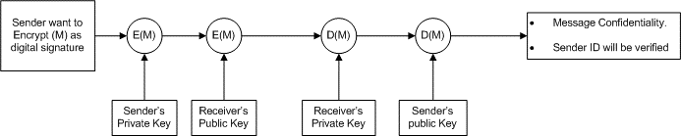
Basic Idea of Digital Signature
Solve Problem
Sender, will do the following
  Encrypt the message (M) using his private key, then
  Encrypt the message (M) using the receiver’s public key.
Receiver will do the following
  Decrypt the E(M) using his private key, then
  Decrypt the E(M) using sender’s public key.
How to check that Message has not be altered?

Slide 29
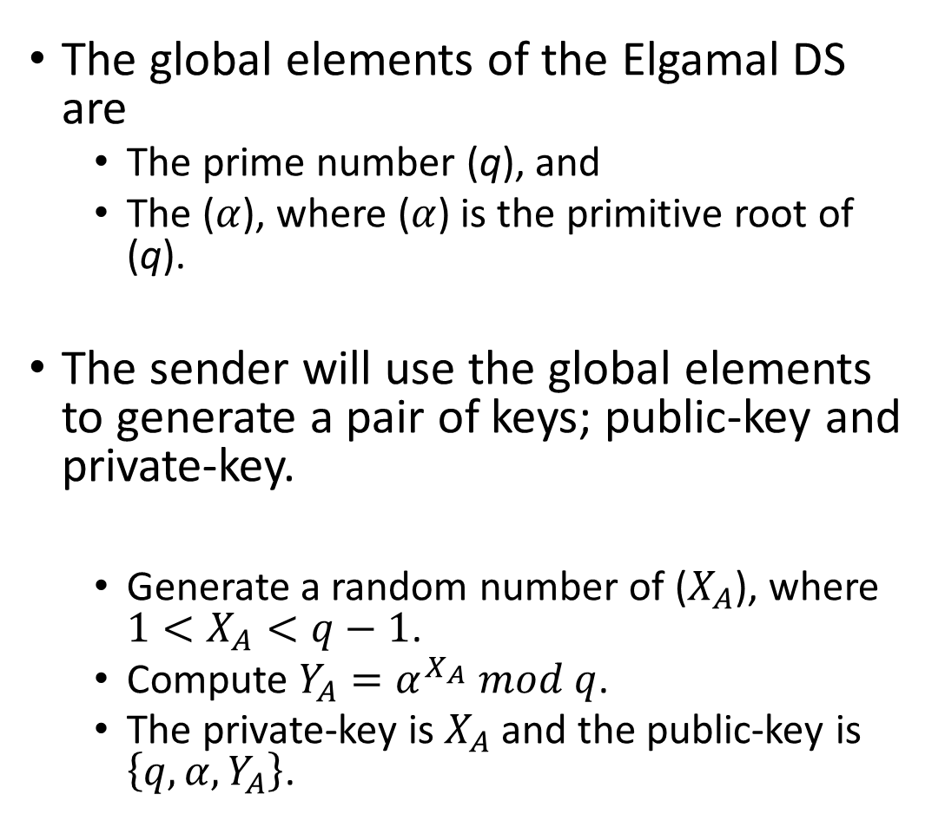
Elgamal DS
Making Signature
The global elements of the Elgamal DS are
  The prime number (q), and
  The ($α$), where ($α$) is the primitive root of (q).
The sender will use the global elements to generate a pair of keys; public-key and private-key.
  Generate a random number of ($X_{A}$), where $1<X_{A}<q−1$.
  Compute $Y_{A}=α^{X_{A}} mod q$.
  The private-key is $X_{A}$ and the public-key is $\left\{q, α, Y_{A}\right\}$.

Slide 30

Elgamal DS
Making Signature
Step One
  Computer the value of $m$ such that $m=H(M)$, where
    $H$ is the hashed function,
    $M$ is the value of the original message, and
    $m$ is the hashed value or is the hash code where, $1<m<q−1$.
Step Two
  Choose the value of $K$, such that $K$ is the primitive root of $q−1$ (Not $q$). Such that, $\gcd\left(K,q−1\right)=1.$
  Compute $S_{1}=α^{K} mod q$. Note that $S_{1}$is the same as $C_{1}$in Elgamal Encryption.
  Find $K^{−1} mod (q−1)$.
  Compute $S_{2}=K^{−1} \left(m−X_{A}S_{1}\right)mod (q−1)$.
  From step Two, getting the signature of two pair ($S_{1}$, $S_{2}$)

Slide 31
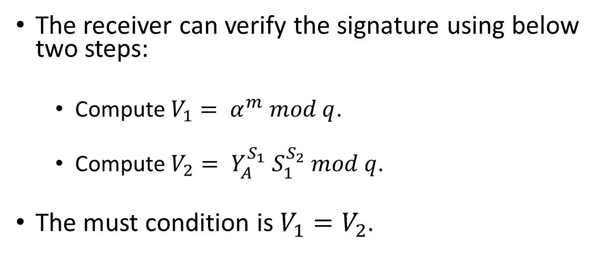
Elgamal DS
Verifying Signature
The receiver can verify the signature using below two steps:
  Compute $V_{1}= α^{m} mod q$.
  Compute $V_{2}= Y_{A}^{S_{1}} S_{1}^{S_{2}} mod q$.
The must condition is $V_{1}=V_{2}$.

Slide 32

CLASS
END

