Slide 1

Trauma- and Stressor-Related Disorders
M.Sc. Hilal Farouq Hussein
30th 04 2026

Slide 2
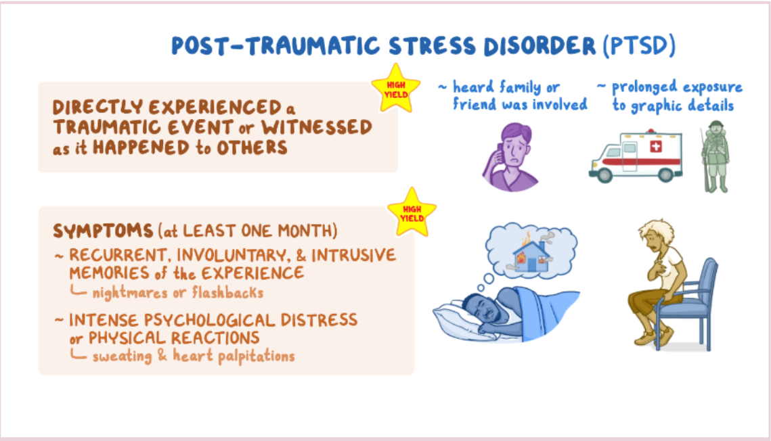

Slide 3
Trauma- and stressor-related disorders
Trauma- and stressor-related disorders include disorders in which exposure to a traumatic or stressful event is listed explicitly as a diagnostic criterion. These include:
  Posttraumatic Stress Disorder
  Acute Stress Disorder
  Adjustment Disorders
  Reactive Attachment Disorder
  Disinhibited Social Engagement Disorder

Slide 4
Diagnostic Criteria of Posttraumatic Stress Disorder (PTSD)
A. Exposure to actual or threatened death, serious injury, or sexual violence in one (or
more) of the following ways:
  Directly experiencing the traumatic event(s).
  2. Witnessing, in person, the event(s) as it occurred to others.
  3. Event(s) that happened to a close family member or close friend. It must have been violent or accidental
  4. Experiencing repeated or extreme exposure to aversive details of the traumatic event(s) (e.g., first responders collecting human remains; police officers repeatedly exposed to details of child abuse).
Note: Criterion A4 does not apply to exposure through electronic media, television,
movies, or pictures, unless this exposure is work related.

Slide 5
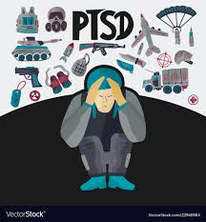

Slide 6
B. Presence of one (or more) of the following intrusion symptoms:
  Recurrent, involuntary, and intrusive distressing memories of the traumatic event(s). (Re-experience to terrible events).
  2. Recurrent distressing dreams are related to the traumatic event(s). (Nightmares).
  3. Dissociative reactions (e.g., flashbacks) in which the individual feels or acts as if the traumatic event(s) were recurring.
  4. Emotional distress after exposure to traumatic reminders
  5. Physical reactivity after exposure to traumatic reminders

Slide 7
C. Avoidance of trauma-related stimuli after the trauma, as evidenced by one or both of the following:
  1. Trauma-related thoughts or feelings(closely associated with the traumatic event(s).
  2. Trauma-related external reminders (people, places, objects, situations).

Slide 8
D. Negative thoughts or feelings that began or worsened after the trauma, as evidenced by two (or more) of the following:
  Inability to recall key features of the trauma (due to dissociative amnesia).
  2. Persistent and exaggerated negative beliefs or expectations about oneself, others,
  or the world (e.g., “I am bad,” “No one can be trusted,” “The world is completely
  Dangerous).
  3. Persistent, distorted cognitions about the cause or consequences of the traumatic
  event(s) that lead the individual to blame himself/herself or others.
  4. Persistent negative emotional state (e.g., fear, horror, anger, guilt, or shame).

Slide 9

D. Negative thoughts or feelings that began or worsened after the trauma, as evidenced by two (or more) of the following
  5. Markedly diminished interest or participation in significant activities.
  6. Feelings of detachment or estrangement from others.
  7. Persistent inability to experience positive emotions (e.g., inability to experience happiness, satisfaction, or loving feelings).

Slide 10


Slide 11

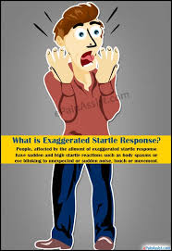
E. Marked alterations in arousal and reactivity associated with the traumatic event(s), beginning or worsening after the traumatic event(s) occurred, as evidenced by two (or more) of the following:
  1. Irritability or aggression
  2. Reckless or self-destructive behavior.
  3. Hypervigilance (Hyperalert).
  4. Exaggerated startle response. an intense, jumpy
  reaction to unexpected stimuli (sounds, touch, movement).
  5. Problems with concentration.
  6. Sleep disturbance (e.g., difficulty falling or staying asleep or restless sleep).

Slide 13
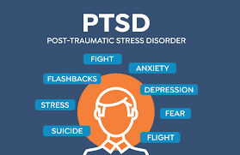

Slide 14
F. Duration of the disturbance (Criteria B, C, D, and E) is more than 1 month.
G. The disturbance causes clinically significant distress or impairment in social, occupational, or other important areas of functioning.
H. The disturbance is not attributable to the physiological effects of a substance (e.g., medication, alcohol) or another medical condition.

Slide 15
Prevalence of PTSD
The lifetime prevalence of PTSD according to DSM-5 criteria is estimated to be approximately 5.7% to 8.7% in the U.S. general population

Slide 16
Risk and Prognostic Factors
Risk factors are generally divided into:
Pre-traumatic (Pre-event factors),
Peritraumatic (Event factors,),
Posttraumatic factors(Post-event factors).

Slide 17
Pre-traumatic factors
Temperamental: These include childhood emotional problems by age 6 years and prior mental disorders (e.g.,
panic disorder, depressive disorder, PTSD, or obsessive-compulsive disorder [OCD]).
Environmental. These include lower socioeconomic status; lower education; exposure to
prior trauma (especially during childhood).
Genetic and physiological. These include female gender and younger age at the time of
trauma exposure (for adults). Certain genotypes may either be protective or increase risk
of PTSD after exposure to traumatic events.

Slide 18
Peritraumatic factors (Event Factors)…
• Witnessing or perpetrating, shocking act (e.g., purposely killing women and children).
• Experiencing dissociation during the trauma and after.
Notes:
Perpetrating: tawan dakat brutal: drnda, be bazae
Atrocity: drndae, dllraqe

Slide 19
Posttraumatic factors
Temperamental: These include negative appraisals(interpretation), inappropriate coping strategies, and development of acute stress disorder.
Environmental: These include subsequent exposure to repeated upsetting reminders, subsequent adverse life events, and financial or other trauma-related losses.
Social support (including family stability, for children) is a protective factor that moderates outcome after trauma.

Slide 20
Culture-Related Diagnostic Issues
The risk of onset and severity of PTSD may differ across cultural groups as a result of variation in the type of traumatic exposure (e.g., genocide or mass killing, Gazza, Halabja).

Slide 21
Common Types of Trauma According to Gender:
Military trauma is the most common type of trauma preceding PTSD for men.
Rape is the most common type of trauma preceding PTSD for women.

Slide 22
Suicide Risk
Traumatic events such as childhood abuse increase a person’s suicide risk.
PTSD is associated with suicidal ideation and suicide attempts, and presence of the disorder may indicate which individuals with ideation eventually make a suicide plan or actually attempt suicide.

Slide 23
Comorbidity
Individuals with PTSD are 80 % more likely than those without PTSD to have symptoms that meet diagnostic criteria for at least one other mental disorder (e.g., depressive, bipolar, anxiety, or substance use disorders).
Comorbid substance use disorder and conduct disorder are more common among males than among females.
Among U.S. military personnel and combat veterans who have been deployed to recent wars in Afghanistan and Iraq, co-occurrence of PTSD and mild traumatic brain injury is 48%.

Slide 24
Trauma Types
Single Incident
Complex Trauma
Developmental Trauma
Historical Trauma
Intergenerational Trauma

Slide 25
Single Incident:
  An unexpected and overwhelming event, such as an accident, natural disaster, a single episode of abuse, sudden loss or witnessing violence.
Complex Trauma:
  Exposure to ongoing, repetitive traumatizing events (e.g., abuse, war). It is often relational and often involves a sense of being trapped emotionally and/or physically.
  Some LGBTQ+ people’s experience repetitive abuse due to their identity.

Slide 26
Developmental Trauma:
Exposure to ongoing/repetitive trauma during a developmentally critical period (e.g., infancy, childhood, adolescence). Examples include neglect, physical abuse, sexual abuse, emotional abuse, verbal abuse, and witnessing violence.
Notes:
Infancy: Sawayate
Abandonment: choll kran, bajehelran

Slide 27
Historical Trauma:
Cumulative wounding emanating from massive group trauma inflicted by a dominant group against a subjugated population. Examples include genocide, colonialism (e.g., Halabja, Anfal, Heroshema, Gazza, ).
Notes:
Cumulative: ko, komalkraw, kalakabw
Wound: bren, zam
Emanate: haldaqulet
Massive: zl, gaura
Brendarbwne kalakabw ka la zabrw zange groupe gaura drust dabe
Subjugate: mlkach dakat
Colonialism: syasate dagerkare
Slavery: koyla

Slide 28
Intergenerational Trauma:
An aspect of historical trauma. Coping and adaptation patterns developed in response to trauma and passed on from one generation to the next(e.g., Halabja, Anbar, Mousel wars ).

Slide 29
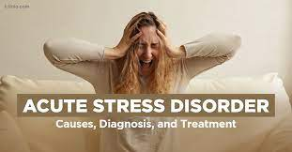


Acute stress disorder: is diagnosed when symptoms occur after a trauma. The symptoms of ASD are fairly similar to those of PTSD, but the duration is shorter; this diagnosis is only applicable when the symptoms last for 3 days to one month.

Slide 30
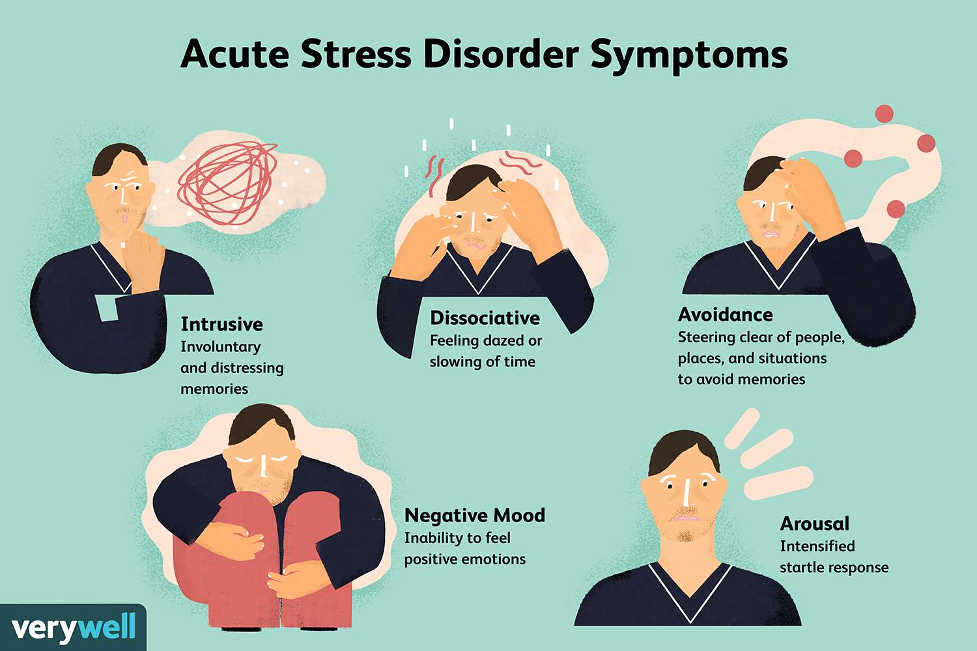

Slide 31
Diagnostic Criteria for Acute Stress Disorder
Exposure to actual or threatened death, serious injury, or sexual violation in one (or more) of the following ways:
Directly experiencing the traumatic event(s).
2. Witnessing, in person, the event(s) as it occurred to others.
3. Learning that the event(s) occurred to a close family member or close friend.

Slide 32
B. Presence of nine (or more) of the following symptoms from any of the five categories of intrusion, negative mood, dissociation, avoidance, and arousal, beginning or worsening after the traumatic event(s) occurred:
Intrusion Symptoms
Recurrent, involuntary, and intrusive distressing memories of the traumatic event(s).
2. Recurrent distressing dreams in which the content and/or affect of the dream are related to the event(s).
3. Dissociative reactions (e.g., flashbacks) in which the individual feels or acts as if the traumatic event(s) were recurring. (Such reactions may occur on a continuum, with the most extreme expression being a complete loss of awareness of present surroundings.)
4. Intense or prolonged psychological distress or marked physiological reactions in response to internal or external cues that symbolize or resemble an aspect of the traumatic event(s).

Slide 33
Negative Mood
5. Persistent inability to experience positive emotions (e.g., inability to experience happiness, satisfaction, or loving feelings).
Dissociative Symptoms
6. An altered sense of the reality of one’s surroundings or oneself (e.g., seeing oneself from another’s perspective, being in a daze, time slowing).
7. Inability to remember an important aspect of the traumatic event(s) (typically due to dissociative amnesia and not to other factors such as head injury, alcohol, or drugs).

Slide 34
Avoidance Symptoms
8. Efforts to avoid distressing memories, thoughts, or feelings about or closely associated with the traumatic event(s).
9. Efforts to avoid external reminders (people, places, conversations, activities, objects, situations) that arouse distressing memories, thoughts, or feelings about or closely associated with the traumatic event(s).

Slide 35
Arousal Symptoms
10. Sleep disturbance (e.g., difficulty falling or staying asleep, restless sleep).
11. Irritable behavior and angry outbursts typically expressed as verbal or physical aggression toward people or objects.
12. Hypervigilance(Hyperalert).
13. Problems with concentration.
14. Exaggerated startle response.

Slide 36
C. Duration of the disturbance (symptoms in Criterion B) is 3 days to 1 month after trauma exposure.
D. The disturbance causes clinically significant distress or impairment in social, occupational, or other important areas of functioning.
E. The disturbance is not attributable to the physiological effects of a substance (e.g., medication or alcohol) or another medical condition (e.g., mild traumatic brain injury) and is not better explained by brief psychotic disorder.

Slide 37
Risk and Prognostic Factors
Temperamental: Risk factors include prior mental disorder, high levels of negative affectivity
(neuroticism), greater perceived severity of the traumatic event, and an avoidant
coping style. Catastrophic appraisals of the traumatic experience, often characterized by
exaggerated appraisals of future harm, guilt, or hopelessness, are strongly predictive of
acute stress disorder.
Environmental: First and foremost, an individual must be exposed to a traumatic event to
be at risk for acute stress disorder. Risk factors for the disorder include a history of prior
trauma.
Genetic and physiological: Females are at greater risk for developing acute stress disorder.

Slide 38
Diagnostic Criteria for Adjustment Disorders
A. The development of emotional or behavioral symptoms in response to an identifiable stressor(s) occurring within 3 months of the onset of the stressor(s).
B. These symptoms or behaviors are clinically significant, as evidenced by one or both of the following:
Marked distress that is out of proportion to the severity or intensity of the stressor, taking into account the external context and the cultural factors that might influence symptom severity and presentation.
2. Significant impairment in social, occupational, or other important areas of functioning.

Slide 39
C. The stress-related disturbance does not meet the criteria for another mental disorder and is not merely an exacerbation of a preexisting mental disorder.
D. The symptoms do not represent normal bereavement.
E. Once the stressor or its consequences have terminated, the symptoms do not persist for more than an additional 6 months.

Slide 40
Prevalence
The percentage of individuals in outpatient mental health treatment with a principal diagnosis of an adjustment disorder ranges from approximately 5% to 20%.

Slide 41


Slide 42
Treatment
• Individual Therapy (CBT, Exposure, NET, EMDR…)
• Group Support (especially for Chronic PTSD)
• Medication:
Antidepressant.
Antipsychotic medication such as Risperidone tab.
Antianxiety such as Benzodiazepams for short period.
Notes:
IMRS: integrated mental rehearsal system

Slide 43
Nursing Interventions for Trauma- and Stressor-Related Disorders
Educate yourself and other staff members about the client’s experience and about posttraumatic behavior (Psychoeducation).
Teach the client and the family or significant others about posttraumatic behavior and treatment (Psychoeducation).
Encourage the client to express his or her feelings through talking, writing, crying, or other ways in which the client is comfortable.
Encourage the client to talk about his or her experience(s); be accepting and nonjudgmental of the client’s accounts and perceptions.

Slide 44
Respect client’s wishes regarding interaction with individuals of opposite sex at this time (especially important if the trauma was rape).
Stay with client during flashbacks, and doing grounding techniques.
Help the client learn and practice stress management and relaxation techniques.
If the client has a religious or spiritual orientation, referral to a member of the Islamic religion man may be appropriate.
Encourage the client to identify and contact supportive resources in the community or on the Internet.
Apply 10 rights about psychotropic medication.
Refer the pt. to psychotherapeutic sessions.

Slide 45
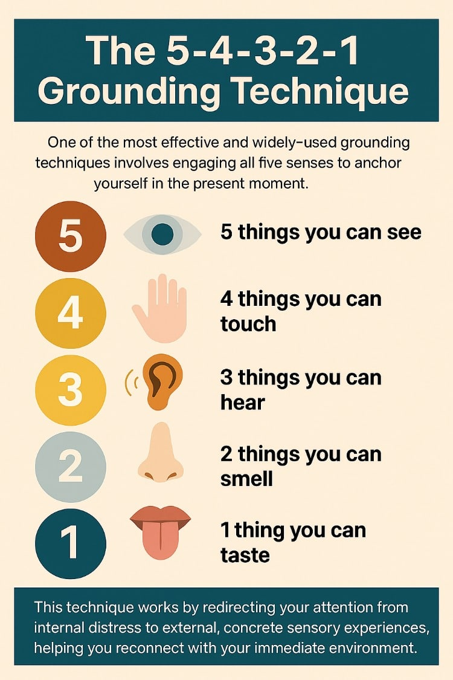

Slide 46
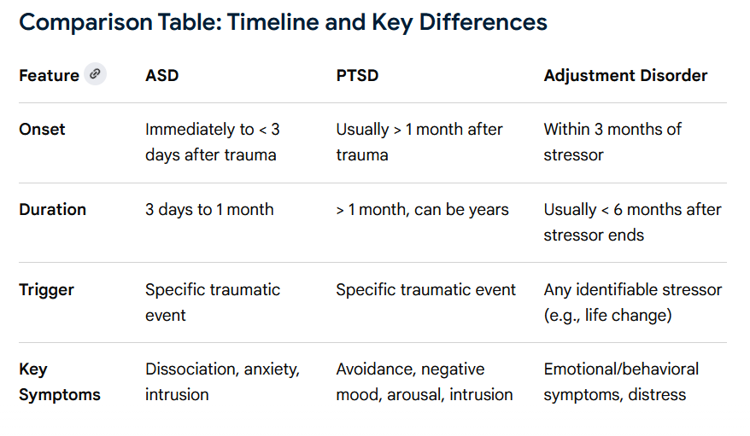

Slide 47
References
American Psychiatry Association(2013). Diagnostic Statistical Manual of Mental Illness- 5 Text Revision. P. 265-289.
Sheila L. Videbeck (2017). PSYCHIATRIC –MENTAL HEALTH NURSING. 7 EDITION. P. 474- 505.

