Slide 1

Nursing Leadership and Management
Dr. Salih A Abdulla
Introduction to Nursing Service Management
Spring Semester
Week 2
2025-2026

Slide 2
OUTLINE
Introduction to Nursing Service Management
Definition of management and nursing service administration
Types of managers
Managerial Skills
Managerial roles
Health Service Organizational Model

Slide 3
Introduction to Nursing Service Management
LEARNING OBJECTIVES
After reading this chapter, the student will be able to:
Define administration/management and nursing service administration
Describe the managerial level, role and skills
Explain the importance of good management in a health service organization

Slide 4
Management is as old as human kind and existed since man has been organized in to communities.
Managers influence all phases of our modern organizations.
a modern organization is one that:
- Uses technology and digital systems
- Focuses on teamwork
- Is influenced by globalization, diversity, and competition
- Pays attention to employees, customers, and stakeholders,

Slide 5
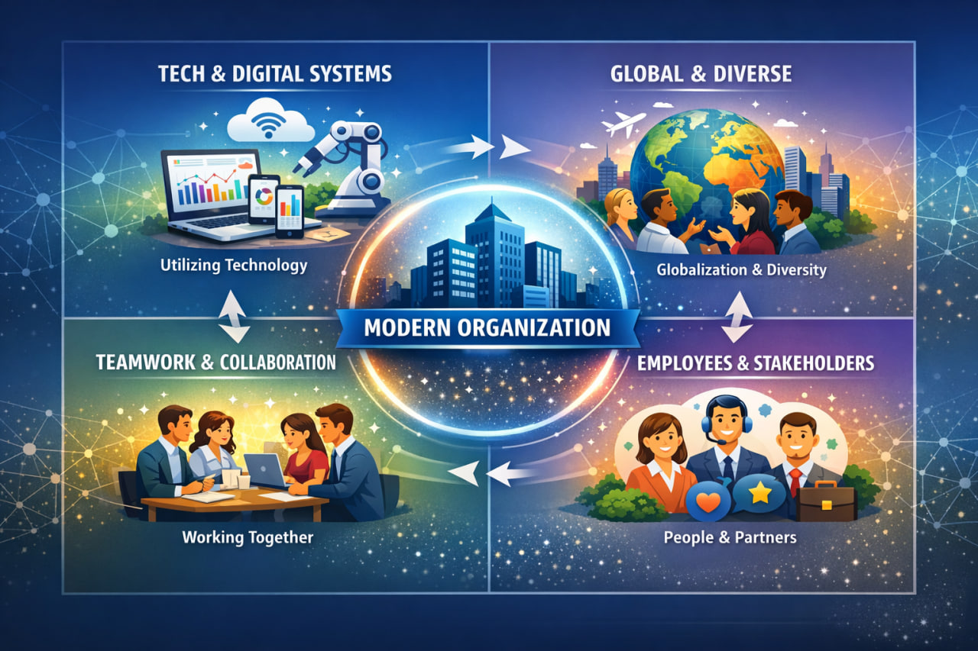

Slide 6
Peter Drucker stating that effective management is quickly becoming the main resource of developed countries and the most needed resource of developing ones.

Slide 7
Essentially, the role of managers is to guide organizations toward goal accomplishment.
All organizations exist for some purpose or objective, and mangers have the responsibility for combining and using organizational resources to ensure that the organizations achieve their purposes.

Slide 8
Management moves organizations toward these purposes or goals by assigning activities that organization member perform.
Management has no meaning apart from its goals.
Management must keep organizational goals clearly in mind at all times.

Slide 9
Definition of management and nursing service administration
Definition of management
Different authorities define management differently but have strong unifying similarities in all the definitions.
Management refer to the process that managers follow to accomplish organizational goals. Management is a cumulative body of information that furnishes insight on how to manage.

Slide 10
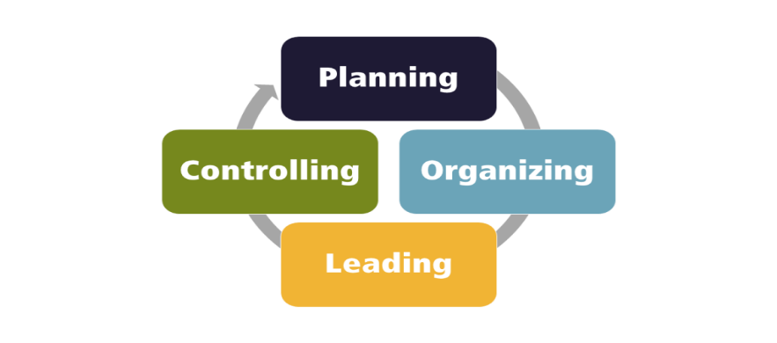
It is the process of planning, organizing, leading and controlling the work of organization members and of using all available organizational resources to reach stated organizational goals.
It is the process of directing, coordinating and influencing the operation of an organization to obtain desired result and enhance total performance.

Slide 11
Nursing service administration
Nursing service administration is a coordinated activity, which provides all of the facilities necessary for the rendering of nursing service to clients.
Nursing service administration is the system of activities directed toward the nursing care of clients, and includes the establishment of over-all goals and policies within the aims of the health agency.

Slide 12
Nursing service administration is the marshaling of resources to accomplish a purpose.
It is both an art and a science. It is a science in the sense that one may systematically study and analyze the behavior of people as a collective endeavor.
It is an art because it requires qualities of dynamic character to make them effective in application.

Slide 13
Nursing service administration is the process of planning, organizing, leading and controlling that encompasses human, material, financial and informational resources in an organizational environment to achieve the predetermined objectives.
The primary objective of the role of nursing service is the provision for continuous individual, group and community service, including whatever is necessary.

Slide 14
The subsidiary objectives of this role are the professional activities of administration, including human relations, communications, teaching, research, and personal development, designed to further the primary objective-the optimum nursing care of patients.

Slide 15
Types of managers, managerial skill and roles
Nursing service managers are people who appointed to positions of authority, which enable others to perform their work effectively, who have responsibility for resource utilization and who are accountable for work.

Slide 16
Types of managers
Traditionally classifications of managers are by level in the organizational hierarchy; common classification is:
Top level–such as board of directors, Presidents and vice presidents
Middle level–such as directors of nursing, supervisory staffs and department heads
First line/front line/ or supervisory management– such as head nurses and staffs.

Slide 17
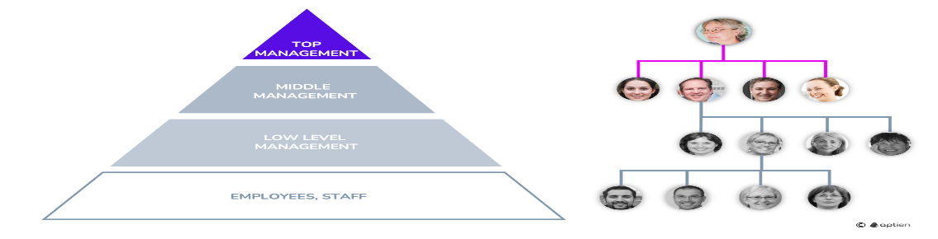

Slide 18
The primary differences between levels of managers are the degree of authority and the scope of responsibility and organizational activity at each level.
For example,
Top-level managers such as nursing administrators have authority over and responsibility for the entire organization.
Middle level managers such as department heads and heads of services have authority over and responsibility for a specific segment, in contrast to the organization as a whole and act as a liaison between top-level managers and first level managers.
First line managers, who generally report to middle level managers have authority over and are responsible for overseeing specific work for a particular group of works.

Slide 19
Managerial Skills
Managers can also be differentiated by the extent to which they use certain skills: conceptual, human relations and technical skills. All managers use human relation skills because they accomplish work through people.
Human relations skills include motivation, leadership and communication skills.

Slide 20
Senior managers use more conceptual skills in their jobs than do middle level or first line managers.
These include recognizing and evaluating multiple complex issues and understanding their relationships, engaging in planning and problem solving that profoundly affect the health service organization, and thinking globally about the organization and its environment.

Slide 21
Managerial roles
All health service managers engage in planning, organizing, staffing, directing, controlling, and decision making to some degree.
Mintzberg’s classification of roles identifies:
Interpersonal
Informational
Decisional roles

Slide 22
Interpersonal role
The three interpersonal roles are;
Figurehead: all managers, but especially senior managers, are figureheads because they engage in ceremonial and symbolic activities such as greeting visitors and making speeches at organizational events.
for example: Nurse manager welcoming new staff or students

Slide 23
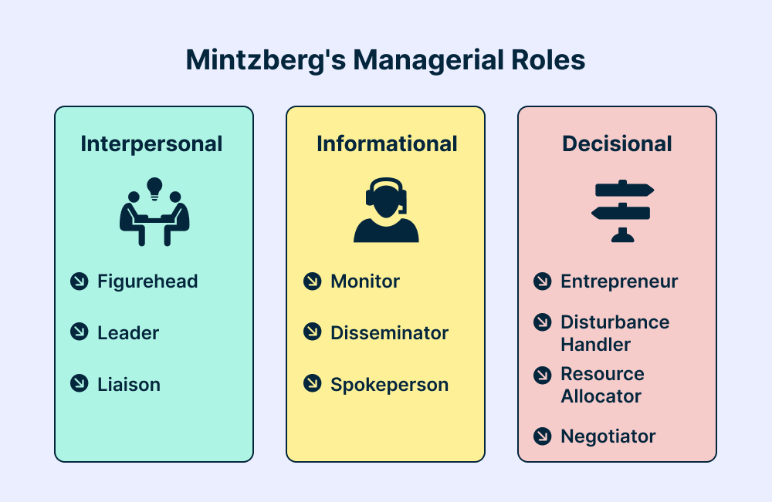
Liaison: involves formal and informal internal and external contacts.
Influencer: includes activities inherent in the directing function, the purpose of which is to motivate and lead.

Slide 24
Informational role
The three informational roles of a manager are:
Monitor (Actively seeks and receives information from inside and outside the organization)
Disseminator (Shares relevant information with subordinates and teams).
Spokesperson (Communicates information to outsiders about the organization).

Slide 25
Decisional Roles
The four decisional roles of a manager are:
Entrepreneur
Initiates change and innovation.
Examples: starting a new project, improving hospital procedures
Disturbance handler
Manages conflicts and crises.
Examples: resolving staff disputes, handling emergencies, managing complaints

Slide 26
Resource allocator
Decides where and how resources are used.
Examples: assigning staff, budgeting funds, scheduling equipment
Negotiator
Represents the organization in negotiations with others.
Examples: negotiating contracts with suppliers, agreements with unions or partners

Slide 27
Health care, health services and health service organizational models Health care:
is the total societal effort, organized or not, whether private or public, that attempts to guarantee, provide, and finance the promotion of health, prevention of diseases, and restoration of health and rehabilitation.

Slide 28
Health service:
is the delivery of health care
Health service organizations:
Deliveries of health services to clients occur in a variety of organizational settings.

Slide 29
Thanks

