Slide 1

Healthcare economics
Dr. Salih A Abdulla
Introduction to economics
Spring Semester
Week 2
2025-2026

Slide 2
OUTLINE
Introduction
Definition of economics
Branches of economics
Basic concepts of supply and demand analysis

Slide 3
LEARN ING OBJEC TIVES
After reading this chapter, the student will be able to:
Understand the meaning and purpose of economics
2. Know the major branches and approaches of economics
3. Be able to identify and understand the basic instruments of microeconomic analysis
4. Understand the implication of economics for business decision making and its role in changing the performance of the national economy.
5. Appreciate the importance of economics to the resource allocation, planning and management of the health sector.

Slide 4
Introduction
Health economics is about how to use limited resources in healthcare in the best way.
In the health sector, resources such as:
Human resources (doctors, nurses, health workers)
Material resources (equipment, medicines, beds)
Financial resources (money, budgets)
“Resources are limited, but the needs of patients are many.”

Slide 5
Health economics helps decide how to use these resources wisely so that maximum health benefits are achieved with minimum waste.
That is why every health worker should understand basic economic concepts. This knowledge helps them:
Plan and manage hospitals or clinics properly
Use staff, supplies, and money efficiently
Provide better health services to more people
Avoid unnecessary costs and shortages.

Slide 6
In short:
Health economics teaches health workers how to make the best decisions with limited resources to improve healthcare delivery efficiently.
Health economics” as a course is meant to give medical, health officer and other paramedical students basic principles regarding economics and its application to the health sector.

Slide 7
Health Economics (as a course) means a subject that studies how limited healthcare resources are allocated and used efficiently to meet the health needs of individuals and populations

Slide 8
Economics is the study of how people allocate their limited resources in an attempt to satisfy their unlimited wants.
Economic Is the study of how people make choices.
Economic is also the study of scarcity and choice, finally helps how to use scarce or limited resource.
Economics lies on the production, distribution and consumption of economic goods.

Slide 9
Branches of economics
Macroeconomics versus microeconomics
A major distinction is made between macroeconomics, which studies the functioning of the economy as a whole, and microeconomics, which analyses the behavior of individual components like industries, firms and households.

Slide 10
Individual components are the separate parts or elements that come together to form a whole.
Examples
Human body → heart, lungs, brain, muscles
Health system → hospitals, doctors, nurses, medicines, equipment
Education system → students, teachers, curriculum, classrooms
Computer → monitor, keyboard, CPU, mouse

Slide 11
Macroeconomics:
The study of the behavior of the entire economy and concerned with the behavior of the economy as a whole or with the broad aggregate of economic life such as national output, income, the overall price level, unemployment, and foreign trade.

Slide 12
It examines such historical issues as why did production and prices in some countries and the rest of the industrial world collapse during the great depression of the 1930s.
Great depression of the 1930s.
It was a period when economies collapsed, businesses failed, banks closed, and millions of people lost their jobs and income

Slide 13
In addition to helping people in their personal lives, economics is required to understand key national issues and to make progress in dealing with them.

Slide 14
Key national issues are the major problems or challenges that affect a country as a whole and need government and public attention.
Common key national issues include:
Economic issues – unemployment, poverty, inflation, cost of living
Health issues – access to healthcare, disease outbreaks, health system quality
Education issues – literacy rates, school quality, access to higher education

Slide 15
Political issues – governance, stability, rule of law
Security issues – crime, terrorism, national defense
Social issues – inequality, gender issues, population growth
Environmental issues – pollution, climate change, water scarcity
Infrastructure issues – electricity, transport, housing, clean water

Slide 16
But for many people the pay-off from such economic knowledge comes when it is applied to a second task, that of improving economic performances.

Slide 17
Microeconomics:
Deals with the behavior of individual prices and quantities.
Our knowledge of economics helps us to manage our personal lives, to understand society and to design better economic policies.
The role of better economic understanding in guiding our individual lives will be as varied as are our personalities or physiognomies.
The doctor, the investor and the farmer all need to understand about accounting and regulation to make the highest profits from their businesses.

Slide 18
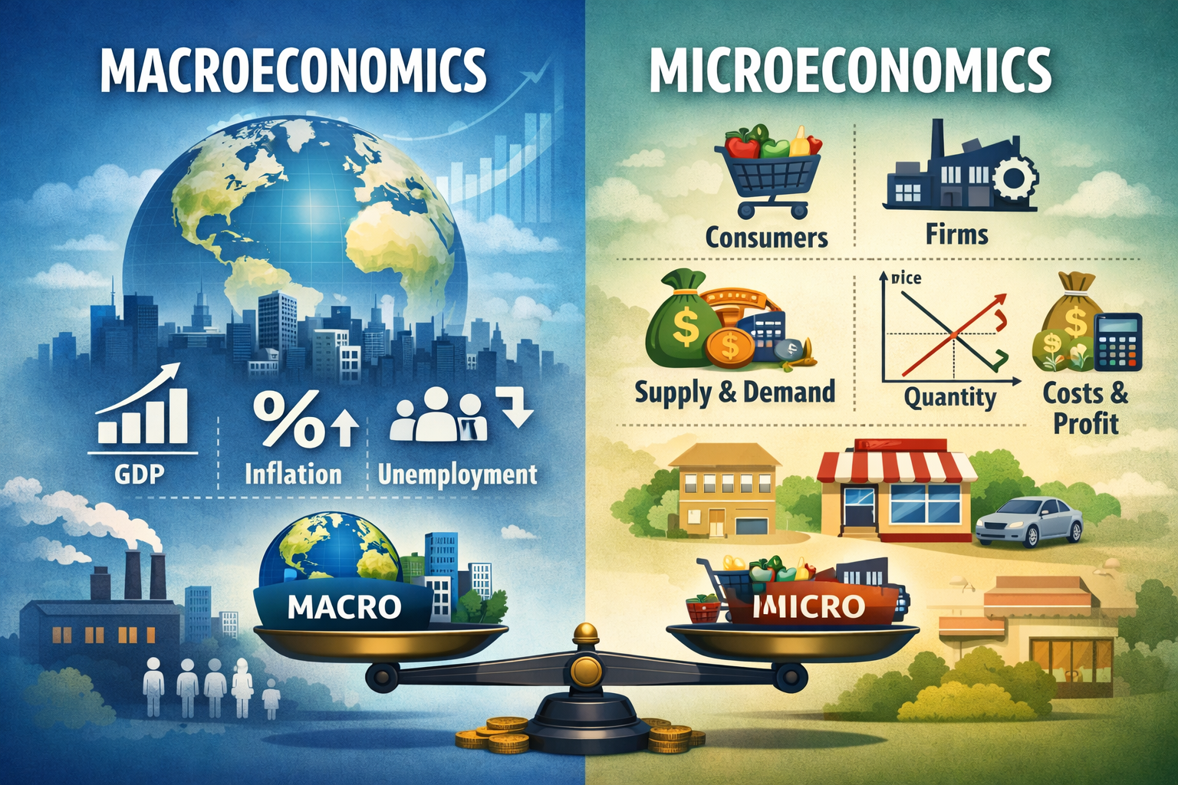

Slide 19
Positive versus normative economics
Positive economics: describes the facts and behavior in the economy. What percentages of teenagers are unemployed?
How many people earn less than 250,000 Iraqi dinar a year?
What will be the effect of higher cigarette taxes on the number of smokers?
These are questions that can be resolved only by reference to facts; they are all the realm of positive economics.

Slide 20
Normative economics: involves ethics and value judgments.
Should the government give money to poor people?
Should the public sectors (government) or the private sector (business) provide extra jobs for unemployed teenagers?
Should higher taxes or lower spending reduce the budget deficit? These are questions involving deeply held values or moral judgments.

Slide 21
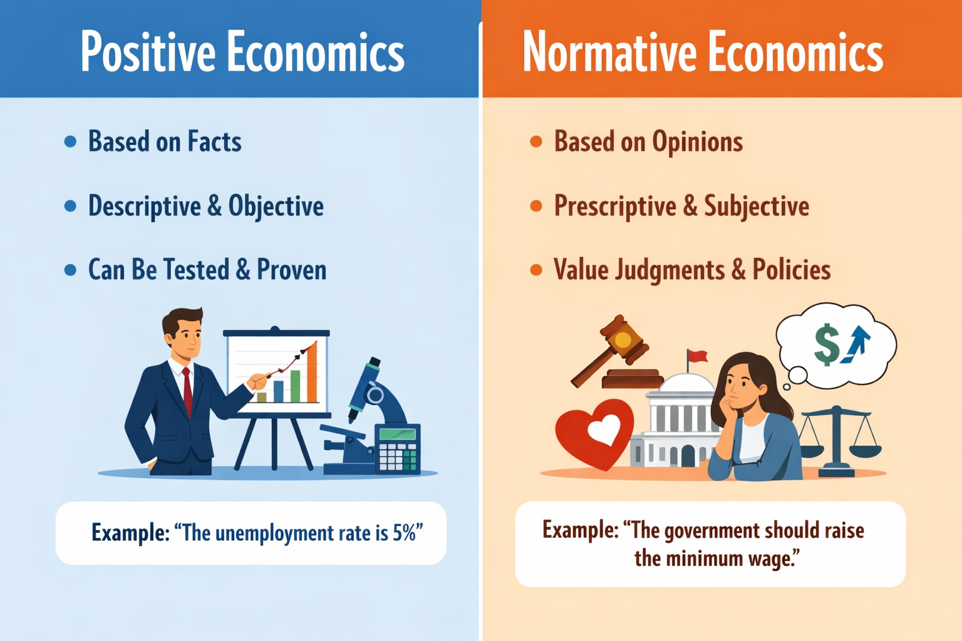

Slide 22
Basic concepts of supply and demand analysis
Definition of Demand:
Need + ability and willingness to pay for a commodity
- The schedule of amounts of any product that buyers will purchase at different prices during some stated time period.

Slide 23
Desire refers to people’s willingness to own a good.
- Demand is the amount of a good that consumers are willing and able to buy at a given price

Slide 24
Definition Supply:
The amounts of a good producer are willing and able to sell at a given price. For many people the word market conjures up a picture of a town square with lots of small stall holders selling everything from fruit and vegetables to meat and fish.

Slide 25
For economists, the term has a much wider meaning. It is used to describe any process of exchange between buyers and sellers. Formally, a market can be defined as any set of arrangements which allows buyers and sellers to communicate and thus arrange exchange of goods, services or resources.

Slide 26
So, a market for health care must involve two groups: the buyers and the sellers, who interact to trade health care.
Who would the buyers and sellers be in such a market?
We all want good health and so most of us would be prepared, if necessary, to purchase medical treatment to cure an illness.

Slide 27
This suggests that everybody is potentially a buyer (or consumer) of health care.
More precisely, at any moment, a buyer would be any body who was ill or who wanted preventative medical treatment such as vaccination or who wanted guidance about their health.

Slide 28
The sellers would be those people who could provide medical and health care services, such as doctors, nurses, physiotherapists, dentists and high street chemists.

Slide 29
Elasticity
Elasticity provides a way of measuring how sensitive demand or supply is to factors such as a change in price.
Take the relationship between price and quantity demanded.
We know that if price rises, then people will buy less, but we do not know how much less.

Slide 30
Gross National Product (GNP) What is a Gross National Product?
It is a term denoting the total money value of the goods and services produced by a nation during a given year.
GNP is used for many purposes, but the most important one is that it measures the overall importance of an economy.

Slide 31
The Gross National Product (GNP) is the most comprehensive measure of a nation’s total output of goods and services.
It is the sum of the monetary values of consumption, investment, government purchases of goods and services and net exports.

Slide 32
Thanks

