Slide 1

Health Promotion
Dr. Salih A Abdulla
Health promotion Part 1
Spring Semester
Week 2
2025-2026

Slide 2
LEARN ING OBJEC TIVES
After reading this chapter, the student will be able to:
Understand Brief Overview of Health in the Twentieth Century
Identify health trends related to chronic disease during the second half of the twentieth century.
Describe modifiable and non-modifiable risk factors.
Identify the leading causes of death in the United States.
Understand Health Promotion as An Emerging Field

Slide 3
OUTLINE
• Introduction
• Brief Overview of Health in the Twentieth Century
• Health Promotion: An Emerging Field
Health Promotion
Health education
Public health

Slide 4

Introduction
Health promotion is a relatively new field and works in conjunction with the fields of health education and public health to improve the health and wellbeing of individuals, communities, and society.

Slide 5
Collectively, professionals in these fields take a leadership role in collaborating with public health departments, communities, work sites, health care organizations, schools, and other entities to deliver programs and create healthful environments that lead to an improved health status of individuals.

Slide 6
Brief Overview of Health in the Twentieth Century
A critical examination of the history of health issues related to death and disability in the United States provides us with an appreciation of how social and environmental factors influence disease patterns.
Social Factors like Poverty, Education level and Occupation.
Environmental Factors like Air pollution, Unsafe water and Poor sanitation.

Slide 7
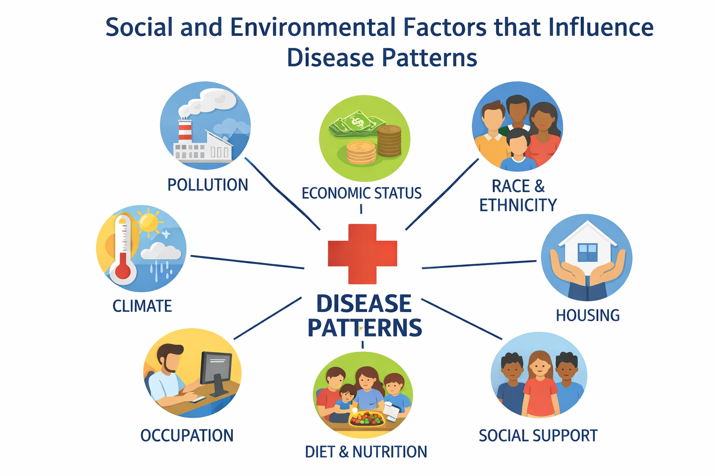

Slide 8
1900– 1950s
During the first half of the twentieth century (1900– 1950s), the topic of health in the nation focused on developing the medical profession and establishing hospitals to treat patients.
Public health departments focused on sanitation, disease control, and health education.

Slide 9
During this time, public health functions included child immunization programs, community health services, substance abuse programs, and sexually transmitted disease control.
Examples of substances:
- Alcohol - Tobacco - Illegal drugs

Slide 10
Life Expectancy
By examining the life expectancy of men and women in the United States
over time, one can understand how medical and health advances have affected the health of a population.
Life expectancy is a measure of the health status of a given population and is defined as “the average number of years a person from a specific cohort is projected to live from a given point of time”.

Slide 11
At the beginning of the twentieth century, the life expectancies of men and women were 46.3 and 48.3 years, respectively.
The discovery of antibiotics and improved sanitation practices significantly contributed to increasing life expectancies by the 1950s, reaching sixty-five and seventy-one years for men and women, respectively.

Slide 12
Chronic Disease
As a result of the advances of immunizations, antibiotics, maternal and child health, and improved sanitation practices, life expectancy increased. Extending years of life was a positive advancement.

Slide 13
However, one result of a longer life expectancy is the more significant impact that personal health choices and environmental factors have on the development of chronic conditions, sometimes referred to as non-communicable diseases, which are not infectious or transferable from one person to another.

Slide 14
Chronic disease is defined as a health condition or disease that lasts for a long period of time, usually for longer than three months. Chronic diseases also tend to take a long period to develop.
Chronic conditions such as high cholesterol have developed over years of consuming high saturated fat and cholesterol foods, which leads to high blood cholesterol levels and is a risk factor for cardiovascular disease.

Slide 15
1960s– 2000s
During the second half of the twentieth century, a number of social and environmental changes occurred that influenced consumer health choices and behaviors.
Changes in the way we live are inevitable; however, health promotion professionals must examine how these changes influence health status and respond to these changes to maintain and improve health for individuals and society.

Slide 16
Health promotion, as a field of study, has a shorter history than public health and health education.
The emergence of health promotion was a direct response to the changes in disease patterns in the United States, particularly the rise of chronic disease rates beginning in the mid-twentieth century.

Slide 17
This rise is attributed primarily to two reasons:
The discovery of antibiotics and vaccinations to prevent and treat infectious diseases and
The adoption of lifestyle behaviors that increase risk for conditions that lead to chronic diseases.

Slide 18
According to the World Health Organization, health promotion is the process of enabling people to increase control over, and to improve, their health.
It moves beyond a focus on individual behavior towards a wide range of social and environmental interventions.

Slide 19
Dr. Michael O’ Donnell (2002), a leading scholar in the field of work site
health promotion, offers this definition of health promotion:
The art and science of helping people discover the synergies between
their core passions and optimal health, enhancing their motivation to
strive for optimal health, and supporting them in changing their
lifestyle to move toward a state of optimal health.

Slide 20
Health Education
Health education is defined by the World Health Organization as any combination of learning experiences designed to help individuals and communities improve their health, by increasing their knowledge or influencing their attitudes.

Slide 21
Public Health
Public health, as defined by the World Health Organization, is concerned with the health of the community as a whole. The three core public health functions are:
1. The assessment and monitoring of the health of communities and populations at risk to identify health problems and priorities;

Slide 22
2. The formulation of public policies designed to solve identified local and national health problems and priorities; and
3. Ensuring that all populations have access to appropriate and cost-effective care, including health promotion and disease prevention services, and evaluation of the effectiveness of that care.

Slide 23
These definitions clearly indicate that public health, health education, and health promotion are all working toward the common goal of improving health for individuals and society.

Slide 24
Public health, as the previous definition demonstrates, is engaged with monitoring the health of the public, formulating policies, and ensuring all citizens have access to health care, all of which are critical to ensuring a healthy society.

Slide 25
Health promotion focuses primarily on chronic disease management by 1. Monitoring health conditions,
2. Assisting individuals to make healthy choices, and
3. Formulating policies that create healthy environments.

Slide 26
Thanks

