Slide 1

Healthcare economics
Dr. Salih A Abdulla The Economics of Healthcare Spring Semester Week 3 2025-2026

Slide 2
OUTLINE
Introduction
The Discipline of Health Economics
The Special Characteristics of the Market for Healthcare
Future Challenges to Health Care Systems

Slide 3
LEARN ING OBJEC TIVES
After reading this chapter, the student will be able to:
Define of health economics
Understand the main characteristics of the healthcare market.
Understand various problems of the health sector
Future Challenges to Health Care Systems

Slide 4
INTRODUCTION
Economists in all sectors are concerned with the allocation of resources between competing demands.
Resources like labor, raw materials, production equipment and land are always finite.
Thus, scarcity of resources becomes the fundamental problem to which economists address themselves.

Slide 5
As economists started to work on problems in the health sector, the new discipline of health economics emerged.
Many of the concerns in health economics are also those of other health scientists – how can we improve survival, quality of life and fairness in access to services?
Therefore, understanding the modern economy requires an appreciation of the special economics of healthcare.

Slide 6
The Discipline of Health Economics
Health economics as an independent scientific discipline started more than seven decades ago, in the sense that the specific treatment of topics relating to the economics of the health care sector has become common.

Slide 7
The field is now well established that it has appeared in the ordinary curriculum of most universities, and academic health economists are found in the medical departments, the connections to economics proper are being strengthened, and the methodology applied is refined.

Slide 8
Economic Problems in the Health Care Sector
1. Rising Costs
Healthcare expenses are increasing faster than incomes or budgets.
For example:
A new cancer drug costs $10,000 per month, but most patients cannot afford it.

Slide 9
2. Limited Resources
There are not enough doctors, nurses, hospital beds, or equipment to meet demand.
For example:
A rural town has only one clinic, so patients must travel far for treatment

Slide 10
3. Inefficient Allocation
Money and resources may be spent on low-value or unnecessary treatments.
For example:
Hospitals spend heavily on expensive MRIs for minor injuries, instead of preventive care.

Slide 11
4. Inequitable Access
Not everyone can access healthcare equally.
For example:
Wealthier people get faster treatment, while poorer patients wait months.

Slide 12
5. Quality Variation
The standard of care differs across regions or facilities.
For example:
A patient receives better surgery outcomes in a city hospital than in a village clinic

Slide 13
6. Uncertain Demand
People don’t know in advance how much healthcare they will need, making planning hard.
For example:
A sudden flu outbreak overwhelms clinics that did not prepare for extra patients.

Slide 14
7. Information Gaps
Patients and providers may lack complete knowledge, leading to poor choices.
For example:
A patient takes unnecessary antibiotics because they were not informed about proper treatment

Slide 15
The Special Characteristics of the Market for Healthcare
The standard theory of how markets work is the model of supply and demand. This model has several notable features:
The main interested parties are the buyers and sellers in the market.
Buyers are good judges of what they get from sellers.

Slide 16
3. Buyers pay sellers directly for the goods and services being exchanged.
4. Market prices are the primary mechanism for coordinating the decisions of market participants.
5. The invisible hand, left to its own devices, leads to an efficient allocation of resources.

Slide 17
For many goods and services in the economy, this model offers a good description.
But none of these features of the standard model reflects what goes on in the health care market.
Like other markets, the health care market has consumers (patients) and producers (doctors, nurses, etc.).
But various features of this market complicate the analysis of their interactions. In particular:

Slide 18
1. Third parties — insurers, governments, and unwitting bystanders—often have an interest in health care outcomes.
2. Patients don’t know what they need and cannot evaluate the treatment they are getting.

Slide 19
3. Health care providers are often paid not by the patients but by private or government health insurance.
4. The rules established by these insurers, more than market prices, determine the allocation of resources.

Slide 20
5. In the light of the foregoing four points, the invisible hand can’t work its magic, and so the allocation of resources in the health care market can end up inefficient.

Slide 21
The typical markets — say, the market for rice — looks like panel (a) of Figure 1.1.
The market has buyers and sellers.
A seller offers a good or service at a price.
A buyer who wants the item simply has to offer the right amount of money.
An exchange is made, and soon the seller is counting her profit and the buyer is enjoying his rice.

Slide 22
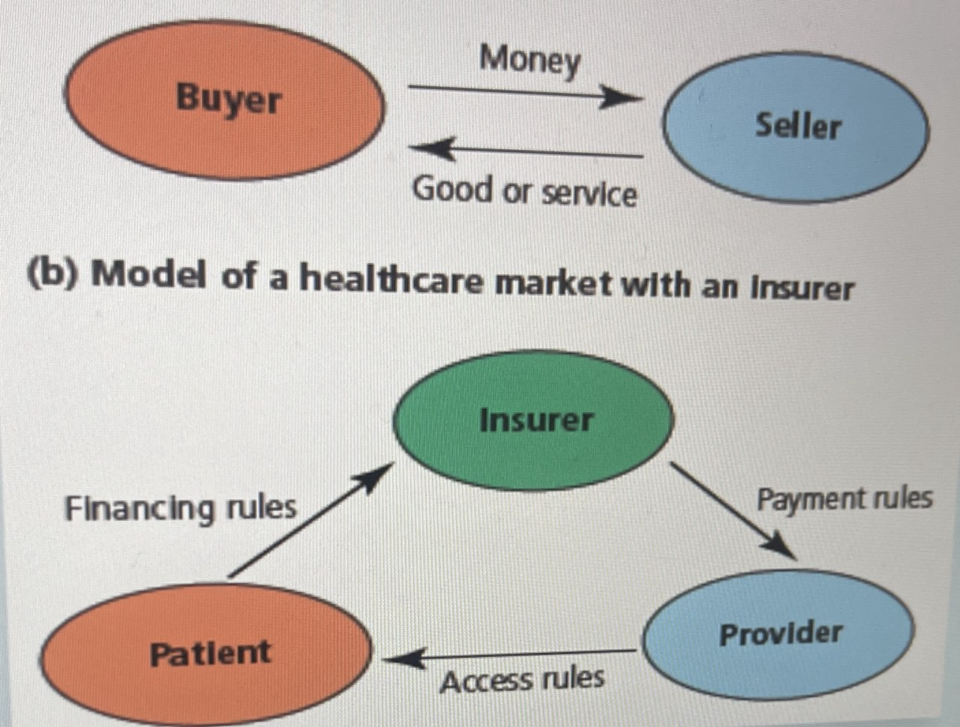
Figure 1.1: Models of Typical Market and Health Care Market

Slide 23
The market for health care looks more like panel (b).
The provider (the seller of medical services) is not paid directly by the patient (the buyer).
Instead, the patient pays money to an insurer in the form of either a premium (if the insurer is a private company) or taxes (if the insurer is the government).

Slide 24
Future Challenges to Health Care Systems
The ensuing disequilibria are perceived as ‘challenges to health care systems. Such challenges have emerged in four areas:

Slide 25
(a). The technological challenge:
In 1980 the magazine Newsweek presented the following medical innovations: a new piece of equipment of significance comparable to the CT scanner which makes brain-waves visible, revolutionary surgical methods for eliminating shortsightedness and infertility in women.

Slide 26
Almost all of these innovations are product innovations, i.e., they save lives or contribute to an improved quality of life, although at (much) higher cost.

Slide 27
(b) The demographic challenge:
At first sight, this is simply to say that more and more people are getting older.
Old age is associated with an increased demand for medical and in particular nursing services, and the issue is how to meet this demand.

Slide 28
(c). The challenge of the ‘Sisyphus Syndrome’: The success of modern medicine reminds one of Sisyphus.
The Sisyphus Syndrome
describes how advances in medicine reduce death but increase long-term care needs, creating ongoing pressure on healthcare systems

Slide 29
(d). The challenge of international competition:
Why international competition is a challenge?
Governments need to make their healthcare system better to retain and attract workers.

Slide 30
Thanks

