Slide 1

Nursing Leadership and Management
Dr. Salih A Abdulla Organization and organizational structure Spring Semester Week 4 2025-2026

Slide 2
OUTLINE
• Systems theory and its components
• Formal and informal organizational structures
• Identify the four types of formal organizational structures
•Describe the differences between centralized and decentralized structures

Slide 3
LEARN ING OBJEC TIVES
After reading this chapter, the student will be able to:
• Discuss systems theory and its components
• Describe formal and informal organizational structures
• Identify the four types of formal organizational structures
• Describe the differences between centralized and decentralized structures

Slide 4
• Discuss advantages and disadvantages of each of the following organizational structure: Pure line, line and staff, functionalized line and staff; and matrix
• Explain the relationship between responsibility and authority under ideal circumstances.
• Identify the major components required to deliver effective nursing care • Discuss and compare each type of client care delivery system

Slide 5
Systems Theory
Ludwig Von Bertalanffy introduced general system theory several decades ago in an attempt to present concepts that would be applicable across disciplines and would be applicable to all systems.
A system may be defined as "sets of elements standing in interrelation".
All systems have elements in common.
Societies, automobiles, human bodies and hospitals are system

Slide 6
The theory of open system is part of a general system theory; An open system is defined as a "system in exchange of matter with its environment, presenting import and export, building up and breaking down of its material components.

Slide 7
Open systems theory emphasizes the relationship between a system and its environment and the interrelationships of different levels of system.
Systems are either closed or open.
Closed systems are self-contained and usually can only be found in the physical sciences.
The open system perspective recognizes the interaction of the system with its environment.

Slide 8
Key Components of a System
Input – Resources entering the system (e.g., patients, staff, information, money)
Process (Throughput) – Activities that transform inputs (e.g., nursing care, treatment, management)
Output – Results produced (e.g., improved health, patient satisfaction)
Feedback – Information used to improve the system (e.g., evaluation, audit results)
Environment – External factors affecting the system (e.g., policies, community, economy)

Slide 9
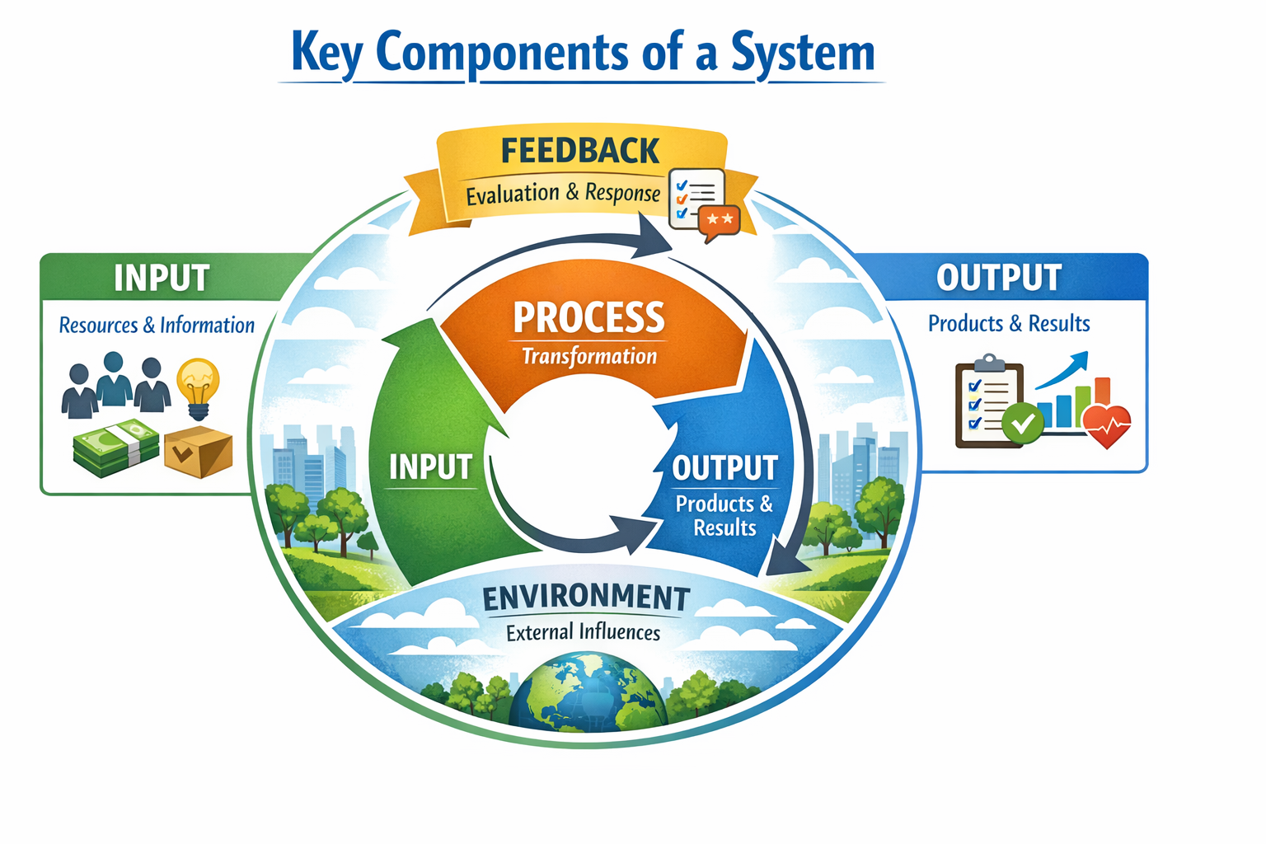

Slide 10
9 characteristics that are common to all open systems.
Understanding these characteristics helps one to conceptually understand how organizations function.
The first characteristic is input, or importation of energy.
Open systems import forms of energy from the external environment. As, the human cell receives oxygen and nourishment from the blood stream, and organization receives capital, human resources, material, or energy (e.g. electricity) from its environment.

Slide 11
The second characteristic is through put, in which open systems transform the energy and materials.
The third characteristic is output.
Open systems export some product (a manufactured substance), an inquiring mind, or a well body into the environment.

Slide 12
Fourth, an organizations throughput works as a system of cyclic events.
Organizational activities occur over and over again, in a self-closing cycle, as the material that is input is transformed by throughput and results in output.

Slide 13
The fifth open system characteristic is negative entropy.
To survive, open systems must reverse the entropic process, they must acquire entropy.
The entropic process is the universal law of nature in which all forms of organization move toward disorganization or death" .

Slide 14
The six characteristic of an open system is information input: the feedback and coding process.
Every organization must take in information and feedback from the environment, code that information, and then store it so, it can be used to predict the environment.

Slide 15
Feedback enables the organization to maintain a steady state, the seventh characteristic of an open system.
Sometimes called homeostasis, a steady state refers to the ability and desire of an organization to maintain some constancy in energy exchange.

Slide 16
The eighth characteristic is differentiation, which occurs with growth of the organization.
This requires multiplication and changes in established roles with new knowledge and expansion of expertise.

Slide 17
The last characteristic of an open system is equi-finality: The principle that any final goal or end can be reached by a variety of means.
As open systems move and develop within their environment, they may set different goals at different times and choose different methods to attain them, but the ultimate goal of any open system is survival.

Slide 18
The total nursing management process and each management functions can be preserved as a system consisting of several inputs, one or more throughput processes, numerous outputs, and multiple feedback processes between outputs and throughput, output and inputs, and throughput and inputs.

Slide 19
Thanks

