Slide 1

Health Promotion
Dr. Salih A Abdulla HEALTH BEHAVIOUR CHANGE, THEORIS AND MODELS
Understanding the process of behavior change Part 1 Spring Semester Week 4 2025-2026

Slide 2
OUTLINE
Introduction
Health Behavior Theories
Methods for increasing self-efficacy in people who desire to change health behaviors
Learning and behavior through a description of constructs

Slide 3
LEARNING OBJECTIVES
After reading this chapter, the student will be able to:
Define the differences between a model and theory.
Describe the role of models and theories in changing health behavior.
Identify the constructs in the social cognitive theory, the health belief model, the trans-theoretical model of behavior change, and the theory of planned behavior.
Discuss changes over time and how these models and theories align with changing health behaviors.

Slide 4
A primary focus of health promotion is to help people limit unhealthy behaviors and, in many cases, replace them with the healthy behavior.
Health promotion professionals have long known that it is not enough to simply help people identify unhealthy behavior in order to eliminate them.
Human behavior is far too complex for that to be effective.

Slide 5
A theory is a general explanation of why people act or do not act to maintain and/or promote the health of themselves, their families, organizations, and communities”
Failure to understand theories may lead to health promotion initiatives that do not succeed because of inaccurate assumptions about participants’ likelihood of successful behavior change.

Slide 6
Although theories can help explain why people act or fail to act, models help to translate theories into a program planning framework.
Models can also be used beyond the planning stage and can serve as a guide for program implementation and evaluation.

Slide 7
Through the study of theories, one learns that theories are subdivided into elements, generally referred to as concepts.
Concepts in turn are described in a more concrete form referred to as constructs, which in their most applicable form are known as variables.
It is the variables that become the basis for assessment of a program.

Slide 8
Health Behavior Theories
Over the years, a number of theories and models related to health behavior change have been developed. In this chapter, four theories are discussed:
• Social cognitive theory
• Transtheoretical model of behavior change
• Health belief model
• Theory of planned behavior

Slide 9
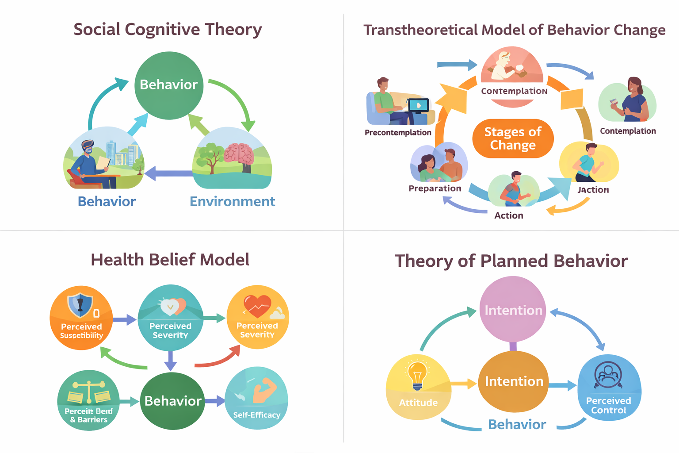

Slide 10
Social Cognitive Theory
Social cognitive theory (SCT), developed by Albert Bandura (1986), focuses on not just the psychology of health behavior but on social aspects as well.

Slide 11
SCT originated as the social learning theory within a psychological domain; it expanded as concepts studied in sociology and political science were included.

Slide 12
SCT embraces the idea that humans do not live in isolation and learn and behave not only according to their own thought processes but also in response to the environments that surround them in terms of the environment of a group (workplace, for example) or the larger society as a whole.

Slide 13
Bandura further emphasizes that individuals are not simply products of their environments but help to create those environments.
He refers to this concept as reciprocal determinism,

Slide 14
SCT explains learning and behavior through a description of constructs:
• Knowledge of health risks and benefits of various health behaviors • Perceived self-efficacy of one’s ability to control one’s own health behaviors
• Outcome expectations related to the consequences of particular health behaviors

Slide 15
• Personal health goals established by individuals
• Perceived facilitators of the desired health behaviors
• Perceived impediments to the desired health behaviors.

Slide 16
