Slide 1

Nursing Leadership and Management
Functions of Management Part 1
Dr. Salih A Abdulla
Spring Semester
Week 6
2025-2026

Slide 2
OUTLINE
Common terms used in the management process
Expected functions of a nurse manager
Concepts of each function using some examples
Effect of delegation on the manager’s responsibility for the delegated functions.

Slide 3
LEARN ING OBJEC TIVES
After reading this chapter, the student will be able to:
At the end of this chapter, the student should be able to:
• Define the common terms used in the management process
• List down the expected functions of a nurse manager
• Discuss the concepts of each function using some examples
• Describe the effect of delegation on the manager’s responsibility for the delegated functions.

Slide 4
Definitions
• Planning
Determining the long-and short-term objectives of the institution or unit and the actions (means) that must be taken to achieve these objectives.

Slide 5
• Staffing
Selecting the personnel to carry out these actions and placing them in positions appropriate to their knowledge and skills.

Slide 6
• Organizing
Mobilizing human and material resources so institutional objectives can be achieved.

Slide 7
• Directing
Motivating and leading personnel to carry out the actions needed to achieve the institution’s objectives.

Slide 8
• Controlling
Comparing results with predetermined standards of performance and taking corrective action when performance deviates from these standards.

Slide 9

• Decision Making
Identifying a problem, searching for solutions, and selecting the alternative that best achieves the decision maker’s objectives.

Slide 10
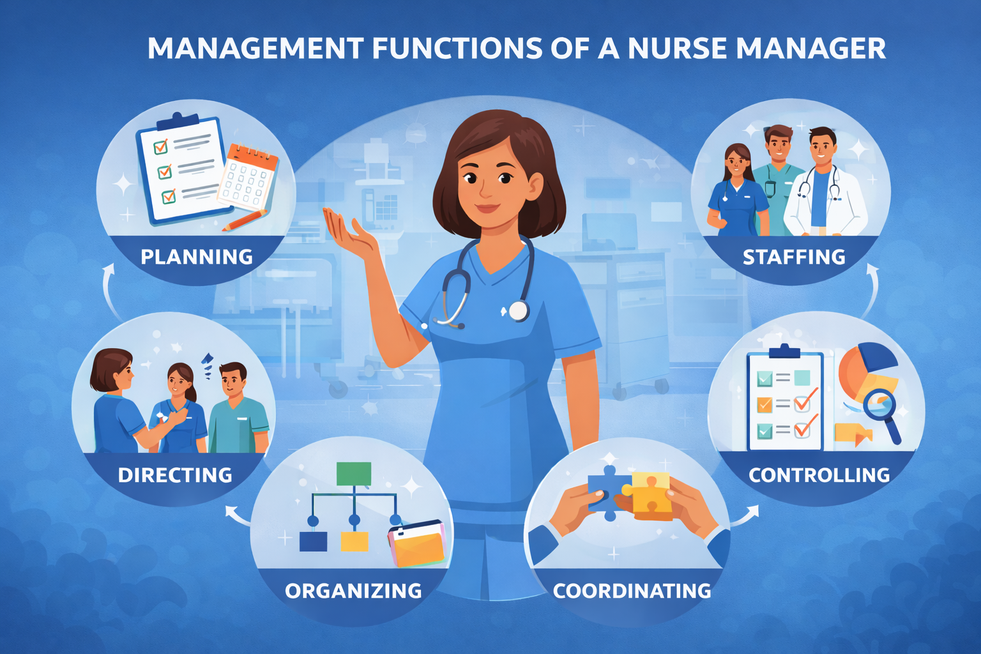
Management Functions of a Nurse Manager
Success of management depends on learning and using the management functions.
These functions include planning, organizing, staffing, directing, coordinating and controlling.

Slide 11
These functions represent these activities expected of managers in all fields.
Managers develop skill in the implementation of these functions as they gain experience in the role of managers.
Nurse Managers also use the same functions as they fulfill their responsibilities in the organization.

Slide 12
Planning
Planning is a technical managerial function that enables organizations to deal with the present and anticipate the future.
It is the first and fundamental function of management because all other management functions are dependent on it.

Slide 13
Planning is deciding what is to be done, when it is to be done, how it is to be done and who is to do it.
It is an orderly process that gives organizational direction.

Slide 14
Planning is the process of determining how the organization can get where it wants to go.
Planning is the process of determining exactly what the organization will do to accomplish its objectives.

Slide 15
In more formal terms, planning has been defined as ‘the systematic development of action programs aimed at reaching agreed objectives by the process of analyzing, evaluating and selecting among the opportunities which are foreseen.

Slide 16
Purpose of planning
It gives direction to the organization.
It Improves efficiency.
It eliminates duplication of efforts.

Slide 17
It concentrates resources on important services.
It reduces guess work.
It improves communication and coordination of activities.

Slide 18
The planning hierarchy
The planning hierarchy shows how an organization’s plans flow from top level → lower levels.
Strategic planning
Top-level managers (CEO, board), formulate long-term strategic planning to reinforce the firm’s mission (the mission clarifies organizational purpose).
Strategic plans are specified for five years period or more.

Slide 19
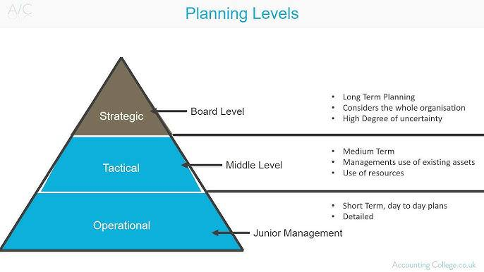
The planning hierarchy

Slide 20
b. Tactical planning
Middle management (department heads, unit managers) is responsible for translating strategies into shorter-term tactics.
Tactical plans are often specified in one-year increments.
Eg. The nursing department plans to train cardiac nurses and purchase specialized equipment.

Slide 21
c. Operational planning
Operational planning is accomplished by first-line managers (Nurse in-charge and Ward supervisor)
Operational planning is most concerned with budgets and schedules.
Time horizon for operational planning is very short.

Slide 22
Thanks

