Slide 1

Healthcare economics
Dr. Salih A Abdulla
Health and Medical Care: An Economic Perspective
Spring Semester
Week 6
2025-2026

Slide 2
OUTLINE
Introduction
Why Good Health? Utility Analysis
What is Medical Care?
The Production of Good Health

Slide 3
LEARNING OBJEC TIVES
After reading this chapter, the student will be able to:
Utility analysis in health care services
Conceptual definition of medical care from economic perspective
Analysis of production of good health

Slide 4
Introduction
Health is defined as “a state of physical, mental and social well-being and the absence of disease or other abnormal condition.” Economists take a radically different approach.
They view health as a durable good, or a type of capital, that provides services.

Slide 5
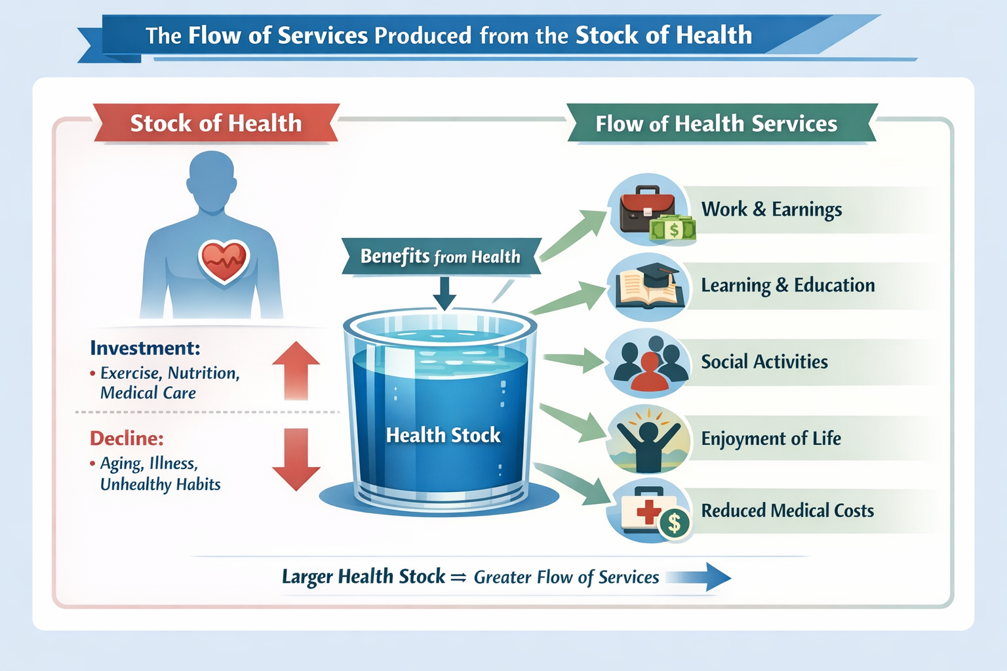
The flow of services produced from the stock of health “capital” is consumed continuously over an individual’s lifetime.

Slide 6
Each person is assumed to be endowed with a given stock of health at the beginning of a period, such as a year.
Over the period, the stock of health depreciates with age and may be augmented by investments in medical services.
Death occurs when an individual’s stock of health falls below a critical minimum level.

Slide 7
Naturally, the initial stock of health, along with the rate of depreciation, varies from individual to individual and depends on many factors, some of which are uncontrollable.
For example, a person has no control over the initial stock of health allowed at birth, and a child with a congenital heart problem begins life with a below-average stock of health.

Slide 8
However, we learn later that medical services may compensate for many deficiencies, at least to some degree.
The rate at which health depreciates also depends on many factors, such as the individual’s age, physical makeup, lifestyle, environmental factors, and the amount of medical care consumed.

Slide 9
For example, the rate at which health depreciates in a person diagnosed with high blood pressure is likely to depend on the amount of medical care consumed. (is this person under a doctor’s care), environmental factors (does he have a stressful occupation?), and lifestyle (does the person smoke or have a weight problem?).
All these factors interact to determine the person’s stock of health at any point in time, along with the pace at which it depreciates.

Slide 10
Why Good Health? Utility Analysis
Health, like any other durable goods, generates a flow of services. These services yield satisfaction, or what economists call utility.
As a good, health is desired for consumption and investment purpose. From a consumption perspective, an individual desire to remain healthy because she receives utility from an overall improvement in the quality of life.
In simple terms, a healthy person feels great and thus is in a better position to enjoy life.

Slide 11
The investment element concerns the relation between health and time. If you are in a positive state of health, you allocate less time to sickness and pursue other activities, such as leisure.
Economists look at education from the same perspective.
Much as a person invests in education to enhance the potential to command a higher wage, a person invests in health to increase the likelihood of having healthier days to work and generate income.

Slide 12
What is Medical Care?
Medical care is composed of myriad of goods and services that maintain, improve, or restore a person’s physical or mental well-being.
For example, a young adult might have shoulder surgery to repair a torn rotator cuff so that he can return to work; an elderly woman may have hip replacement surgery so that she can walk without pain, or a parent may bring a child to the hygienist for an annual cleaning of his teeth to prevent future dental problems.

Slide 13
Prescription drugs, wheelchairs, and dentures are examples of medical goods, while surgeries, annual physical exams, and visits to physical therapists are examples of medical services.

Slide 14
As a service, medical care exhibits four characteristics that distinguish it from a good: intangibility, inseparability, inventory, and inconsistency.
The first characteristic, intangibility means that a medical service is incapable of being assessed by the five senses. Unlike a new car or a new CD, the consumer cannot see, taste, feel, or hear a medical service.

Slide 15
Inseparability means that the production and consumption of a medical service take place simultaneously.
For example, when you visit your dentist for a checkup, you are consuming dental services at the exact time the dentist is producing them.

Slide 16
Inventory is directly related to inseparability.
Because the production and consumption of a medical service occur simultaneously, health care providers are unable to stockpile or maintain an inventory of medical services.
For example, a dentist cannot maintain an inventory of dental checkup to meet demand during peak period.

Slide 17
Finally, inconsistency means that the composition and medical services consumed vary widely across medical events.
Although everyone visits a physician at some time or another, not every visit to a physician is for the same reason.
One person may go for a routine physical, while another may go because he needs heart bypass surgery.

Slide 18
The Production of Good Health
Health economists take the view that the creation and maintenance of health involves a production process. Much as a firm uses various inputs, such as capital and labour, to manufacture a product, an individual uses medical inputs and other factors, such as healthy lifestyle, to produce health.

Slide 19
The relation between medical inputs and output can be captured in what economists call a production function. A health production function indicates the maximum amount of health that an individual can generate from a specific set of inputs in a given period of time.

Slide 20
In mathematical terms it shows how the level of output (in this case, health) depends on the quantities of various inputs, such as medical care.

Slide 21
Thanks

