Slide 1
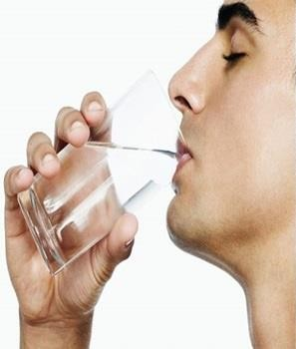
Water and health
Assist Prof Yasen Galali
Nutrition and dietetics Dept.

Slide 2
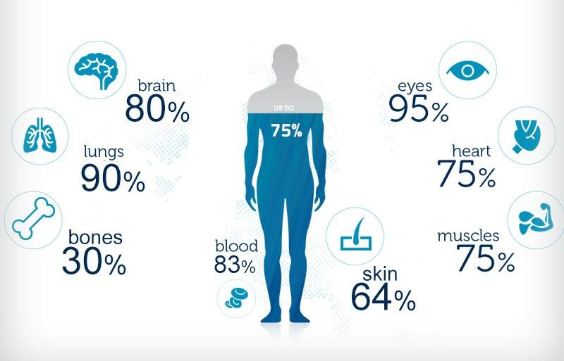
You’ve heard it’s important to drink plenty of water, but water not only quenches your thirst, it’s essential for your health and survival.

Slide 3
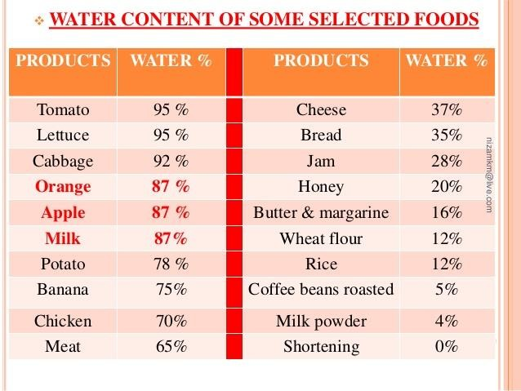
Our bodies are about up to 60-70 percent water.
We get water by drinking it, by drinking other beverages, and in solid foods rich with water, such as juicy fruits and vegetables.

Slide 4

Bodies Don’t Store Water
Drink water on a daily basis to replenish loss.
Beverages like milk and juice contain water.
Some solids contain water.
Fluids from caffeinated and non- caffeinated beverages count towards water intake.

Slide 5
Pregnancy. Women who are pregnant or breast-feeding need additional fluids to stay hydrated. The Office on Women's Health recommends that pregnant women drink about 10 cups (2.4 liters) of fluids daily and women who breast-feed consume about 13 cups (3.1 liters) of fluids a day.
Old age: because of low thirst sensation and water retention, they require more water
Stress: Studies have shown that dehydration leads to higher cortisol levels—the stress hormone
High fiber diets.
Illness: Your body loses fluids when you have a fever, vomiting or diarrhea. Drink more water or follow a doctor's recommendation to drink oral rehydration solutions
Exposure to extreme temps: Hot or humid weather can make you sweat and requires additional fluid intake. Dehydration also can occur at high altitudes
Strenuous exercise: If you do any activity that makes you sweat, you need to drink extra water to cover the fluid loss. It's important to drink water before, during and after a workout.

Slide 6

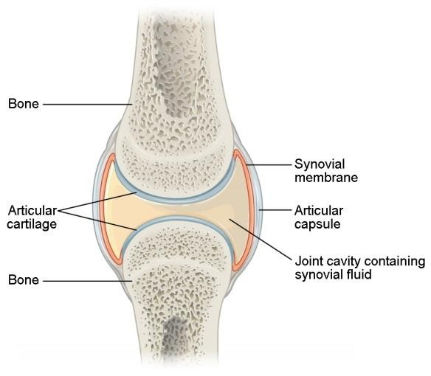
It lubricates the joints
Cartilage, found in joints and the disks of the spine, contains around 80 percent water.
Long-term dehydration can reduce the joints' shock-absorbing ability, leading to joint pain.

Slide 7

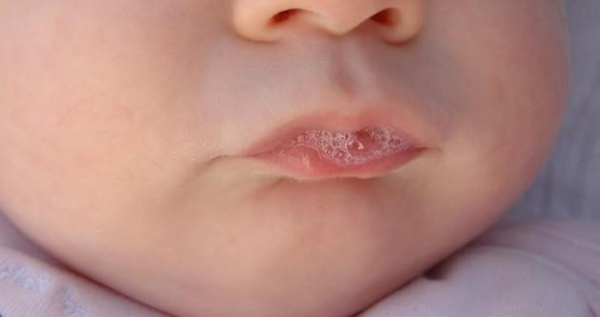
Saliva helps us digest our food and keeps the mouth, nose, and eyes moist. This prevents friction and damage.
Drinking water also keeps the mouth clean. Consumed instead of sweetened beverages, it can also reduce tooth decay.

Slide 8

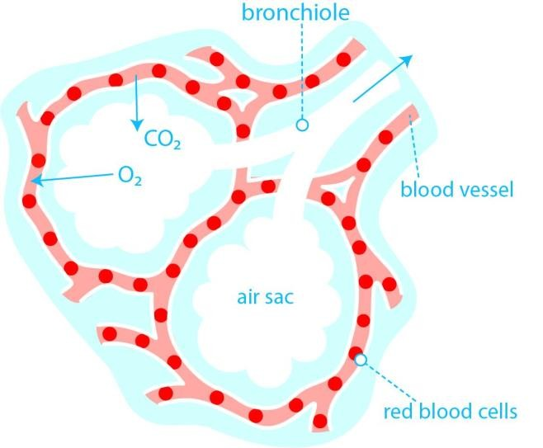
Blood is more than 90 percent water, and blood carries oxygen to different parts of the body.
Thick blood cannot deliver enough oxygen.

Slide 9

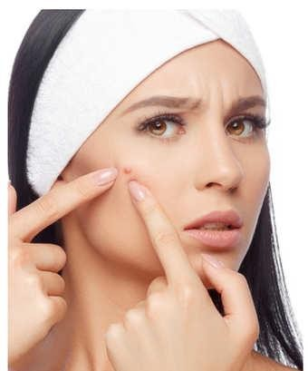
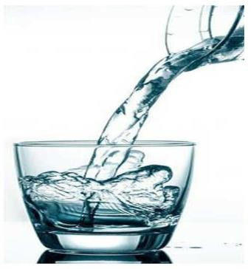
With dehydration, the skin can become more vulnerable to skin disorders and premature wrinkling.
Water also help to detoxify of the body, leading to fewer acne.

Slide 10

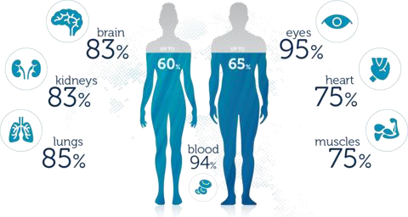
Dehydration can affect brain structure and function.
It is also involved in the production of hormones and neurotransmitters. Prolonged dehydration can lead to problems with thinking and reasoning.

Slide 11
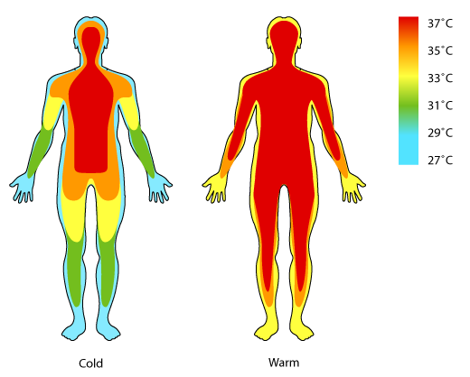
Water that is stored in the middle layers of the skin comes to the skin's surface as sweat when the body heats up.
As it evaporates, it cools the body.

Slide 12

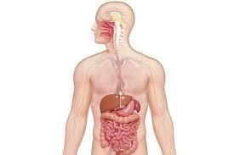
The bowel needs water to work properly. Dehydration can lead to digestive problems, constipation, and an overly acidic stomach.
This increases the risk of heartburn and stomach ulcers.

Slide 13
Water helps you go to the bathroom, so when you drink water you are detoxing your body.
Water is needed in the processes of sweating and removal of urine and feces.
When you go to the bathroom you are expelling toxins from your body
The more water you drink, the cleaner your body will be. It also helps reduce swelling.

Slide 14

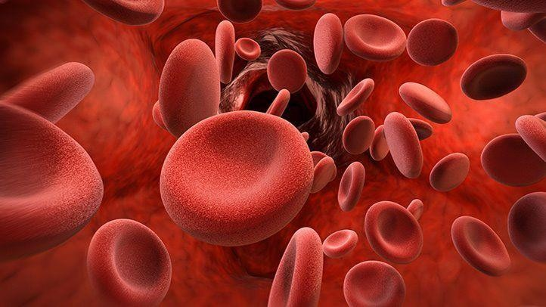
A lack of water can cause blood to become thicker, increasing blood pressure.
Drinking water on an empty stomach stimulates red blood cells to grow faster.
This, in turn, results in more oxygenated blood that makes you feel more energetic.

Slide 15


Most of the time, we experience headaches due to dehydration.
Drinking water in the morning ensures that your body is hydrated.

Slide 16
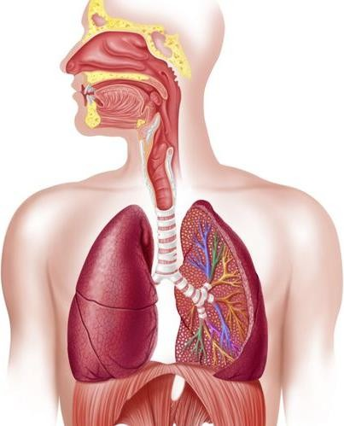
Research has shown that dehydration
vastly affects all of the systems in your body including your respiratory system.
Drinking water helps to thin the mucus lining your airways and lungs.
Dehydration can cause that mucus to thicken and get sticky, which slows down overall respiration and makes you more susceptible to illness, allergies and other respiratory problems.

Slide 17

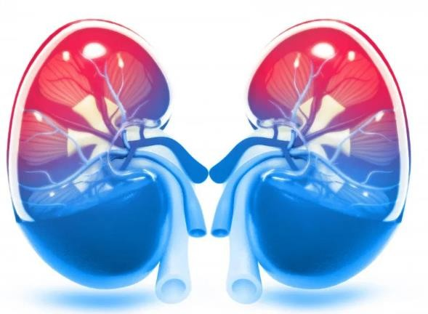
The kidneys regulate fluid in the body. Insufficient water can lead to kidney stones and other problems.
Water helps dissolve minerals and nutrients, making them more accessible to the body. It also helps remove waste products.

Slide 18

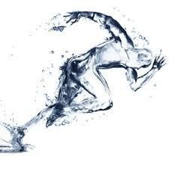
Some scientists have proposed that consuming more water might enhance performance during strenuous activity
A review found that dehydration reduces performance in activities lasting longer than 30 minutes.

Slide 19

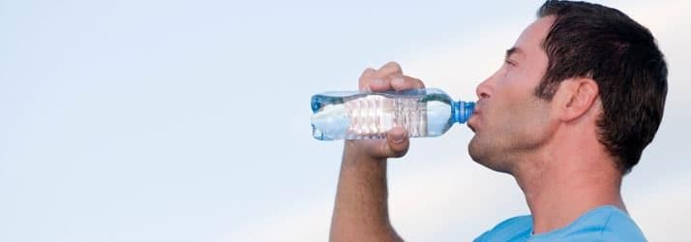
Water may also help with weight loss, if it is consumed instead of sweetened juices and sodas.
"Preloading" with water before meals can help prevent overeating by creating a sense of fullness.
It is one of the best strategies when you are on a diet.

Slide 20

• Occurs when the body loses so much water that function are affected.
• People who work or play outdoors or in hot climates are at risk.
• Dehydration can be caused by diarrhea, vomiting and fever.

Slide 21

Take water breaks.
Keep a water pitcher with water in the refrigerator.
Keep a water bottle with you. Include water, soup, or some other beverage.
Be sure to drink some water before, during, and after physical activity.
Enjoy fruits and vegetables that have a high water content.

Slide 22

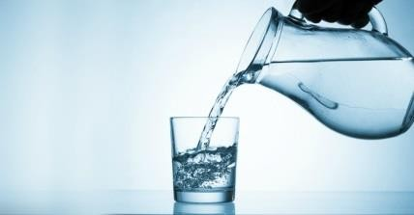
Every day you lose water through your breath, perspiration, urine and bowel movements. For your body to function properly, you must replenish its water supply by consuming beverages and foods that contain water.
About 15.5 cups (3.7 liters) of fluids a day for men
About 11.5 cups (2.7 liters) of fluids a day for women
These recommendations cover fluids from water, other beverages and food. About 20% of daily fluid intake usually comes from food and the rest from drinks.

Slide 23
What about the advice to drink 8 glasses a day?
You've probably heard the advice to drink eight glasses of water a day. That's easy to remember, and it's a reasonable goal.

Slide 24

Also known as water poisoning, hyper- hydration, over-hydration, or water toxemia, is a potentially fatal disturbance in brain functions that results when the normal balance of electrolytes in the body is pushed outside safe limits by excessive water intake.
Doing so increases the amount of water in the blood. This can dilute the electrolytes, especially sodium, in the blood.
If sodium levels fall below 135 millimoles per liter (mmol/l), doctors refer to the issue as hyponatremia.
Sodium helps maintain the balance of fluids inside and outside of cells.

Slide 25
When sodium levels drop due to excessive water consumption, fluids travel from the outside to the inside of cells, causing them to swell.
When this happens to brain cells, it can be dangerous and even life threatening.

