Slide 1


Introduction to Human Nutrition
Assist Prof Yaseen Galali

Slide 2
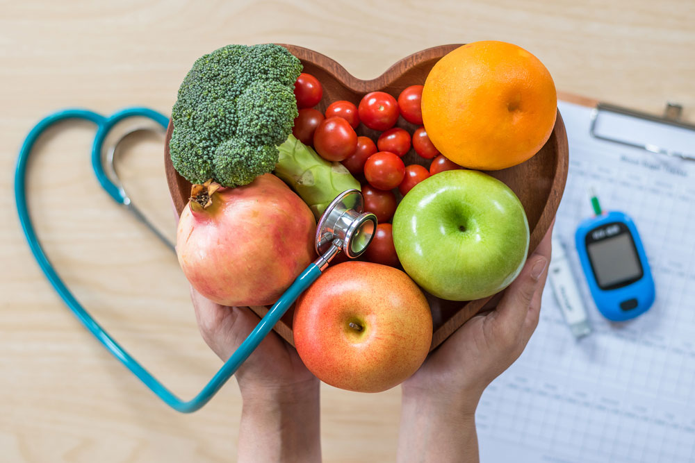
Nutrition
Nutrition is the study of nutrients in food, how the body uses nutrients, and the relationship between diet, health, and disease.

Slide 3
Definitions
Foods is any substance when ingested or eaten nourishes the body.
Nutrient – is a chemical component needed by the body to provide energy, to
build and repair tissues and to regulate life process.
Digestion – it is a mechanical and chemical breakdown of food into smaller components.
Notes:
The concept of functional food backs to the middle of 1980s, when first promoted in Japan by expertise who studied the connection between nutrition, supplementation and alteration physiological system. Then after the interest of functional food spread over EU and US.
The term refers to the food that supplemented with a particular component that possess positive physiological influences (Van Kleef et al., 2005). This concept (FF) has been described many times and there is no single agreed definition to precisely describe FF (Alzamora et al., 2005). Up to date, various food scientists, organisations and academics have suggested different definitions

Slide 4
Absorption – it is a process where the nutrients from foods are absorb by the body
into the bloodstreams.
Metabolism – is a chemical process of transforming foods into other substance to
sustain life.
Enzymes – an organic catalyst that are protein in nature and are produced by living cells.
A catalyst speeds up or slows down chemical reactions without itself undergoing change.

Slide 5
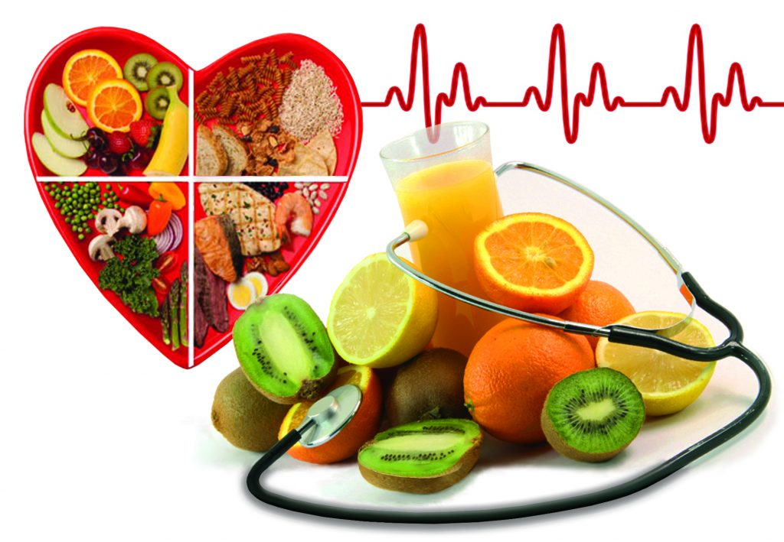
Nutritional Status – is the condition of the body resulting from the utilization of essential nutrients. Calorie – fuel potential in a food. One calorie represents the amount of heat required to raise one liter of water one degree Celsius. Malnutrition – It is the condition of the body resulting from a lack of one or more essential nutrients or due to excessive nutrient supply.
Notes:
To make the bread we used this ingredients; but for the DF, we used 20 different combination and tested quality. After a series of tests we found this does will be the best

Slide 6
Nutrients classification
Classification of Nutrients
1) According to function:
- Function as energy giving, body building, body regulating.
2) According to chemical properties:
a) Organic – protein, lipids, carbohydrates and vitamins
b) Inorganic – water & minerals
Notes:
We recruited a 9 healthy volunteers from staff and students of Plymouth university. After we made sure they do not have any health problems. We asked them to come to lab after they fast overnight. We served a proper breakfast with our bread corresponding to 50g of carbohydrate. Then we asked them to eat blood themselves at different time according this form.

Slide 7
Functions of foods
Body building or growth
Providing energy
Regulation of body process (beating of the heart etc)
Protective function.( recovery from diseases)
Maintenance and repairs

Slide 8
Class/category | Subclass/category | Nutrient examples
Carbohydrates (macronutrients) | Monosaccharides Disaccharides Polysaccharides | Glucose, fructose, galactose Sucrose, maltose, lactose Starch and dietary fi ber
Proteins (macronutrients) | Plant and animal source proteins | Amino acids (n = 20): aliphatic, aromatic, sulfur-containing, acidic, basic
Fats and oils (lipids) (macronutrients) | Saturated fatty acids Monounsaturated fatty acids Polyunsaturated fatty acids (n-3, n-6, n-9 | Palmitic and stearic acid Oleic (cis) and elaidic fatty acids Linoleic, α-linolenic, arachidonic, eicosapentaenoic, docosahexaenoic acid
Minerals (micronutrients | Minerals and electrolytes Trace elements | Calcium, sodium, phosphate, potassium, iron, zinc, selenium, copper, manganese, molybdenum, fl uoride, chromium
Vitamins (micronutrients) | Fat soluble Water soluble | Retinol (A), calciferols (D), tocopherols (E), vitamin K Ascorbic acid (C), thiamine (B1), ribofl avin (B2), niacin (B3), pyridoxine (B6), folate, cobalamin (B12)
Water | Water | Water

