Slide 1



Tishk International University
Faculty of Applied Science
Nutrition and Dietetics Department
Microbiology of Milk
Food Microbiology /7th Lecture
2nd Grade / Spring Semester
Instructor: Adam Jalal Mohammed
Email: adam.jalal@tiu.edu.iq
Food Microbiology
2025 - 2026

Slide 2
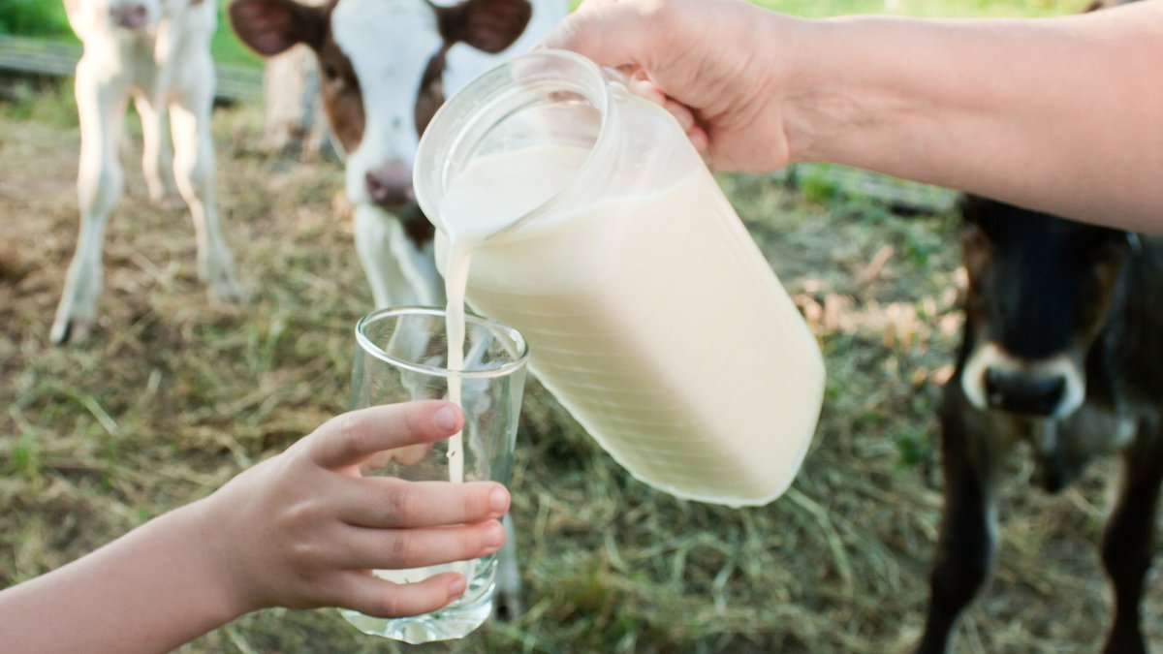
Introduction
Milk is a highly nutritious medium for bacteria; it can spoil easily.
Initially, milk has few organisms, but bacteria can enter the milk during milking processes and handling.
Refrigeration improved the milk industry, but still other improvements needed to be made to reduce the risk of pathogenic microorganisms.

Slide 3
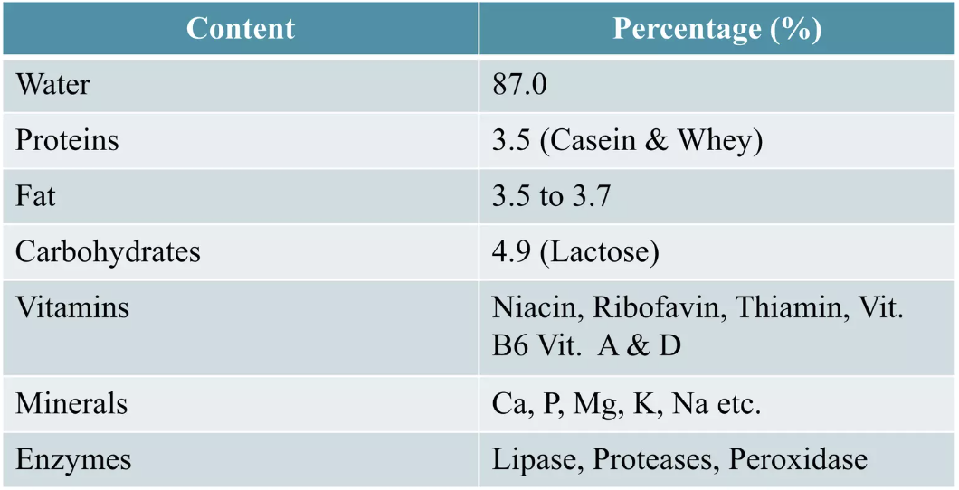
Compostion

Slide 4
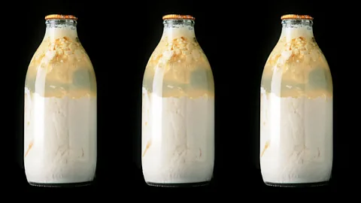
Non-pathogens in milk
Airborne contaminants: Pseudomonas, Flavobacterium, Alcaligenes, Micrococcus, and fungi.
Psychrotrophs: More detrimental to milk.
They are able to grow at 5 °C or less and make up a large number of the microbes in milk; they are natural soil inhabitants and widespread in the environment, especially water.
Spoilage of refrigerated milk consists of a bitter, rancid, fruity flavor.
Spoilage of milk at room temperature usually consists of a sour flavor.

Slide 5
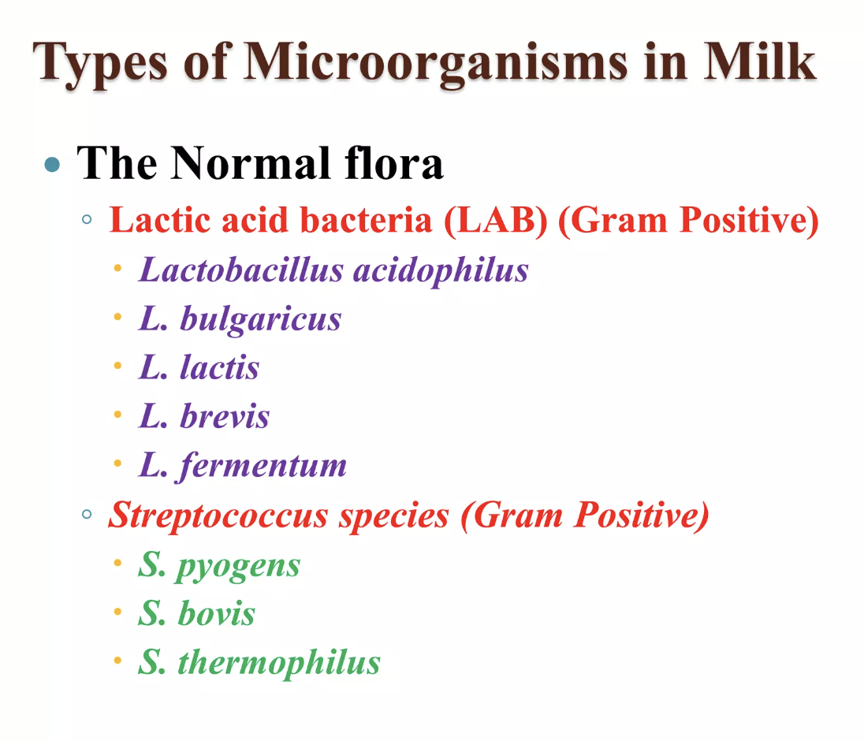
Types of Microorganisms in milk

Slide 6
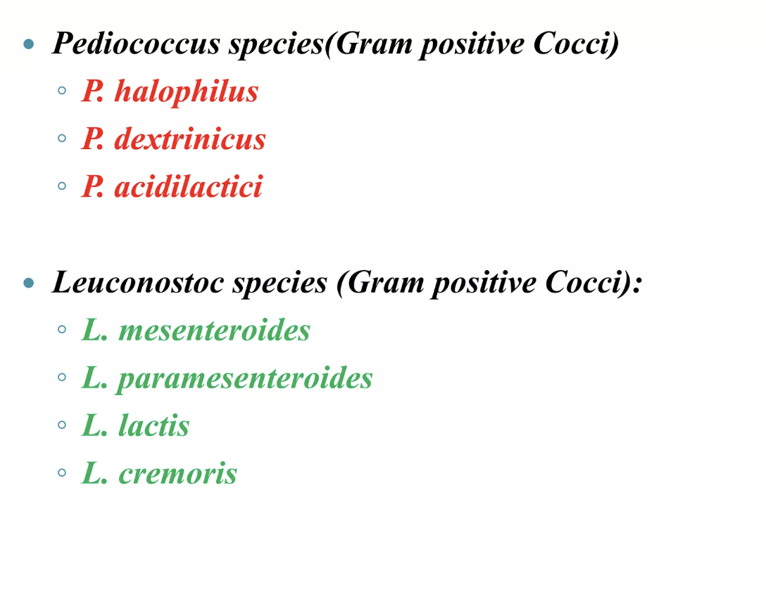
Types of Microorganisms in milk

Slide 7
01
Primary Contamination Sources
Animal Sources
Milking Equipment
Udder and adjacent parts are primary sources of microorganisms. The udder canal and teat surface harbor natural microflora including Micrococci, Streptococci, and Corynebacteria.
Milking machines and milk cans can harbor bacteria if not properly sanitized. Equipment surfaces provide ideal environments for microbial biofilm formation.
Improper cleaning allows bacterial proliferation
These organisms can enter milk during the milking process
Milking Environment
Dairy Workers
Environmental factors include airborne contaminants, dust particles, insects, and animal feed. These can introduce gram-negative rods, spore-forming bacteria, and other environmental microbes.
Human sources include hands, clothes, sneezing, coughing, and poor personal hygiene. Workers can transfer pathogens and spoilage organisms directly to milk.
Proper hygiene training is essential
Poor ventilation increases contamination risk
Transportation Contamination
Milk can become contaminated during transport through unclean containers, temperature abuse, and extended storage times. Transportation vehicles must be properly sanitized and maintained at appropriate temperatures.

Slide 8
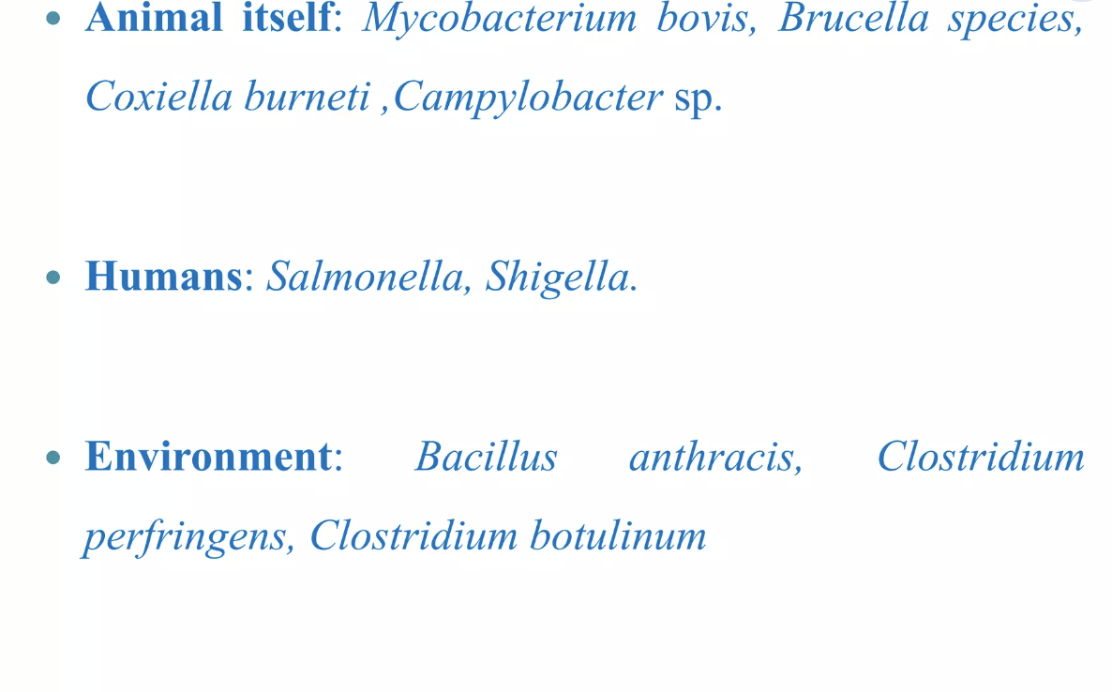
Source of pathogens in Milk

Slide 9
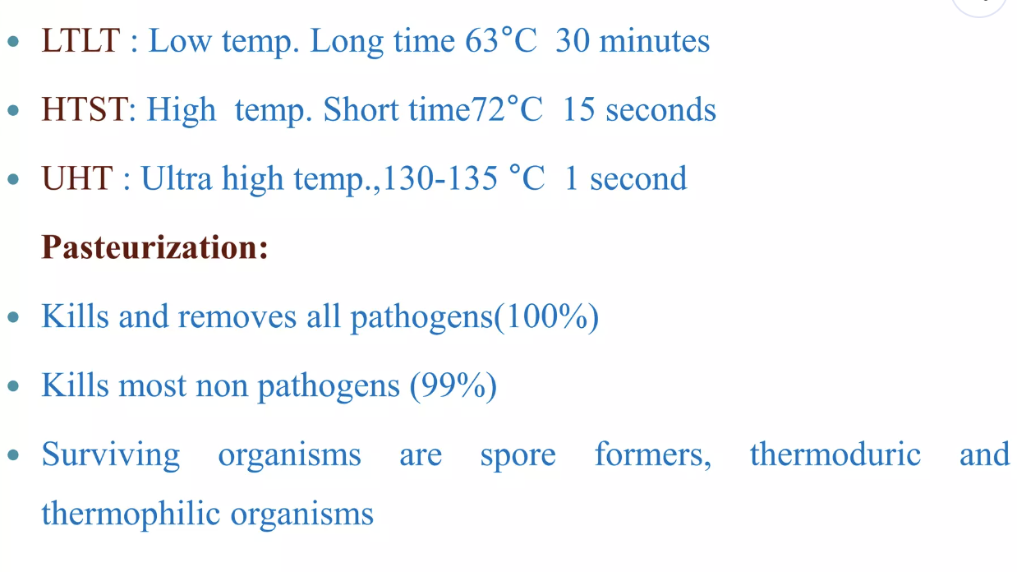
Pasteurization of Milk

Slide 10
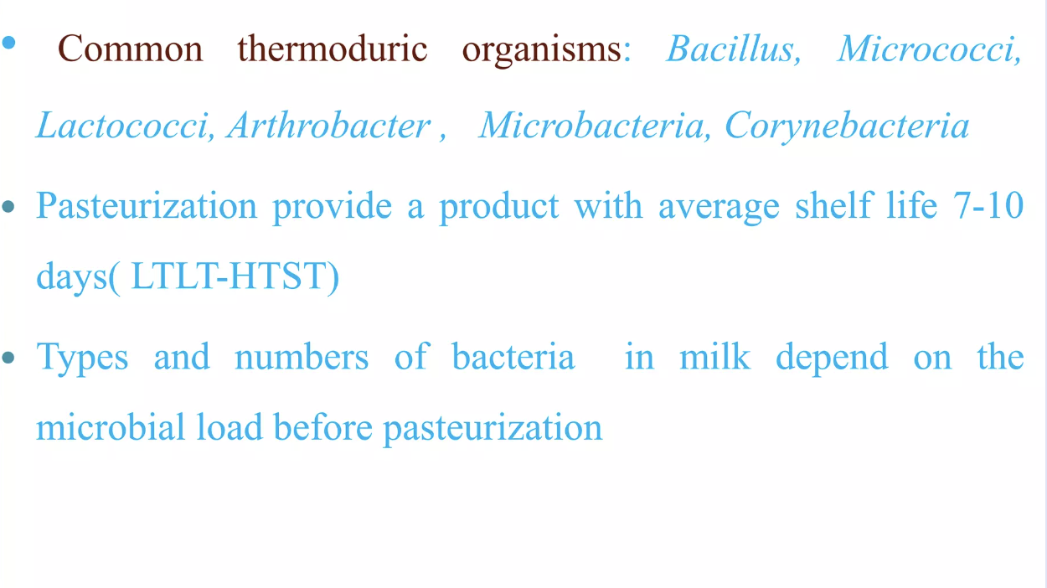
Pasteurization of Milk

Slide 11
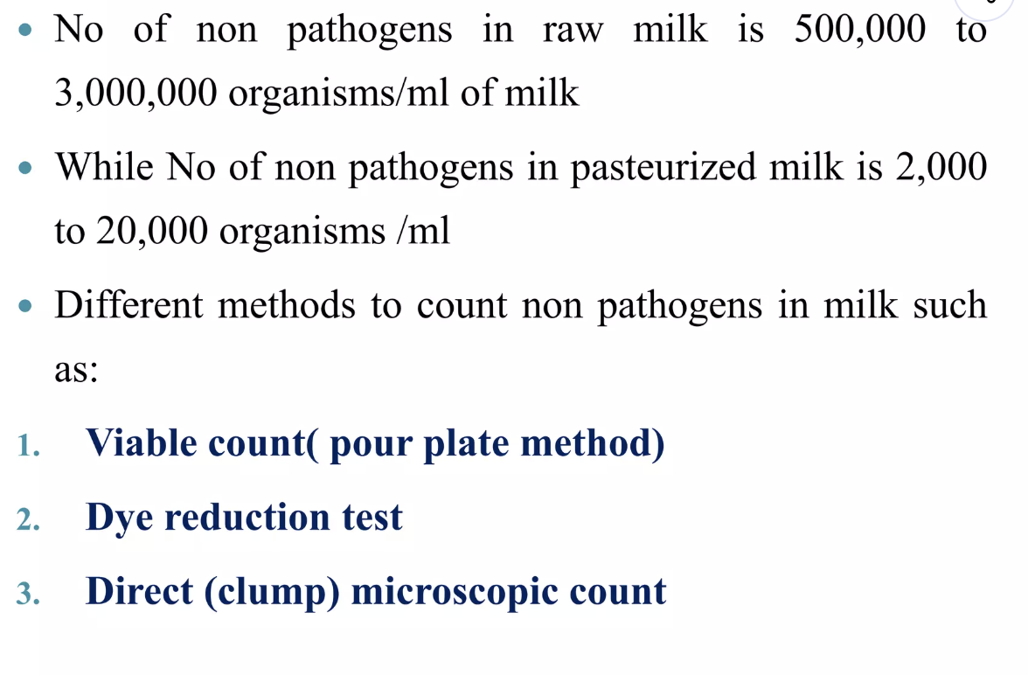
Pasteurization of Milk

Slide 12
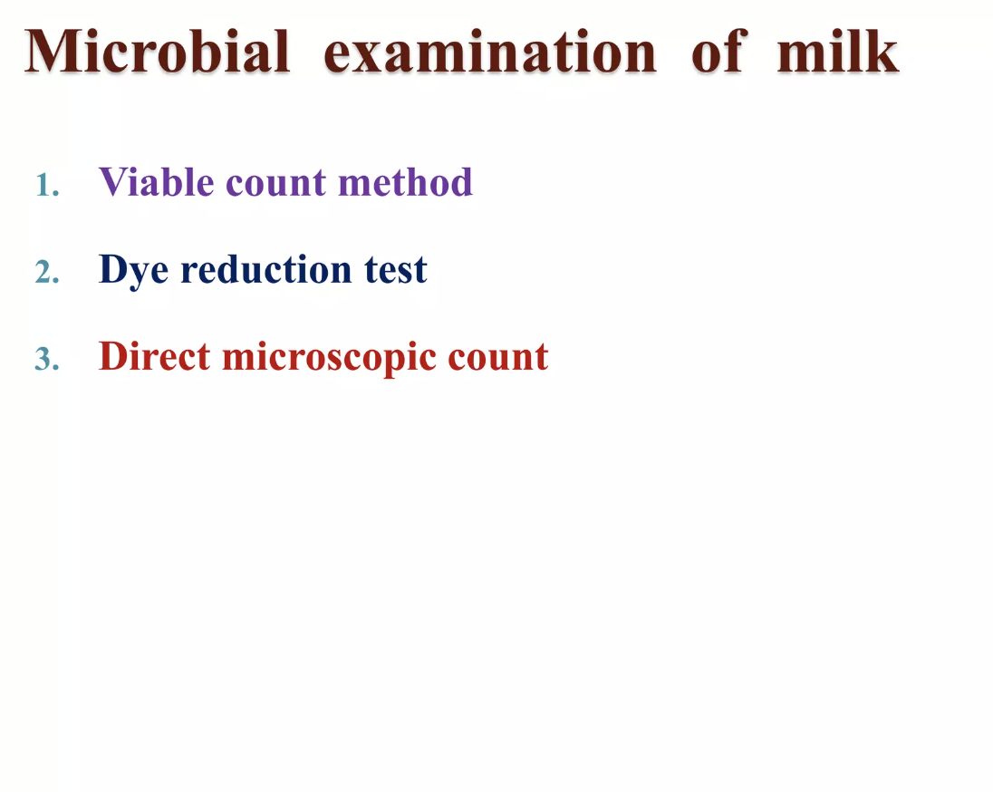

Slide 13
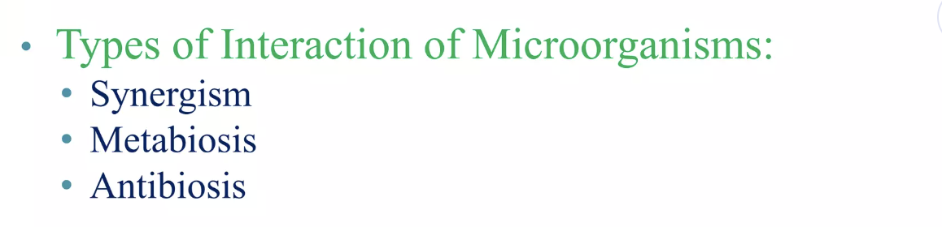
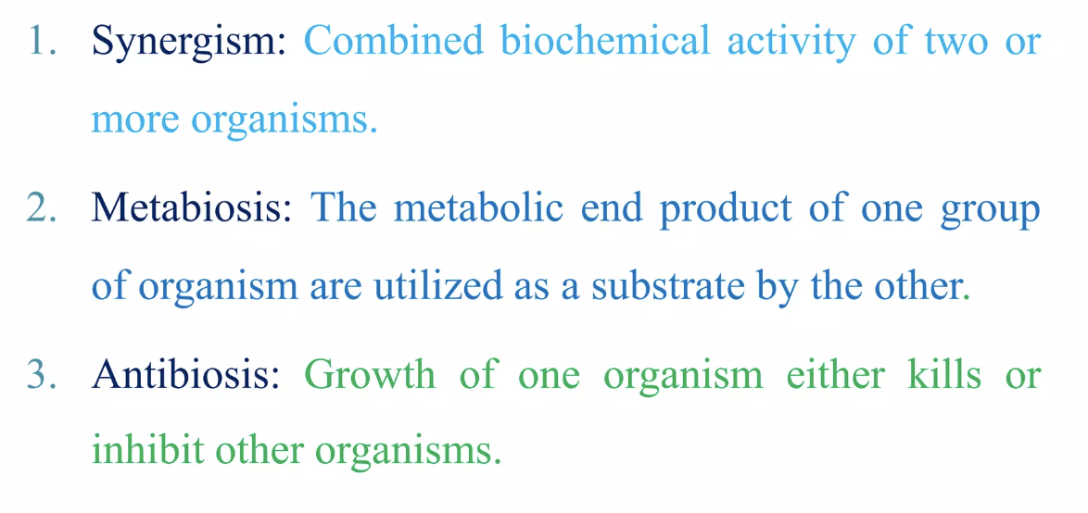
Microbial spoilage of milk and milk products

Slide 14
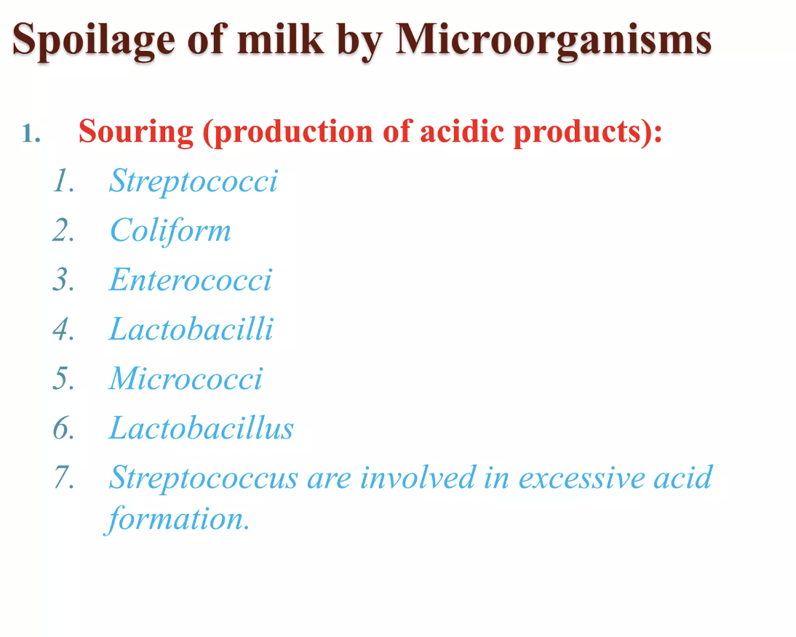

Slide 15
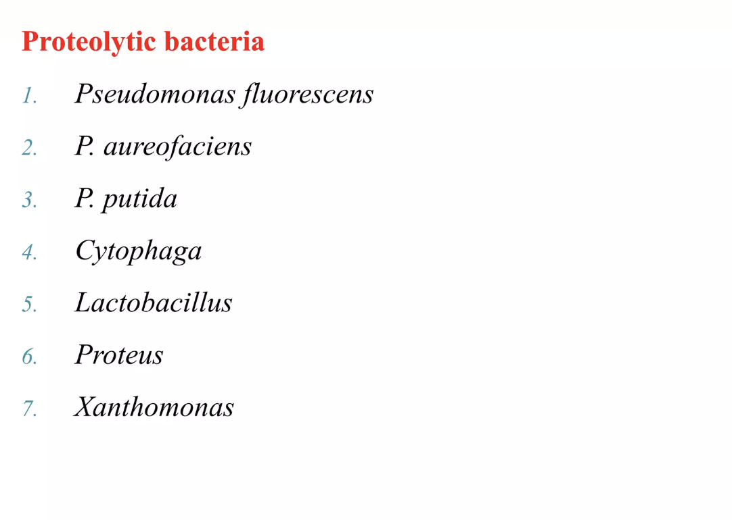

Slide 16
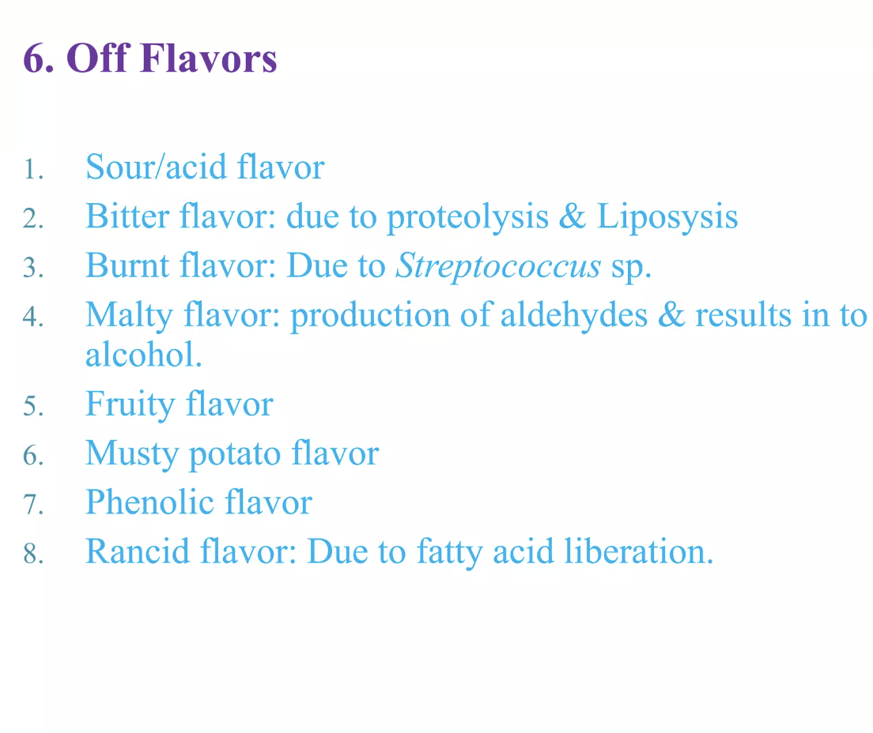
Microbial spoilage of milk and milk products

Slide 17
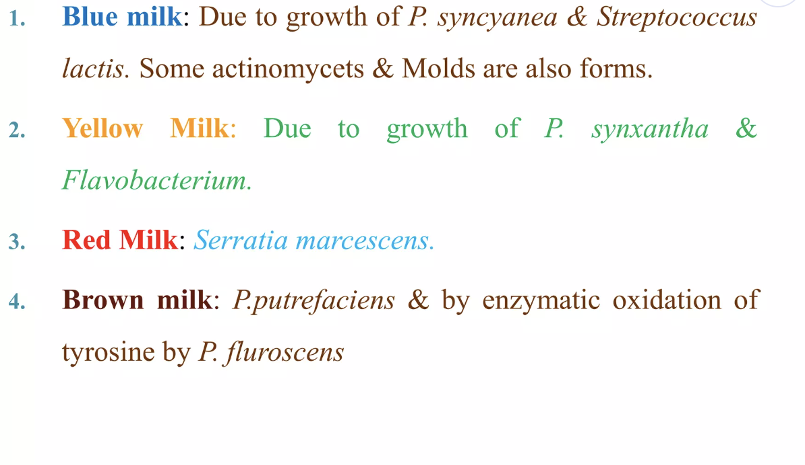
Microbial spoilage of milk and milk products

Slide 18
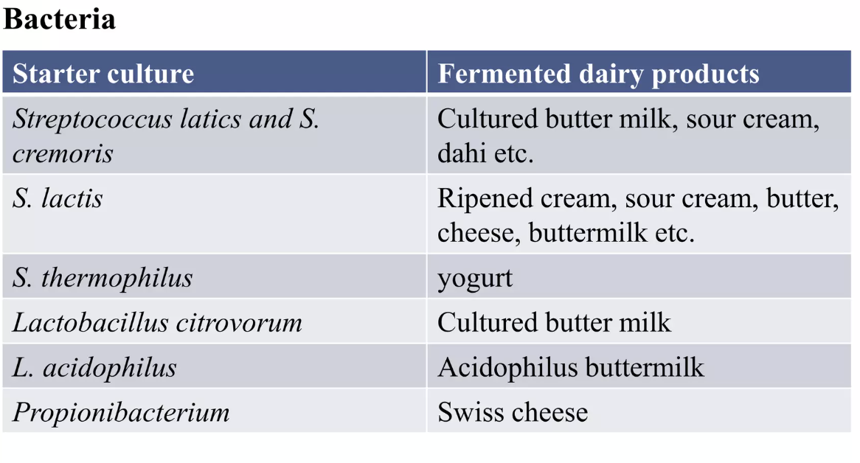
Microbial spoilage of milk and milk products

Slide 19
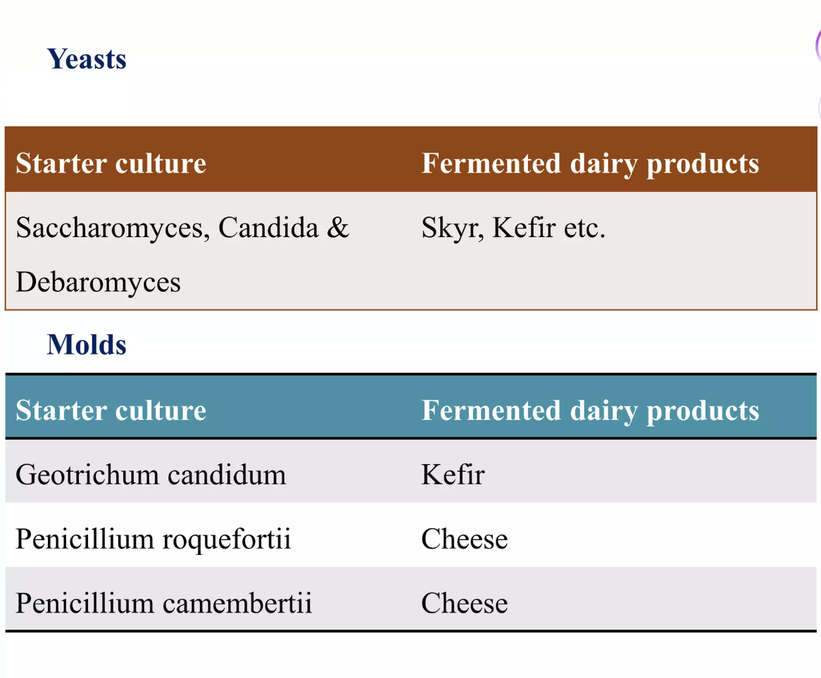
Application of Microorganisms in Diary Industry

Slide 20
