Slide 1
Macronutrients
Yaseen Galali
Nutrition department

Slide 2
MACRONUTRIENTS
Carbohydrates
A normal diet, where approximately half (45-55%) of the daily calories come from carbohydrates, provides enough for most moderately active people. For example, a person weighing 70 kg needs about 210-350 g carbohydrates per day

Slide 3
Sugars are Of particular concern for the athlete is the quantity of sports drinks they may consume to enhance exercise performance, in terms of both general and dental health. Even, if they are ‘rinsing and spitting’, the sugar will stay in contact with their teeth for a period of time and can have a direct impact on the development of dental cavities.

Slide 4
Very active people, who perform high intensity exercise regularly (e.g. 2-3 hours intense exercise per day, 5-6 times per week), will need to consume extra energy and increase carbohydrate intake to 55-65% of total daily calories.
The exact amount needed increases with the amount and the intensity of exercise

Slide 5
Carbohydrate loading’ is useful for athletes taking part in events lasting more than 90 mins to maximise energy stores before their event. This involves eating 10-12 g of carbohydrate per kg body weight, per day, for 1.5-2 days before the event, while also resting from training.
For a person weighing 70 kg, this translates to 700–840 g carbohydrate per day (contributing 2,800-3,350 kcal)

Slide 6
GLYCEMIC INDEX AND SPORT NUTRITION
The glycaemic response is defined by the length of time it takes for glucose to be absorbed from foods that have been consumed.
Regardless of whether the foods contain disaccharides or polysaccharides. A low glycaemic response indicates that the glucose is slowly absorbed over a longer period of time,

Slide 7
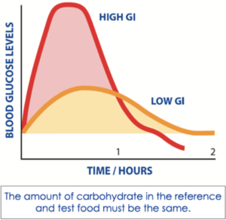
A high glycaemic response indicates that the
glucose is absorbed more quickly and that there is a sharp immediate rise in blood glucose levels

Slide 8
FACTORS INFLUENCING GI
Fat content (delays gastric emptying)
Acid content (delays gastric emptying)
Protein content (delays gastric emptying)
Amount and types of fibre (soluble fibre has lower glycaemic index than insoluble fibre)
Type of starch (depending on the structure of the molecule, which affects the rate of enzyme digestion)
Level of processing (wholegrain bread has a lower glycaemic index than wholemeal bread)
Sugar type (fructose and lactose have lower glycaemic index than glucose).

Slide 9
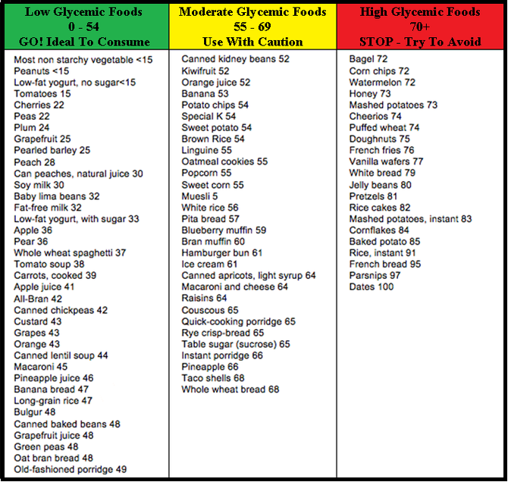

Slide 10
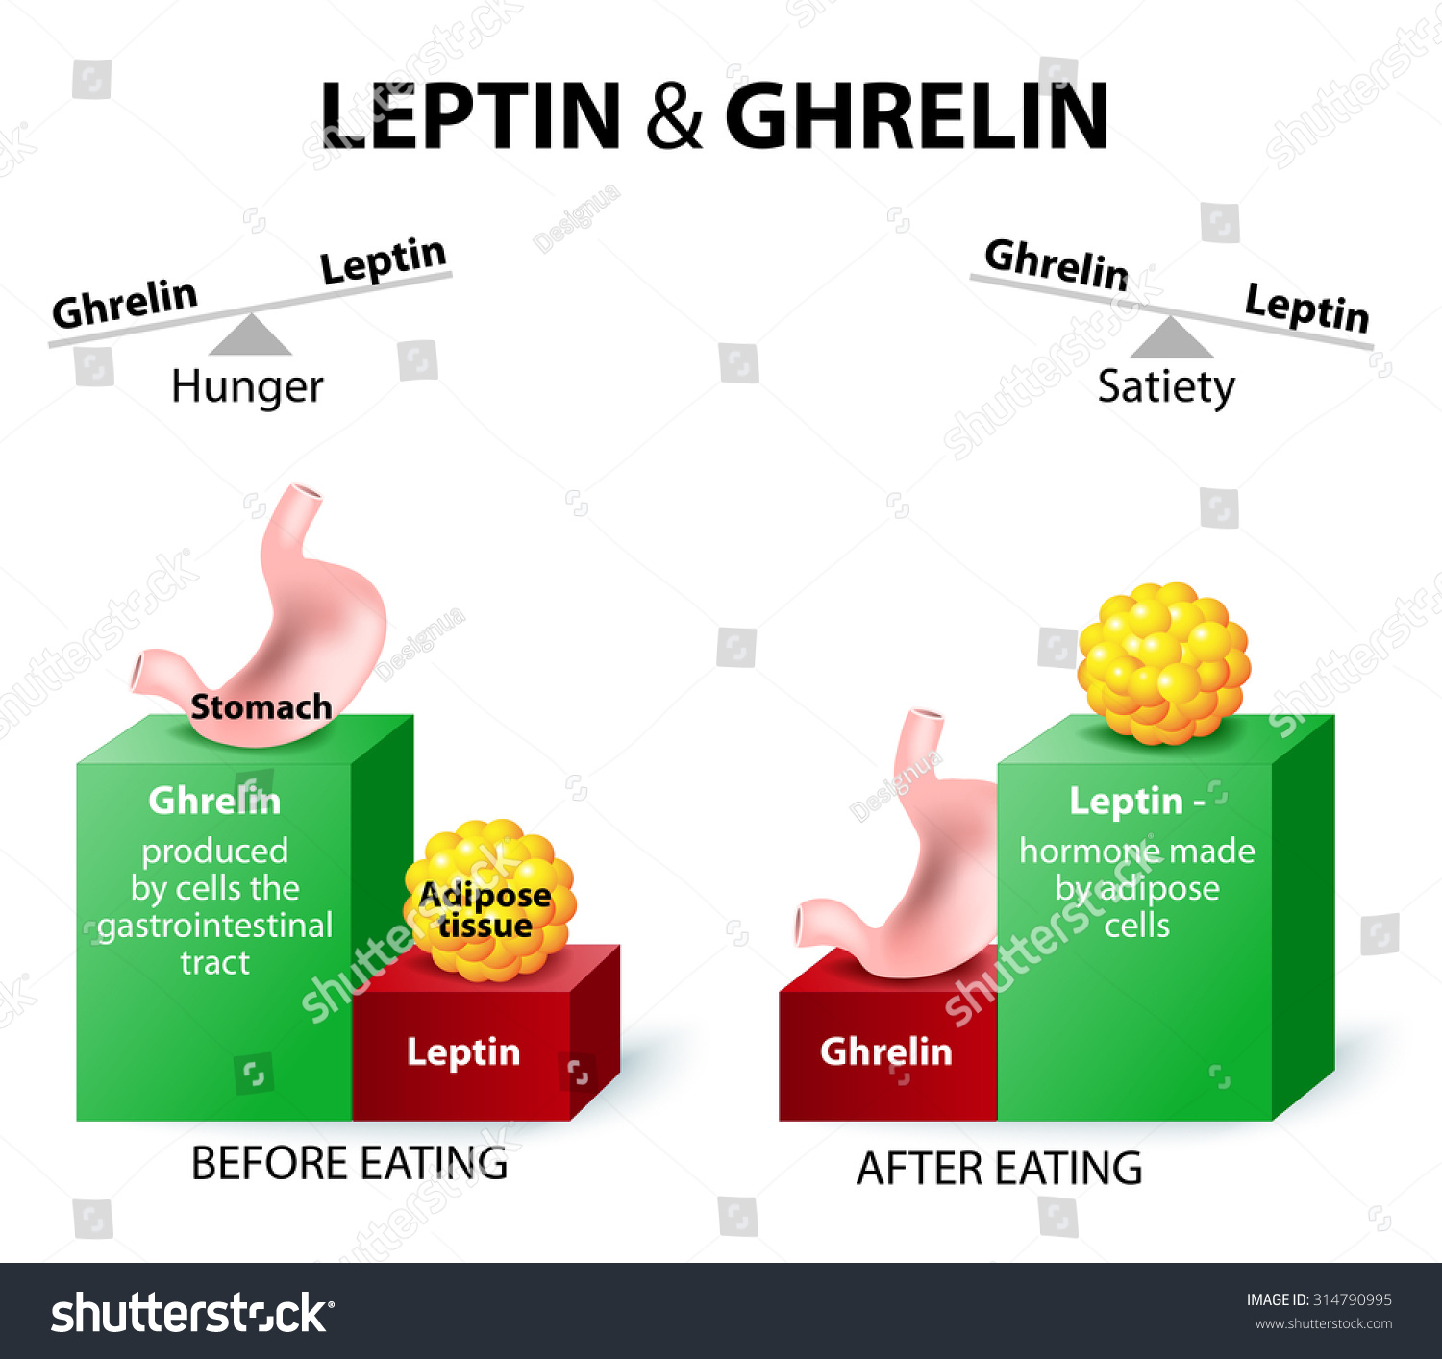
GI to promote satiety and confer health benefits, for the athlete, knowledge of the GI of foods is also important for implementing nutrition plans to optimize performance.

Slide 11
Meals before exercise focus on consuming low-GI foods to enable a sustained release of glucose in the blood.
However, during and after exercise, high-GI foods are preferred to promote a quicker glycaemic response, allowing the absorbed glucose to be utilized for performance and to replace lost glucose respectively.

Slide 12
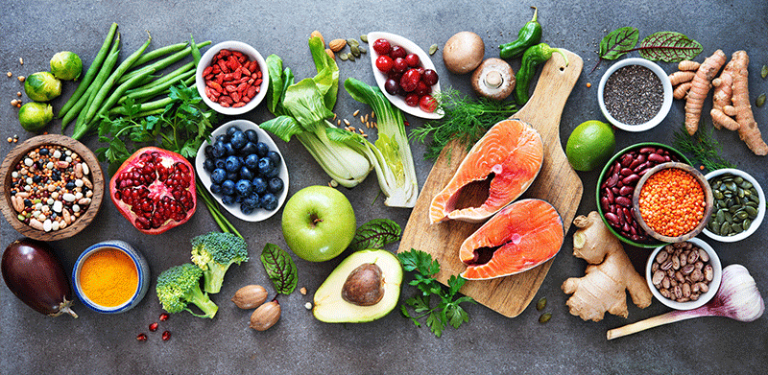
The impact of hyperglycaemia (high blood glucose levels) on cells and tissues in the body is also cause for concern.
An indirect impact of eating large amounts of added sugars is that they may replace other nutrient-rich foods and result in nutrient deficiencies.

Slide 13
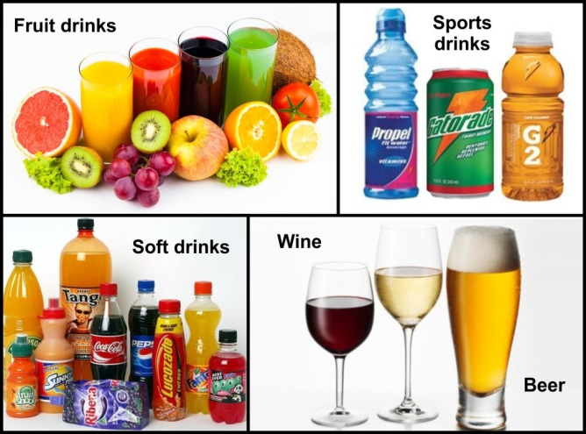
Foods such as lollies, cakes, biscuits, doughnuts, muffins and chocolate, and drinks such as sports drinks, soft drinks and fruit drinks, all have high amounts of added sugar with few other nutrients in them, so they are referred to as nutrient-poor.

Slide 14
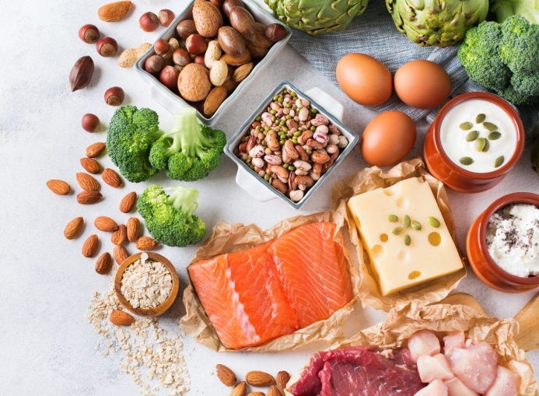
PROTEIN
For normal people, the amount of protein needed is 0.8-1.2g/kg
If training intensely, we need extra protein (1.4-2 g/kg body weight per day, or around 100-140 g protein per day for a person weighing 70 kg)

Slide 15
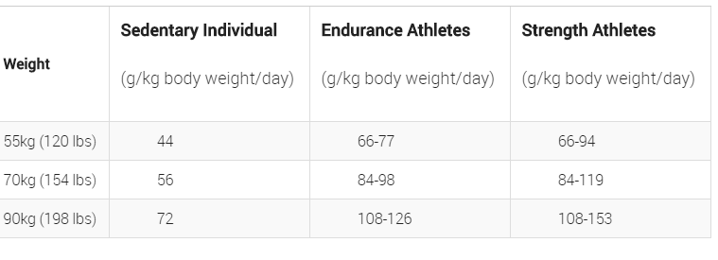

Slide 16
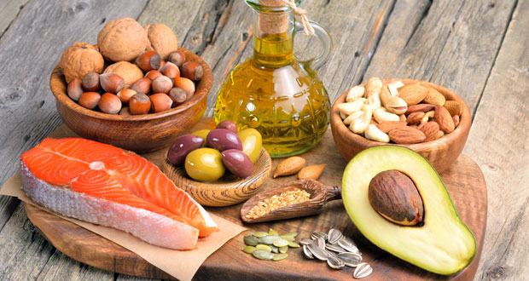
FAT
Active people need a moderate amount of fat (about 30% of daily calories).
which can easily be achieved by including oily fish (like salmon), vegetable oils or spreads, nuts, seeds and avocado in the diet

Slide 17
Current dietary guidelines recommend that
10% of fat intake should come from monounsaturated sources,
10% from polyunsaturated sources, and
no more than 10% from saturated fat

Slide 18
ALCOHOL
however, it is not necessary to include when planning diets and nutritional intakes for people, including athletes, due to the negative health and performance effects.
alcohol refers to compounds containing a hydroxyl group (–OH), which include methanol, ethanol, isopropyl alcohol, glycerol, butanol and pentanol. However, for most people the term ‘alcohol’ is used to describe alcoholic beverages containing ethanol

Slide 19
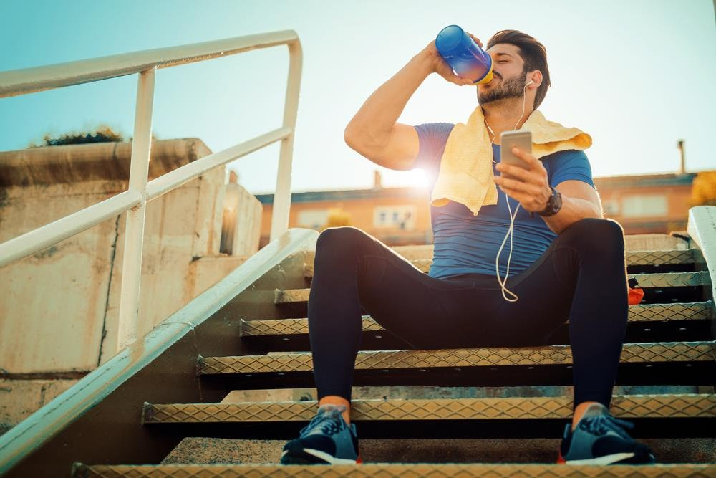
Ethanol is a depressant of the brain and nerve tissues and affects a number of neurochemical processes. leading to an increased risk of suffering mental health problems
Importantly, if consumed as part of after-game celebrations, alcohol can limit athletes’ ability to adhere to nutrition recovery plans

