Slide 1
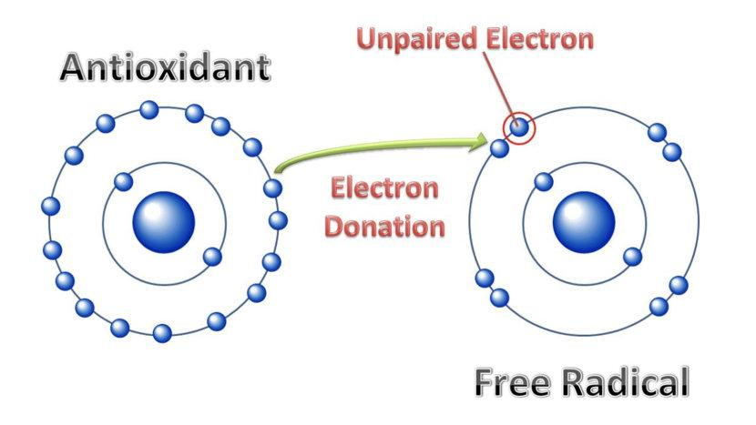
EXERCISE OXIDATIVE STRESS AND ANTIOXIDANTS
Free radicals, including reactive oxygen species, are molecules with one or more unpaired electron.

Slide 2
WHERE DO WE GET?
Cells contain small structures called mitochondria, which work to generate energy in the form of adenosine triphosphate (ATP).
Mitochondria combine oxygen and glucose to produce carbon dioxide, water, and ATP. Free radicals arise as byproducts of this metabolic process.

Slide 3

OTHER FACTORS FOR FREE RADICALS
Smoking
Air pollution
Pesticides
Diet
Alcohol
Radiation and UV light

Slide 4
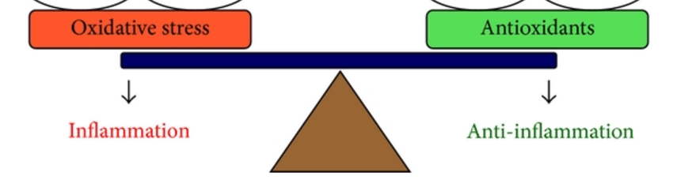
OXIDASE STRESS
Oxidative stress can occur when there is an imbalance of free radicals and antioxidants in the body.

Slide 5
The body’s cells produce free radicals during normal metabolic processes. However, cells also produce antioxidants that neutralize these free radicals. In general, the body is able to maintain a balance between antioxidants and free radicals.

Slide 6
The effects of oxidative stress vary and are not always harmful. For example, oxidative stress that results from physical activity may have beneficial, regulatory effects on the body.
Exercise increases free radical formation, which can cause temporary oxidative stress in the muscles. However, the free radicals formed during physical activity regulate tissue growth and stimulate the production of antioxidants.

Slide 7
SOURCES OF ANTIOXIDANTS
Like free radicals, antioxidants come from several different sources.
Cells naturally produce antioxidants such as glutathione.
A person’s diet is also an important source of antioxidants. Foods such as fruits and vegetables provide many essential antioxidants in the form of vitamins and minerals that the body cannot create on its own.

Slide 8
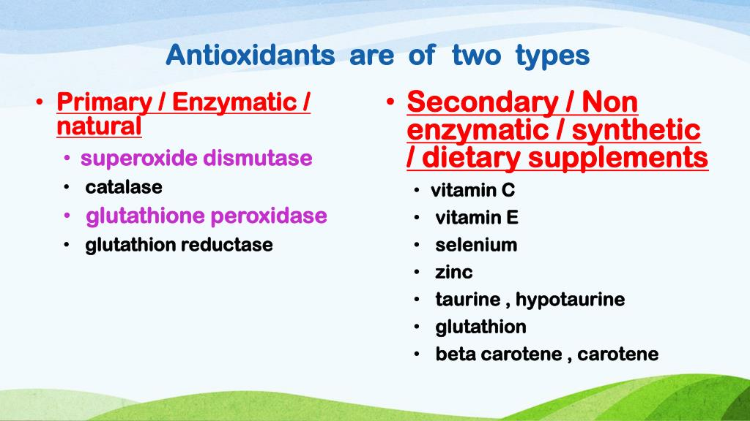
Types of anti-oxidants

Slide 9
Introduction to diet plan
Yaseen Galali

Slide 10
INTRODUCTION TO DIET PLAN
One of the main roles of nutrition professionals working with athletes and
active people is to help them develop and implement
we will describe the steps involved in planning diets for individual athletes and for teams, and consider a range of factors that
influence an athlete’s nutrition plan their nutrition plans

Slide 11
We will also consider strategies to use
when working with athletes to increase engagement and participation in the
diet-planning process.

Slide 12
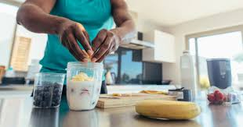
ATHLETES
Developing a nutrition plan is a complex task. There are a number of factors
that may influence dietary intake; these are described in more detail below.
To help simplify the process, the following steps may be used as a guide to
follow when developing a nutrition plan.

Slide 13
STEP 1: COLLECT INFORMATION
Identify baseline physiological requirements. How much energy and nutrients are required at rest?
Identify additional requirements related to training and competition. How much extra energy is needed to support training sessions and competition events? Should this energy be focused on any specific macronutrients?

Slide 14
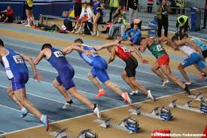
Determine when training, competition and recreational activity will take place. It is important to be able to time meals to effectively fuel training, competition and recovery.
Identify any dietary requirements related to allergies, intolerances, religious or cultural beliefs, or personal values. Are there any foods that the athlete cannot consume?
Assess current body composition and evaluate this against any required standards or goals. What information is currently available? Take additional measurements if trained to do so and relevant to the athlete’s goals.

Slide 15
Identify any factors that may influence access to food. Does the athlete have access to fresh food outlets? Can they afford to buy this food? Do they have facilities for food storage, preparation and cooking, and do they have the skills to do so?
Identify social influences on dietary intake. Where does the athlete eat, and who do they eat with? Do they prepare their own meals? Are they cooking for other members of their household? How is their day scheduled? Do they have time to cook?

Slide 16
Identify any nutrition-related health concerns. Does the athlete have any health issues that require input from a dietitian or other health professional?
Identify any team requirements, restrictions or habits regarding food, beverages and supplements. What type of sport do they play? What is their goal?

Slide 17
position and what does it involve? How long do games/events run for? Will the athlete play for the entire game? Will they have access to food or fluid while they are playing or during breaks? Does the team or club eat meals together or provide food or supplements for athletes?
Collect and assess information about the athlete’s usual diet and supplement use. What do they eat currently (what, when and how much)? Are they happy with this? What would they like to change and why?

Slide 18
STEP 2: IDENTIFY PRIORITY AREAS
Ask the client what is important to them.
Common goals include increasing lean (muscle) mass, reducing fat mass, or providing strategic fueling suggestions to maximize performance in training or competition.
There will be other important aspects to consider—for example, the athlete focused on fuelling a training session may also be interested in recovery strategies

Slide 19
But- these do not all need to be addressed at the first appointment. Depending on the athlete’s situation, you may also ask for input from a coach or trainer to help identify nutrition goals.

Slide 20
STEP 3: DEVELOP A PLAN
Put together a specific plan with detailed recommendations for when to eat,
what to eat and how much to eat. Athletes will often like the structure of a rigid plan,
but it is helpful to provide some flexibility to allow for changes in circumstances, preferences and access to foods.
A flexible plan that includes options will also help to teach the athlete about the components of their dietary plan and enable them to make appropriate choices on their own.

Slide 21
STEP 4: TRIAL THE PLAN
Nutrition plans must be tailored to the individual athlete.
As much as we can try to develop helpful nutrition solutions for athletes based on what we know about their needs and what we know about food, the only way to determine with any certainty whether a plan will be tolerated by an athlete and help to achieve their nutrition-related goals is to trial the nutrition plan.
Ask the athlete to trial the plan at least once or twice before your next consultation with them.
Nutrition plans that will be used in competition should be trialed in training as much as possible, to familiarize the athlete with the plan and to help train the gut.

Slide 22
STEP 5: ASSESS THE PLAN
Once the athlete has had some experience with the nutrition plan, it is important to meet and review how well the plan was tolerated and accepted by the athlete, and whether it is helping to achieve their nutrition-related goals.
it cause any gastrointestinal discomfort?
Did the athlete like the foods.
Were the foods easy to access and prepare?
Were foods planned for use during competition or training easy to consume during the activity?
Were there any changes noted in performance at training, or in energy or mood through the day?
Were there any barriers encountered in implementing the
plan?

Slide 23
STEP 6: REVISE THE PLAN
Based on the feedback provided by the athlete, make modifications to the plan. The new plan should also be trialed, assessed and revised as needed.
Following these steps should help you collect all of the information you require to work with an athlete to develop a nutrition plan

Slide 24
EXAMPLE:
TIMING Of TRAINING/COMPETITION/ACTIVITY
Trains after work (5 p.m.) during the week, and in the mid-morning on weekends.
BODY COMPOSITION
BMI = 57 kg/ (1.68 m)2 = 20.2 kg/m2 (considered to be within healthy range)
More detailed anthropometric measurements have not been performed. In recreational athletes of healthy BMI with no personal concerns about their body composition, there is no need to perform detailed anthropometric measurements.

Slide 25
DIETARY REQUIREMENTS
Nil allergies or intolerances.
PERSONAL PREFERENCES, LIKES AND
DISLIKES
Prefers dairy, eggs and vegetable sources of protein to meat.
FACTORS INFLUENCING ACCESS TO
FOOD
Works full time; is able to access shops on evenings and weekends.
Shares a kitchen with one roommate.

Slide 26
SOCIAL INFLUENCES
Usually eats alone; occasionally eats dinner with her roommate. Eats lunch at her desk during the week. Works 8.30 a.m.–4.30 p.m. in an office close to home. Enjoys cooking, but not baking.
NUTRITION-RELATED HEALTH
CONCERNS
Nil

Slide 27
TEAM REQUIREMENTS, RESTRICTIONS
OR HABITS
Long weekly training runs will require a source of carbohydrate, electrolytes and fluid while training. Race-day nutrition strategies should be practised in training.

Slide 28
USUAL DIET
Breakfast (7 a.m.): 1 cup of cereal with skim milk and a glass of orange juice
Morning snack (9 a.m.): 2 slices of wholemeal toast with peanut butter and coffee with skim milk
Lunch (12 p.m.): 2 cups of salad using leftover vegetables from dinner plus 2 eggs, a small tin of tuna or crumbled feta with olive oil and vinegar to dress the salad plus an apple or pear
Afternoon snack (2.30 p.m.): chocolate bar or similar from the vending machine
Dinner (7 p.m.): pasta or rice with lentils, chickpeas or beans and vegetables, and fruit with ice cream or custard for dessert

Slide 29
CALCULATING ENERGY REQUIREMENT STEP ONE
Calculate your basal metabolic rate (BMR), the minimal number of calories your body needs just for daily survival. Use this formula:
BMR = 66 + (6.23 x weight in pounds) + (12.7 x height in inches) – (6.8 x age in years)
1 inch=2.54
1 Kg=0.453

Slide 30
Example: If Jenica weigh 220 pounds,’ 6′ tall, and 20 years old, your calculations would look like this:
BMR = 66 + (6.23 x 220) + (12.7 x 72) — (6.8 x 20). That’s 2214 calories per day.

Slide 31
STEP TWO
Calculate your Energy Expended for Physical Activity (EEPA), which is all the calories you expend in a day. You can figure this out with this formula:
EEPA = BMR x Activity Level=2214x1.9=4206
1.200 | sedentary (little or no exercise due to injury or illness)
1.375 | lightly active (about 30 minutes training, moderate 1 to 3 days/week)
1.550 | moderately active (moderate 45 minutes, 3 to 5 days/week)
1.725 | very active (1 hour, 6 to 7 days a week)
1.900 | 1.900+ = extra active (very hard training including weight lifting 2-3 days/week)
Most athletes are between 1.550 and 1.9, depending on the their training. For athletes training at very high levels (3 hours or more per day), calorie needs may exceed recommendations.

Slide 32
STEP THREE
Calculate your Specific Dynamic Action of Food (SDA) by multiplying the total of BMR and EEPA in step two by 10%.
Example: Your SDA equals 4206 x 0.1 = 420 calories

Slide 33
STEP FOUR
Add the total from step two to the total from step 3 to get the overall number of calories you need daily to maintain your present weight.
Total Calorie Needs: 4206 + 420 = 4626 calories

Slide 34
ANOTHER METHOD
Example A athlete weight (220 pound ) train for three hours
1-For basal requirement( Need)
weight (pound) X 10 =220x10=2200
2-Then for basic activity
Multiply by 10% to 30%
=2200X1.2 to1.3
= 2,640 – 2,860 calories
3- Then add 100 calorie for 10 min exercise
If runs for three hours ( 30 minutes)
=300 calorie
Total = 300+2,640 – 2,860 = 2940 – 3,160 calories per day

Slide 35
PROPOSED PLAN
7 a.m. | 2 poached eggs on 2 slices of sourdough bread with 1 tomato and 6 mushrooms, grilled with 1 tsp olive oil 200 mL of orange juice
10 a.m. | 2 slices of whole meal toast with 2 tbsp peanut butter 250 mL coffee with skim milk
1 p.m. | 1 cup of salad vegetables plus 95 g tuna, salmon or sardines and 30 g feta or ricotta cheese and 1 cup leftover cooked starchy vegetables with 1 tsp olive oil and 2 tsp vinegar and a dinner roll One piece of fruit
4 p.m. | 1 cup of cereal (not a high-fibre option) with ½ cup skim milk
5 p.m. | Training
6 p.m. | 3 piececes of fruit with a 20 g slice of cheese
7p .m. | 1 cup cooked wholemeal pasta or brown rice with ½ cup cooked lentils, chickpeas or beans, ¾ cup tomato-based sauce, ½ cup cooked starchy vegetables (e.g. potato, sweet potato, corn) and ½ cup green vegetables (e.g. broccoli, green beans, spinach)
9p .m. | 300 mL yoghurt or custard with 1/2 cup nuts and 1 cup berries

Slide 36
This plan provides more than 3000
145 g protein, 95 g fat and 350 g carbohydrate per day.
Did you notice that this plan contains many elements from the athletes usual diet?
We have moved the order and timing of some of the foods,
But it is helpful to include as many foods as possible that are already familiar to and known to be tolerated by the athlete

Slide 37
You may also note that the total energy provided by the nutrition plan is not exactly what we calculated Janice’s requirements to be.
Remember that estimates of energy requirements are just that—estimates. It is more important to note Janice’s usual intake and any changes in weight or body composition with dietary changes to inform finetuning of the nutrition plan.
Estimated energy requirements are more likely to be used when an athlete requires a more substantial change to their diet,
or when you have limited background information available to inform your plan

Slide 38
Janice will now trial this plan on two training days and keep track of her experience in a
She will record what she eats and when, as well as her energy levels and any gastrointestinal discomfort. After these two trial days, you meet with Janice to discuss her experience.
Janice reports no concerns except that she felt hungry during training.
Together, you adjust her lunch and pre-training snack to include more low-GI sources of carbohydrate, and you ask her to return with feedback after her next training day.

Slide 39
Time | Food consumed | Mood and energy levels | Gastrointestinal symptoms
4 p.m. | 1 cup cornflakes ½ cup milk | Energetic | Nil

