Slide 1

Helicobacter pylori
Ms. Heshu J. Ahmed
PhD Candidate
Medical Bacteriology 423
Spring Semester
Week Ten

Slide 2
Outline
• Introduction and historical background
• Morphology and biological properties
• Epidemiology and transmission
• Defense mechanisms and site of infection
• Pathogenesis and virulence factors
• Clinical manifestations and associated diseases
• Laboratory diagnosis and treatment
Medical Bacteriology 423

Slide 3
Objectives
• Describe the main characteristics of Helicobacter pylori.
• Explain how H. pylori survives in the acidic stomach environment.
• Identify the major virulence factors involved in colonization and tissue injury.
• Relate H. pylori infection to gastritis, peptic ulcer disease, gastric cancer, and MALT lymphoma.
• Compare invasive and non-invasive diagnostic methods.
• Summarize the basic principles of H. pylori eradication therapy.
Medical Bacteriology 423

Slide 4
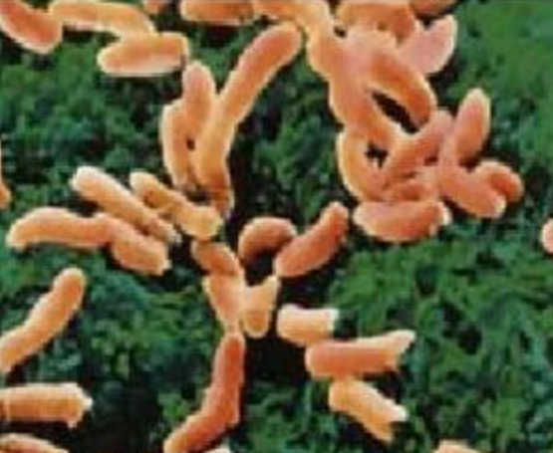
Introduction
• Helicobacter pylori is a spiral, gram-negative bacterium adapted to the gastric mucosa.
• For many years, the human stomach was considered too acidic for bacterial colonization.
• Marshall and Warren identified and cultured the organism in 1982.
• The discovery changed the understanding and treatment of gastritis and peptic ulcer disease.
• H. pylori infection is usually chronic and may persist for decades without eradication.
Medical Bacteriology 423

Slide 5
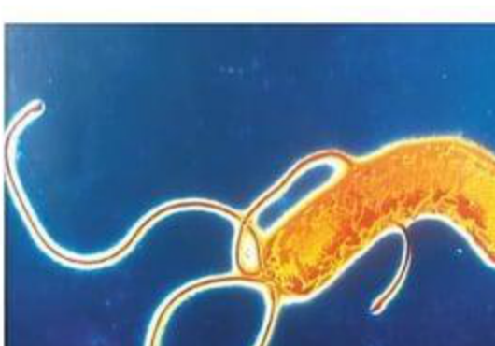
Morphology and structure of H. pylori
• Spiral or curved gram-negative rod.
• Motile by multiple polar flagella, usually 4–6 flagella.
• Microaerophilic: requires oxygen, but at lower levels than atmospheric oxygen.
• Oxidase-positive, catalase-positive, and strongly urease-positive.
• Usually found in the mucus layer overlying gastric epithelial cells.
Medical Bacteriology 423

Slide 6
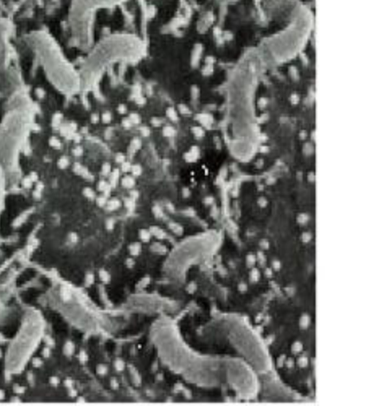
Biological properties
• Produces adhesins that help the bacterium attach to gastric epithelial cells.
• Uses urease to break down urea into ammonia and carbon dioxide.
• Ammonia helps neutralize acid around the organism.
• Motility allows penetration into the gastric mucus layer.
• The infection is not easily cleared by the host immune response.
Medical Bacteriology 423

Slide 7
Epidemiology
• H. pylori is one of the most common chronic bacterial infections in humans.
• Acquisition is strongly related to socio-economic status and living conditions early in life.
• In developing countries, many infections are acquired during childhood.
• In developed countries, childhood infection is less common, but prevalence increases with age.
• Most infected individuals are asymptomatic, but chronic inflammation may continue.
Medical Bacteriology 423

Slide 8
Transmission of H. pylori
• The exact route of transmission is not fully defined.
• Humans are considered the main reservoir.
• Person-to-person transmission is most likely.
• Fecal–oral and oral–oral exposure are possible routes.
• Family members may carry similar strains because of shared living environments.
• Environmental or animal sources cannot be completely excluded.
Medical Bacteriology 423

Slide 9
Defense mechanism: urease
• After reaching the mucus layer, H. pylori avoids the strongest acidity of the gastric lumen.
• Urease hydrolyzes urea into ammonia and carbon dioxide.
• Ammonia acts as a local base and creates a protective neutral microenvironment.
• This mechanism helps the bacterium survive long enough to colonize the mucosa.
• Urease activity is also used clinically in rapid urease testing and urea breath testing.
Medical Bacteriology 423

Slide 10
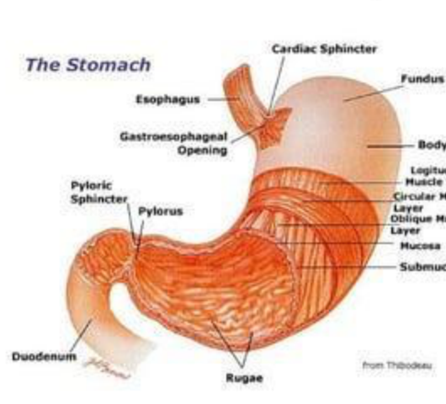
Site of infection
• H. pylori is highly adapted to live on gastric mucosa.
• The gastric antrum is a common favored site.
• The organism is present in the mucus that overlies the mucosa.
• It may be suspended in mucus or attached to epithelial cells.
• Colonization stimulates chronic active gastritis.
Medical Bacteriology 423

Slide 11
Pathogenesis
• Most bacteria are killed in the hostile acidic environment of the gastric lumen.
• H. pylori survives by combining motility, urease activity, and adherence to epithelial cells.
• The organism proliferates in the mucus layer over the epithelium.
• Disease outcome depends on interaction between bacterial virulence factors, host response, and gastric acid production.
• Inflammation and epithelial injury lead to gastritis and may progress to ulcer disease.
Medical Bacteriology 423

Slide 12
Virulence factors
• Flagella: allow movement through gastric mucus.
• Adhesins: mediate binding to gastric epithelial cells.
• Urease: protects against acidity by producing ammonia.
• Mucinases and phospholipases: disrupt the protective gastric mucus barrier.
• VacA: causes vacuolation and epithelial cell damage.
• CagA/type IV secretion system: contributes to inflammation and epithelial alteration.
Medical Bacteriology 423

Slide 13
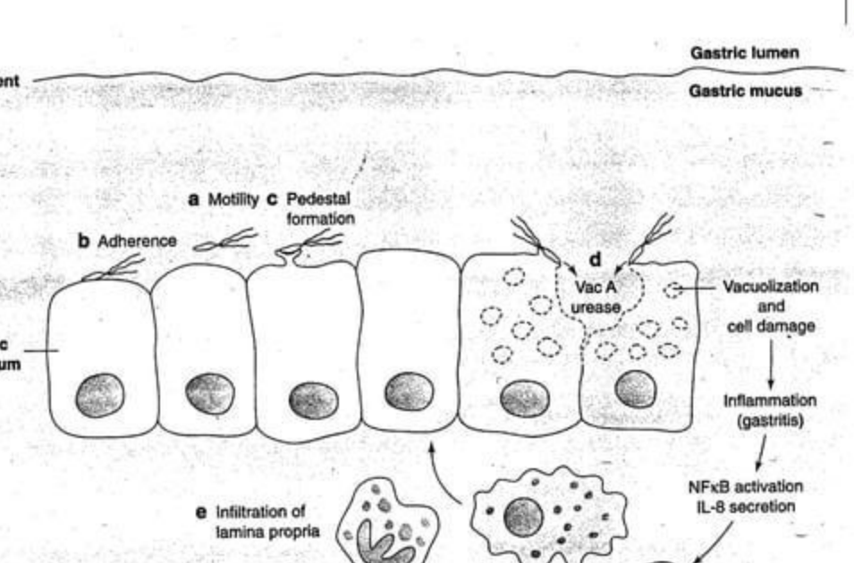
Mechanism of H. pylori infection
Medical Bacteriology 423

Slide 14
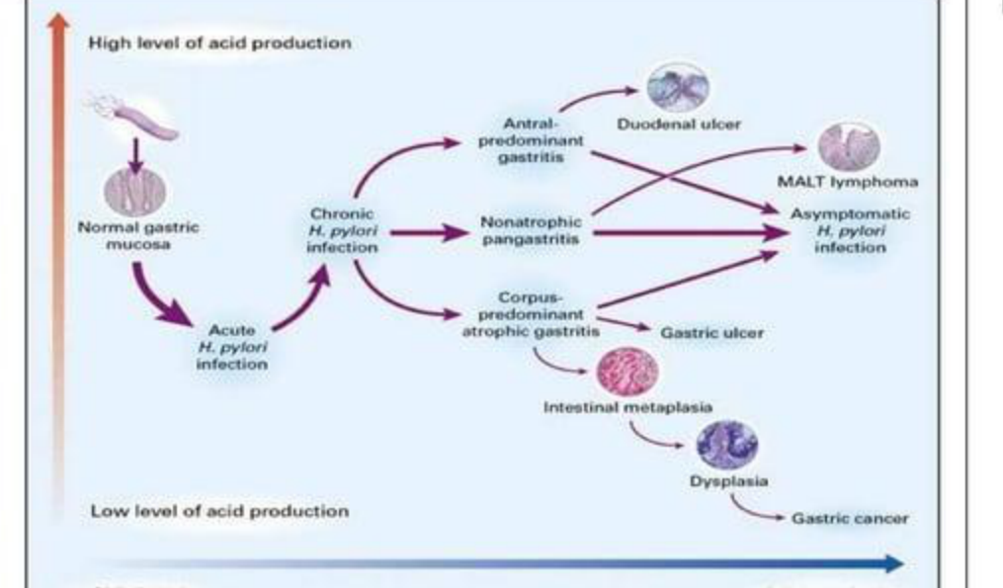
How H. pylori infection progresses?
Medical Bacteriology 423

Slide 15
Clinical manifestations
• Many infected persons remain asymptomatic.
• Abdominal pain with burning or gnawing sensation.
• Pain may be worse with an empty stomach and may occur at night.
• Dyspepsia, belching, nausea, and vomiting.
• Poor appetite and weight loss may occur.
• Alarm symptoms such as blood in stool require medical evaluation.
Medical Bacteriology 423

Slide 16
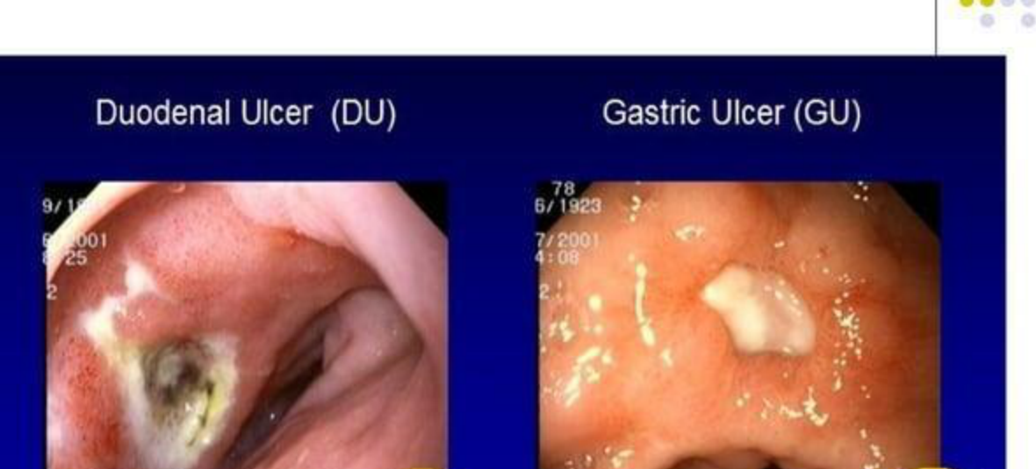
Diseases associated with H. pylori
• Chronic active gastritis.
• Duodenal ulcer.
• Gastric ulcer.
• Non-ulcer dyspepsia.
• Gastric adenocarcinoma.
• MALT lymphoma.
Medical Bacteriology 423

Slide 17
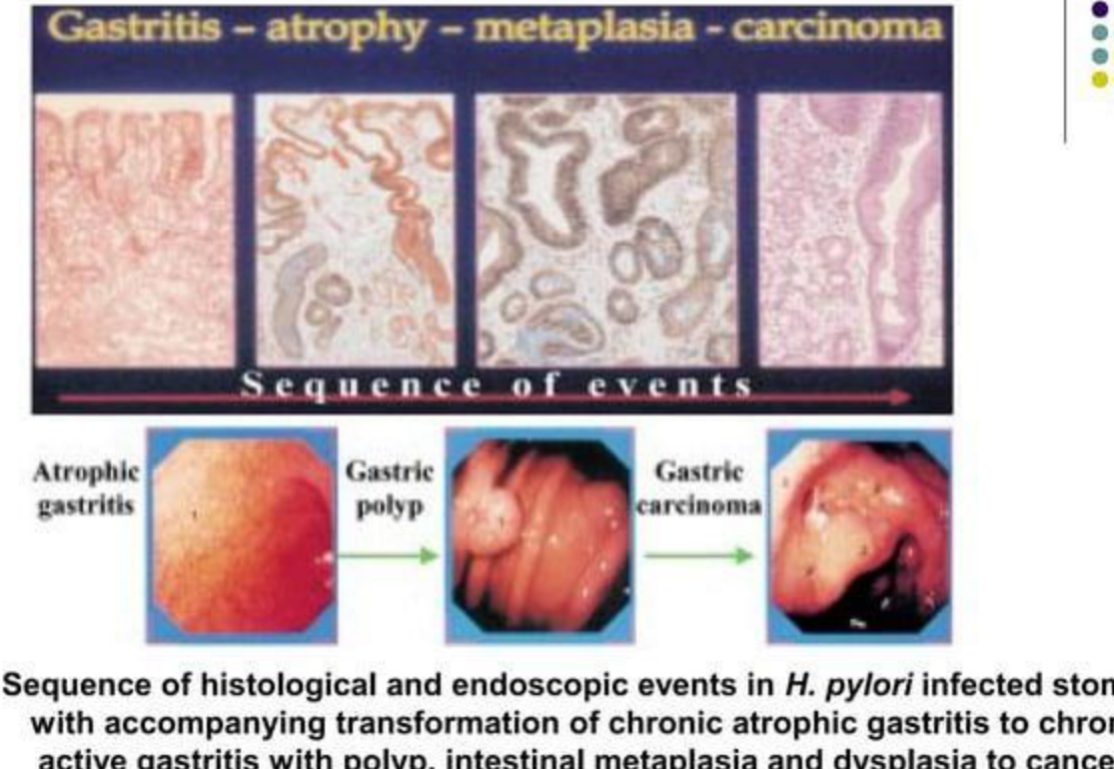
Gastritis to carcinoma sequence
Medical Bacteriology 423

Slide 18
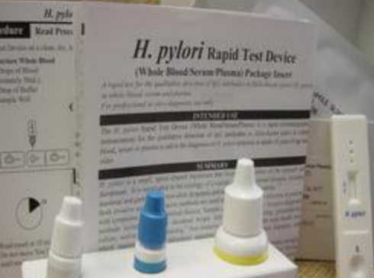
Laboratory diagnosis: non-invasive tests
• Serology: detects antibodies, but cannot reliably distinguish active from past infection.
• Urea breath test: detects active infection by measuring labeled carbon dioxide after urea ingestion.
• Stool antigen test: detects H. pylori antigen in fecal samples.
• PCR can detect H. pylori DNA, but is not always routine in clinical practice.
• Non-invasive tests are useful for initial diagnosis and for confirming eradication.
Medical Bacteriology 423

Slide 19
Laboratory diagnosis: invasive tests
• Endoscopy allows gastric or duodenal biopsy specimens to be obtained.
• Histological examination can show H. pylori and associated gastritis.
• Rapid urease test detects urease activity in biopsy specimens.
• Culture is less sensitive and requires special media and incubation conditions.
• Culture can be useful for antibiotic susceptibility testing in persistent infection.
Medical Bacteriology 423

Slide 20
Treatment
• The goal of therapy is complete eradication of H. pylori.
• Treatment usually combines acid suppression with more than one antibiotic.
• When antibiotic susceptibility is unknown, optimized bismuth quadruple therapy for 14 days is commonly recommended as first-line therapy.
• Clarithromycin-based triple therapy should not be used empirically where resistance is likely or susceptibility is unknown.
• Successful treatment should be confirmed after completion of therapy using a test for active infection.
Medical Bacteriology 423

Slide 21
Summary
• H. pylori is a curved, motile, urease-positive gram-negative bacterium.
• It colonizes the gastric mucus layer and persists despite host immune responses.
• Urease, flagella, adhesins, VacA, and CagA are important in survival and pathogenesis.
• Infection can cause chronic gastritis, peptic ulcers, gastric cancer, and MALT lymphoma.
• Diagnosis may be invasive or non-invasive; active infection tests are preferred for confirmation of eradication.
• Eradication requires combination therapy and follow-up testing.
Medical Bacteriology 423

Slide 22
Questions
• How does urease help H. pylori survive in the stomach?
• What are the main virulence factors of H. pylori?
• How can H. pylori infection lead to peptic ulcer disease?
• Compare invasive and non-invasive methods for diagnosis of H. pylori.
Medical Bacteriology 423

Slide 23
References
• Sherris Medical Microbiology: An Introduction to Infectious Diseases.
• Jawetz, Melnick & Adelberg's Medical Microbiology.
• Prescott's Microbiology by Joanne Willey, Linda Sherwood, and Christopher J. Woolverton.
• American College of Gastroenterology. Clinical Guideline: Treatment of Helicobacter pylori Infection, 2024.
• Provided H. pylori overview lecture and provided Medical Bacteriology lecture format examples.
Medical Bacteriology 423

