Slide 1

Database Administration Security
Cybersecurity Department
Course Code: CBS 214
Practical Lecture 2: SQL Server Fundamentals
Halal Abdulrahman Ahmed

Slide 2

Lecture Outlines
Introduction to SQL Server Management Studio (SSMS)
Understanding SSMS Environment (Object Explorer, Query Editor, Results, Messages)
Creating Tables with Constraints (PRIMARY KEY, IDENTITY, CHECK, DEFAULT)
Managing Data (SELECT, WHERE, LIKE, UPDATE, DELETE)
Introduction to BikeStores Database & ERD
Understanding Database Tables and Relationships

Slide 3
Learning Outcomes
By the end of this lecture, students will be able to:
Navigate and use SQL Server Management Studio (SSMS)
Create tables with appropriate constraints to ensure data integrity
Perform basic data manipulation operations (Search, Update, Delete)
Understand relationships between tables using ERD
Identify the structure and purpose of real-world database tables

Slide 4
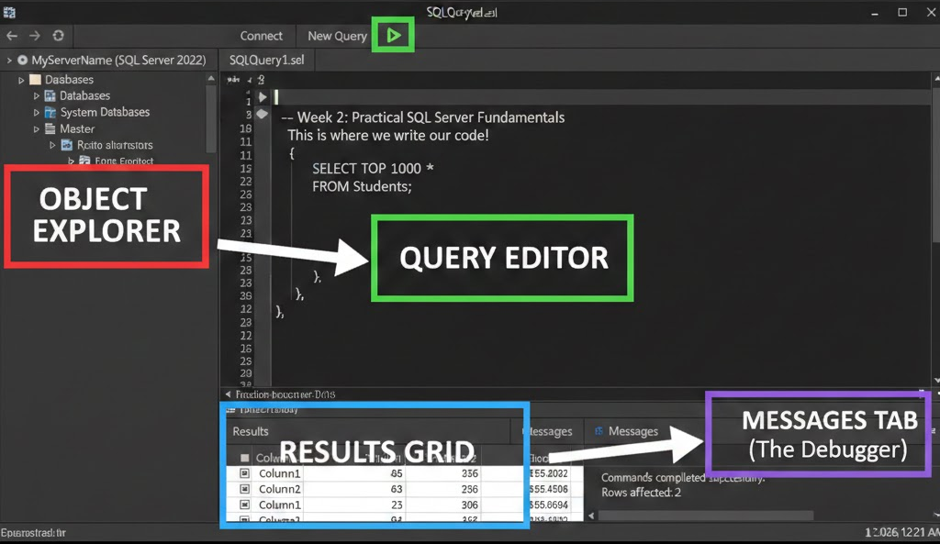
The Environment: SQL Server Management Studio (SSMS)
Object Explorer: The tree view on the left where you navigate databases and tables.
Query Editor: The central workspace where T-SQL code is written.
Results Grid: Where data appears after execution.
Messages Tab: Where SQL Server tells you if your code succeeded or why it failed (The "Debugger").

Slide 5
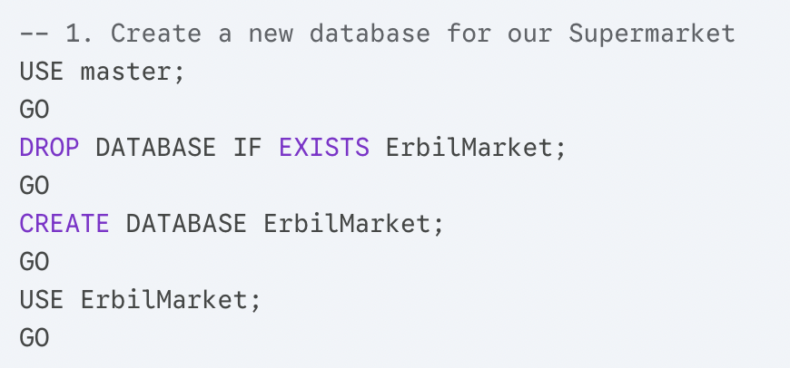
Building the Shop (Design & Constraints)

Slide 6
Tables and "Smart" Rules
Concept: Data Integrity. We don't just store data; we protect it with Constraints.
IDENTITY(1,1): Auto-counts IDs (1, 2, 3...).
CHECK: Prevents impossible data (like negative prices).
DEFAULT: Fills in missing data automatically.

Slide 7
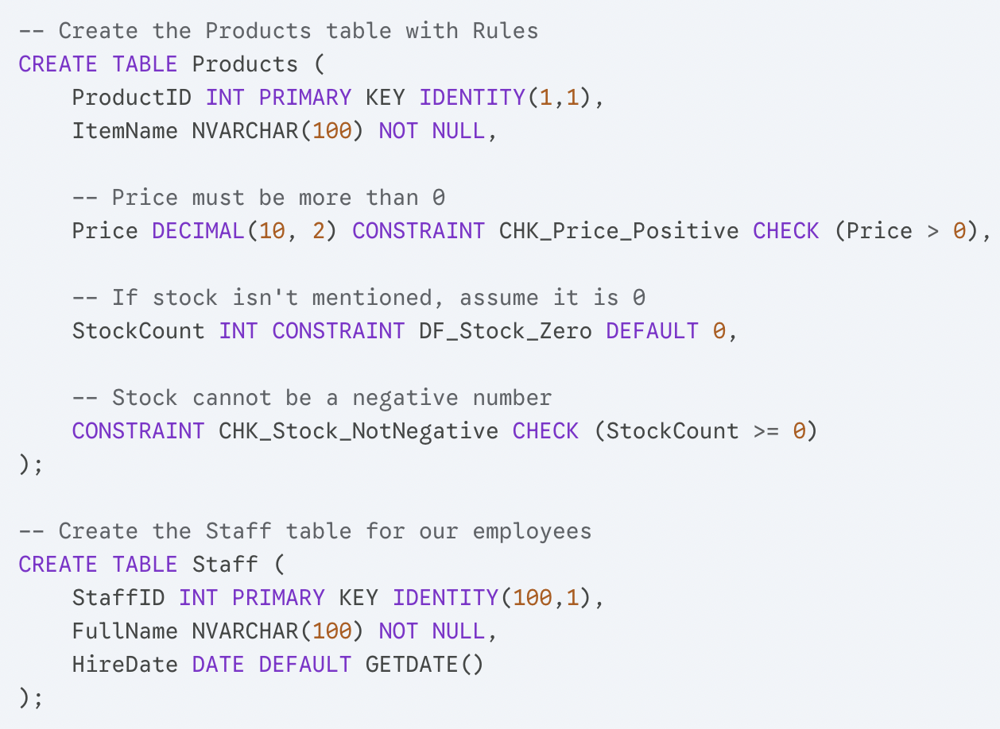

Slide 8
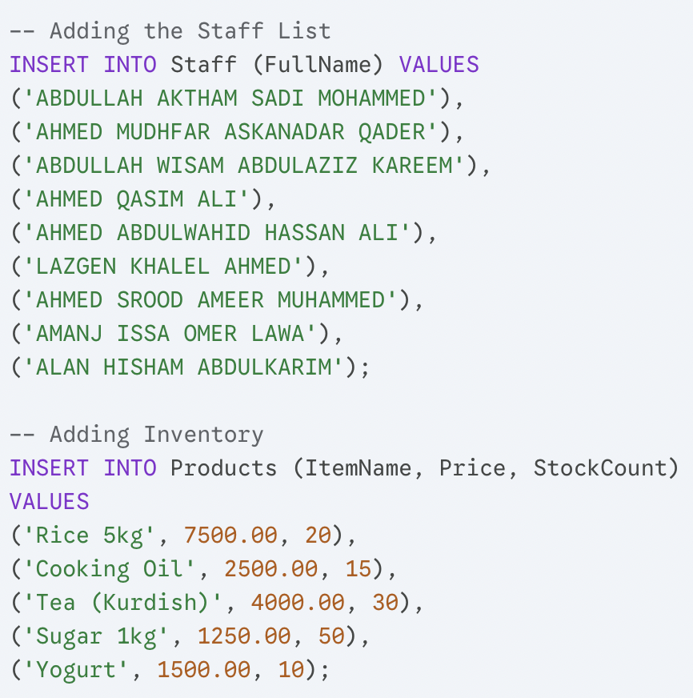

Slide 9
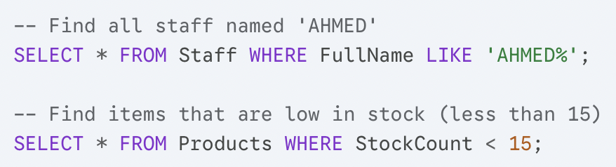
Managing Data
Task A: The Search (WHERE & LIKE)

Slide 10
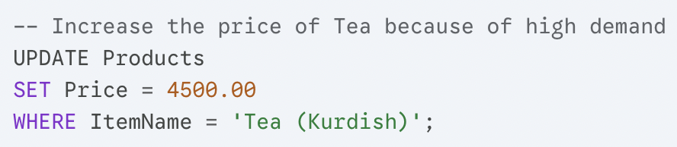
Managing Data
Task B: The Update (Changing Data)

Slide 11
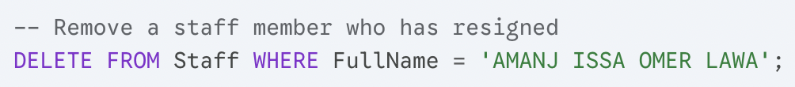
Managing Data
Task C: The Delete (Removing Data)

Slide 12
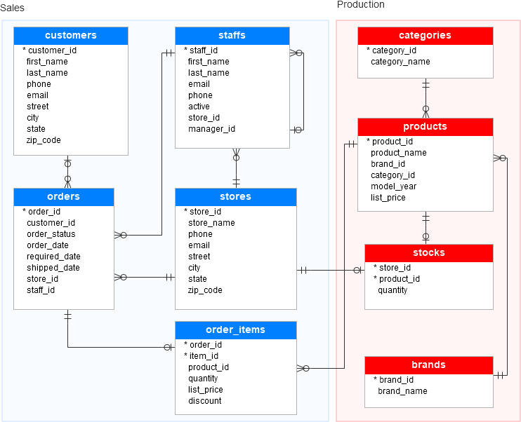
BikeStores Entity–Relationship Diagram (ERD)

Slide 13
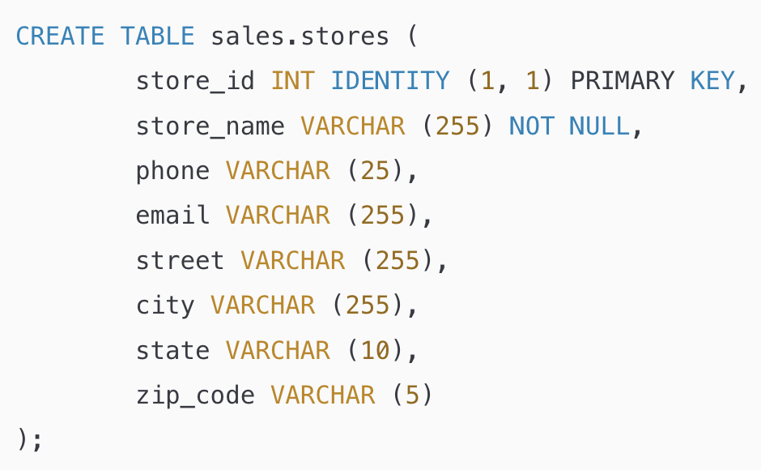
Database Tables
Table sales.stores
The sales.stores table includes the store’s information. Each store has a store name, contact information such as phone and email, and an address including street, city, state, and zip code.

Slide 14
Table sales.staffs
The sales.staffs table stores the essential information of staffs including first name, last name. It also contains the communication information such as email and phone.
A staff works at a store specified by the value in the store_id column. A store can have one or more staffs.
A staff reports to a store manager specified by the value in the manager_id column. If the value in the manager_id is null, then the staff is the top manager.
If a staff no longer works for any stores, the value in the active column is set to zero.

Slide 15
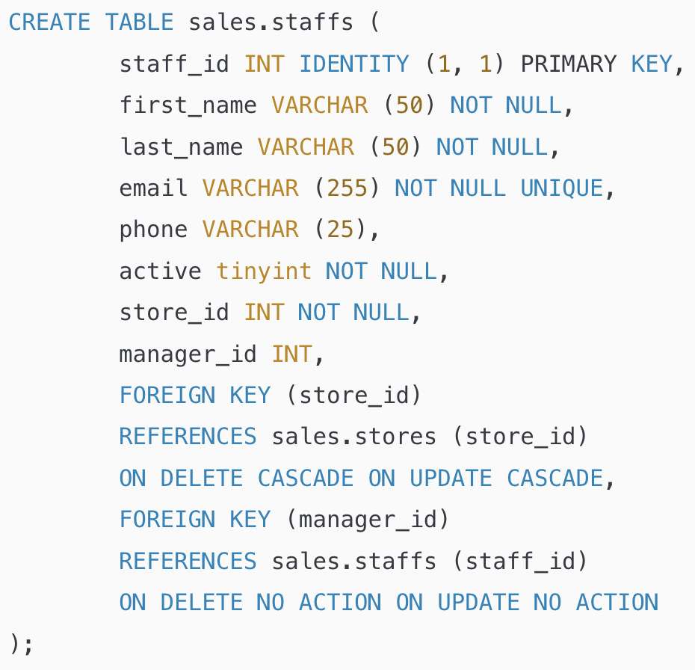

Slide 16
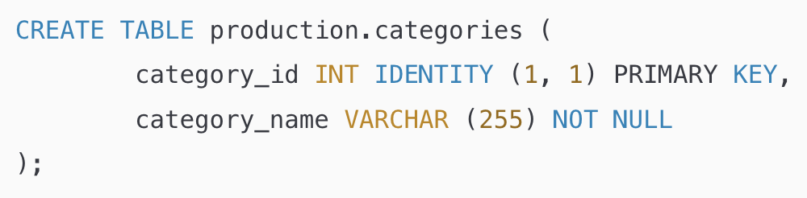
Table production.categories
The production.categories table stores the bike’s categories such as children bicycles, comfort bicycles, and electric bikes.

Slide 17
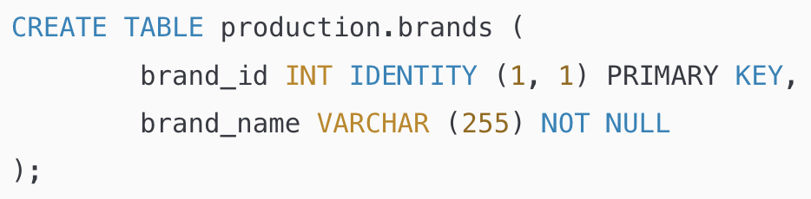
Table production.brands
The production.brands table stores the brand’s information of bikes, for example, Electra, Haro, and Heller.

Slide 18
Table production.products
The production.products table stores the product’s information such as name, brand, category, model year, and list price.
Each product belongs to a brand specified by the brand_id column. Hence, a brand may have zero or many products.
Each product also belongs a category specified by the category_id column. Also, each category may have zero or many products.

Slide 19
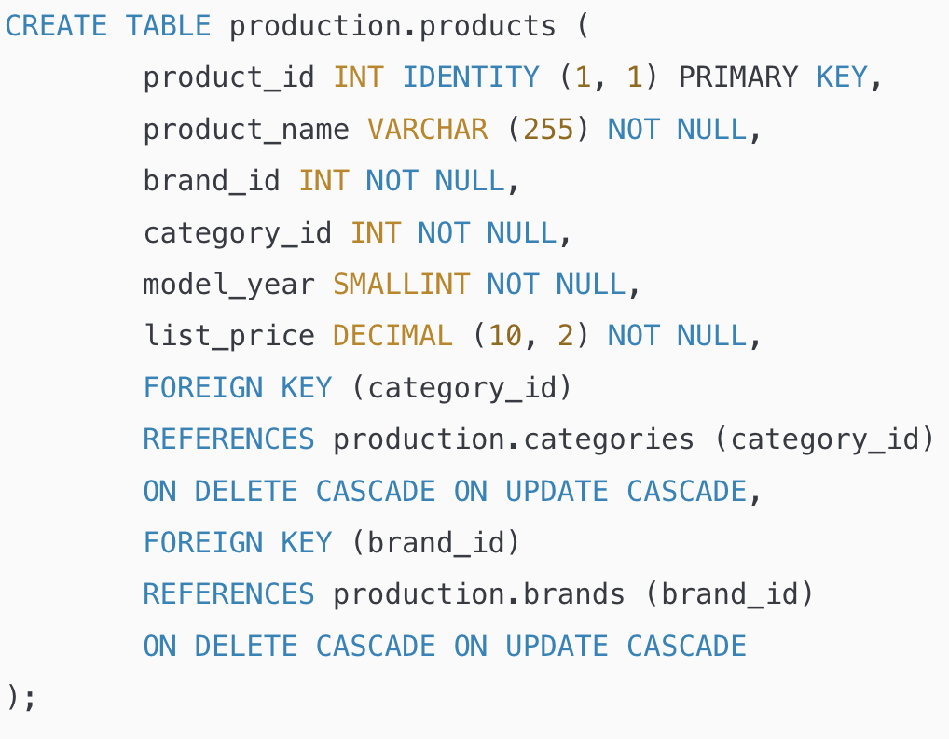

Slide 20
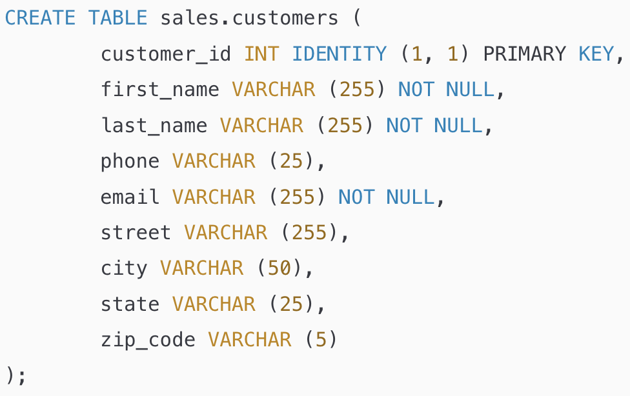
Table sales.customers
The sales.customers table stores customer’s information including first name, last name, phone, email, street, city, state and zip code.

Slide 21
Table sales.orders
The sales.orders table stores the sales order’s header information including customer, order status, order date, required date, shipped date.
It also stores the information on where the sales transaction was created (store) and who created it (staff).
Each sales order has a row in the sales_orders table. A sales order has one or many line items stored in the sales.order_items table.

Slide 22
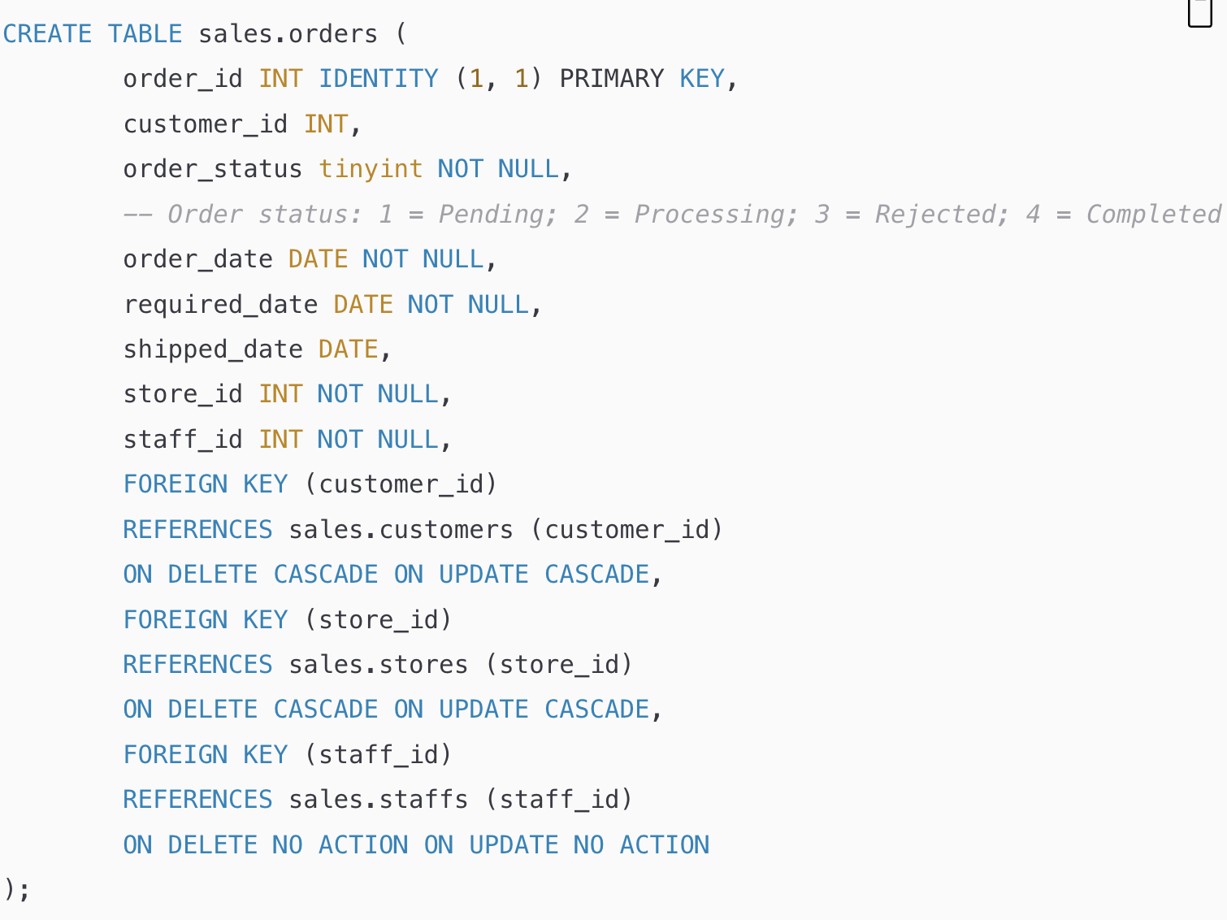

Slide 23
Table sales.order_items
The sales.order_items table stores the line items of a sales order. Each line item belongs to a sales order specified by the order_id column.
A sales order line item includes product, order quantity, list price, and discount.

Slide 24
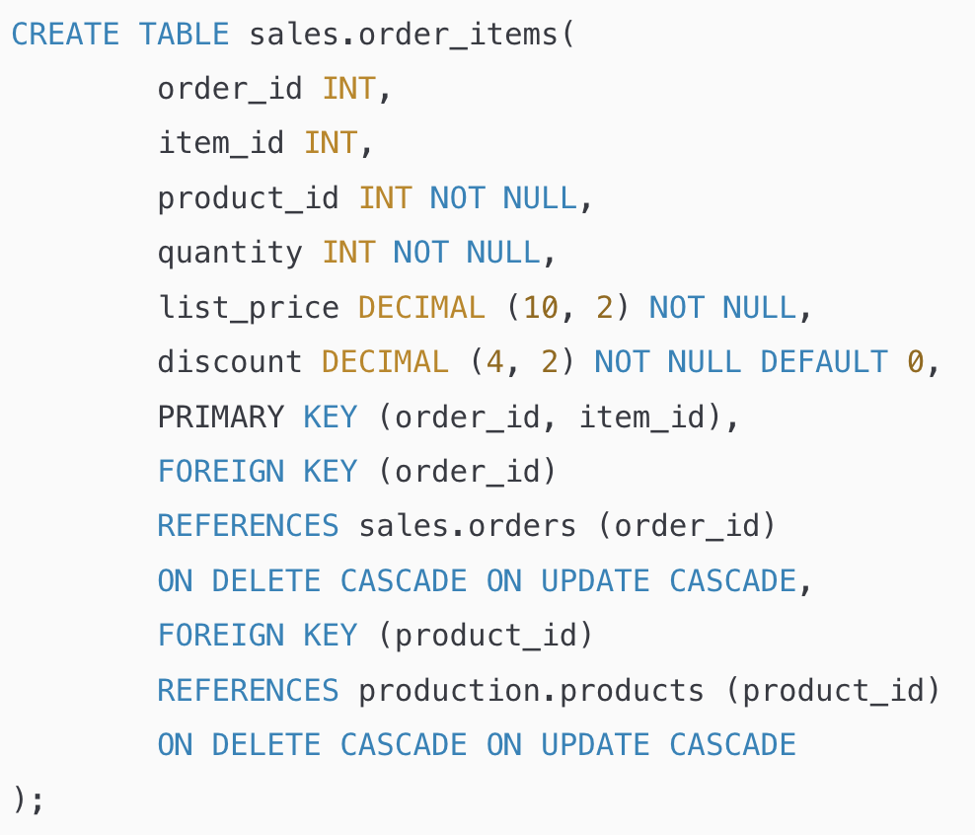

Slide 25
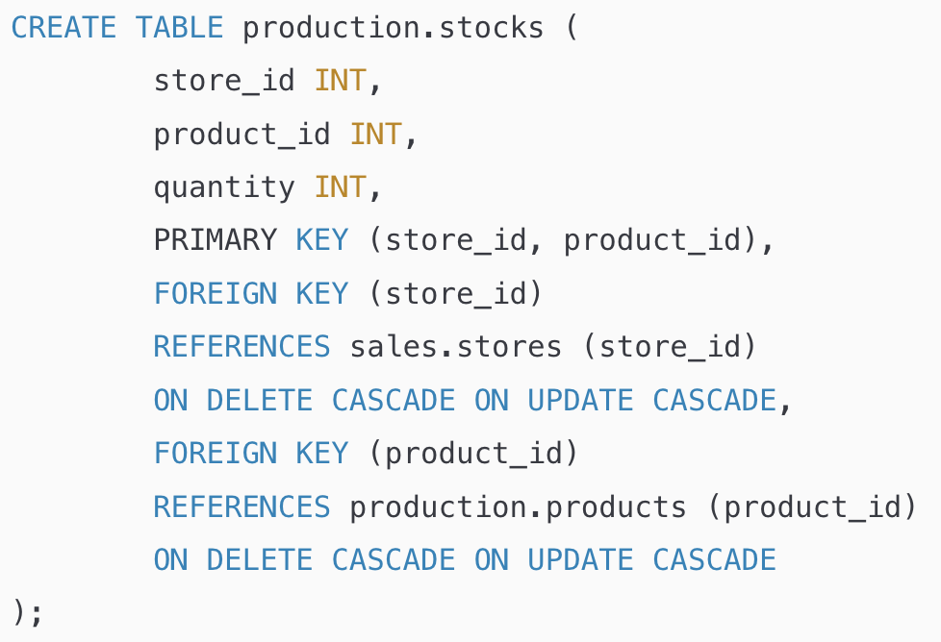
Table production.stocks
The production.stocks table stores the inventory information i.e. the quantity of a particular product in a specific store.

Slide 26
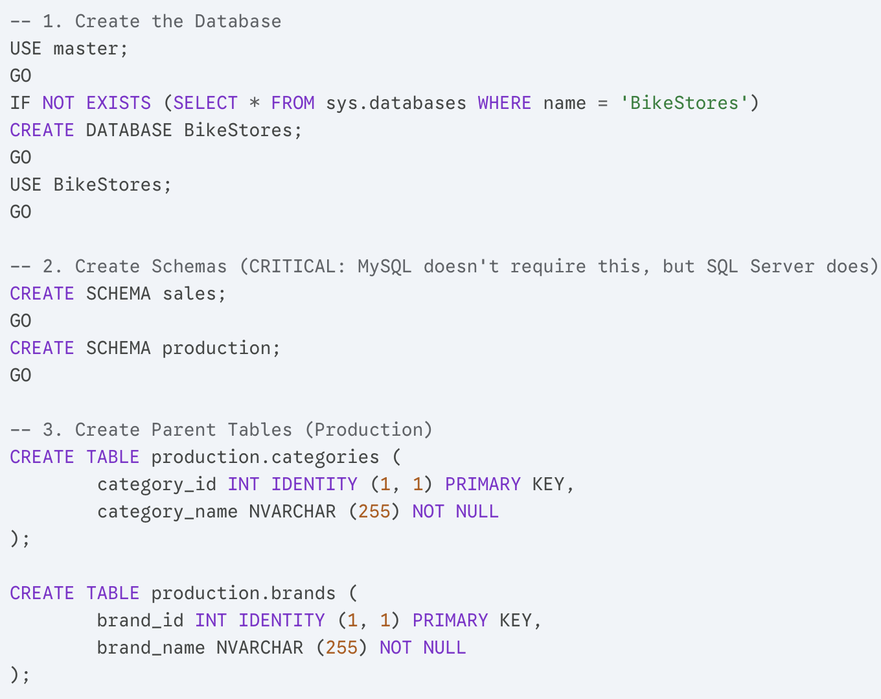

Slide 27
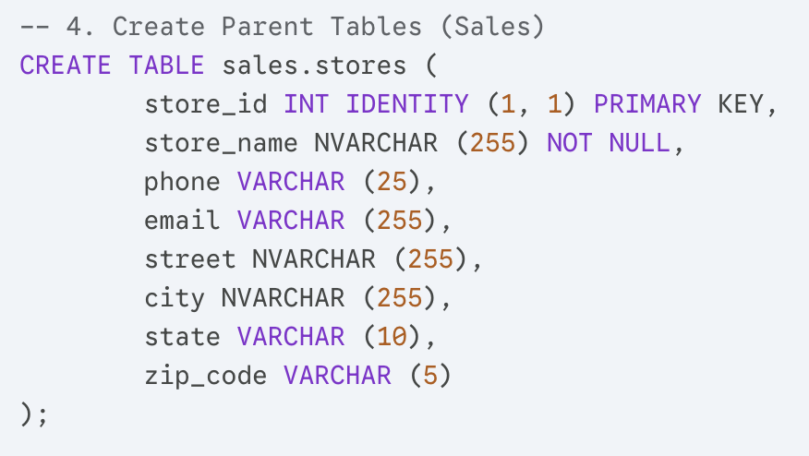

Slide 28
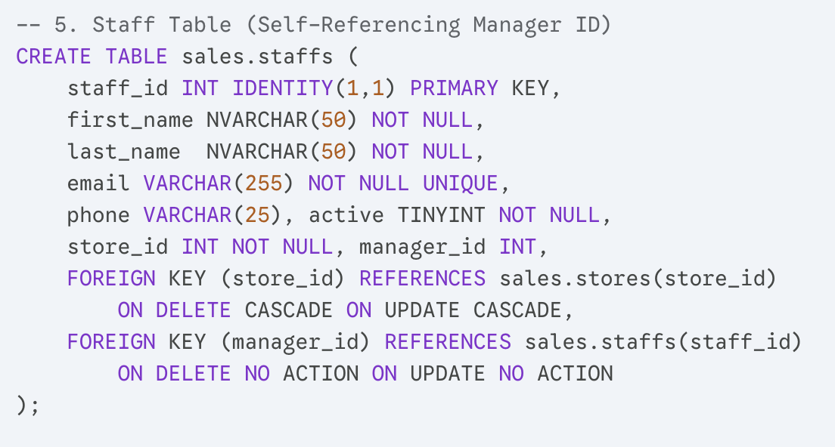

Slide 29
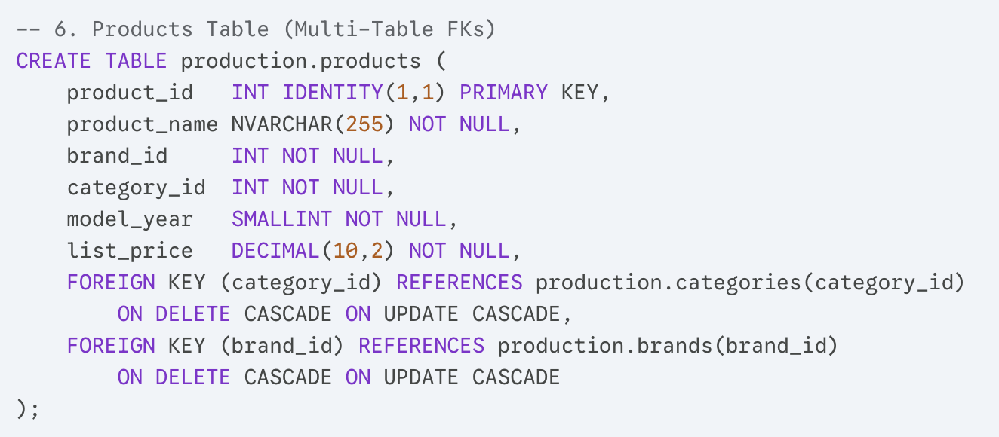

Slide 30
References
Ben-Gan, I. (2016). T-SQL fundamentals (3rd ed.). Microsoft Press.

Slide 31


