Slide 1

Nutrition & Biochemistry
Dr. Roza Talaat Yaseen

Slide 2
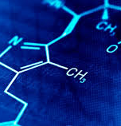
What is Biochemistry?
Biochemistry is the study of the chemical processes that occur in living organisms, including the structure, function, and interactions of biological molecules such as proteins, carbohydrates, lipids, nucleic acids, and vitamins. It helps us understand how cells and tissues function at a molecular level and how these biochemical processes relate to health and disease.

Slide 3
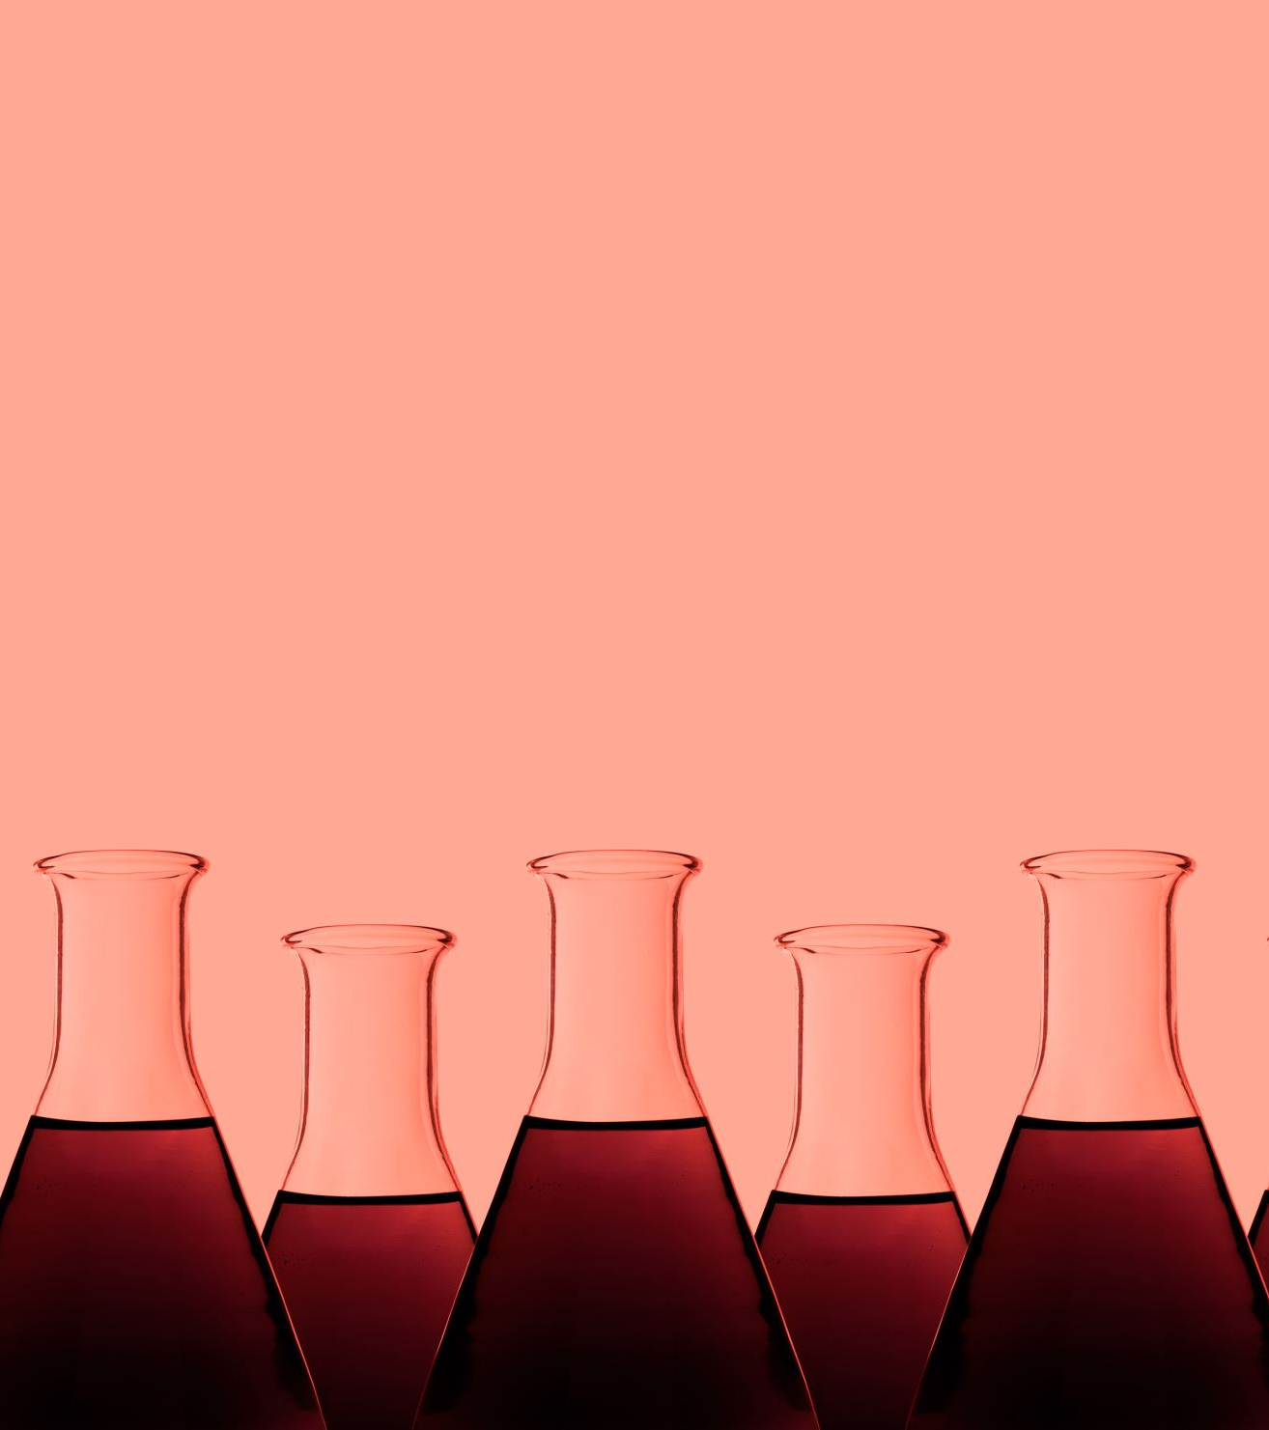
Why study Biochemistry?
For medical students, biochemistry is essential for understanding the biochemical basis of health, disease, and medical treatments. It provides insights into:
How nutrients are metabolized in the body.
The biochemical basis of diseases and how they develop at a molecular level.
The action of drugs, their metabolism, and their effects on different biochemical pathways.
How to maintain homeostasis, improve patient care, and apply nutritional knowledge in disease prevention.

Slide 4
Nutritional Biochemistry: The Role of Nutrition in Health
Macronutrients and Their Metabolism
Carbohydrates: Provide 4 kcal/gram; metabolized via glycolysis, Krebs cycle, and oxidative phosphorylation to produce ATP for energy.
Proteins: Provide 4 kcal/gram; used for muscle repair, enzyme function, immune response, and neurotransmitter synthesis.
Lipids: Provide 9 kcal/gram; essential for hormone production, cell membranes, and energy storage. Lipid metabolism involves beta-oxidation and ketogenesis.

Slide 5
2.Micronutrients: Vitamins and Minerals
Vitamins: Act as coenzymes in metabolism (e.g., Vitamin B12 in DNA synthesis, Vitamin C in collagen formation, Vitamin A in vision and immunity)
Minerals: Involved in nerve function (e.g., sodium, potassium), bone health (e.g., calcium, phosphorus), oxygen transport (e.g., iron in hemoglobin), and enzyme activation (e.g., magnesium, zinc)

Slide 6
3. Antioxidants and Free Radicals
Free radicals are unstable molecules that can damage cells and contribute to aging and chronic diseases like cancer and cardiovascular diseases.
Antioxidants (e.g., Vitamin C, Vitamin E, selenium, flavonoids) help neutralize free radicals and prevent oxidative stress.

Slide 7
4. Nutritional Deficiencies and Their Impact
Iron Deficiency: Leads to anemia, fatigue, impaired cognitive function, and weakened immunity
Vitamin D Deficiency: Causes weakened bones (osteomalacia in adults, rickets in children), muscle weakness, and immune dysfunction
Protein Malnutrition: Results in muscle wasting, weakened immune system, and severe conditions like Kwashiorkor (edema, enlarged liver) and Marasmus (severe wasting)
Calcium and Vitamin K Deficiency: Leads to osteoporosis, increased risk of fractures, and poor blood clotting

Slide 8
5. Nutrition in Disease Prevention
A balanced diet rich in whole foods, lean proteins, healthy fats, and fiber reduces the risk of chronic diseases such as diabetes, cardiovascular diseases, and obesity.
Dietary modifications play a key role in managing metabolic disorders:
  Low-Carb Diets: Useful in diabetes management by stabilizing blood glucose levels
  Mediterranean Diet: High in healthy fats (olive oil, nuts), fish, vegetables, and whole grains, beneficial for heart health
  DASH Diet (Dietary Approaches to Stop Hypertension): Helps control blood pressure with low sodium and high potassium intake
  Anti-Inflammatory Diet: Rich in antioxidants and omega-3 fatty acids to reduce inflammation and prevent chronic diseases

Slide 9
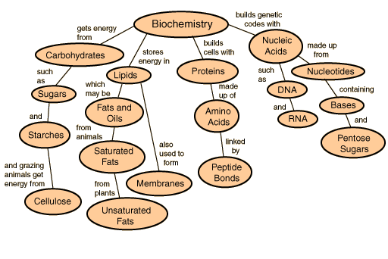
What are Organic Compounds?
Organic compounds are molecules that contain carbon atoms bonded to hydrogen, oxygen, nitrogen, and other elements.
Organic compounds are essential for life and can be classified into several types, each with specific structures and functions.

Slide 10
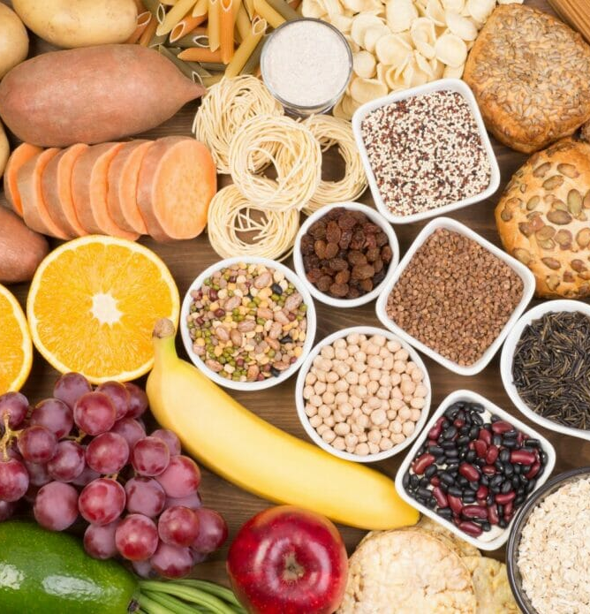
1. Carbohydrates
Carbohydrates are organic molecules composed of carbon, hydrogen, and oxygen, typically with the ratio of hydrogen to oxygen being 2:1 (like in water, H₂O). They are a primary source of energy for the body, and they are involved in structural and regulatory functions.
Carbohydrates are divided into 3 types
Monosaccharides: These are the simplest form of carbohydrates, often referred to as "simple sugars." Monosaccharides consist of one sugar unit and can be used immediately by cells for energy.

Slide 11
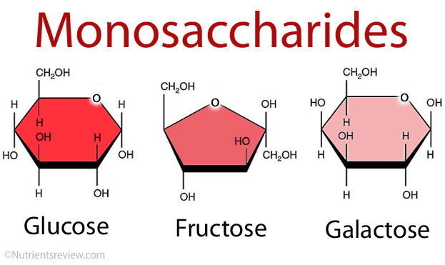
Example of Monosaccharides
Glucose: The most important energy source for the body’s cells.
Fructose: Found in fruits, it’s a sugar that can be converted to glucose in the body.
Galactose: A sugar found in milk.

Slide 12
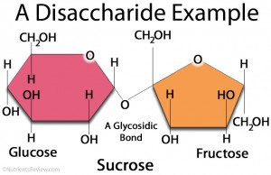
Disaccharides: These are composed of two monosaccharides linked by a covalent bond.
Disaccharides are broken down into monosaccharides by enzymes in the body.
Examples of Disaccharides:
Sucrose (table sugar): Made of glucose and fructose.
Lactose (milk sugar): Made of glucose and galactose.
Maltose: Made of two glucose units, often produced during the digestion of starch.

Slide 13
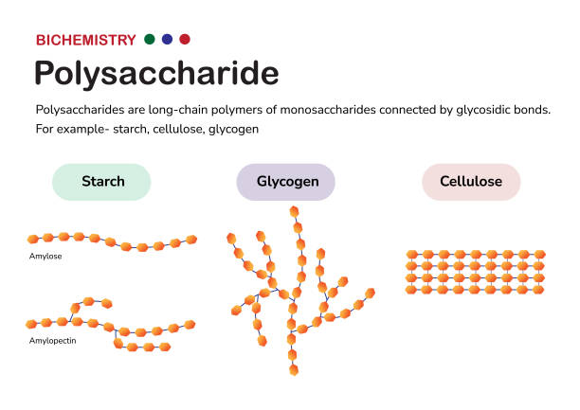
Polysaccharides: These are complex carbohydrates made up of many monosaccharides linked together. They are often used by the body for storing energy or providing structural support.
Examples of Polysaccharides:
Starch: The primary form of carbohydrate storage in plants, which humans digest for energy.
Glycogen: The form in which animals store glucose in the liver and muscles for quick energy use.
Cellulose: A structural carbohydrate found in plant cell walls. Humans cannot digest cellulose, but it provides dietary fiber.

Slide 14
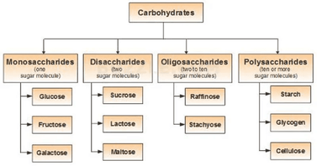
Oligosaccharides are carbohydrates made up of a small number of monosaccharide units (typically 3 to 10) linked together by glycosidic bonds.
They are larger than monosaccharides (simple sugars) but smaller than polysaccharides (like starch or cellulose).

Slide 15
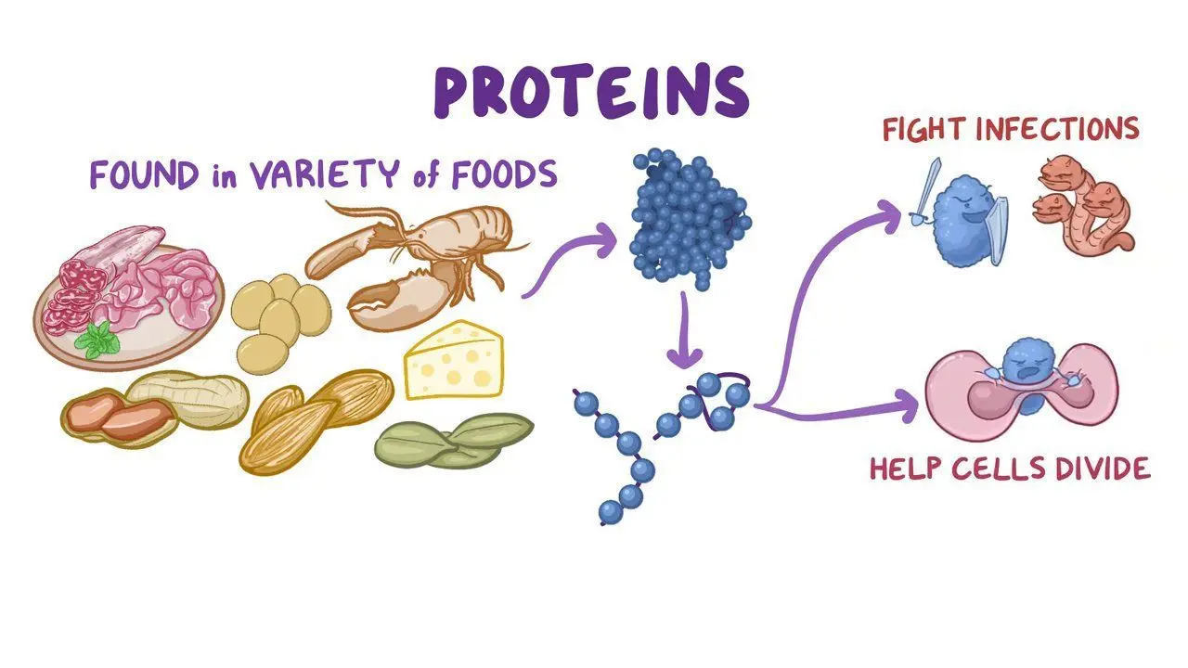
2. Proteins
Proteins are large molecules made up of amino acids, which are the building blocks of proteins. They play a key role in nearly every biological process, including structural support, enzyme function, transport, immune responses, and muscle contraction.
Amino Acids: There are 20 different amino acids, and they combine in various sequences to form proteins. Each protein has a unique sequence of amino acids, which determines its function and structure.

Slide 16
Depending on the importance of the body, proteins are divided into two subgroups.
Essential Amino Acids: These cannot be made by the body and must be obtained through food (e.g., leucine, valine).
Non-essential Amino Acids: These can be produced by the body (e.g., alanine, asparagine).
Aside from this classification, proteins are also subdivided into the following
Peptides: Short chains of amino acids. When amino acids link together through peptide bonds, they form peptides. If the peptide is long enough, it becomes a protein.
Example: Small peptides like glutathione play roles in antioxidant defense.

Slide 17
Polypeptides: A chain of many amino acids. When polypeptides fold into a specific three-dimensional structure, they form functional proteins.
Examples:
Enzymes: Proteins that catalyze (speed up) biochemical reactions. For example, amylase that breaks down starch.
Hemoglobin: The protein in red blood cells that carries oxygen throughout the body.
Collagen: A protein that provides structural support to skin, bones, and connective tissues.

Slide 18
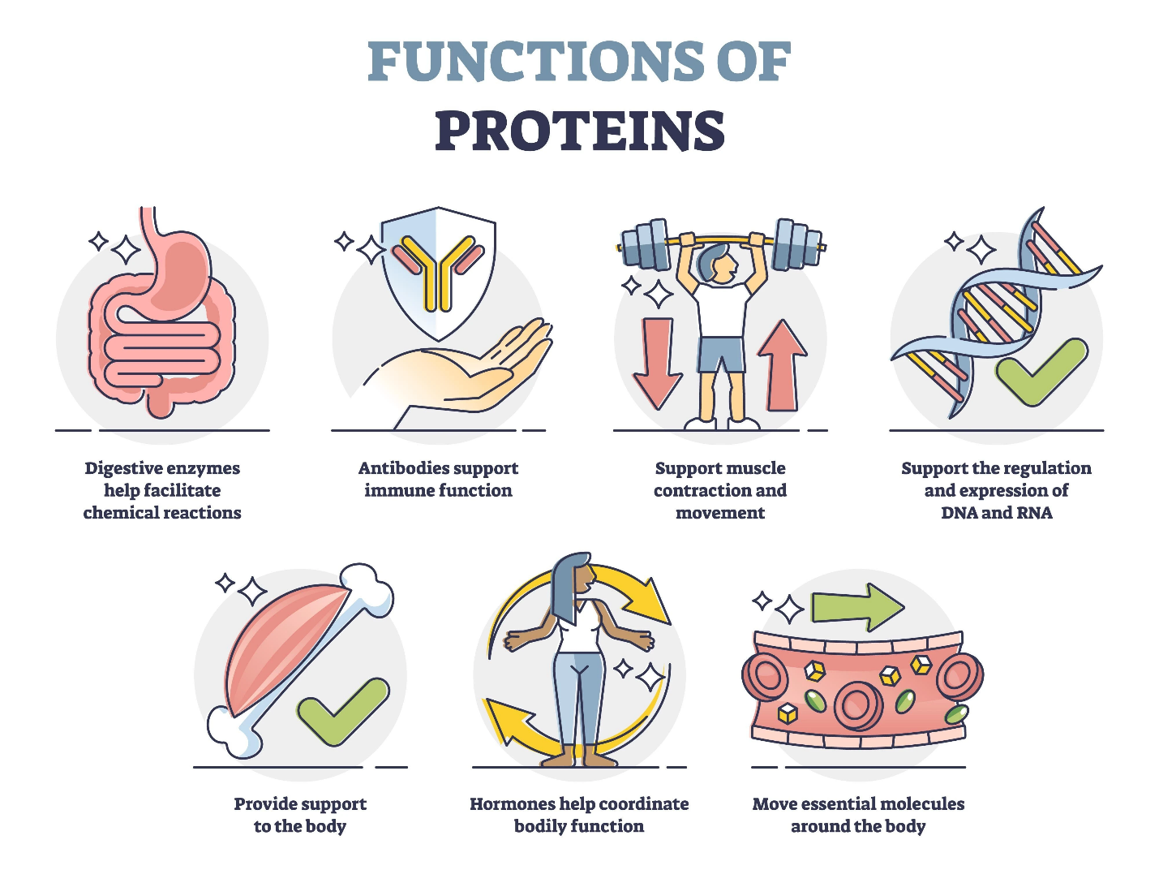

Slide 19
3. Lipids
Lipids are a diverse group of organic compounds that are hydrophobic (do not dissolve in water). They store energy, form cell membranes, and act as signaling molecules.
Fatty Acids: Long hydrocarbon chains (chains of carbon atoms bonded with hydrogen atoms) that are a basic unit of lipids. Fatty acids can be saturated or unsaturated.

Slide 20
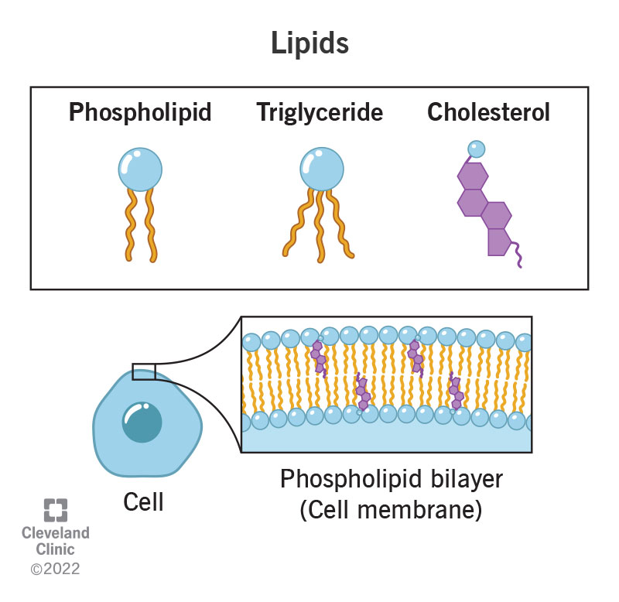

Slide 21
Lipids are divided into groups as follows
Saturated fatty acids: Have no double bonds between the carbon atoms (e.g., butter, lard).
Unsaturated fatty acids: Have one or more double bonds between carbon atoms, making them liquid at room temperature (e.g., olive oil).
Triglycerides: The most common type of fat in the body, consisting of three fatty acids attached to a glycerol molecule. They store energy and are found in fat cells.
Example: Fat in foods like oils, butter, and fatty meats is mostly triglycerides.

Slide 22
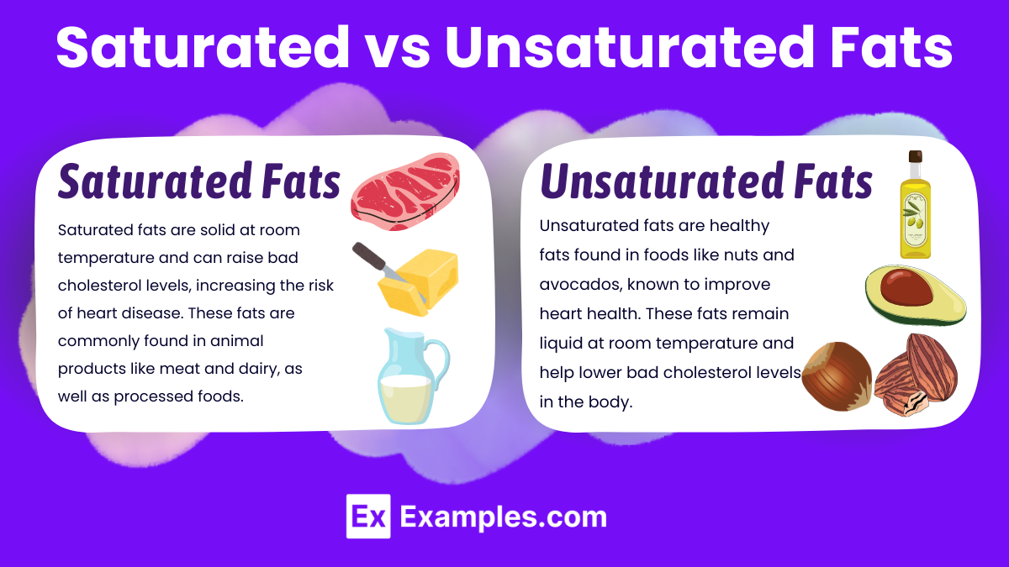

Slide 23
Phospholipids: A type of lipid that is crucial for forming cell membranes. They have a hydrophilic "head" (water-attracting) and two hydrophobic "tails" (water-repelling).
Example: The lipid bilayer of cell membranes, which separates the inside of the cell from the external environment.
Steroids: A group of lipids with a characteristic four-ring structure. They serve as signaling molecules and structural components of cell membranes.
Example:
Cholesterol: A steroid that is part of cell membranes and is used to make hormones like estrogen and testosterone.
Hormones: Steroids like cortisol and aldosterone help regulate metabolism and salt balance.

Slide 24
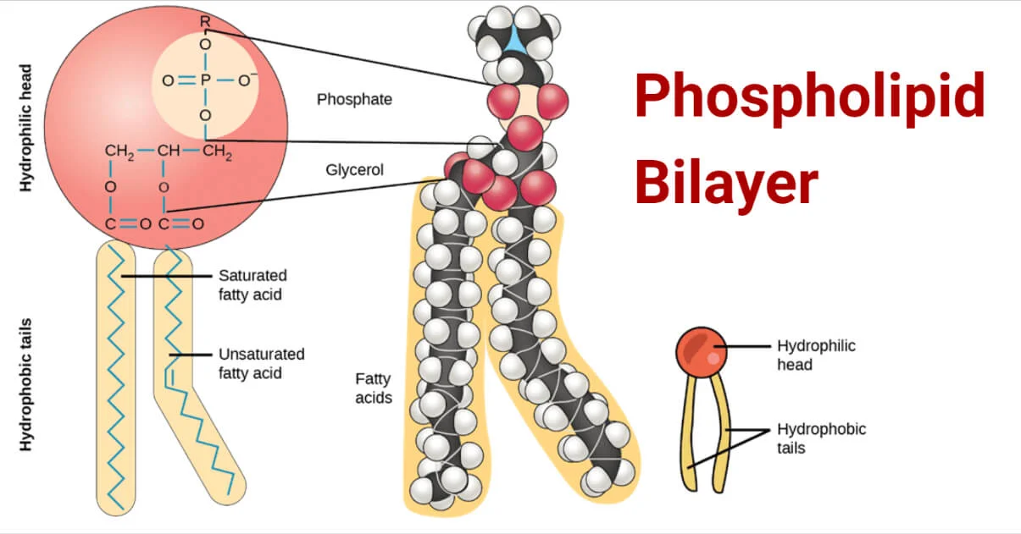

Slide 25
4. Nucleic Acids
Nucleic acids are the molecules that store and transmit genetic information in living organisms. They are made up of nucleotides.
DNA (Deoxyribonucleic Acid): A double-stranded molecule that carries genetic instructions for growth, development, and functioning. DNA is organized into genes, which are the blueprints for proteins.
Structure: DNA has a double helix structure, with two strands of nucleotides twisted together.
Function: DNA contains the genetic code that is passed from one generation to the next.

Slide 26
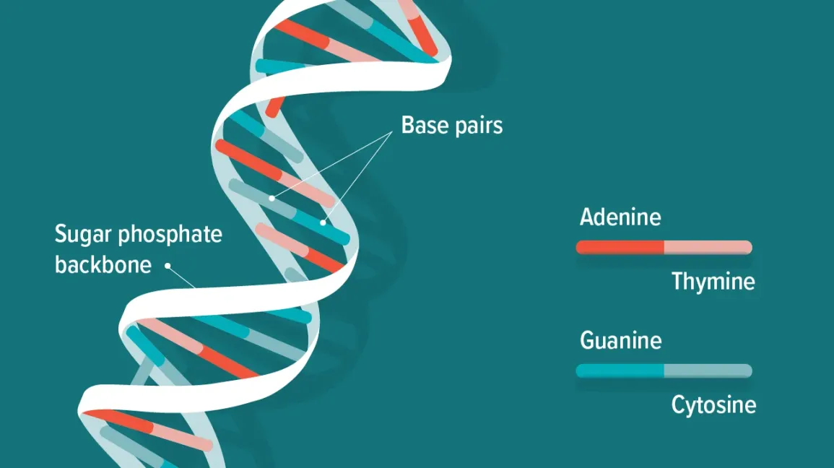

Slide 27
RNA (Ribonucleic Acid): RNA is a single-stranded molecule that plays several roles in protein synthesis and gene expression.
Types of RNA:
mRNA (messenger RNA): Carries genetic information from DNA to the ribosome, where proteins are made.
tRNA (transfer RNA): Helps translate mRNA into amino acid sequences during protein synthesis.
rRNA (ribosomal RNA): Forms part of the ribosome, which is responsible for assembling proteins.

Slide 28
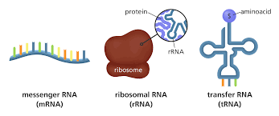

Slide 29
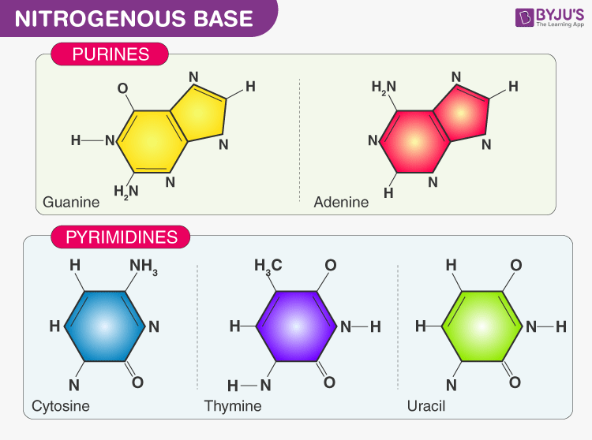
Nucleotides: The building blocks of nucleic acids, consisting of sugar, a phosphate group, and a nitrogenous base.
Examples of bases: Adenine (A), Thymine (T), Cytosine (C), and Guanine (G) for DNA. For RNA, thymine is replaced with uracil (U).

Slide 30
5. Vitamins
Vitamins are organic compounds that are required in small amounts for essential bodily functions. While they don’t provide energy, they are vital for processes such as metabolism and immune function.
Fat-soluble vitamins: These are stored in the body's fat and liver.
Vitamin A: Important for vision and immune function.
Vitamin D: Helps the body absorb calcium for bone health.
Vitamin E: Acts as an antioxidant, protecting cells from damage.
Vitamin K: Essential for blood clotting.

Slide 31
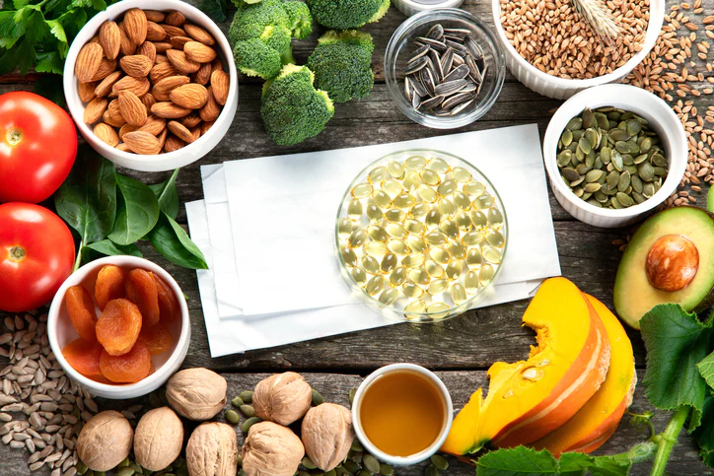

Slide 32
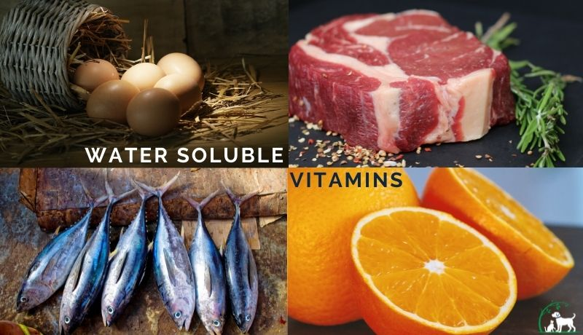
Water-soluble vitamins: These are not stored in the body and must be replenished regularly.
Vitamin C: Important for skin, bones, and connective tissue. Also acts as an antioxidant.
B vitamins (e.g., B1, B2, B3, B12): Help convert food into energy and support brain and nerve function.

Slide 33
6. Enzymes
Enzymes are proteins that act as biological catalysts, speeding up chemical reactions in the body. They are crucial for metabolism, digestion, and other biochemical processes.
How they work: Enzymes lower the activation energy required for a reaction to occur, allowing reactions to happen more quickly and efficiently.
Examples:
Amylase: Breaks down starch into sugars during digestion.
Pepsin: Breaks down proteins in the stomach.
DNA polymerase: Helps replicate DNA.

Slide 34
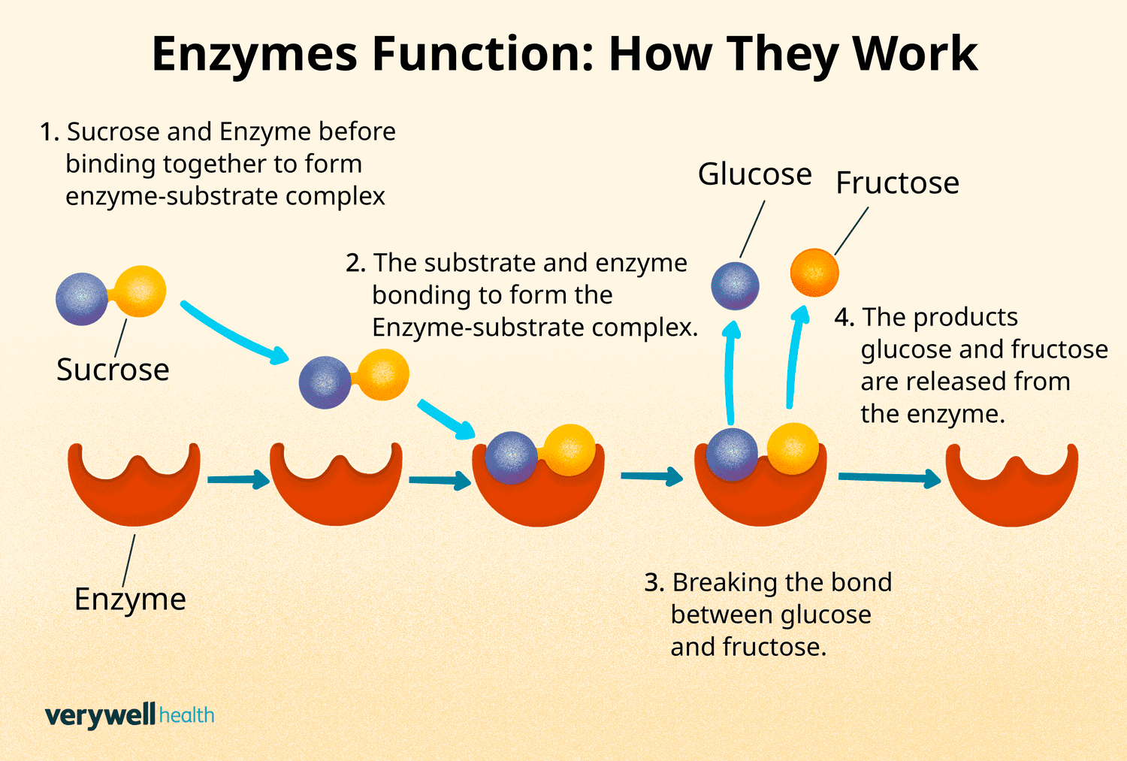

Slide 35
Reference Sources:
Nelson, D. L., Cox, M. M. (2017). Lehninger Principles of Biochemistry (7th ed.). W.H. Freeman and Company.
Berg, J. M., Tymoczko, J. L., Gatto, G. J., & Stryer, L. (2015). Biochemistry (8th ed.). W.H. Freeman.

Slide 36

Any Questions???

