Slide 1

Dietary
Fiber
Dr.Roza T. Yaseen

Slide 2
Dietary fiber:
The term fiber refers to carbohydrates that can not be digested (that resist human digestive enzymes). Fiber is present in all plants that are eaten for food, including fruits, vegetables, grains, and legumes.

Slide 3
In general, fibers are divided into two main components; water insoluble fiber and water-soluble fiber.
Water insoluble fiber like; cellulose and lignin.
Water soluble fiber like; hemicellulose, gum and pectin.

Slide 4
Insoluble fiber does not soluble in water. It can be metabolically inert and provide bulking prebiotic and absorb water as the move through the digestive system, easing defecation.

Slide 5
Soluble fiber dissolve in water. It is readily fermented in the colon into gases and physiologically active byproducts. Soluble fibers tend to slow the movement of food through the system.

Slide 6
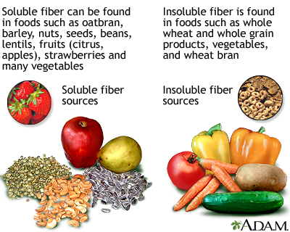

Slide 7
Properties of fiber:
Water holding capacity:
The dietary fibers have a property of holding water and swell like sponge
with concomitant increase in viscosity.
Thus, fiber adds bulk to the food and increase transit time in the gut (gastric emptying time), due to high viscosity.

Slide 8
Absorption of organic molecules:
The organic molecules like bile acids, neutral sterols, carcinogens, and toxic compounds can be absorbed on dietary fiber and facilitates its excretion.

Slide 9
It increases stool bulk:
The fiber absorbs water and increases the bulk of the stool and helps to reduce the tendency towards constipation by increasing bowel movements.

Slide 10
Hypoglycemic and hypocholesteromic effects of fiber:
Adverse effect of dietary fiber:
Dietary fiber also have some adverse effects on nutrition by binding some mineral elements and preventing their proper absorption especially zinc ion.

Slide 11
One type of insoluble dietary fiber, resistant starch has been shown to directly increase insulin sensitivity in healthy people, in type 2 diabetes and in individuals with insulin resistance.

Slide 12
Dietary fiber and obesity
One of the functions of dietary fiber may be to aid in energy control and reduced risk for development of obesity.
In general, fiber-rich diets, have to reduced energy density compound with high fat diets. This is related to fibers ability to add bulk and weight to the diet.

Slide 13
Daily requirement:
Recommended approximately (14gm) dietary fiber/1000Kcal. It is suggested that an intake of 35-40 gm fiber a day is desirable for adults.
For children over the age two years, the recommended intake is child's age +5 grams.

Slide 14

Eat Your Fiber!

Slide 15
Significance of dietary fiber in medicine:
High fiber diet is associated with reduced incidence of a number of diseases like;
Coronary heart disease (CHD)
Colon cancer
Diabetes
Diverticulosis
Hemorrhoids

Slide 16

Alcohol
C₂H₅OH
Ethanol (ethyl alcohol)
Grain Alcohol
Drinking Alcohol

Slide 17
Alcohol:
Alcohol is the only substance that is both a nutrient and affecting the brain function. The word alcohol is used to mean ethyl alcohol (ethanol), CH3CH2OH.
Alcohol is normally consumed not pure (neat) but in aqueous solution in alcoholic beverages.

Slide 18
Absorption and metabolism:
Ethanol is readily absorbed unchanged from the jejunum; it is one of the few substances that is also absorbed from the stomach. It is distributed throughout the total body water “moving easily through cell membranes”

Slide 19
Alcohol is nearly all metabolized in the liver but a small amount is already metabolized as it passes through the stomach wall.

Slide 20
A small amount of alcohol passes unchanged into the urine and even smaller “but diagnostically useful” amount is excreted in the breath.
The pathway of alcohol metabolism is start with alcohol dehydrogenase (ADH), a zinc-containing enzyme in the cytoplasm of the liver.

Slide 21
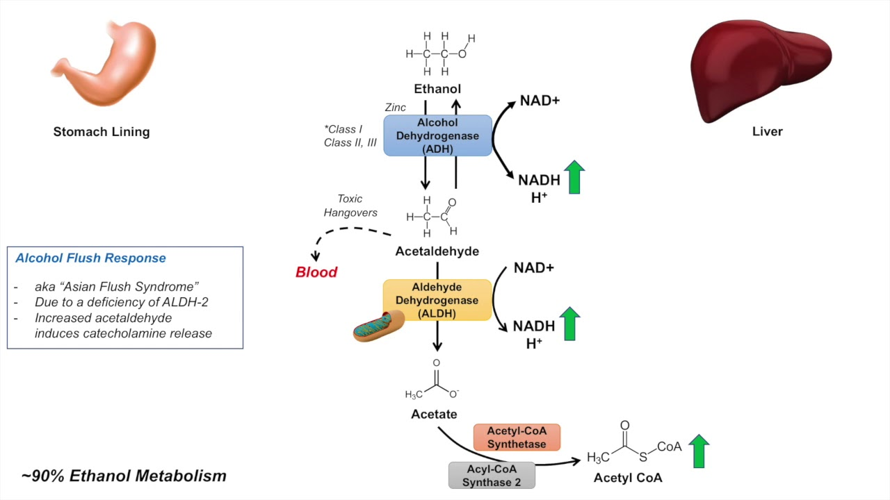
Metabolism

Slide 22
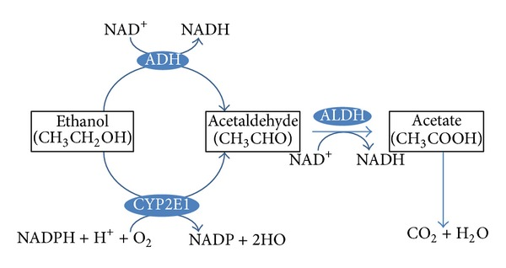
Metabolism

Slide 23
Toxic effects of alcohol:
It appears that various organ disorders and biochemical alterations are induced by either ethanol or acetaldehyde, the effects are summarized in the following table;
System Effect
CNS Disorientation, coma, Memory loss,
psychosis seizures
Cardiovascular Cardiopathy
Skeletal muscle Myopatheis

Slide 24
Gastric mucosa Irritation, Gastritis,
Ulceration
Liver Fatty liver, Cirrhosis,
decreased tolerance to
xenobiotics.
Kidney Diuresis
Blood Anemia,
Thrombocytopaenia
Testes Impotence
Foetus Fetal alcohol syndrome

Slide 25
MEDICAL CONSEQUENCES OF EXESS ALCOHOL CONSUMPTION:
1-Liver disease:
Metabolism of large amounts of ethanol in the liver produce an increased ratio of NADH/NAD .This depresses of citric acid cycle and oxidation of fatty acids and favors triacylglycerol synthesis in the liver cells,continously for long time alcohol drinking cause cirrhosis.

Slide 26
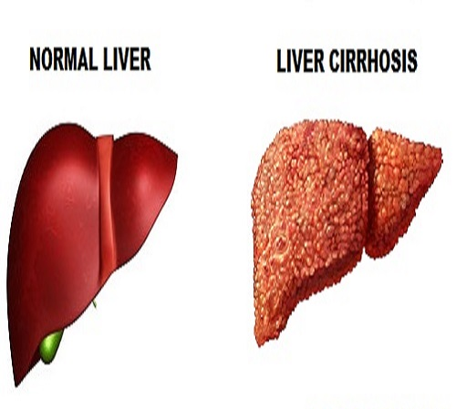

Slide 27
2-Fetal alcohol syndrome:
Women who drink alcohol heavily during pregnancy can give birth to a baby with an unusual facial appearance. ( small eyes, absent philtrum, thin upper lip, prenatal and postnatal growth impairment, central nervous system dysfunction and often other physical abnormalities).

Slide 28
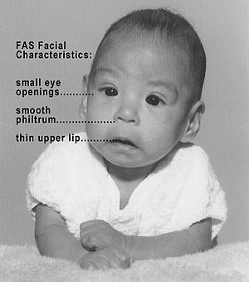

Slide 29
3-Wernicke-Koraskoff syndrome:
In binge drinkers who consume large amounts of alcohol, brain function
can be affected by acute thiamin deficiency. Ethanol uses up thiamin for its metabolism, yet alcohol beverages provide no thiamin; there is no rich food source of thiamin and body stores are very small.

Slide 30
4-Predisposition of some types of cancer:
The risk of cancer of the mouth and pharynx is increased, especially when high alcohol intakes are combined with smoking, other cancers associated with alcohol consumption are those of esophagus or liver.

