Slide 1

Encryption Algorithms and Daily Applications
Applied Cryptography – Conceptual Understanding

Slide 2
Course Plan
There will be 12 weeks
Each week, we have 3 hrs of theory, and 2 hrs of practical.
Assessments will be:
  Attendance (5)
  Participation (5)
  Quiz (10)
  Homework (5)
  Practical Exam (10)
  Midterm Exam (25)
  Final Exam (40)

Slide 3
Google Classroom Code
kmv7txzu

Slide 4
Course Objectives
Reviewing the most modern cryptography algorithms.
Develop the ability to analyze why specific cryptographic algorithms are chosen for different real-world applications
Prepare students to interpret and analyze encrypted communication
Equip students with a modern cryptographic foundation

Slide 5
Class Objective
Identify how cryptographic algorithms are used in real-world applications such as online banking, secure messaging, and cloud storage.
Explain the role of each cryptographic algorithm (e.g., AES, ECC, SHA-256) within a complete application.

Slide 6
1) HTTPS (Web Browsing)
Purpose: Securely browse websites and submit sensitive data.
Algorithms used: AES, RSA/ECC, ECDHE, SHA-256, Digital Certificates
Why they are needed:
  AES → encrypts page content (fast for large data)
  RSA/ECC → authenticates the website (certificate trust)
  ECDHE → securely agrees on a session key (Perfect Forward Secrecy)
  SHA-256 → ensures data integrity
  Digital signatures → prove the website identity
Prevents eavesdropping, tampering, and fake websites (phishing)

Slide 7
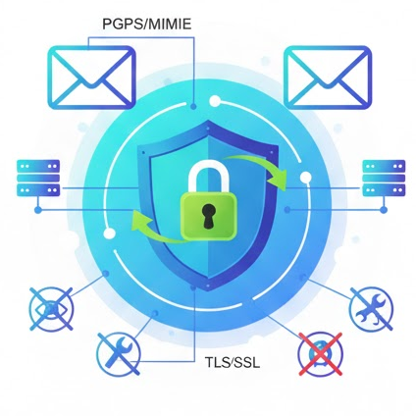
2) Email Communication
Purpose: Send and receive confidential electronic messages.
Algorithms used: AES, RSA/ECC, SHA-256, Digital Signatures
Why they are needed:
  AES → encrypts email content
  RSA/ECC → encrypts AES key & authenticates sender
  SHA-256 → detects message modification
  Digital signatures → sender cannot deny sending the email
Ensures confidentiality, integrity, and non-repudiation

Slide 8
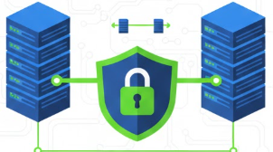
3) Secure File Transfer (SFTP / SCP)
Purpose: Safely upload and download files over networks
Algorithms used: AES, RSA/ECC, ECDHE, HMAC
Why they are needed:
  AES → encrypts transferred files
  RSA/ECC → authenticates server/client
  ECDHE → safely exchanges session keys
  HMAC → ensures file integrity during
  transfer
Prevents file interception and modification

Slide 9
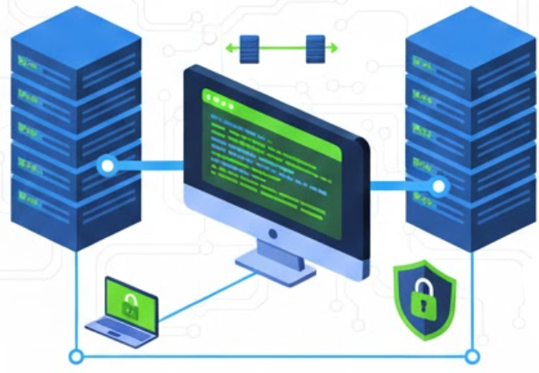
4) SSH Remote Access
Purpose: Securely manage and control remote servers.
Algorithms used: AES, RSA/ECC, ECDHE, SHA-256
Why they are needed:
  AES → encrypts commands and outputs
  RSA/ECC → authenticates server and user
  ECDHE → protects session keys
  SHA-256 → ensures command integrity
Stops command hijacking and credential theft

Slide 10
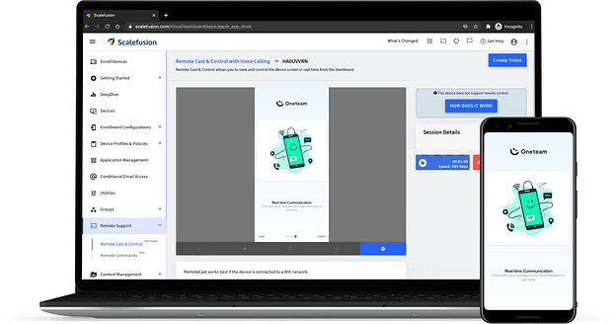
5) Remote Desktop Access
Purpose: Remotely access and control another computer securely.
Algorithms used: AES, RSA/ECC, TLS
Why they are needed:
  AES → encrypts screen, keyboard, mouse data
  RSA/ECC → authenticates the remote host
  TLS → secures the entire remote session
Prevents spying on screen or keystrokes

Slide 11

6) Cloud Storage
Purpose: Store and access files securely via the internet.
Algorithms used: AES-256, RSA/ECC, SHA-256
Why they are needed:
  AES-256 → encrypts files at rest
  RSA/ECC → protects encryption keys
  SHA-256 → verifies file integrity
Protects stored data even if servers are compromised

Slide 12
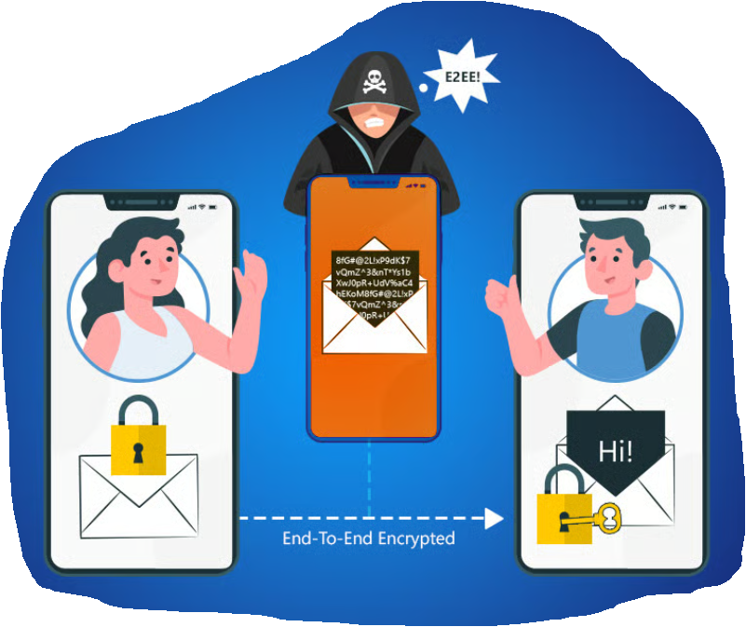
7) Instant Messaging (End-to-End Encryption) E2EE
Purpose: Exchange private messages in real time.
Algorithms used: AES, ECC (X25519), HMAC, SHA-256
Why they are needed:
  AES → encrypts messages.
  ECC → securely exchanges keys
  between users.
  HMAC → authenticates messages
  SHA-256 → ensures integrity.
Only sender and receiver can read messages
(not even the provider)

Slide 13
8) Video Conferencing
Purpose: Conduct secure real-time online meetings.
Algorithms used: AES-GCM, ECC, SRTP, SHA-256
Why they are needed:
  AES-GCM → encrypts live audio/video
  ECC → authenticates participants
  SRTP → secures real-time streams
  SHA-256 → protects stream integrity
Prevents meeting hijacking and stream interception

Slide 14
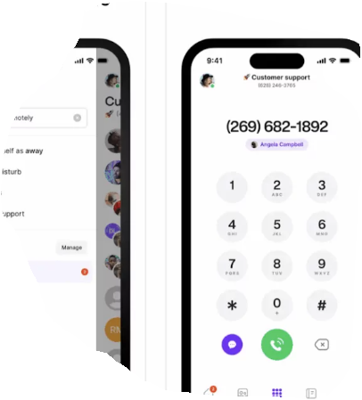
9) VoIP Calls
Purpose: Make encrypted voice calls over the internet.
Algorithms used: AES, Diffie-Hellman, SRTP
Why they are needed:
  AES → encrypts voice data
  Diffie-Hellman → establishes shared keys
  SRTP → protects real-time voice packets
Stops call eavesdropping and replay attacks

Slide 15
10) Online Banking
Purpose: Perform secure financial transactions online.
Algorithms used: AES, RSA/ECC, SHA-256, Digital Signatures
Why they are needed:
  AES → encrypts transactions
  RSA/ECC → authenticates bank & user
  SHA-256 → ensures transaction integrity
  Digital signatures → prevents transaction denial
Protects money, identity, and transaction trust

Slide 16
11) VPN Services
Purpose: Secure all internet traffic on untrusted networks.
Algorithms used: AES, ECC, Diffie-Hellman, HMAC
Why they are needed:
  AES → encrypts all traffic
  ECC → authenticates VPN endpoints
  Diffie-Hellman → securely exchanges keys
  HMAC → prevents packet tampering
Secures traffic on untrusted networks (public Wi-Fi)

Slide 17
12) Secure DNS (DoH/DoT)
Purpose: Protect DNS queries from spying and manipulation.
Algorithms used: AES, ECC, TLS
Why they are needed:
  AES → encrypts DNS queries
  ECC → authenticates DNS servers
  TLS → protects DNS communication channel
Prevents DNS spying and manipulation

Slide 18
13) Software Updates
Purpose: Ensure updates are authentic and unmodified.
Algorithms used: RSA/ECC, SHA-256, Digital Signatures
Why they are needed:
  SHA-256 → verifies file integrity
  RSA/ECC signatures → verify software origin
  Digital signatures → prevent fake updates
Stops malware injection via updates

Slide 19
14) Peer-to-Peer (P2P)
Purpose: Securely share data directly between users.
Algorithms used: AES, Diffie-Hellman, SHA-256
Why they are needed:
  AES → encrypts shared data
  Diffie-Hellman → establishes peer keys
  SHA-256 → verifies file integrity
Protects privacy and file correctness

Slide 20
List of Algorithms
The algorithms that need be covered are:
  SHA-256
  AES-128
  Message Authentication Code (HMAC)
  Asymmetric – ECC
  Key Exchange – Diffie–Hellman (ECDHE)
  Digital Signatures (Hash→Sign→Verify) , ECDSA, and Certificate).

