Slide 1

Information Security
Advanced Encryption Standard
Saman.mirza@tiu.edu.iq

Slide 2
Advanced Encryption Standard
(AES)

Slide 3
Class Objective
After this class, you should be able to:
Present an overview of the general structure of Advanced Encryption Standard (AES).
Understand the four transformations used in AES.
Explain the AES key expansion algorithm.

Slide 4
Advanced Encryption Standard (AES)
Introduction
AES is a symmetric block cipher that is intended to replace DES as the approved standard for a wide range of applications.
The cipher takes a plaintext block size of 128 bits, or 16 bytes.
The key length can be 16, 24, or 32 bytes (128, 192, or 256 bits).
The algorithm is referred to as AES-128, AES-192, or AES-256, depending on the key length.

Slide 5
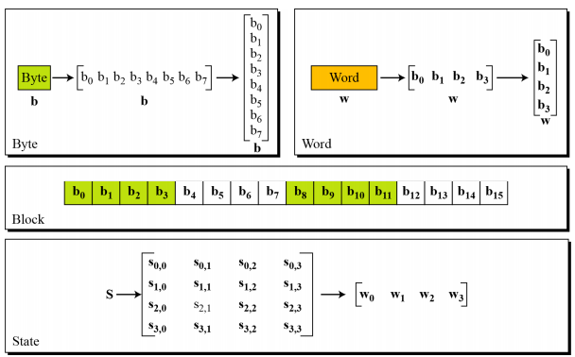
Data Units or
Structure

Slide 6
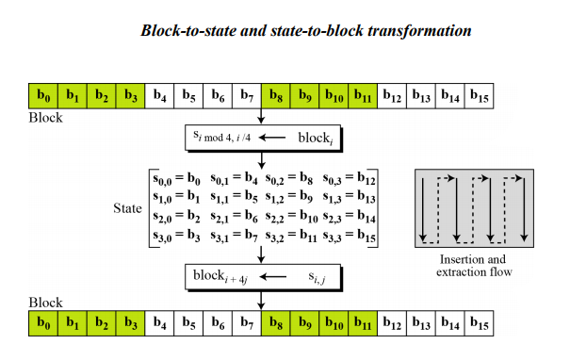
.../ Data Units/State Transformation

Slide 7
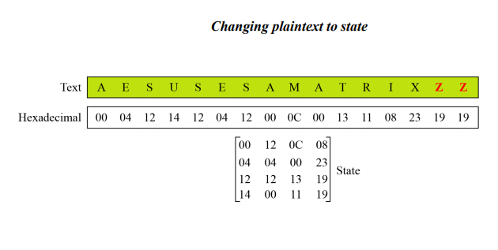
.../ Data Units/
State Transformation/Example
Convert the plaintext “AES uses a matrix”.
Complete the plaintext with bogus letter (Z) to be in the 16 multiplexer. (16, 32, 48, 64, …)
Notes:
Bogus is fake (زائف)

Slide 8
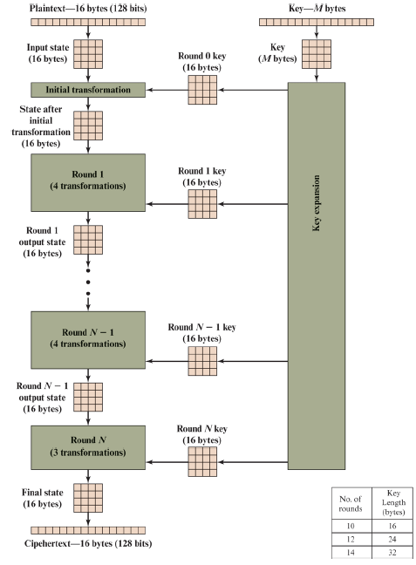
Introduction
AES Structure
The size of plaintext is 16 bytes (128 bits).
The key length could be 16, 24 or 32 bytes (AES-128, AES-192, AES-256).
The input to the encryption and decryption is a single 128 bits block.
  Letters will be converted to Hexadecimals.
Blocks will be depicted to a state. (4 x 4).
  This state will be changed at each round.
Number of rounds (N) depends on key length.
Number of keys is (N+1).

Slide 9
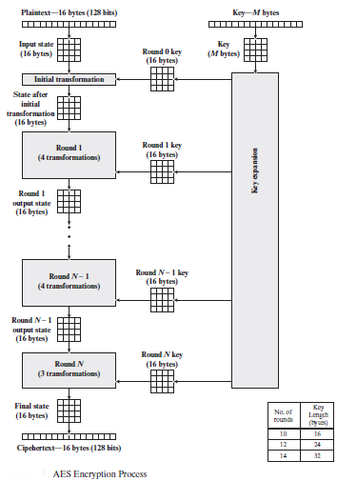
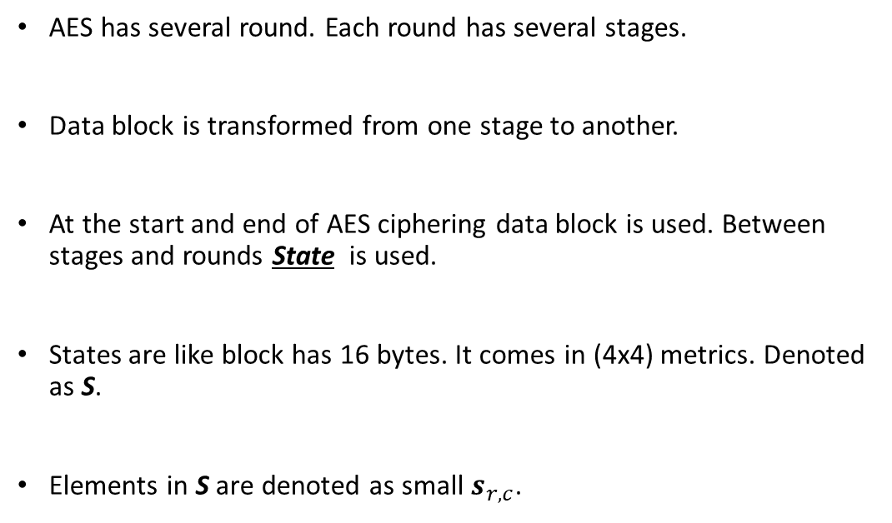
.../ Data Units/State
AES has several round. Each round has several stages.
Data block is transformed from one stage to another.
At the start and end of AES ciphering data block is used. Between stages and rounds State is used.
States are like block has 16 bytes. It comes in (4x4) metrics. Denoted as S.
Elements in S are denoted as small $s_{r,c}$.

Slide 10
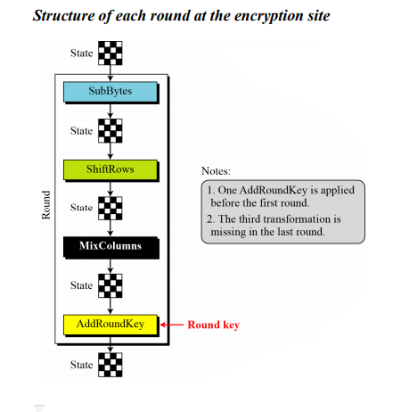
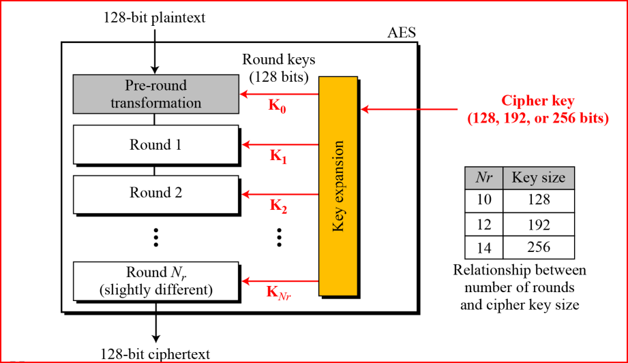
.../ Round/
Structure of each Round
SubBytes, ShiftRows, MixColumns, and AddRoundKey.
First round only uses one transformation, Addroundkey.
Last round only uses three transformations, missing MixColumn Transformation
Notes:
Bogus is fake (زائف)

Slide 11
...Structure of each Round
/Substitution
AES dose substitution like DES, with differences :
  Substitution done on bytes not bits.
  Only one table used for transformation.
This class focus on table look up, which called SubBytes in the AES.
The content of the byte will be changed but the location will be the same location as before.
Notes:
Bogus is fake (زائف)

Slide 12
...Structure of each Round
/Substitution
Every two bytes as base 16 will be changed to different two bytes to same base.
  5A₁₆ and 5B₁₆ will be transformed to BE₁₆ and 39₁₆
Same two bytes are transformed to same two digits.
  5A₁₆ and 5A₁₆ will be transformed to BE₁₆ and BE₁₆
You need to have both subbyte table for transformation and inverse transformation.
Notes:
Bogus is fake (زائف)

Slide 13

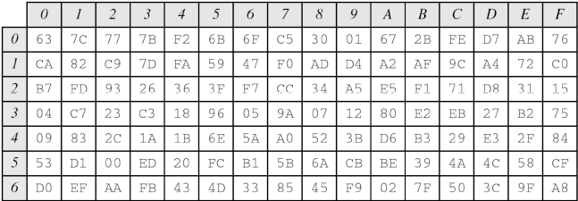


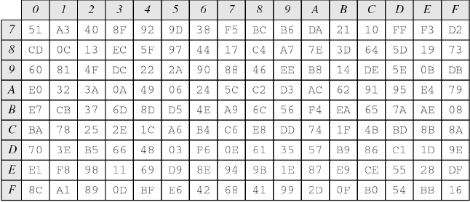

.../Substitution
Let us try some values for transformation (SubByte)
Notes:
Bogus is fake (زائف)

Slide 14
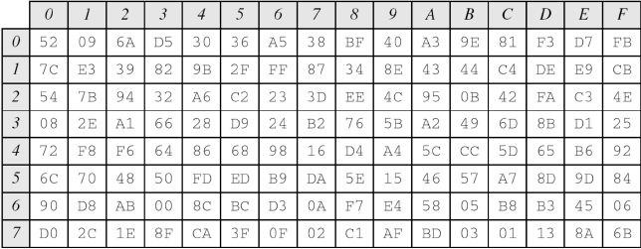
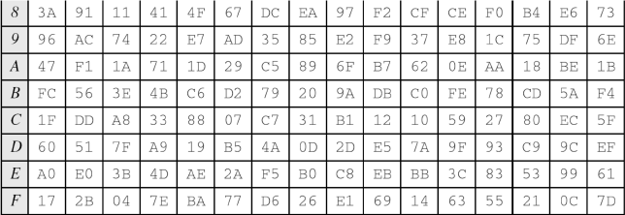
.../Substitution
Let us try some values for inverse transformation (InvSubByte)
Notes:
Bogus is fake (زائف)

Slide 15
.../Permutation
In AES, permutation is done based on Bytes, not on bits like DES.
  Do the order of the bits in a byte changed?
The transformation uses Row Shifting to left.
The number of shifted bytes depends on the number of row:
  Row (0) no shift at all.
  Row(3) three bytes shifted.

Slide 16
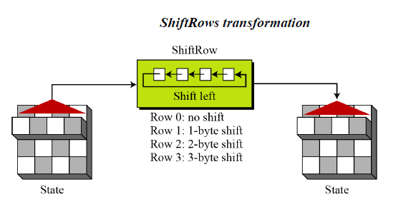
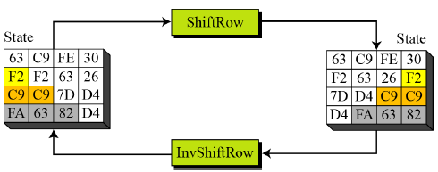
.../Permutation/Row Shift
In Row shift, number of shifted bytes depends on the number of row:
  Row (0) no shift at all.
  Row(3) three bytes shifted.
One row is shifted at a time.

Slide 17
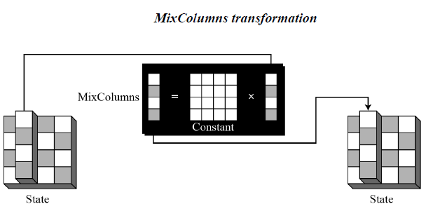
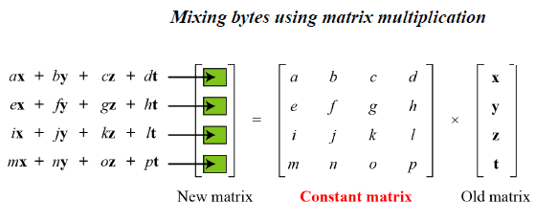
/Permutation/ MixColumns
Row shift, do not change bits inside a byte. It needs to apply MixColumns method to do that and provide diffusions.
The MixColumns transformation operates at the column level; it transforms each column of the state to a new Column.
You need to understand Matrix and Hexadecimal Multiplication.

Slide 18
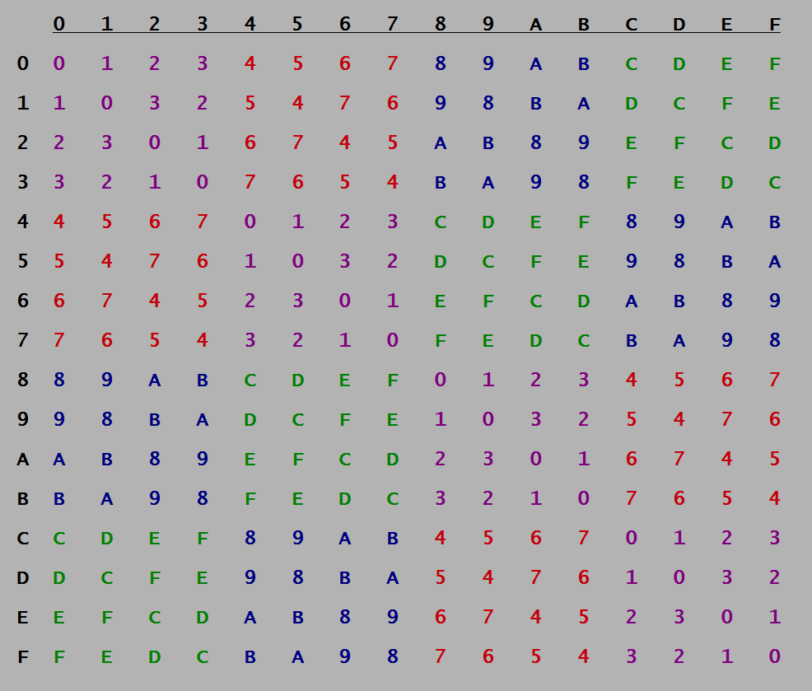

Slide 19
Next Class

Slide 20
...Structure of each Round
/AddRoundKey
All steps that have been done is just transformation of the plaintext.
  Attackers can easily detect plaintext form ciphertext if no adding key added to the AED at each round.
AES uses Key Expansion.
Number of keys that generated is equal to (Nr+1), where Nr is number of rounds.
Key at each round has 128 bits size.
  Divided in two four 32 bits ( four words).
  Each word arranged as one column.
  A key is four (1x4) matrix.
  Each element is a 32 bits in hexadecimal number.
Notes:
Bogus is fake (زائف)

Slide 21
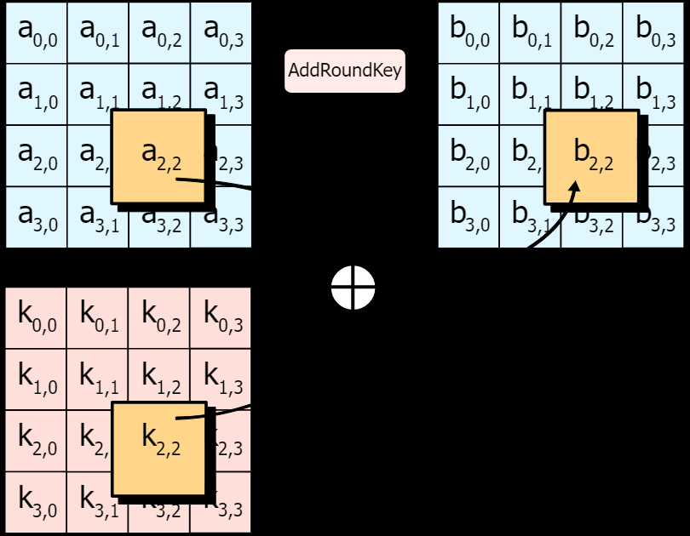
...Structure of each Round
/AddRoundKey
The relation between key generation and the round is the number of words that used for all rounds.
  We need a key for each round.
  The size of key is 128 bits (Four 32 bits, means 4 words).
  For Nr rounds we need (4 xNr) words.
  No. of rounds is (Nr. + 1), therefore we need 4 x(Nr.+1).
For each version:
  AES128 → 4(10+1) = 44
  AES192 → 4(12+1) = 52
  AES256 → 4(14+1) = 60
Notes:
Bogus is fake (زائف)

Slide 22
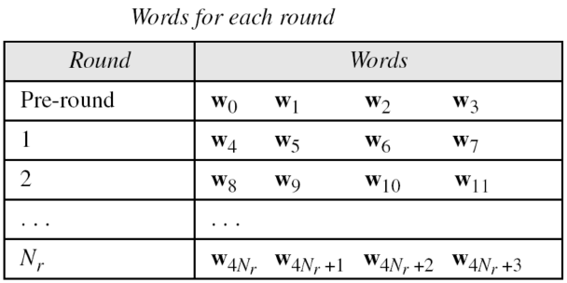
...Structure of each Round
/AddRoundKey
If you have Nr rounds, the key generation will provide Nr+1 keys.
However, each comes with (1 x 4) words vector.
Notes:
Bogus is fake (زائف)

Slide 23
.../AddRoundKey /
Key Expansion
This example is about expansion key with AES-128.
First step is generating initial key with size of 128 bits.
Later, from this initial key other 43 keys will be formed.
Notes:
Bogus is fake (زائف)

Slide 24
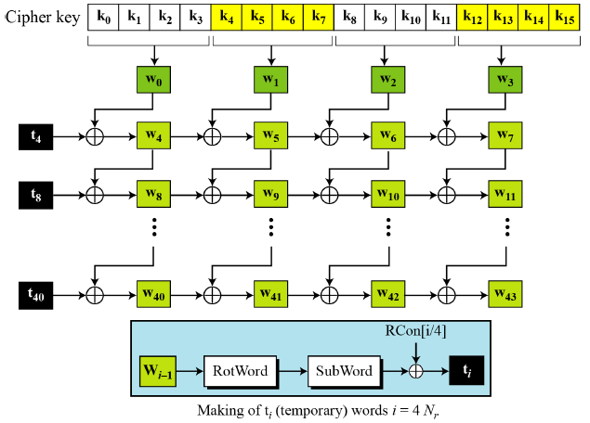
.../AddRoundKey /
Key Expansion
Below is the process of key expansion
First Step:
  Generating the initial key.
  Each consist of 4 words.
  Each word is four bytes.
  Bytes W₀ to W₃ is the first word.
  Bytes W₄ to W₇ is the second word.
  Initial key used with
  Pre-Round transformation.
Notes:
Bogus is fake (زائف)

Slide 25

.../AddRoundKey /
Key Expansion
For the rest of words ($w_{i}$) where ($i=4 to 43$)
If $i mod 4 ≠0$, do the following:
  $w_{i}=w_{i−1}⨁$ $w_{i−4}$
To find $w_{5}:$
  $w_{5}=w_{4}⨁w_{1}$
Notes:
Bogus is fake (زائف)

Slide 26
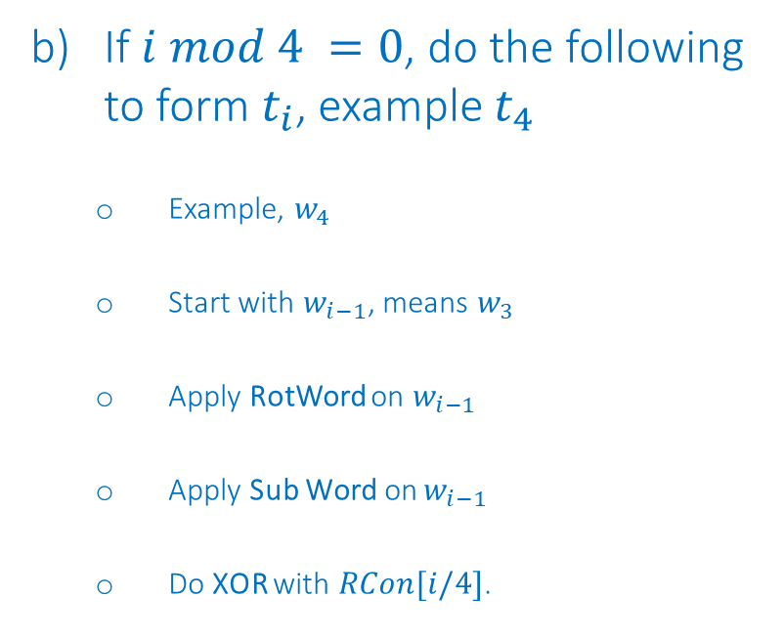
.../AddRoundKey /
Key Expansion
For the rest of words ($w_{i}$) where ($i=4 to 43$)
If $i mod 4 =0$, do the following to form $t_{i}$, example $t_{4}$
  Example, $w_{4}$
  Start with $w_{i−1}$, means $w_{3}$
  Apply RotWord on $w_{i−1}$
  Apply Sub Word on $w_{i−1}$
  Do XOR with $RCon[i/4]$.
Notes:
Bogus is fake (زائف)

Slide 27
.../AddRoundKey /
Key Expansion
RotWord means Rotate Word,
and similar to ShiftRow.
Only applied to one word.
4D | 27 | E0 | 1A
27 | E0 | 1A | 4D
SubWord means Substitute word.
  Applied to four bytes.
27 | E0 | 1A | 4D
CC | E1 | A2 | E3
Notes:
Bogus is fake (زائف)

Slide 28
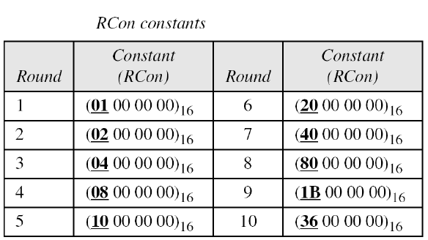


.../AddRoundKey /
Key Expansion
RCon means round constant. As shown in the table, for each round a constant will be generated and added to the word that obtained from Substitution process.
4D | 27 | E0 | 1A
CC | E1 | A2 | E3
$$⨁$$
01 | 00 | 00 | 00
----------------------------
$t_{4} is$ →
80 | C7 | 42 | FB
Notes:
Bogus is fake (زائف)

Slide 29



.../AddRoundKey /
Key Expansion
Now, $t_{4}$ is ready. We need to XOR it with $w_{4−4}$ which is $w_{0}$.
80 | C7 | 42 | FB
$$⨁$$
$$Whatever values of w_{0}$$
$$You will get the value of w_{4}$$
Notes:
Bogus is fake (زائف)

Slide 30
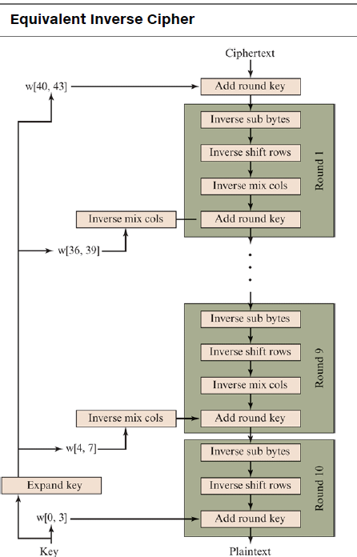
AES
Decryption

Slide 31

CLASS
END

