Slide 1

Applied Cryptography
SHA512
Saman.mirza@itu.edu.iq

Slide 2
HTTPS (Web Browsing)
Purpose: Securely browse websites and submit sensitive data.
Algorithms used: AES, RSA/ECC, ECDHE, SHA-256, Digital Certificates
Why they are needed:
  AES → encrypts page content (fast for large data)
  RSA/ECC → authenticates the website (certificate trust)
  ECDHE → securely agrees on a session key (Perfect Forward Secrecy)
  SHA-256 → ensures data integrity
  Digital signatures → prove the website identity
Prevents eavesdropping, tampering, and fake websites (phishing)

Slide 3
Class Objectives
The main objective of this class is to:
Summarize the applications of cryptographic hash functions.
Explain why a hash function used for message authentication needs to be secured.
Present an overview of the basic structure of cryptographic hash functions.
Describe how cipher block chaining can be used to construct a hash function.
Understand the operation of SHA-512.

Slide 4
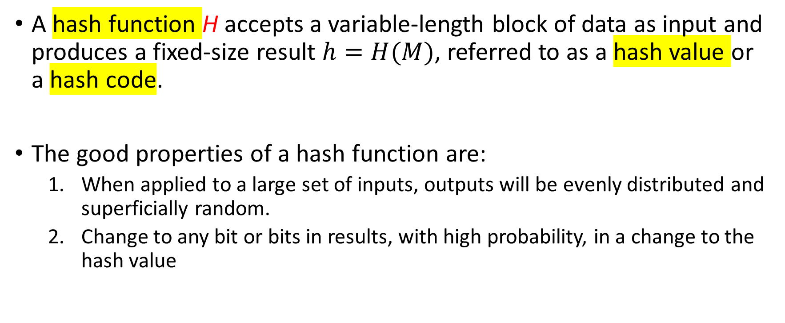
Cryptography Hash Function
A hash function H accepts a variable-length block of data as input and produces a fixed-size result $h=H(M)$, referred to as a hash value or a hash code.
The good properties of a hash function are:
  When applied to a large set of inputs, outputs will be evenly distributed and superficially random.
  Change to any bit or bits in results, with high probability, in a change to the hash value

Slide 5
Cryptography Hash Function
A cryptographic hash function is an algorithm for which its reverse computation infeasible to find either:
  A data object that maps to a pre-specified hash result (the one-way property) or
  Two data objects that map to the same hash result (the collision-free property).
Because of these characteristics, hash functions are often used to determine whether data has changed or not.

Slide 6
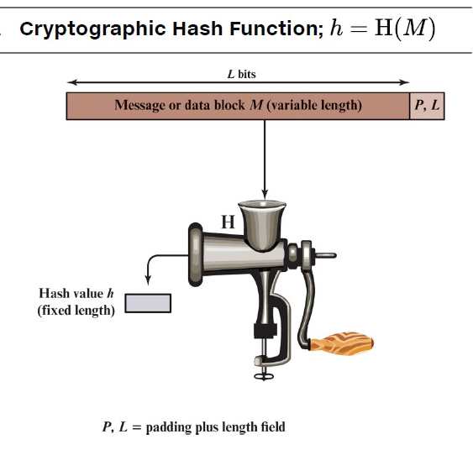
Cryptography Hash Function

Slide 7
Applications of Cryptographic Hash Functions
Perhaps the most versatile cryptographic algorithm is the cryptographic hash function.
It is used in a wide variety of security applications and Internet protocols.
Cryptographic hash functions is useful for a range of applications.
  Message Authentication.
  Digital Signatures

Slide 8
Cryptographic Hash Functions
Message Authentication
Message authentication is a mechanism or service used to verify the integrity of a message.
  Message authentication assures that data received are exactly as sent (i.e., there is no modification, insertion, deletion, or replay).
  The requirement that the authentication mechanism assures that the purported identity of the sender is valid.
When a hash function is used to provide message authentication, the hash function value is often referred to as a message digest.

Slide 9
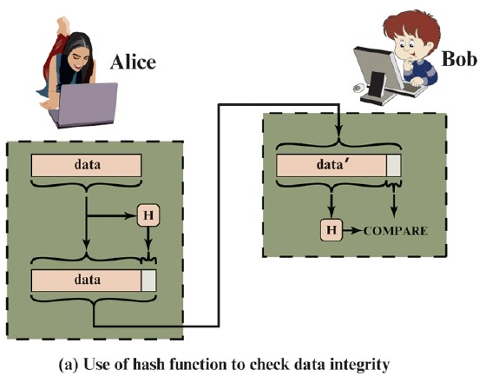
Message Authentication Process
The sender computes a hash value as a function of the bits in the message and transmits both the hash value and the message.
The receiver performs the same hash calculation on the message bits and compares this value with the incoming hash value.
If there is a mismatch, the receiver knows that the message (or possibly the hash value) has been altered.

Slide 10
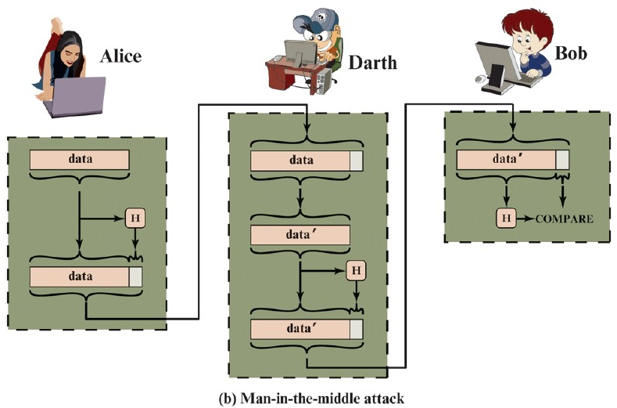
Attack on Message Authentication
Attackers will generate new message and uses same hash algorithm to generate hash value.
Attacker will attach the hash value to the modified message and send it to Bob.
Bob will know that the message has been send by Alice.

Slide 11
Methods of Message Authentication
Message authentication could be achieved through the following tools:
  Message Encryption Code.
  Message Authentication Code (MAC)
  Cryptographic Hash Function.

Slide 12
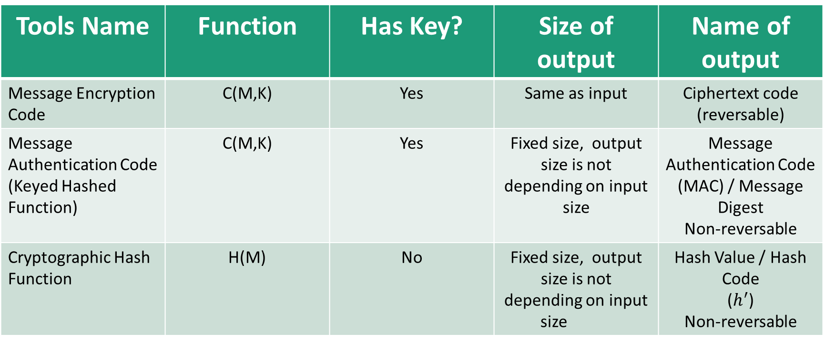
Introduction
Tools Name | Function | Has Key? | Size of output | Name of output
Message Encryption Code | C(M,K) | Yes | Same as input | Ciphertext code (reversable)
Message Authentication Code (Keyed Hashed Function) | C(M,K) | Yes | Fixed size, output size is not depending on input size | Message Authentication Code (MAC) / Message Digest Non-reversable
Cryptographic Hash Function | H(M) | No | Fixed size, output size is not depending on input size | Hash Value / Hash Code ($h^{′}$) Non-reversable

Slide 13
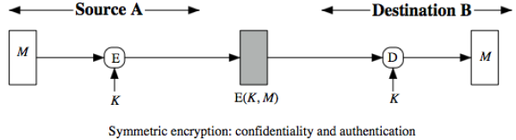
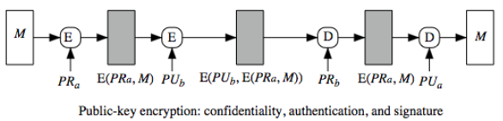
Message Encryption symmetric and Asymmetric Systems
Encryption can also provide authentication.
With symmetric key
  Confidentiality is there.
  Authentication is there too
What will be changed with asymmetric key encryption system?
  confidentiality is there, but authentication is not. Why?
  How can we provide authentication with asymmetric system?

Slide 14
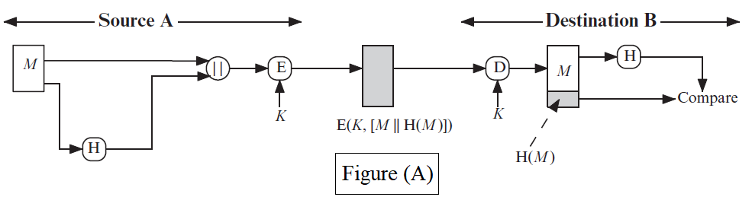
Cryptographic Hash Function
Types of Message Authentication
Figure A, B, C and D illustrate a variety of ways in which a hash code can be used to provide message authentication, as follows:
Figure (A)
The message plus concatenated hash code is encrypted using symmetric encryption.
Since only A and B share the secret key, the message must have come from A and has not been altered.
The hash code provides the structure or redundancy required to achieve authentication.

Slide 15
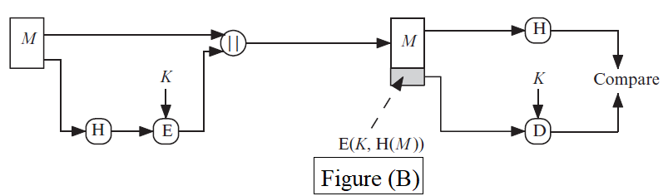
Cryptographic Hash Function
Types of Message Authentication
Figure A, B, C and D illustrates a variety of ways in which a hash code can be used to provide message authentication, as follows:
Figure (B)
Only the hash code is encrypted, using symmetric encryption.
This reduces the processing burden for those applications not requiring confidentiality.

Slide 16
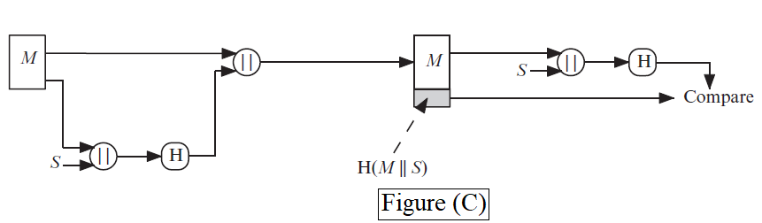
Cryptographic Hash Function
Types of Message Authentication
Figure (C)
Shows the use of a hash function but no encryption for message authentication.
The technique assumes that the two communicating parties share a common secret value S.
A computes the hash value over the concatenation of M and S and appends the resulting hash value to M.
Because B possesses S, it can re-compute the hash value to verify.
Because the secret value itself is not sent, an opponent cannot modify an intercepted message and cannot generate a false message.

Slide 17
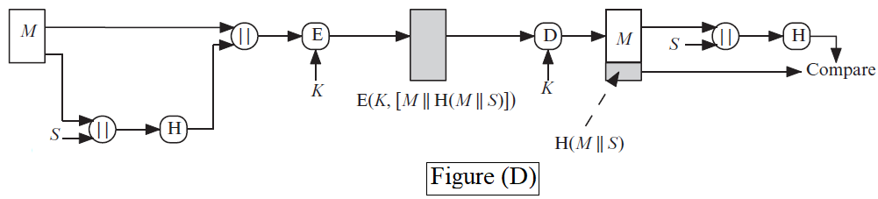
Cryptographic Hash Function
Types of Message Authentication
Figure (D)
Confidentiality can be added to the approach of (c) by encrypting the entire message plus the hash code.

Slide 18
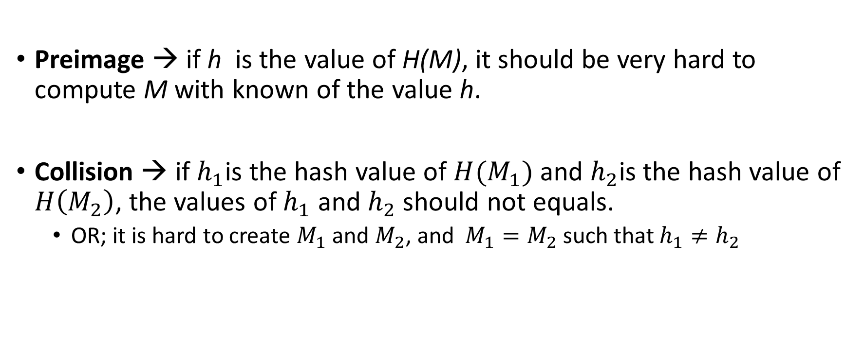
Security Requirements
Preimage → if h is the value of H(M), it should be very hard to compute M with known of the value h.
Collision → if $h_{1}$is the hash value of $H(M_{1})$ and $h_{2}$is the hash value of $H\left(M_{2}\right)$, the values of $h_{1}$ and $h_{2}$should not equals.
  OR; it is hard to create $M_{1}$ and $M_{2}$, and $M_{1}=M_{2}$ such that $h_{1}≠h_{2}$

Slide 19
Class Objective
The main objective of this class is to:
  Introducing SHA.
  Compare different types of SHA.
  To explain the steps of SHA-512

Slide 20
Secure Hash Algorithm (SHA)
Introduction
It is the most widely used cryptographic hash function.
It has many versions, depending on some predefined features:
  Message size
  Block size
  Word size
  Message digest size.

Slide 21
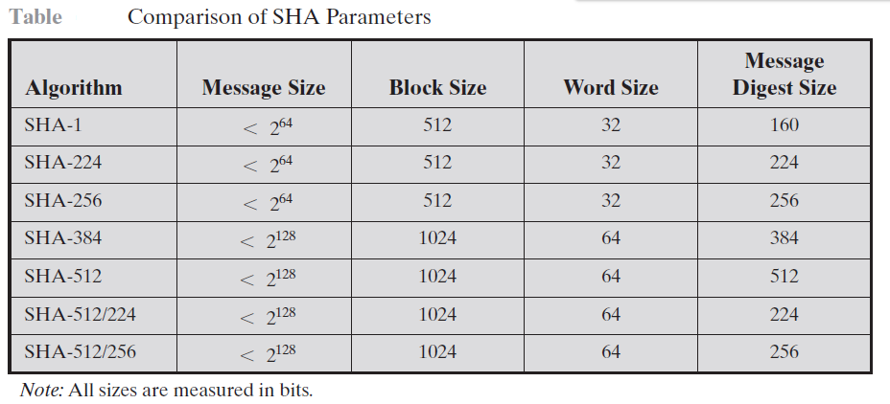
Secure Hash Function
Introduction
This table shows the versions of SHA and values of their parameters.
This class will explain the steps of SHA-512, as it is more like all previous versions and newer versions.

Slide 22
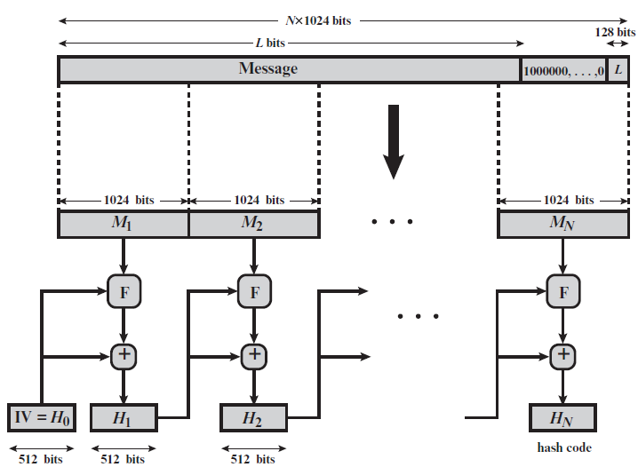
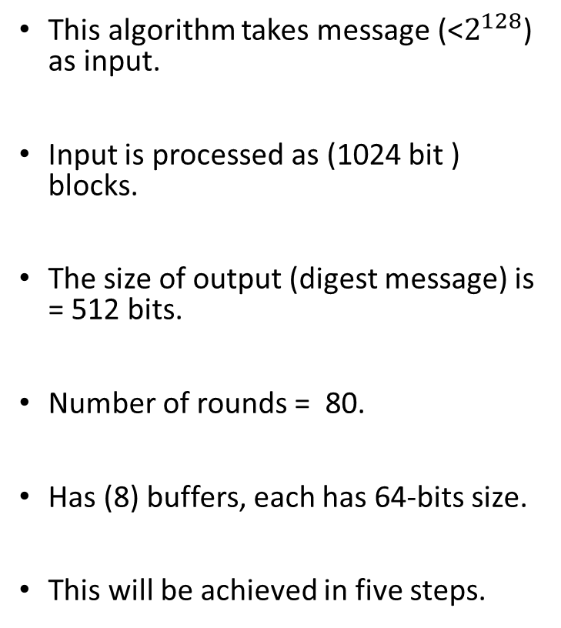
SHA - 512
This algorithm takes message (<$2^{128}$) as input.
Input is processed as (1024 bit ) blocks.
The size of output (digest message) is = 512 bits.
Number of rounds = 80.
Has (8) buffers, each has 64-bits size.
This will be achieved in five steps.

Slide 23
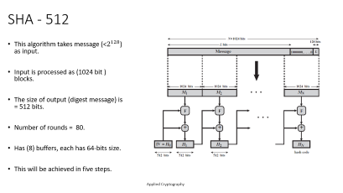
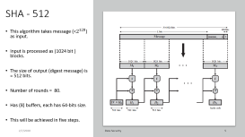
Steps of SHA-521
Pad the bits of (10000…..0) so that, the length of the plaintext should be 128 bits less than multiple of 1024.
Append (128 bit) representation of original plaintext such that the overall length of the message should be multiple of 1024 bits.
Initialize the buffers (a,b,c,d,e,f,g, and h). Each has 64-bit in hexadecimal.
Process each block of the original plaintext in 80 rounds/steps.
Output of the buffers will be (Hash Code / Digest Message).

Slide 24
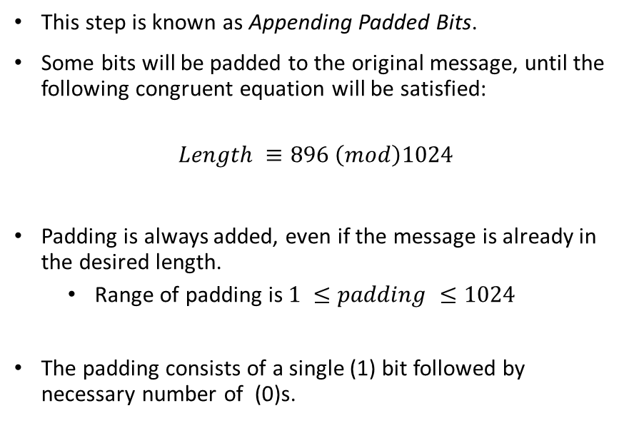
SHA-512
Step - 1
This step is known as Appending Padded Bits.
Some bits will be padded to the original message, until the following congruent equation will be satisfied:
$$Length ≡896 \left(mod\right)1024$$
Padding is always added, even if the message is already in the desired length.
  Range of padding is $1 ≤padding ≤1024$
The padding consists of a single (1) bit followed by necessary number of (0)s.

Slide 25
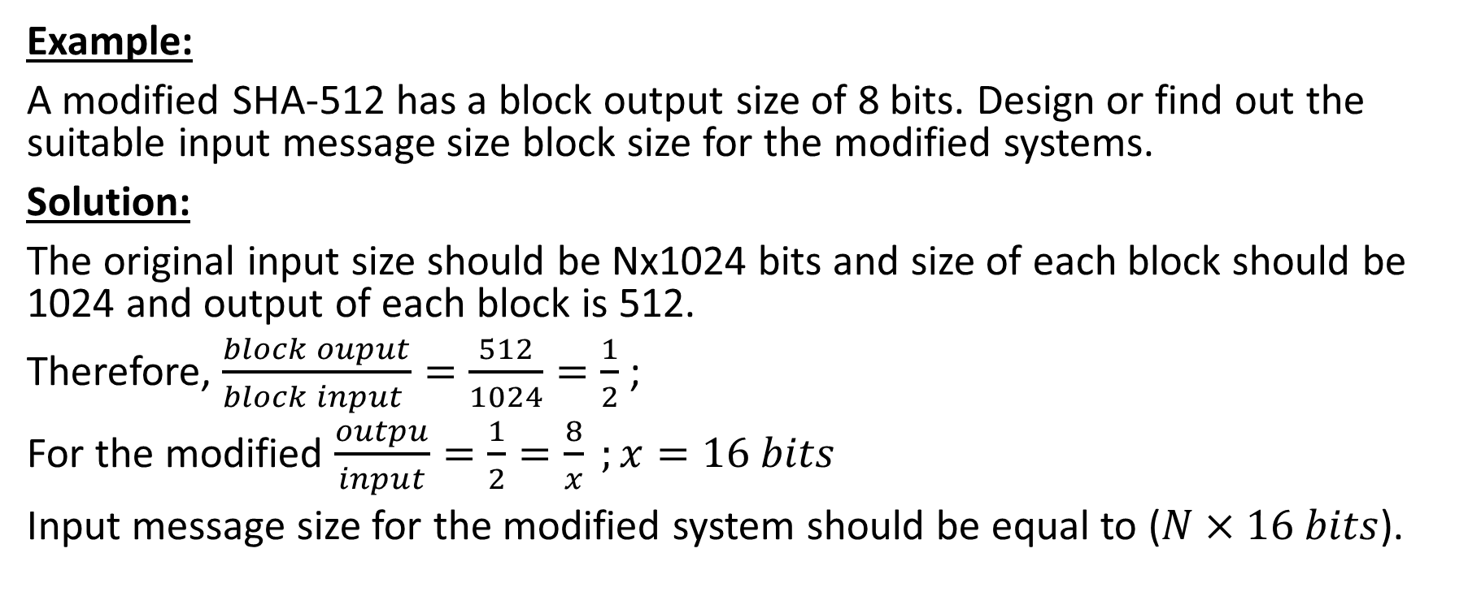
SHA-512
Step - 1
Example:
A modified SHA-512 has a block output size of 8 bits. Design or find out the suitable input message size block size for the modified systems.
Solution:
The original input size should be Nx1024 bits and size of each block should be 1024 and output of each block is 512.
Therefore, $\frac{block ouput}{block input }=\frac{512}{1024}=\frac{1}{2}$ ;
For the modified $\frac{outpu}{input}=\frac{1}{2}=\frac{8}{x} ;x=16 bits$
Input message size for the modified system should be equal to ($N×16 bits$).

Slide 26
SHA-512
Step - 2
This step is known as Appending Length Bits.
The size of block is 128 bits.
It is the length of the message in bits. (integer)
The output of Step-1 and Step-2 is a message with (Nx1024).
Message is expanded to N of blocks, each block with 1024-bit size.

Slide 27
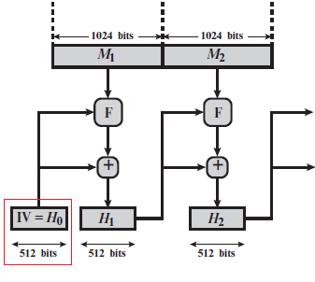
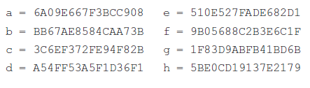
SHA-512
Step-3
This step called Initial Hash Buffer.
This buffer will be used to save the intermediate and final output of the hash function.
The buffer can be represented as eight 64-bit registers (a, b, c, d, e, f, g, and h).
They are initialized to the following 64-bit integers (hexadecimal value)

Slide 28
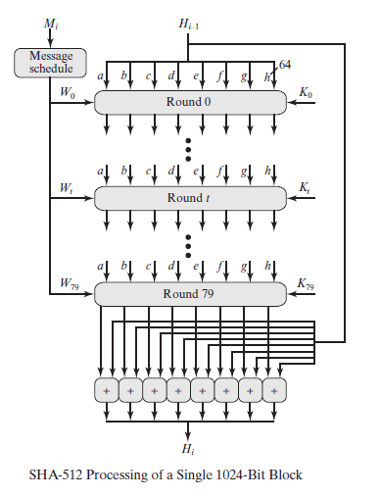
SHA-512
Step-4
This step is knowing as Processing Message in 1024-bit.
It is considered as the heart of SHA-512 algorithm.
It is consisted of 80 rounds.
Each round has three inputs
  Values of Buffer registers.
  Part of the original Message.
  A constant K

Slide 29
SHA-512
Step-4 / rounds
Each round has three inputs
  Values of Buffer registers.
    Eight 64-bit words will be Initialized.
    They will be updated for each round. (HOW)
  Part of the original Message.
    There is a process for that.
    There are Eighty 64 bits. What we have is 16 words (64-bits) (HOW)
  A constant K
    Eighty 64-bits will be generated randomly. (one time generated)
The question is “How these inputs will be mixed at each round?”

Slide 30
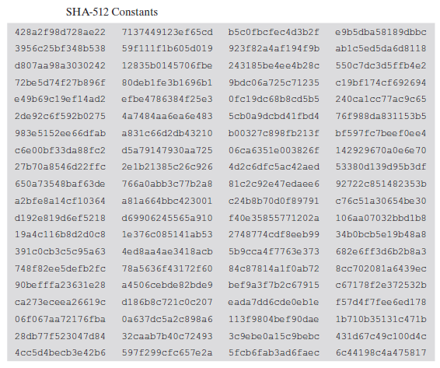
SHA-512
Step-4 / rounds/
Constant K and Buffers
K Constant
  There are 80 constant K.
  Each will be used for a round.
  Each constant has 64-bit size.
  Generated randomly one time.
Buffers
  There are 8 buffers
  Each is in 64-bit size
  Initialized randomly, but updated within each round

Slide 31
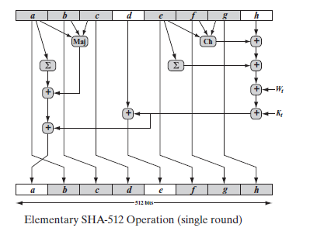
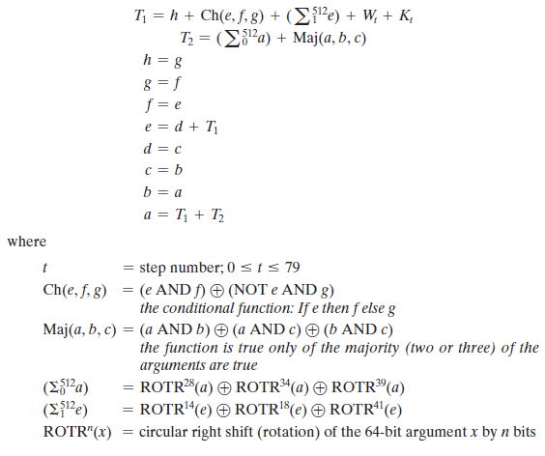
Round Function
The process of each round is going according to the shown equations.
Most of the equations have logic processes.
Inputs to all equations are
  K constant values
  Buffers’ content value
  Part of the message (w)s

Slide 32
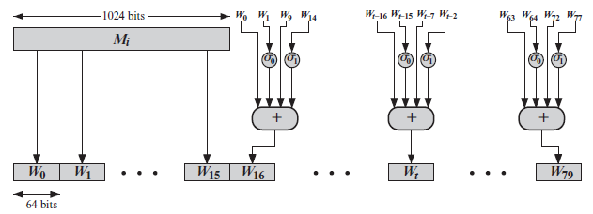
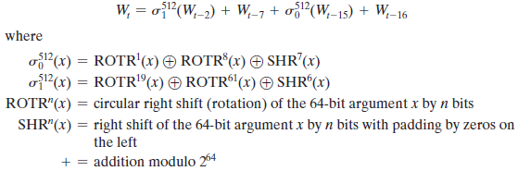
Creating the 80 words
The first 16 words are coming from the original message directly.
The others are created according to the figure or the equations shown.

Slide 33
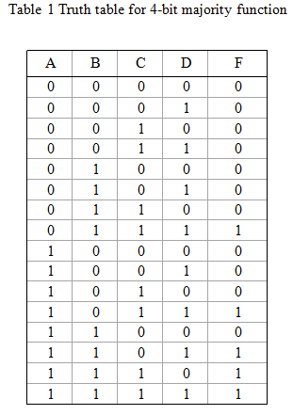
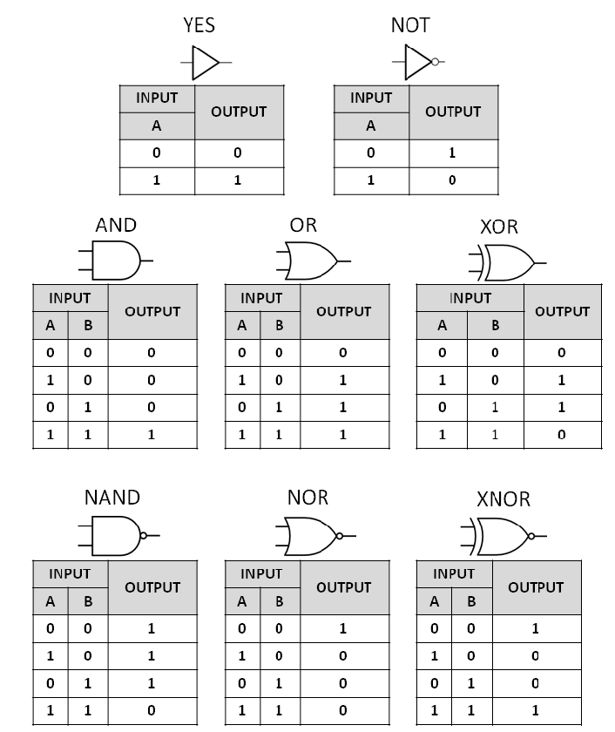
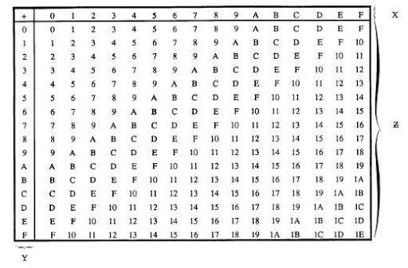
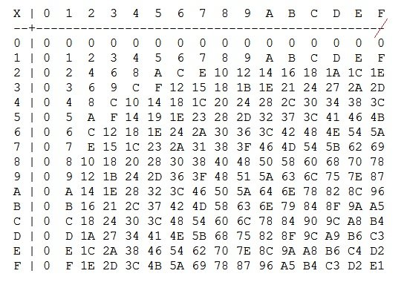
Some Truth Tables
Hexadecimal Addition
Hexadecimal Multiplication

Slide 34
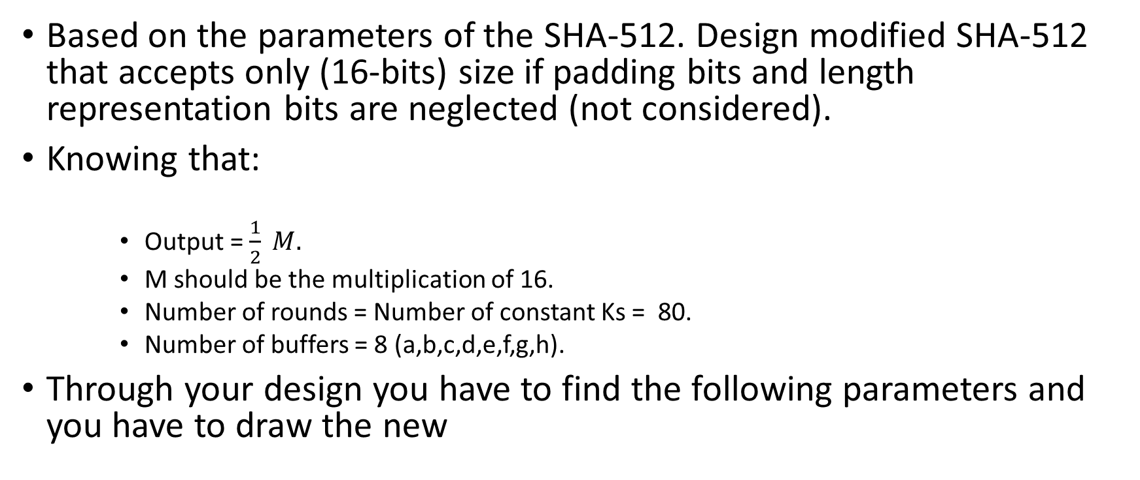
Quiz
Based on the parameters of the SHA-512. Design modified SHA-512 that accepts only (16-bits) size if padding bits and length representation bits are neglected (not considered).
Knowing that:
    Output = $\frac{1}{2} M.$
    M should be the multiplication of 16.
    Number of rounds = Number of constant Ks = 80.
    Number of buffers = 8 (a,b,c,d,e,f,g,h).
Through your design you have to find the following parameters and you have to draw the new

Slide 35

CLASS
END

