Slide 1

Applied Cryptography
Saman.mirza@itu.edu.iq

Slide 2
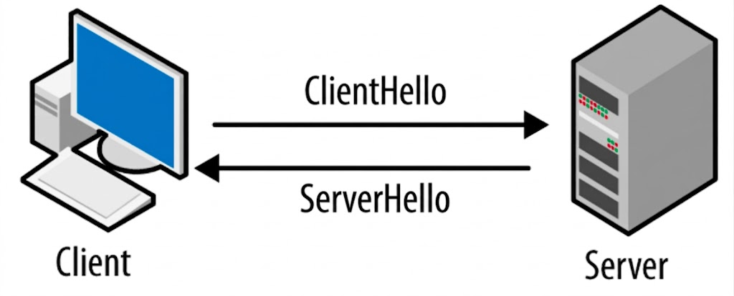
1) HTTPS (Web Browsing)
TLS: AES_128_GCM_SHA256 _ ECDHE_ RSA
Purpose: Securely browse websites and submit sensitive data.
What algorithms needed and Why:
  AES → encrypts page content (fast for large data)
  RSA/ECC → authenticates the website (certificate trust)
  ECDHE → securely agrees on a session key (Perfect Forward Secrecy)
  SHA-256 → ensures data integrity
  Digital signatures → prove the website identity
Prevents eavesdropping, tampering, and fake websites (phishing)

Slide 3
What Explained
We already explained the followings:
  AES ---> it classifies as symmetric encryption algorithm.
  It needs to share a secrete key. (Not explained yet)
  SHA-512 ---> it provided Integrity?
  Not fully. SHA-512 could be attacked, why?

Slide 4
Normal SHA512
They agree to use SHA256 for Integrity
M
H
It has the Message (M).
It wants to keep the integrity.
It uses SHA-512 for that.
It found H = SHA-512(M)
It appends the H with the M

Slide 5
Normal SHA512
They agree to use SHA256 for Integrity
M
H
The server receives the M.
It uses the same SHA-512
It compute the value of (H)
It compare it with the (H) value that got from client.

Slide 6

Why SHA512 Attacked?
They agree to use SHA256 for Integrity
M
H
P
h

Slide 7
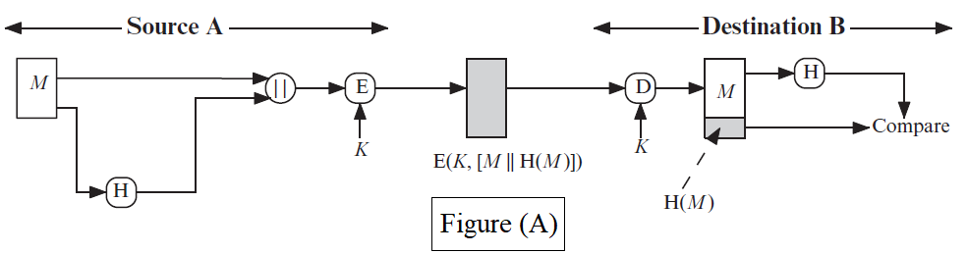
Cryptographic Hash Function
Types of Message Authentication
Figure (A)
The message plus concatenated hash code is encrypted using symmetric encryption.
Since only A and B share the secret key, the message must have come from A and has not been altered.
The hash code provides the structure or redundancy required to achieve authentication.

Slide 8
Explaining Secure Message Transmission
Using Simple Hash and Simple Encryption
Goal of the System
  Confidentiality (hide message)
  Integrity (detect modification)
  Using: Encryption + Hash

Slide 9
Simple Functions and Example
Given parameters
  H(M) = sum of ASCII mod 100
  E_K(x) = x + K
  D_K(x) = x - K
  K = 10
Original Message :
  M = 'AB'
  A = 65
  B = 66

Slide 10

Solution
Compute Hash
  H(M) = (65 + 66) mod 100 = 31
Combine Message and Hash
  [65, 66, 31]
Encrypt Data ($E_{k}(x) = x + K, where K=10)$
  65→75
  66→76
  31→41
  Cipher: [75, 76, 41]

Slide 11
Solution (Decryption)
Compute Hash
  H(M) = (65 + 66) mod 100 = 31
Combine Message and Hash
  [65, 66, 31]
Encrypt Data ($E_{k}(x) = x + K, where K=10)$
  65→75
  66→76
  31→41
  Cipher: [75, 76, 41]

Slide 12
Attack Example
[65, 66, 31] → [65, 67, 32]

Slide 13
What Did We Learn?
It becomes clear that:
  Encryption hides data
  Hash detects modification
  But not fully secure
Key Problem
  Attacker can create new valid message and hash (MIMA)
Solution
  Use HMAC(K, M)

Slide 14
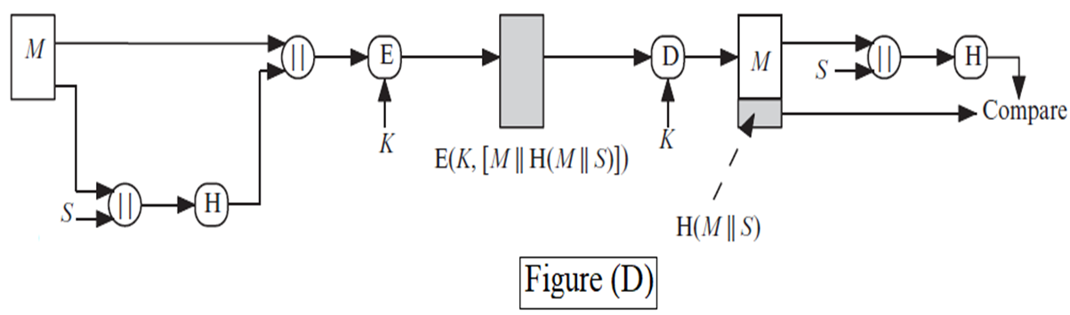
2nd Method
Combine message, secret, hash, and encryption

Slide 15
Simple Functions and Example
Given parameters
  H(M) = sum of ASCII mod 100
  E_K(x) = x + K
  D_K(x) = x - K
  K = 10
  S=5
Original Message :
  M = 'AB'
  A = 65
  B = 66

Slide 16
Solution

Slide 17
Attack Example
75,76,46]→[75,90,46]]

Slide 18
2nd Method
Outcome of this method:
  Encryption hides
  Secret improves hash
  Detects modification
Limitation is not a secure standard.
  Solution is using HMAC(K,M) or AES-GCM

