Slide 1

Applied Cryptography
End – to – End – Emcrytpnion
E2EE
WhatsApp Application
Saman.mirza@itu.edu.iq

Slide 2
Class Objectives
To introduce the network structure of the WhatsApp application.
  Core components only.
To provide the security and the encryption background for WhatsApp application.
To explain the flow of the message in WhatsApp step-by-step.

Slide 3
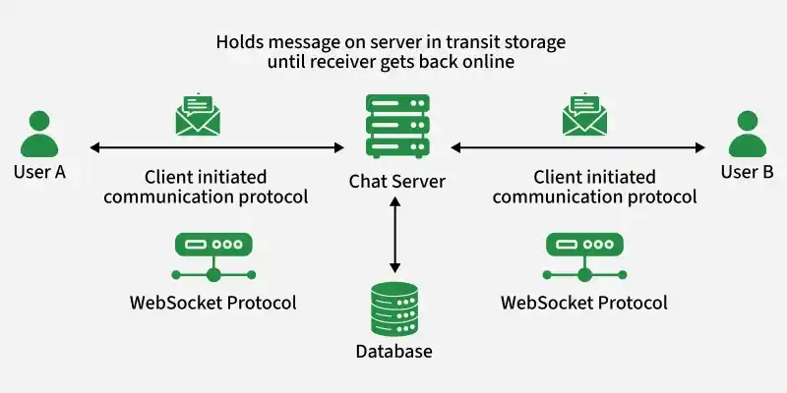
WhatsApp Network Structure (High-Level)
Core Components
The WhatsApp network is a client–server architecture with end-to-end encryption (E2EE).
It consists of:
  Client Devices (Users)
    Your phone and the receiver’s phone
    Each device:
      Generates its own public/private key pair
      Encrypts and decrypts messages locally
    No plaintext message leaves the device

Slide 4

CLASS
END

