Slide 1

Applied Cryptography
End – to – End – Emcrytpnion
E2EE
WhatsApp Application
Saman.mirza@itu.edu.iq

Slide 2
Class Objectives
To introduce the network structure of the WhatsApp application.
  Core components only.
To provide the security and the encryption background for WhatsApp application.
To explain the flow of the message in WhatsApp step-by-step.

Slide 3
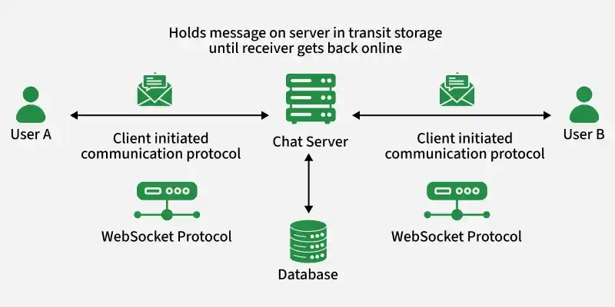
WhatsApp Network Structure (High-Level)
Core Components
The WhatsApp network is a client–server architecture with end-to-end encryption (E2EE).
It consists of:
  Client Devices (Users)
    Your phone and the receiver’s phone
    Each device:
      Generates its own public/private key pair
      Encrypts and decrypts messages locally
    No plaintext message leaves the device

Slide 4
E2EE
The Key Bundle
When you first install and open WhatsApp, the app immediately generates three sets of Curve25519 cryptographic keys directly on your device:
  Identity Key Pair: A long-term "ID card" for your phone.
  Signed Pre Key: A medium-term key signed by your Identity Key.
  One-Time Pre Keys: A batch of keys used for single sessions when someone first messages you.

Slide 5

Identity Key Pair
Public / Private Key Generation
Long-Term Duration:
The identity key pair stays on your device for a long time—usually until you reinstall the app or change phones.
Public/Private Split:
  Private Key: Stored securely on your device (usually in a Secure Element). It never leaves the phone. $\left( 0 ≤X ≤ 2^{255} −19\right)$ , usually (512-bit integer)
  Public Key: Shared with the server and other users to verify your identity, often visible as a safety number or fingerprint. ( It is a point multiplication math process)

Slide 6
Signed Pre-key
A medium-term public key that stays on the server for weeks.
The Signature: It is mathematically "signed" by your Identity Key to prove it’s really yours.
It is the fallback key. If you are offline for a long time and the server "runs out" of One-Time Keys, the Signed Pre-key allows people to still send you encrypted messages.
Benefit: Ensures Reliability. Without it, you couldn't receive messages from new people if your "One-Time" stock was empty.

Slide 7
One-Time Pre-keys
A batch of ~100 disposable public keys.
Role: Used only once to start a new conversation.
Benefit: Provides Maximum Forward Secrecy. Once a message is sent using one, the server deletes it. If a hacker steals your phone later, they can't recover the keys used for those specific past messages.

Slide 8
Key Calculation

Slide 9
Summary of the keys
Key | Main Job | Stored on Mobile | Stored on Server
Identity Key | Permanent identity/authentication | Private key | Public key
Signed Pre-Key | Session establishment | Private key | Public key + signature
One-Time Pre-Key | One-time secure session creation | Private key | Public key

Slide 10

Key Calculation
Overview of Identity Key Pairs
While real-world cryptography uses massive numbers (256-bit), we can demonstrate the math using a smaller Elliptic Curve and simple integers. This specific math is called Scalar Multiplication.
The Mathematical Goal
  In cryptography like Curve25519, the relationship is:
  Where the “X" isn't normal multiplication, but "Point Addition" on a curve.

Slide 11
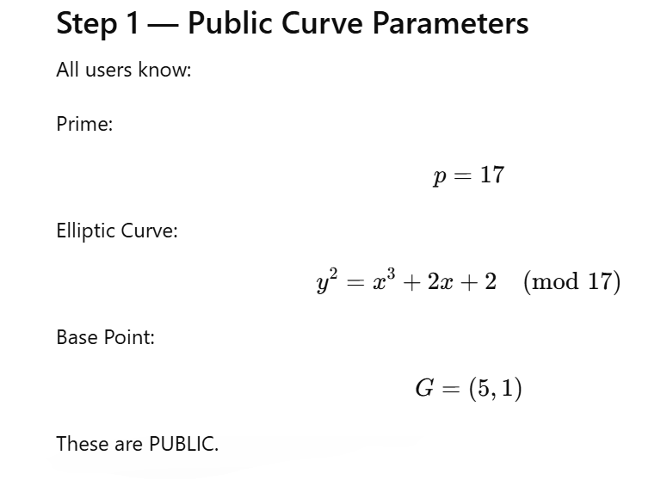

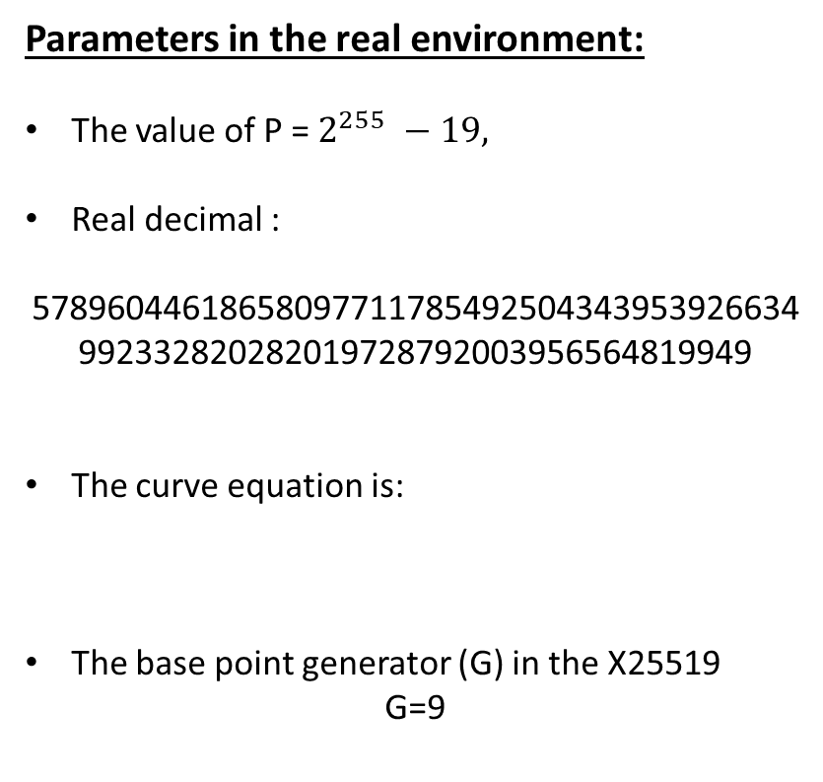
Key Generation
1. Defining the Environment
Parameters in the real environment:
The value of P = $2^{255} −19,$
Real decimal :
57896044618658097711785492504343953926634992332820282019728792003956564819949
The curve equation is:
The base point generator (G) in the X25519
G=9

Slide 12
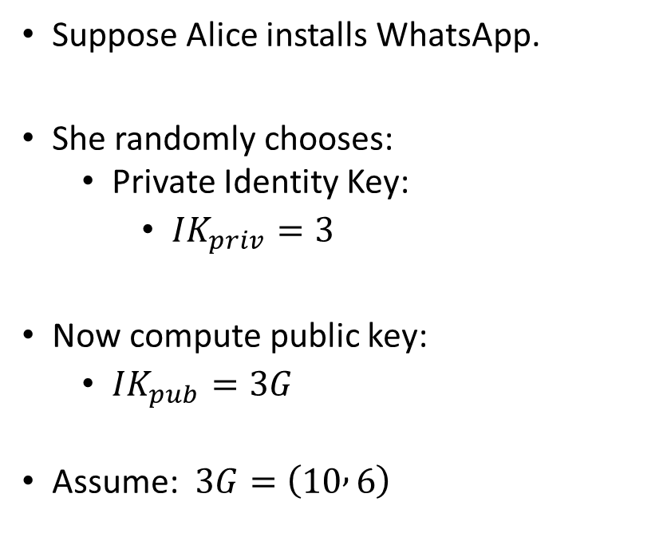
Key Generation
Identity Key Pair (Step 2)
Key | Value | Location
Identity Private Key | 3 | User’s Mobile
Identity Public Key | (10,6) | WhatsApp Server
Suppose Alice installs WhatsApp.
She randomly chooses:
  Private Identity Key:
    $IK_{priv}=3$
Now compute public key:
  $IK_{pub}=3G$
Assume: $3G=\left(10 , 6\right)$
Bundel Contents
Key | Value
Identity Public Key | (10,6)

Slide 13
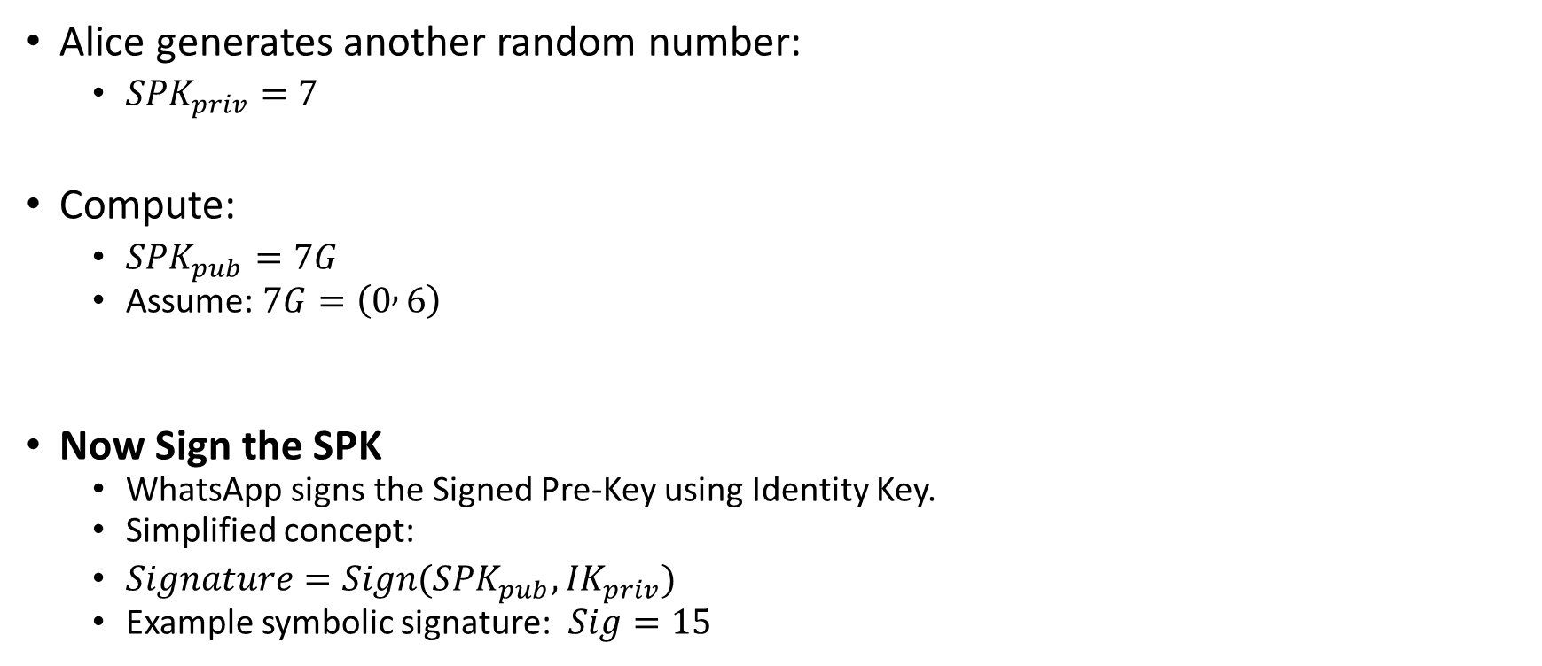
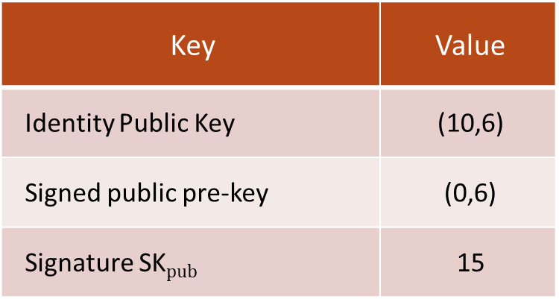
Key Generation
Signed Pre-Key (Step 3)
Key | Value | Location
Signed Private Pre-Key | 7 | User’s Mobile
Signed Public Pre-Key | (0,6) | WhatsApp Server
Signature | 15 | WhatsApp Server
Alice generates another random number:
  $SPK_{priv}=7$
Compute:
  $SPK_{pub}=7G$
  Assume: $7G=\left(0 , 6\right)$
Now Sign the SPK
  WhatsApp signs the Signed Pre-Key using Identity Key.
  Simplified concept:
  $Signature=Sign({SPK}_{pub},{IK}_{priv})$
  Example symbolic signature: $Sig=15$
Bundel Contents
Key | Value
Identity Public Key | (10,6)
Signed public pre-key | (0,6)
Signature SK$pub$ | 15

Slide 14
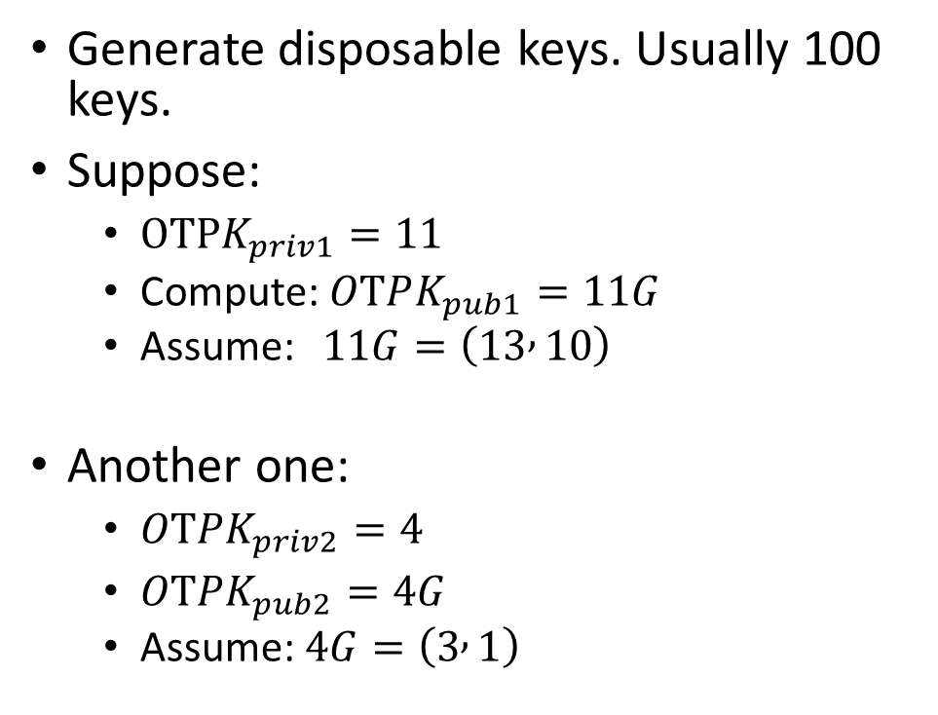
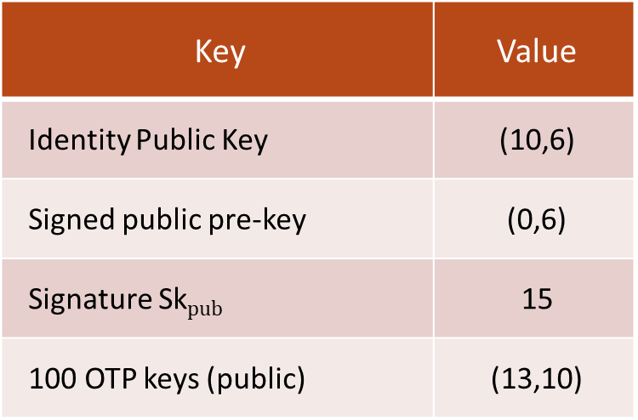
Key Generation
One-Time Pre-Key (Step 4)
Key | Value | Location
100 OTP keys (private) | 11 | User’s Mobile
100 OTP keys (public) | (0,6) | WhatsApp Server
Generate disposable keys. Usually 100 keys.
Suppose:
  $OTPK_{priv1}=11$
  Compute: $OTPK_{pub1}=11G$
  Assume: $11G=\left(13 , 10\right)$
Another one:
  $OTPK_{priv2}=4$
  $OTPK_{pub2}=4G$
  Assume: $4G=\left(3 , 1\right)$
Bundel Contents
Key | Value
Identity Public Key | (10,6)
Signed public pre-key | (0,6)
Signature Sk$pub$ | 15
100 OTP keys (public) | (13,10)

Slide 15

Calculation
How to Calculating 3 G
Given:
  G = (5,1)
  K = 3
  $y^{2} = x^{3} + 2x + 2 mod 17$
Aims:
  Finding the public key through calculating ($P= 3G → G+G+G)$

Slide 16
End-to-End
Encryption

Slide 17
WhatsApp Identity Infrastructure
Internally, WhatsApp identities are represented as:
  E164_Phone_Number + Public Key Bundle
  Example: +9647501234567
Linked Cryptographic Keys:
  Identity Public Key
  Signed Pre-Key
  One-Time Pre-Keys
Notes:
The phone number acts as the global identifier, while the public key bundle enables authentication, secure session establishment, and end-to-end encryption.

Slide 18
Fist Time End-to-End Chatting
Step 1 — Request Public Key Bundle
User A’s mobile asks WhatsApp server:
  “Give me B’s public key bundle.”
Server returns:
  Identity Public Key
  Signed Pre-Key
  One-Time Pre-Key

Slide 19

Fist Time End-to-End Chatting
Step 2 — Verify Signed Pre-Key
User A’s App verifies:
  $Verify$ ($Signature , {IK}_{public} )$
Aims is to ensure Signed Pre-Key truly belongs to B
This prevents fake key injection.

Slide 20
Step 3 — Creating the Ephemeral Key (EK)
User A generates a temporary ECC key pair:
  Ephemeral Private Key: EK_A^priv = 4
  Ephemeral Public Key: EK_A^pub = 4G
  Using ECC point multiplication: 4G = (3,1)
EK is temporary and used only for this session
  Provides Forward Secrecy and unique session creation
  Only EK_A^pub will later be sent to User B
Notes:
The Ephemeral Key is generated dynamically by the sender before session establishment. It is not a permanent identity key. It helps create fresh session secrets and improves forward secrecy.

Slide 21





Step 4 — Shared Secrete Session
DH# | Equations | Output | Points | Value
DH1 |  | S1 | (16,13) | 16
DH2 |  | S2 | (5,1) | 5
DH3 |  | S3 | (9,16) | 9
DH4 |  | S4 | (0,9) | 0
$$16 || 5 || 9 || 0$$

Slide 22
Step 5 — KDF — Key Derivation Function
KDF is a cryptographic function that transforms raw shared secret material into usable symmetric keys.
KDF converts the four DHs to :
  The concatenated DHs to stream of bits.
The stream contains:
  256 bit as secrete key for AES (Encryption).
Here, AES is used to encrypt the message what be sent by A to B.

Slide 23
Step 6 — Encryption
Here, AES is used to encrypt the message wants be sent by A to B.
The secrete key that used by AES is generated through a sequence of computation in both A and B sides.
User A | Server | User B
IKA Private = 3 EKA Private = 4 | IKA Public = 3G EKA Public = 4G IKB Public= 5G SPKB Public = 7G OTPKBPublic = 9G | IKB Private = 5 SPKB Private = 7 OTPKB Private = 9
Let us find all DH1, DH2, DH3, and DH4 at both sides:

Slide 24
Server Decryption
Why dose the Server cannot encrypt the message ?
  The server dose not have the private keys.

Slide 25

CLASS
END

