Slide 1
UNIT 2: Working In General Practice
Mr. Soran A. Abdulrahman

Slide 2
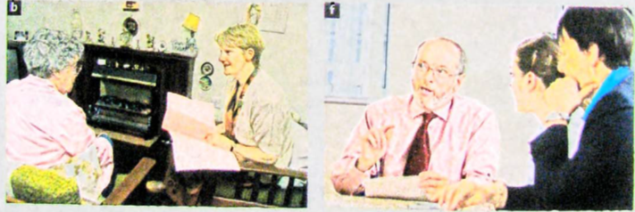
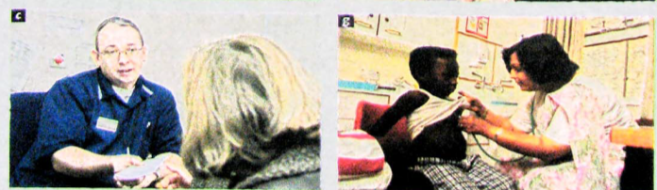
Matching Jobs to The Pictures
What do you think is the most stressful aspect of medical work? What is the most rewarding?

Slide 3

Practice Manager
A practice manager is the administrator who runs a doctor's office, group practice, medical clinic, hospital department and other forms of medical offices. They are sometimes called medical managers, medical practice administrators, healthcare administrators and healthcare executives.

Slide 4
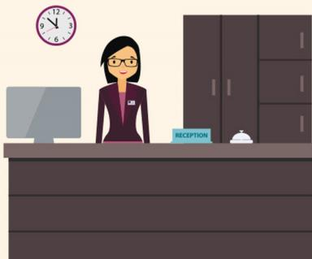
Receptionist
Serves visitors by greeting, welcoming, and directing them appropriately. Notifies company personnel of visitor arrival. Maintains security and telecommunications system. Informs visitors by answering or referring inquiries.

Slide 5

General Practitioner/Dentist
General practitioners (GPs) treat all common medical conditions and refer patients to hospitals and other medical services for urgent and specialist treatment. They focus on the health of the whole person combining physical, psychological and social aspects of care.
A general dentist is your primary care dental provider. This dentist diagnoses, treats, and manages your overall oral health care needs, including gum care, root canals, fillings, crowns, veneers, bridges, and preventive education.

Slide 6
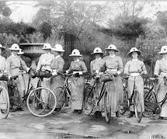
District Nurse
(in the UK) a nurse who visits and treats patients in their homes, operating in a specific area or in association with a particular general practice surgery or health centre.

Slide 7

Health Visitor
Health visitors are nurses or midwives who are passionate about promoting healthy lifestyles and preventing illness. They work with families to give pre-school-age children the best possible start in life.

Slide 8

Practice Nurse
Practice nurses work in surgeries where they plan and provide nursing care, treatment and health education to patients of all ages. Previous relevant experience prior to training is not essential, but any gained caring for or working with people can be helpful.

Slide 9

Midwife
A midwife is a trained health professional who helps healthy women during labor, delivery, and after the birth of their babies. Midwives may deliver babies at birthing centers or at home, but most can also deliver babies at a hospital.

Slide 10
Matching Jobs to The Pictures
What do you think is the most stressful aspect of medical work? What is the most rewarding?
F
A
G
D
E
B
C

Slide 11
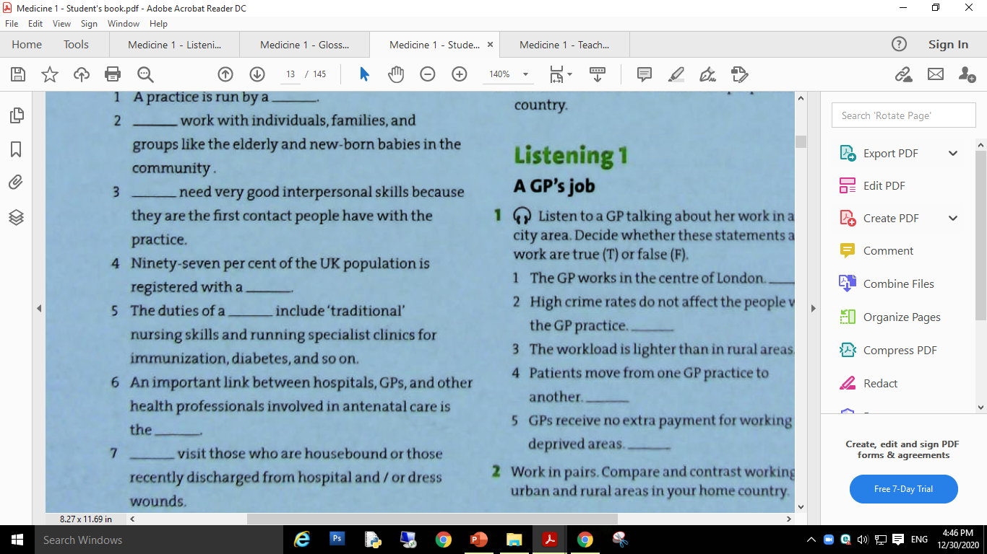
Let's have a bit practice with the given common nouns.
practice manager
Health visitors
Receptionist
Immunization (or vaccination) protects people from disease by introducing a vaccine into the body that triggers an immune response
general practitioner.
practice nurse
Antenatal care is the care you get from health professionals during your pregnancy. It's sometimes called pregnancy care or maternity care.
midwife
District nurses

Slide 12

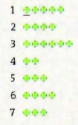
Main stress
1. Listen mark the main stress in the words and phrases.
Listening ( Where is the main stress?)
practice manager
receptionist
general practitioner
midwife
district nurse
health visitor
practice nurse

Slide 13

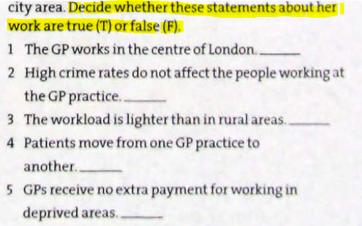
Listening 1:
T
F
F
T
F
not having the things that are necessary for a pleasant life, such as enough money, food, or good living conditions:

Slide 14
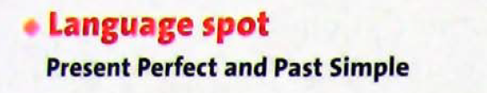
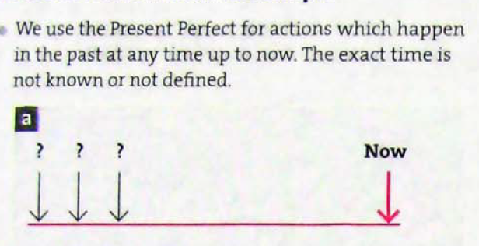
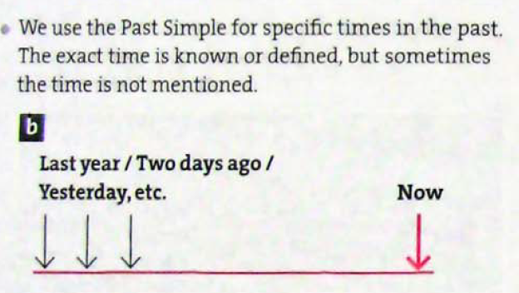
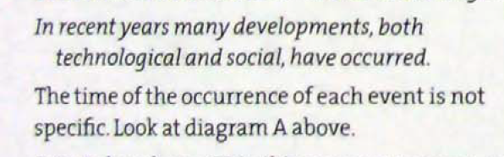

Slide 15
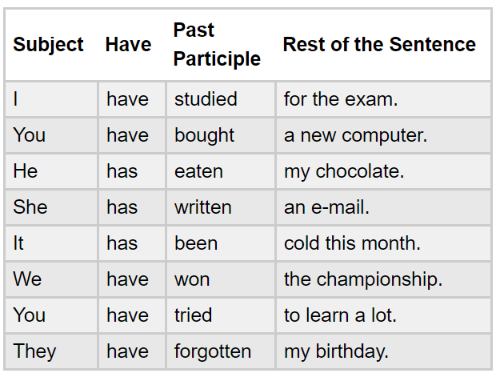
Present Perfect

Slide 16
Usages
A. Unfinished Actions
B. Finished Actions
1. Life experience
2. With an unfinished time word (this month, this week, today)
3. Result
4. We can also use the present perfect to talk about something that happened recently, even if there isn’t a clear result in the present.

Slide 17
Unfinished Actions
We use this tense when we want to talk about unfinished actions or states or habits that started in the past and continue to the present. Usually we use it to say 'how long' and we need 'since' or 'for'. We often use stative verbs.
• I've known Karen since 1994.
• She's lived in London for three years.
• I’ve worked here for six months.

Slide 18
B. Finished Actions
1. Life experience
I have been to Tokyo.
We have never seen that film.

Slide 19
2. With an unfinished time word (this month, this week, today). The period of time is still continuing.
• I haven't seen her this month.
• She's drunk three cups of coffee today.
• I’ve already moved house twice this year!
We CAN’T use the present perfect with a finished time word.
• I’ve seen him yesterday. (wrong)

Slide 20
3. A finished action with a result in the present.
I've lost my keys (so I can't get into my house).
She's hurt her leg (so she can't play tennis today).
They've missed the bus (so they will be late).

Slide 21
We can also use the present perfect to talk about something that happened recently, even if there isn’t a clear result in the present. This is common when we want to introduce news and we often use the words ‘just / yet / already / recently’
I’ve just seen Lucy.
The Mayor has already announced a new plan for the railways.

Slide 22

Past Simple or Present Perfect
I _________________ (see) three police cars this morning (it’s still morning).
After he _________________ (arrive) home, he _________________ (unpack) and _________________ (go) to bed early.
A: What’s wrong? B: I _________________ (break) a glass!
I _________________ (be) in London for three years. I love it here.
We _________________ (see) Julie last night.

Slide 23
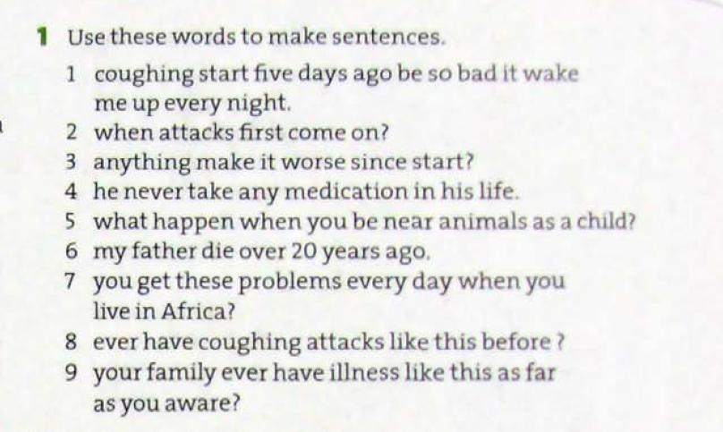

Slide 24
Past tense and Present Perfect Tense Samples (???)
1 The coughing started five days ago and it has been so bad that it has woken me up every night.
2 When did the attacks first come on?
3 Has anything made it worse since it started?
4 He has never taken any medication in his life.
5 What happened when you were near animals as a child?
6 My father died over 20 years ago.
7 Did you get these problems every day when you lived in Africa?
8 Have you ever had coughing attacks like this before?
9 Has anyone in y our family ever had an illness like this as far as you are aware?

Slide 25
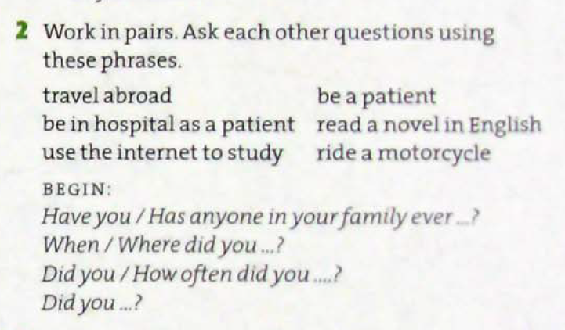
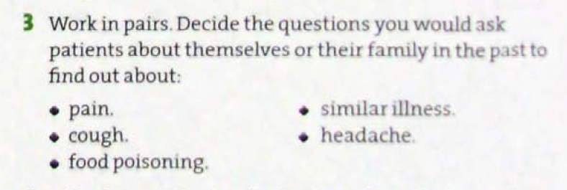

Slide 26
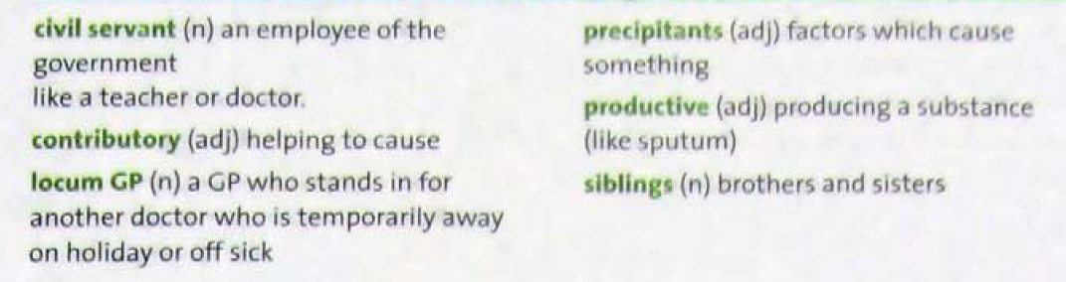

Slide 27
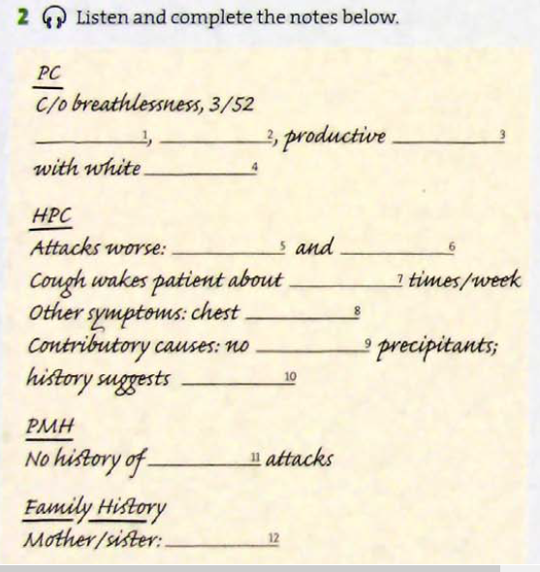
LISTENING 2: Listen and complete the notes below.
breathlessness
wheezing
cough
phlegm
at night
in the morning
three
tightness
known
asthma
previous
eczema

Slide 28
Signs and Symptoms
A sign is an indication of particular disorder that the doctor sees but which is not apparent to the patient
A symptom is a change in your body that shows that you are not healthy. It is what the patient notices himself/herself.

Slide 29
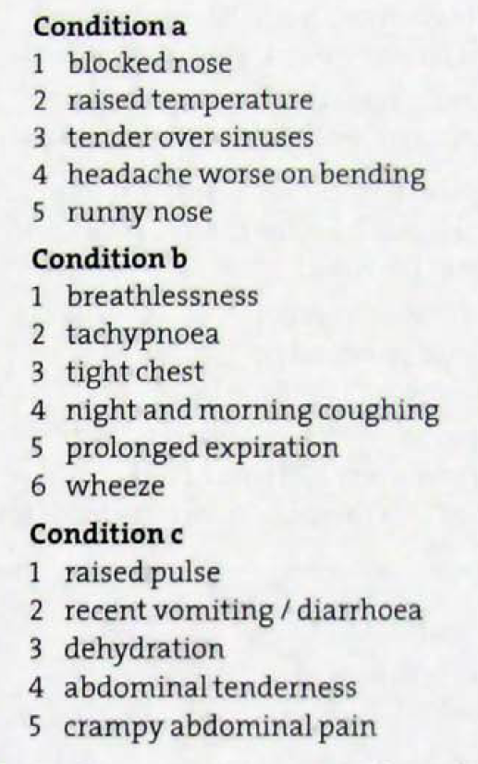
Blocked nose: stuffy nose, nasal congestion
Tender: (of a part of the body) painful when you touch it.
Sinus: is any of the spaces inside the head that are connected to the back of the nose.
Runny (nose): producing a lot of liquid. (rhinorrhea)
Breathlessness: shortness of breath, dyspnoea
Tachypnea is a condition that refers to rapid breathing.
Prolonged: continuing for a long time.
Expiration: exhalation
Wheeze: to breathe noisily and with difficulty
diarrhoea (diarrhea):​an illness in which waste matter is emptied from the bowels much more frequently than normal, and in liquid form.
Cramp: a painful involuntary spasmodic contraction of a muscle.

Slide 30
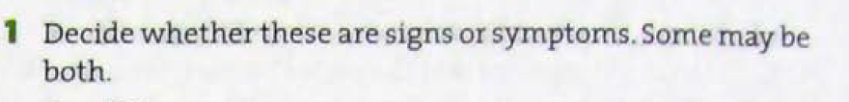
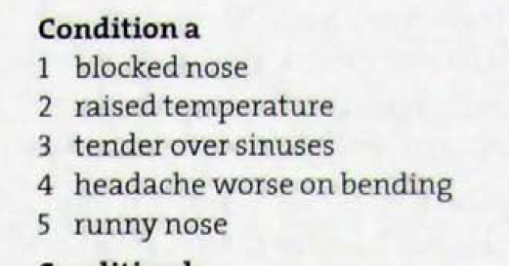
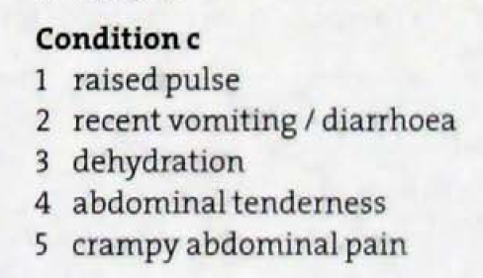
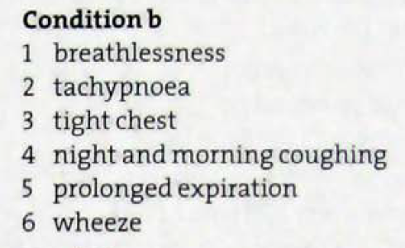
Symptom
Sign/ Symptom
Sign/ Symptom
Symptom
Symptom
Sign
Symptom
Sign
Sign
Symptom
Symptom
Sign
Symptom
Symptom
Sign
Sign/ Symptom

Slide 31
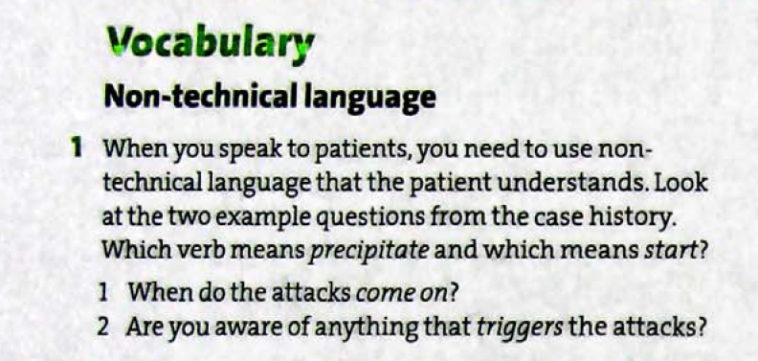
to make something, especially something bad, happen suddenly or sooner than it should
start
precipitate

Slide 32
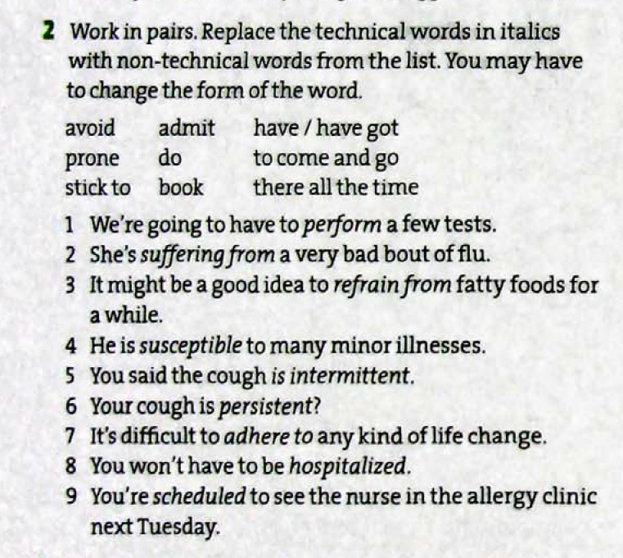
do
has got
avoid
prone (liable)
comes and goes
there all the time
stick to
admitted
booked

Slide 33
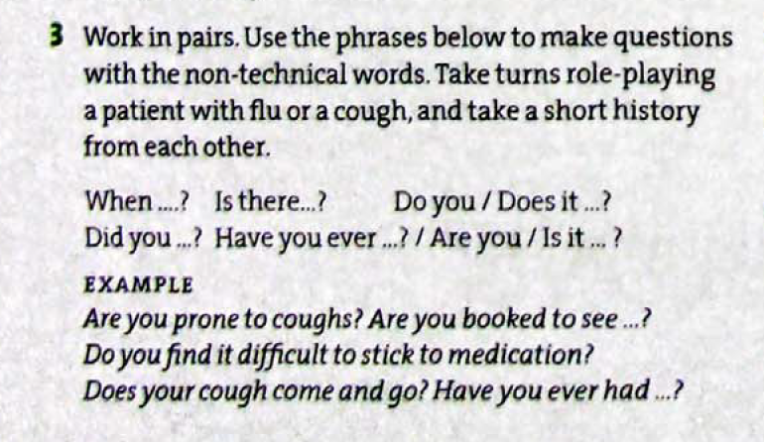

Slide 34
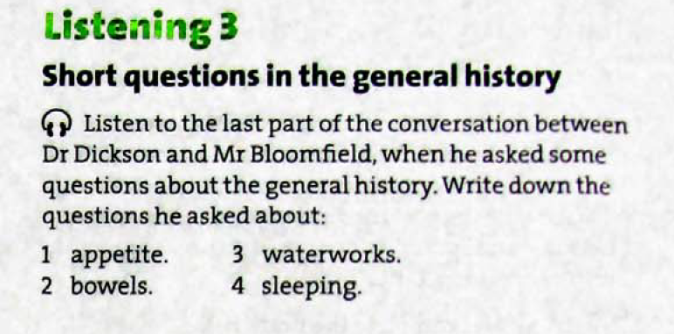
waterworks: The urinary system
Is your appetite OK?
Bowels OK?
Waterworks OK?
Sleeping OK?

Slide 35
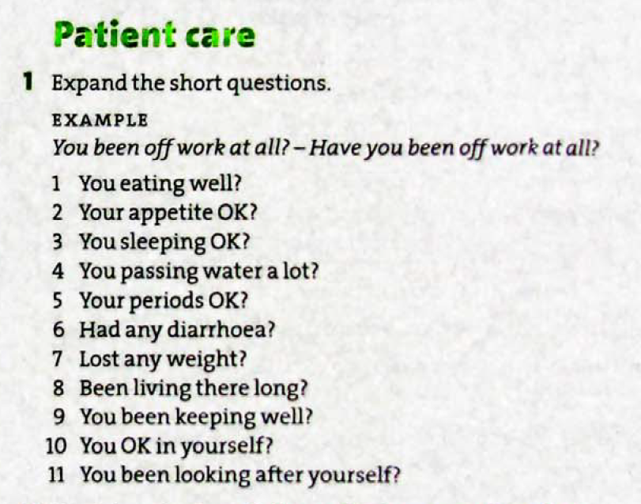
Are you eating well? Have you been eating well?
Is your appetite OK? Has your appetite been OK?
Are you sleeping well? Have you been sleeping well?
Are you/ Have you been passing water a lot?
Are your periods OK? Have your periods been OK?
Have you had any diarrhea?
Have you lost any weight.
Have you been living there long?
Have you been keeping well?
Are you/ Have you been OK in yourself?
Have you been looking after yourself?

Slide 36
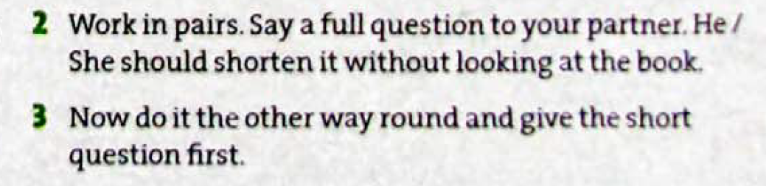

Slide 37
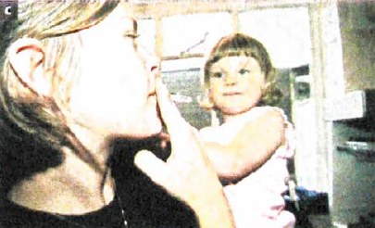


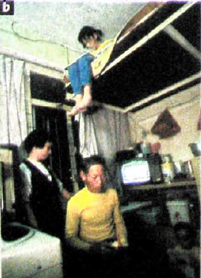

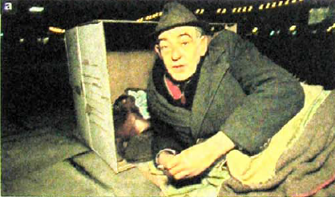
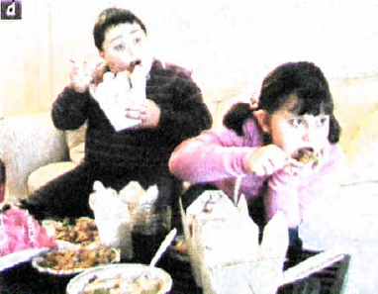


Slide 38
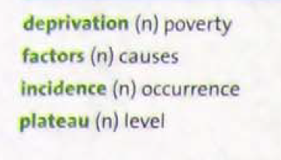
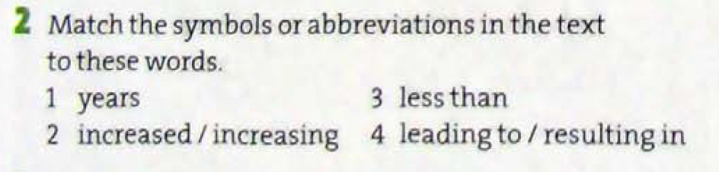
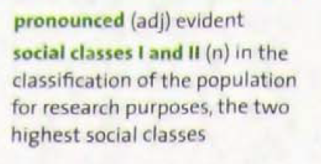
Read the text and do activity 1 and 2.

Slide 39
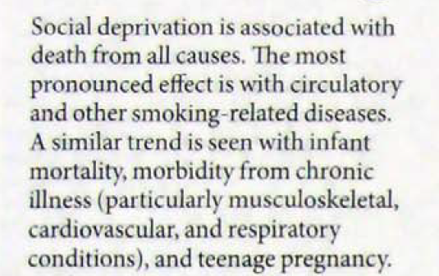
the fact of having a particular disease; the number of people who have a particular disease.

Slide 40
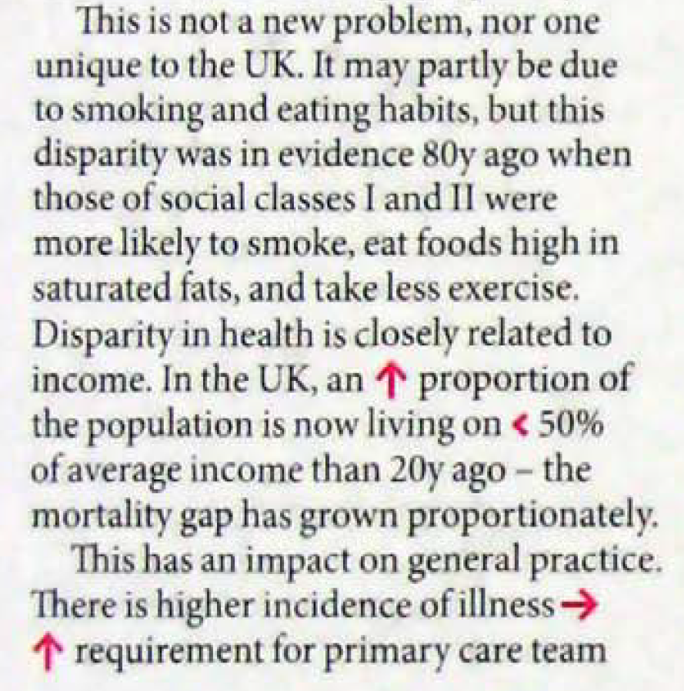
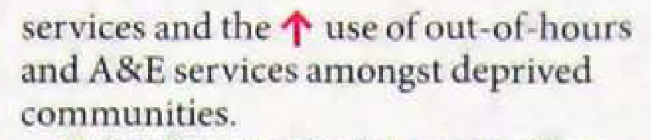
a difference, especially one connected with unfair treatment
​a type of fat found, for example, in butter, fried food and many types of meat, that is considered to be less healthy in the diet than other types of fat
​in a way that increases or decreases in size, amount or degree according to changes in something else

Slide 41
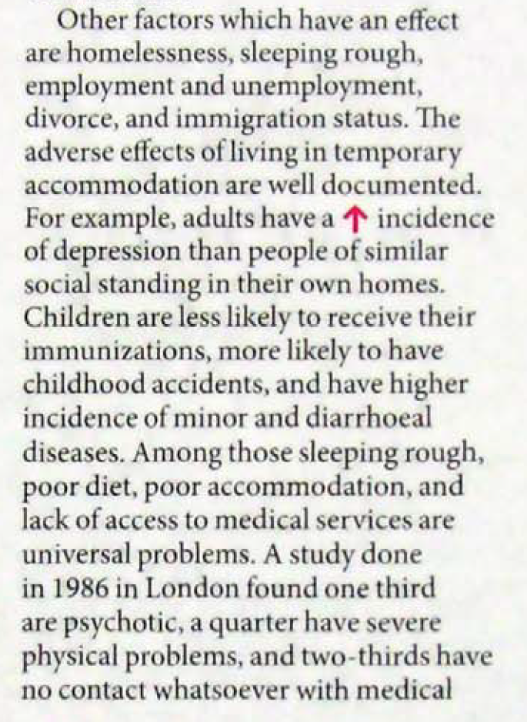
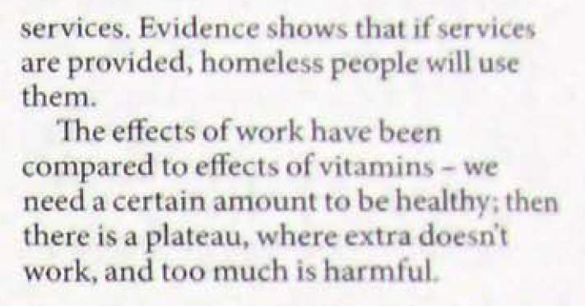
​negative and unpleasant; not likely to produce a good result
​relating to diarrhoea

Slide 42
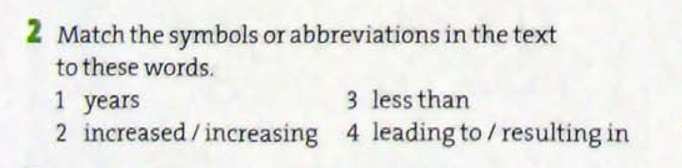





Slide 43
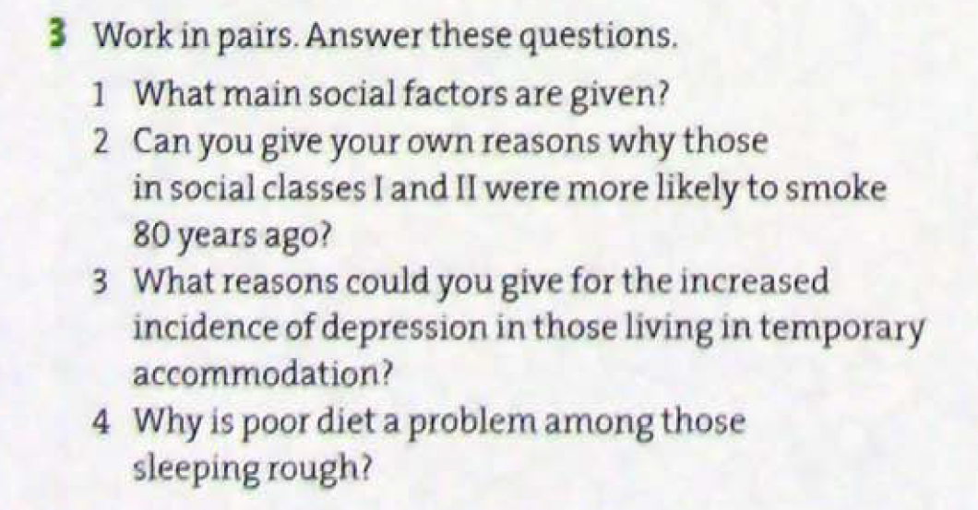
Homelessness, sleeping rough, employment and unemployment, divorce and immigrations status.
80 years ago, tobacco was fashionable and more affordable for those in higher paid jobs.
Some general reasons are general anxiety about living conditions, lack of security, worry about the future.
Some reasons are they probably have little or no money; no access to cooking facilities; lack of balanced diet with fresh vegetables; fixed routine.

Slide 44
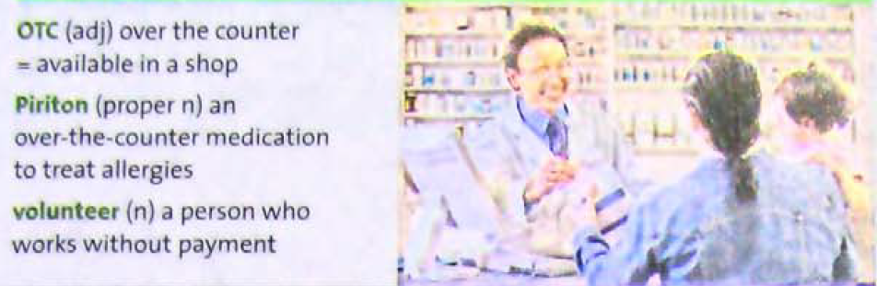
nonprescription medicine

Slide 45
Referral letter
A referral letter is a formal document written by a healthcare professional, typically a general practitioner (GP), primary care doctor, or specialist, to recommend a patient for further assessment, diagnosis, or treatment by another medical specialist.
For example: A GP refers a patient with chronic joint pain to a rheumatologist. The referral letter includes the patient's symptoms, past tests, and response to pain medication. The rheumatologist now has a clear picture and can build on what’s already been done, rather than repeating basic investigations.
Purpose of a Referral Letter:
To transfer care to a specialist with more expertise in a specific area (e.g., cardiology, psychiatry, dermatology).
To request diagnostic tests or second opinions.
To ensure continuity of care across healthcare provider

Slide 46
Significant Components of RL
Patient Information: Name, age, medical history, current symptoms.
Reason for Referral: What issue the referring doctor wants the specialist to assess or manage.
Relevant Findings: Results of previous tests, observations, or treatment.
Urgency Level: Routine, urgent, or emergency.
Referring Doctor’s Details: Contact info and professional signature

Slide 47
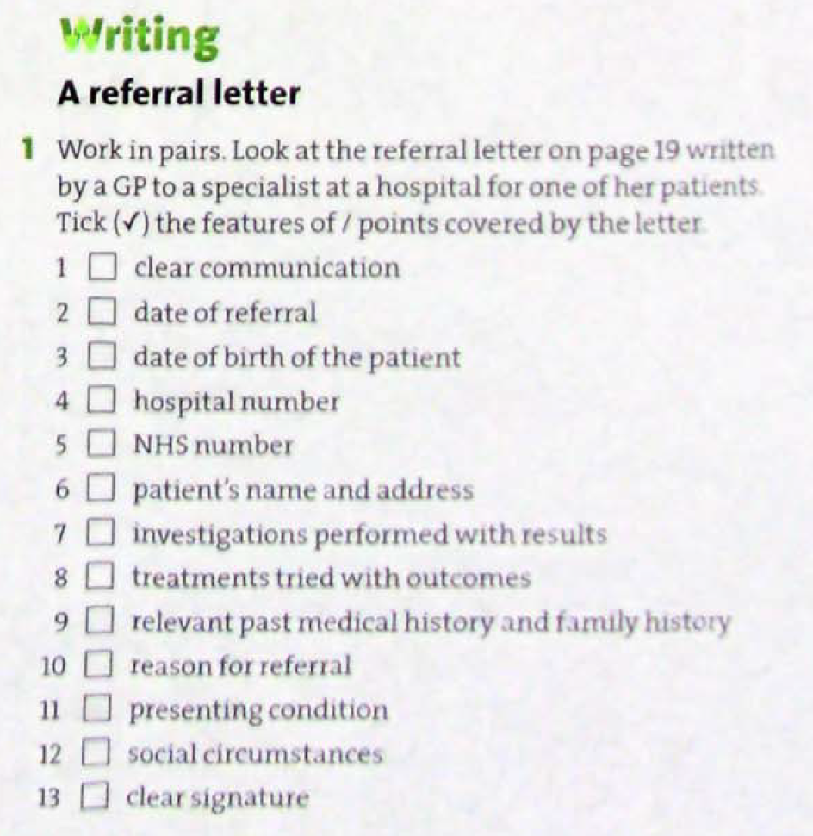

Next

Slide 48
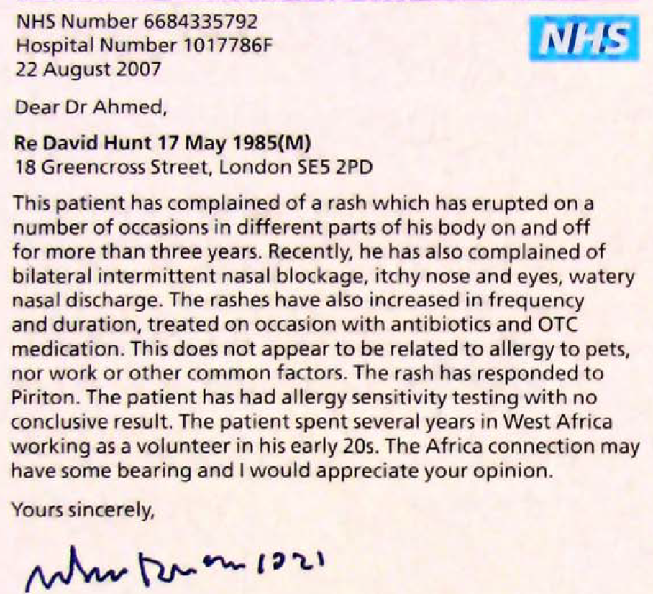
Back

