Slide 1
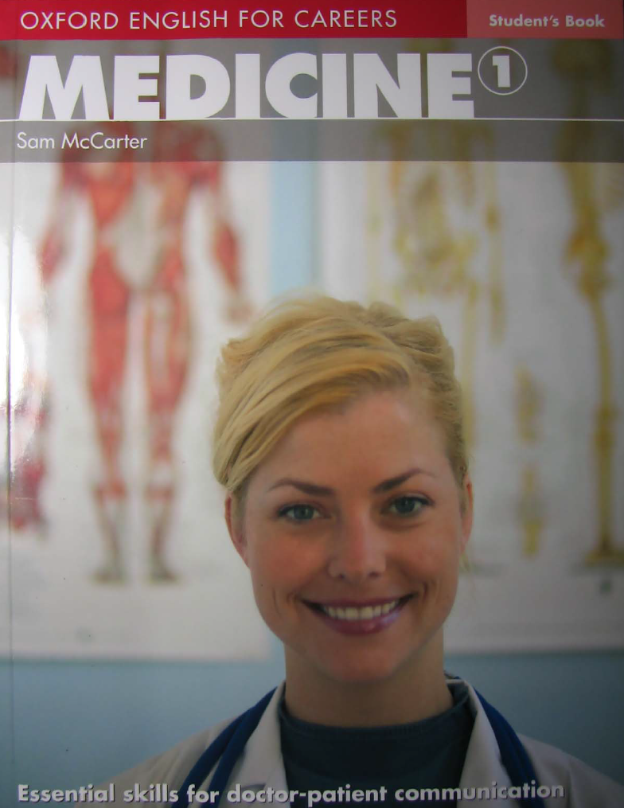
Liva Adil Shareef

Slide 2
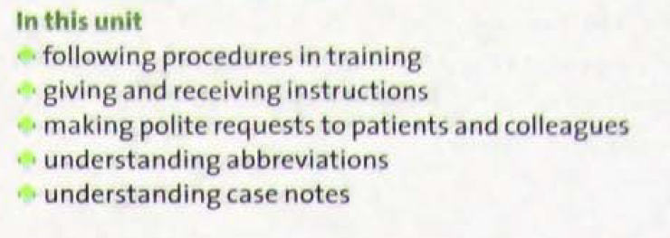
Unit 3
Instructions and Procedures
When it comes to talking to patients in a patient-centred environment, it is essential to take a gentle and indirect approach to fit in with the conventions of politeness in English. This is especially important when people are feeling vulnerable and perhaps ill at ease.

Slide 3
Specialist / Medical Specialist / Physician Specialist
Dermatologist: a doctor who studies and treats skin diseases.
Ophthalmologist: a doctor who studies and treats the diseases of the eye.
Obstetrician: a doctor who is trained in obstetrics (the birth of children).
Cardiologist: a doctor who studies and treats heart diseases.
Nephrologist: a nephrologist focuses on kidney care and conditions that affect the kidneys.
Otolaryngologist (ENT): a doctor who treats ear, nose and throat.
Neurologist: a doctor who studies and treats diseases of the nerves and brain.
Pediatrician: a doctor who studies and treats the diseases of children.

Slide 4
9. Psychiatrist: a doctor who studies and treats mental illnesses.
Oncologist: a doctor who studies and treats cancer in the body.
Radiologist: a doctor who is trained in radiology.
Rheumatologist: a doctor who diagnoses and treats rheumatic diseases.
Surgeon: a doctor who is trained to perform surgery.
Anesthesiologist: a doctor who studies the use of anesthetics.

Slide 5
Diseases, disorder, and symptoms
Diabetes: a medical condition which makes the patient produce a lot of urine and feel very thirsty.
Chickenpox: a diseases, especially of children, that causes a slight fever and many spots on the skin.
Malaria: a disease that causes fever and shivering caused by the bite of some types of mosquito.
Diarrhea: an illness in which waste matter is empties from the bowels much more frequently than normal.
Vomiting: to bring food from stomach back out through the mouth. Informal terms, throw up, bring sth up, puke.
Constipation: the condition of being unable to get rid of waste material from the bowels easily.

Slide 6
AIDS: Acquired Immune Deficiency Syndrome, caused by the Human Immunodeficiency Virus (HIV)
Down syndrome: a medical condition, caused by a fault with one chromosome, in which a person is born with particular physical characteristics and a mental ability that is below average.
Epilepsy: a disorder of the nervous system that causes to become unconscious suddenly, often with violent movements of the body.
Autism: a mental condition in which a person finds it very difficult to communicate or form relationships with others.
Infertility: the fact that a person or animal is not able to have babies.
Nauseous: feeling as if you want to vomit.
Chronic: lasting for a long time; difficult to cure or get rid of it.
Vein: any of the tubes that carry blood from all parts of the body towards the heart.
Artery: any of the tubes that carry blood from the heart to other parts of the body.

Slide 7
Paramedic: a person whose job is to help people who are sick or injured.
Optician: a person whose job is to examine people’s eyes and to recommend and sell glasses.
Physical therapy: the treatment of diseases, injury or weakness in the joints or muscles by exercise.

Slide 8
Eye chart: a chart used in measuring the sharpness of a person's vision, typically consisting of a number of rows of letters of decreasing size.
Eye drops: liquid medication to be applied in very small amounts to the eyeball.
Syrup: a sweet liquid made from sugar and water, often used in cans of fruit.
Ointment: a smooth substance that you rub on the skin to heal a wound or sore place.
Lotion: a liquid used for cleaning, protecting the skin.
Scales: an instrument for weighing people or things.
Palpitation: palpitations are feelings or sensations that your heart is pounding or racing.

Slide 9
In a training environment:
Insert the needle between…..
You insert the needle ……
Not impolite
Not impolite
When talking to patients:
Undress/ Take your clothes off
Could you take your clothes off, please?
Use:
Could you ……/ Can you..... ?
I’d like you to …..
I need you to …..,if you can.
impolite
polite

Slide 10
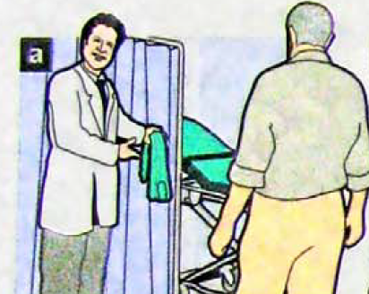
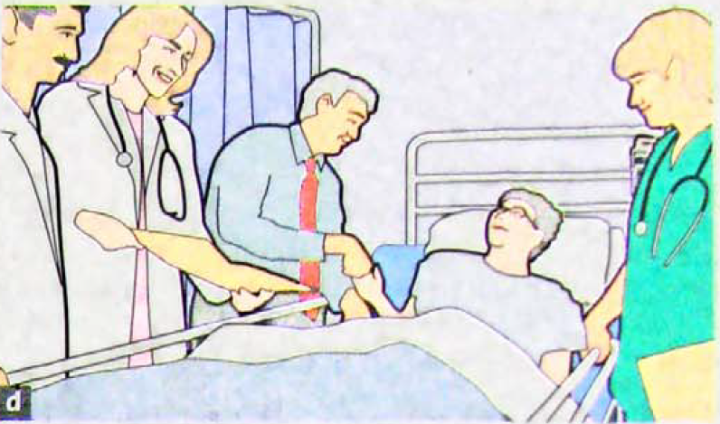
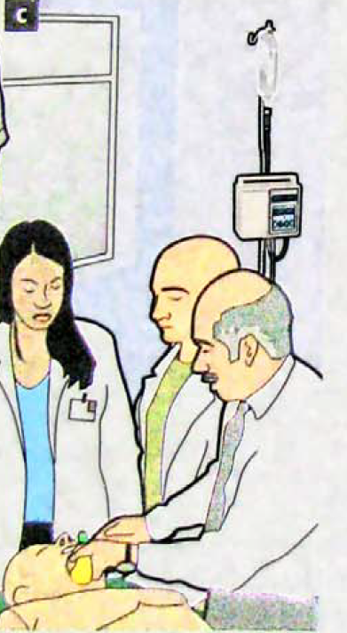
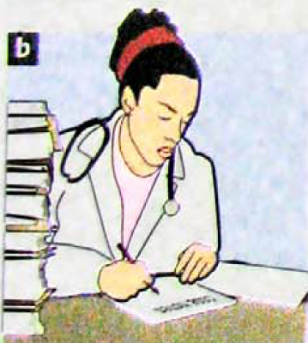
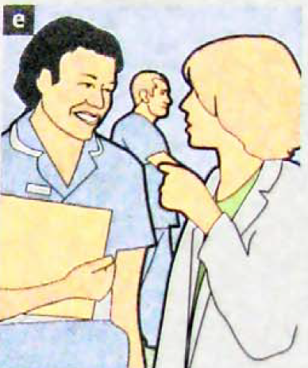
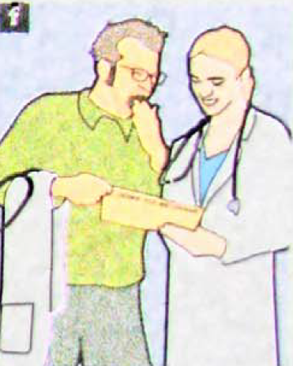
What pictures a-f have in common?
They all show a newly qualified/ junior doctor at work.

Slide 11
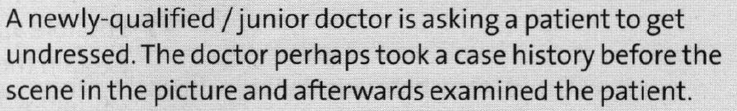
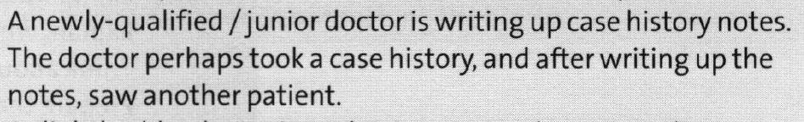
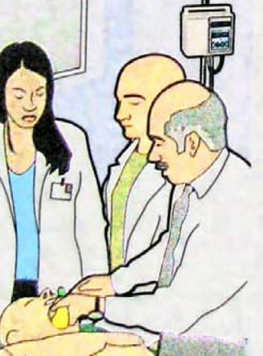
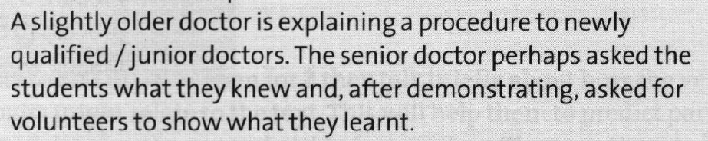
What is happening and what you think happens before and after each picture?

Slide 12
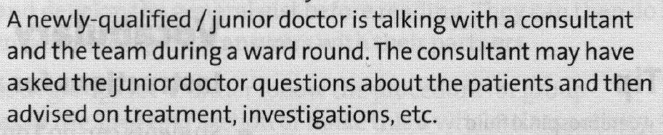
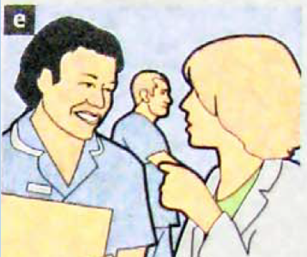
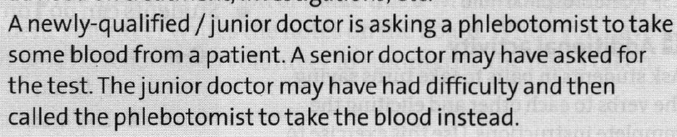
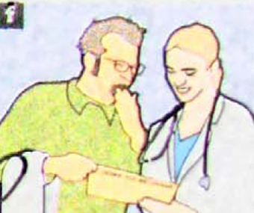
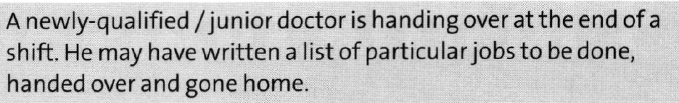

Slide 13

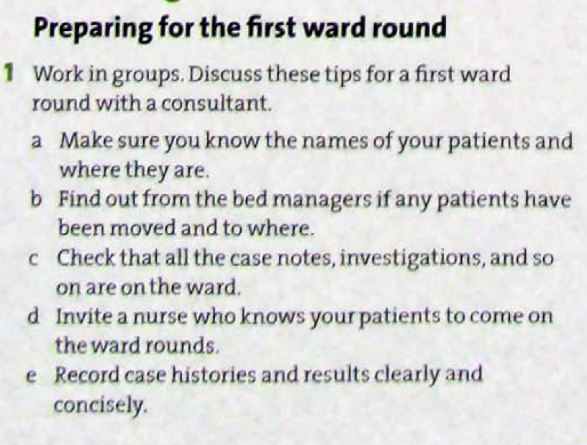

Slide 14
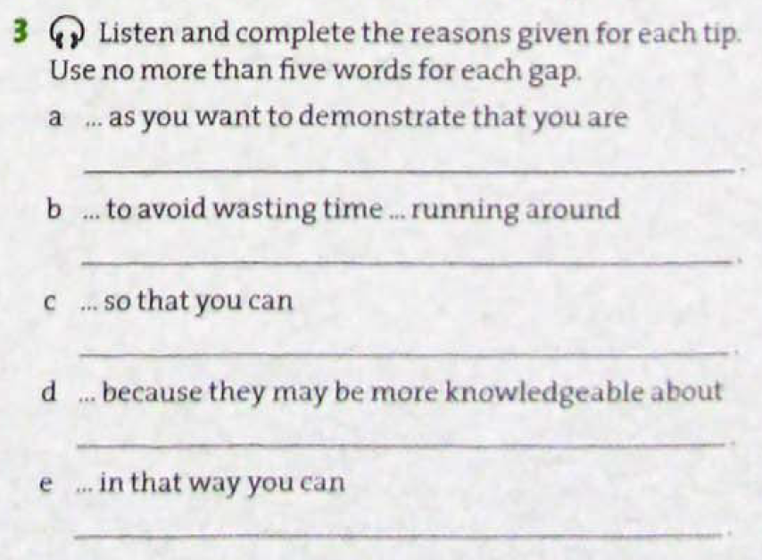






Slide 15
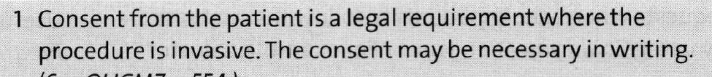
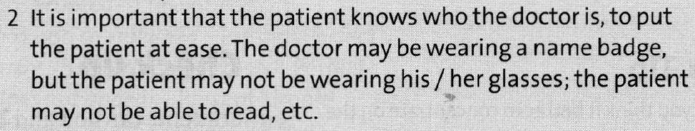
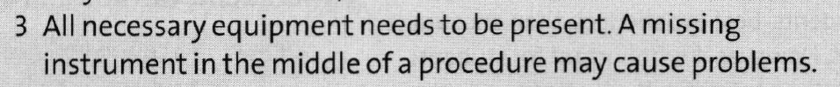
Patient care
Why do you need to do these things before you carry out a procedure?
Obtain consent from the patient for the procedure.
Introduce yourself.
Prepare the trolley
A cart or wheeled stand used for conveying something

Slide 16
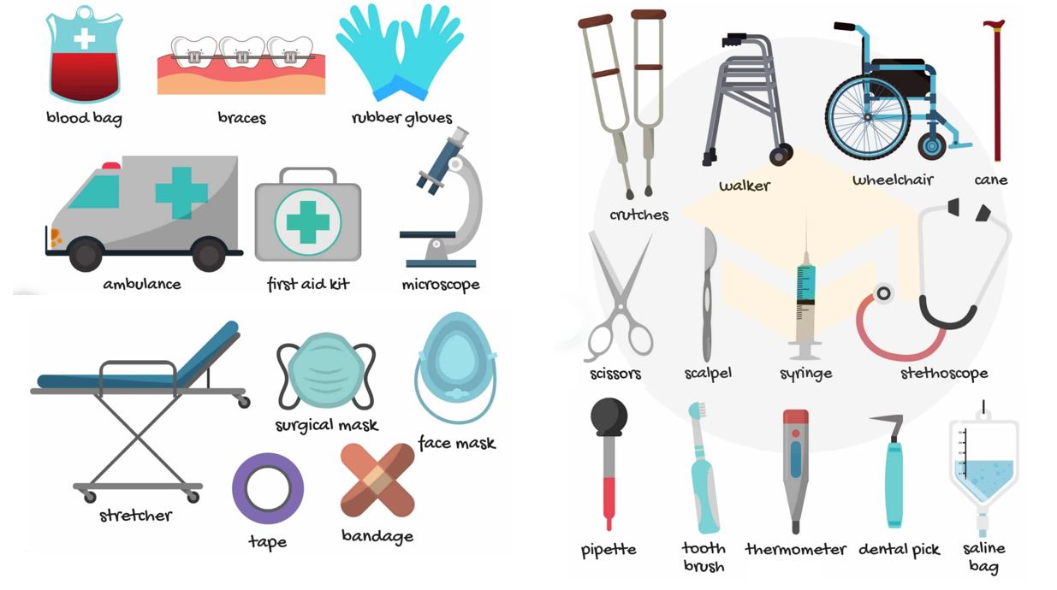

Slide 17
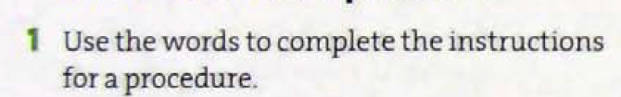
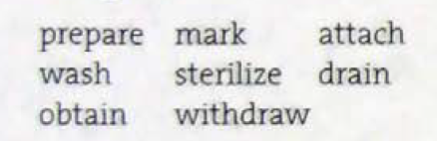

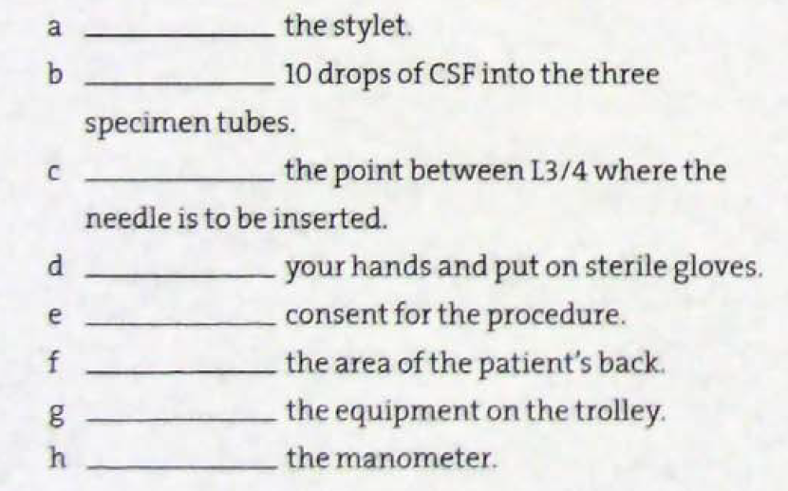


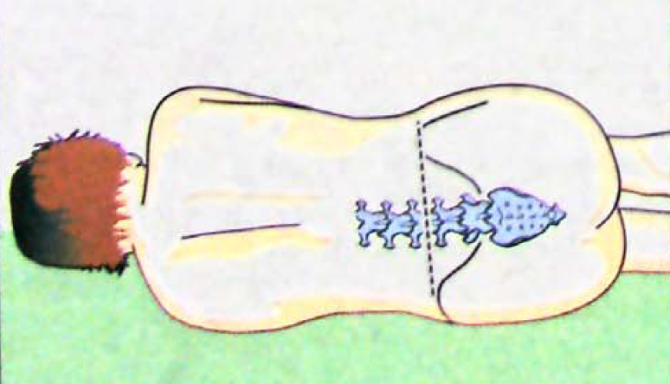





Introductions for a procedure
Cerebrospinal fluid
The procedure is lumbar puncture

Slide 18
Steps
Order | Action | Purpose
1 | Obtain consent | Legal/ethical requirement
2 | Wash hands | Prevent infection
3 | Prepare trolley | Set up all equipment
4 | Mark site | Identify correct needle insertion location
5 | Sterilize back | Aseptic technique
6 | Insert needle | Begin the lumbar puncture
7 | Withdraw stylet | Allow CSF to flow
8 | Attach manometer | Measure CSF pressure
9 | Drain CSF | Collect fluid for analysis

Slide 19
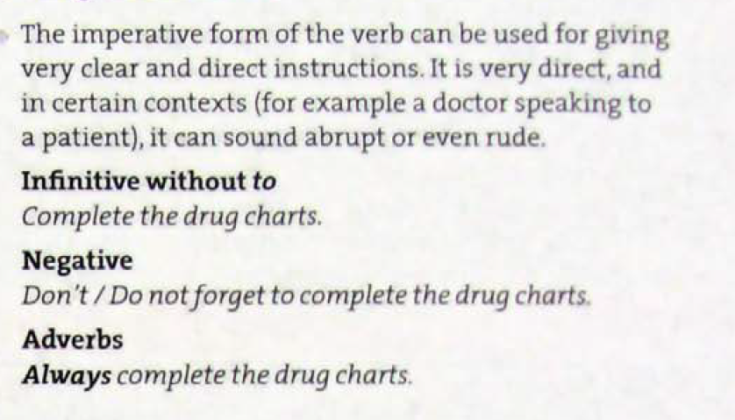
Language spot
Giving instructions

Slide 20
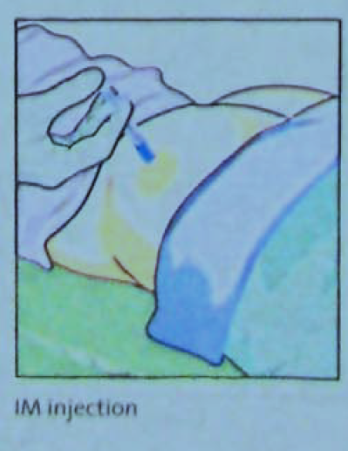
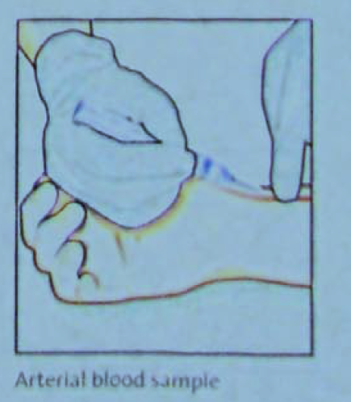
Intramuscular(IM) injection is a technique used to deliver a medication deep into the muscles. This allows the medication to be absorbed into the bloodstream quickly.

Slide 21
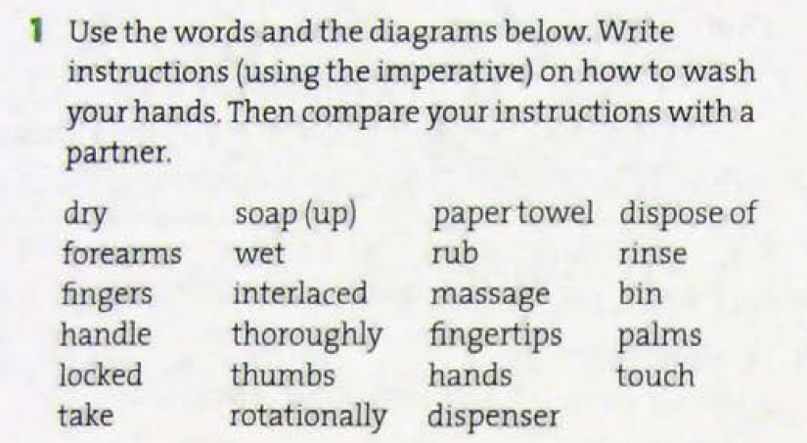
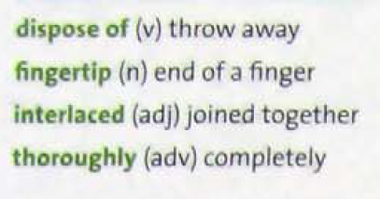
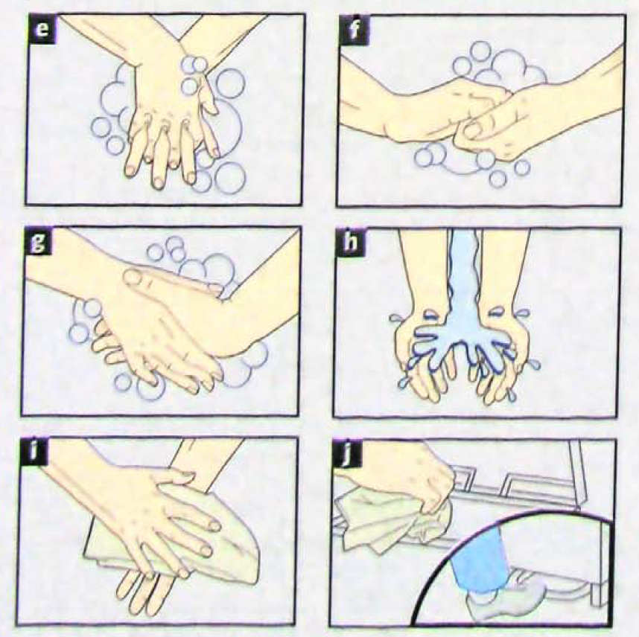
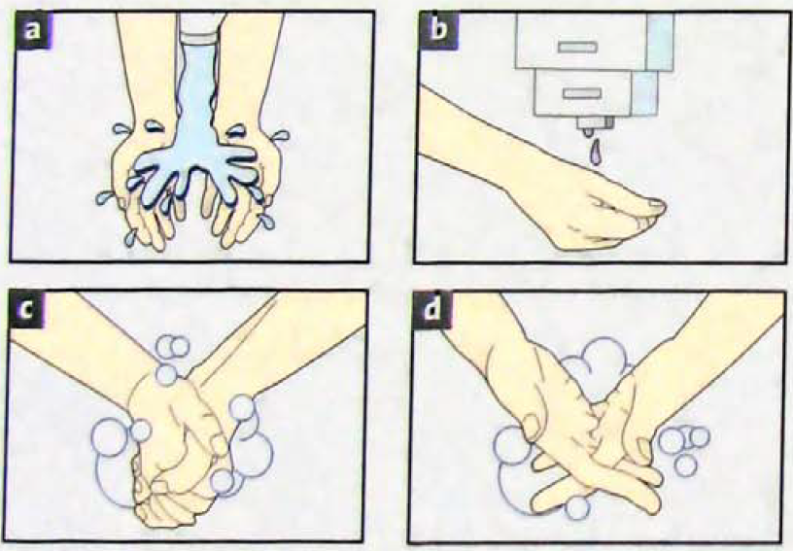

Slide 22
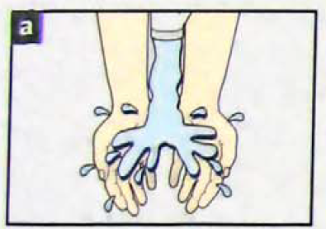
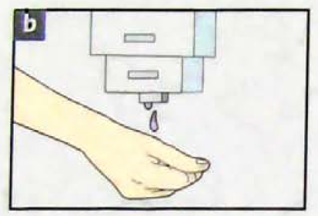

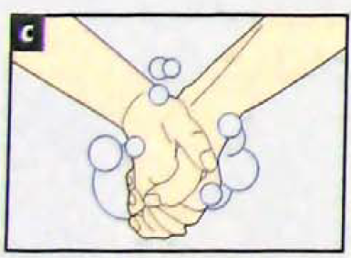

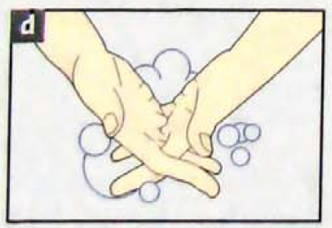

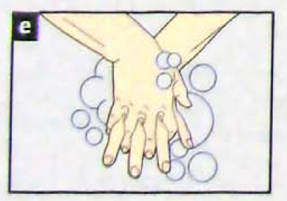
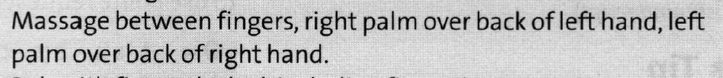

Slide 23
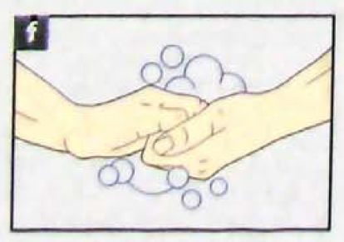
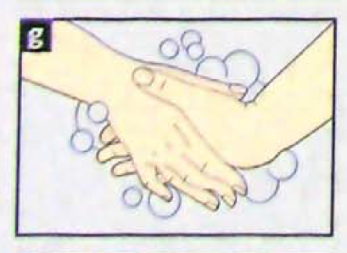
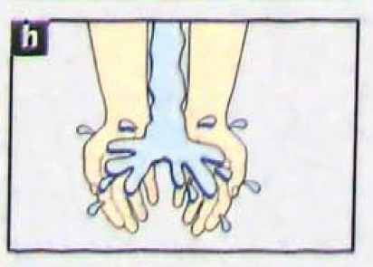

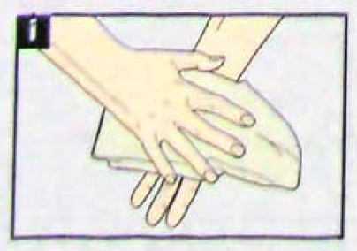
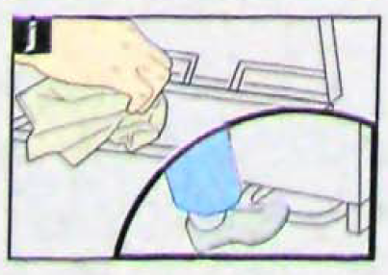
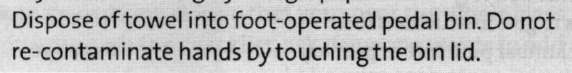

Slide 24
Discuss this text with your friend.
Controlled studies in hospitals have followed health care workers with video cameras through their daily routines. Many health care professionals actually do not wash their hands and, surprisingly, doctors were the worst offenders. Up to 50% of doctors do not wash their hands in between patients.
Is hand washing always necessary? When and why do you think it is necessary?

Slide 25
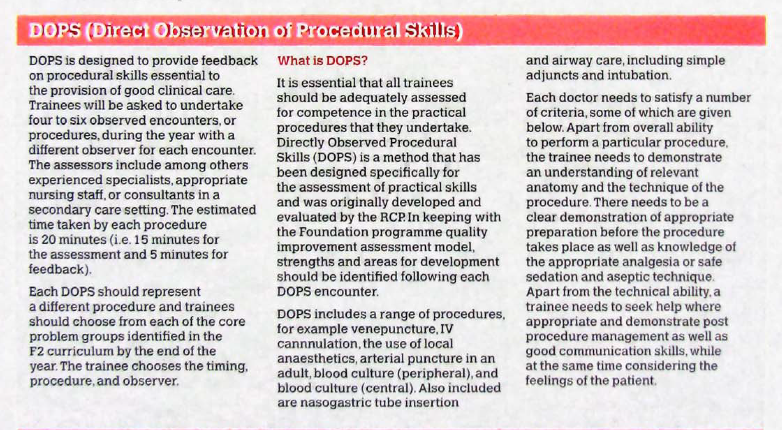
Read the text and do activity 1,2,3 and 4 at home.

Slide 26

1. Underline the noun which you think will follow the verb in the text.
1 provide
feedback food information data
2 Undertake
searches procedures surveys investigations
3 assess
theory attitude competence cost
4 identify
people strengths patients places
5 administer
medications help business punishment
6 seek
property keys time help
7 consider
feelings age reason cost

Slide 27
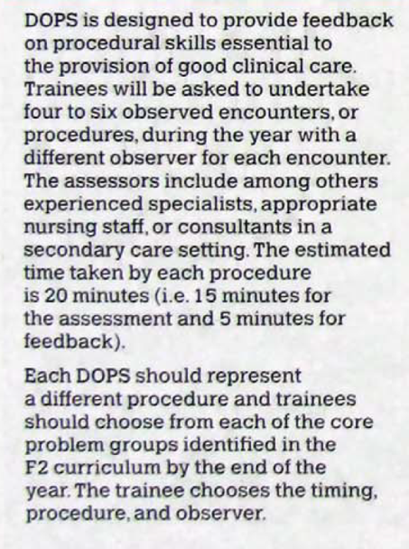
​a person who is being taught how to do a particular job
to make yourself responsible for something and start doing it
A health care contact between the patient and the provider who is responsible for diagnosing and treating the patient.

Slide 28
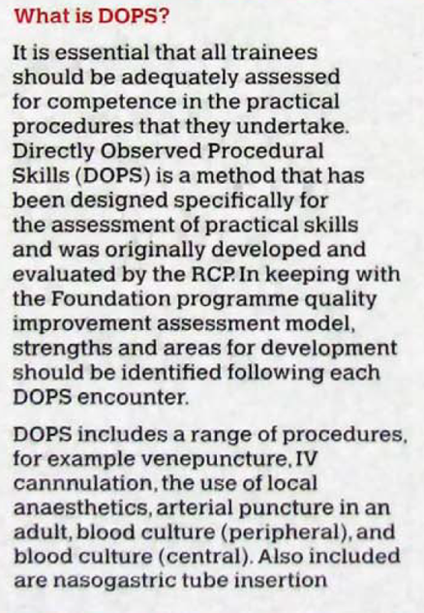
to a satisfactory or acceptable extent.
the puncture of a vein as part of a medical procedure, typically to withdraw a blood sample or for an intravenous injection.
Intravenous (IV) cannulation
Local anesthesia, also called local anesthetic, is usually a one-time injection of medicine that numbs a small area of the body.
is a special tube that carries food and medicine to the stomach through the nose.

Slide 29
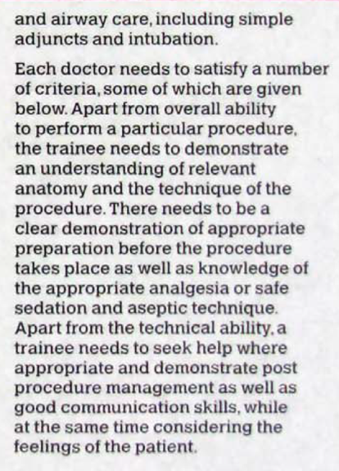
A thing joined or added to another thing, which is not an essential part thereof
is a process where a healthcare provider inserts a tube through a person's mouth or nose, then down into their trachea (airway/windpipe).
the inability to feel pain.
is medically induced temporary depression of consciousness prior to procedures that cause pain or discomfort to patients
preventing infection

Slide 30



Slide 31
What is DOPS?
DOPS is a method used to give medical trainees feedback on how well they perform important clinical procedures. The purpose is to improve their skills and ensure they can do these procedures safely and correctly.
Each trainee must perform 4 to 6 procedures throughout the year.
Each procedure must be observed by a different supervisor, such as a senior doctor or experienced nurse.
One DOPS session takes about 20 minutes: 15 minutes for watching the procedure, 5 minutes for giving feedback

Slide 32














Listen. Match each instruction with a picture.

Slide 33

What procedure is shown in the picture?
Intravenous (IV) cannulation
It is a technique in which a cannula is placed inside a vein to provide venous access.

Slide 34



Make a list of instructions you would give a patient to carry out the whole procedure.

Slide 35

Language spot
Making polite requests to patients
Use can / could to make the instruction gentler by changing it into a request.

Slide 36
Can you (just) + infinitive without to +(please)?
Can you just clench your fist, please?
Could you just clench your fist for me, please?
You can also use if you can/ could you just
+ infinitive without to + (please)

Slide 37


Slide 38


you just pop behind the
could turn onto your tummy
you to stand up for me
you just tilt your
make a
‘d like you to keep nice and

Slide 39

Read the text and answer the question.

Slide 40

To go to somebody for help
A doctor who is receiving advanced training in a specialist field of medicine in order to become a consultant .
A regular visit to patients in hospital by medical staff for the purpose of making decisions concerning patient care
The directing of a patient to a medical specialist by a GP.
To make yourself responsible for something and start doing it
A job that prepares a person for a more senior or more specialized position; a traineeship.

Slide 41

​very busy; full of activity
An informal and unpaid 2–4 month work placement carried out at a hospital, in which a person (junior doctor, medical student or other) shadows a doctor, usually a consultant.
The act of taking a full history, a physical examination and documentation in the patient's notes.
to work closely with somebody and exchange information with them
involving several different subjects of study
a person who is the same age or who has the same social status as you

Slide 42



1. a firm
2. two senior doctors
3. specialist registrars (SpR)
4. specialist registrars (SpR)
5. the consultant
6. the consultant’s rounds
7. the junior doctor

Slide 43



Ward Round
road traffic accident
road traffic collision
observation
temperature
blood pressure
on examination
International normalized ratio
Liver function test
Urea and electrolytes
Home
Tomorrow morning
Out-patient in 6 weeks

Slide 44
Thanks for your attention

