Slide 1

Workbook answer key / Starter
Zainab Nizar Karam
Advanced English - ELT 203/I
2024 – 2025
First Semester
Week 2

Slide 2

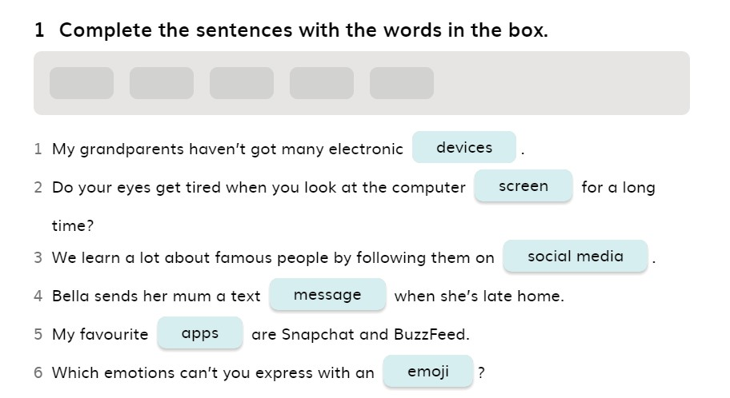
T◤echnology 1 page 4

Slide 3
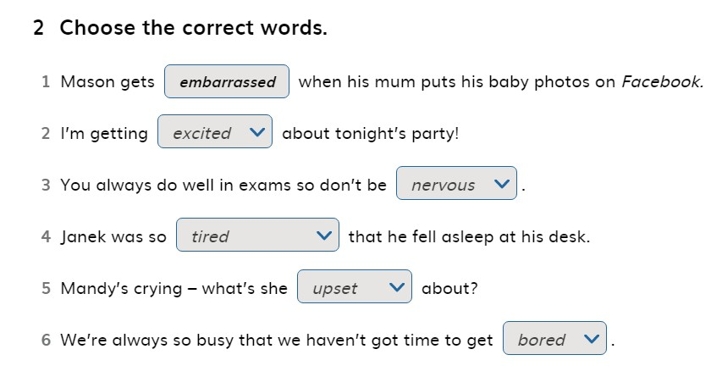
Ex.◤ 2 Page 4

Slide 4
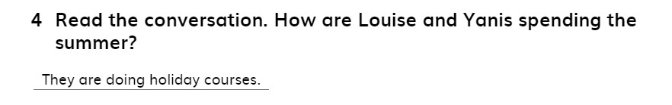
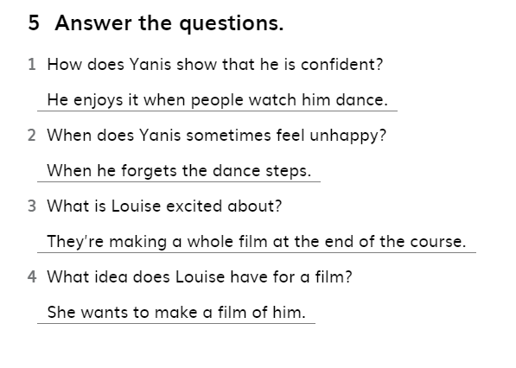
Ex. 4 & 5 Page ◤4

Slide 5
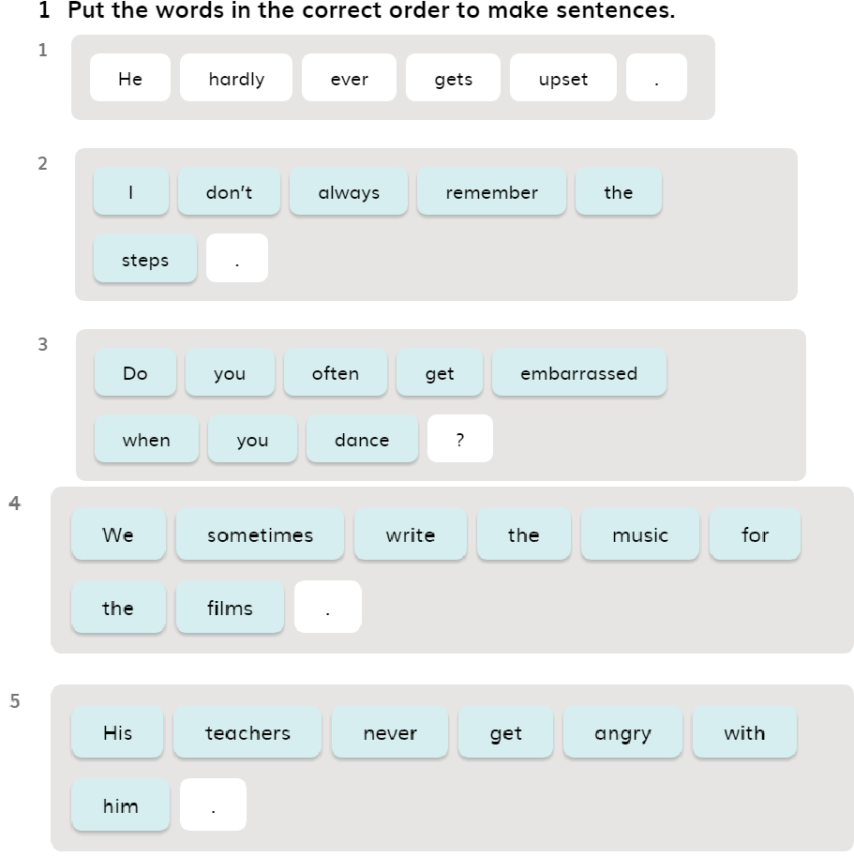
Ex. 1 Page 5
◤

Slide 6
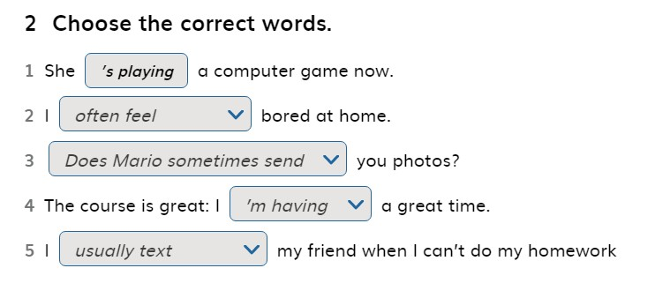
Ex. 2 Page 5
◤

Slide 7
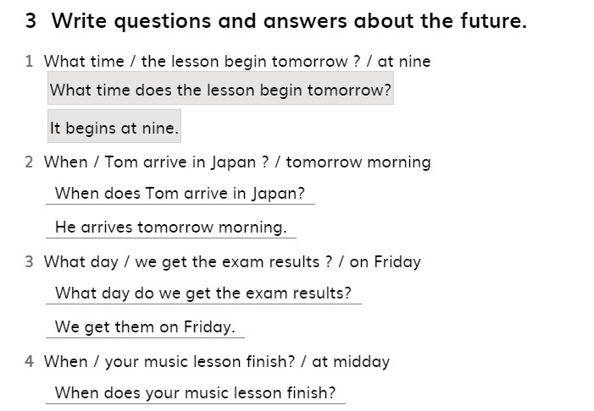
Ex. 3 Page 5
◤

Slide 8
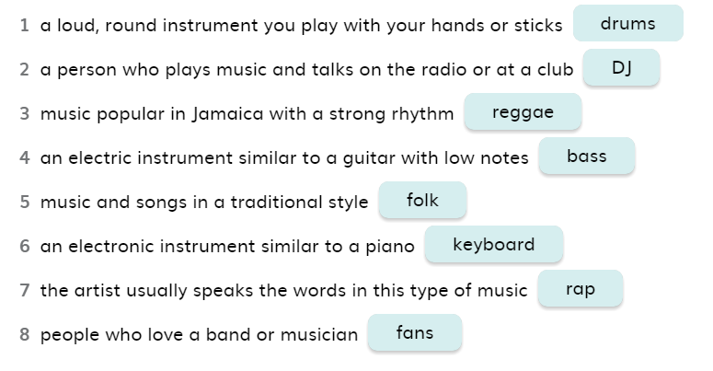
Ex. 5 Page 5
◤

Slide 9
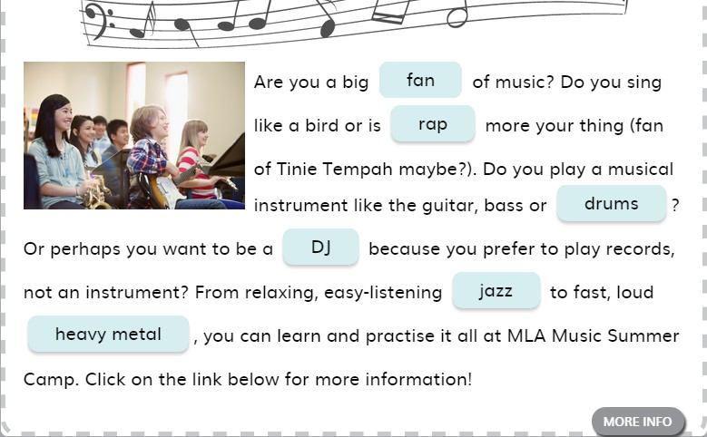
Ex. 6 Page 5
◤

Slide 10
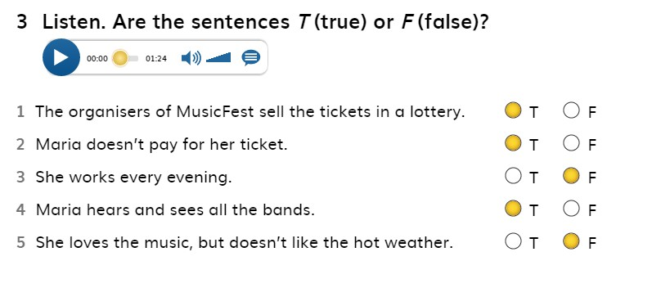
Ex. 3 Page 6
◤

Slide 11
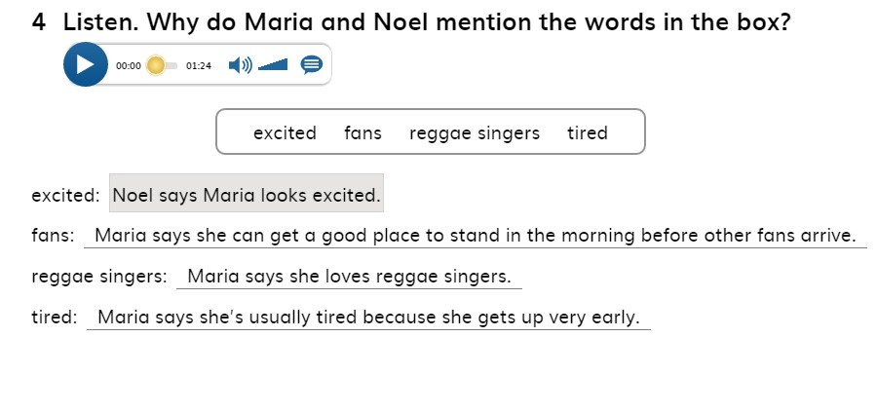
Ex. 4 Page 6
◤

Slide 12
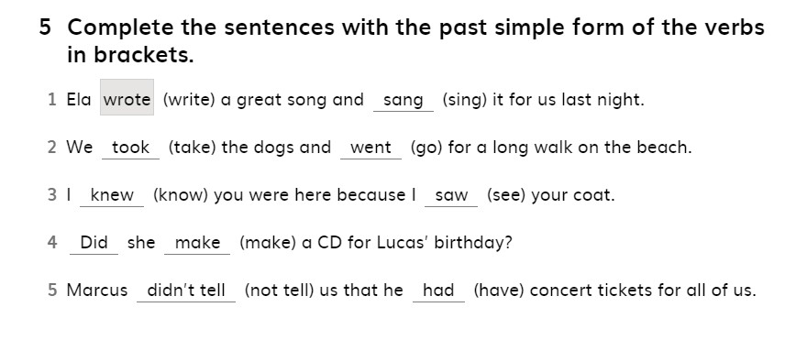
Ex. 5 Page 6
◤

Slide 13
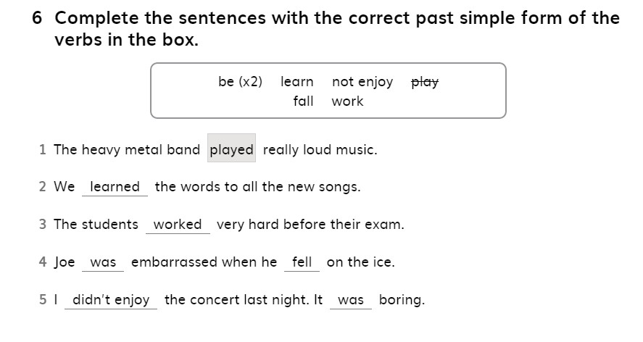
Ex. 6 Page 6
◤

Slide 14
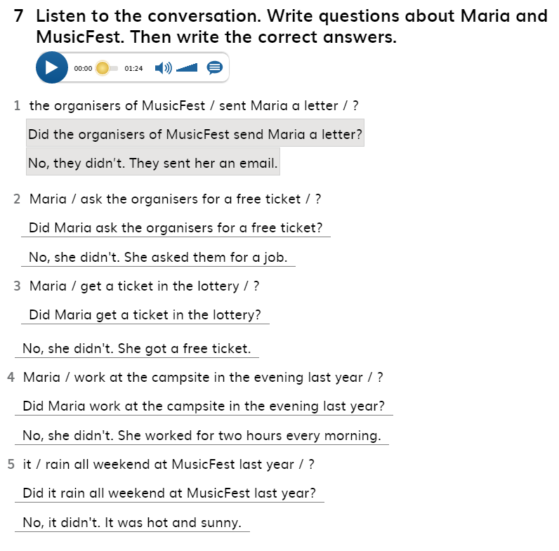
Ex. 7 Page 6
◤

Slide 15
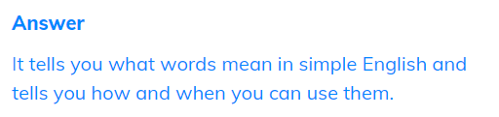
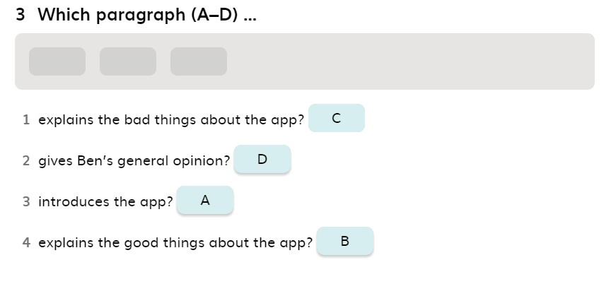
Ex. 1 Page 7
◤
Ex. 3 Page 7

Slide 16
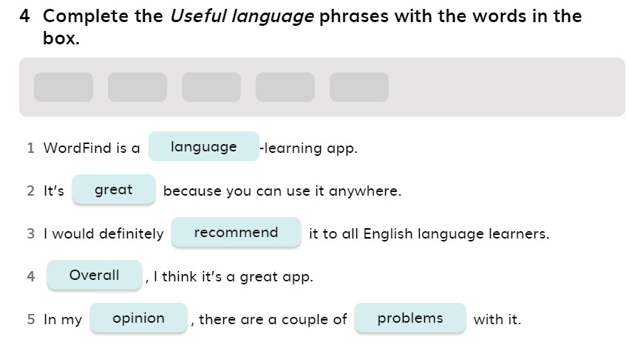
Ex. 4 Page
◤

