Slide 1

Unit One
Zainab Nizar Karam
Advanced English - ELT 203/I
2024 – 2025
First Semester
Week 3

Slide 2

Outline
Vocabulary
Describing people
Language in action
Past simple and past continuous with ( when, while, and as)
Vocabulary
Phrasal verbs
Language in action
Used to
Speaking and pronunciation
Interviewing someone
Writing
A letter to a magazine

Slide 3
Objectives:
Describe people’s personality and characters which eventually enhances communication skills, allowing individuals to more accurately and effectively express thoughts, opinions, and observations about others.
Identify and differentiate when to use past simple and past continuous with when, while and as.
Express past habits with the use of “ used to’ which enables the learners to describe actions or situations that were regularly experienced in the past, but no longer occur.
Identify the characteristics, experience, and the contribution of the students’ inspiring person, as well as developing critical thinking and writing skills.

Slide 4
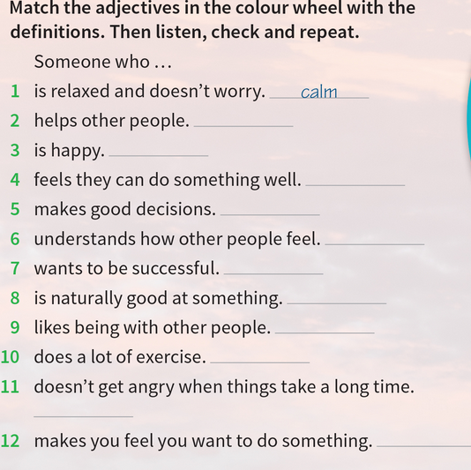
Describing People
Helpful
Cheerful
Confident
Sensible
Sensitive
Ambitious
Talented
Sociable
Active
Patient
Inspiring

Slide 5
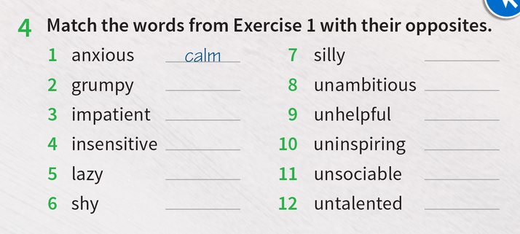
Opposites
Sensible
Cheerful
Ambitious
Patient
Helpful
Sensitive
Inspiring
Active
Sociable
Confident
Talented

Slide 6
-ed and –ing adjectives:
-ing adjectives are used to describe someone or something. (interesting, exciting, annoying, amazing)
-ing adjectives are used for describing people and things
They are very annoying children.
It is a boring program
–ed adjectives are used to express how we feel, or how others feel. (interested, excited, annoyed, amazed)
- ed adjectives used only for people
He is bored.
I am excited about the new advanture.

Slide 7
Exercise:
I felt ……………….. during the lecture. (bored/boring).
They were ……………….. about the trip. ( excited/exciting).
The lecture was ………………… (bored/boring)
The instructions were ………………….. (confused/confusing).
The teacher was ………………. by our answers. (amazed/amazing).
The ending of the movie was very ……….. The audience were shocked. (surprised/surprising)
bored
excited
boring
confusing
amazed
surprising

Slide 8
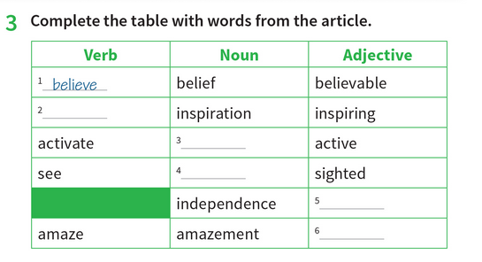
Parts of speech
inspire
activity
sight
independent
amazing

Slide 9
Parts of speech:
It is crucial to know which part of speech of a word we need to use for each sentence. For example, nouns can be at the beginning or end of a sentence, while verbs follow the subject. Check out the following examples:
I ………………. my Facebook account last week ( activated/ activation)
Your bank account needs ………………………. (activate/ activation).
I cannot ……………anything in the dark. (see / sight)
He lost his ………………….when he was a baby. (see/ sight)
activated
activation
see
sight

Slide 10
Past simple and past continuous (as, while, when)
Past simple: is used for activities happened and finished in the past.
I graduated from university last year.
They passed their exam successfully.
Past continuous: is used with activities which were in progress in the past.
I was preparing some questions last night.
He was sleeping for a long time.

Slide 11
Past continuous
Positive sentence:
Sub + was /were + (v.ing) …
+ She was teaching them a new topic.
Negative sentence:
Sub. + wasn’t / weren’t + (v.ing) …
- I wasn’t conducting a new study.
Yes/no-question
Was/Were + Sub. + (v.ing) … ?
? Were they preparing a new presentation?
Wh-question
Wh + was / were + Sub. + (v+ing) … ?
? where were you spending the new year’s eve?

Slide 12
While , When, As
While + past continuous
The student entered the class while I was explaining the lesson.
As + past continuous
As he was leaving the court, a group of photographers gathered around her.
When + past simple / past continuous ( we must focus on the verb following (when).
In case of any interruption in the sentence, we have to focus very well.
If “when” is followed by the shorter action, then it will be in the past tense.
But if “when” if followed by the longer action, then it will be in the past continuous tense.
The girl was driving her car when her friends saw her.
When he was running in the park, he saw his friend fighting with some people.

Slide 13
Past simple or past continuous?
If we have two actions in the past, we need to focus on the following situations:
One action was in progress (longer action), and the other one is shorter and interrupts the longer action, the longer action will be in the past continuous, and the shorter action will be in the past simple.
Two actions were in progress at the same time with no interruption, both actions will be in the past continuous.
The actions are happening after each other, all actions will be in the past simple.

Slide 14
Examples
While I ………………….. (run) in the park, I ………………. (fall) and ………………..(break) my leg.
We ………………….. (walk) to the store when we …………… (see) a dog.
…………….you ………………..(speak) in English as you ………………… (walk) into the class.
When my parents ………….. (call), I ………………..(dig) the garden.
was running
fell
broke
were walking
saw
Were
speaking
Were walking
called
was digging

Slide 15
Phrasal verbs
Hang out: spend time relaxing.
Take care of: look after.
Get on with: have a good relationship with.
Look up to: admire.
Depend on: need someone’s help.
Deal with: manage to do.
Give up: stop trying.
Cheer up: make someone feel happier.

Slide 16
Used to
We use “used to” to talk about repeated action in the past that we stopped doing them in the present time.
I used to visit them every summer when I was a kid.
He used to smoke heavily last year.
The students used to be late to their classes.
We don’t use “USED TO” for actions that happened only one time in the past.
He graduated last year.
They moved to Spain two months ago.

Slide 17
Sentence formation with used to
Positive sentence:
Sub. + used to + V. base …
I used to drive fast when I was younger.
Negative sentence:
Sub. + didn’t use to + V. base …
We didn’t use to listen to rock music.
Yes/no-questions:
Did + Sub. + use to + V. base … ?
Did you use to watch horror movies?
Wh-questions:
Wh + did+ Sub. + use to + V. base … ?
Where did you use to spend your summer holidays?

Slide 18
Interviewing Someone
Everyday English
1. Think someone did a good thing: Good for (her/you/him ….)
2. Tell someone it is o to start: Go ahead.
3. Agree with someone: I’m with you there.
4. Introduce a problem: the thing is …

Slide 19
Writing
A letter to a magazine
In this part students are required to write a letter to a magazine about an inspiring person who, according to their opinion, deserves to participate in the magazine’s competition.
The writing must be divided in to three paragraphs.
The first paragraph includes the name of the inspiring person.
The second paragraph includes the inspiring person’s deeds that make him inspiring to others.
The Third paragraph why should this person win the competition.

Slide 20
Useful language and tips for writing:
Make sure to organize your writing in three paragraphs.
Try to include the adjectives that we used in this unit, which are used to describe the personality of people, such as, talented, confident, inspiring, patient, social …etc (check slides no. 4+5, also check the book p. 11)
Also, use the phrasal verbs that we learnt, such as, look up to, depend on, cheer up, look after, deal with …etc. (check slide 15, also check the book p. 14)
Moreover, don’t forget to use some important expressions, such as:
for me, ….
in my opinion, ….
Personally, I think …….

Slide 21
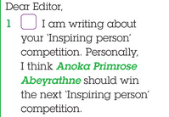
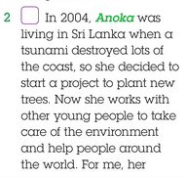
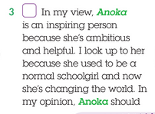

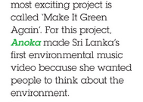
1. Who should win the competition
2. What inspiring things does this person do?
3. Why do you think she should win ?

Slide 22
Cause and effect
Identifying something happened (the cause) and what happened (the effect) can improve your reading.
We use so to show the effect of something.
I feel sick , so I need to see the doctor.
The cause
The effect

Slide 23
Exercise:
couldn’t afford the car he likes.
was ready to publish it.
got high marks.
called the police.
She didn’t feel safe so she …………………………………..
The student finished his report so he ………………………….
the man didn’t have enough money, so he ………………………………….
She dedicated all her time for studying , so she ………………………………
called the police
was ready to publish it.
couldn’t afford the car he liked
got high marks

Slide 24
Adjectives + preposition
Interested in
I am interested in horror movies.
Good at
The boy is good at playing football.
Tired of
She is tired of repeating the same thing every day.
Proud of
I am proud of my achievements.
Excited about
The students are excited about the summer holiday.

