Slide 1

Unit Two
Zainab Nizar Karam
Advanced English - ELT 203/I
2024 – 2025
First Semester
Week 6

Slide 2

Outline:
Vocabulary
Visual and performing arts
Making nouns for people
Language in action
Present perfect with regular and irregular verbs
Vocabulary
Music and theater
Language in action
Present perfect with already, just, still and yet
Speaking
Describing a picture
Writing
A review
The art project

Slide 3
Objectives:
Understanding texts about artists and an audition.
Understanding the use of present perfect for experiences and the use of already, just, still and yet.
Recognize noun endings for people.
Differentiating between visual arts and performing arts.
Defining and categorizing words related to music and theatre.
Gathering information from reliable online sources.
Writing about unusual performances.
Writing artists profile and describing pictures and the embedded meaning behind them.

Slide 4
Sculpture: the art of forming solid objects that represent a thing, person, idea, etc. out of a material such as wood, clay, metal, or stone.
Contemporary dance: is a style of Concert Dance, or dance intended to be performed for an audience, that incorporates elements of Modern Dance, Ballet, Jazz, as well as various other dance styles.
Illustration: a picture in a book, magazine, etc. or the process of illustrating something.
Architecture: the art and practice of designing and making buildings.
Street art: is visual art created in public locations for public visibility.

Slide 5
Gallery: a room or building that is used for showing works of art, sometimes so that they can be sold.
Exhibition: an event at which objects such as paintings are shown to the public, or the act of showing these things.
Musical theatre :is a form of theatrical performance that combines songs, spoken dialogue, acting and dance.
Performance: an act of presenting a play, concert, or other form of entertainment.
Fashion design: is the ideation and creation of apparel, accessories, and shoes.

Slide 6
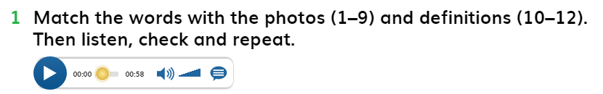
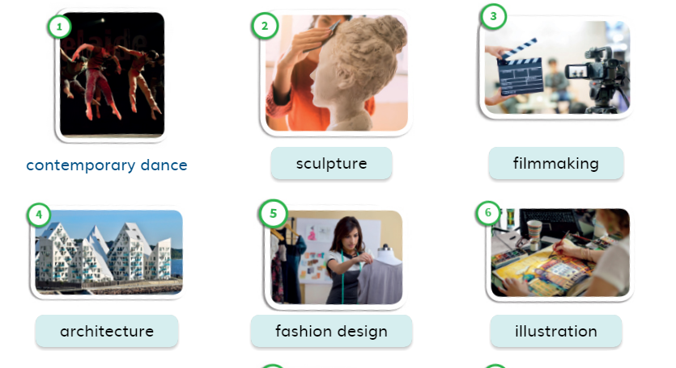
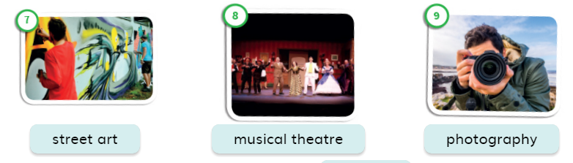

Slide 7
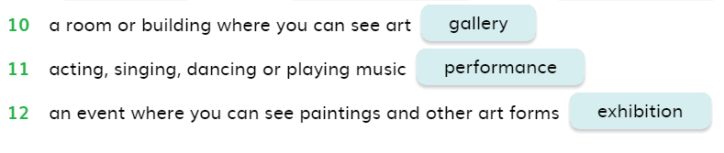
Ex.1 Page 23

Slide 8
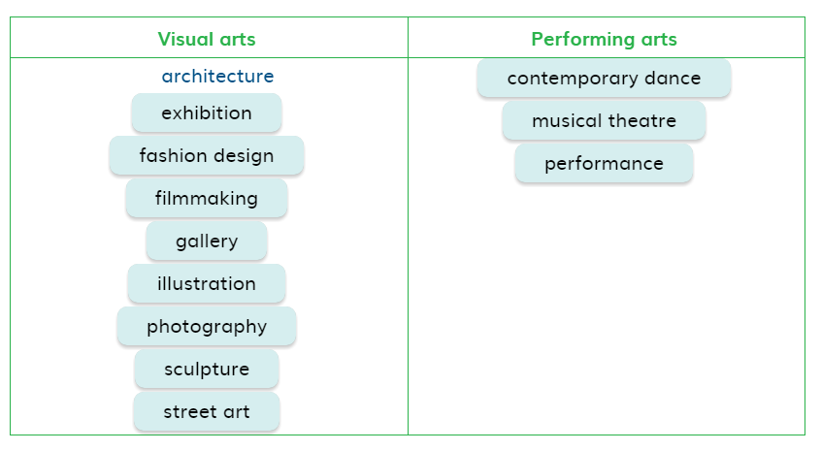

Slide 9
Making nouns for people P. 23
In the previous slide we mentioned some activities related to art. We can refer to the people who perform these activities by adding –er, -or, -ist to these activities as the following:
Filmmaking ___ filmmaker.
Illustration ____ Illustrator.
Art __________ artist.

Slide 10
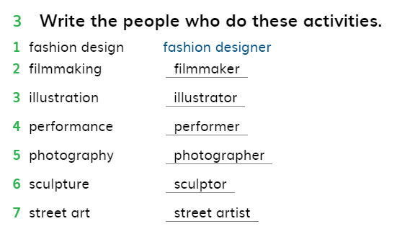

Slide 11
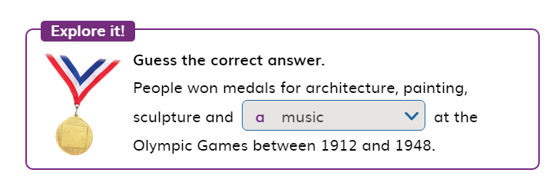

Slide 12
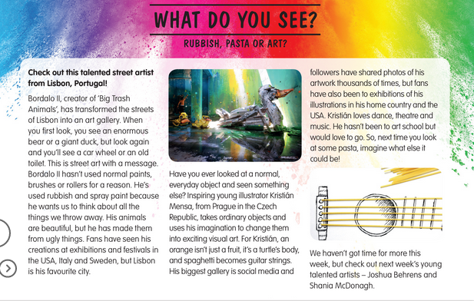
Reading page 24

Slide 13
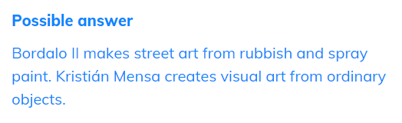
Ex.1 Page 24

Slide 14
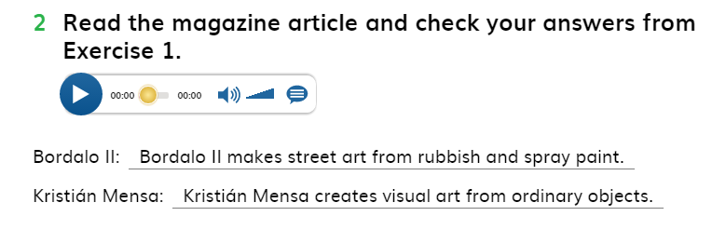
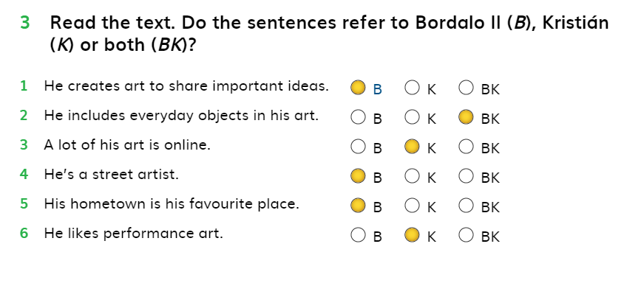

Slide 15
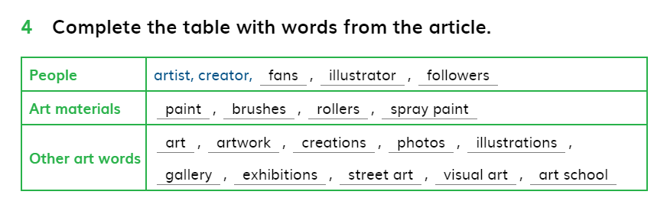

Slide 16
Present perfect with regular and irregular verbs
We use the present perfect to talk about our experience happened in the past without mentioning the exact time.
Affirmative form of present perfect
Sub + has/have + pp (past participle/ 3rd form of the verb)
I have been to Dubai.
She has seen that movie before.
The teacher has explained this topic earlier.

Slide 17
Negative sentences with the present perfect
Sub + hasn’t /haven’t + PP
The girl hasn’t arrived yet.
I have never cheated in my exams.
The teacher hasn’t checked the papers yet.
My friends haven’t finished their final exams.

Slide 18
Questions with the present perfect
Yes/no-Questions
Has / Have + sub + ever + pp … ?
Have you ever met a celebrity? Yes, I have. / No, I haven’t.
Has your friend ever annoyed you? Yes, she has. / No, she hasn’t.
Wh- Questions
Wh + has/have + sub + ever + pp … ?
What have you done during your summer holiday? I have travelled.
Where have you been? I have been to school.

Slide 19
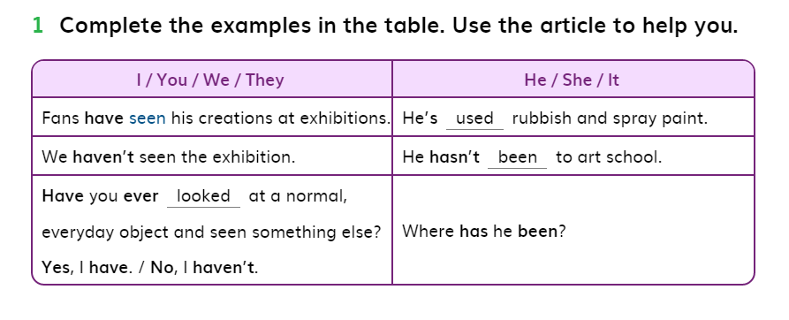
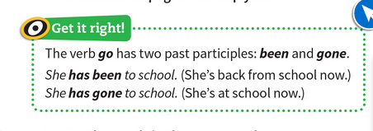
Ex.1 Page 25

Slide 20
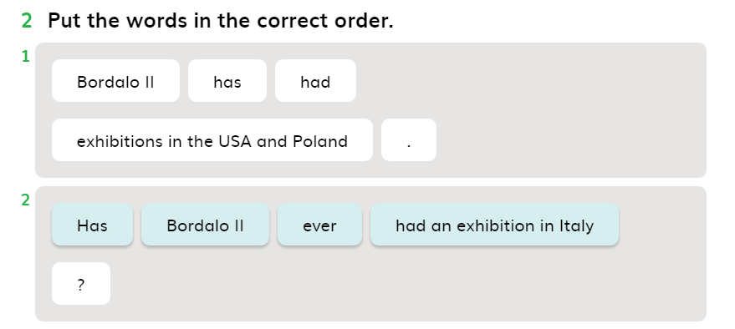
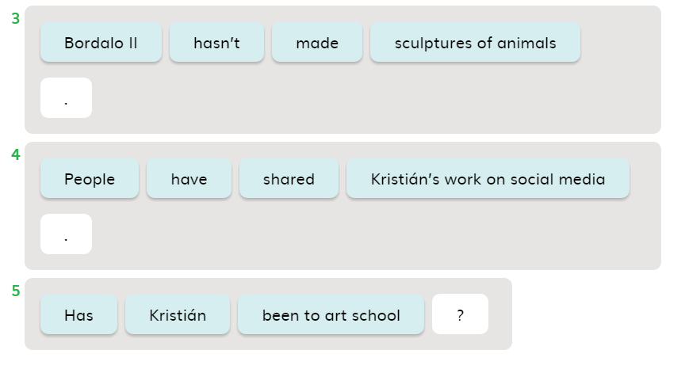

Slide 21
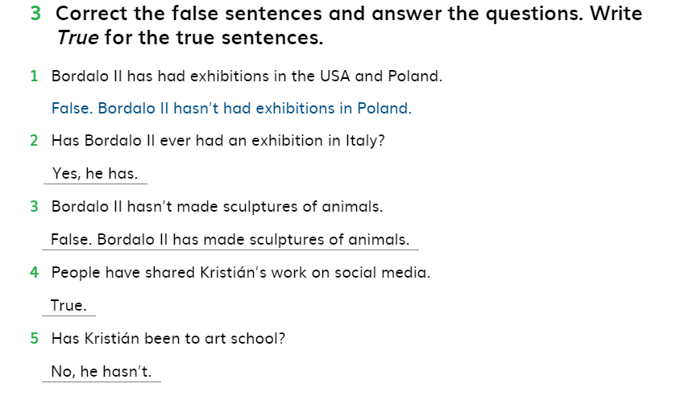

Slide 22

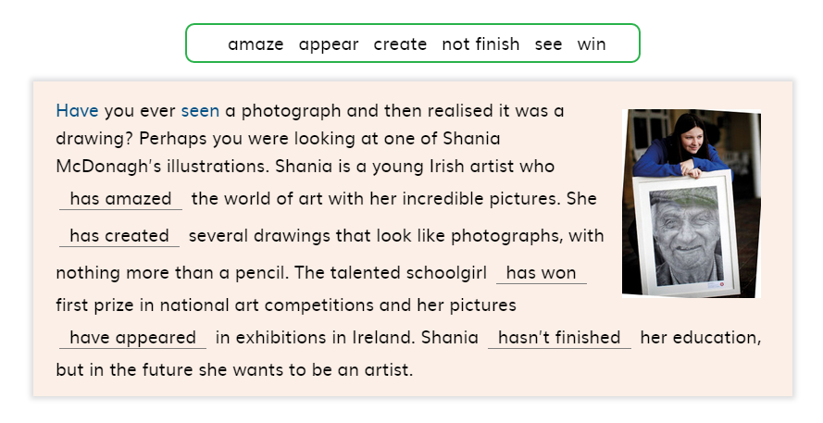

Slide 23
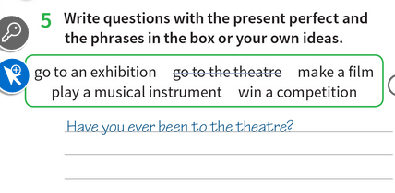
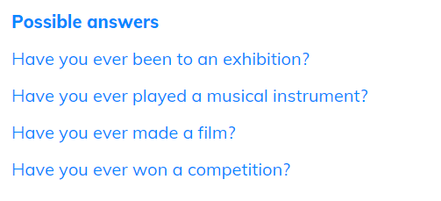

Slide 24
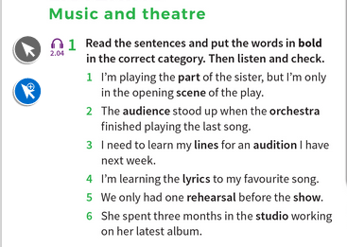
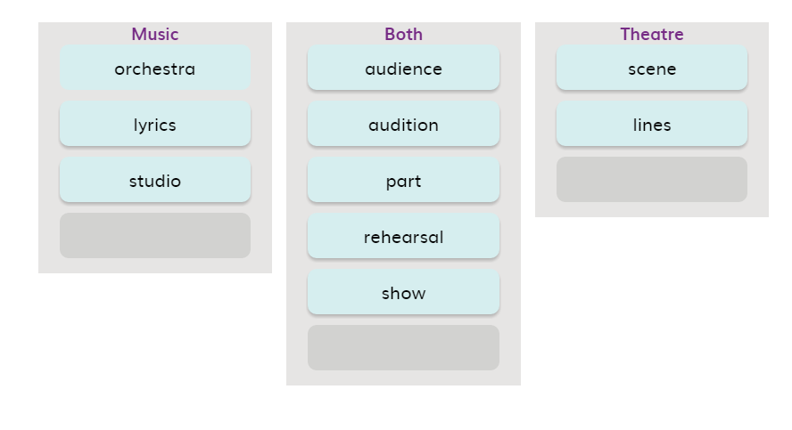

Slide 25
Orchestra: a large group of musicians who play many different instruments together and are led by a conductor.
Lyrics: the words of a song.
Audience: the group of people together in one place to watch or listen to a play, film, someone speaking, etc.
Audition: a short performance that an actor, musician, dancer, etc. gives in order to show they are suitable for a particular play, film, show, etc.
Rehearsal: a time when all the people involved in a play, dance, etc. practice in order to prepare for a performance.
Scene: a part of a play or film in which the action stays in one place for a continuous period of time.
Lines: are dialogues that actors memorize from the script which are the words that their character says during the play

Slide 26
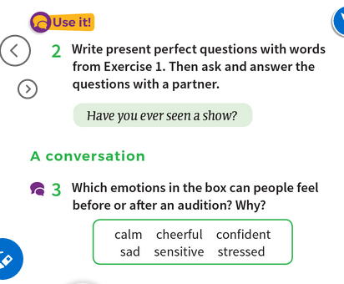

Slide 27
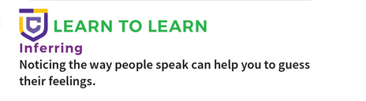
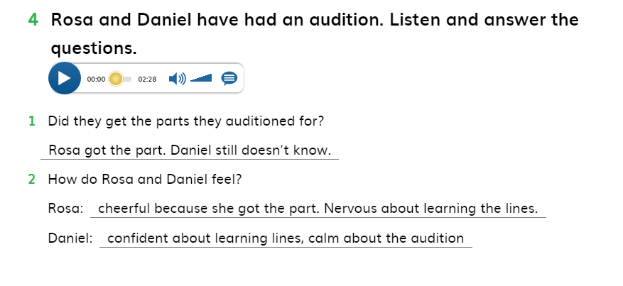

Slide 28
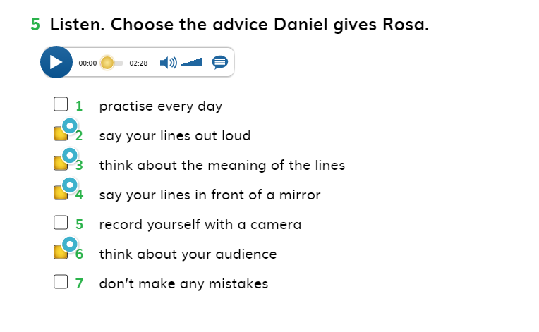

Slide 29

We use already, just, still and yet in the present perfect tense.
We use already to mention that we have done something earlier.
I have already called my friends.
We use just to say that we have done this action just now.
I have just finished my exam.
We use yet in negative sentences to say that we haven’t finished this action till this moment. And also we use yet in the questions. In both cases, yet is used at the end of the sentence.
I haven’t explained this topic for my students yet.
We use still in negative sentences to say that we haven’t done this thing till now.
She still hasn’t finished her studies.

Slide 30
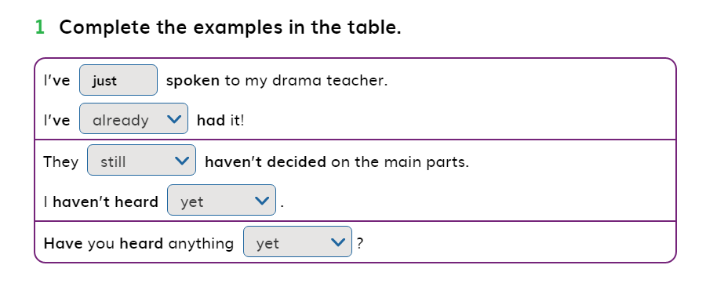
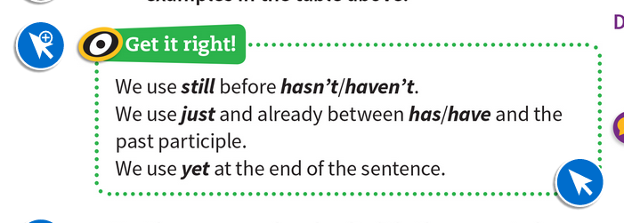

Slide 31
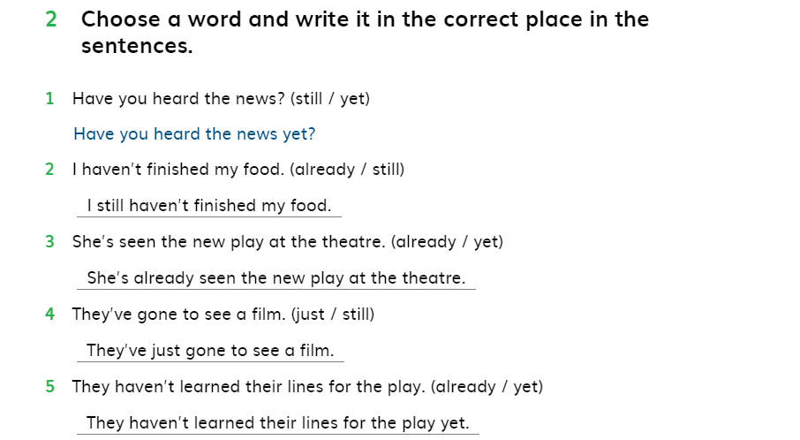

Slide 32
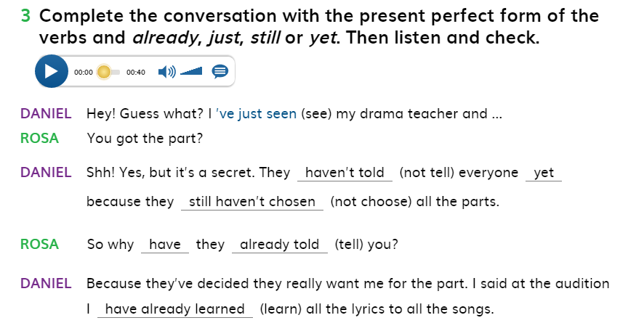
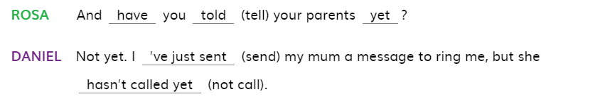

Slide 33
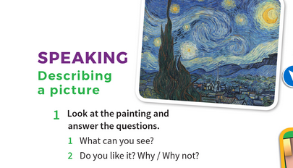

Slide 34
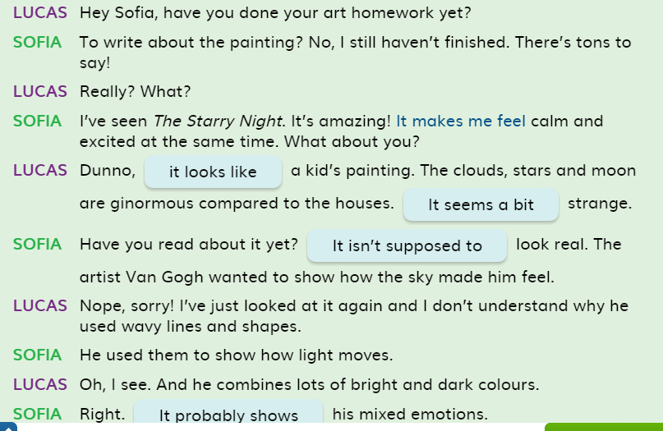

Slide 35
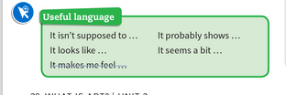
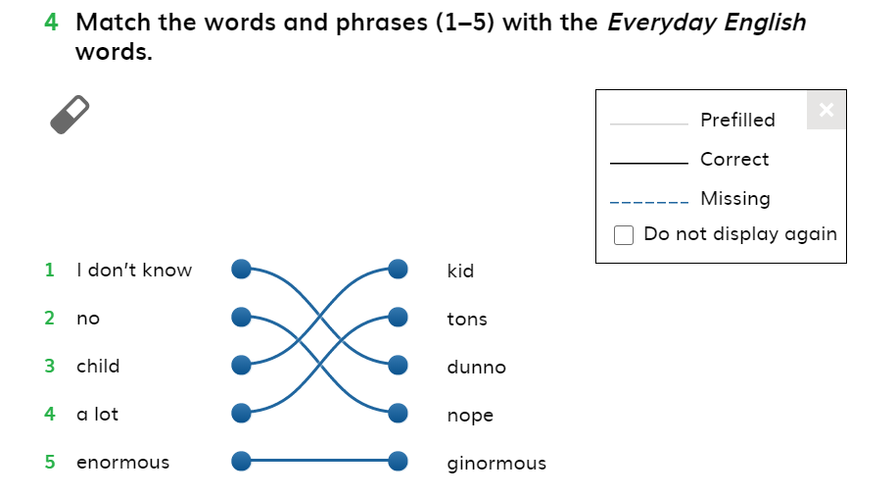

Slide 36
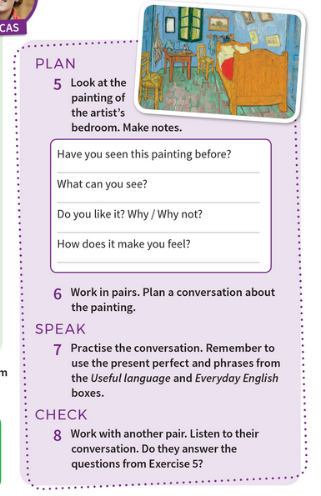

Slide 37
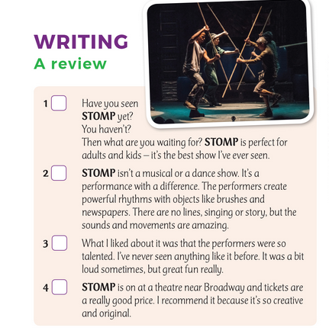


Slide 38
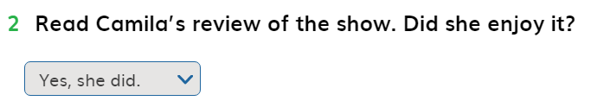
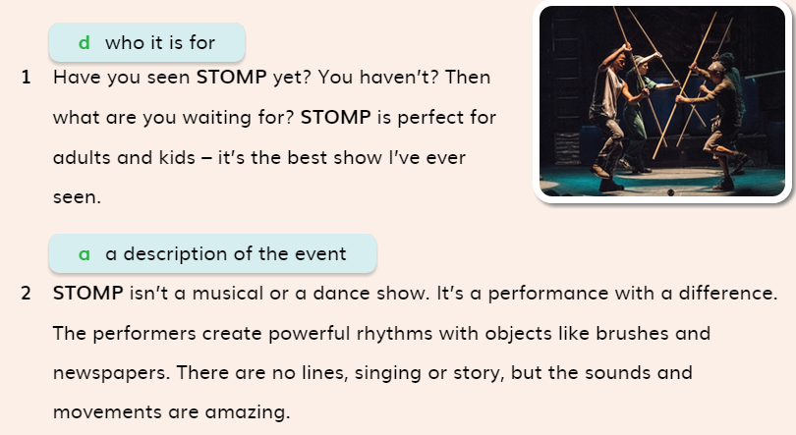
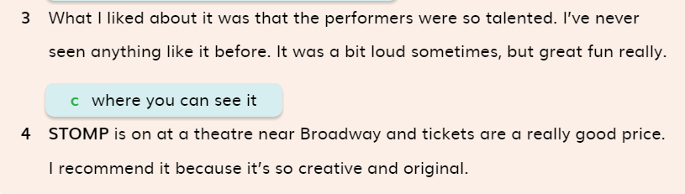

Slide 39
Writing:
Write a paragraph about a performance. The performance is unusual one, like they don’t use musical instrument, instead, they use other stuff to make sounds, such as sticks, heels, clapping, or whistling. Or, you can also write about a performance has been done by a band, like rock group.
Make sure to use the present perfect and the useful language available in page 29.
First, divide your paragraph into four parts.
In the first part, mention what is the performance, and where did you see it.
The second part includes information about who can watch this performance, such as, it is suitable for kids, teenagers, adults, or all ages.
In the third part, describe the performance. For example, mention how many performers were there, their age, and gender as well, how long did it take, what things did they use. What movements did they do, such as jumping, rolling, slipping on the ground… etc. Or what instrument did they use during their performance.
The last part includes the things you liked/ didn’t like about the performance. For example, the performers were moving smoothly, and the sounds they made were very affective.
Or, the sounds the performers made were very loud, their movements were not aligned with each other, or the music was very loud. ( CHECK THE SAMPLE IN THE NEXT SLIDE)

Slide 40
I recently attended a performance at a local theater that was unlike any I had ever seen. Instead of using traditional musical instruments, the performers created all the sounds by using everyday objects such as sticks, heels, clapping, and whistling. The performance was full of energy, and the audience was amazed by how creative they were with these simple items.
This performance is suitable for all ages. Children, teenagers, and adults alike can enjoy the unique sounds and movements. The creativity and humor involved make it enjoyable for everyone, and it's a great way for families to experience something different together.
There were five performers in total. The performance lasted about 45 minutes, and it was full of surprising moments. The performers used a variety of objects, including wooden sticks, high heels, and even their own hands and feet to create musical sounds. They moved across the stage, jumping, clapping, and even slipping on the ground, all while producing fascinating rhythms that kept the audience fascinated.
What I liked about the performance was the way the performers used ordinary objects to make extraordinary sounds. The movements were smooth, and the atmosphere was lively and exciting. However, at times, the sound of the clapping and sticks was a bit loud, which made it hard to focus on the rest of the performance. But overall, I have never seen anything like it before. I recommend it because it’s such a unique and entertaining experience, and the creativity behind it is impressive. It is one of the best shows I have ever seen!

Slide 41
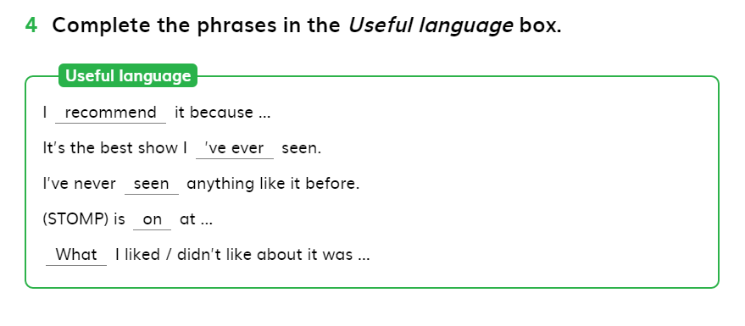

Slide 42
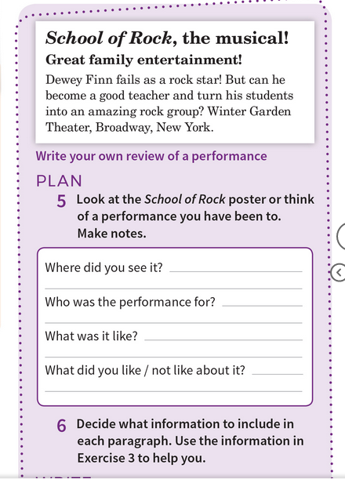
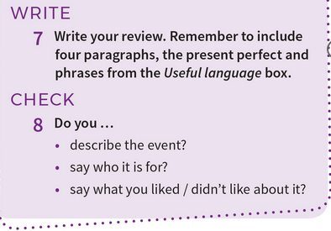

Slide 43
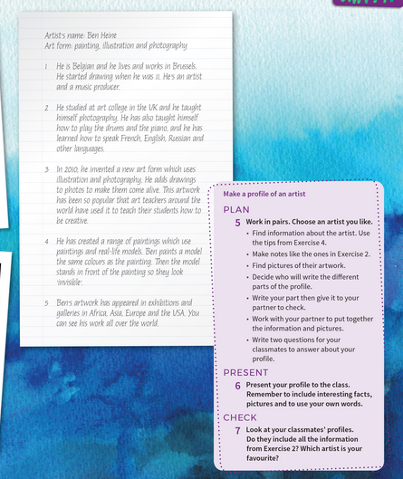
Reading part
P.31

Slide 44
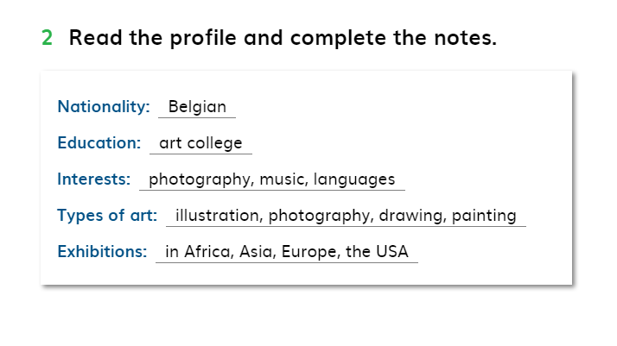
P. 30 Ex. 2

Slide 45
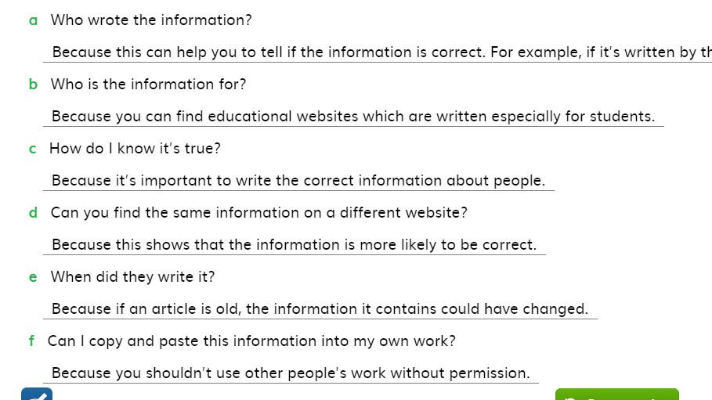
3Why is it important to think about these questions when you read information online?

Slide 46
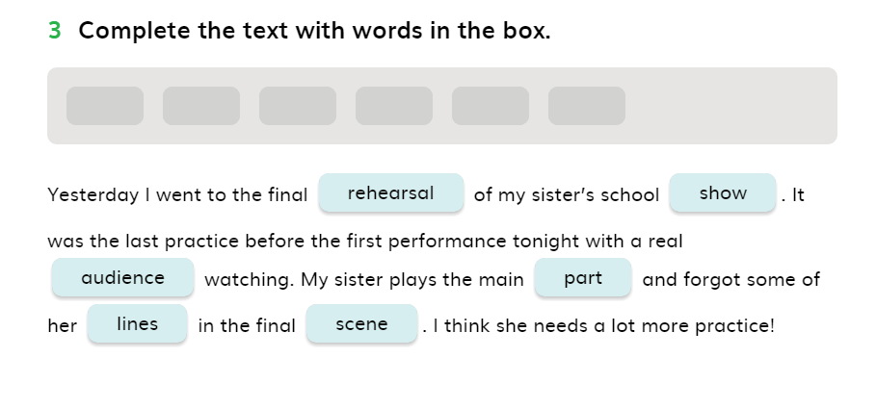

Slide 47
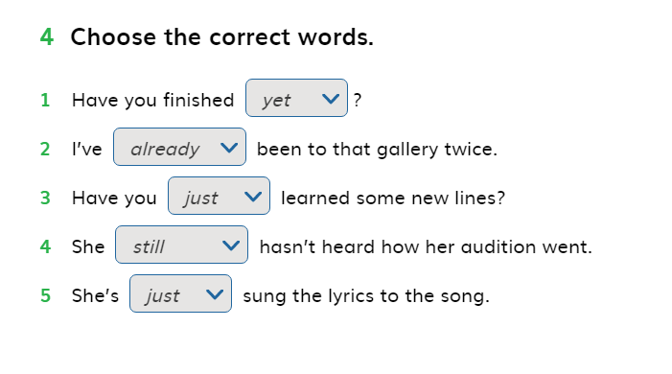

Slide 48

