Slide 1

Unit Three
Zainab Nizar Karam
Advanced English - ELT 203/I
2024 – 2025
First Semester
Week 8

Slide 2

Outline:
Vocabulary
communication
Communication with words / communication with body language
Language in action
Can, could, will be able to
Vocabulary
Collocation with say and tell
Language in action
Present perfect with for/since and how long
Speaking
Asking for something you need
Writing
Writing a listicle.
Reading
A magazine article

Slide 3
Objectives:
Understanding the importance of non-verbal communication and how body language complements verbal communication. They will learn to interpret and use appropriate gestures, facial expressions, and posture to enhance the clarity and effectiveness of their message.
Expressing ability, possibility, and future capability using "can," "could," and "will be able to.
Identifying and using common collocations with the verbs "tell" and "say," distinguishing between their proper usage in different contexts (e.g., "tell a story" vs. "say something").
Using the present perfect tense with "since," "for," and "how long" to talk about actions or states that started in the past and continue to the present. They will practice constructing and responding to questions and statements that reflect these time expressions.
Focusing on how the past simple relates to specific, completed actions in the past, while the present perfect connects past actions to the present moment.
Learning the structure and conventions of writing a listicle, including how to create catchy titles, write engaging introductory paragraphs, and organize content into clear, concise points.

Slide 4
Describe (v.): to say or write what someone or something is like.
Could you describe your attacker?
Gesture (n.) : a movement of the body, hands, arms, or head to express an idea or feeling.
He made a rude gesture to the crowd after his tennis match.
Greet (v.): to welcome someone with particular words or a particular action.
He greeted me at the door.
Interpret (v.): to change what someone is saying into another language.
We had to ask our guide to interpret for us.
Post (v.): to publish something such as a message or picture on a website or using social media.
I never post anything on the internet.
Post (n.): something such as a message or picture that you publish on a website or using social media.
Many people liked my last post on Instagram.
Shout (v.): to speak with a very loud voice.
The woman was shouting when the thief attacked her.
Translate (v.): to change words into a different language.
We were asked to translate a list of sentences.
Wave (v.): to raise your hand and move it from side to side as a way of greeting someone.
I waved at him from the window but he didn't see me.
Whisper (v.): to speak very quietly, using the breath but not the voice, so that only the person close to you hear you.
She leaned over and whispered something in his ear.

Slide 5
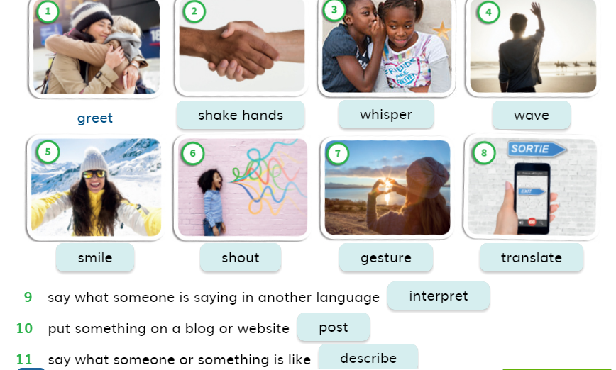

Slide 6

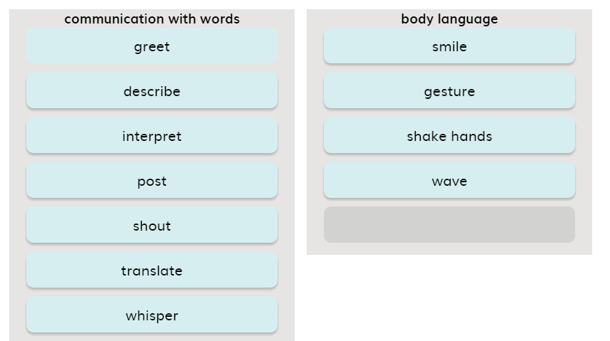

Slide 7
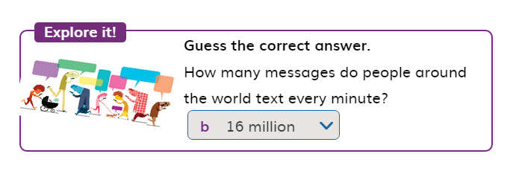

Slide 8
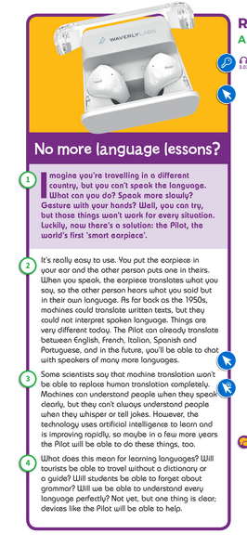

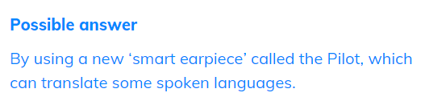

Slide 9
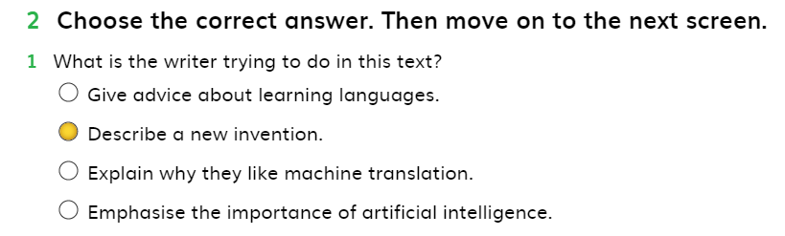
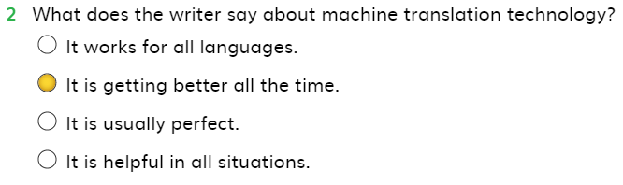
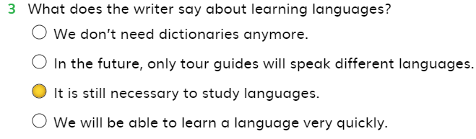

Slide 10
Adjectives and adverbs
Adjectives: are used to describe a noun
The book is useful.
The ambiance of the restaurant is very nice.
Adverbs: are used to describe the verb, or the action done.
We generally form Adverbs by adding –ly to the Adjectives, as shown below:
Nice – nicely
Beautiful – beautifully
Quiet - quietly
Ex: She is a quick runner.
She runs quickly.
They were talking loudly.
We also have some irregular Adverbs, that do not take –ly, such as :
Good – well
Hard – hard
Fast – fast
Ex: Brad Pitt is a good actor.
Brad Pitt acts well.
They run fast.
He doesn’t work hard.

Slide 11
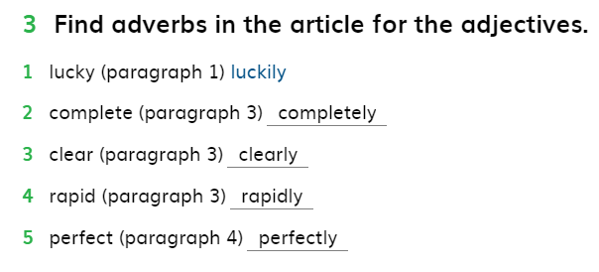

Slide 12
Can, Could, Will be able to
Can is use to talk about ability in the present time.
Could is used to talk about ability in the past.
Will be able to is used to talk about ability in the future.
All forms are followed by verb base.
He can use different gadgets.
the athlete will be able to compete at an international level.

Slide 13
Negative form
To form negative sentence with ( can, could, will be able to), we just add (not) to these modal verbs to change the sentence into negative:
Can – cannot / can’t
Could – couldn’t
Will be able to – will not be able to / won’t be able to
He cannot understand you without being with an interpreter.
They couldn’t use buy TV sets when they were first invented.
I will not be able to submit my work until they agree on it.

Slide 14
Questions
Yes/no Questions
Wh- Questions
Can
Could
Can you attend the conference?
Could people travel to space in the past?
Will + sub + be able to + v.base
Will you be able to control everything in the workshop?
Wh + can/could + sub + v.base … ?
Can you use any musical instrument?
Could people keep their food fresh without fridges in the past?
Wh + will + sub + be able to + v.base … ?
Where will you be able to publish your new article?
Sub. + V. base … ?

Slide 15
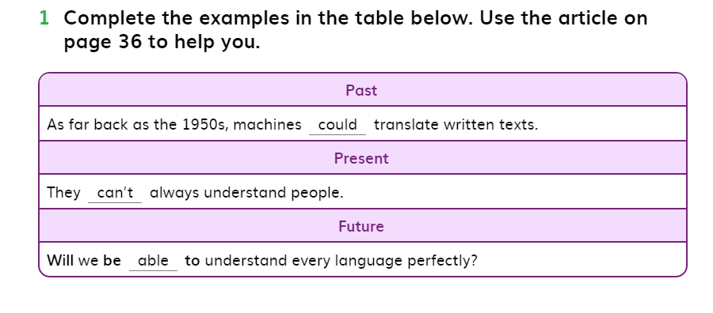

Slide 16
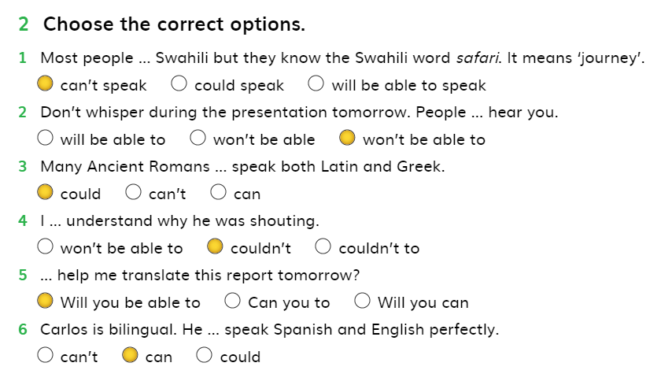

Slide 17
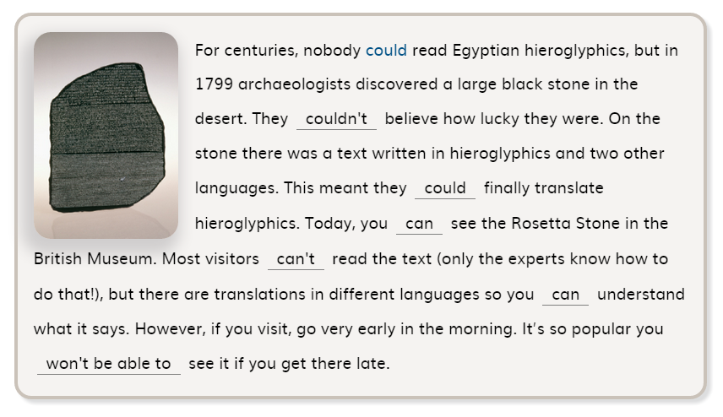

Slide 18

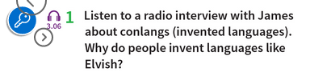
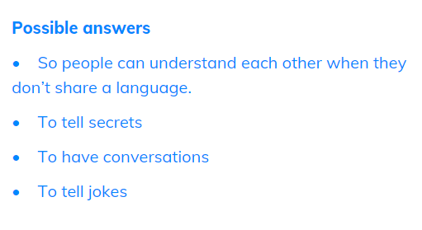

Slide 19
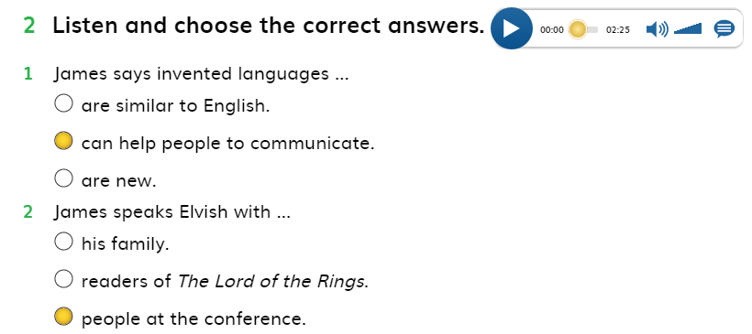
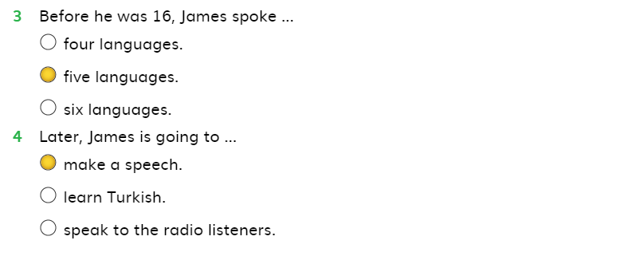

Slide 20
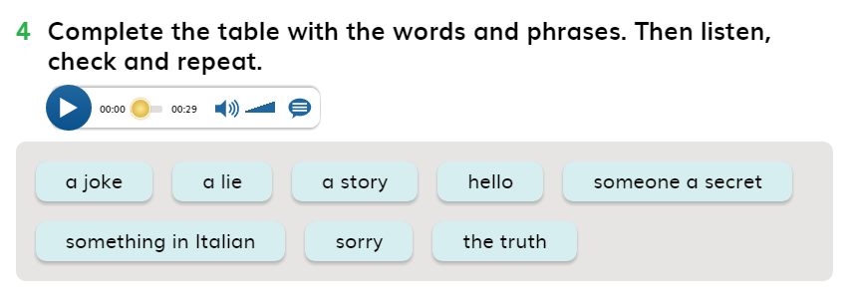
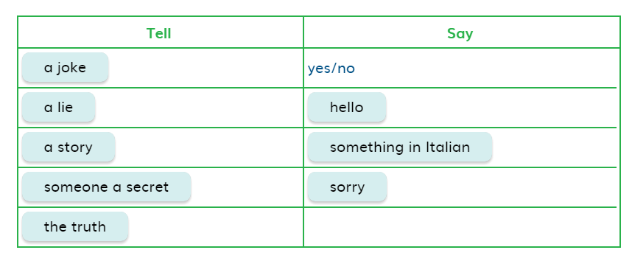

Slide 21

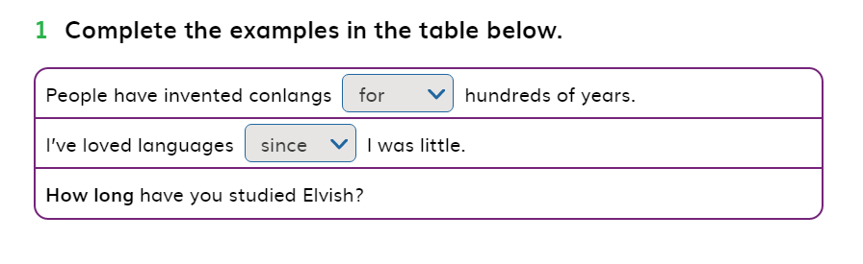
For + a period of time
For a year, for two hours, for ages, for a long time
Since + beginning or end of an event
Since 1999, since new year eve, since my childhood, since 2 o’clock.

Slide 22
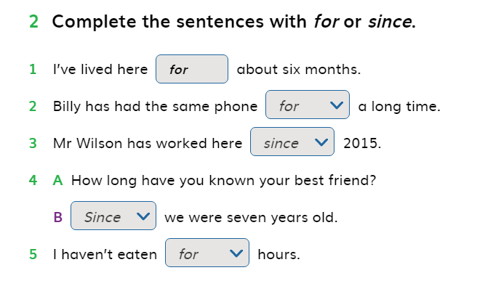

Slide 23
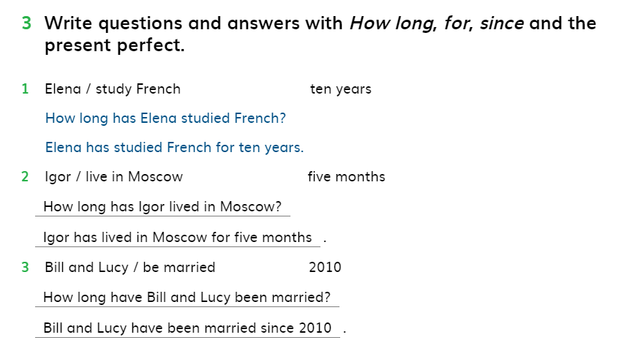

Slide 24

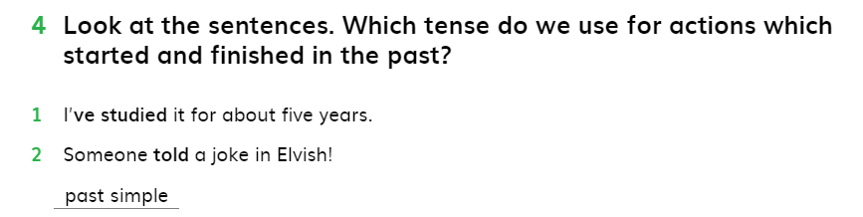

Slide 25
Present perfect
Past simple
Present perfect is used to talk about actions started in the past and still continue in the present time
I have studied at TIU since December. ( the action of studying started in the past and still continuing in the present moment.
We use present perfect for actions in someone’s life ( for a living person’s experience).
Jamie has been to Japan five times.
Past simple is used to talk about actions which are finished in the past.
I studied at TIU four years ago. ( the action of studying happened and finished in the past)
Past simple is used for a finished action in someone’s life ( the person is dead)
Her great grandfather went to Japan three times.

Slide 26
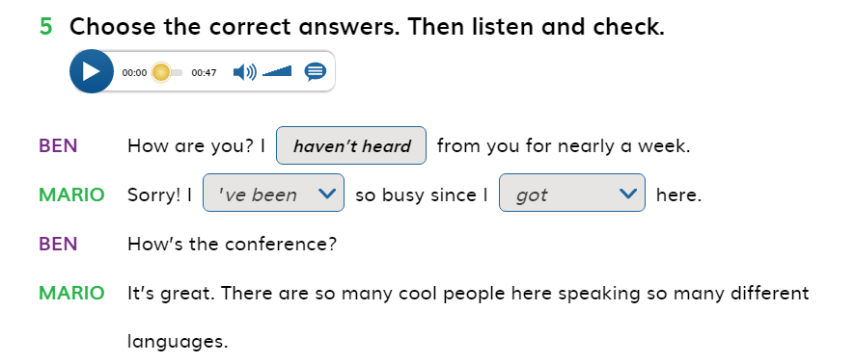
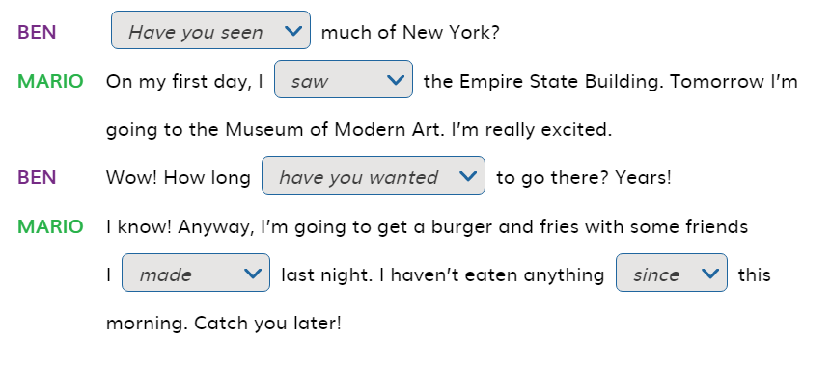

Slide 27
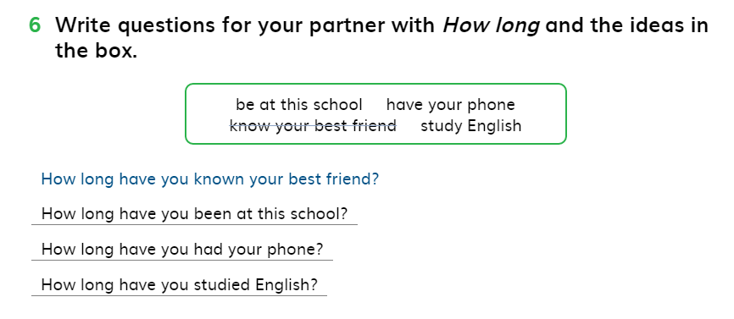

Slide 28
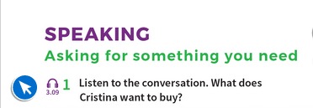
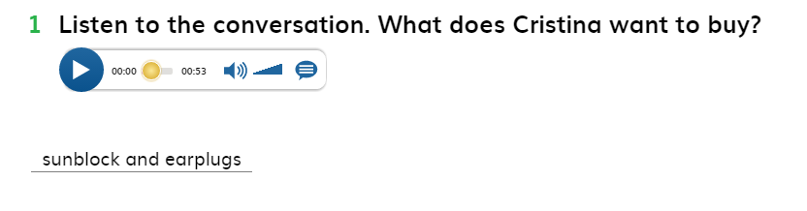

Slide 29
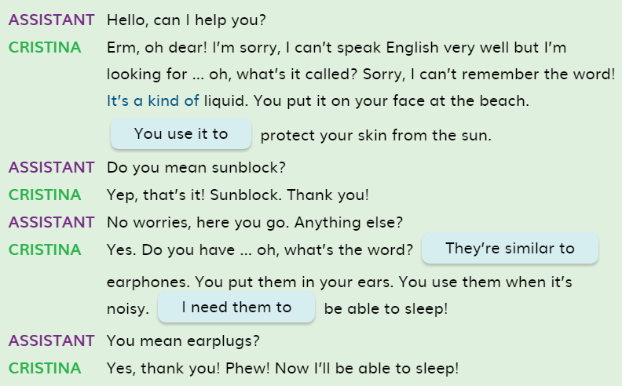

Slide 30
Present perfect
Past simple
With the present perfect, time is not specified. For including any time reference in the present perfect, we use since or for.
I have seen that movie already.
We use present perfect with a finished action with a result in the present
I have lost my phone.
Present perfect is used with unfinished time word (this week, today, this morning)
I have seen my siblings this month
Past simple we mention certain time.
I saw that movie on Thursday.
Past simple is used to talk about actions finished in the past with no result in the present.
I lost my phone a month ago.
Past simple is used with finished time word ( last week, yesterday, two days ago)
I saw my siblings last month.

Slide 31
Fill in the gaps with the correct form of the verbs, use past simple or present perfect:
I …………………………..………..(never/go) to Vienna.
My great great grandfather ……………………..……… (have) five sisters.
He ……………………………… (live) in Milano for a year when he was a kid.
Oh no, I …………………..……(lose) my wallet.
…………………….…………….(you/see) Julie today?
At the weekend, they ………………………(play) football, and then they ……..…….(go) to the restaurant.
I ………….………… (read) five books this week.
have never been
had
lived
have lost
Have you seen
played
went
have read

Slide 32
Sally ………………..(live) in Portugal when she was young.
She …………….( visit) her grandmother last month.
The Vandals …………..(invade) Rome in the year 455.
King Henry the Eighth of England ………….(have) six wives
I ……………….(go) to the cinema last night.
Oh! I ……………… (cut)my finger.
She …………….(break) her leg the day before her exam.
He ………………… (be) here all morning.
lived
visited
invaded
had
went
have cut
broke
has been

Slide 33
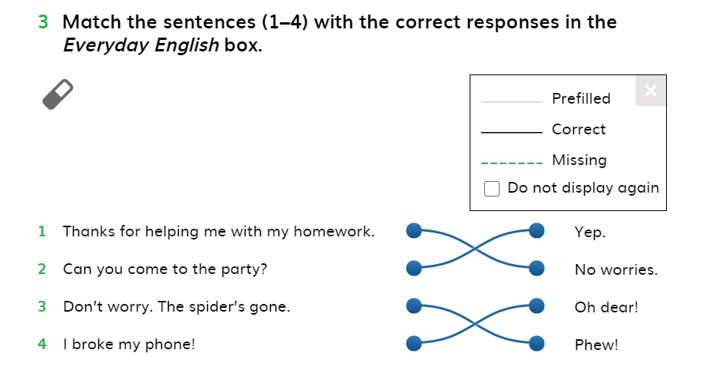

Slide 34
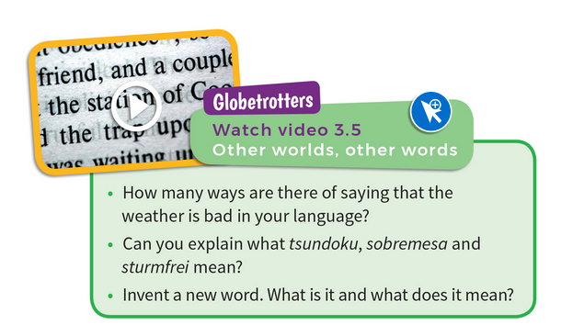
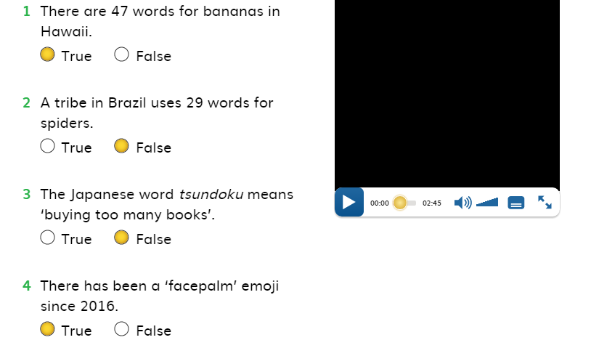

Slide 35
Writing a listicle
What is a listicle?
A listicle: is an article written in list format. Each list item will typically include a few sentences or multiple paragraphs to educate or delight readers.
A listicle: is a type of article or blog post that is structured as a list, typically featuring a series of items, points, or ideas. The term is a combination of "list" and "article." Each item in the list is often accompanied by a short description, explanation, or commentary. Listicles are popular because they are easy to read and provide quick, digestible information on a specific topic.

Slide 36
How to write a listicle
Select a topic that is interesting, informative, and relevant to your audience.
Example topics: ‘ My multilingual friend’, ‘5 Tips for better time management’, ‘Steps of learning a forging language’, ‘How to be a good presenter’.
Start with a brief introduction to set the stage. Explain why the topic is important or relevant.
Example: "Whether you're just starting out or looking to improve, mastering time management can help you stay on top of your tasks and achieve your goals more efficiently. Here are 10 tips that will transform your productivity.“
Number or use bullets for each item to make it easy for readers to follow.
Conclusion or Call-to-Action: end your listicle with a conclusion that summarizes the key points.

Slide 37
My multilingual friend
Languages are used to communicate and interact with others worldwide. Most of people are bilingual. They can speak two languages. However, nowadays people tend to learn more languages. My friend Mustafa can speak 5 languages perfectly. Here are some interesting facts about Mustafa and the way he learned languages.
Introduction
Before, Mustafa couldn’t speak until he was five years old! He could only utter few words in three different languages, Turkish, English and Kurdish. He couldn’t form a full sentence even.
Later on, Mustafa joined kindergarten and soon he could learn Arabic fluently.
Since joining primary school, Mustafa has started learning English, Kurdish and Arabic.
These days, Mustafa is busy learning Spanish, and he believes he will be able to speak it fluently.
Interesting facts
Short ending
For learning a language, you need to believe that it is possible and you can learn any language perfectly.

Slide 38
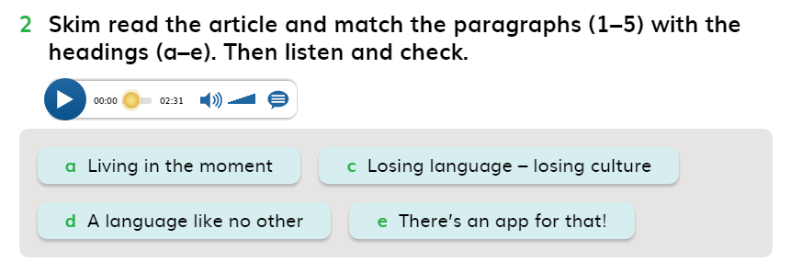
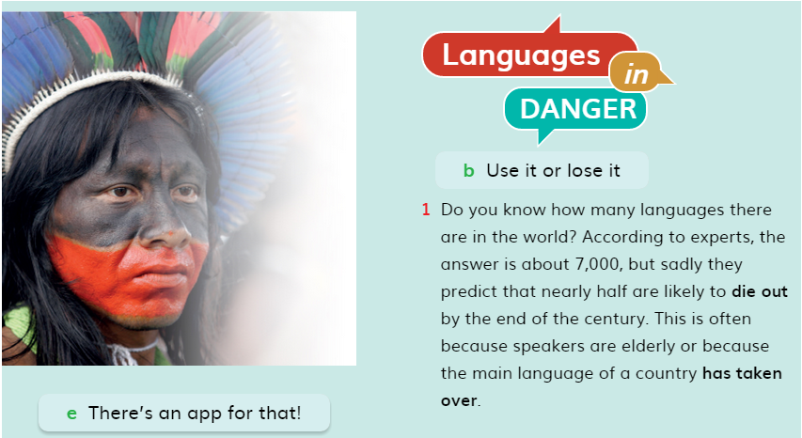

Slide 39
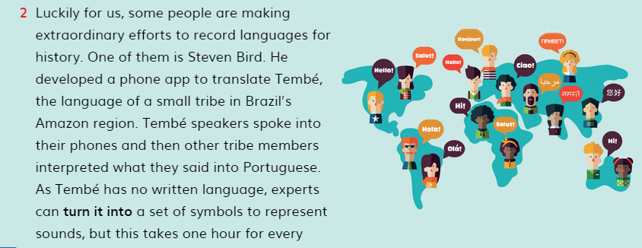

Slide 40
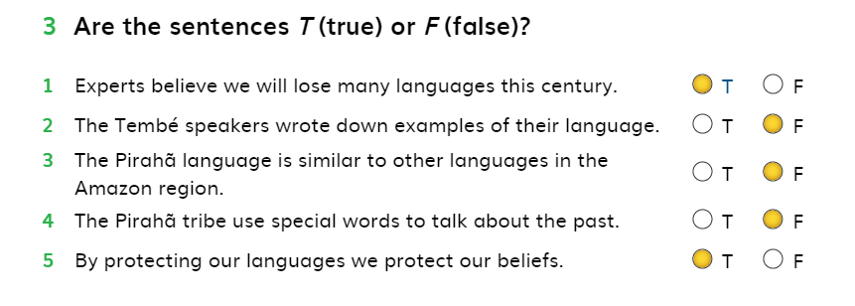

Slide 41
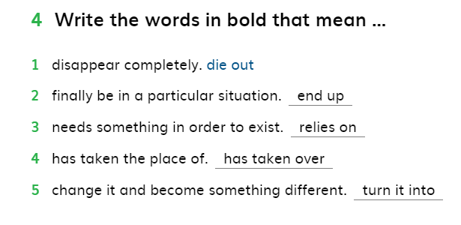

Slide 42
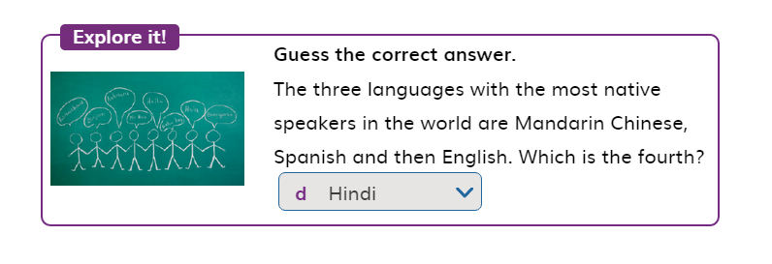

Slide 43
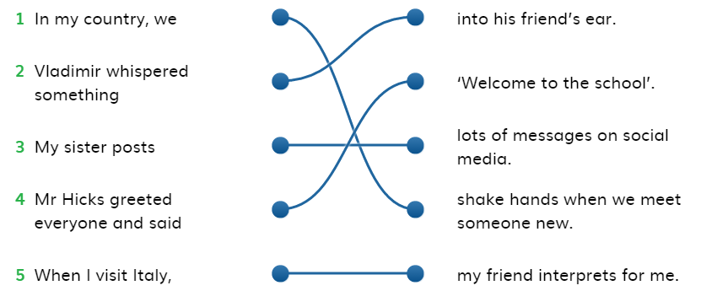

Slide 44
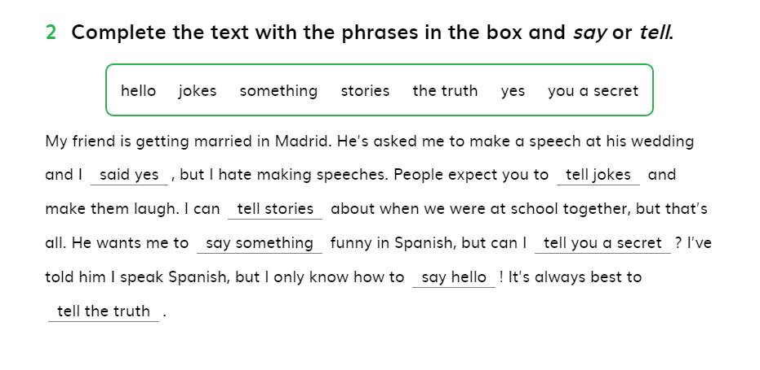

Slide 45
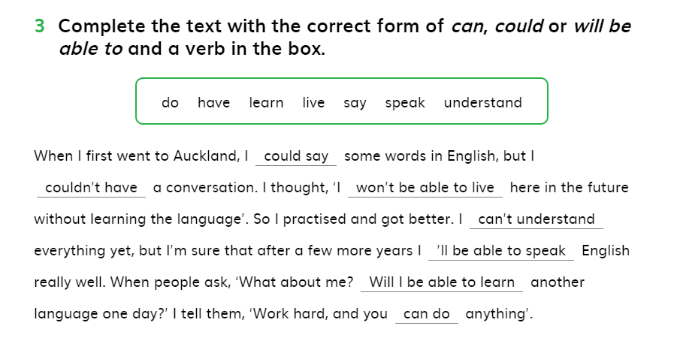

Slide 46
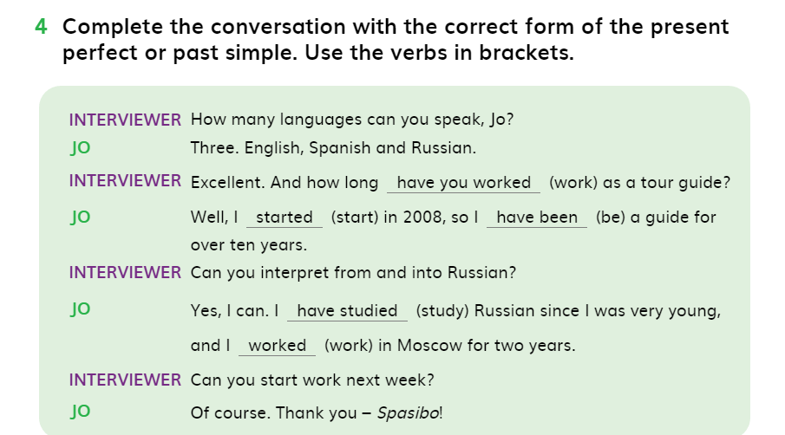

Slide 47
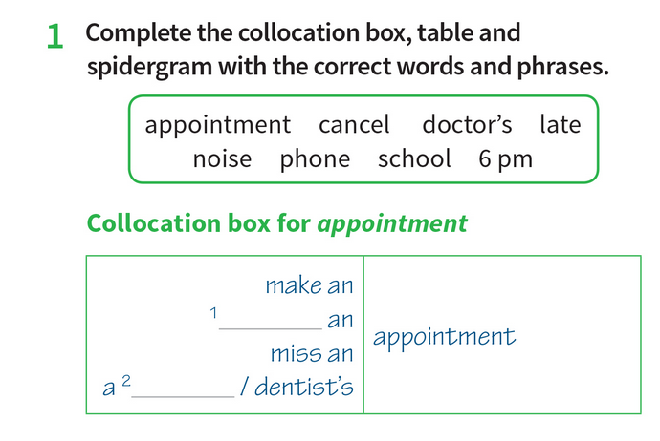
cancel
doctor’s

Slide 48
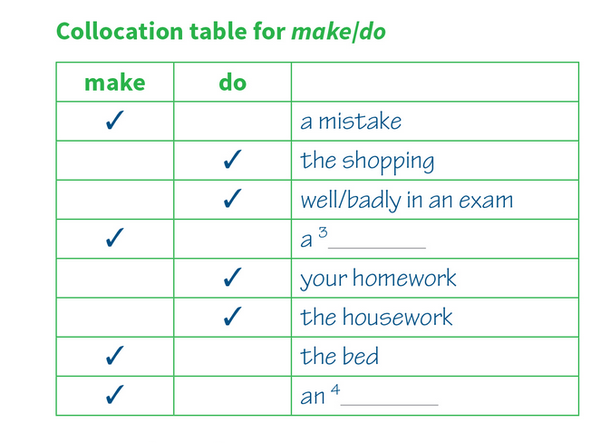
noise
appointment

Slide 49
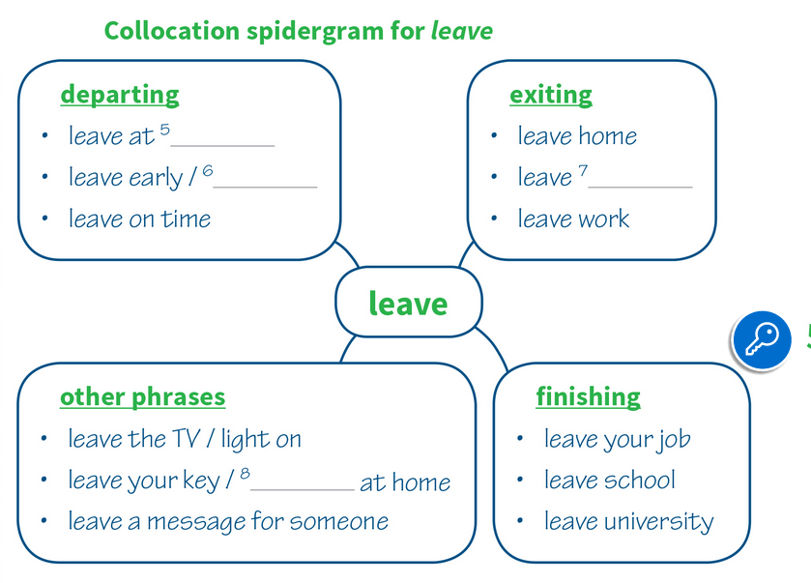
6 pm
late
school
phone

Slide 50
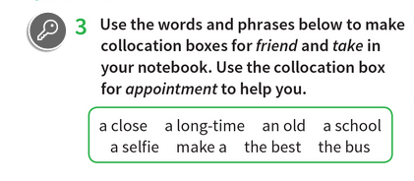
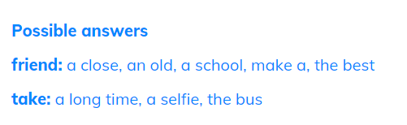

Slide 51
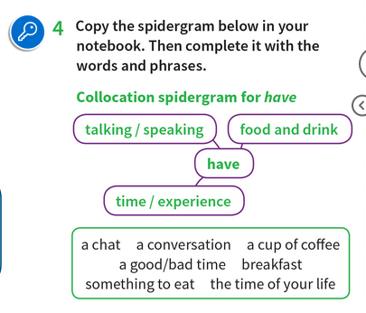
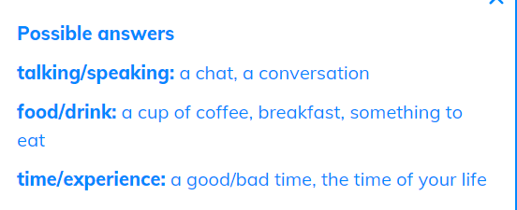

Slide 52
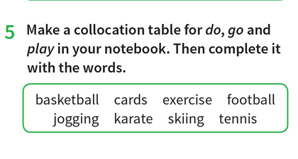
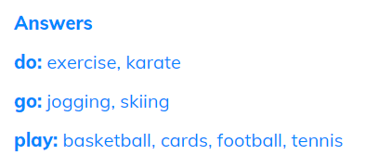
Do + an activity
Go + (v+ing)
Play + a game
do yoga, do Pilates, do judo.
go running, go swimming, go shopping.
play cards, play chess, play video games.

