Slide 1
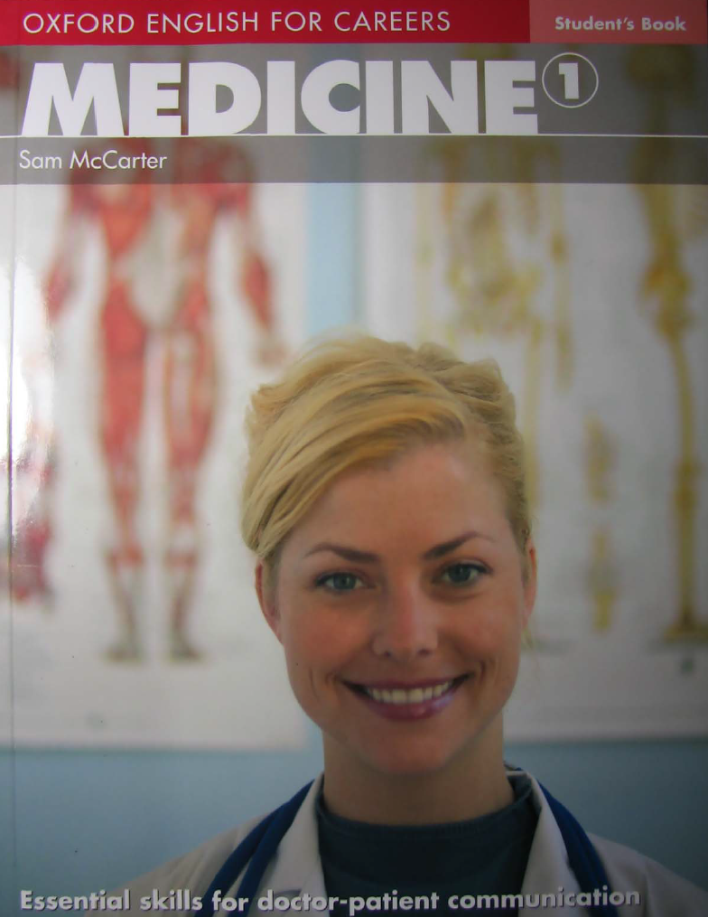

Technical English
Lecturer:
Miss Liva Adil Shareef

Slide 2
Medicine 1: Unit 1
Presenting complaint

Slide 3
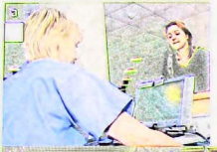
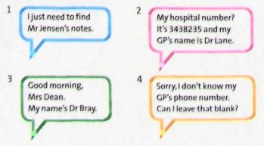
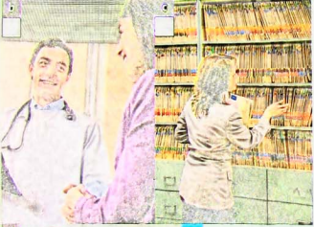
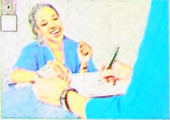
Match each photo with what the person is saying?
Notes:
1. finding patient notes. 2. giving personal medical information 3.introducing oneself as a doctor 4. filling in a form

Slide 4
Vocabulary
People
doctor / Dr: a medical doctor
patient: a person receiving medical care
GP: General Practitioner, the family doctor
receptionist: the person working at the front desk
Hospital / office words
notes: medical records or written information about a patient
hospital number: the patient’s identification number in the hospital
form: a paper to fill in with information

Slide 5
Pediatrician:
a doctor who studies and treats the diseases of children.
Dermatologist:
a doctor who studies and treats skin diseases.
Ophthalmologist:
a doctor who studies and treats the diseases of the eye.
Obstetrician:
a doctor who is trained in obstetrics (the birth of children).
Cardiologist:
a doctor who studies and treats heart diseases.

Slide 6
Nephrologist:
a nephrologist focuses on kidney care and conditions that affect the kidneys.
Otolaryngologist (ENT):
a doctor who treats ear, nose and throat.
Neurologist:
a doctor who studies and treats diseases of the nerves and brain.
Psychiatrist:
a doctor who studies and treats mental illnesses.
Oncologist:
a doctor who studies and treats cancer in the body.

Slide 7
Radiologist:
a doctor who is trained in radiology.
Rheumatologist:
a doctor who diagnoses and treats rheumatic diseases.
Surgeon:
a doctor who is trained to perform surgery.
Anesthesiologist:
a doctor who studies the use of anesthetics.

Slide 8


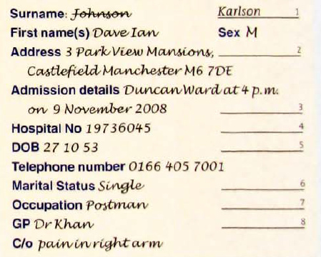



Slide 9
3. Work in pairs. Decide what questions the doctor asks for each piece of information on the form.
Can you tell me what your family name is?
And your first name?
Any other names?
And can you tell me what your address is?
When were you admitted?
And do you know your hospital number?
And what's your date of birth?
Your telephone number?
Are you married or single?
What do you do for a living?
And lastly, who’s your GP?

Slide 10
Language Spot
Asking short and gentle questions
Ask gentle questions to put the patient at ease.
Can you tell me what/who + subject + verb?
What’s your family name?
Can you tell me what your family name is?
Remove words to make questions shorter.
What’s your first name? Your first name?
Do you have any other names? (And) Any other names?

Slide 11
Direct Questions
Indirect Questions
Where is Dr Ahmed?
Is it your first time?
What did you eat last night?
Can you tell me where Dr Ahmed is?
Can you tell me if it is your first time?
Can you tell me what you ate last night?
Some other phrases used in indirect Questions
Can I ask ... ?
I’d like to know ...
I’d like to know ...
I was wondering ...
Could you let me know ... ?
Do you happen to know ... ?

Slide 12
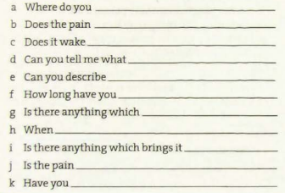
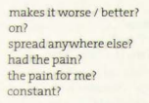

When taking the history of the presenting complaint (HPC), You often ask about pain. Use these words to complete the questions.
sharp
dull
burning
stabbing
Where is the pain? Where does it hurt?
Radiate, move to another part of the body
Severity, seriousness
E.g. sharp, dull, burning, stabbing
E.g. It’s a sharp pain. It feels like pressure. It comes and goes.
G. E.g. movement makes it worse
j. constant, intermittent pain = comes and goes

Slide 13
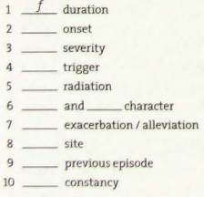
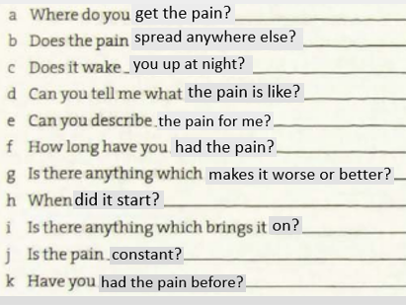
Match these words to questions in exercise 2.

Slide 14
Adjectives describing pain
throbbing (adj): a pain that feels like regular beating or pulsing
boring (adj): (of a pain) passing through one part of the body to another.
Tender (adj) :(of a part of the body) painful when you touch it.
gnawing (adj) :a dull, continuous pain that does not go away
sharp (adj) : (of a pain) sudden and severe pain that feels like a knife or a sting
Crushing: a very heavy, strong pain or pressure, as if something is pressing hard on the body

Slide 15

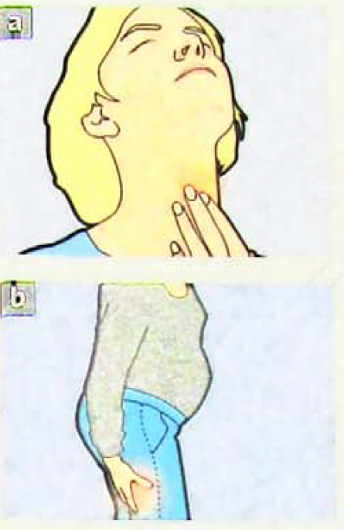
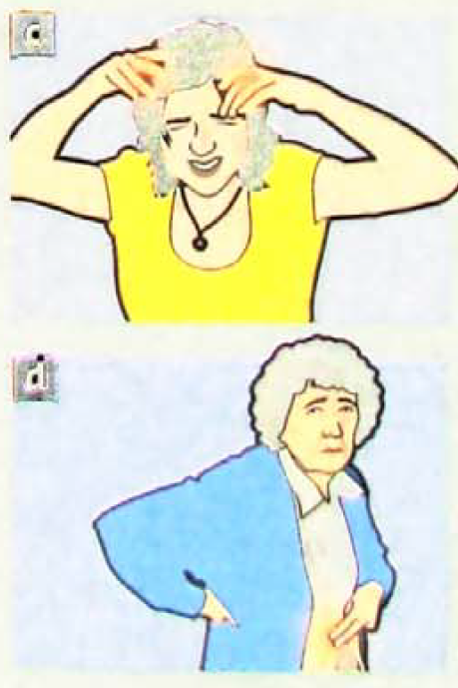
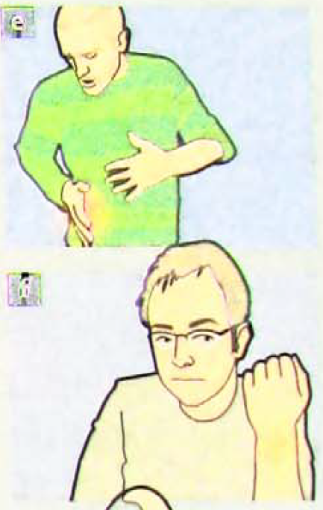

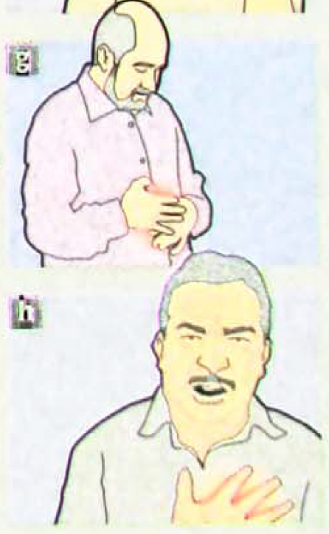








Slide 16
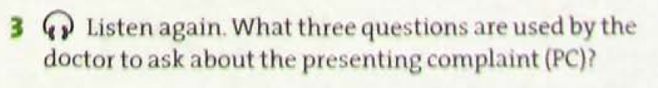
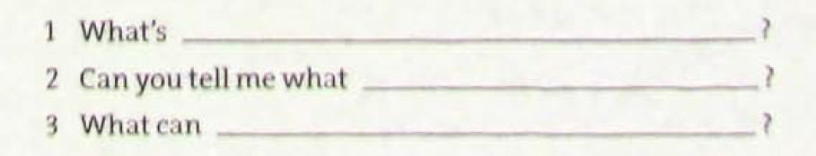




Slide 17
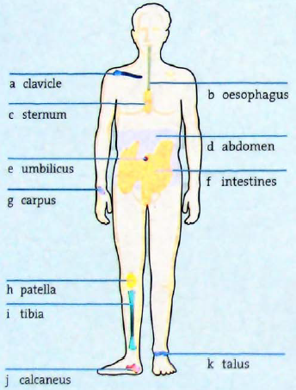











6. Think about non-technical terms for body parts a-k

Slide 18
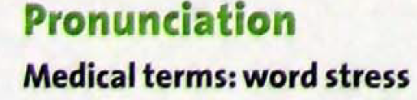


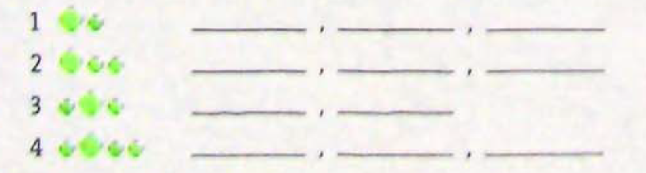










Slide 19
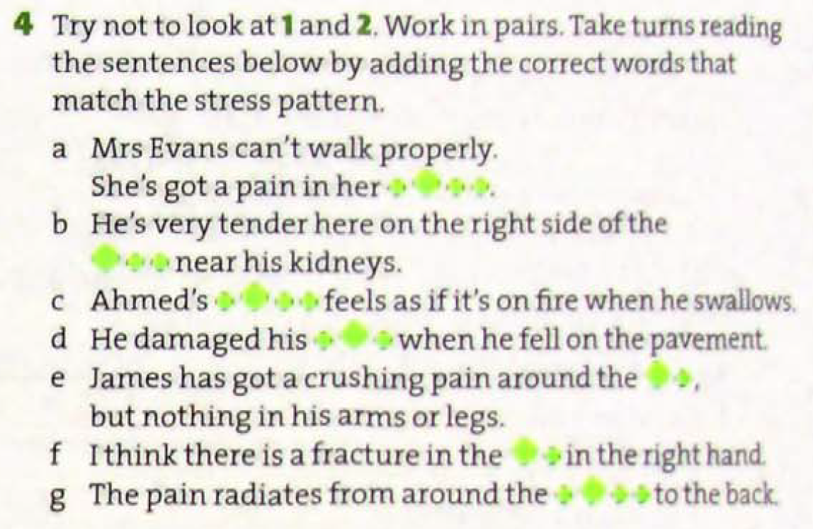








Slide 20
SOCRATES
Use SOCRATES in the history of presenting complaint to help you remember the main questions you need to ask about pain.
Site
Onset
Character
Radiation
Association
Timing
Exacerbating and alleviating factors
Severity

Slide 21
SOCRATES: Site, onset , character, radiation, association, timing, exacerbating and alleviating factors, severity
Where do you get the pain?
Does the pain spread anywhere lese?
Does it wake you up at night?
When did it start?
Can you describe the pain for me?
Is there anything which brings it on?
How long have you had the pain?
Is there anything which makes it worse/better?
site
radiation
severity
onset
character
Association
timing
exacerbating and alleviating factors

Slide 22
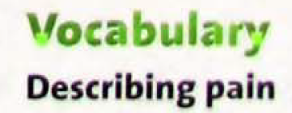
piercing / boring
extremely severe / intense
aching
scalding / burning
like a tight band around my head
dull / persistent / vague
excruciating / thunderclap
shooting
spasmodic
crushing / gripping
sciatica
ureteric colic
acute pancreatitis
appendicitis
degenerative arthritis
cluster headache
cystitis
tension headache
sub-arachnoid haemorrhage
angina pectoris
Next

Slide 23
Words to describe pain
piercing: feeling as a sharp object is pushing in your body.
scalding: very strong and giving a feeling of burning.
persistent: continuing for a long period of time without interruption.
Vague: mild, not very severe
excruciating: extremely severe.
thunderclap: sudden and very tense.
Shooting: a sudden sharp pain that moves quickly across an area of the body.
Spasmodic: (of a pain) caused by your muscles becoming tight in a way that you cannot control.
Gripping: feeling as if something is squeezing or holding a part of your body very hard.
back

Slide 24
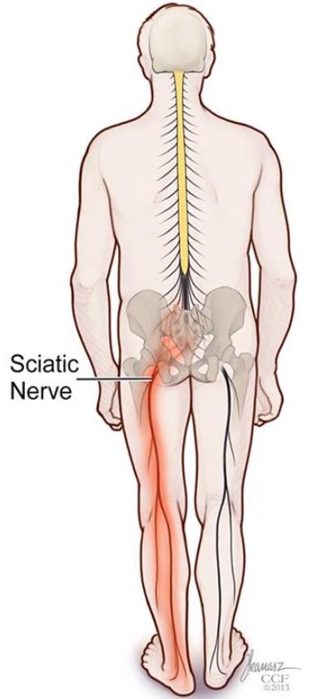
Back
Sciatica refers to back pain caused by a problem with the sciatic nerve. This is a large nerve that runs from the lower back down the back of each leg.

Slide 25
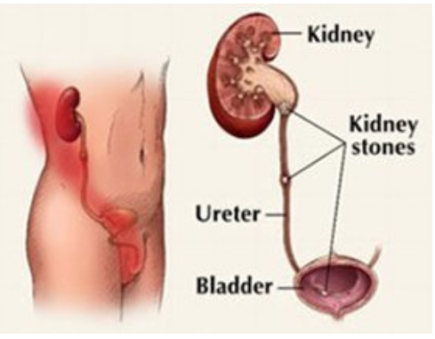
Ureteric colic (renal colic) is defined as a medical condition characterized by the presence of a urinary stone, leading to a severe urinary system pain.
(Han)
Back

Slide 26
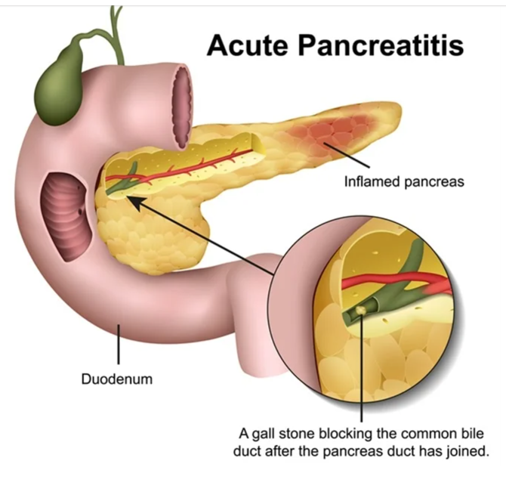
Acute pancreatitis is sudden inflammation of the pancreas.
(Dreams time)
Back

Slide 27
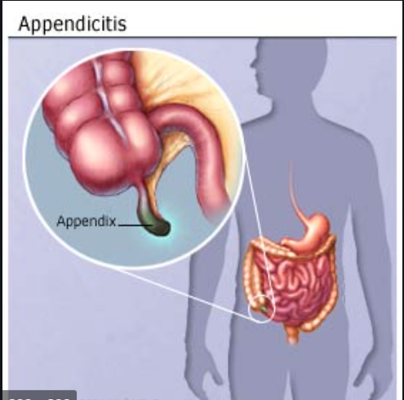
Appendicitis occurs when the appendix becomes inflamed and filled with pus. It requires surgery.
(Khatri, 2019)
Back

Slide 28
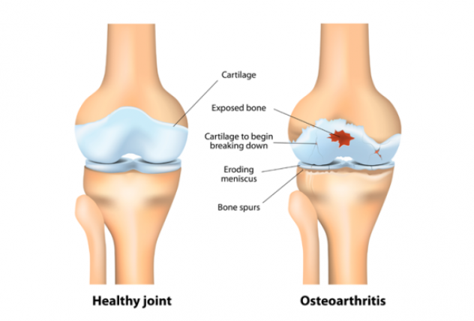
Degenerative arthritis (Osteoarthritis) is a condition that involves the chronic breakdown of cartilage in the joints leading to painful joint inflammation. (Mayo Clinic)
Back

Slide 29
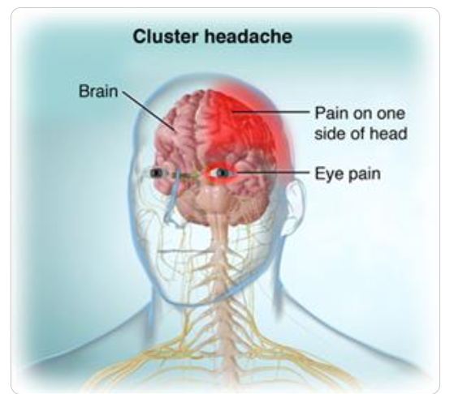
Back
Cluster headache (CH) is on one side of the head, typically around the eye. There is often accompanying eye watering, nasal congestion, or swelling around the eye on the affected side. (Orchard Health)

Slide 30
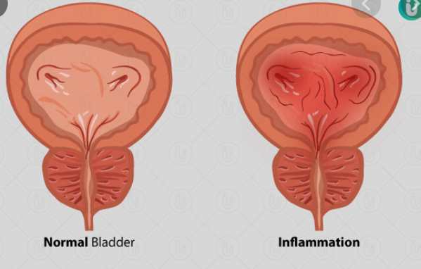
Back
Cystitis is an inflammation of the bladder.
(Rajalakshmi)

Slide 31
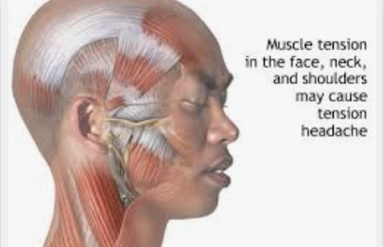
A tension headache is the most common type of headache. It can cause mild, moderate, or intense pain behind your eyes and in your head and neck. Some people say that a tension headache feels like a tight band around their forehead.
(Medlineplus)
Back

Slide 32
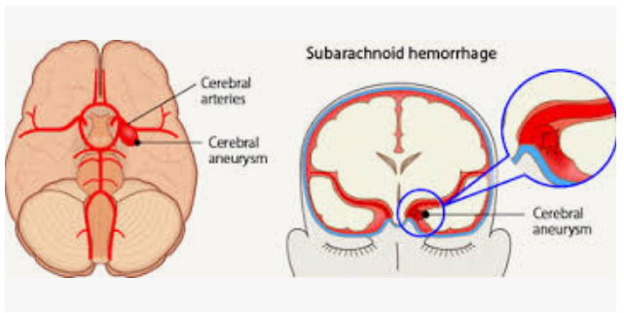
Subarachnoid hemorrhage (SAH) is a life-threatening type of stroke caused by bleeding into the space surrounding the brain.
Back
(Furst, 2020)

Slide 33
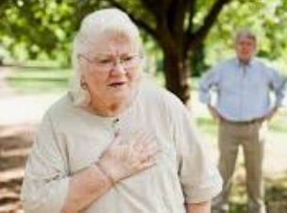
Angina pectoris is the medical term for chest pain or discomfort due to coronary heart disease. It occurs when the heart muscle doesn't get as much blood as it needs.
(American Heart Association, 2015)
Back

Slide 34


Which descriptions 1-10 do you associate with the conditions a—j? In some cases, there may be mare than one answer.
piercing / boring
extremely severe / intense
aching
scalding / burning
like a tight band around your head
dull / persistent / vague
excruciating / thunderclap
shooting
spasmodic
crushing / gripping
sciatica
ureteric colic
acute pancreatitis
appendicitis
degenerative arthritis
cluster headache
cystitis
tension headache
sub-arachnoid haemorrhage
angina pectoris

Slide 35



3. For each description, write M (mild), S (severe), or V (very severe). Then say which condition a–j in 1 each patient below is possibly describing.
……….. I get this vague headache sometimes during the week.
……….. The headache is excruciating. I can’t bear to look at the light.
……….. The pain in my stomach is so bad it makes me double up.
……….. I get this sharp pain when you press my side here on the right and then let go.
……….. All my joints hurt. I am wracked with pain.
Possible conditions: 1. Tension headache 2.Cluster headache 3. Acute pancreatitis 4. Appendicitis 5. Degenerative arthritis.

Slide 36
4. You can ask a patient to describe pain on a scale of 1 to 10. What other ways can you ask a patient to assess the severity of pain?
Visual Analog Scale (VAS): Ask the patient to mark their pain level on a straight line from ‘no pain’ to ‘worst pain imaginable’.
Verbal Rating Scale (VRS): Use words to describe pain, such as mild, moderate, severe, or unbearable.
Faces Pain Scale (FPS-R): Show a series of facial expressions ranging from a smiling face (no pain) to a crying face (worst pain) and ask the patient to choose one.
Descriptive Pain Scale: Ask the patient to describe their pain using terms like throbbing, stabbing, burning, or crushing.

Slide 37
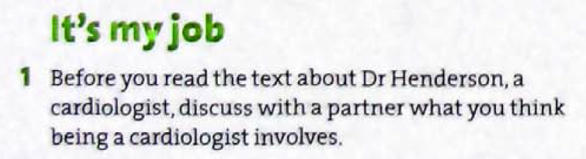
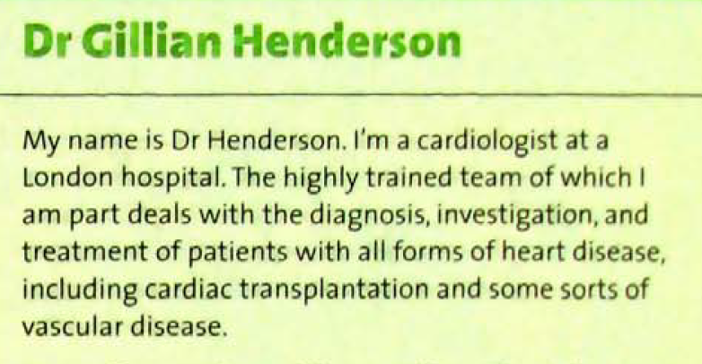

Slide 38
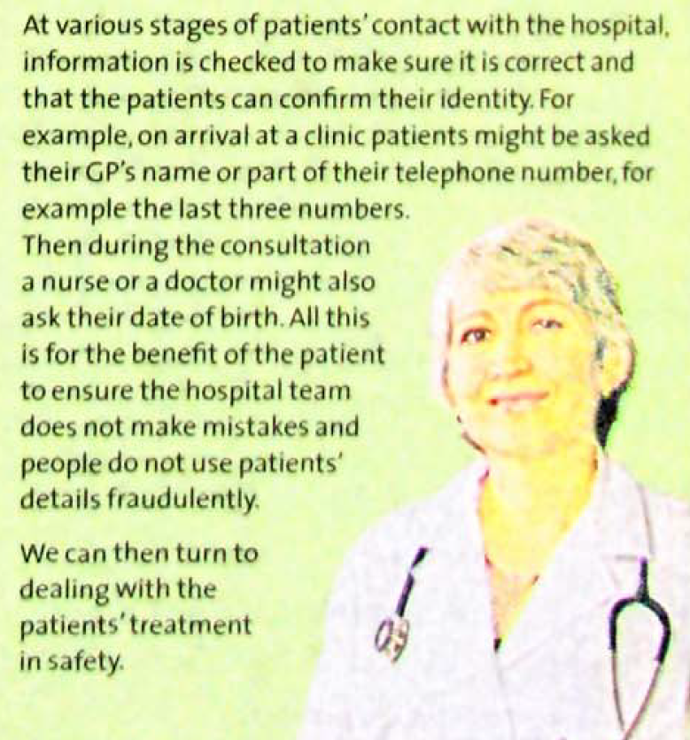
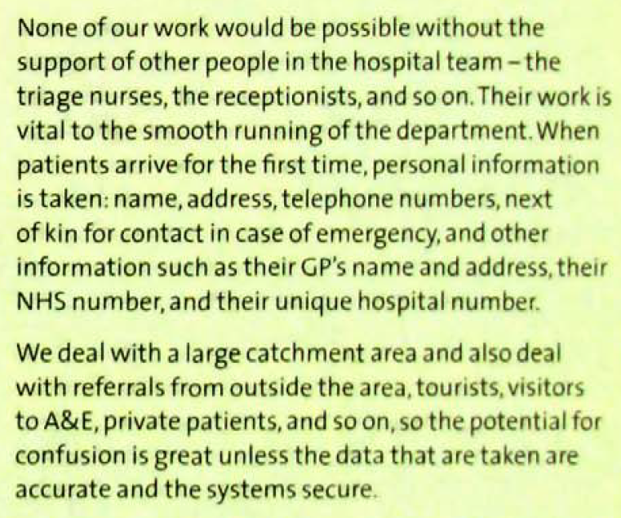

Slide 39
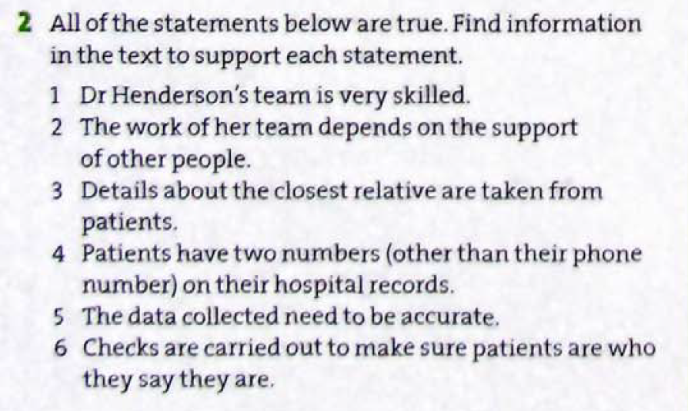

Slide 40
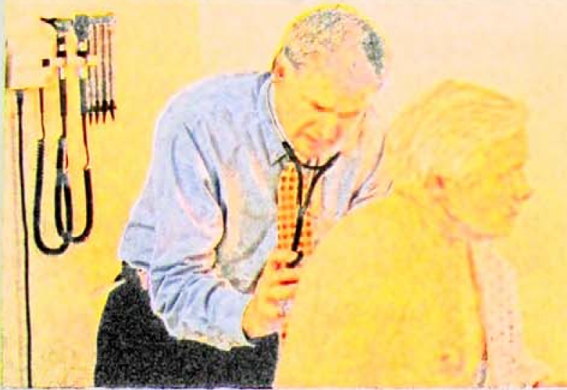
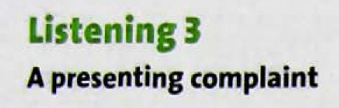
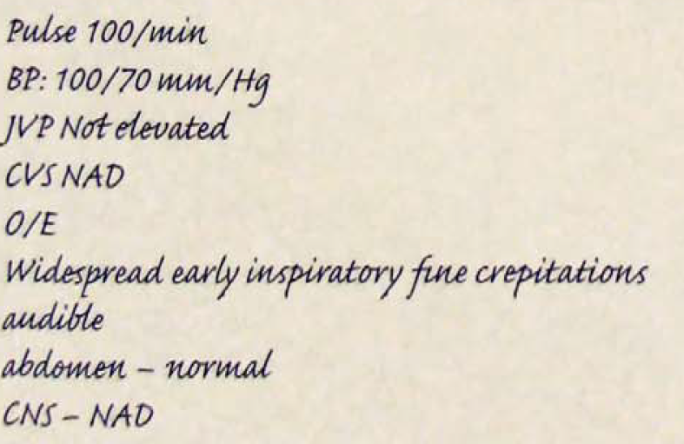








Listen and make notes about Mr. Wood’s presenting complaint.
Hydrargentum/ Hydrargyrion

Slide 41

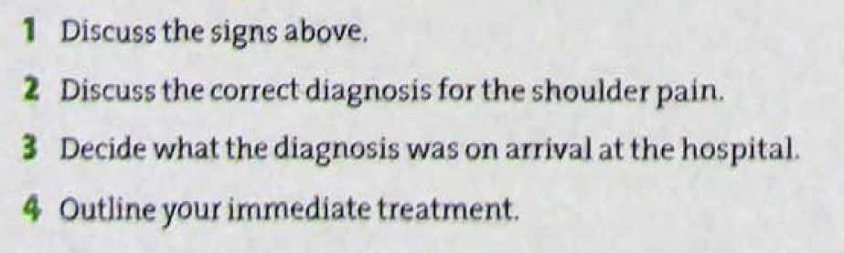


Slide 42
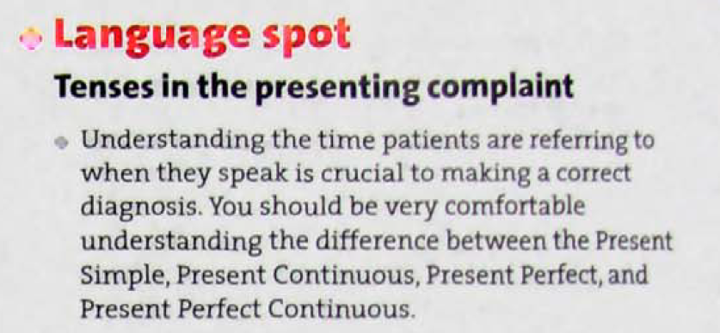
Grammar

Slide 43
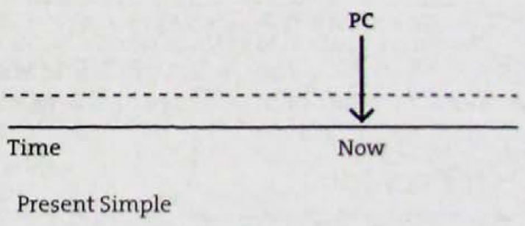
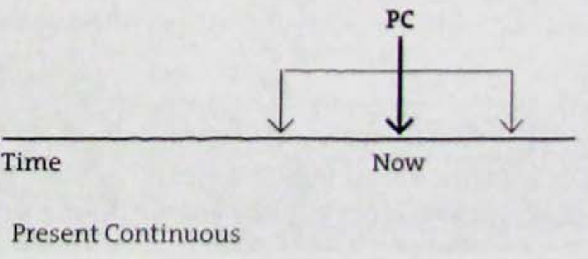

Slide 44
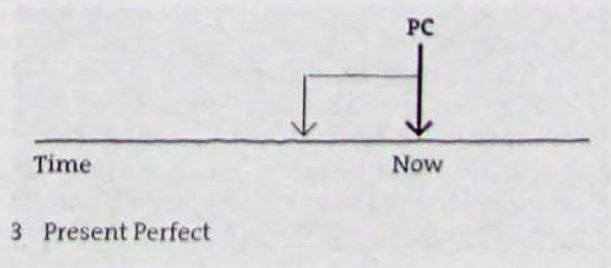
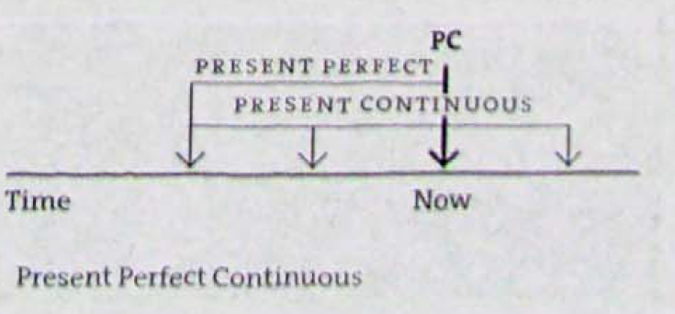

Slide 45
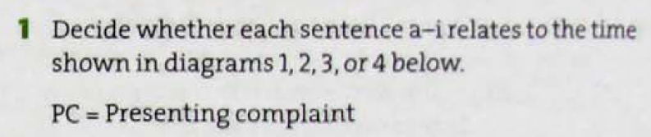
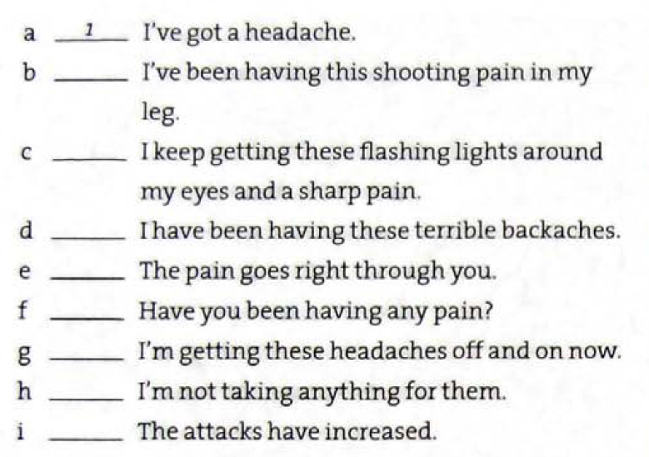





Slide 46
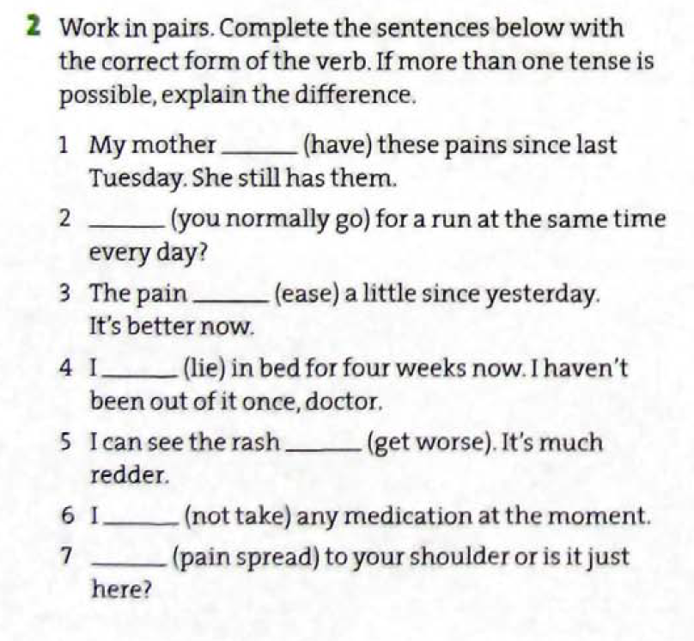







Slide 47
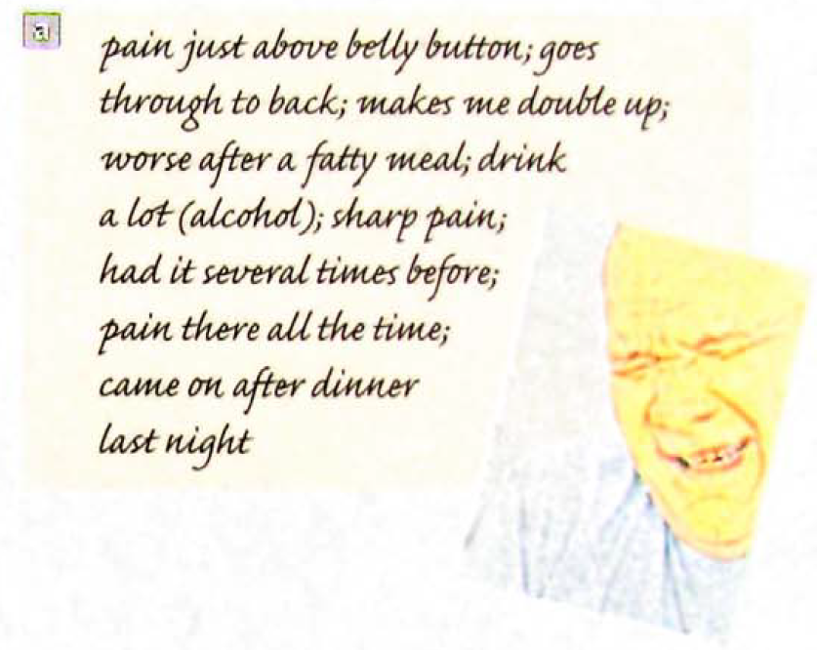
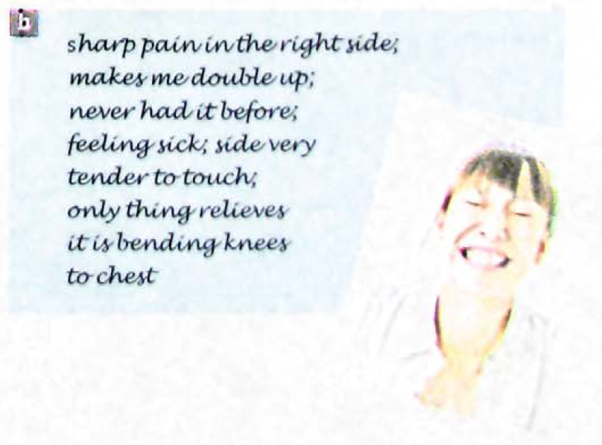
Speaking
B
appendicitis
cholecystitis (gallbladder inflammation)
gallstone
ureteric colic
A
acute pancreatitis
gastritis: (Inflammation of the lining of the stomach)
Duodenitis (inflammation in your duodenum lining)

Slide 48





Slide 49



Slide 50





Slide 51





Glyceryl trinitrate (GTN) is a spray used to relieve angina (chest pain).

