Slide 1

Case studies on ENZYMES OF CLINICAL IMPORTANCE
Dr. Jaafaru Sani/Tolaz Kadhim
Advanced Clinical Biochemistry II (MA 416)
Spring Semester
Week Four
31/08/2026

Slide 2

Outlines
• Definition of case study
Advantages of case study
Case one and its response
Case two and its response

Slide 3

Objectives
At the end of this lesson, the students should be able to:
Understand the concept and aim of case studies.
Study carefully and interpret clinical and laboratory-based potential cases.
Make sense of the case(s) and provide potential, meaningful and relevant solution(s)

Slide 4

Introduction
Case study has been described as an intensive, systematic health-wise investigation of a single individual, group, or community.
It could even be an investigation of other units that the scientist (expert) examines.
Case studies are also a record of clinical interactions which help us to frame questions for more rigorously designed clinical studies.

Slide 5
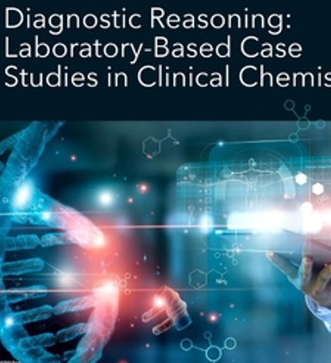
Advantages
Ability to see a relationship between phenomena, context, and people in health care delivery.
Flexibility to collect data through various means and make sense of it.
Ability to capture the context of participants and present it in real-life situations.
Flexibility to be used at various points in a health care service delivery, including clinical pilot research.

Slide 6
Case 1
A 58-year-old man presents himself to a consultant with severe chest pain radiating to the left arm, shortness of breath, and sweating. Electrocardiogram
(ECG) confirms ST-elevation myocardial infarction (STEMI), and the results indicated that CK: 280 U/L, CK-MB: 85 U/L, AST: 75 U/L, and LDH: 410 U/L levels are all high, with positive troponin I.
Study the case and describe the situation
Notes:
S-wave and S-wave

Slide 7
General Response
Elevated CK-MB, AST, and LDH indicate myocardial cell injury.
CK-MB is more cardiac-specific and rises within 4–6 hours post-infarction, peaking at 18–24 hours.
Elevated AST supports myocardial necrosis, though it can also be seen in liver and muscle diseases.

Slide 8
Case 2
A 45-year-old woman reports sudden, intense epigastric pain radiating to the back, accompanied by nausea and vomiting. No history of alcohol abuse. The physician that attended the case order for some laboratory tests with the results below:
Laboratory Results:
Serum Amylase: 610 U/L (high)
Serum Lipase: 510 U/L (high)
ALT and AST: Within normal range
ALP: Normal
Comment on the case

Slide 9
General Response
Marked elevation of both amylase and lipase is characteristic of acute pancreatitis.
Lipase is more specific and remains elevated longer than amylase.
The normal liver enzymes helped in excluding a biliary originated complication.

Slide 10
Case 3
A 30-year-old male presents with jaundice, malaise, dark urine, and right upper quadrant discomfort. Recent history of travel to an area endemic for hepatitis A.
Laboratory Results:
ALT: 1145 U/L (high)
AST: 980 U/L (high)
ALP: 120 U/L (slightly high)
GGT: 65 U/L (slightly high)
Bilirubin (Total): 5.6 mg/dL

Slide 11


