Slide 1


Antifungal Agent
Course instructor: Soran Kayfi
Course: Medical Mycology
Summer School
W5

Slide 2
Antimicrobial Agents
Antimicrobial agents: are substances used to kill or inhibit the growth of microorganisms, including bacteria, fungi, viruses, and parasites.
Antimicrobial can be natural, semi-synthetic, or synthetic.

Slide 3

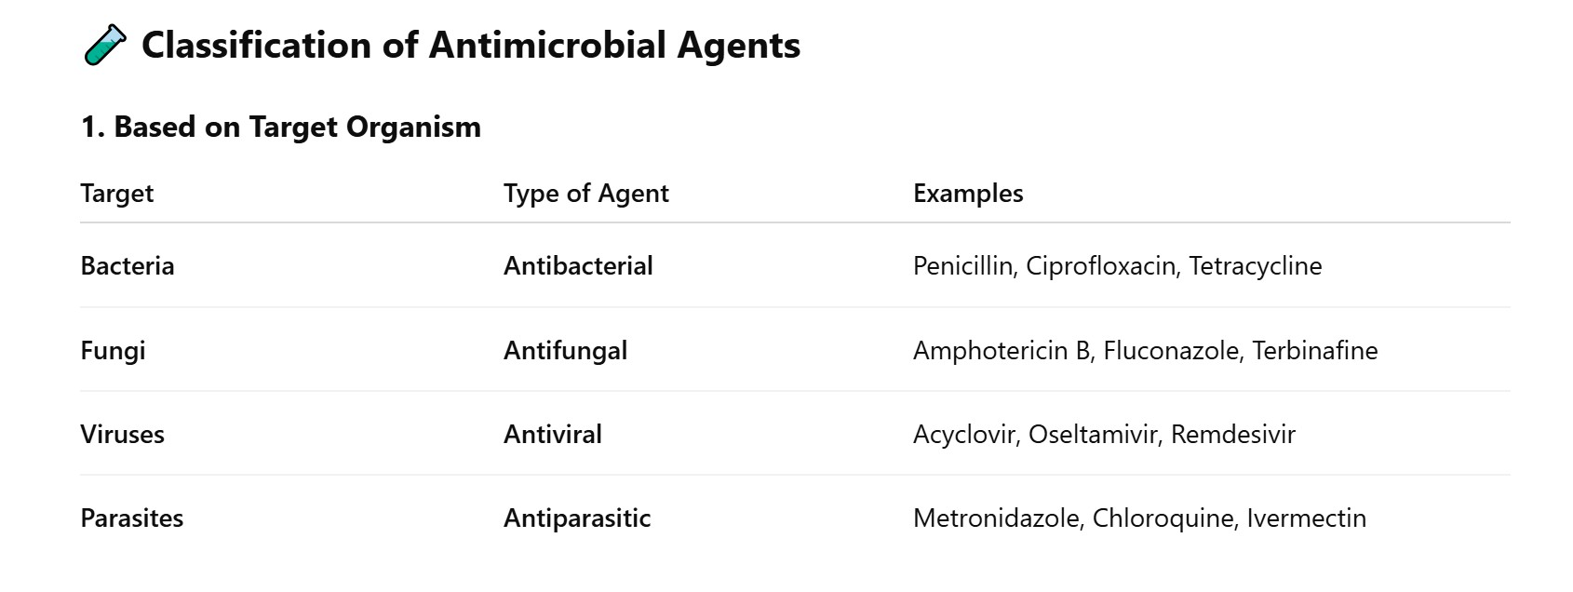

Slide 4
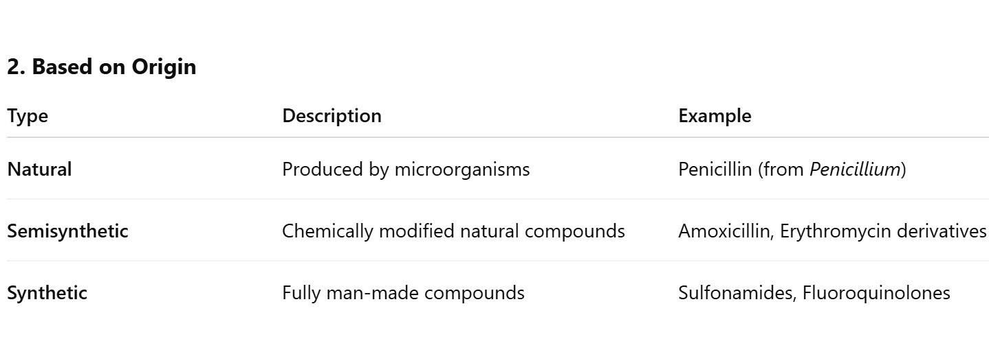

Slide 5
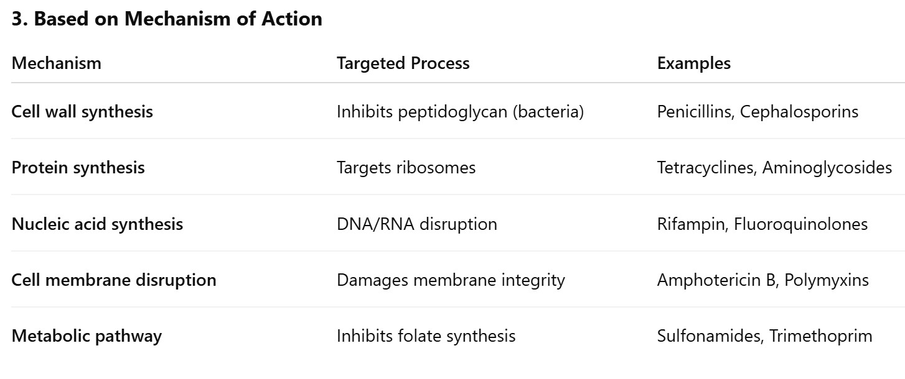

Slide 6
Spectrum of Antifungal medications
Broad-spectrum: an antibiotic that is effective against a wide range of microorganisms.
Narrow-spectrum: an antibiotic that is effective against a limited group of microorganisms.

Slide 7
Antifungal medications Main categories
Cell Membrane Disruptors: (Ergosterol Binding or Synthesis Inhibitors)
Cell Wall Synthesis Inhibitors: Echinocandins.
Nucleic Acid Synthesis Inhibitor: Flucytosine.

Slide 8
1- Cell Membrane Disruptors (Ergosterol Synthesis Inhibitors)
Polyenes: Amphotericin B and Nystatin.
Azoles (inhibit ergosterol synthesis): FluconazoleI
Allylamines: Naftifine.

Slide 9
Mechanism of Action of Amphotericin B steps
Binds to Ergosterol: Amphotericin B has a strong affinity for ergosterol, a key component of fungal cell membranes (analogous to cholesterol in human cells).
Pore Formation: After binding to ergosterol, Amphotericin B aggregates and forms pores (channels) in the fungal cell membrane.
Loss of Membrane Integrity: These pores allow leakage of intracellular ions (especially K⁺, Mg²⁺) and small molecules.
Cell Death: This disruption leads to fungal cell death.

Slide 10
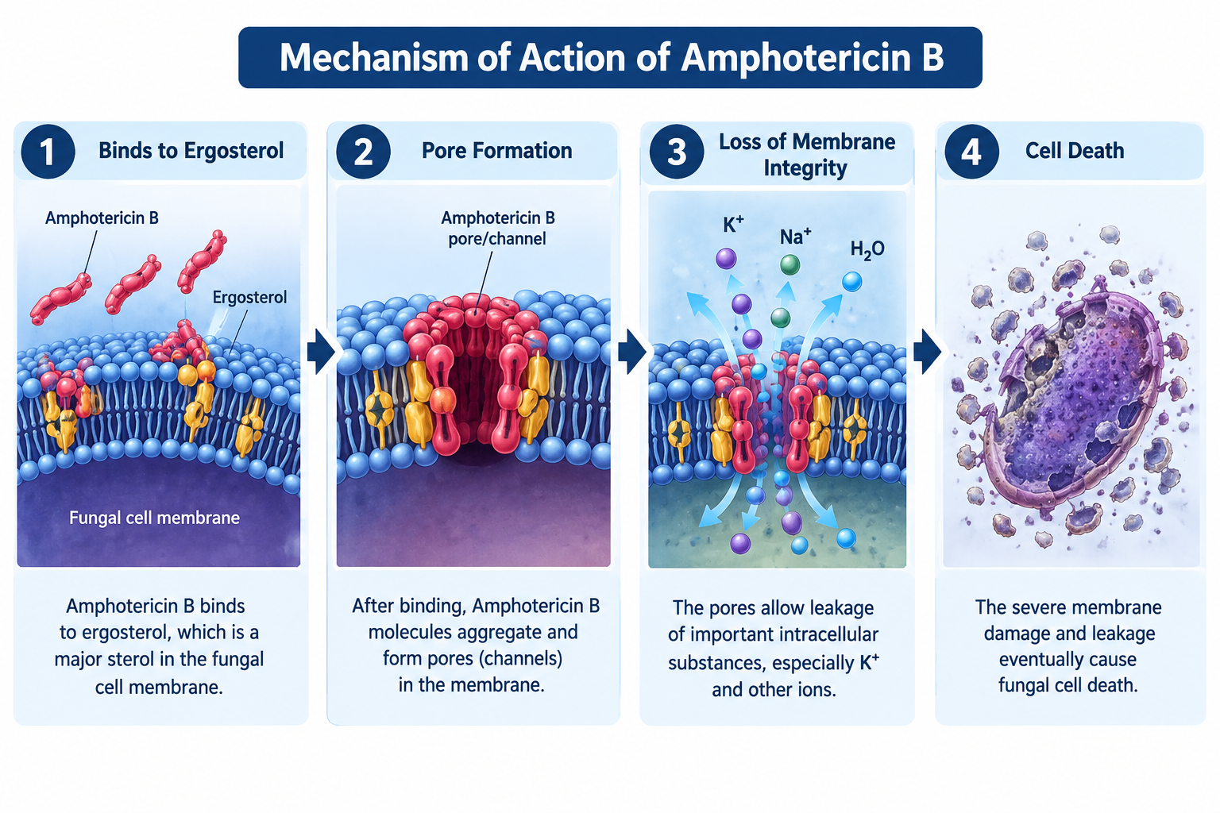

Slide 11
Main Uses of Amphotericin B1
Systemic Mycoses (Deep Fungal Infections): Cryptococcal meningitis,
Histoplasmosis, Blastomycosis
Invasive Candidiasis: For disseminated Candida infections in critically ill or
neutropenic patients.
Aspergillosis: When patients are intolerant to or not responding to
voriconazole.
Mucormycosis (Zygomycosis) Amphotericin B is the first-line treatment.

Slide 12
Echinocandins (work on cell wall)
Echinocandins are a newer class of antifungal drugs that are fungicidal (kill the fungal cell) against most Candida species and fungistatic (stop the growth of fungal cell) against Aspergillus.

Slide 13
Echinocandins mechanism of action
Inhibits β-1,3-glucan synthesis: Echinocandins specifically inhibit the enzyme β-1,3-D-glucan synthase, which is essential for fungal cell wall synthesis.
Disrupt Cell Wall Integrity: Inhibition leads to a defective cell wall, making the fungal cell fragile and susceptible to osmotic lysis.
Fungal Cell Death (Candida): This results in cell death in Candida or inhibition of hyphal growth in Aspergillus.

Slide 14
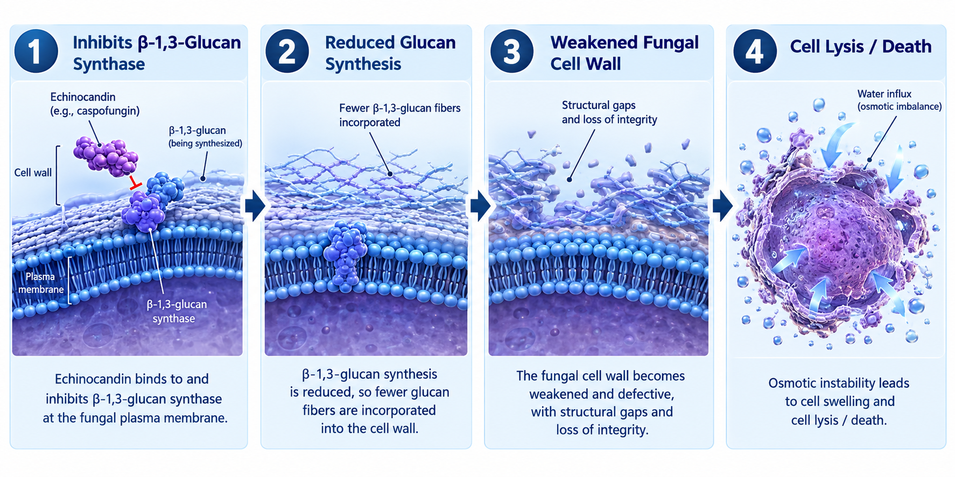

Slide 15
Echinocandins
Feature | Description
Target | β-1,3-D-glucan synthase
Effect | Inhibits glucan synthesis → weakens cell wall
Fungal Action | Fungicidal (Candida), Fungistatic (Aspergillus)
Selectivity | Selective for fungi (no cell wall in humans)

Slide 16
Flucytosine (work on nucleic acid synthesis)
Flucytosine is an antifungal antimetabolite that inhibits nucleic acid synthesis.
It is fungistatic and is often used in combination with Amphotericin B to treat serious fungal infections.

Slide 17
Clinical Use of Flucytosine
Used in combination with Amphotericin B for:
Cryptococcal meningitis
Candida infections

Slide 18
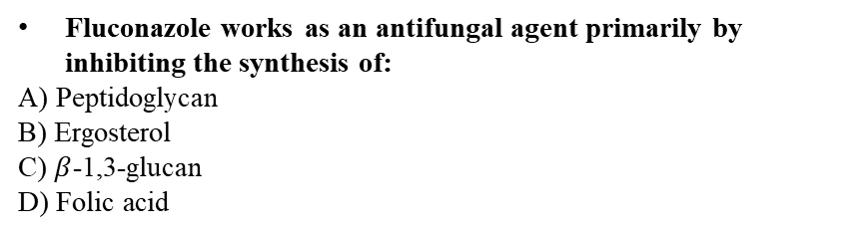
Antimicrobial agents can be derived from which of the following origins?
A) Natural only
B) Synthetic only
C) Natural, semi-synthetic, or synthetic
D) Fungal only
Metabolic pathway inhibitors like Sulfonamides and Trimethoprim target the synthesis of:
A) Peptidoglycan
B) Ergosterol
C) Folate
D) Ribosomes
Which class of antimicrobial agents is produced entirely by fully man-made chemical processes?
A) Natural
B) Semisynthetic
C) Synthetic
D) Polyenes
Amphotericin B and Nystatin belong to which specific class of cell membrane disruptors?
A) Azoles
B) Polyenes
C) Allylamines
D) Echinocandins
Antibacterial drugs such as Penicillins and Cephalosporins exert their activity by targeting:
A) Protein synthesis
B) Cell wall synthesis
C) Nucleic acid synthesis
D) Folate pathway synthesis
Which of the following is classified as a narrow-spectrum antimicrobial concept?
A) Effective against a wide range of microorganisms
B) Effective against a limited group of microorganisms
C) Kills all prokaryotic and eukaryotic cells
D) Inhibits human protein synthesis
Fluconazole works as an antifungal agent primarily by inhibiting the synthesis of:
A) Peptidoglycan
B) Ergosterol
C) $β$-1,3-glucan
D) Folic acid
Which drug is an example of a nucleic acid synthesis inhibitor used in bacteria? A) Tetracycline
B) Rifampin
C) Amphotericin B
D) Trimethoprim

Slide 19
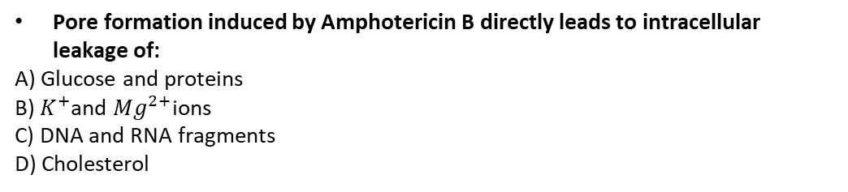
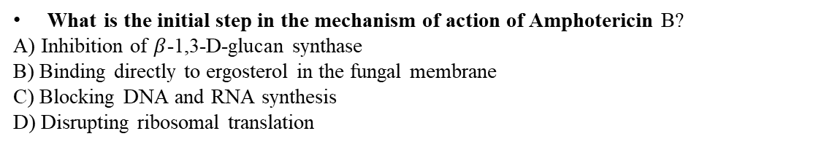
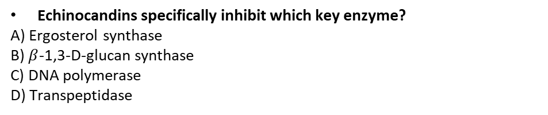
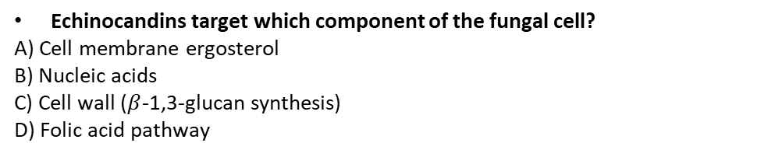
What is the initial step in the mechanism of action of Amphotericin B?
A) Inhibition of $β$-1,3-D-glucan synthase
B) Binding directly to ergosterol in the fungal membrane
C) Blocking DNA and RNA synthesis
D) Disrupting ribosomal translation
What is the effect of Echinocandins against Aspergillus species?
A) Fungicidal
B) Fungistatic
C) Complete cell lysis
D) No activity
Pore formation induced by Amphotericin B directly leads to intracellular leakage of:
A) Glucose and proteins
B) $K^{+}$and $Mg^{2+}$ions
C) DNA and RNA fragments
D) Cholesterol
Why are Echinocandins highly selective for fungal cells compared to human cells?
A) Human cells lack ergosterol
B) Human cells do not possess a cell wall
C) Human cells break down Echinocandins rapidly
D) Human ribosomes are resistant
Echinocandins target which component of the fungal cell?
A) Cell membrane ergosterol
B) Nucleic acids
C) Cell wall ($β$-1,3-glucan synthesis)
D) Folic acid pathway
What is the primary fungal action of Flucytosine?
A) Fungicidal
B) Fungistatic
C) Lytic
D) Sporicidal
Echinocandins specifically inhibit which key enzyme?
A) Ergosterol synthase
B) $β$-1,3-D-glucan synthase
C) DNA polymerase
D) Transpeptidase
Flucytosine is most commonly administered in combination with Amphotericin B to treat:
A) Cryptococcal meningitis
B) Athlete's foot
C) Dermatophytosis
D) Tinea capitis
The action of Echinocandins against Candida species is classified as:
A) Fungistatic
B) Fungicidal
C) Ineffective
D) Broad-spectrum antibacterial
Naftifine belongs to which class of cell membrane disruptors?
A) Polyenes
B) Azoles
C) Allylamines
D) Echinocandins

Slide 20
Define the followings
Antimicrobial Agents:
Broad-Spectrum Agent: Narrow-Spectrum Agent
Fungicidal
Fungistatic
Enumerate the 3 classes of antimicrobial agents based on origin with one example for each:
Enumerate the 4 sequential steps in the Mechanism of Action of Amphotericin B:
Enumerate the 3 main categories of antifungal medications based on targeted site:
Enumerate 4 clinical indications for the use of Amphotericin B:

Slide 21
Questions and Comments?

