Slide 1


Dermatophytes
Course instructor: Soran Kayfi
Course: Medical Mycology
Summer School
Lecture 5

Slide 2
Dermatophytes
Dermatophytes are a group of fungi that cause infections in keratinized tissues, such as the skin, hair, and nails.
These infections are commonly referred to as tinea or ringworm.

Slide 3
Common Dermatophyte Infections
Tinea pedis (Athlete’s foot) – Feet
Tinea corporis (Ringworm) – Body
Tinea cruris (Jock itch) – Groin
Tinea capitis – Scalp (common in children)
Tinea unguium (Onychomycosis) – Nails
Tinea manuum – Hands

Slide 4
Transmission
Direct contact with infected humans, animals (zoophilic, e.g., cats, dogs), or soil (geophilic).
Indirect contact via contaminated surfaces (e.g., towels, floors).

Slide 5
Dermatophytes belong to three main genera:
Trichophyton – Infects skin, hair, and nails (e.g., T. rubrum, T. mentagrophytes).
Microsporum – Primarily infects skin and hair (e.g., M. canis, M. audouinii).
Epidermophyton – Infects skin and nails (e.g., E. floccosum).

Slide 6
1- Trichophyton: Overview
Trichophyton is the most common genus of dermatophytes, responsible for fungal infections (tinea) of the skin, hair, and nails.
It includes several pathogenic species that affect humans and animals.

Slide 7
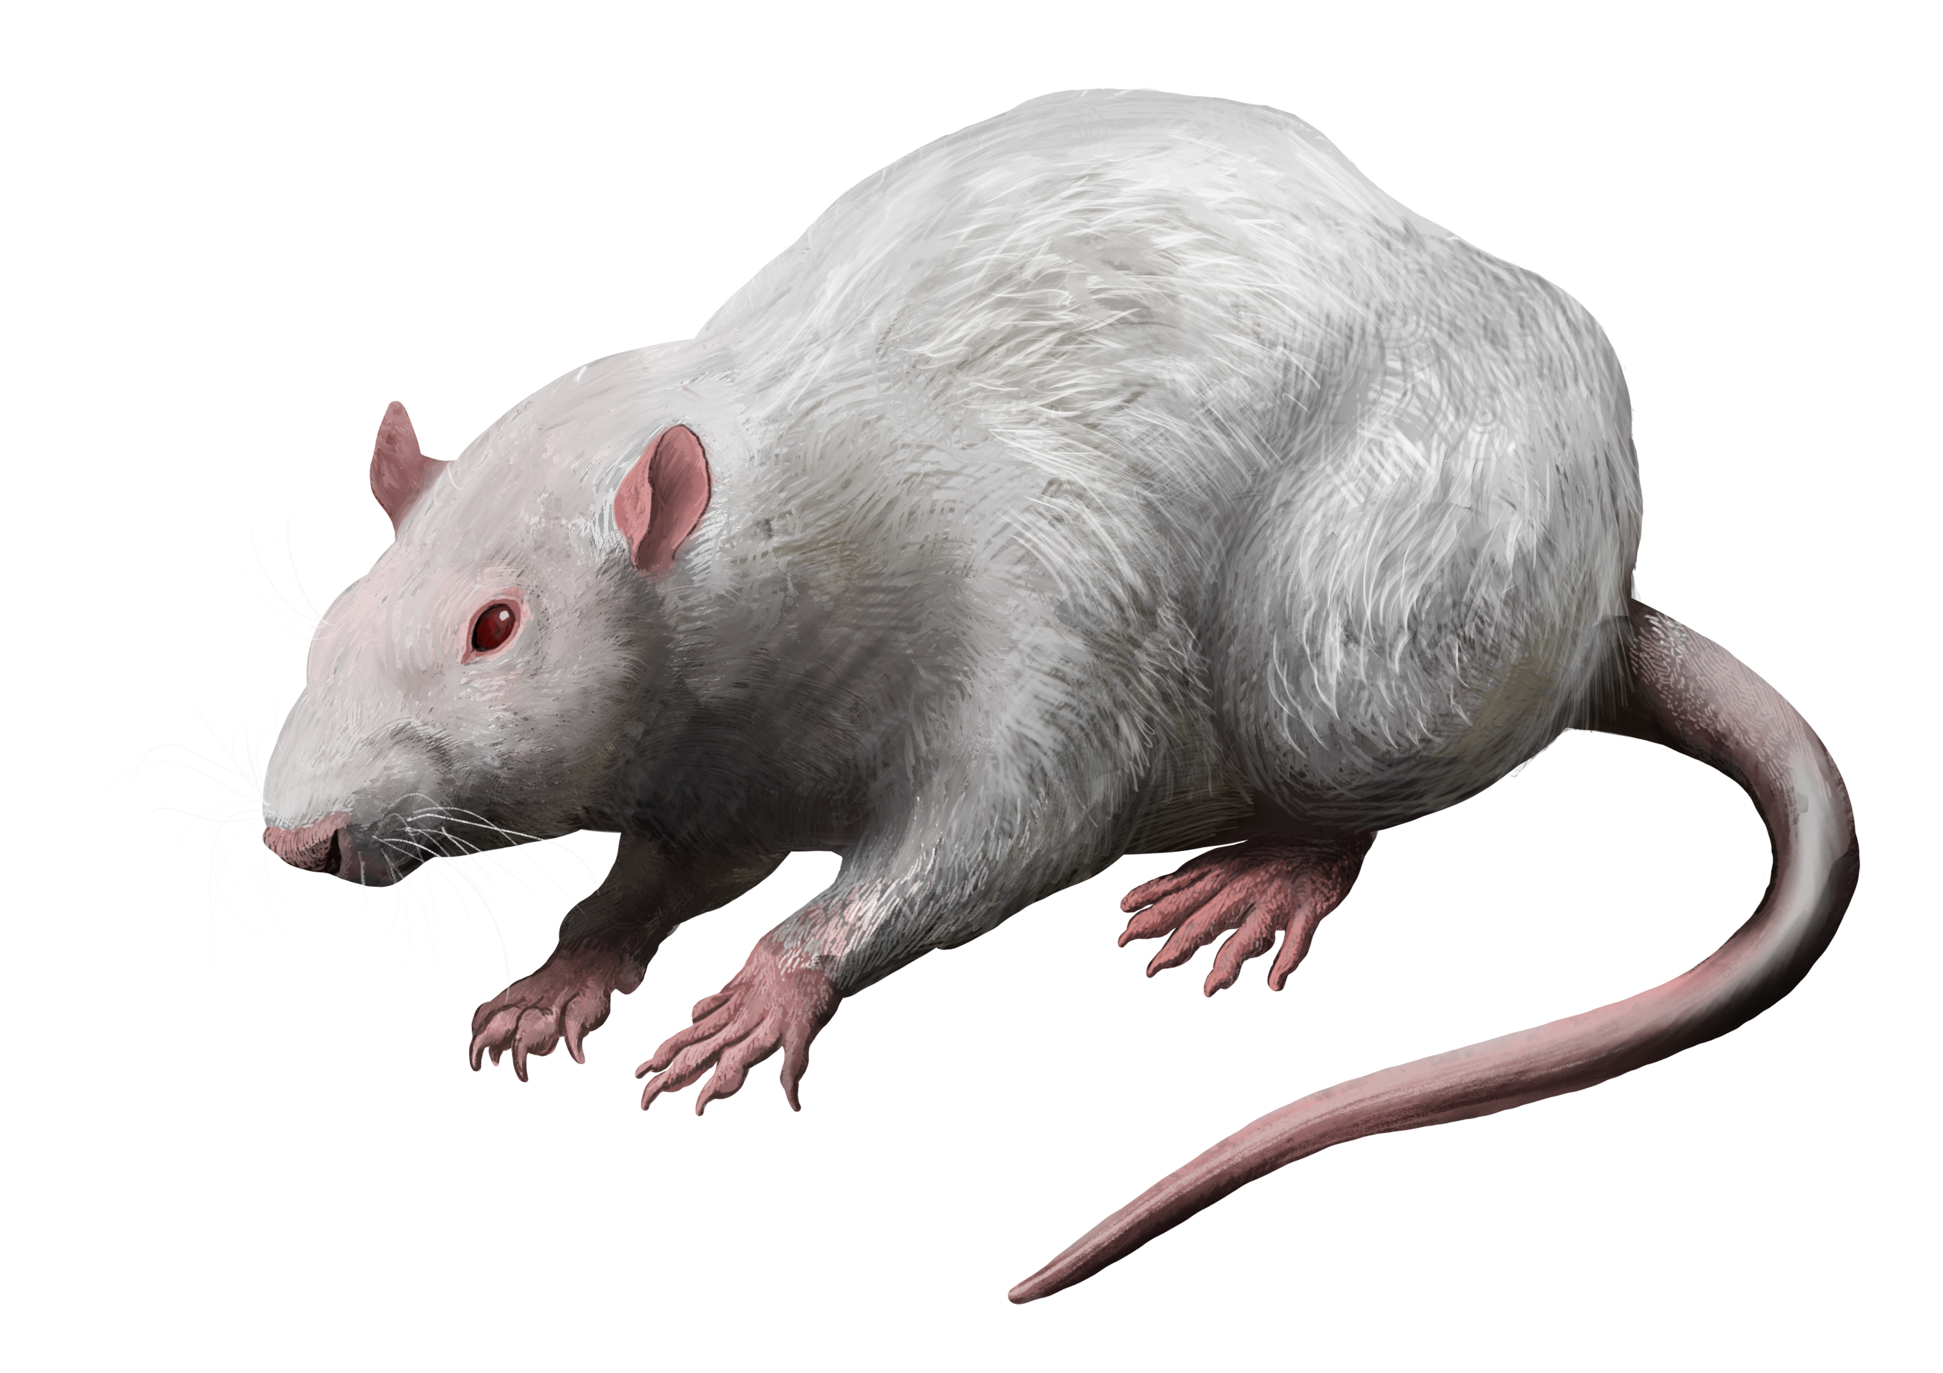
Major Pathogenic Species of Trichophyton
Trichophyton rubrum: Most common cause of tinea pedis (athlete’s foot).
Trichophyton mentagrophytes: Causes tinea pedis, tinea corporis, and is associated with zoonotic infections (e.g., from rodents , and pets).
Trichophyton tonsurans: Leading cause of tinea capitis (scalp ringworm).
Trichophyton verrucosum: Cattle-associated; causes inflammatory tinea barbae (beard infections) in farmers.

Slide 8
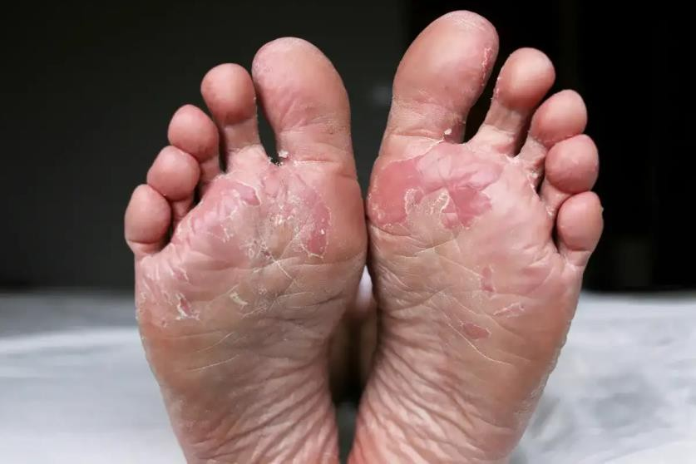
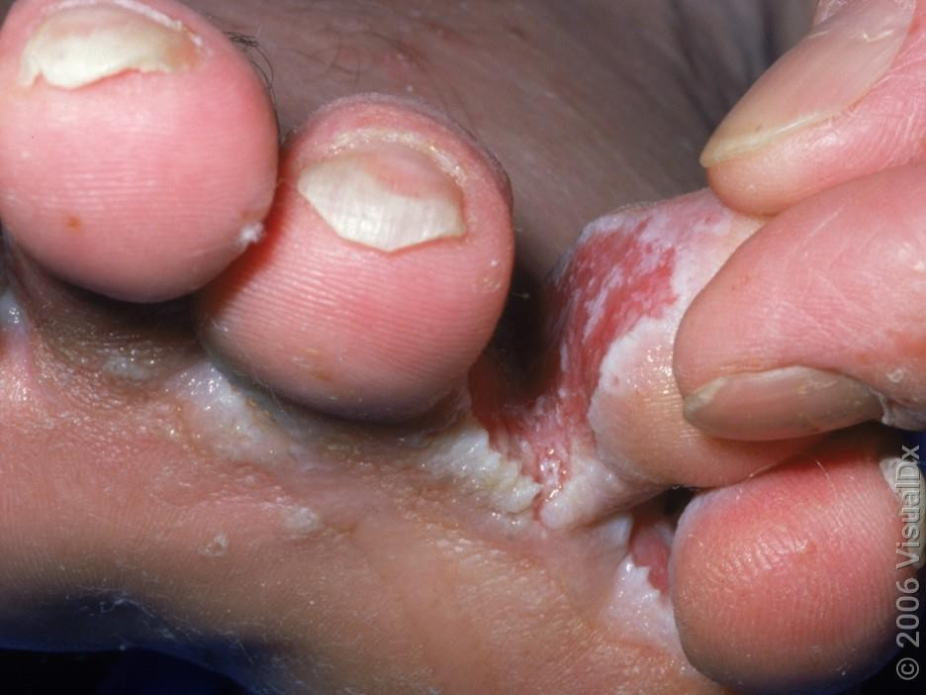
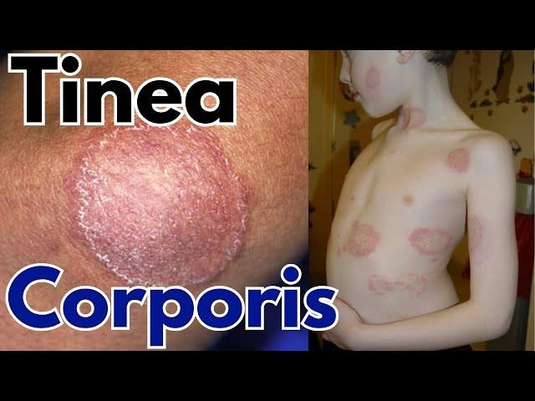
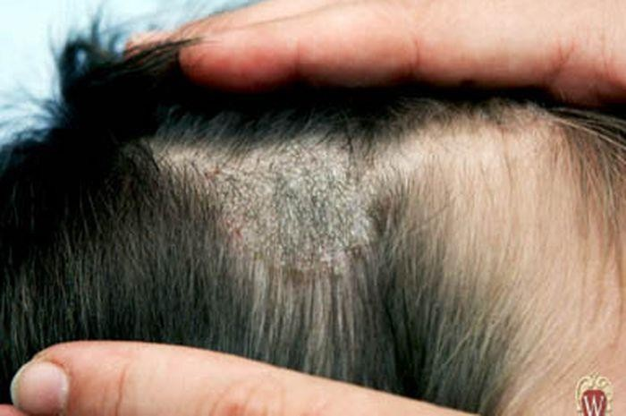
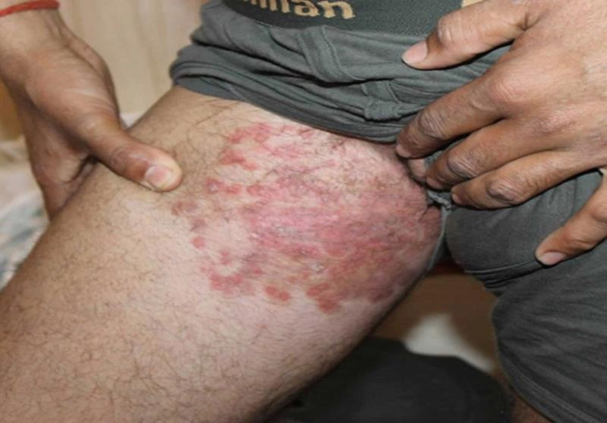
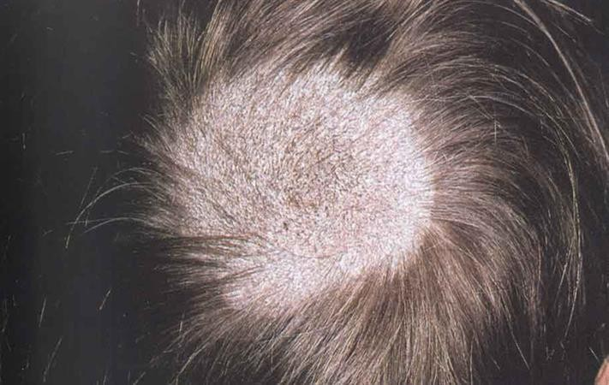
Athlete’s foot
Athlete’s foot
tinea cruris (jock itch)
Black dot: broken hair shafts
Tinea capitis/barbae

Slide 9
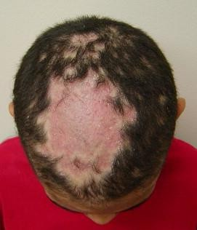
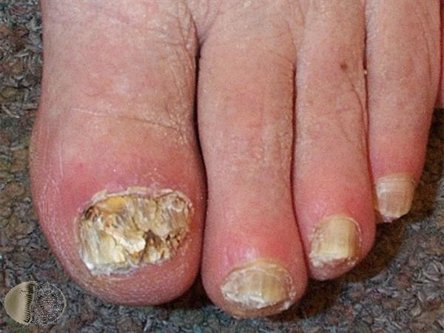
Nails (Onychomycosis)
tinea capitis

Slide 10
Clinical Manifestations
Skin: Red, scaly, circular patches (ringworm), itching.
Nails (Onychomycosis): Thickened, discolored, brittle nails.
Hair (Tinea capitis/barbae): Hair loss, scaling, pustules, "black dot" appearance.

Slide 11
2. Microsporum:
Microsporum is a genus of dermatophytes that primarily infects hair and skin, causing tinea capitis (scalp ringworm), tinea corporis (body ringworm), and occasionally tinea barbae (beard infections).
Unlike Trichophyton, Microsporum rarely invades nails.

Slide 12
Pathogenic Species of Microsporum
Anthropophilic (Human-Adapted): Microsporum audouinii: Classic cause of tinea capitis in children (especially in Africa).
Zoophilic (Animal-Adapted): Microsporum canis (Most clinically significant): Acquired from cats, dogs, and rabbits. Causes inflammatory tinea capitis/corporis (often with pustules).
Geophilic (Soil-Dwelling): Microsporum gypseum: Found in soil; affects farmers/gardeners. Causes mild, inflammatory lesions on skin/scalp.

Slide 13
Microsporum Clinical Features
Tinea capitis: Scaly patches, hair breakage, black dot (if Trichophyton) or gray patch (if Microsporum).
Kerion (severe inflammatory reaction with pustules).
Tinea corporis: Circular, red, scaly plaques with central clearing.

Slide 14
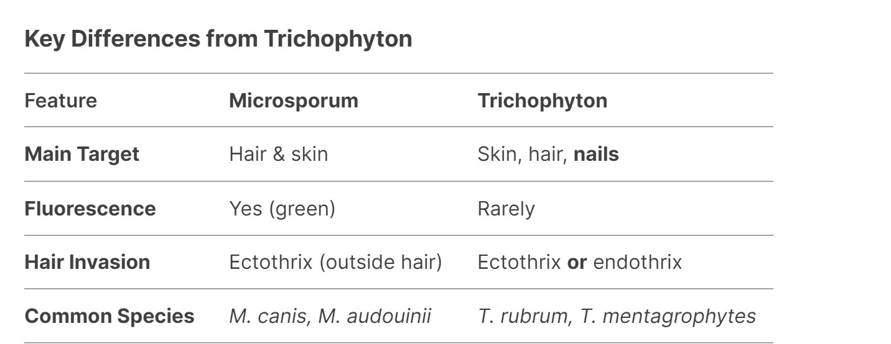

Slide 15
3. Epidermophyton:
Epidermophyton is a genus of dermatophytes that primarily infects skin (stratum corneum) and nails, but does not invade hair.
The most clinically significant species is Epidermophyton floccosum, a common cause of tinea cruris (jock itch), tinea pedis (athlete’s foot), and tinea unguium (nail infections).

Slide 16
Clinical Infections
Tinea cruris (groin infection) – Red, scaly, itchy patches with well-defined edges.
Tinea pedis (athlete’s foot) – Scaling, maceration between toes. Tinea corporis (body ringworm) – Circular, erythematous plaques.
Onychomycosis (nail infection) – Less common than Trichophyton but causes distal/lateral subungual thickening.

Slide 17
Dermatophyte treatments
Topical antifungals (e.g., clotrimazole, terbinafine) for mild skin infections.
Oral antifungals (e.g., terbinafine, itraconazole, griseofulvin) for severe or hair/nail infections.
Hygiene measures – Keep skin dry, avoid sharing personal items.

Slide 18
Dermatophyte Prevention
Pets: Check for lesions (especially cats/dogs with M. canis).
Hygiene: Avoid sharing combs, hats, and towels.
Disinfection: Clean surfaces with bleach (dermatophytes survive on fomites).

Slide 19
Dermatophytes are specialized fungi that cause infections primarily in which tissues?
A) Vascular endothelial tissues
B) Keratinized tissues (skin, hair, nails)
C) Deep mucosal membranes
D) Central nervous system
Dermatophyte infections are clinically referred to as:
A) Candidiasis
B) Mycetoma
C) Tinea or Ringworm
D) Aspergillosis
Tinea pedis is the medical term for fungal infection of the:
A) Scalp
B) Groin
C) Feet (Athlete's foot)
D) Nails
Infection of the groin region by dermatophytes is known as:
A) Tinea corporis
B) Tinea cruris
C) Tinea capitis
D) Tinea manuum
Tinea unguium is also known as:
A) Kerion
B) Onychomycosis
C) Athlete's foot
D) Jock itch
Which dermatophyte genus is capable of infecting skin, hair, and nails?
A) Epidermophyton
B) Microsporum
C) Trichophyton
D) Candida
Which genus of dermatophytes infects skin and hair, but rarely invades nails?
A) Trichophyton
B) Microsporum
C) Epidermophyton
D) Aspergillus
Which genus of dermatophytes infects skin and nails, but does not invade hair?
A) Trichophyton
B) Microsporum
C) Epidermophyton
D) Malassezia
What is the most common cause of Tinea pedis (athlete’s foot)?
A) Trichophyton rubrum
B) Microsporum canis
C) Epidermophyton floccosum
D) Trichophyton verrucosum
Trichophyton tonsurans is recognized as a leading cause of:
A) Tinea pedis
B) Tinea capitis (scalp ringworm)
C) Onychomycosis
D) Tinea barbae
Trichophyton verrucosum is associated with cattle and commonly causes inflammatory tinea barbae in:
A) School children
B) Farmers
C) Laboratory workers
D) Pet owners

Slide 20
Which species is an anthropophilic dermatophyte responsible for classic tinea capitis in children, particularly in Africa?
A) Microsporum canis
B) Microsporum audouinii
C) Microsporum gypseum
D) Trichophyton rubrum
Microsporum canis is classified as a zoophilic dermatophyte acquired mainly from:
A) Soil
B) Cats, dogs, and rabbits
C) Cattle
D) Contaminated towels
Microsporum gypseum is ecologically classified as a:
A) Anthropophilic organism
B) Zoophilic organism
C) Geophilic (soil-dwelling) organism
D) Endogenous organism
What type of fluorescence is characteristically exhibited by Microsporum species?
A) Red fluorescence
B) Green fluorescence
C) Blue fluorescence
D) No fluorescence
What type of hair invasion is produced by Microsporum species?
A) Endothrix
B) Ectothrix
C) Subungual
D) Intracellular
A severe, boggy, inflammatory reaction of the scalp with pustules associated with tinea capitis is called a:
A) Kerion
B) Black dot
C) Onychomycosis
D) Ringworm plaque
What is the most clinically significant species of the genus Epidermophyton?
A) Epidermophyton canis
B) Epidermophyton floccosum
C) Epidermophyton rubrum
D) Epidermophyton tonsurans
Oral antifungals such as terbinafine or griseofulvin are specifically indicated for dermatophyte infections involving:
A) Mild, localized skin patches
B) Hair or nail infections, or severe cases
C) Non-keratinized tissue
D) Bacterial co-infections
Which chemical disinfectant is explicitly recommended to clean surfaces and eliminate dermatophyte fomites?
A) Ethanol
B) Bleach
C) Chlorhexidine
D) Iodine

Slide 21
Questions and Comments?

